Slide 1
Turning of the Wheel
Meeting the Challenges and Charting/Creating the World with Spokes and a Hub
12 September 2011
Rodney Frey,
Professor of Ethnography and Distinguished Humanities Professor
College of Letters, Arts and Social Sciences
with support from:
University of Idaho’s Humanities Endowment, National Endowment for the Humanities, and
gifts from friends of the College of Letters, Arts and Social Sciences

Slide 2
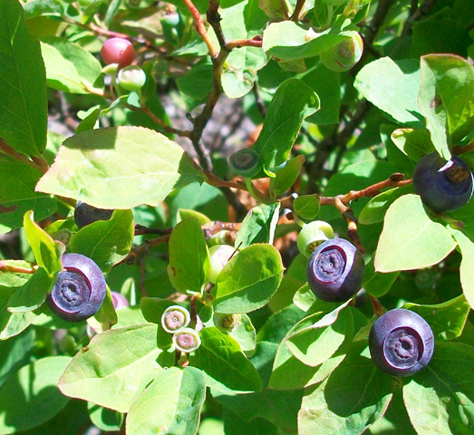
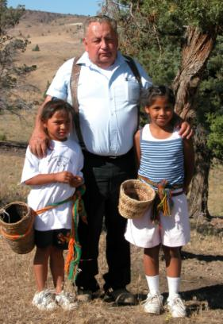
Gathering the Huckleberries
Photo: John Hartman 2011
Elysia Moran and Victoria Spino, with Grandpa, Rob Moran.
Photo: Frey 2003

Slide 3
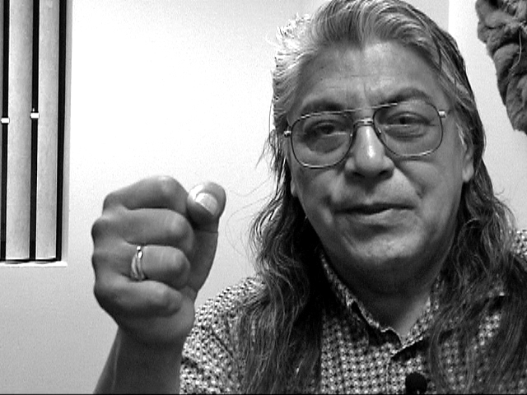
Healing Journeys
pay attention to both the “external and inner healing,” both “head knowledge and heart knowledge”
Cliff SiJohn, Coeur d’Alene Casino. Photo: Frey 2002

Slide 4
Head Knowledge and Heart Knowledge
Material Reductionism Cartesian Dualism Scientific Method
Spiritual Animation
Unified Holism
a tangible world of discrete quantifiable objects viewed as if behind a glass pane
a transitory world co-created at the convergence of those participating, an event in the making
binary oppositions
kinship
devoid of spirit
imbued with spirit
contrasting world views, contrasting epistemologies

Slide 5
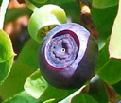
Head Knowledge and Heart Knowledge
geological processes
Coyote and Snake
Along the Clearwater River NEPE-HI-0959
the physical action/reaction
of scalpel and chemo drugs
the pulsating through an
Eagle-feather
“mutually exclusive”? huckleberry to guide?

Slide 6
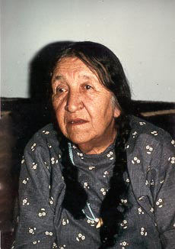
Lives of Tom and Susie Yellowtail
Apsáalooke (Crow) of 1970s
as Sundance chief and Akbaalía, as Baptist, as nurse, as healer, on Presidential-appointed councils
Tom and Susie Yellowtail, Wyola. Photo: Frey 1974

Slide 7
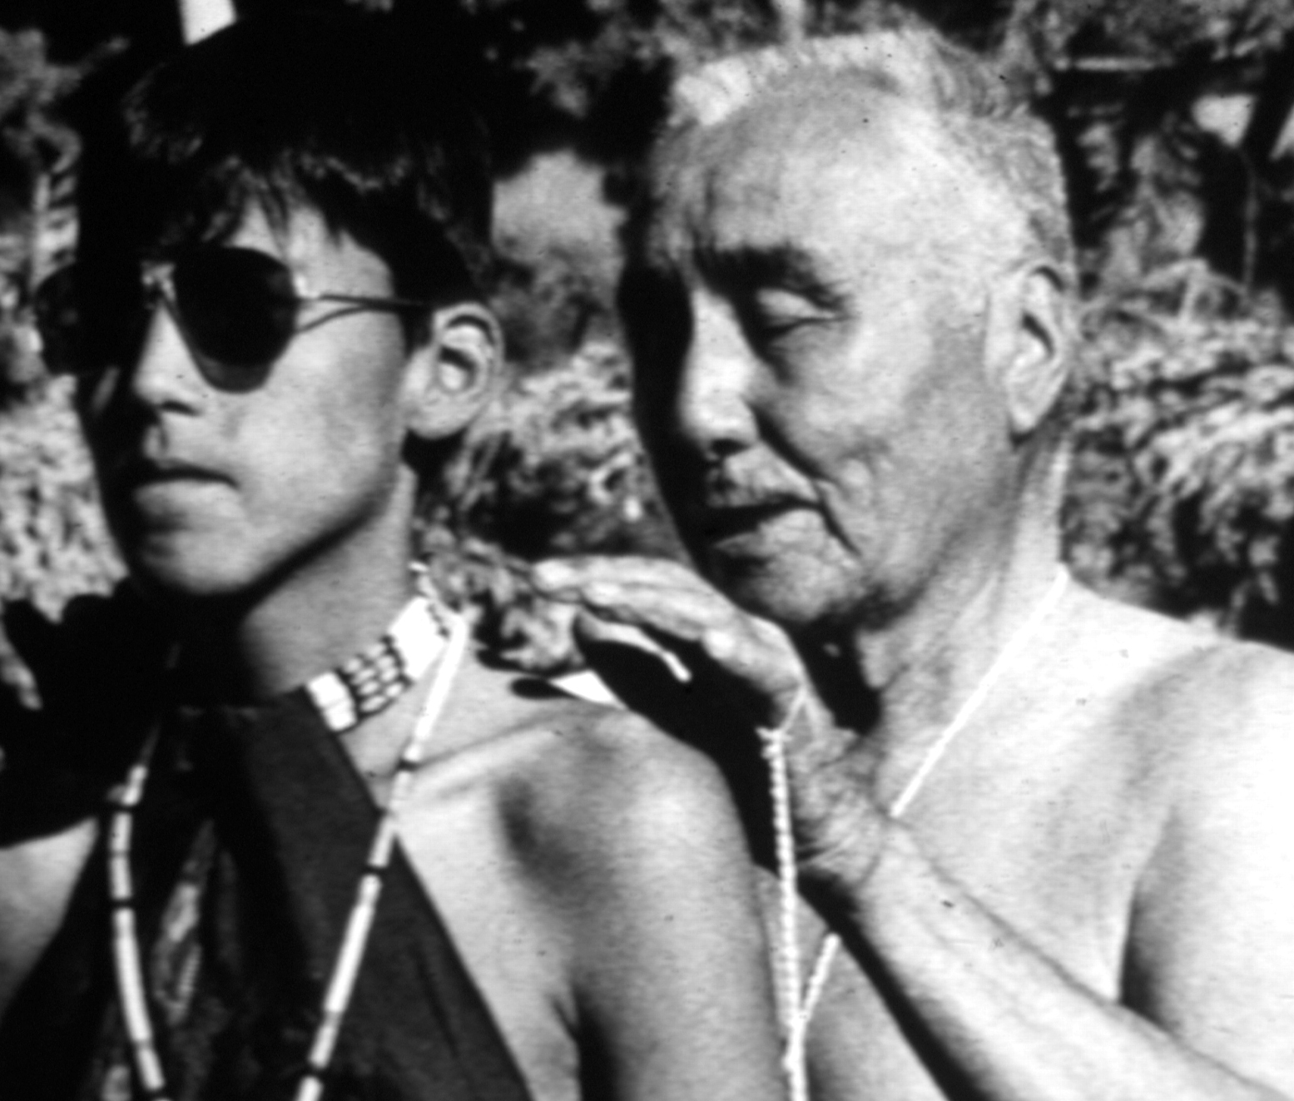
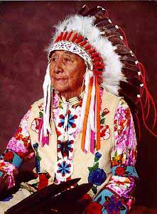
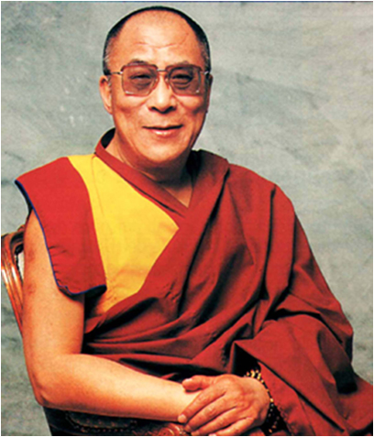
Tom Yellowtail offering a Prayer
Tom offering prayer at the Sundance. Pryor. 1974

Slide 8
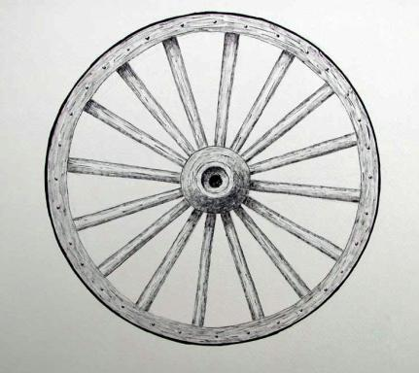
The Wheel
Tom Yellowtail’s “Wagon Wheel”

Slide 9
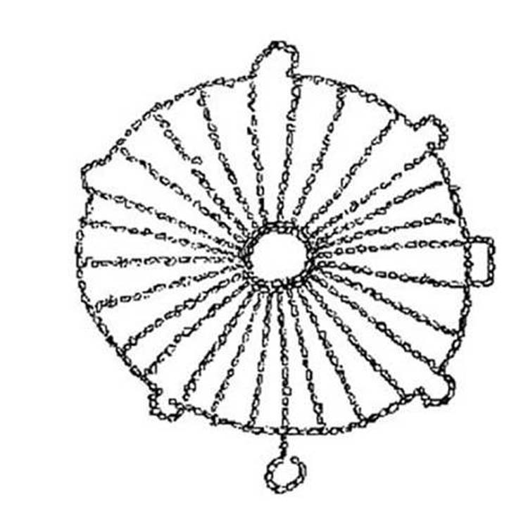
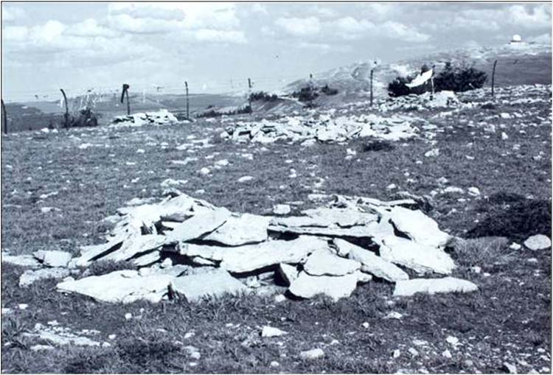
Big Horn Medicine Wheel
Burnt Face
Rocks of the Big Horn Medicine Wheel, Wyoming, Photo: Frey 1993

Slide 10
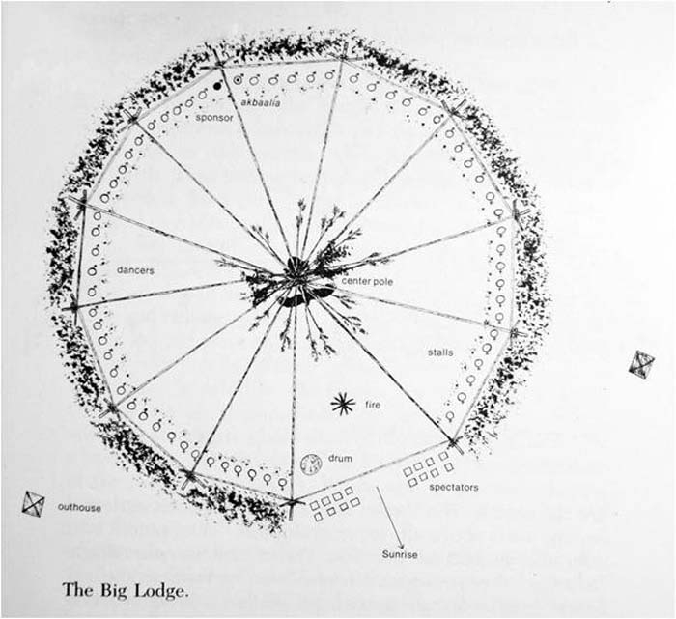
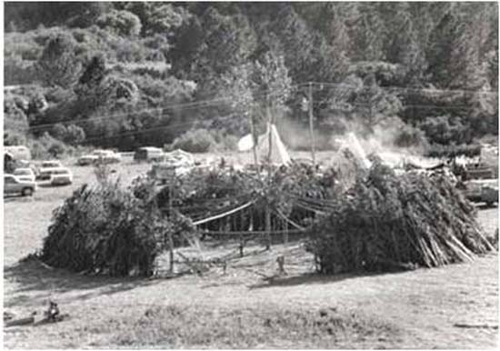
Sundance lodge
Crow Sundance Lodge, Wolf Mountains. Photo: Frey 1993
Ashkísshe

Slide 11
Tom Yellowtail’s Wheel
the various paths, the spokes, distinct and equal,
yet all linked by the same rim and hub,
if the wheel is to turn

Slide 12
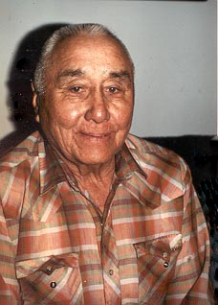
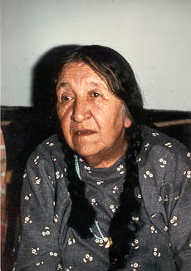
Varied Paths
can travel the many but distinct spokes, when maintaining integrity of each, while each part of a greater whole
a map
competency
without threat of the “mutually exclusive”

Slide 13
Huckleberries
wagon wheels and rock medicine wheels
Sundancer participants, Baptist parishioners, IHS practitioners
spokes and a hub
interplay of the unique and universal,
our collective diversity and what we share in common
huckleberries offered, lessons to be learned?
attend to heart and head ways of knowing

Slide 14
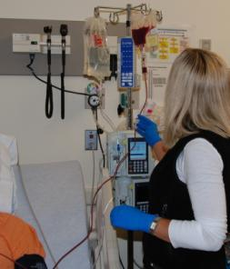
Biomedical and Sundance Ways
traveling the distinct healing spokes: reclining with an IV of stem cells, dancing with Buffalo Spirit
Receiving the stem cells, Seattle. Photo: Kris Roby 2009
The Buffalo and Eagle being blessed before the start of the Sundance, Gordon Plain Bull and Tom Yellowtail. Pryor 1974

Slide 15
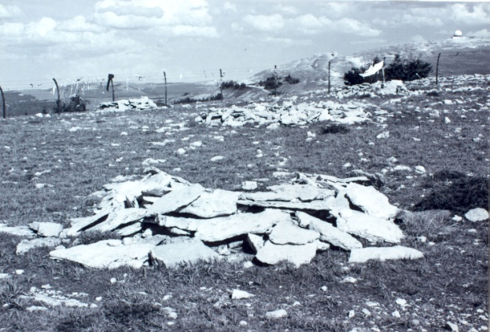
Inner Healing
Burnt Face
stumble and fall - health taken
confusion and solitude, replaced by loving support
journey of perseverance and sacrifice
transformation possible:
a child’s face restored
reborn as a child

Slide 16
liminality
CHAOS
“betwixt and between”
timeless and spaceless, between the spokes, devoid of distractions and mundane sensibilities
listen deeply – most essential

Slide 17
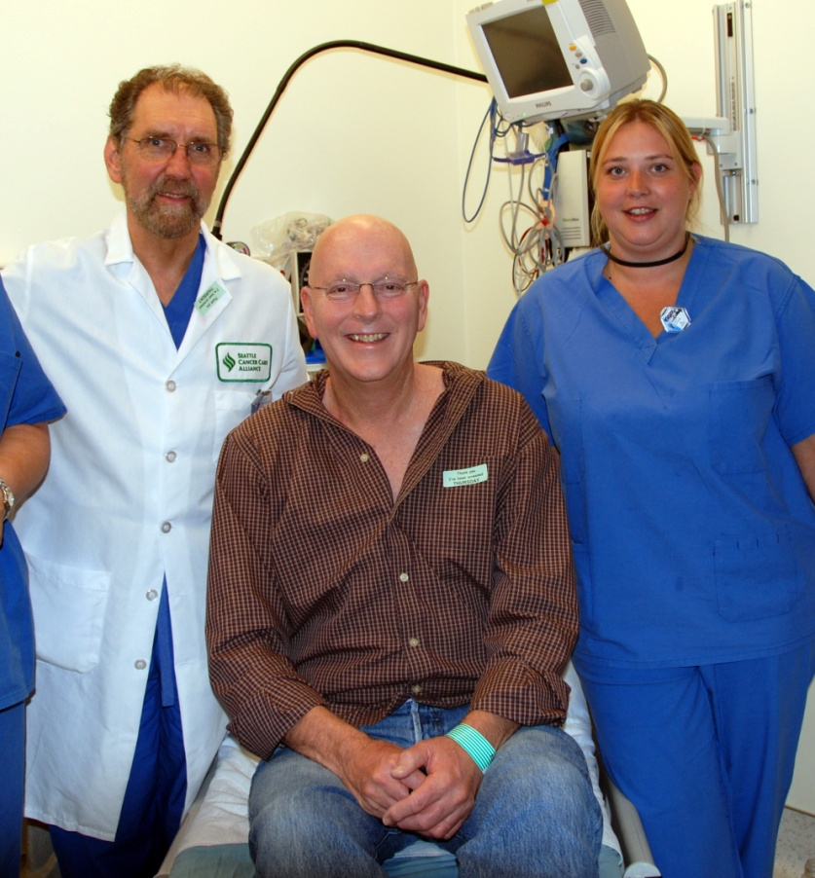
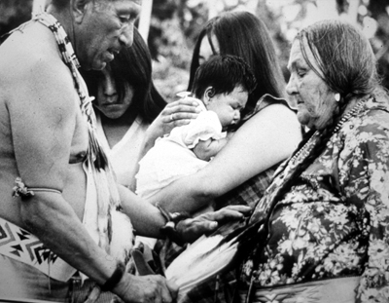
Empathy - Compassion
OUT OF THE CHAOS, OUT OF THE LIMINALITY
- placing one’s self in the shoes of another
- unselfish support for another
a healing language of the hub/rim
Mable Pretty On Top being “doctored,” Sundance, Pryor. 1974
Frey following the stem cell transplant, Seattle. Photo: Kris Roby 2009.
“that pat on the back from doctor‘s hand or Eagle-feather held in hand”

Slide 18
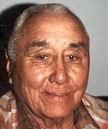
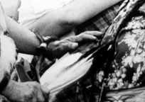
EMPATHY - Compassion
that certain look in Tom’s face - that Eagle-feather fan held in hand
another huckleberry?

Slide 19
Tom Attending to his Chores
“as if we’d known each other for years,”
yet so fundamentally different, so little in common
Tom Yellowtail, Wyola. Photo: Joseph Epes Brown, circa 1970s
how can two people so different, relate so effortlessly?

Slide 20
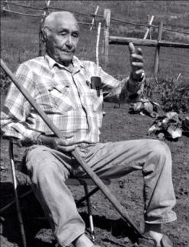
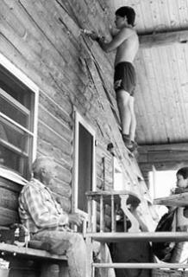
baaéechichiwaau
“re-telling one’s own”
act of telling of Coyote or of one’s own life-defining events
a gift received, now re-told, gifted to you
power of story a language of our shared humanity, our hub/rim
Tom Yellowtail, retelling a favorite story, with his great grandkids, at his cabin, east of Wyola. Photo: Frey 1993
bridging what can divide the spokes,
the “mutually exclusive”

Slide 21
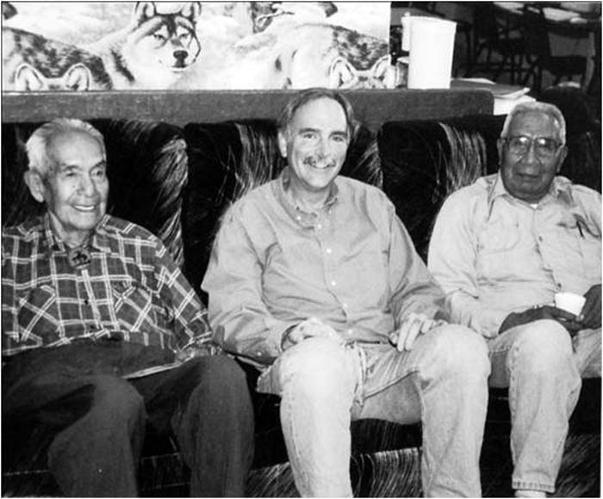
Further Applications - Implications?
Schitsu’umsh elders Lawrence Nicodemus and Felix Aripa, along with Frey, Plummer. Photo: Rosemary Peone 2000
for our unfolding stories, as students, teachers, researchers,
for your unfolding story
what huckleberries await?
let’s take a journey, a humanities expedition together
as ethnographer, researcher and teacher

Slide 22
Another Dance
as “distinguished humanities professor” – aka as “ethnographer”
a “research design” – the humanities
human condition
interpretive
wisdom
reflect and respond

Slide 23
A Community of “vandals”
questions to ask you and others:
“what is the interplay between the unique and universal,
between the particular and ubiquitous,
between our collective diversity and shared humanity?”
a community ethnography

Slide 24
VANDAL COMMUNITY
David Adler - Public Policy
Katherine Aiken - History
Barry Bilderback - Music
Dan Bukvich, Navin Chettri and their Students - Music and the Jazz Choir
Don Burnett - Jurisprudence
Rob Caisley, Lojo Simon and their Students - Theatre and the play, Adoration of Dora
Nancy Chaney - Mayor and Alumni
Marco Deyasi - Art Historian
Stephen Drown - Landscape Architecture
Dan Edwards - Chemistry
Sanford Eigenbrode - Chemical Ecology and Entomology
James Foster - Biology and Computer Science
Heather Gasser - Women's Center
Janis Johnson and Nez Perce elders - Literature and an evening of Nez Perce Jazz
David Lee-Painter and his Students - Theatre
Sally Graves Machlis and Delphine Keim-Campbell - Art and Design
John Mihelich - Anthropology and Sociology
Garth Reese - Religious Studies
Michael O'Rourke - Philosophy
Marty Peterson - Legislative Representative for the President
Brandon Schrand and his Students - Creative Writing
Bill Smith - International Relations
Carmen Suarez - Human Rights, Access and Inclusion Office
Bill Voxman - Photographer and Mathematics

Slide 25
Implications
how we conceptualize the interplay between diversity and universality has far reaching implications on our capacities:
for communication and collaboration,
for creativity in the arts and discovery in the sciences,
for tolerance, civility, and respect
for building local and global community
you’re invited to an Humanities Exploration. let’s see what huckleberries await.

