Slide 1
The wheel as political metaphor
Humanities Exploration
University of Idaho
April 10, 2012
Nancy Chaney, Mayor, City of Moscow

Slide 2
Mayor’s job description
Mayor
(Executive Branch)
City Supervisor, (Admin Assistant under direction & authority of Mayor)
6-member
City Council
(Legislative Branch, Quasi-Judicial) functions
Arts Director
HR Director
City Attorney
Info Systems Director
Community Devel Director
Parks & Rec Director
Finance Director
Police Chief
Fire Chief
Public Works Director
Superintending and administrative officer
of the City
Empowered to call meetings of the Council; sign contracts; offer rewards;
Veto Council decisions; require reports from departments;
Police power within 5 miles for health issues & within one mile for other matters except taxation; call citizens to aid; subpoena witnesses
Term of office: Four years
Elected directly by voters
No term limits

Slide 3
Desirable traits for elected leaders
Personal Characteristics
Practiced Skills
Determined
Hard-working
Compassionate
Good-humored
Curious
Likes variety
Patient
Envisions connections
Trustworthy
Organized
Communicates effectively in a variety of ways
Capable of shifting and refocusing attention
Knows how to delegate
Inspires others
Balances ego with humility
Understands teamwork

Slide 4
Building a wheel out of traits and skills
Luck, happenstance, spiritual intervention
Binary choices
Connecting the spokes
Learned, taught, practiced and evolving techniques
Strength of relationships, chance meetings, kaleidoscopic interaction
The road traveled: Life lessons, experiences
Going with the flow

Slide 6
Coyote in mythology. (n.d.). In Wikipedia. Retrieved April 5, 2012, from http://en.wikipedia.org/wiki/Coyote_in_mythology

Slide 7
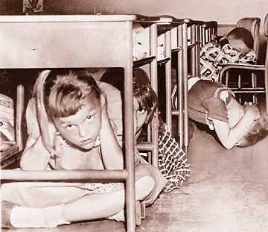
‘Duck & Cover’ Classroom Exercise
http://apps.detnews.com/apps/history/index.php?id=48
The Detroit News Photo Archives, with permission
Article: “When bomb shelters were all the rage” by Pat Zacharias, 4-01-99

Slide 8
Moscow 1903
Photo from City archives

Slide 9
Moscow then (1944)…
Photo from City archives

Slide 10
…and recently (Anderson’s silos in Legacy Crossing)
(From City archives)

Slide 11
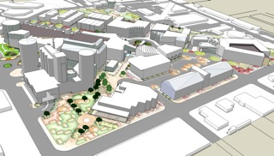
Tomorrow? Images courtesy of Professor D. Nels Reese

Slide 12
Chalk art wheel from Safe Routes to School
Photo courtesy of Helen Brown and Brooke Lowry, UI

Slide 13
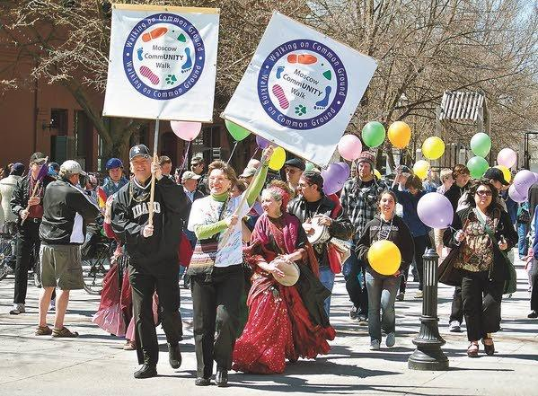
Moscow CommUNITY Walk
Photo by S.M. ‘Ghazi’ Ghazanfar

Slide 14
Neil Armstrong steps on lunar surface, July 21, 1969
Source: Wiki television image

Slide 16
“Two inches of snow on Palouse farmland” Photo by T. Alan Place, Moscow ID

Slide 17
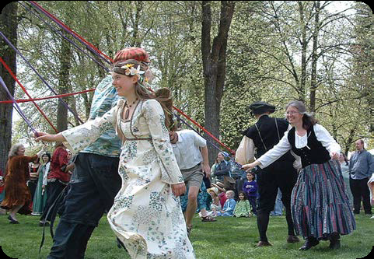
Renaissance Fair May Pole Dance, East City Park, Moscow
www.wikipedia.com

Slide 18
Special Olympics Law Enforcement Torch Run
Jan. 2009, Moscow
Provided by Andrea Kramer, Photographer, Naples, ID www.stampedelakestudio.com

Slide 19
My Own Home, Moscow
Pictured (L-R): Nancy Lyle, Barbara Wells, Cathy Porter
Senior Fair, Palouse Mall, June 2010
Photo used with permission

Slide 20
SYNC: Serving Your New Community, UI 2011
Photo courtesy University of Idaho

Slide 21
John Dickinson had a vision…
Used with permission from family

Slide 22
Itty-bitty Bike Races at Latah Trail Benefit Function
Pictured: Nancy Chaney, Mayor & Tom Lamar, City Council Member
Photo by Aly Lamar

Slide 23
Travel through time…
Where did you come from?
What memories are fondest?
Which relationships are most vivid?
Where are you now?
What knowledge have you gained?
What relationships have you forged?
What are your aspirations?
How can you accomplish them?
What path shall you take?

Slide 24
Thank you
Photo by T. Alan Place
Nancy Chaney, Mayor, City of Moscow
www.ci.moscow.id.us
nchaney@ci.moscow.id.us
W: 883-7080 H: 882-9350

