Slide 1
A Historian Looks at Valentine’s Day – the Interplay of Dollars and Cupids
February 14, 2012
Katherine G. Aiken
Professor of History

Slide 2
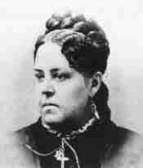
Esther Allen Howard 1828-1904

Slide 3
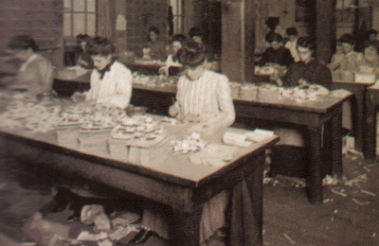
Women on Assembly Line Worcester, Massachusetts

Slide 4
Howland Valentines

