Slide 1
Redox Reactions in Batteries
Chem 253 November 11, 2013

Slide 2
Lead-Acid
1859 Gaston Plante’
Discharge – Galvanic Cell (Spontaneous)
Negative plate:
Pb⁽⁰⁾(s) + HSO₄⁻(aq) → Pb^{(II)}SO₄(s) + H⁺(aq) + 2e⁻ E⁰ = - 0.36 V
Positive Plate
Pb^{(IV)}O₂(s) + HSO₄⁻ + 3H⁺ + 2e⁻ → Pb^{(II)}SO₄(s) + 2H₂O E⁰ = 1.69 V

Slide 3
Cell Reaction
Conc. H₂SO₄ (aq) (6 M)
Pb⁽⁰⁾(s) + Pb^{(IV)}O₂(s) + 2HSO₄⁻(aq) + 3H⁺ → 2Pb^{(II)}SO₄(s) + H⁺(aq) + 2H₂O
E_{cell} = E_{cath} – E_{anod} = 1.69 V – (-0.36) V = 2.05 V
Complete discharge H₂SO₄ (aq) (3 M)

Slide 4
More Negative
E⁰ = - 0.36 V
Pb⁽⁰⁾(s) + HSO₄⁻(aq) → Pb^{(II)}SO₄(s) + H⁺(aq) + 2e⁻
Discharge
E (V)
Charge
E⁰ = 1.69 V
Pb^{(IV)}O₂(s) + HSO₄⁻ + 3H⁺ + 2e⁻ → Pb^{(II)}SO₄(s) + 2H₂O
More Positive

Slide 5
Voltmeter or
Electrical Load
Rxn Zone
Rxn Zone
6 M H₂SO₄
HSO₄⁻
HSO₄⁻
Pb Electrode
PbSO₄(s)
PbSO₄(s)
PbO₂(s)
Pb⁽⁰⁾+ HSO₄⁻ →
Pb^{(II)}SO₄+ H⁺ + 2e⁻
Pb^{(IV)}O₂ + HSO₄⁻ + 3H⁺ + 2e⁻ →
Pb^{(II)}SO₄ + 2H₂O

Slide 6
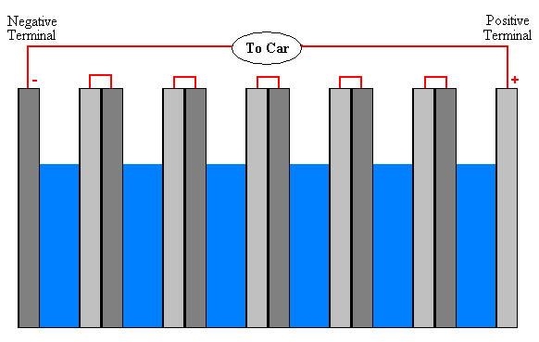
Car Battery 6 cell (series)
6 * 2.05 V = 12 V battery
http://www2.ignatius.edu/faculty/decarlo/EarthToMoon/pages/LeadAcidBatteryLesson9-12.htm

Slide 7
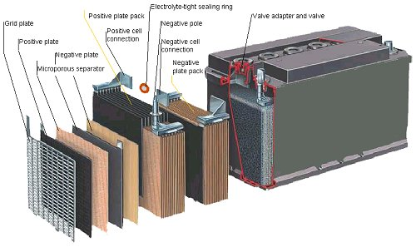

Slide 8
Lead Acid
Rate of reaction – requires porous PbSO₄ layers
Rxn Rate → electrical current
Lead is abundant
99% recycled – none of Li Ion is recyclable
30-60% reaction yield

Slide 9
Alkaline Battery
http://en.wikipedia.org/wiki/Alkaline_battery
Zn_{(s)} + 2OH⁻_{(aq)} → ZnO_{(s)} + H₂O_{(l)} + 2e⁻ [E° = 1.28 V]
2MnO_{2(s)} + H₂O_{(l)} + 2e⁻ → Mn₂O_{3(s)} + 2OH⁻_{(aq)} [E° = +0.15 V]
Overall reaction:
Zn_{(s)} + 2MnO_{2(s)} ZnO_{(s)} + Mn₂O_{3(s)} [e° = 1.43 V]

Slide 10
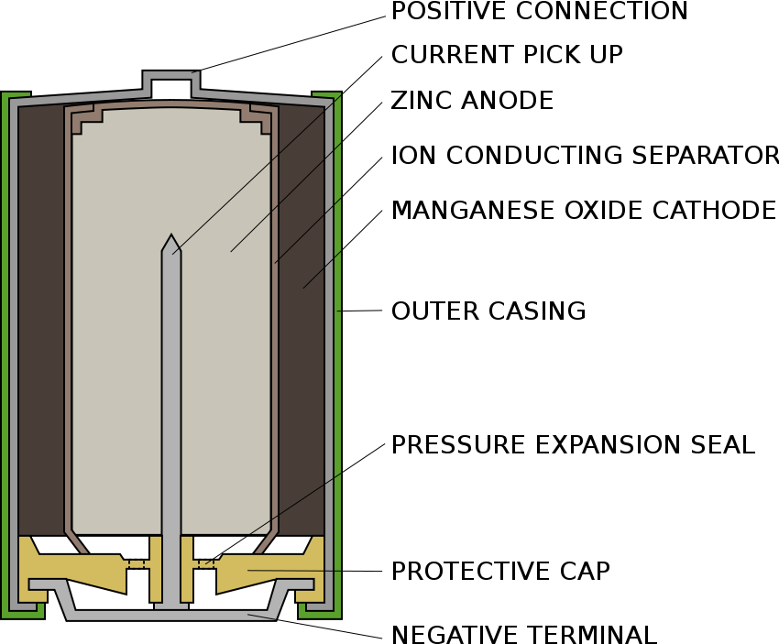

Slide 11
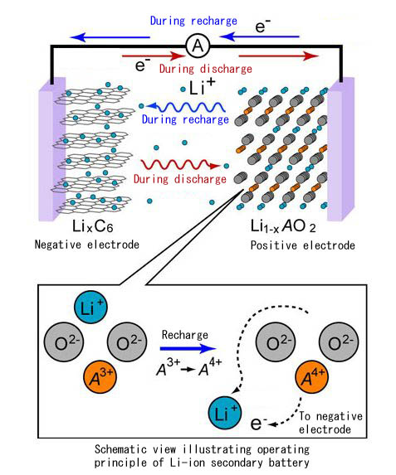
Li Ion Battery
The positive electrode half-reaction is:^{[45]}
The negative electrode half reaction is:
http://en.wikipedia.org/wiki/Lithium-ion_battery
http://techon.nikkeibp.co.jp/english/NEWS_EN/20080820/156592/

Slide 12
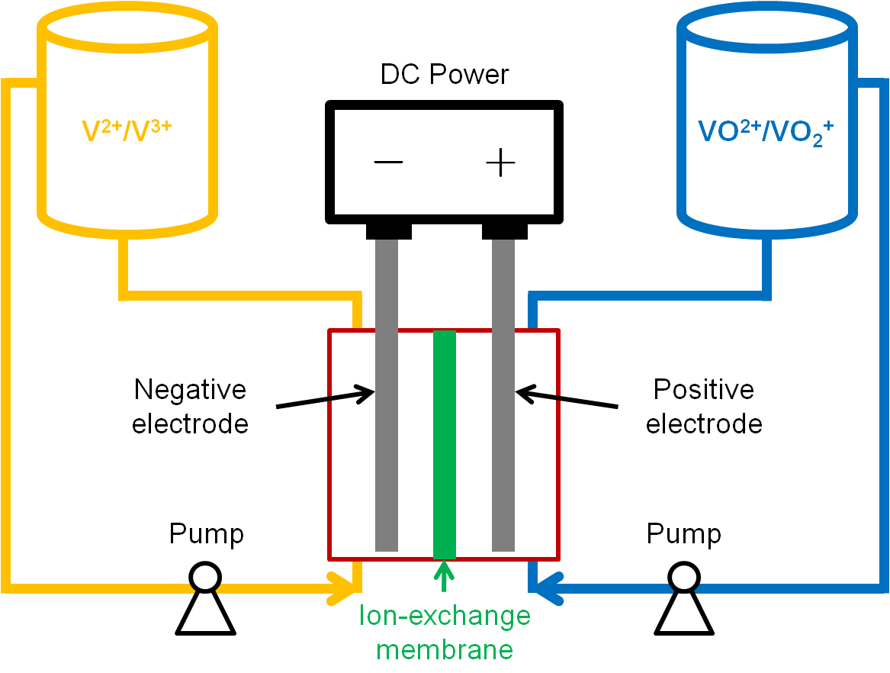
Redox Flow Battery
New design
http://large.stanford.edu/courses/2011/ph240/xie2/

Slide 13
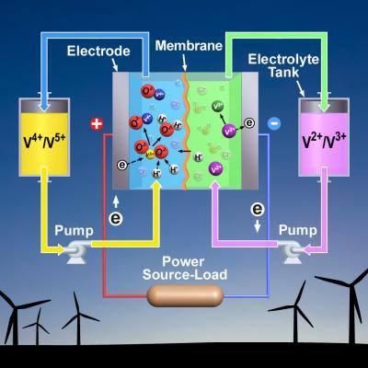
http://esciencenews.com/articles/2011/03/17/upgrading.vanadium.redox.battery

Slide 14
Vanadium Redox Flow Battery
Aqueous system
Discharge
Positive Electrode:
V^{(V)}O₂⁺ + 2 H⁺ + e⁻ → V^{(IV)}O²⁺ + H₂O (E⁰ = 0.99 V vs. SHE)
Negative Electrode:
V²⁺ → V³⁺ + e⁻ (E⁰ = -0.26 V vs. SHE)
E_{cell} =0.99 V – (-0.26) = 1.25 V

Slide 15
VRF Future Research
Electrodes for fast e- transfer
H₂ interference during charging cycle
V³⁺ + e⁻ → V²⁺ (E⁰ = -0.26 V vs. SHE)
2H⁺ + 2e⁻ → H₂ E0 = 0.00 V (preferred)
Generates OH⁻ poisons VRF battery

Slide 16
https://www.youtube.com/watch?v=ut1wxZ6-tb0

