Slide 1
GUITAR: A New Material For Dimensionally Stable Anodes
Paper No. 19649, 244th American Chemical Society National Meeting, Philadelphia, PA
Frank Cheng, Isaiah Gyan, Yuqun Xie, Nolan Nicholas, David N. McIlroy
Department of Chemistry
University of Idaho
Moscow, ID 83844-2343
ifcheng@uidaho.edu
208-885-6387

Slide 2
Outline
Discovery
  University of Idaho Thermolyzed Asphalt Reaction (UITAR)
  Graphene from UITAR (GUITAR)
Comparison of GUITAR with Literature
  Morphological
  Spectroscopic
Electrochemical Stability of GUITAR Anodes
  Comparison with Boron-Doped Diamond Anodes
  Kinetics of Methylene Blue Degradation

Slide 3
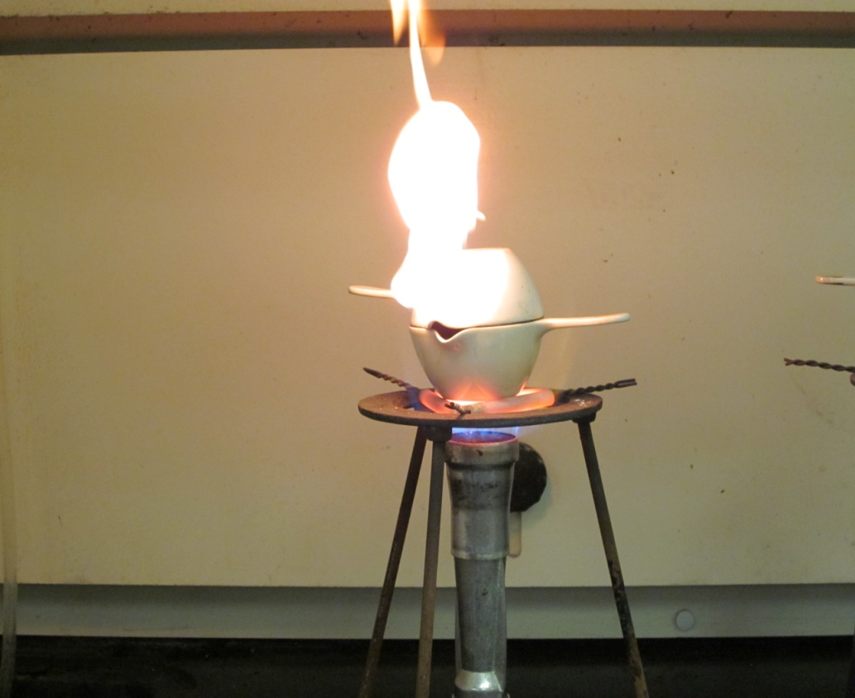
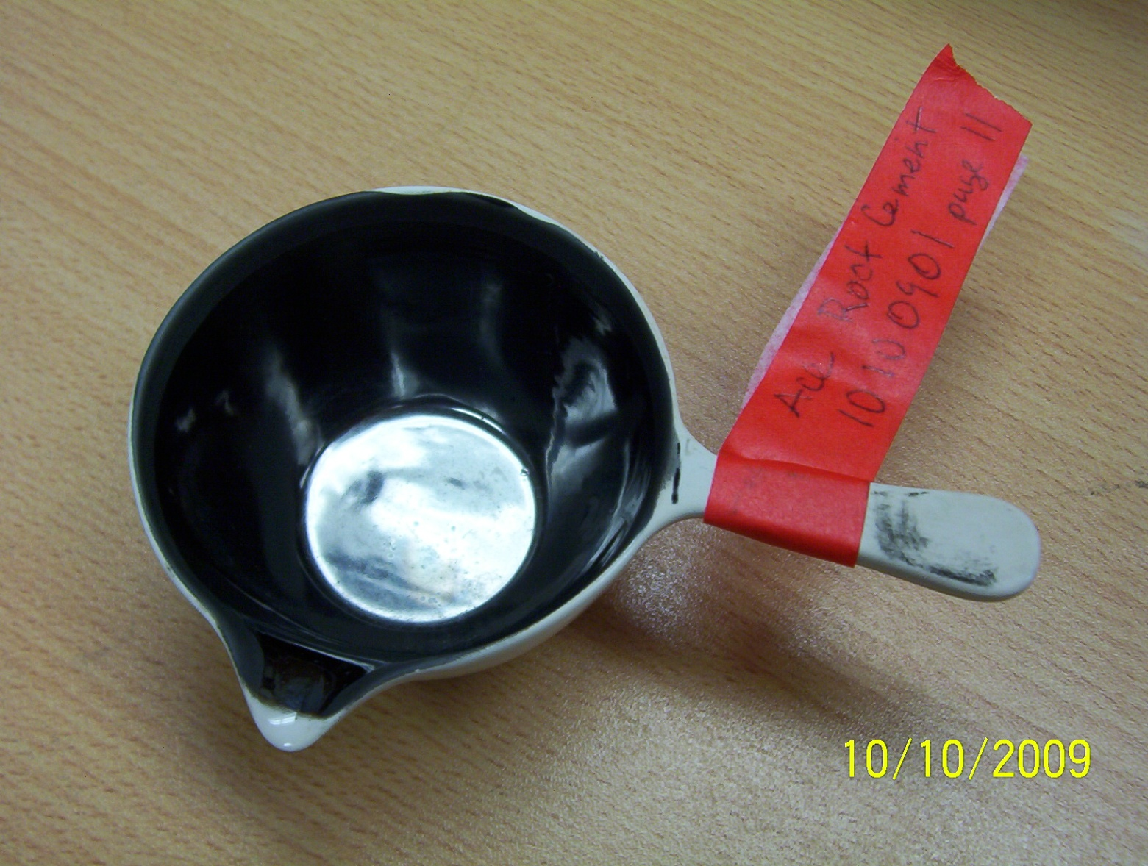
University of Idaho Thermolyzed Asphalt Reaction
Flames from
precursor
combustion
Porcelain Cover
Porcelain Crucible
Brownish Fumes
Inner Crucible with precursors
Heat
Figure 2.0.1 (Left) Pyrolysis of roofing tar, (Middle) schematic of the process, (Right) finished product.

Slide 4
UITAR-University of Idaho Thermolyzed Asphalt Reaction
Successful Reagents
  Shale Oil
  Crude Oil
  Roofing Tar (Ace Hardware)
  Taco Chips
  Some Candy Bars
Failed
  Motor Oil, 5W-20
  Paraffin
  Pyrene

Slide 5
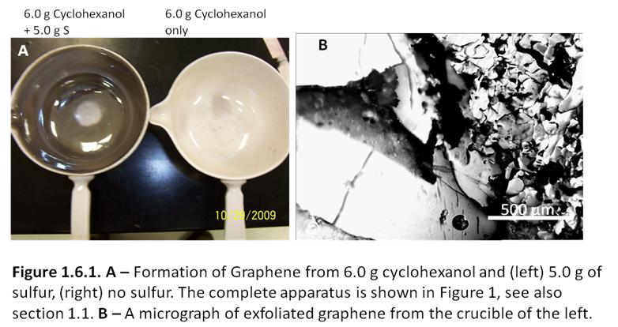
Mechanism of Formation
First Hunch – Sulfur is Involved
cyclohexanol and Sulfur
cyclohexanol only

Slide 6
Summary of Formation
TGA and Raman Evidence
  Intermediates formed with S between 120 – 450 ⁰C
  Graphene/Graphite formation at 600 ⁰C
Reagents
  Organic BP – MP 100-250 ⁰C
  Elemental Sulfur, Organic Sulfur

Slide 7
Hypothesized UITAR Mechanism
Cheng et al, J. Mater. Chem. 2012, 22, 5723-29

Slide 8
Morphology
Atomic Force Microscopy
  Atomically Flat
  Interatomic Distance of 0.1485 Å, sp² C
SEM
  Flat and Layered
Conformal Coatings
  Unique to UITAR
  Deposition onto silica nanostructures

Slide 9
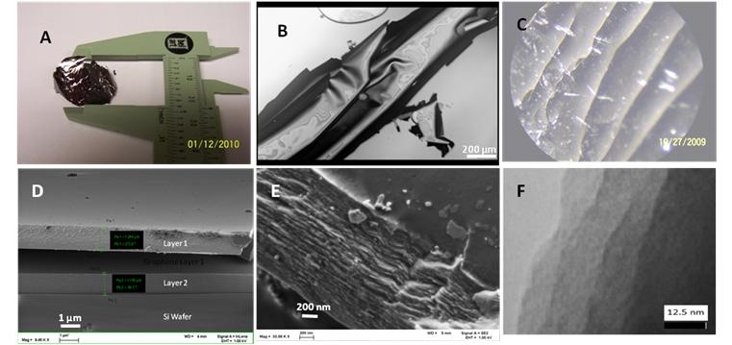
Figure 2.0.2 GUITAR graphene, A – a photograph of a flake approximately 25 mm in diameter. B – an optical micrograph (400x) in water. C – graphene layers (400x). D – 9.45K x SEM of microtomed layers on Si. E – 23.08K x SEM showing layered characteristics. F – A TEM showing layered characteristics on the nanometer scale.

Slide 10
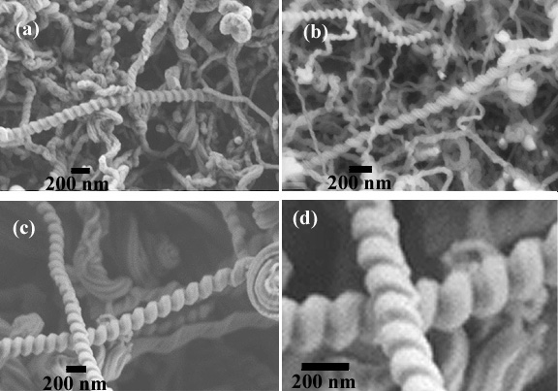
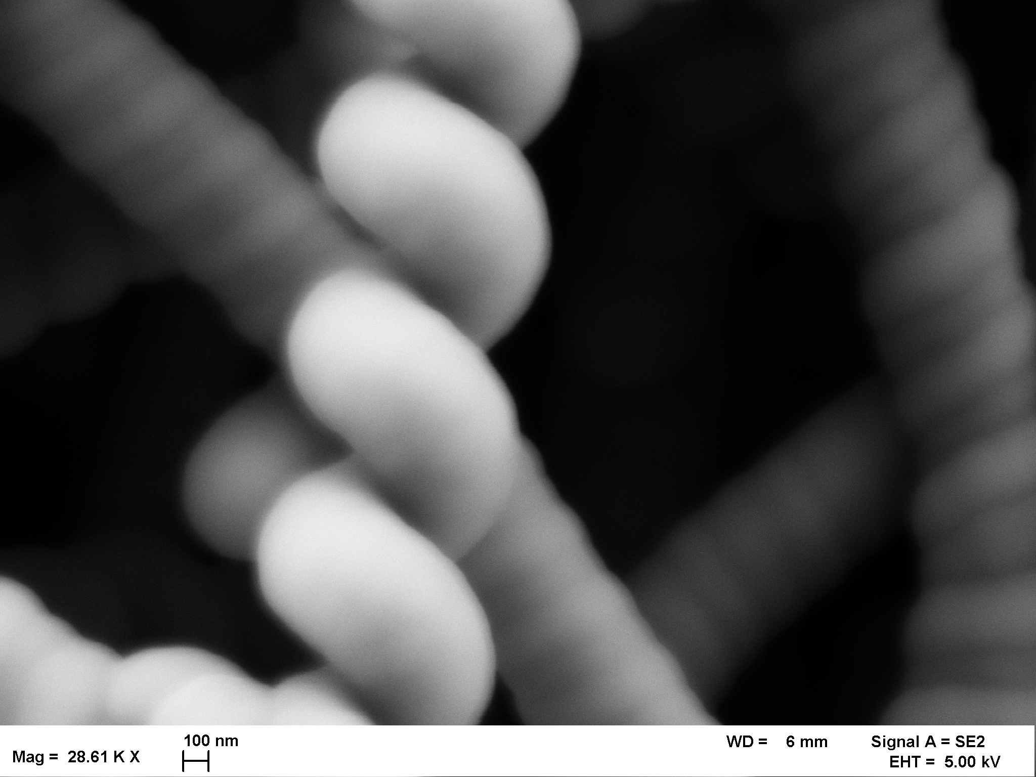
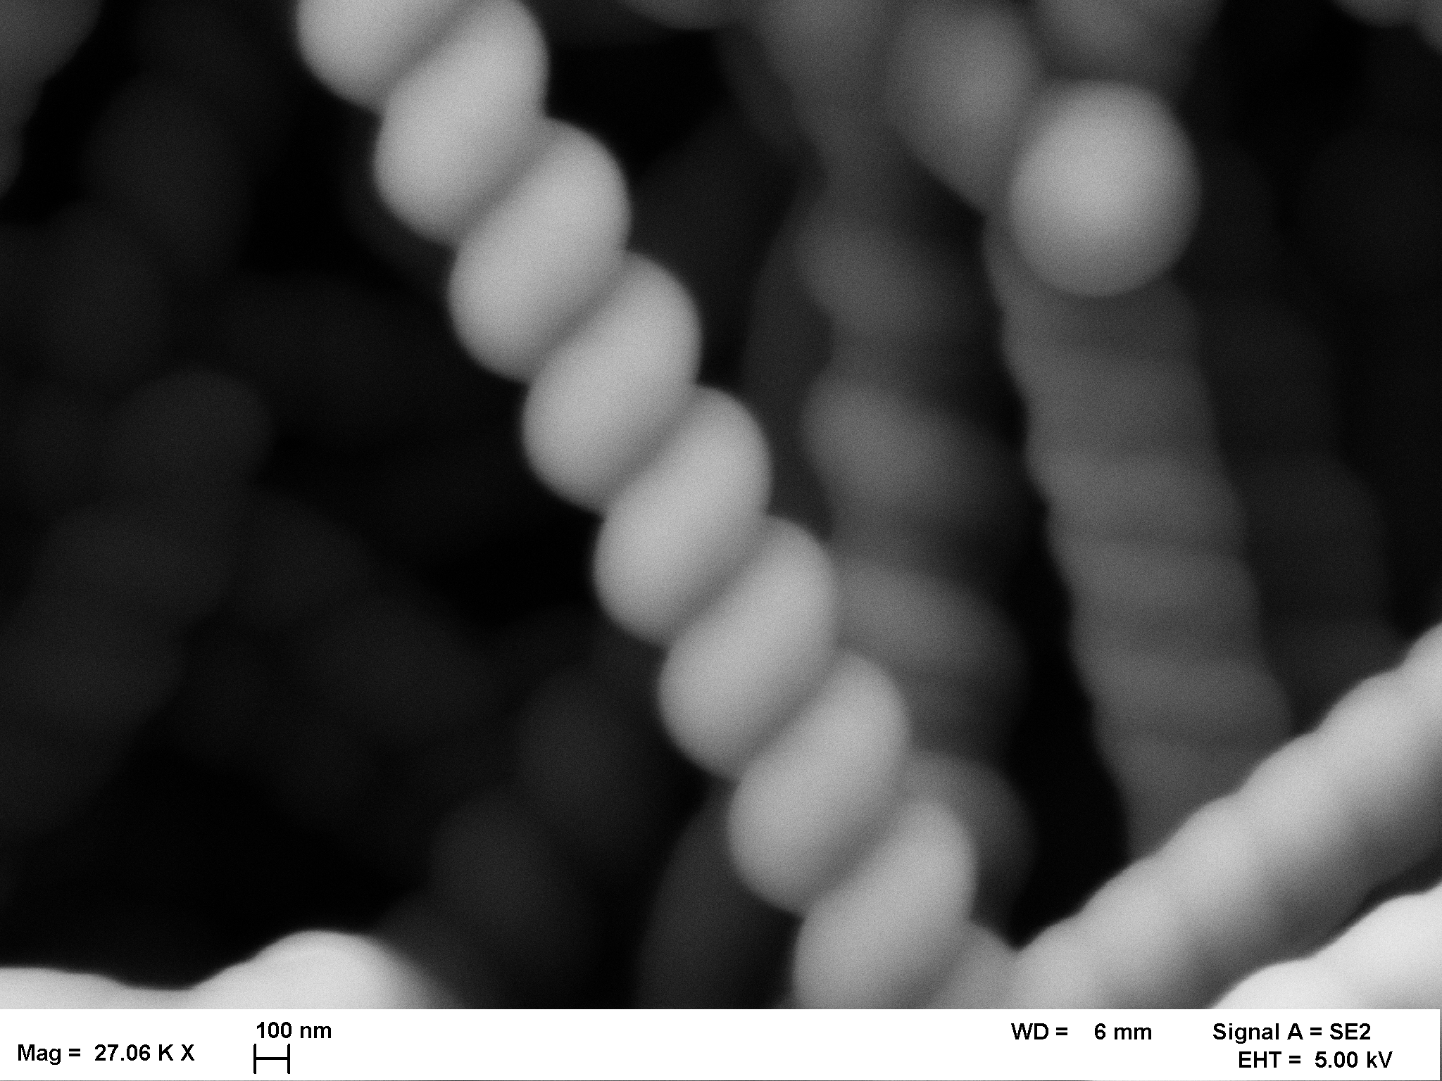
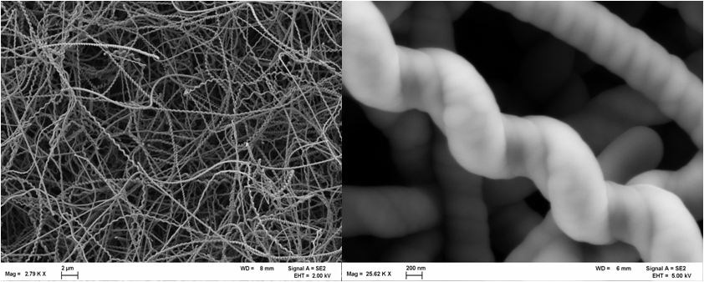
A
B
Figure 2.0.3
A – Bare silica nanosprings.
B – D Silica nanosprings coated with multilayer graphene by the G-UITAR process.
200 nm
D
C
D
200 nm
2 µm
200 nm

Slide 11
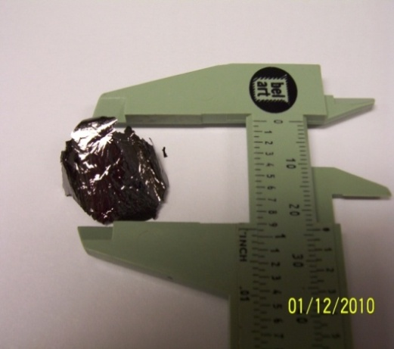
What is that Material?
Carbon – XPS data
Metallic
Layered
Conductive
Inert
-Aqua Regia
-Conc. H₂SO₄

Slide 12
Physical Characterization
XPS – Nearly Pure sp² Carbon
Raman
  G Band 1593 cm⁻¹, D Band 1350 cm⁻¹
IR
  861 and 1576 cm⁻¹ peaks – intralayer graphene stretches
  No other surface functionalities

Slide 13
Raman Spectrum of UI Carbon
I_{D} /I_{G}= 0.93
Tuinstra-Koenig relationship: I_{D} /I_{G} = C(_{λ})/La
  C(_{λ}) = 532 NM
UI carbon grain size, La = 5.3 nm²
Other forms of multilayer graphene
  Graphene Paper, reduced Graphene Oxides
  3 – 6 nm²
Ferrari and Robertson, Phys Rev B, 2000, 61, 14095-107
S. Stankovich, et,al. Carbon. 2007, (45), 1558-1565

Slide 14
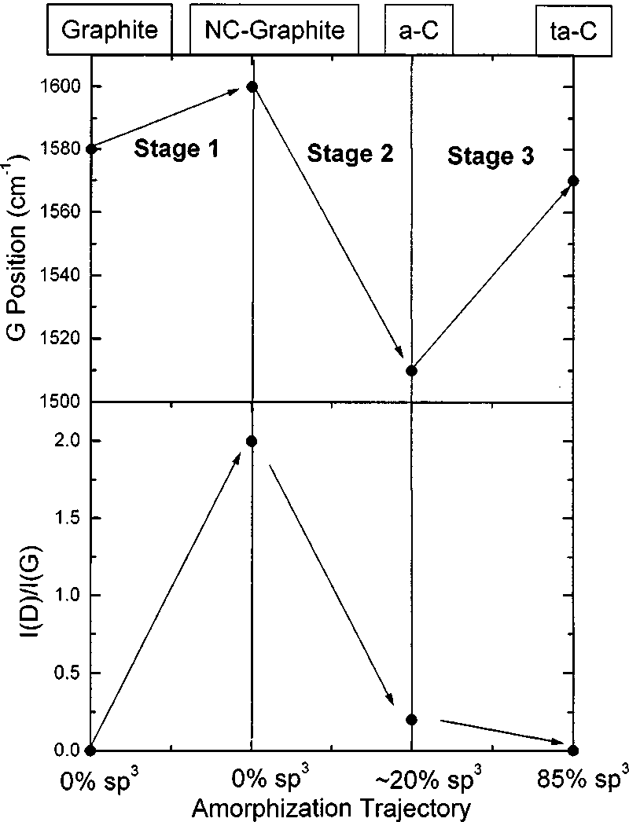
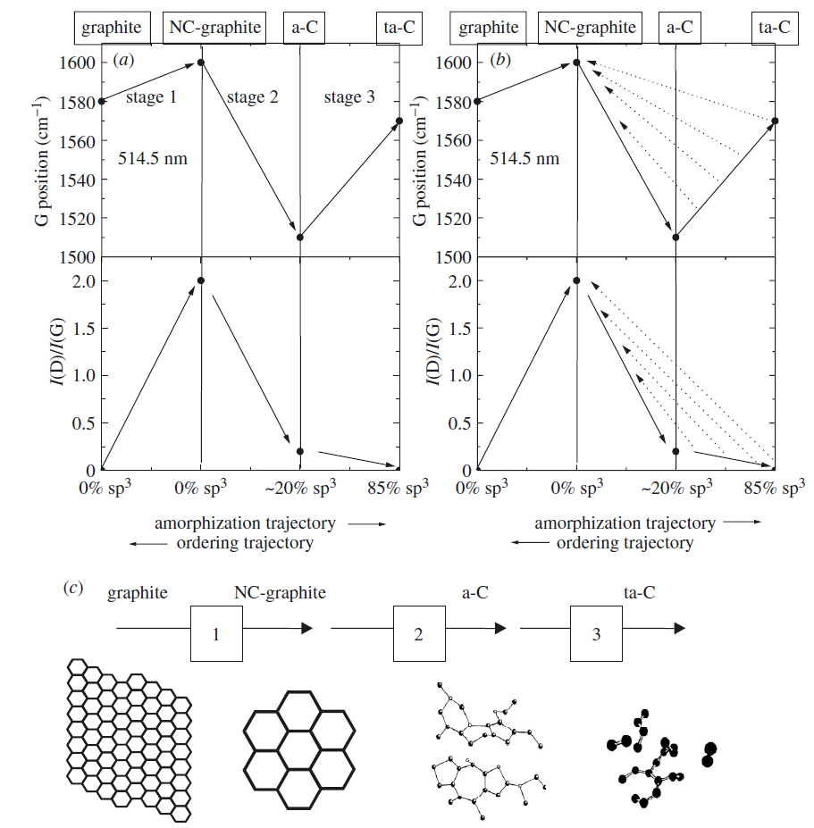
Ferrari Amorphization Trajectory
1594
Figure 10 from Ferrari, Robertson. Phys Rev. 2000, (B61), 14095-14107
0.93
Between Graphite to NC-graphite
0% sp³ hybridization

Slide 15
UI Carbon
SEM
  Flat, layered morphology Resembles Highly Ordered Pyrolytic Graphite (HOPG)
  Does Not Appear to be Graphene Paper (GP)
Raman Studies
  Grain Size 5.3 nm² with GP/r-GO parameters 3-6 nm²
  Closer to GP than HOPG
Neither HOPG or GP

Slide 16
UI Carbon - Structure
Textured surface
Flat
Flat
Graphene Paper
UI Material (Proposed)
HOPG
Ferrari, Robertson. Phys Rev. 2000, (B61), 14095-14107

Slide 17
G-UITAR , Graphene (Graphite) from UITAR
UI Carbon Material Unlike
  HOPG
  Graphene Paper (r-GO)
UI Carbon, G-UITAR
  Graphene (Graphite) from UITAR
GUITAR vs. GP and HOPG
  Any Advantages?

Slide 18
Electrochemical Investigations of GUITAR
Cyclic Voltammetry
  Comparisons with other carbon materials
  Facile Electron Transfer
  GUITAR >> HOPG
Voltammetric Potential Window
  Anodic stability ≈ Boron Doped Diamond
New Material for Dimensionally Stable Anodes
  More Cost Effective than other Materials

Slide 19
Figure 2.7.1 - Cyclic voltammograms of Fe(CN)₆^{3-/4-} (l) and Ru(NH₃)₆^{3+/2+} (r) with 1 cm² GUITAR electrodes, in 0.1 M KCl electrolyte at a potential sweep rate of 0.1 V/s.

Slide 20
Summary of CV @ 100 mV/s in 1 M KCl(aq).
Note GUITAR vs. HOPG
- Basal Plane

Slide 21
i] Cheng Xiang Lim, Hui Ying Hoh, Priscilla Kailian Ang, and Kian Ping Loh. Direct Voltammetric Detection of DNA and pHSensing on Epitaxial Graphene: An Insight into the Role of Oxygenated Defects. Anal. Chem. 2010, 82, 7387–7393
ii] Tang, L. Preparation, Structure, and Electrochemical Properties of Reduced Graphene Sheet Films. Adv. Funct. Mater. 2009, 19, 2782–2789
iii] Kristin R. Kneten, Richard L. McCreery. Effects of redox system structure on electron-transfer kinetics at ordered graphite and glassy carbon electrodes. Anal.Chem.1992, 64, 2518-2524

Slide 22
e- Transfer Rates
Surface Area Effect?
  No Evidence of Adsorption
Electronic Surface States
  Gateways to e- transfer
  Basal vs. Edge and Defects
Electron transfer rates
  Edge > Basal Plane
Basal
Edge

Slide 23
Electron Transfer Rate Trends
Fastest Left → Right
Glassy Carbon ≈ GUITAR
≈ Graphene (Edges)
> Boron Doped Diamond
> HOPG (Basal Planes)

Slide 24
Electron Transfer on Carbon Electrodes
Extremely Slow from Basal Planes
  HOPG Electrodes
  CVD grown Single Layer Graphene
Fast on
  Graphite Structures with high electronic Density of States (DOS)
  Edges
  GUITAR Electrodes
    Not edge effect but from structural defects

Slide 25
McCreery et al, J. Phys. Chem. 1994, 98, 5314-5319
E_{Fermi}
E_{Fermi}
Valence
Band
Conduction
Band
DOS
σ+
π+
π-
σ-
Energy (eV)
Crystalline Graphite
Disordered Graphite
 | Free e- density (cm⁻³) | DOS at Fermi Level states/atom/eV
Au | 6 × 10²² | 0.28
HOPG | 5 × 10¹⁸ | 2.2 x 10⁻³
From McCreery Table 5

Slide 26
GUITAR Electrodes
Higher DOS along Structural Defects?
Structural Defects
  Sites for fast e- transfer?
  Nano-crystals 5 nm²
e-
e-
e-

Slide 27
GUITAR as Dimensionally Stable Anodes (DSA’s)for Remediation
Potential Window
Anodic Limits
  Water breakdown
  2H₂O → O₂ + 4H⁺ + 4e- E⁰ = 1.23 volts
  2H⁺ + 2e- → H₂(g) E⁰ = 0.00 volts
  Corrosion
  C + 2H₂O → CO₂ + 4H⁺ + 4e- E⁰ = 0.207 V

Slide 28
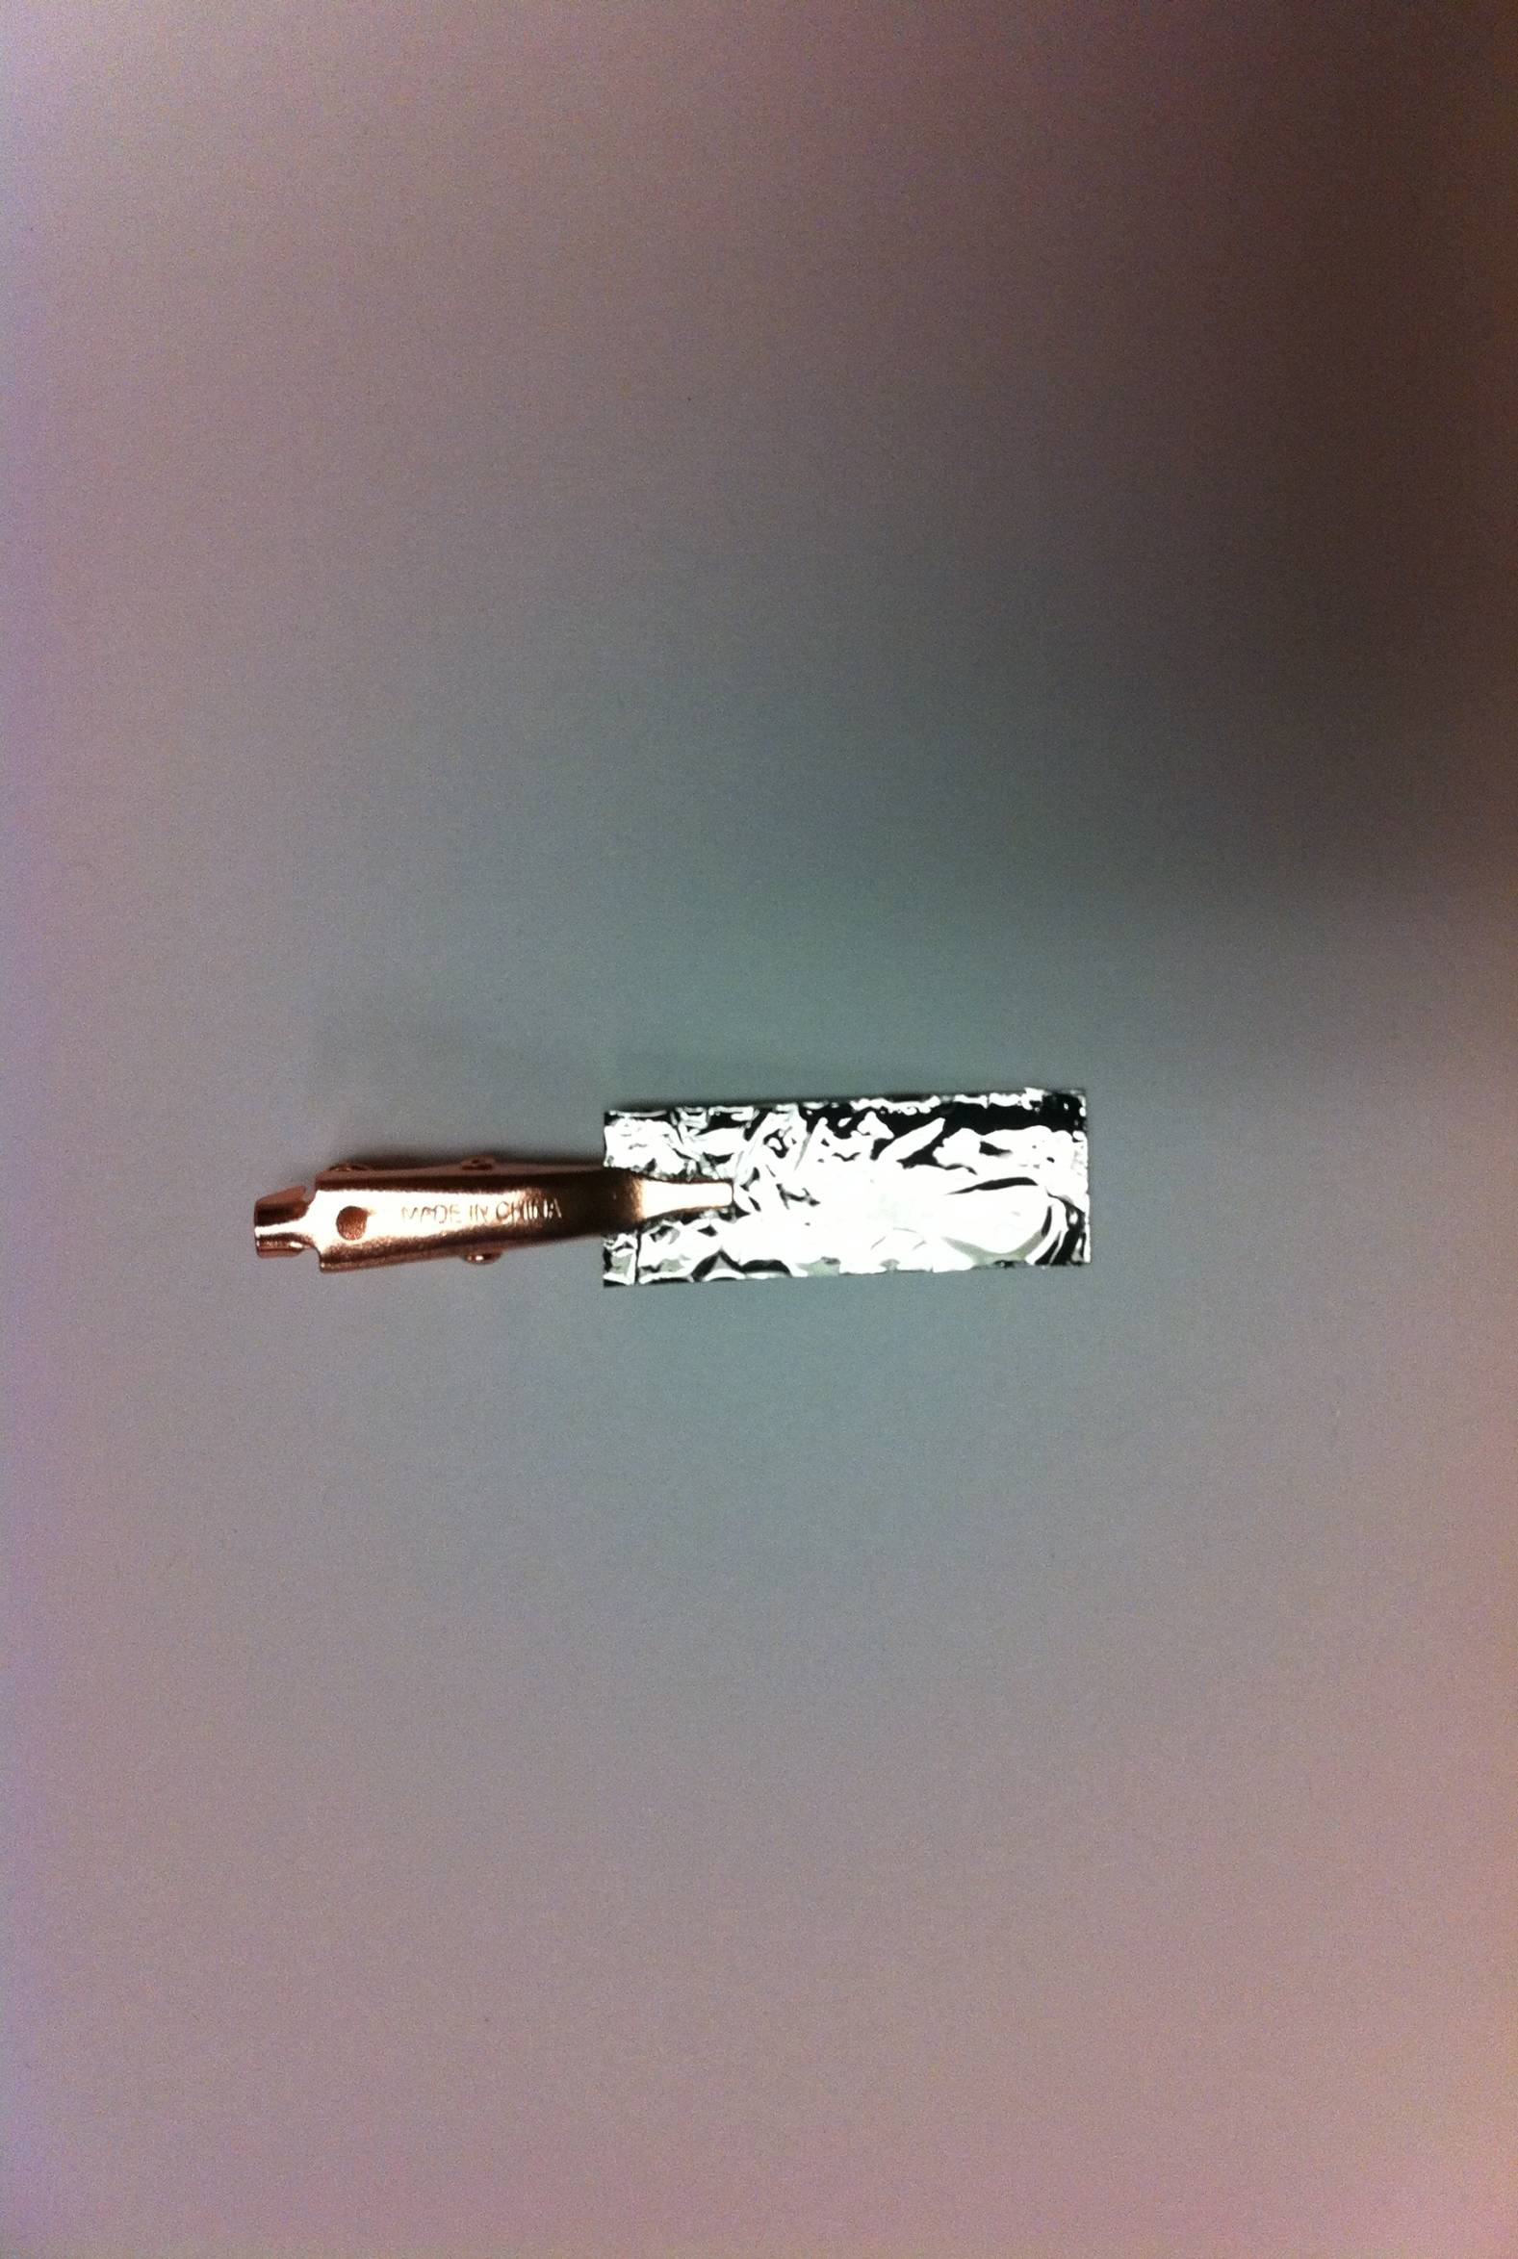
Cyclic voltammograms of a GUITAR electrode (above) in 1 M H₂SO₄ at a potential sweep rate of rate 50 mV/s, under Ar purge.
Top Right – The anodic limit at 200 µA/cm² is 2.7 volts.
Bottom Left – The same voltammogram at mA/cm² sensitivity.

Slide 31
[ 1] Granger, M. C. Standard Electrochemical Behavior of High-Quality, Boron-Doped Polycrystalline Diamond Thin-Film Electrodes. Anal. Chem. 2000, 72, 3793-3804.
[ 2] Gandini, D. Oxidation of carboxylic acids at boron-doped diamond electrodes for wastewater treatment. J. Electrochem. 2000, 30(12), 1345-1350.
[ 3] Panizza, M.; Michaud, P. A.; Cerisola, G.; Comninellis, C. Anodic oxidation of 2-naphthol at boron-doped diamond electrodes. J. Electroanal Chem. 2001, 507(1-2), 206-214
[4 ] Kevin W. Hathcock, Jay C. Brumfield, Charles A. Gross, Eugene A. Irene, Royce W. Murray, “Incipient Electrochemical Oxidation of Highly Oriented Pyrolytic Graphite: Correlation Between Surface Blistering and Electrolyte Anion Intercalation. Analytical Chemistry, 1995, 67, 2201-2206.
[ 5] J. Iniesta. Electrochemical oxidation of 3-methylpyridine at a boron-doped diamond electrode: application to electroorganic synthesis and wastewater treatment. Electrochem Comm. 2001, 3, 346-351.
[ 6] Cheng, X. L. Low-potential electrochemiluminescent sensing based on surface unpassivation of CdTe quantum dots and competition of analyte cation to stabilizer. Anal. Chem. 2010, 82(8), 7387-93.
[7] A. Zeng, E. Liu, S. N. Tan, S. Zhang, J. Gao, Cyclic Voltammetry Studies of Sputtered Nitrogen Doped Diamond-Like Carbon Film Electrodes, Electroanalysis 2002, 14, No. 15-16

Slide 33
[1] Canizares, P. Dominguez, J. A. Rodrigo, M. A. Villasenor, J. Rodriguez, Effect of the Current Intensity in the Electrochemical Oxidation of Aqueous Phenol Wastes at an Activated Carbon and Steel Anode, J. Ind. Eng. Chem. Res. 1999, 38, 3779.
[2] Polcaro, A. M. Palmas, S. Electrochemical Oxidation of Chlorophenols, Ind. Eng. Chem. Res. 1997, 36, 1791.
[3] Polcaro, A. M. Palmas, S. Renoldi, F. Mascia, M. Three-dimensional electrodes for the electrochemical combustion of organic pollutants, Electrochim. Acta 2000, 46, 389.
[4] Panizza, M. Cerisola, G. Influence of anode material on the electrochemical oxidation of 2-naphthol: Part 1. Cyclic voltammetry and potential step experiments, Electrochim. Acta 2003, 48, 3491.
[5] Zanta, C. L. P. S. De Andrade, A. R. Boodts, J. F. C. Electrochemical behaviour of olefins: oxidation at ruthenium-titanium dioxide and iridium-titanium dioxide coated electrodes, J. Appl. Electrochem. 2000, 467.
[6] Panizza, M. Cerisola, G. Electrocatalytic materials for the electrochemical oxidation of synthetic dyes, Appl. Catal., B 2007, 75, 95.
[7] Comninellis, C. Pulgarin, C. Anodic oxidation of phenol for waste water treatment, J. Appl. Electrochem. 1991, 21, 703.
[8] Gattrell, M. Kirk, D. A study of the oxidation of phenol at platinum and preoxidized platinum surfaces, J. Electrochem. Soc. 1993, 140, 1534.
[9] Comninellis, C. Electrocatalysis in the electrochemical conversion/combustion of organic pollutants for waste water treatment, Electrochim. Acta 1994, 39, 1857.
[10] Hsu, Y.-S. Ghandhi, S. K. The effect of phosphorous doping on tin oxide films made by the oxidation of phosphine and tetramethyltin I: growth and etching properties, J. Electrochem. Soc. 1980, 127, 1592.
[11] Hsu, Y.-S. Ghandhi, S. K. The effect of phosphorous doping on tin oxide films made by the oxidation of phosphine and tetramethyltin II: electrical properties, J. Electrochem. Soc. 1980, 127, 1595.
[12] Jarzebski, Z. M.; Marton, J. P. physical properties of SnO2 materials I. preparation and defect structure, J. Electrochem. Soc. 1976, 123, 199C.
[13] Gherardini, L. Michaud, P. A. Panizza, M. Comninellis, C. Vatistas, N. Electrochemical Oxidation of 4-Chlorophenol for Wastewater Treatment: Definition of Normalized Current Efficiency ( ), J. Electrochem. Soc. 2001, 148, D78.
[14] Pavlov, D. Monahov, B. Mechanism of the elementary electrochemical processes taking place during oxygen evolution on the lead dioxide electrode, J. Electrochem. Soc. 1996, 143, 3616.
[15] Pavlov, D. The lead-acid battery lead dioxide active mass: a gel-crystal system with proton and electron conductivity, J. Electrochem. Soc. 1992, 139, 3075.

Slide 34
Anodic Stability Trends
GUITAR ≈ BDD ≈ DLC > HOPG > Graphite > Glassy Carbon ≈ Metal Oxides > Pt > Metals
Costs
  Advantage to GUITAR over all others

Slide 35
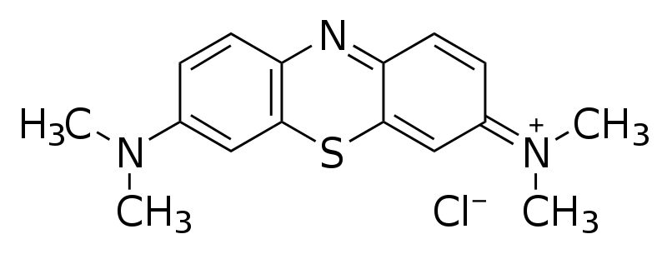
GUITAR as DSA
UV-VIS absorption at 663 nm
Methylene Blue Electro-oxidation @ 2 V vs. Ag/AgCl
C₁₆H₁₈ClN₃S → 16CO₂ + 6H₂O + H₂SO₄ + 3HNO₃ + HCl or colorless product
-Common Probe for DSA Performance

Slide 36
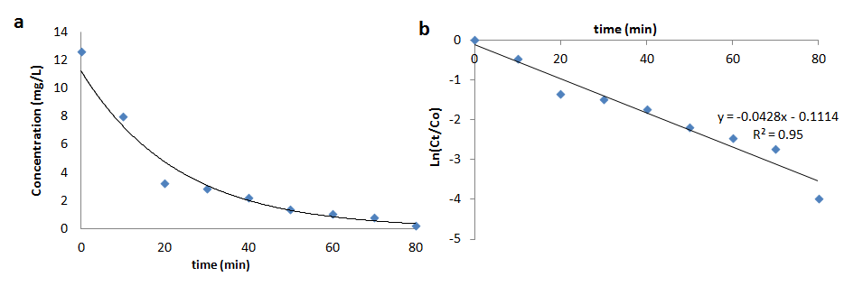
GUITAR Electro-oxidation of MB @ 2 V
UV-VIS absorption at 663 nm
Degradation curve
Pseudo first order
R=0.0428

Slide 37
Comparison of Kinetics with Literature
Two orders of magnitude higher k than other electrodes
Electrodes | Normalized k (min/cm²)
GUITAR | 3.45x10⁻² ± 2.46x10⁻² n=3
Boron doped diamond | 3.42x10⁻⁴
TiO₂/Carbon Aerogel | 2.47x10⁻³
Bi₂WO₆/C₆₀ | 2.02x10⁻⁵
M. Panizza, et al. Separation and Purification Technology 2007 , (54 ) ,382–387
M. Wu, et al. Environ Sci Technol. 2010, (44), 1780-1785
S. Zhu, et al. Environ Sci Technol. 2007, (41), 6234-6239

Slide 38
GUITAR DSA Performance
Better than Boron Doped Diamond (BDD) Electrodes
  Predicted by ∆Ep Studies
  More DOS’s Than BDD?
GUITAR
  Very Inexpensive Material
  New Material for Water Purification

Slide 39
GUITAR vs. HOPG Anodic Limits
HOPG limit = +1.8 V SSCE
  Murray et al, Anal. Chem.1995, 67, 2201
  Can’t do MB Anodic Degradation @ 2.0 V
GUITAR limit = 2.5 V Ag/AgCl
Anodic Limit
  GUITAR > HOPG
Why?

Slide 40
Corrosion on HOPG is initiated with electrolyte intercalation. Murray et al, Analytical Chemistry, 1995, 67, 2201-2206
Electrolytic penetration
HOPG anodic limit 1.8 V
Micron size grains
Pin-Holes
gas
Gas Evolution
Blister and
Pit Formation

Slide 41
Defects HOPG vs. GUITAR
Highly Ordered Pyrolytic Graphite (HOPG)
  Grain Defects with Holes, Crevasses
  Nearly Flawless Structure
    Raman G-Band only
GUITAR
  Structural Defects with No Holes
    Raman D/G band
    No Electrolyte Intercalation – Cyclic Voltammetry

Slide 42
CV evidence for electrolyte intercalation
Murray and coworkers, Analytical Chemistry, 1995, 67, 2201-2206
McCreery and Alsmeyer, Anal. Chem. 1992, 64, 1528-1533

Slide 44
Current Model
HOPG anodic limit 1.8 V
GUITAR anodic limit 2.5 V
Electrolytic penetration
Micron size grains
Pin-Holes
-Fewer DOS
Nano-size Grains w/Structural Defects
Pin-Hole Free?
-Higher DOS

Slide 45
Summary
GUITAR
  A new material
    Not HOPG, Graphene Paper
    Sulfur a key component to formation
      Low T, economical, conformal coatings
    Atomically Smooth with nano-size grains
    Fast Electron Transfer
      High DOS?
    New Dimensionally Stable Anode
      Anodic Limit > HOPG, BDD
    Pin Hole – free
      Corrosion Resistance

Slide 46
Future
1450 cm⁻¹ intermediate
  S enhancement in CVD
  Scale up
Pursue DSA
  Water Purification
High Surface Area GUITAR Electrodes
  DSA
  Ultra-capacitors
  Li-ion Cathodes
  CNT Replacement in Fuel Cells

Slide 47
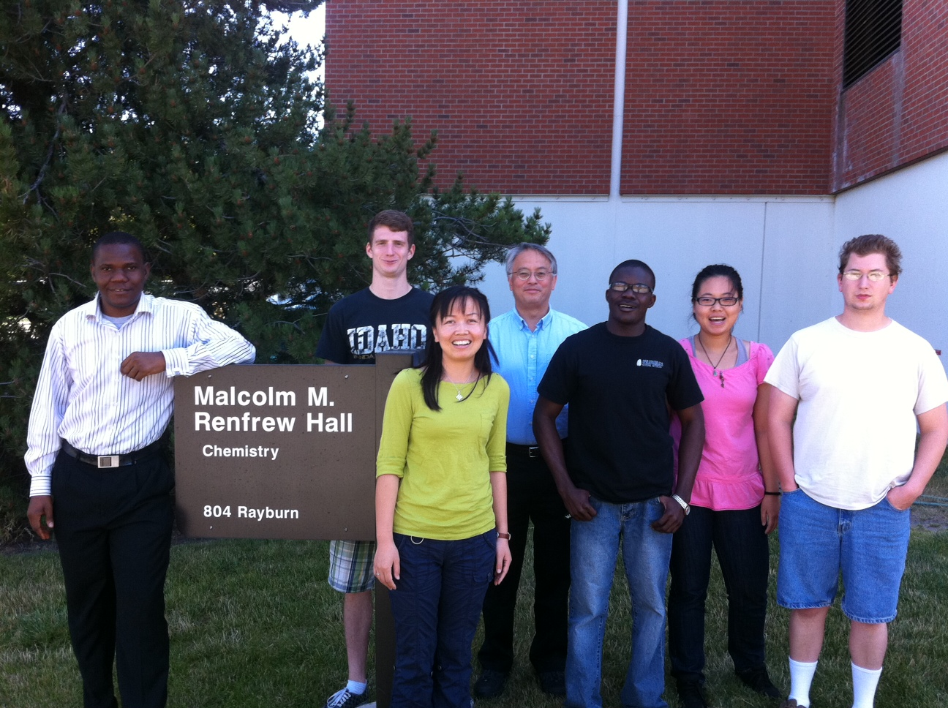
Graduate Students
Yuqun Xie
Isaiah Gyan
Haoyu Zhu
not pictured
Dr. Nolan Nicholas
Jeremy Foutch
Prof. David McIlroy UI-Physics
Prof. Peter Griffiths UI-Chemistry

Slide 48
Supplementary Material

Slide 49
Figure 1. SEM images of silica nanosprings using different deposition temperatures: (a) 350 ◦C, (b) 650 ◦C, (c) 1000 ◦C, and (d) an expanded image of panel (c).
From D. McIlroy, UI-Physics

Slide 50
GUITAR Nanospring Composites

Slide 52
GUITAR Nanospring Composites
High Surface Area Electrodes
  Ultra-Capacitors
  DSA for Water purification
    Organic adsorption
    Stable Anode
Replacements for Carbon Nanotubes
  Less Expensive
  Faster e- Transfer?
  Substrates for Fuel Cell Catalysts

Slide 53
Thermogravimetric analysis
Cycohexanol (40 mg)
Element sulfur (1 mg)
Final temperature 600 ⁰C
Temperature ramp 10⁰C/min
Under N₂ purge
I.F. Cheng, et al. J. Mater. Chem. 2012, 22, 5723-29

Slide 54
Raman indicates an intermediate at 1450 cm⁻¹
Minimum temperature 600⁰C
O₂ not affect graphene formation
Graphene forms under N₂
1450 cm⁻¹ intermediate at 400⁰C
Y. Xie, I.F. Cheng, et al. Submitted

Slide 55
Hypothesis
Ethanol and isopropanol failed
Ethene and propene boil off before 100⁰C required for S cross-linking
Compounds | Melting Point [ºC]
Anthracene | 218
Fluoranthene | 110
Pyrene | 145-148
High MP polyaromatic compounds failed
Compounds in solid state at T required for S cross-linking @ 100⁰C

Slide 56
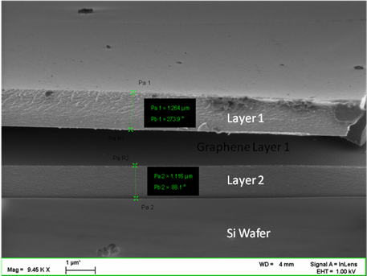
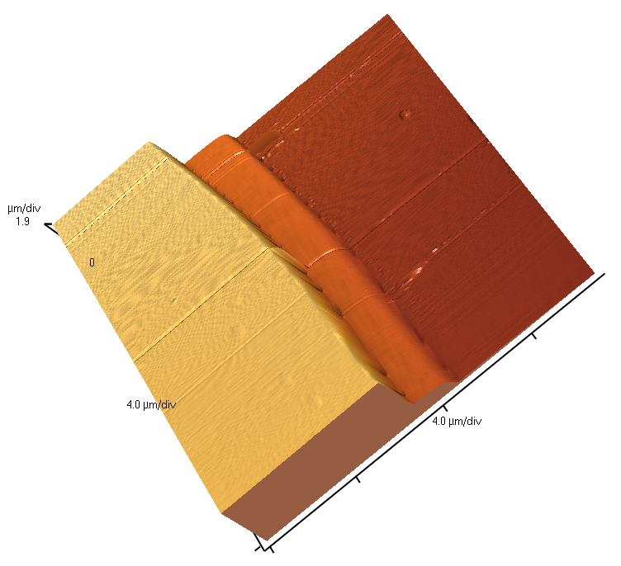
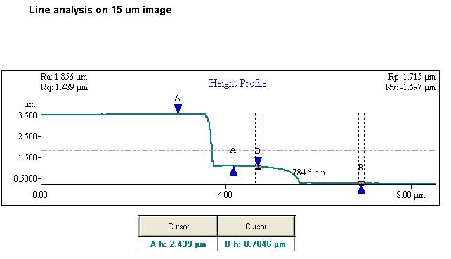
UI Material is Nearly Atomically Flat
Micron Scale AFM of UI Carbon

Slide 57
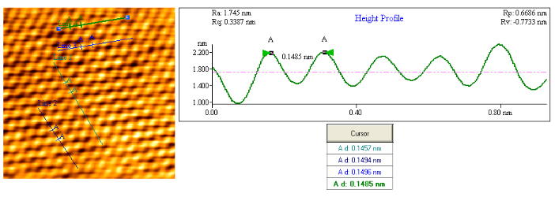
Atomic Scale AFM of UI Carbon
Hexagonal pattern consistent with graphite/graphene
Atomic distance of 0.1485 matches that of sp² carbon.

Slide 58
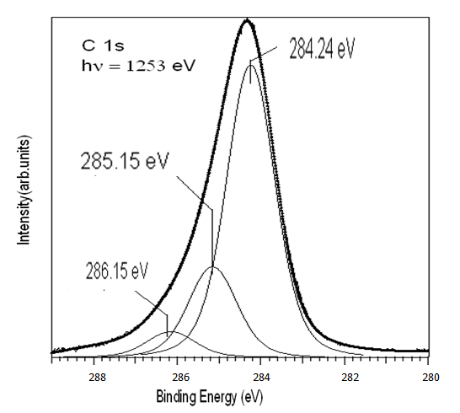
XPS –UI Material is Nearly Pure Carbon
C=C sp²
UI Carbon – XPS Analysis by McIlroy Lab at UI Physics.
Cheng, et al. Carbon. 2011,(49), 2852-2861
C=N sp²
C-O

Slide 59
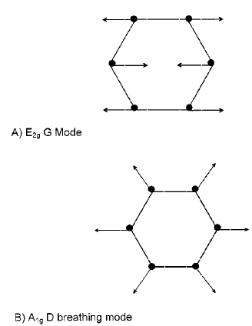
Raman Spectroscopy of sp²
Carbon
  G Band 1585 cm⁻¹ graphite (good) band
  D Band 1350 cm⁻¹ defect or diamond band
2D double-resonance process
K. S. Kim, et al, Nature. 2009,(457),705
A. C. Ferrari and J. Roberton, Phys Rev B. 2000,(61),103

Slide 60
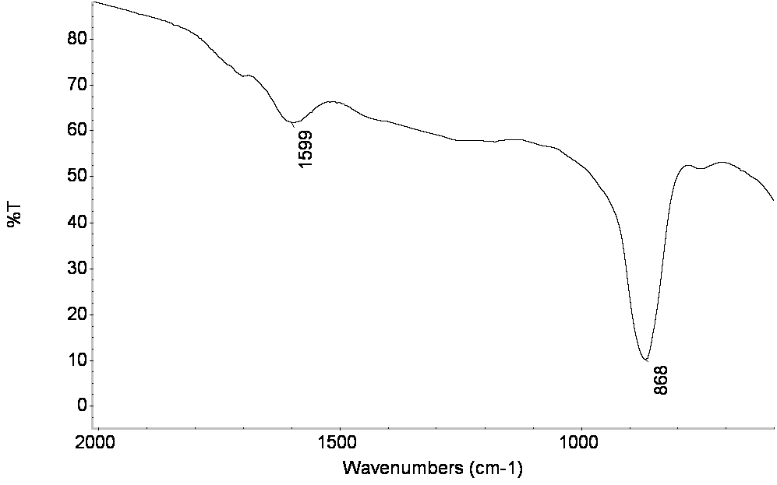
FT-IR
IR spectrum of graphene on a germanium disk. The 861 and 1576 cm⁻¹ peaks correspond to the A_{1u} and E_{1u} intralayer graphene stretches.

Slide 61
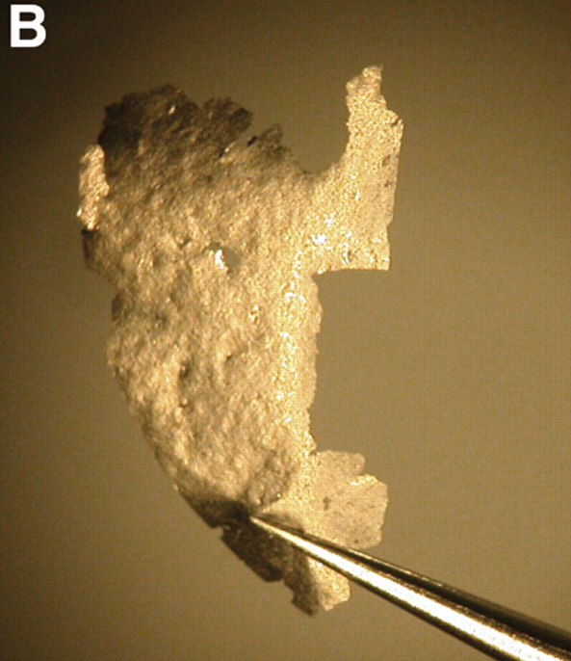
Geim, Science, 2009, 324, 1530-4
UI Material

Slide 62
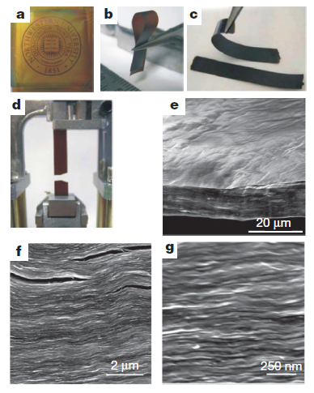
Morphological Differences GP – UI Carbon
Ruoff, et al. Nature, 2007, (448), 457-460
UI Material

Slide 63
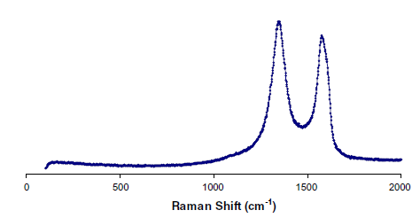
Raman Spectrum of UI Carbon
D 1354
G 1593
1000 2000 3000
r-GO Paper
UI Carbon
I.F. Cheng, et al. Carbon. 2011,(49), 2852-2861
S. Stankovich, et,al. Carbon. 2007, (45), 1558-1565

Slide 64
UI Carbon is different than GP
Graphene Paper
UI Material (Proposed)

Slide 65
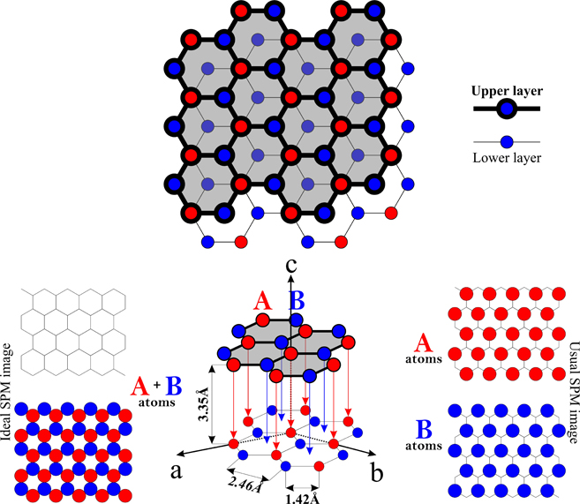
UI Carbon, Is it HOPG?
http://nanoprobes.aist-nt.com/apps/HOPG%20info.htm

Slide 66
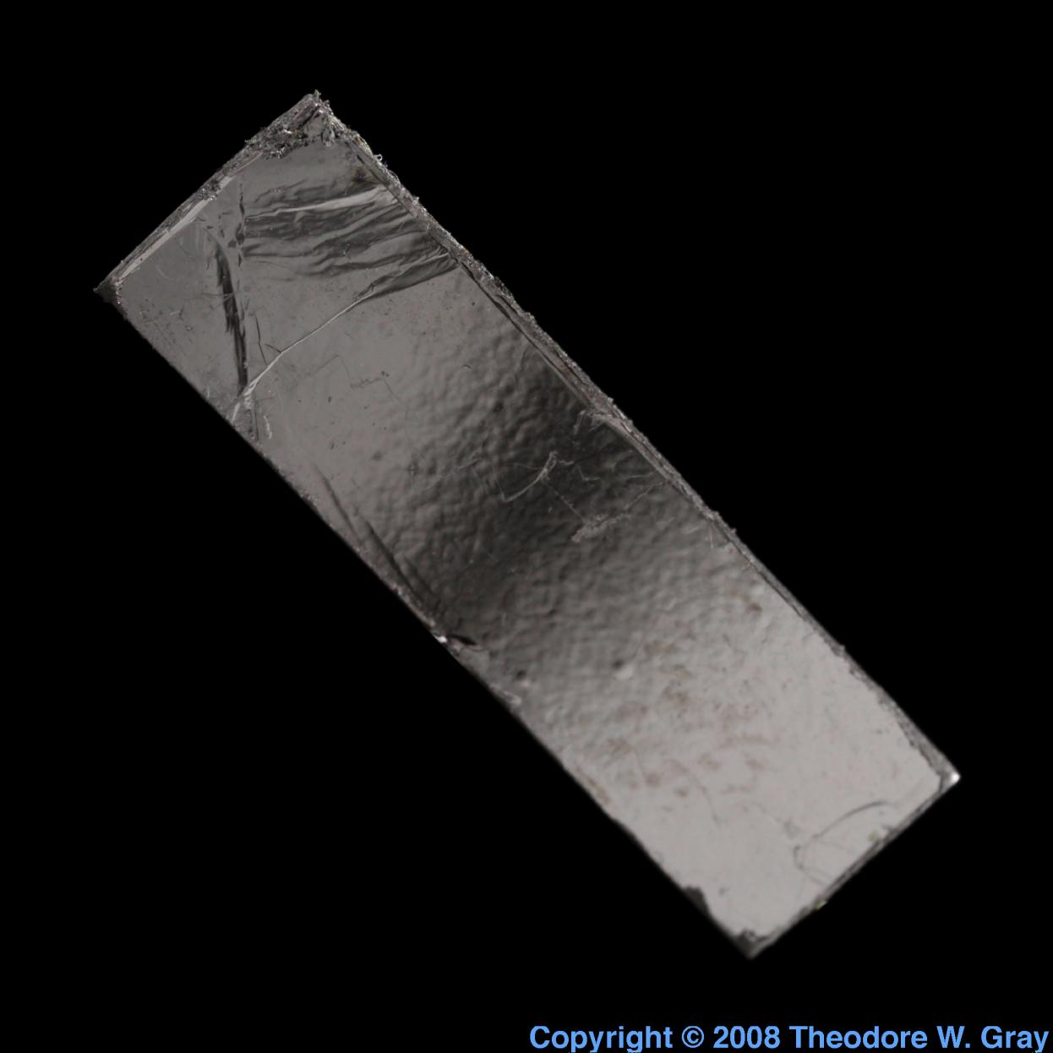
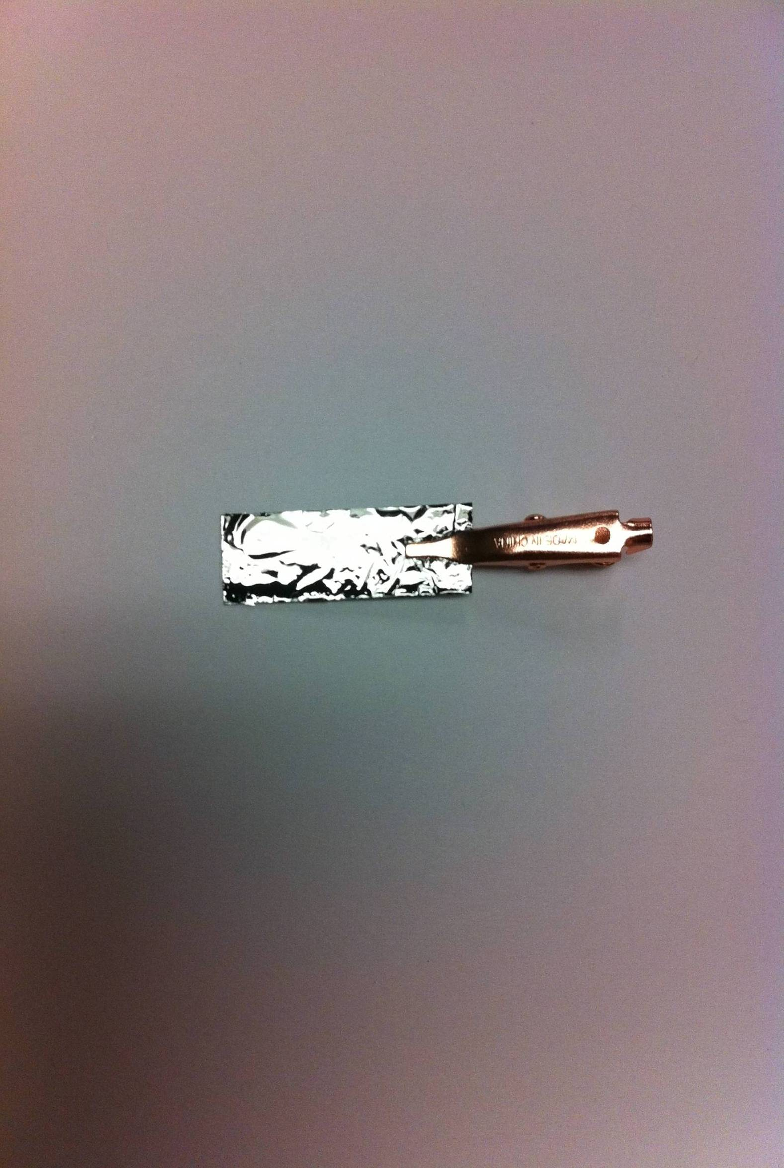
HOPG and UI Carbon
http://www.theodoregray.com/periodictable/Elements/006/index.s14.html#sample31

Slide 67
Why the Difference in e- Transfer Rates?
HOPG – Slow – From Basal Planes
  Atomically Flat
  Large Crystal Grains 100 nm²-mm²
r-GO – Fast – Edges
  Grain Size 3-6 nm²
Epitaxial Graphene – Fast - Edges
GUITAR – Fast – From Basal Planes
  Atomically flat
  Small Crystal Grains ≈5 nm²

Slide 68
GUITAR Electrodes
Atomically Flat over cm²
-similar to HOPG
Fast e- Transfer

