Slide 1
Increasing lead-acid battery performance
Research Seminar
Simon McAllister
7 October 2008

Slide 2
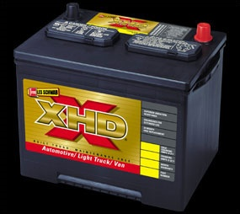
Outline
What are lead-acid batteries (LAB)?
  History
  How do they work
  What are the pros and cons
Why study LABs?
  Electric vehicles
Research and results
Common Lead Acid Battery, SLI type.
http://www.lesschwab.com/batteries/xhd.asp

Slide 3
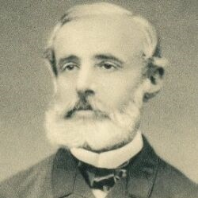
History
Basis of a hydrogen fuel cell discovered first by putting two platinum electrodes in sulfuric acid.
Planté in 1859 stores energy by permanently polarizing two lead electrodes in sulfuric acid.
  Discovers that the capacity and output dependent on how long he charged it, and how much surface area he had.
  Planté cell yielded the most current for the time.
http://people.clarkson.edu/~ekatz/scientists/plante2.jpg
H. Bode, Lead-Acid Batteries, John Wiley and Sons, Inc.,1977, 1-4.

Slide 4
Reactions
Positive Plate
Negative Plate
Potential around 2 V depending on acid concentration

Slide 5
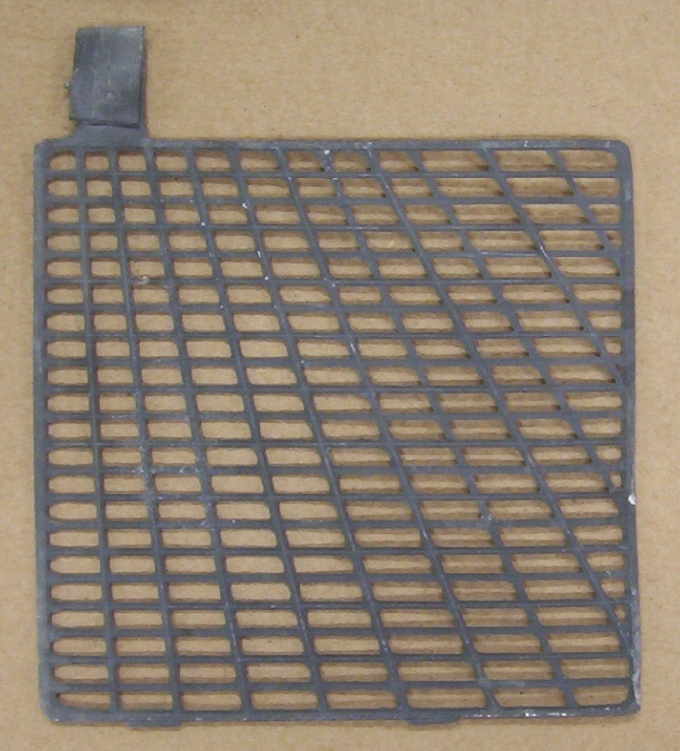
Modern battery design
Over next 100 years, a series of improvements were made:
  Lead oxide pasted to lead grids for increased surface area and amount of active material.
  Alloyed lead to increase strength of grid.

Slide 6
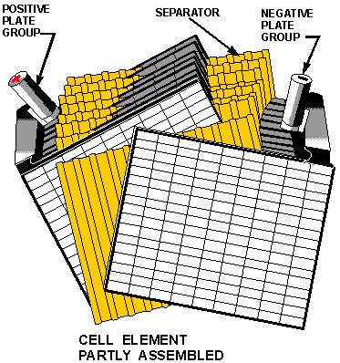
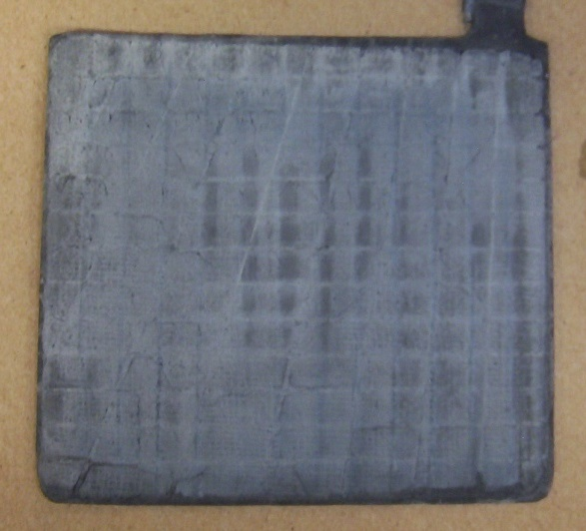
Lead-acid battery construction
Pasted commercial lead plate
http://www.tpub.com/neets/book1/chapter2/1e.htm

Slide 7
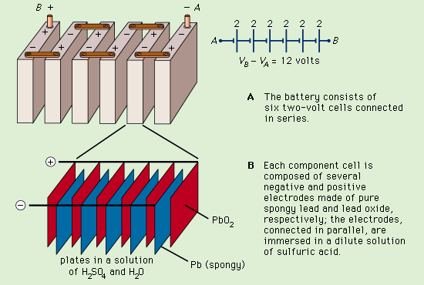
http://original.britannica.com/eb/art-1333

Slide 8
Lead-acid batteries are competitive
Advantages
  Low cost
  High power density
  Safe
  Wide operating temperature range
Disadvantages
  Low specific energy (which only effects electric drive range)
  Shorter life when deep discharged
 | LAB | NiMH | Li-Ion
Specific energy | 25-35 Wh/kg | 65-75 Wh/kg | 100-150 Wh/kg
Cost | 150 euro/kWh | >600 euro/kWh | >600 euro/kWh
Specific power | 70-100 W/kg | 120-150 W/kg | 150-250 W/kg
Self discharge/mo. | 2-40% wet, indef. dry | 30% | 5-10%, lifetime ~2 years
J. Garche, Physical Chemistry Chemical Physics, 3 (2001) 356-367.

Slide 9
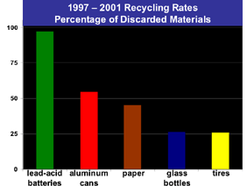
Environmentally Friendly
Over 97% of LAB are recycled.
  Lead, lead oxides, electrolyte, and plastic.
  A new LAB contains 60-80% recycled material.
http://www.batterycouncil.org/LeadAcidBatteries/BatteryRecycling/tabid/71/Default.aspx

Slide 10
What limits the capacity of the LAB?
Theoretical Capacity | 167 Wh/kg
Incomplete Utilization | ~109 Wh/kg
Acid dilution | ~85 Wh/kg
Acid Surplus | ~65 Wh/kg
Inactive Components | ~33 Wh/kg
J. Garche, Physical Chemistry Chemical Physics, 3 (2001) 356-367.

Slide 11
Factors we can/cannot change
Limitations to capacity we can improve on
  Utilization
  Inactive components
Limitations we cannot get around
  Acid dilution
  Acid surplus
D. Berndt, Maintenance-Free Batteries, second ed., John Wiley & Sons, New York, 1997, p. 106-107.

Slide 12
Why Study 150 year old technology?
Hybrid electric vehicles can reduce energy consumption in transportation. Lead-acid batteries can provide the necessary performance for an affordable price now.

Slide 13
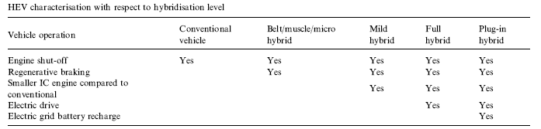
Hybrid Electric Vehicles
HEVs contain a conventional engine as well as an electric one.
HEVs have some or all of the following fuel saving characteristics, which determine level of hybridization.
G. Fontaras, P. Pistikopoulos, Z. Samaras, Atmospheric Environment, 42 (2008) 4023-4035.

Slide 14
http://www.fueleconomy.gov/feg/atv.shtml

Slide 15
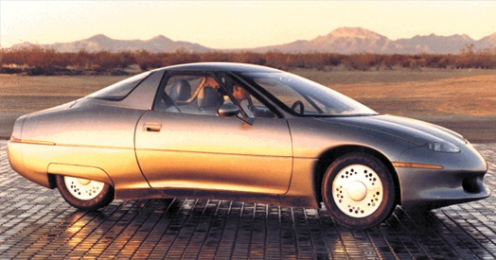
LAB use in hybrid electric vehicles
Majority of driving is under 50km/day.
Performance of LAB is suitable for power assist hybrids (mild) now.
Due to the availability and affordability, LABs are a good choice.
GM’s Impact powered by lead-acid batteries (pure electric) and had a >100 mile range at 55 mph.
C. Samaras, K. Meisterling, Environ. Sci. Technol., 42 (2008) 3170-3176.
P.T. Moseley, B. Bonnet, A. Cooper, M.J. Kellaway, J. Power Sources 174 (2007) 49-53.
Michael Shnayerson, The Car that Could, 1996, Chpt 2. http://www.acpropulsion.com/car_that_could.htm.

Slide 16
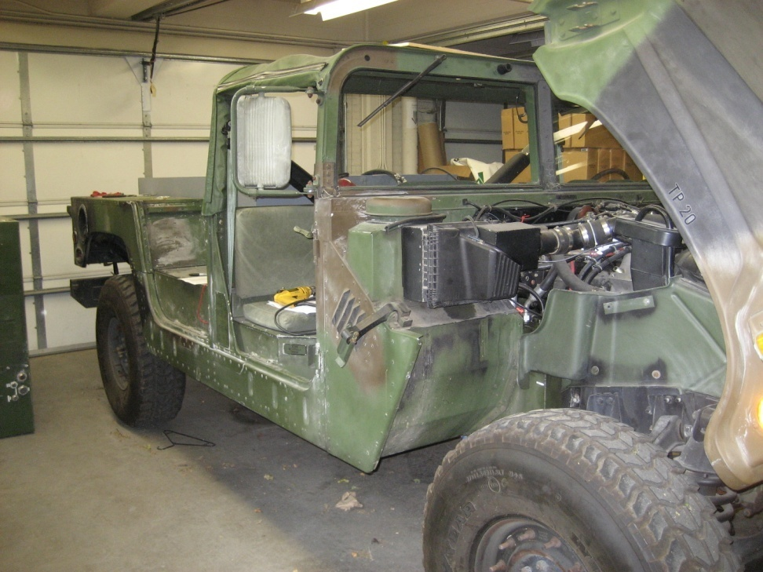
Our Research Project
Office of Naval Research is funding “Advanced lead-acid battery development for military vehicles,” which we are working on with the Engineering College.
  Working prototype of a series hybrid electric HMMWV at UI, with some batteries designed here.

Slide 17
Overall research goal
Improve lead-acid batteries for use in hybrid vehicles for:
  Improved gas mileage
  Powering the electric grid with the vehicle
  Stealth operation

Slide 18
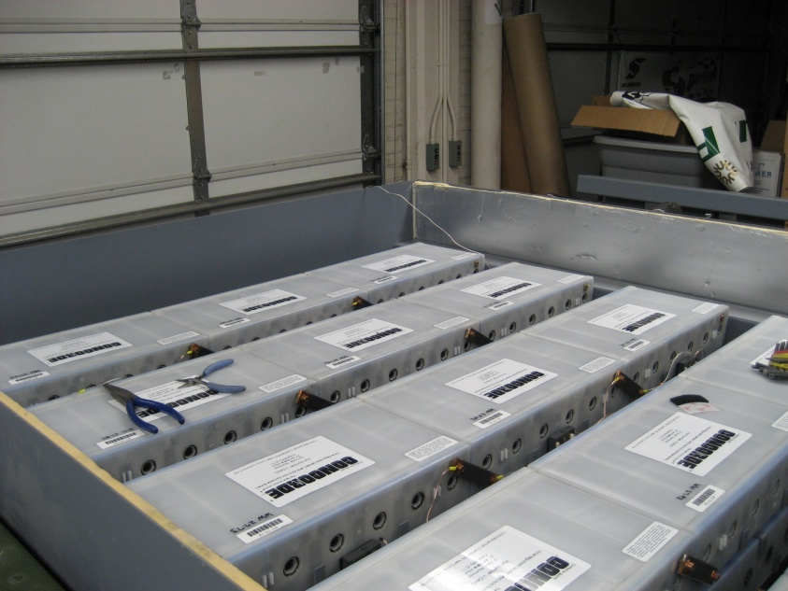
Limitations due to inactive components
Dr. Dean Edwards and others in the engineering department have changed the design of the:
  Battery box
  Grid
  Separator
  to reduce weight, which
  has improved the specific
  energy of the battery.
Battery pack for HMMWV

Slide 19
Review of some terms
Utilization (%) – Q_{out}/Q_{theo}
Specific capacity (Ah/kg) – Q_{out}/m_{tot}
Specific energy (Wh/kg) – E_{out}/m_{tot}
Positive active material – PbO₂

Slide 20
Incomplete utilization improvement
We’re working on finding paste additives that improve ionic conductivity or electronic conductivity in the positive active material.
Previously presented work on diatomaceous earth additive.
  “Increase of Positive Active Material Utilization in Lead-Acid Batteries Using Diatomaceous Earth Additives,” S.D. McAllister, R. Ponraj, I.F. Cheng, D.B. Edwards, J. Power Sources, 173 (2007) 882-886.

Slide 21
How the positive active material works in a LAB
    Pb^{(IV)}O₂ + SO₄²⁻ + 4H⁺ + 2e⁻ = Pb^{(II)}SO₄ + 2H₂O
Ion conductivity
  Sulfuric acid is a reactant
  Reaction limited by diffusion at fast discharge
Electrical conductivity
  PbO₂ is a conductor, PbSO₄ is not
  Reaction limited by paste conductivity at slow discharge

Slide 22
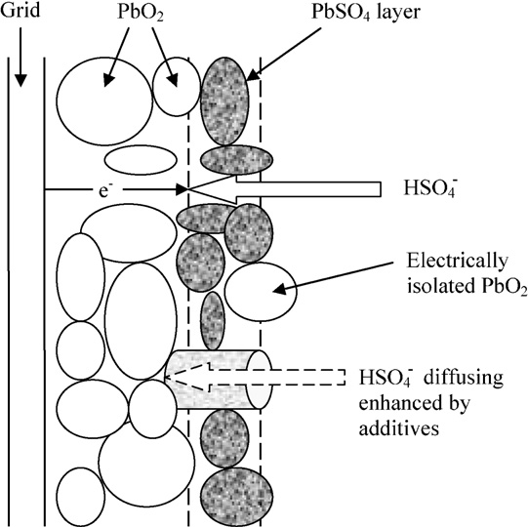
Review of Porous non- conductive additives
At fast discharge rates, the hydrogen sulfate is consumed faster than it can diffuse into the plate, limiting the overall utilization.
With the addition of 3 wt.% diatoms, 12 % increase in utilization at a fast discharge rate
S.D. McAllister, R. Ponraj, I.F. Cheng, D.B. Edwards, J. Power Sources, 173 (2007) 882-886.

Slide 23
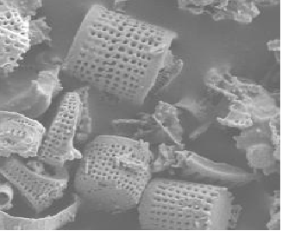


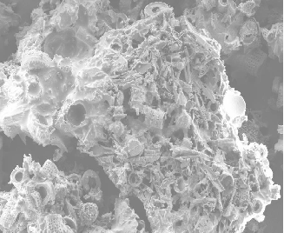

Previous additive used to increase utilization
A
B
C
SEM of diatomites of different sizes:
(A) 20–30 µm
(B) 53–74 µm
(C) >90 µm

Slide 24

During slow discharge, some active material is isolated and unused
Isolated PbO₂
Pb^{(II)}SO₄ is an insulator, so isolated PbO₂ can’t discharge due to lack of conductivity
H⁺_{(aq)}
HSO₄⁻_{(aq)}
Pb Grid
Pb^{(IV)}O₂
Pb^{(II)}SO₄
Electrolyte

Slide 25
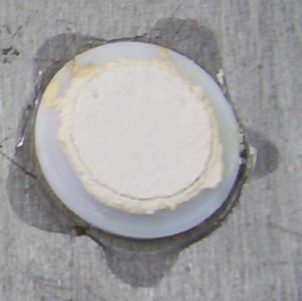
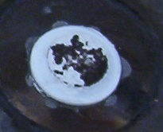
Conductive additives
Next part of project is finding and testing additives that increase conductivity
  Titanium and tin materials tested
  Indication of conductivity from color change during formation. Pb(II) → Pb(IV) + 2e⁻
Formation changes color from white lead sulfate, to brown lead dioxide

Slide 26
Conductive additives can bridge isolated regions
Electrically Conductive Additive
H⁺_{(aq)}
i
HSO₄⁻_{(aq)}
Pb Grid
Pb^{(IV)}O₂
Pb^{(II)}SO₄
Electrolyte

Slide 27
Literature Results
BaPbO₃ (10⁻⁴ Ω cm) – increases formation efficiency, but is not long term stable. It decomposes to PbO₂ and BaSO₄ at charging potentials.
Graphite, carbon fiber, polyacene – carbon based additives oxidize readily.
Wen-Hong Kao, S.L. Haberichter, P. Patel, J. of Electrochemical Society, 141 (1994) 3300-3305.
S. Wang, B. Xia, G. Yin, P. Shi, J. Power Sources, 55 (1995) 47-52.

Slide 28
Literature results
TiSi₂ – best additive for bipolar LAB substrates. Stable and conductive.
SnO₂ coated glass flakes – increased utilization, enhanced formation, and improved life.
W-H. Kao, J. Power Sources, 70 (1998) 8-15.
L.T. Lam, O. Lim, H. Ozgun, D.A.J. Rand, J. Power Sources, 48 (1994) 83-111.

Slide 29
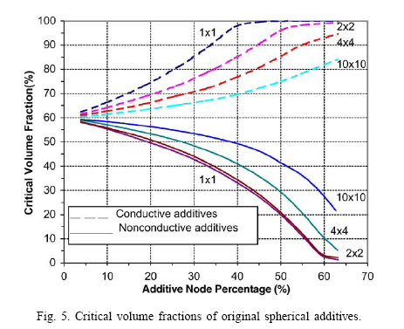
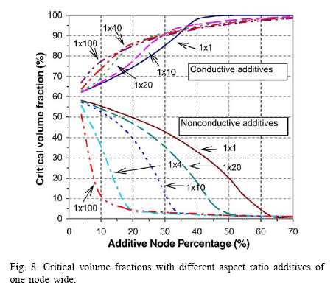
Critical volume fraction model
Node % is analogous to volume percent. 1x1 equals one node, supposed to represent one PbO₂ particle. Approximately 3-5 µm.
D.B. Edwards, S. Zhang, J. Power Sources, 135 (2004) 297–303.

Slide 30
Testing process
Paste leady oxide to lead strip
Cure in pressure cooker Pb⁽⁰⁾ → Pb^{(II)}
Test for porosity and Pb⁽⁰⁾ content using water absorption and atomic absorption
Formation charge Pb^{(II)} → Pb^{(IV)}O₂
Take capacity measurements

Slide 31
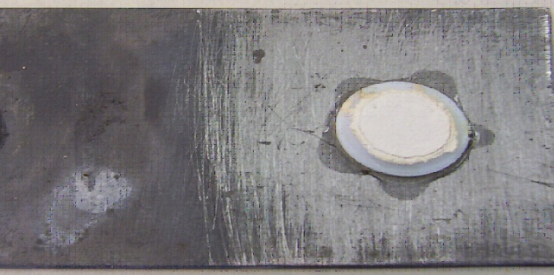
Positive Electrode
The support structure for our battery electrode is a Teflon ring attached to a sanded lead strip with cyanoacrylate superglue
Lead Strips - Pb and 4-6% Sb
Mass without paste taken after super glue dries
Pb alloy strip
Paste inside Teflon ring (inside volume 0.24 ml)

Slide 32
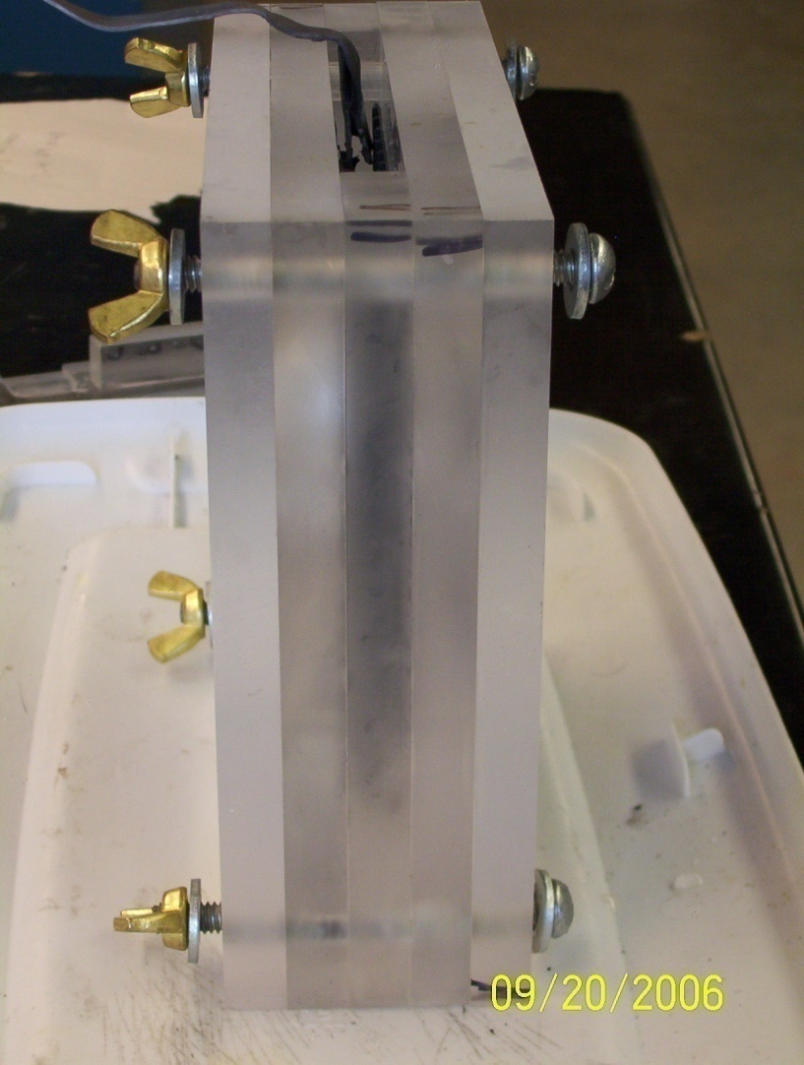
Formation
Positive plates formed against commercially available negative plate with polyethylene separator
1.1 sp. gr. H₂SO₄
Theoretical capacity - 0.2241 Ah/g
Fast charge - current to obtain capacity in 24 hrs, to 125% capacity
Slow charge – half of fast charge applied for 12 hours, reach 150% theoretical
D. Berndt, Maintenance-Free Batteries, second ed., John Wiley & Sons, New York, 1997, p. 103.
N.E. Hehner, J.A. Orsino, Storage Battery Manufacturing Manual, third ed., IBMA, Largo, Florida, 1986, p. 40-43.

Slide 33
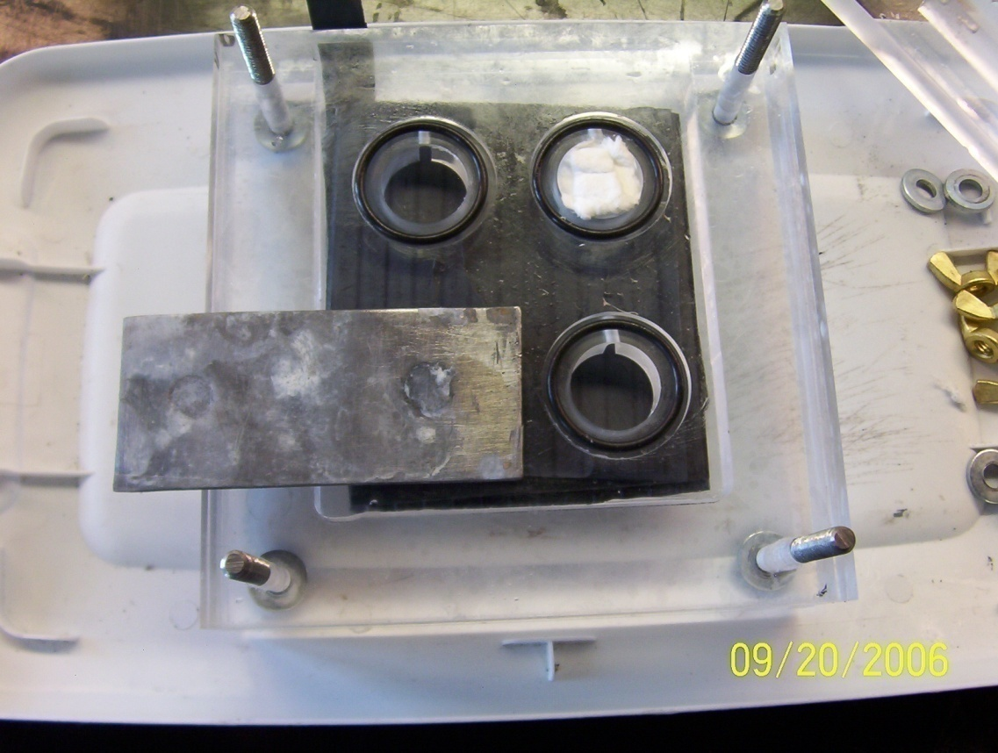
Formation Cell
Because some of the paste lifted up from the plate, we packed the holes on the formation cell with glass mat to keep slight pressure on the paste during formation.

Slide 34
Additives tried
Material | resistivity (ohm*cm)
PbO₂ | 10 - 10²
PbSO₄ | 10⁸
TiO₂ | 10⁸ - 10¹²
SnO₂ | 10 - 10⁶
TiSi₂ | 10⁻⁵
Titanium silicide (TiSi₂ <44 µm particles)
Titanium dioxide fibers (<10 µm diameter)
Titanium dioxide (2-3 µm particles)
Titanium wire (76 µm diameter, chopped)
Tin dioxide (<10 µm particles)
Conductive additives have to have certain characteristics
  Chemically stable in 27% H₂SO₄.
  Oxidatively stable at 1.6 – 1.8 V.
  Higher conductivity than PbSO_{4.}
J. Garche, Physical Chemistry Chemical Physics, 3 (2001) 356-367.
H. Braun, K.J. Euler, P. Herger, J. Applied Electrochemistry, 10 (1980) 441-448.
R.W. Mann, L.A. Clevenger, P.D. Agnello, F.R. White, IBM Journal of Research & Development, V39, I4 (1995) 403-417.
M.D. Earle, Physical Review, 61 (1942) 56-62.

Slide 35
Titanium Silicide

Slide 36

High aspect ratios predicted to work best
Grid
PbO₂
Longer additive lengths mean increase probability that they will connect isolated lead dioxide
PbSO₄
e⁻
HSO₄¯
Electrically isolated PbO₂
Conductive fiber connects isolated sections
HSO₄¯ diffusing enhanced by additives

Slide 37
Synthesis of TiO₂ additive
Titanium(IV) isopropoxide added to water acidified with HCl
Chopped cotton fiber soaked in solution
Fibers filtered out of solution and placed in furnace at 450°C until cotton is gone
M. Kh Aminian, N. Taghavinia, A. Iraji-zad, S.M. Mahdavi, M. Chavoshi, S. Ahmadian, Nanotechnology, 17 (2006) 520-525.

Slide 38
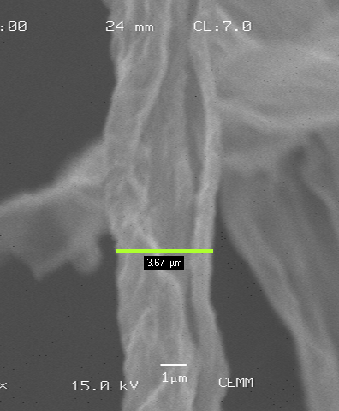
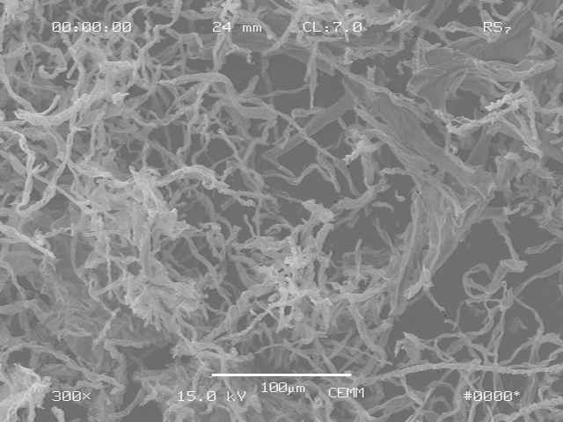
TiO₂ fibers

Slide 39
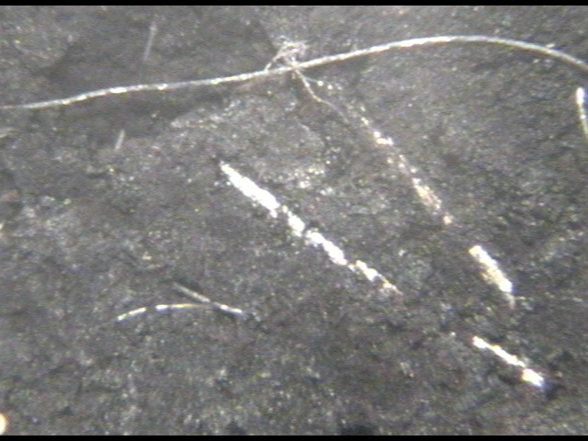
Titanium fiber after cycling
Dynel
Lead Dioxide
Titanium
4x optical microscope image of the surface of the positive active material.

Slide 40
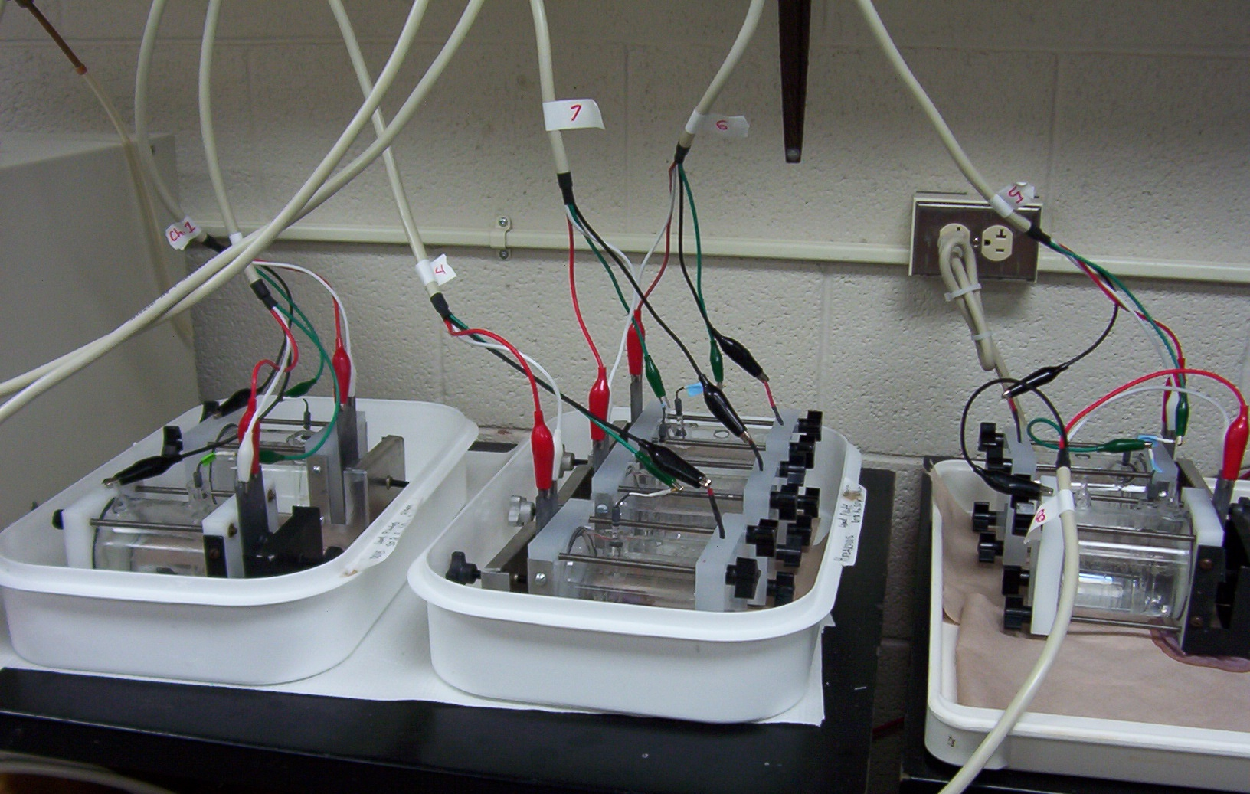
Test setup

Slide 41
Results

Slide 42
Titanium Dioxide and Silicide
Utilization = capacity/theoretical capacity.
TiO₂ probably about 1x1 node, TiSi₂ about 10x10 or less.

Slide 43
Titanium wire
Percent Change in Utilization

Slide 44
Tin Dioxide Powder
Percent Change in Utilization
Although there isn’t a significant change in utilization, the formation was enhanced, which is beneficial

Slide 45
Percent additives used
Additives used in the active material have limits. A little bit of a good thing will be detrimental if too much is added
  Replaces active material with inactive compound
  Reduces cohesion of the paste, and therefore reduces life

Slide 46
Summary
Titanium dioxide particles (2-3 µm)
  No benefits
Titanium dioxide fibers (<10 µm diam)
  No benefits
  SEM after pasting shows no evidence of fibers
Titanium silicide (<44 µm)
  No benefits

Slide 47
Summary cont.
Titanium Fiber (76 um Diameter)
  Formation improved
  Utilization improved by 12.3% at 10 mA/cm²
Tin dioxide (<10 µm)
  Formation improved, as evidenced by the change in color of the electrodes

Slide 48
Further work necessary
Currently running tantalum. Although it is expensive and more dense than lead, it’s corrosion resistant and may at least reinforce the model
Looking for a coated fiber, possibly Dynel or glass fiber coated with titanium or tin alloys
Necessary to test promising materials in full size battery plates, to verify behavior on larger scale

Slide 49
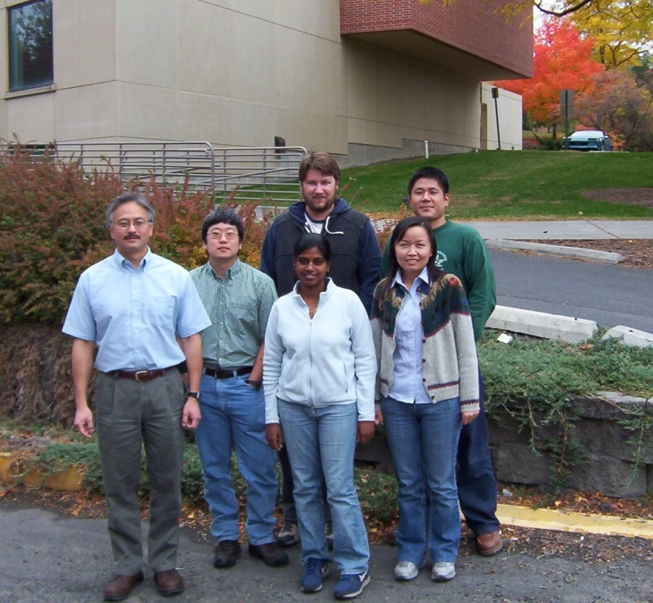
Acknowledgements
Dr. I. Francis Cheng
Dr. Dean Edwards
Rubha Ponraj
Dr. Derek Laine
Dr. Kenichi Shimizu
Dr. Song Zhang
Dr. and Mrs. Renfrew
Office of Naval Research Award Number: N00014-04-1-0612
Department of Chemistry faculty and staff

Slide 50
Method of paste preparation
0.5% Dynel fibers, variable amount of additive, and leady oxide for total mass of 10 g.
1.2 ml of DI water.
1 ml of 1.4 sp.gr. H₂SO₄.
Additional water until paste reaches maximum density.
Our densities around 2.5 – 3.5 g/cm³.
Teflon rings filled with paste.

Slide 51
Hydroset and Testing
Hydroset process converts Pb⁰ to Pb^{II}.
36-48 hrs hydroset – 215 °F in pressure cooker.
Dried overnight.
Weigh plates to get mass of paste.
Before formation, Pb⁰ content and porosity are measured (AA, water absorption).

