Slide 1
Application of Galvanic Exchange Reaction for Preparation of Pt coated Fe Nanoparticles supported by Single-Walled Carbon Nanotubes: Fuel Selective Reduction of Oxygen over Methanol Oxidation
November 14, 2008
Kenichi Shimizu, I. Francis Cheng, Chien, M. Wai
Dept. of Chemistry at University of Idaho
ifcheng@uidaho.edu
208-885-6837

Slide 2
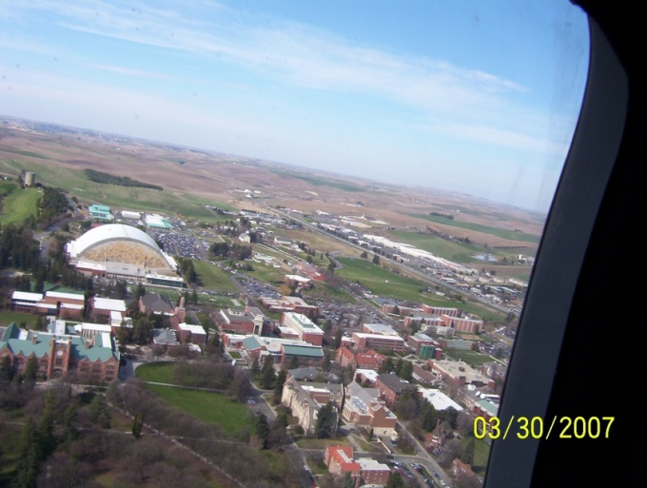
Moscow, Idaho

Slide 3
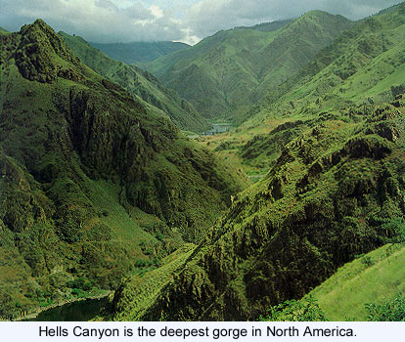
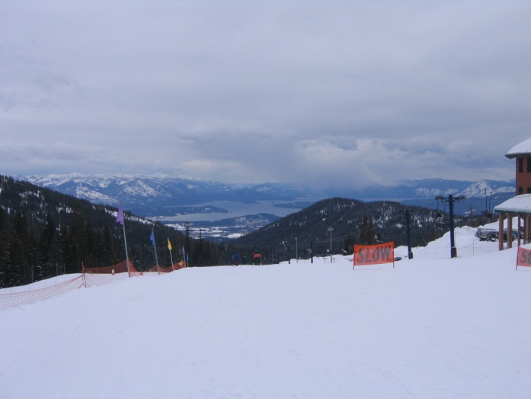
Area Around
www.ubcbotanicalgarden.org/potd/2007/
http://imnh.isu.edu/digitalatlas/hydr/concepts/surfhyd/main/imgs/hellscan.jpg

Slide 4
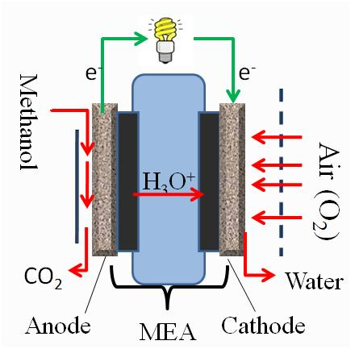
Developing catalyst for fuel cells
MEA
MEA: Membrane Electrode Assembly

Slide 5
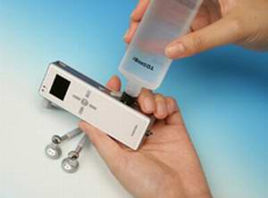
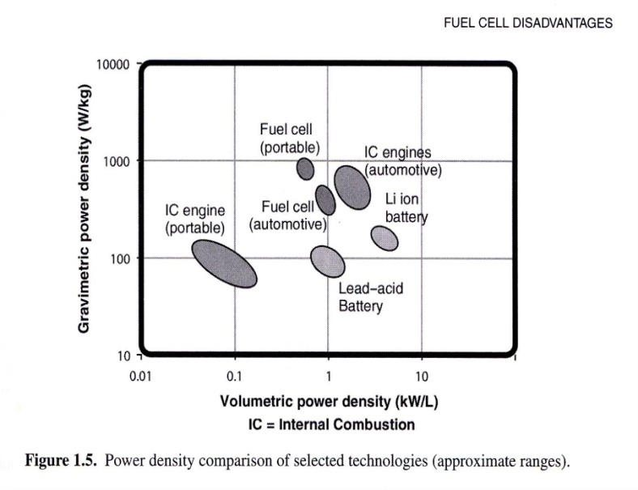
Advantages of Fuel Cells:
Better sustainability.
Larger power output.
Quick recharge.
www.physorg.com/news6542.html
pr.fujitsu.com/en/news
O’Hayre, R. et al. Fuel Cell Fundamentals. John Wiley & Sons. N.Y. 2006.

Slide 6
Limitations of Fuel Cells
Low power density.
Kinetic limitations.
High cost.
Pt catalyst.
O’Hayre, R. et al. Fuel Cell Fundamentals. John Wiley & Sons. N.Y. 2006.

Slide 7
Deposition of Pt nanoparticles on carbon nanotubes
Water-in- supercritical CO₂ microemulsion
Direct supercritical CO₂ deposition
Shimizu, K. et al. Energy & Fuels 2008, 22, 2543.
Yen, C.H.; Shimizu, K. et al. Energy & Fuel 2007, 21, 2268.

Slide 8
Pt deposited on carbon nanotubes
Increasing cost of synthesis.
Large amount of chemical wastes.
Little to No control in particle size.

Slide 9
Nano is not small enough
Let’s assume there is a Pt nanoparticle with 5 nm diameter
Carbon nanotube
More than 50 % will in the core part
and will not be utilized for catalysis.
25 to 50 % of the surface is already
in contact with carbon (nanotube support).
In total, up to 75 % of Pt will be wasted by using nanoparticles.
In addition, the surface availability can be affected by surfactant resides.

Slide 10
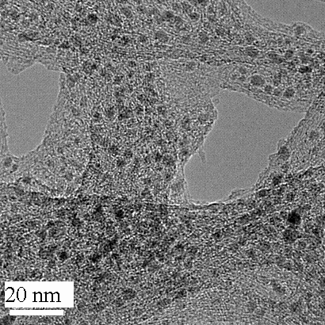
Replace Pt core with Fe
Fe (also Co and Ni) are often used as catalysts to grow carbon nanotubes (HiPco).
No purification needed.
As produced single-walled carbon nanotubes

Slide 11
Galvanic Exchange
Fe²⁺ + 2e⁻ Fe⁰ E⁰ = -0.44 V
Pt²⁺ + 2e⁻ Pt⁰ E⁰ = 1.19 V
Pt²⁺ + Fe⁰ Fe²⁺ + Pt⁰ E⁰ = 1.63 V
Pt²⁺
Fe²⁺
Carbon nanotube
Fe⁰
Fe⁰
Fe⁰
→Much better utilization of Pt than nanoparticles!!

Slide 12
Only in an aqueous solution
Pt²⁺ is quickly reduced by organic solvents

Slide 13
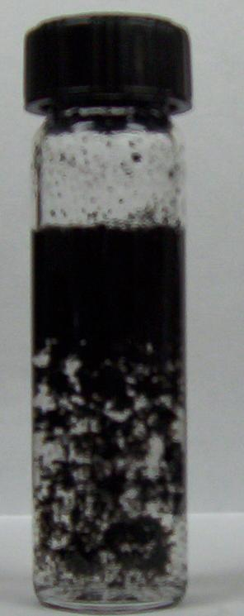
Approach
Vigorous shaking
by hand
for 30 seconds
Ultrasonic
agitation
for 30min

Slide 14
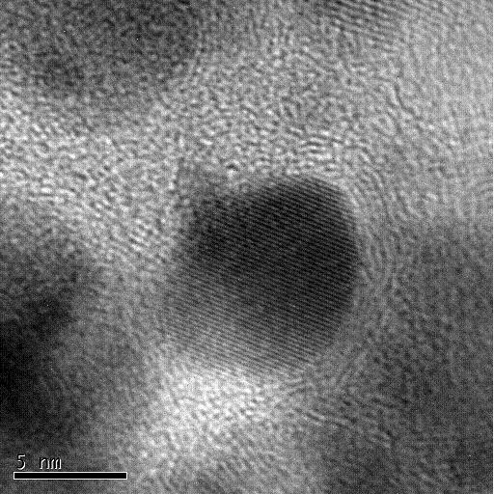
Transmission Electron Microscopy
As-received SWNT (Fe/SWNT)
Pt-Fe/SWNT
5 nm
Fe⁰

Slide 15
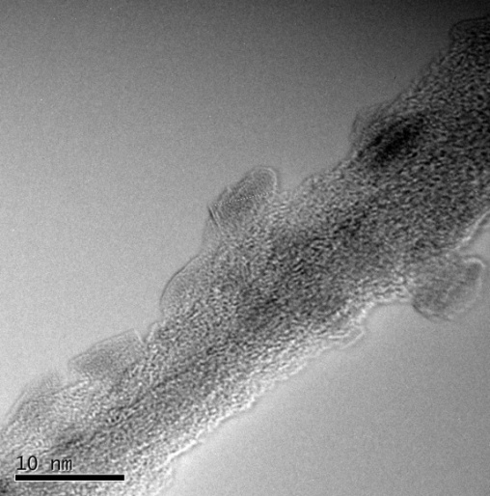
Selected Area Analysis
Energy Dispersive X-ray Diffraction Spectroscopy

Slide 16
Quantitative Analysis
 | wt.% Pt (ICP) | wt.% Fe (AAS)
As-received SWNT | -- | 30.4 (± 0.9)
Pt-Fe/SWNT | 5.4 (± 0.1) | 25.6 (± 1.4)
Pt/CB E-TEKª | (20) | 0
ICP: Inductive Coupled Plasma-Atomic Emission Spectroscopy.
AAS: Atomic Absorption Spectroscopy.
ª Commercial catalyst from ETEK. 20 wt% is a vender provided value.
Catalysts were dissolved in a slightly heated 50/50 HNO₃/H₂SO₄.

Slide 17
Electrochemical Characterization of Pt-Fe/SWNT
Electroactive surface area
Activity towards:
Reduction of Oxygen
Oxidation of Methanol

Slide 18
Half Cell Analysis
Auxiliary Electrode
Quick & Cheap.
Focus on one reaction a time.
Limited amount of catalyst (~ 5 mg per synthesis).
Based on the result, we apply to a full size fuel cell.
1 M H₂SO₄
Catalyst/water/methanol/Nafion®

Slide 19
Use of Cyclic Voltammetry to Identify Formation of Pt⁰
1 M H₂SO₄
N₂ purged
50 mV/s
Cao, D. et al. J. Phys. Chem. B 2007, 109, 1162.
Biegler, T. J. Electroanal. Chem. 1971, 29, 269.

Slide 20
Electroactive Surface Area
Area of Pt that can potentially used for electrocatalysis.
 | Wt % Pt | Area (cm²/mg-Pt)
Pt-Fe/SWNT | 5.4 | 1500
Pt/CB E-TEK | 20 | 540
Pt/CB E-TEK* | 10 | 91.5
Pt/CNT* | 17.7 | 311
*Shimizu, K. et al. Energy & Fuels 2008, 22, 2543
Biegler, T.; et al. J. Electroanal. Chem. 1971, 29, 269-277

Slide 21
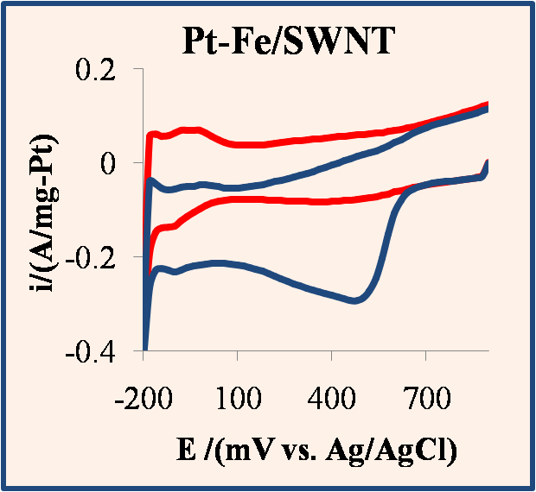
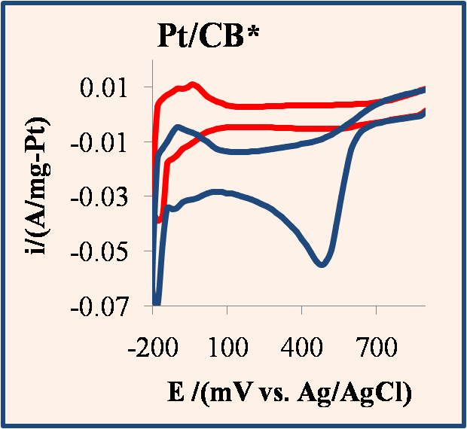
Cyclic Voltammetric Response for O₂ reduction
N₂ purged
O₂ purged
1 M H₂SO₄
50 mV/s
 | Ep (mV) | Ip (mA/mg-Pt)
Pt-Fe/SWNT | 472 (± 49) | 290 (± 37)
Pt/CB E-TEK | 495 (± 85) | 72 (± 14)
( ): standard deviation (n > 3)

Slide 22
Linear Sweep Voltammetry
Better utilization of Pt than the commercial sample.
1 M H₂SO₄
O₂ purged
10 mV/s
500 rpm

Slide 23
Cyclic Voltammetric Response for Methanol Oxidation
w/o methanol
w/ 0.1 M methanol
N₂ purged
1 M H₂SO₄
50 mV/s

Slide 24
Fuel Crossover
H₃O⁺
Methanol
H₃O⁺
Air
H₃O⁺
(Anode)
PEM
(Cathode)
PEM: Polymer Electrolyte Membrane
Methanol oxidation occurs at cathode.
De-activate cathode catalyst.
Potential loss
Meier, F.; et al.; J. Membr. Sci. 2004, 241, 137.
Mauritz, K.A.; Moore, R.B.; Chem. Rev.2004, 104, 4535.

Slide 25
Interference of Methanol in O₂ Reduction
0.1 M methanol was added.
Average current losses
16 % by Pt-Fe/SWNT.
40 % by Pt/CB.
Seems like it is fuel selective.
i/i₀ = (current w/ methanol)/(current w/o methanol)

Slide 26
Why & How ?
Tafel Plot
Electrochemical Impedance Spectroscopy

Slide 27
Tafel Analysis for Reaction Kinetics
E vs. ln |i|
Often used in Corrosion studies.
E⁰’ is zero overpotential (E_{app} — E^{0’} = 0) → the onset potential.
i₀ is the exchange current. (i₀ α kC)
ln(i₀)
1 M H₂SO₄
O₂ purged
1 mV/s
500 rpm
E^{0’}

Slide 28
Tafel Analysis for Reaction Kinetics
 | E^{0’} (mV) | i₀ (A)
Pt-Fe/SWNT | 668 (± 28) | 1.48 (± 0.32)
Pt/CB E-TEK | 713 (± 23) | 2.26 (± 0.25)
1 M H₂SO₄
O₂ purged
1 mV/s
500 rpm
Pt-Fe/SWNT has slower rate of reaction than the commercial catalyst. (!?)

Slide 29
Summary
Galvanic deposition of Pt using the pre-existing Fe as the core metal is possible.
Cyclic voltammetry is the cheapest and fastest way of identify Pt.
Larger Electroactive surface area.
Higher activity towards oxygen reduction.
→ Better utilization of Pt.

Slide 30
Summary
Fuel selectivity of the catalyst towards O₂ reduction over methanol oxidation.
Tafel analysis indicated slow rate of reaction of Pt-Fe/SWNT over Pt/CB.

Slide 31
Future Work
Investigate how the catalyst can be fuel selective → EIS.
Decreasing particle size α increasing charge transfer resistance → decreasing rate of reaction.
Prepare thicker Pt shell. (Search for the optimal condition)

Slide 32
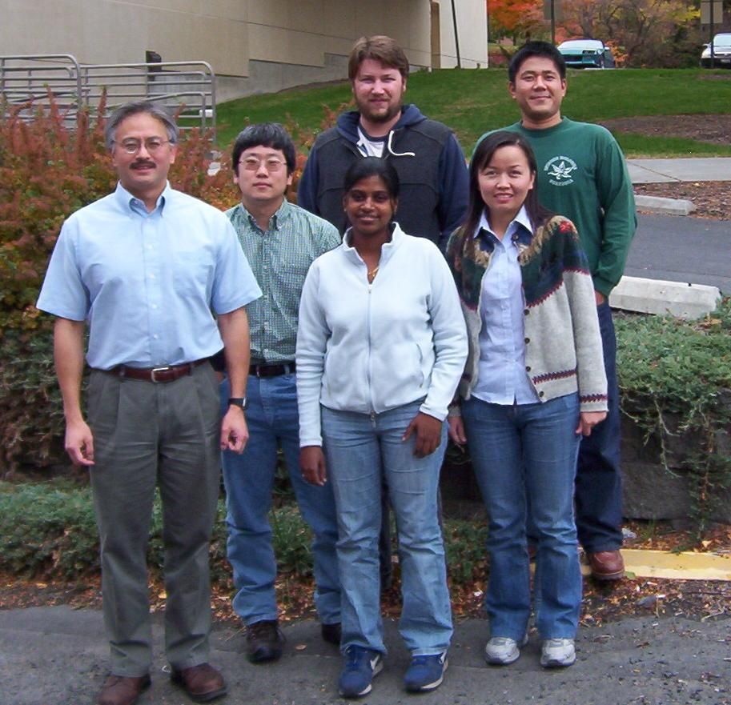
Acknowledgement
Dr. I. Frank Cheng
Dr. Chien M. Wai
Dr. Chonming Wang
EPRI (Electric Power Research Institute)
Dr. and Mrs. Renfrew Summer Scholarship
Graduate and Professional Student Association Travel Award

