Slide 1
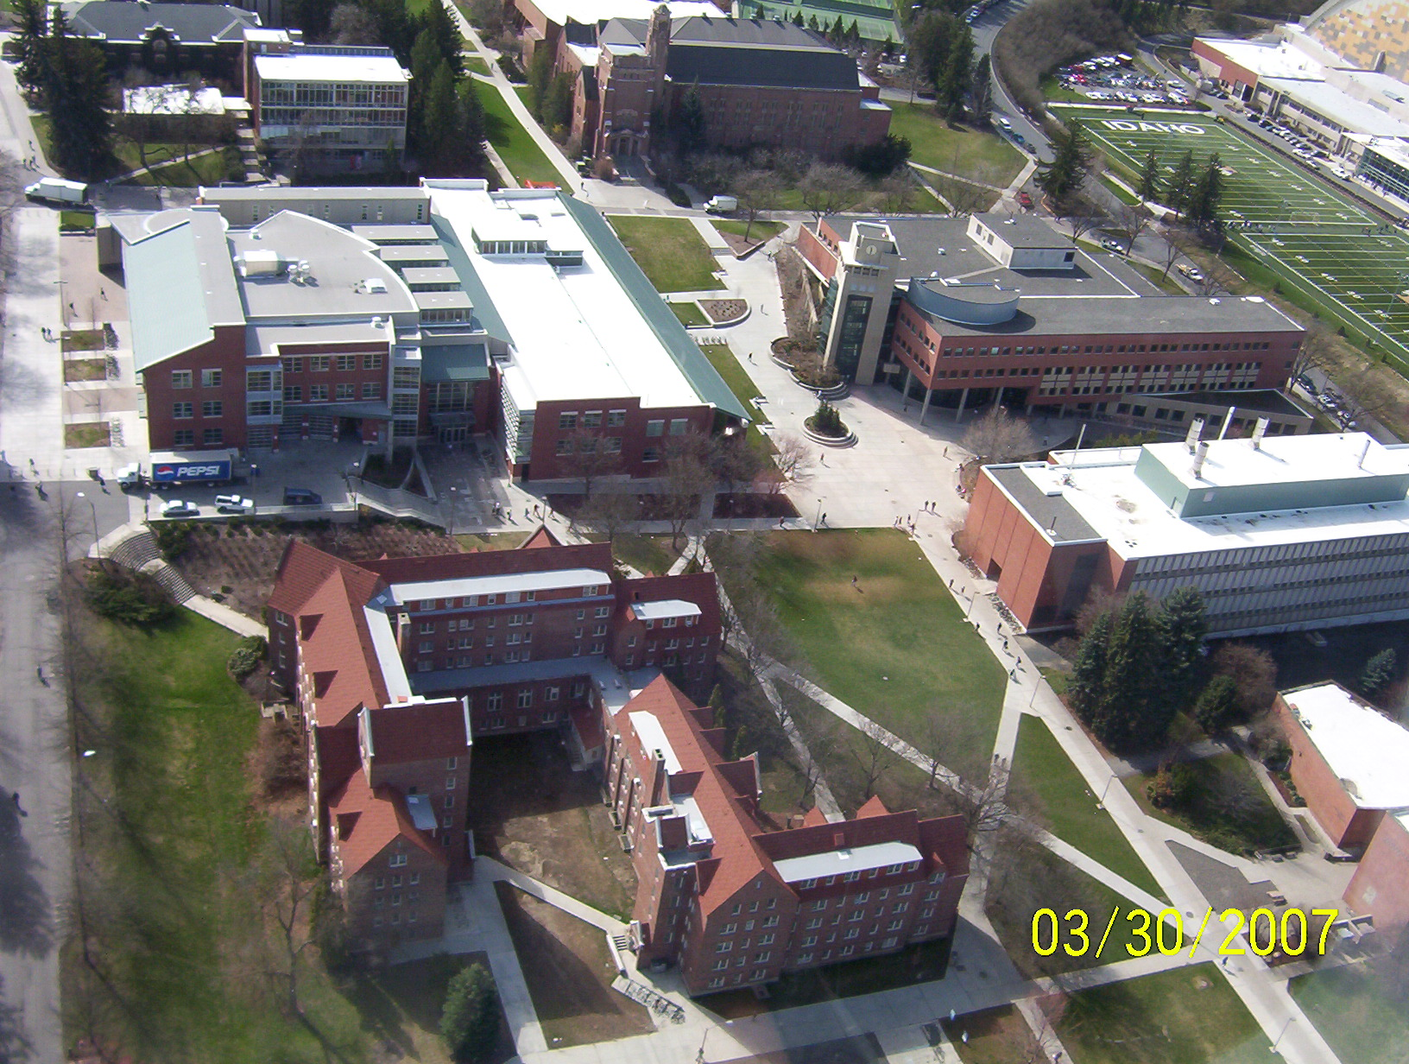

Slide 2
I. Deep Oxidations of Aqueous Organic Pollutants Under RTP Conditions
II. A New Avenue to Carbon Nano-structures by the Thermal Degradation of Asphalt; Is it Multilayered Graphene?
Frank Cheng
Professor of Chemistry
    University of Idaho, Moscow, ID 83844-2343 Email: ifcheng@uidaho.edu

Slide 3
2 Accidental Discoveries
….Other Areas of Research
Fuel Cells
Batteries
Antioxidants
Detection of Improvised (kitchen sink) Explosives
Mechanisms of Photosystem II
http://www.chem.uidaho.edu/faculty/ifcheng/pubs.htm

Slide 4
Road Map to Discovery –
RTP Deep Oxidation w/O₂
Environmental Remediation –
Reductive Dechlorination Reactions By Fe(0)
RTP Activation of O₂ –
Deep Oxidations of organics
Analysis of PCB/DDT congeners
Mechanisms
Environmental Remediations
Models for biological oxidations
Ca²⁺ as pro-oxidant
Zn²⁺ as a antioxidant

Slide 5
Environmental Remediations
Halocarbons
  PCB
  TCE
  DDT/DDE
Incineration

Slide 6
Reduction by Fe(0)
Spontaneous, mild rxn conditions
R-X + 2H⁺ + 2e⁻ → R-H + HX E⁰ > 0.1 volts
Fe²⁺ + 2e⁻ → Fe(0) E⁰ = -0.44 V
E_{cell} > 0 Spontaneous

Slide 7
PCBs and most Halocarbons are Kinetically Stable in the Presence of Fe(0) or Mg(0)

Slide 8
Pd/Mg or Pd/Fe is more Effective
Cheng et al Microchemical Journal, accepted April 2002.
Cheng et al, Journal of Hazardous Materials, B90 (2002), 97-108
Cheng et al Chemosphere 2001, 43, 195-199
Cheng et al, LC-GC, 1999, 18, 154-160.
Cheng et al, Microchemical Journal 1999, 60, 290-295

Slide 9
Side Reactions of Halocarbons with Fe(0)
R-X + 2H⁺ + Pd/Fe(0) → R-H + HX + Fe²⁺(aq)
Evidence of Oxidized Products?
LMW carboxylates
By GC-MS

Slide 10
Attempt at Improve Kinetics w/o Pd Catalysts
R-X(aq) + 2H⁺ R-H + HX + Fe²⁺(aq)
Iron Oxides/Hydroxides
Fe(0)
F
Rust inhibits halocarbon reduction

Slide 11
Hypothesis -- EDTA will improve Fe(0) performance
Fe^{II}EDTA & Fe^{III}EDTA
Fe(II) & (III)
Fe(0)
+ HCl(aq)

Slide 12
Addition of EDTA Gives Deep Oxidations!
Unexpected Result –
Oxidation of 4-chlorophenol,
not reductive dechlorination
0.5 g of 40-70 mesh Fe(0)
10 mL of solution
0.32 mM EDTA
140 ppm 4-chlorophenol
4 hour reaction time
GC and LC-MS
RTP

Slide 13
RTP Based Oxidations – Green Oxidations
Green Oxidations
Problems with chlorine based bleaching methods.
Low temperature and pressures
Synthetic Schemes, very few use O₂
  Gif Rxn, TAML
Oxygen is the ultimate green oxidant.
  Problem - Oxygen is kinetically stable

Slide 14
RTP utilization of O₂
Biological Systems are adept at O₂ activation
Use of O₂ at room temperature and pressure by non-biological systems is rare.
Usually requires an Fe complex

Slide 15
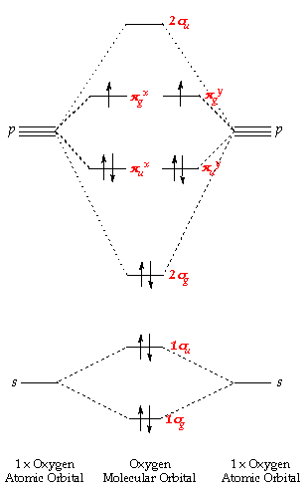
The Activation Barrier
O₂ is kinetically stable
Oxygen’s two unpaired electrons make it difficult to accept a bonding pair
Partially reduced oxygen

Slide 16
Reactive Oxygen Forms – Partially Reduced O₂
•O=O• b.o. = 2
≈ 120 kcal/mol
+e⁻
+2e⁻
+2H⁺
•O-O• b.o. = 1.5
≈ 80 kcal/mol
ΔG
+4e⁻
+4H⁺
HO-OH b.o. = 1
≈ 60 kcal/mol
2H₂O

Slide 17
From H₂O₂ to HO• -- The Fenton Reaction
H₂O₂ + e⁻ → HO• + HO⁻
Fe(II) → Fe(III) + e⁻
Fe(II) + H₂O₂ → Fe(III) + HO• + HO⁻
  HO• + e⁻ → HO⁻ E⁰ ≈ 2 volts
H.J.H. Fenton. J. Chem. Soc. 1894, 65, 889.
F. Haber and J.J. Weiss. Proc. Roy. Soc. London, Ser. A. 1934, 147, 332.

Slide 18
Proposed Mechanism of Action
III
III
O
Fe
O
Fe
EDTA
EDTA
2
2
0
0
Fe
Fe
-
-
e
e
.
.
-
-
.
.
-
-
+
O
+
O
O
II
O
II
+
+
+
+
2H
Fe
2H
Fe
EDTA
EDTA
2
2
2
2
2+
Fe
2+
Fe
+ EDTA
+ EDTA
-
-
HO
HO
·
+
·
II
+
II
+
H
+
H
O
O
III
III
+
Fe
+
Fe
EDTA
EDTA
H
H
O
Fe
O
Fe
EDTA
2
EDTA
2
2
2

Slide 19
Fe°, EDTA, Air (ZEA) system
Fe(0), EDTA, & air
Rare nonbiological system known to date that can activate O₂ under RTP and produce a facile oxidizing species capable of extensively degrading xenobiotics
  Organophosphorous agents
  Halocarbons
  Organics
  EDTA
IF Cheng, et al, Ind. & Eng. Chem. Res. 2003, 42(21), 5024-5030.

Slide 20
Concerns about EDTA
  Many industrial chelating agents are not degradable by methods currently found in wastewater treatment facilities – Commonly found in consumer products, e.g. foods, cosmetics
  Not readily biodegradable – increase metal mobilities
  Considerable quantities of EDTA pass through wastewater treatment facilities in the form of Fe^{III}EDTA, as high as 18µM
  Sillanpaa, Mika; Orma, Marjatt; Ramo, Jaakko; Oikair; “The importance of ligand speciation in environmental research: a case study”; The Science of the Total Environment; 2001; 267, 23-31.
  Sillanpaa, M; Pirkanniemi, K.; “Recent Developments in Chelate Degradation”; Environmental Technology, 2001, 22, 791.
  Kari, F. G.; Giger W; Modeling the Photochemical Degradation of Ethylenediaminetetraacetate in the River Glatt; Environmental Science and Technology; 1995, 29, 2814.
  Nirel, P. et. al.; Method for EDTA Speciation Deteremination: Application to Sewage Treatment Plant Effluents; Wat. Res; 1998; 32, 3615.
  Kari, F. G. and Giger W.; Speciation and fate of EDTA in municipal wasterwater treatment. Wat. Res., 1996, 30, 122-134.

Slide 21
Hydroxyl Radical Attacks EDTA
III
III
O
Fe
O
Fe
EDTA
EDTA
2
2
0
0
Fe
Fe
-
-
e
e
.
.
-
-
.
.
-
-
+
O
+
O
O
II
O
II
+
+
+
+
2H
Fe
2H
Fe
EDTA
EDTA
2
2
2
2
2+
Fe
2+
Fe
+ EDTA
+ EDTA
-
-
HO
HO
·
+
·
II
+
II
+
H
+
H
O
O
III
III
+
Fe
+
Fe
EDTA
EDTA
H
H
O
Fe
O
Fe
EDTA
2
EDTA
2
2
2

Slide 22
Degradation of EDTA by ZEA reaction
1 mM EDTA
(50mL, aqueous)
2.5g Fe° + air

Slide 23
Carbon Balance - Total Organic Carbon*, ESI-MS**, HPLC#
Trapping of the volatile gases using Tenax® showed no volatile organic carbon of molecular weight C4 and above released from the system during the course of the reaction

Slide 24
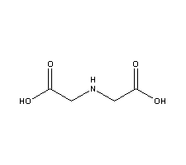
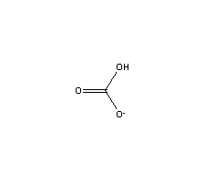
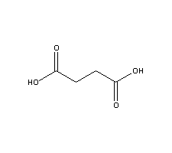
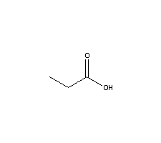
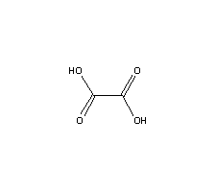
Kinetically stable organic products from ZEA degradation.
iminodiacetic acid (degrades after 12 hrs)
succinic acid
bicarbonate
propionic acid
Oxalic acid
Degradation products for -EDTA
-Malathion (VX surrogate)
-TNT
-4-chlorophenol
-pentachlorophenol
-phenol

Slide 25
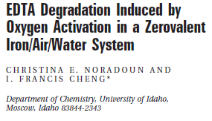
ZEA Mechanism
Evidence for HO• production
  Scavenging by 1-butanol, TBARS

Slide 26
Rate limiting step?
Fe° → Fe²⁺ (dissolution)
Fe²⁺ → Fe^{II}EDTA (Fe-EDTA formation)
  Homogenous chemical steps
Fe^{II}EDTA + O₂ = Fe^{II}EDTA-O₂
Fe^{II}EDTA-O₂ → Fe^{III}EDTA + O₂•⁻
O₂•⁻ + O₂•⁻ + 2H⁺ → H₂O₂ + O₂
Fe^{II}EDTA + H₂O₂→ Fe^{III}EDTA + HO• +HO- (Fenton rxn)
Xenobiotic degradation
  Heterogeneous reduction steps
Fe^{III}EDTA → Fe^{II}EDTA

Slide 27
Experimental Setup
1 mM EDTA (Total Vol. 50mL)
2.5g Fe°
Open to the Atmosphere
Aliquots were taken directly from reaction vessel, diluted, filtered and injected into HPLC
125 ml round bottom flask
stir bar
2.5 g Fe°
BAS stir plate

Slide 28
Arrhenius plot shows dependence of observed rate constants on temperature
k = A exp^{(-Ea/RT)}
2.5g Fe°, 1mM EDTA, 50ml total volume, reactions conducted using a temperature bath and a water-jacketed cell

Slide 29
Overall Scheme (simplified)
Metal dissolution:
Fe(0) → Fe²⁺ + 2e⁻ (1)
Complex formation
Fe²⁺ + EDTA → Fe^{II}EDTA (2)
Homogeneous O₂ activation:
2Fe^{II}EDTA + O₂ + 2H⁺ → 2Fe^{III}EDTA + H₂O₂ (3)
Fenton Reaction
Fe^{II}EDTA + H₂O₂ → Fe^{III}EDTA + OH• + OH- (4)
EDTA degradation:
OH• + FeEDTA →Fe^{2+/3+} + EDTA* (5)
        EDTA* = damaged EDTA
Redox Cycling:
Fe^{III}EDTA + e⁻ →Fe^{II}EDTA (6)
This study, ES&T 2005, 39, 7158 | 25.5 kJ/mol
Beenackers Ing. Eng. Chem. Res. 1992, 32, 2580 | 27.2 kJ/mol
Van Eldik Inorg. Chem, 1997, 36, 4115-4120 | 33.9 kJ/mol
Step 3 is Rate-Limiting

Slide 30
Rate limiting step
Fe° → Fe²⁺ (dissolution)
Fe²⁺ → Fe^{II}EDTA (Fe-EDTA formation)
  Homogenous chemical steps
Fe^{II}EDTA + O₂ = Fe^{II}EDTA-O₂
Fe^{II}EDTA-O₂ → Fe^{III}EDTA + O₂•⁻
O₂•⁻ + O₂•⁻ + 2H⁺ → H₂O₂ + O₂
Fe^{II}EDTA + H₂O₂→ Fe^{III}EDTA + HO• +HO- (Fenton rxn)
Xenobiotic degradation
  Heterogeneous reduction steps
Fe^{III}EDTA + e- → Fe^{II}EDTA
Potential rate limiting step with an activation energy of 25 kJ/mol
Can’t rule out heterogeneous rate limiting step with mass transport limited kinetics

Slide 31
Voltammetric Studies
ZEA reaction rate is dependent on pH
Reaction Rate Fastest 2.5 < pH < 4.5
LMW Acids Self Buffers the ZEA reaction at 3.5
Oxygen Activation Rates Measured By Cyclic Voltammetry

Slide 32
Cyclic Voltammetry of Fe(II/III)EDTA
1.0 mM Fe^{III}EDTA
pH 7.40, 0.1 M HEPES buffer
10 mV/sec
C disk electrode
Fe^{III}EDTA + e⁻ → Fe^{II}EDTA
Fe^{III}EDTA + e- ← Fe^{II}EDTA

Slide 33
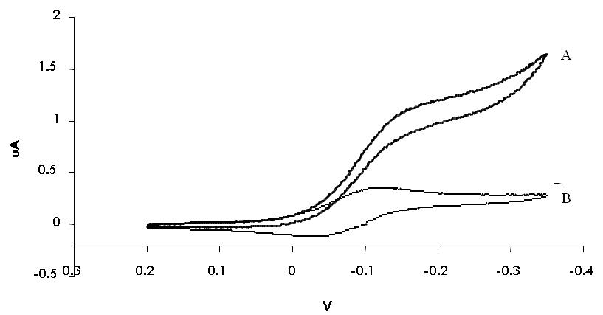
CV of Fe(II/III)EDTA in the presence of O₂
Electrocatalytic (EC’) Voltammetry
pH =3 sample
A) 0.1 mM Fe^{III}EDTA, air saturated
B) 0.1 mM Fe^{III}EDTA only, N₂ purged scan rate = 5 mV/s.

Slide 34
Electrocatalytic currents at -200mV at 5mV/s.

Slide 35
2.5 < pH < 4.5
Free Fe(II)
Fe^{II}EDTA
Fe^{II}EDTA(OH)
Fe^{II}EDTA(H)
Fe^{II}EDTA(H₂)
Figure 2. Top, Amplified reduction current due to the activation of O₂ by Fe^{II}EDTA at various pH values. Current was sampled at -200 mV for each cyclic voltammogram at its corresponding pH.
Bottom, Fe^{II}EDTA species distribution diagram generated by Hyperquad Speciation and Simulation (HYSS). The formation of the mono-protonated Fe^{II}EDTA complex coincides with the current maximum above.

Slide 36
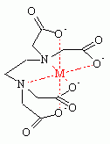
COO⁻
COO⁻
COO⁻
COO⁻
N
Fe
⁻OOC
N
Fe
O₂
N
N
COOH
COO⁻
COO⁻
4.5 < pH < 8
2.5 < pH < 4.5
Fe^{II}EDTA
Fe^{II}(H)EDTA

Slide 37

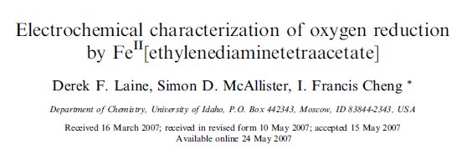

Modeling of Voltammetric Curves

Slide 38
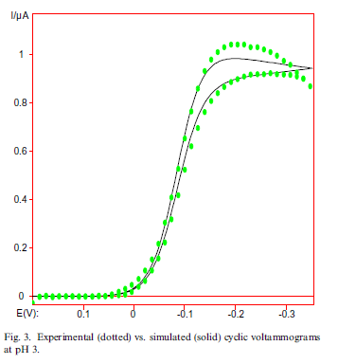

Slide 39
Table 1. Kinetic data obtained by digital simulation as compared to literature values found at pH = 5.0.
Reaction | pH = 5.0 | Simulation | Literature¹⁵
5 | Fe^{II}EDTA + O₂ → Fe^{II}EDTA-O₂ | K = 2.30 x 10⁻³ k = 1.07 x 10⁴ M⁻¹s⁻¹ | K = 2.00 x 10⁻³ k = 10³ – 10⁷ M⁻¹s⁻¹
6 | Fe^{II}EDTA-O₂ → Fe^{III}EDTA + O₂∙⁻ | k = 6.23 x10⁹ s⁻¹ | k = 10⁵ – 10⁹ M⁻¹s⁻¹
2 | Fe^{II}EDTA + O₂∙- + 2H⁺ → Fe^{III}EDTA + H₂O₂ | k = 1.00 x 10⁴ M⁻¹s⁻¹ | k = 10⁶ – 10⁷ M⁻¹s⁻¹
Table 2. Rate constants obtained through DigiSim computer modeling for Reactions 5, 6, and 2 over a pH range of 3.0 – 5.5.
Reaction | pH = 3.0 | pH = 3.5 | pH = 4.0 | pH = 4.5 | pH = 5.0 | pH = 5.5
5 k/M⁻¹ s⁻¹ | 1.57 x 10⁴ | 1.86 x 10⁴ | 1.45 x 10⁴ | 1.31 x 10⁴ | 1.07 x 10⁴ | 1.07 x 10⁴
6 k/s⁻¹ | 3.41 x 10¹¹ | 1.80 x 10¹⁰ | 1.03 x 10⁸ | 8.32 x 10¹⁰ | 6.23 x10⁹ | 6.00 x10⁹
2 k/M⁻¹s⁻¹ | 2.29 x 10⁸ | 9.00 x 10⁵ | 3.27 x 10⁵ | 1.20 x 10⁴ | 1.00 x 10⁴ | 1.11 x 10⁴
[15] V. Zang, R. van Eldik, Inorg. Chem. 29 (1990) 1705-1711.

Slide 40
Advantage of Cyclic Voltammetry over Stopped-Flow techniques
  Fe^{II}EDTA is very air sensitive – produced/consumed at electrode surface
  Rapidly obtain data across pH spectrum – ability to examine all species –H and –OH complexes
  Rapidly assess Fe catalysts for O₂ reduction
    Fuel Cells
    Models for Biological Applications

Slide 41
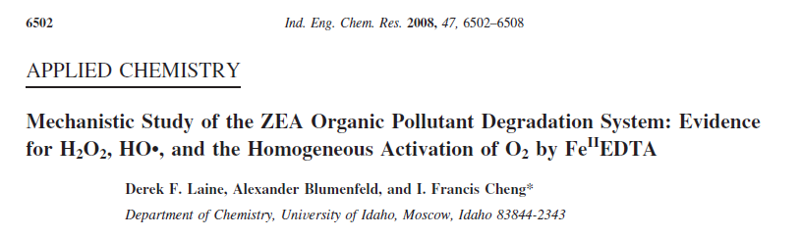
ESR studies also indicate O₂ reduction by Fe^{II}EDTA

Slide 42
ZEA Reaction – Conclusions I
This system is a viable option for the destruction of a variety of pollutants and has a strong possibility for scale up.
The only system known to date that can obtain non-biological Oxygen Activation at room temperature and pressure to produce reactive oxygen species that are capable of fully degrading pollutants to LMW carboxylates and inorganic forms
Due to the duality of EDTA acting as both a pro-oxidant and antioxidant, controlling the [EDTA] is imperative to the success of the process.
Rate-limiting steps is (are) oxygen activation
Fe^{II}EDTA voltammetric studies may provide insights into biological oxygen activation with other metal complexes

Slide 43
Accidental Discovery II – UI Carbon is it Multilayer Graphene?
Metals Analysis of Oil Shale
-Precious Metals
Formation of Carbon Films (UI Carbon)
pyrolysis
?
Raman & IR -- Peter Griffiths (Chemistry)
And Eric Aston (Chem E)
XPS & AFM – David McIlroy (Physics)
Optical & Electron Microscopy
Multilayer Graphene?

Slide 44
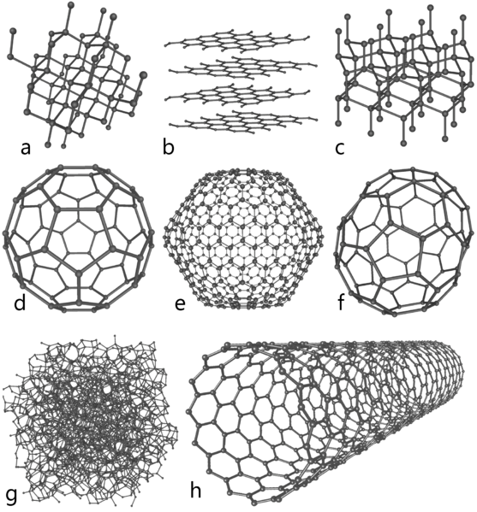
http://en.wikipedia.org/wiki/Allotropes_of_carbon
Eight allotropes of carbon:
Diamond, (sp³)
b) Graphite, (sp²)
c) Lonsdaleite, (sp³)
d) C₆₀ (Buckminsterfullerene or buckyball),
e) C₅₄₀, f) C₇₀,
g) Amorphous carbon, and
h) single-walled carbon nanotube or buckytube.

Slide 45
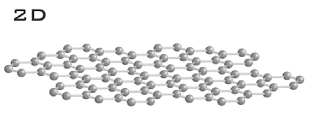
What is Graphene?
One atomic layer of sp² - bonded carbon atoms
Free standing two dimensional semimetal
Basic building block of graphite
A.K. Geim, Science 324, 1530 (2009);

Slide 46
Is it the next wonder material?
Single Layer Graphene
Electronic properties → Replacement for Silicon
  Superior Physical Properties
    Thermal conductivity
  IBM 100 GHz transistor
Mechanical Aspects
  Breaking strength 200 times greater than steel
Optically Transparent (monolayer)
  Less expensive than indium tin oxide based touch screen systems
  K.S. Novoselov, A.K. Geim. Science Oct 22 (2004) pp1-3
  Changgu Lee, James Hone. Science 18 July 2008: Vol. 321. no. 5887, pp. 385 – 388
  J. Scott Bunch, Paul L. McEuen. Science 26 January 2007 Vol. 315. no. 5811, pp. 490 – 493

Slide 47
Multilayered Graphene
100 nm – 100 µm, Also known as graphene ‘paper’
Composite materials
RF shielding
Thermal Conduction
Electrodes
  Supercapcitors
  Li ion batteries
  Fuel Cells
http://news.cnet.com/8301-17938_105-20004710-1.html http://www.nature.com/nmat/journal/v9/n7/abs/nmat2753.html

Slide 48
Lack of Synthetic Methods - I
Need for those that are Scalable to Industrial Production
  Economics
Present Methods to Single Layer Graphene
Exfoliation of HOPG/Graphite
SiC @ 1200-1500 ºC
Chemical vapor deposition (CVD) with Ni or Cu @ 800-1000 ºC
Fujitsu Process CVD onto Fe @ 650 ºC → Few Layered Graphene
  http://www.scientificamerican.com/slideshow.cfm Keun Soo Kim, Yue Zhao . NATURE| Vol 457|5 February 2009
  Aristov et al. Graphene Synthesis on Cubic SiC/Si Wafers. Perspectives for Mass Production of Graphene-Based Electronic Devices. Nano Letters, 2010; 10 (3): 992 DOI: 10.1021/nl904115h
  http://www.fujitsu.com/global/news/pr/archives/month/2009/20091127-01.html

Slide 49
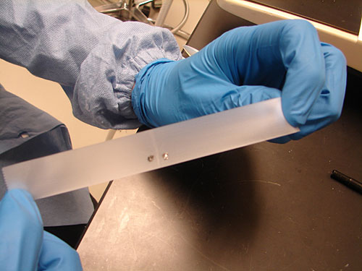
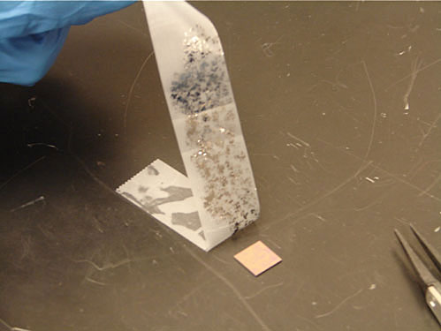
Exfoliation Method
http://www.scientificamerican.com/slideshow.cfm
http://www.youtube.com/watch?v=rphiCdR68TE

Slide 50
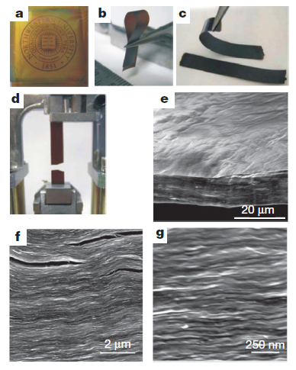
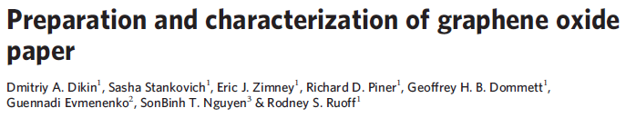
Multilayer Graphene Oxide/Graphene ‘Paper’
Multilayers of Graphene – 0.1-100µm
Applications – Electrodes
Li ion batteries
Sensors
Thermal Conduction
Composite materials
Ruoff et al, Nature, 2007, pp457-460

Slide 51
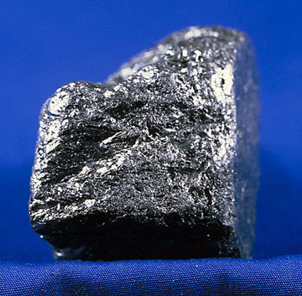
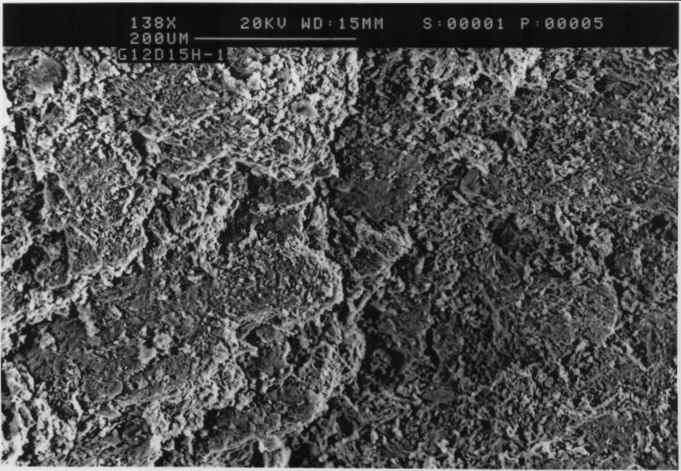
Graphite Morphology

Slide 52

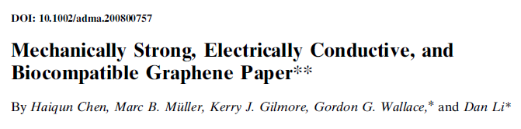
Graphene paper synthesis
oxidation
filtration
Graphite
reduction
GO paper
Graphene Oxide
Aqueous suspension
Nature 2007, 448, 457-460
Adv. Mater. 2008, 20, 3557–3561

Slide 53
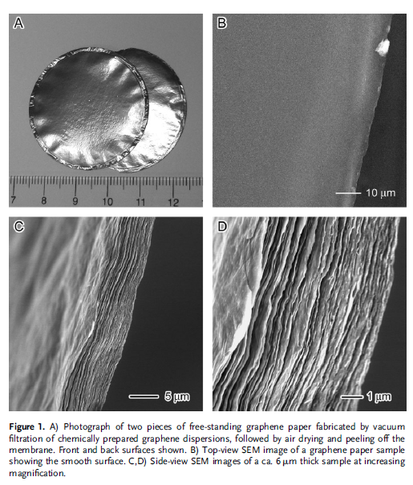
Adv. Mater. 2008, 20, 3557–3561

Slide 54
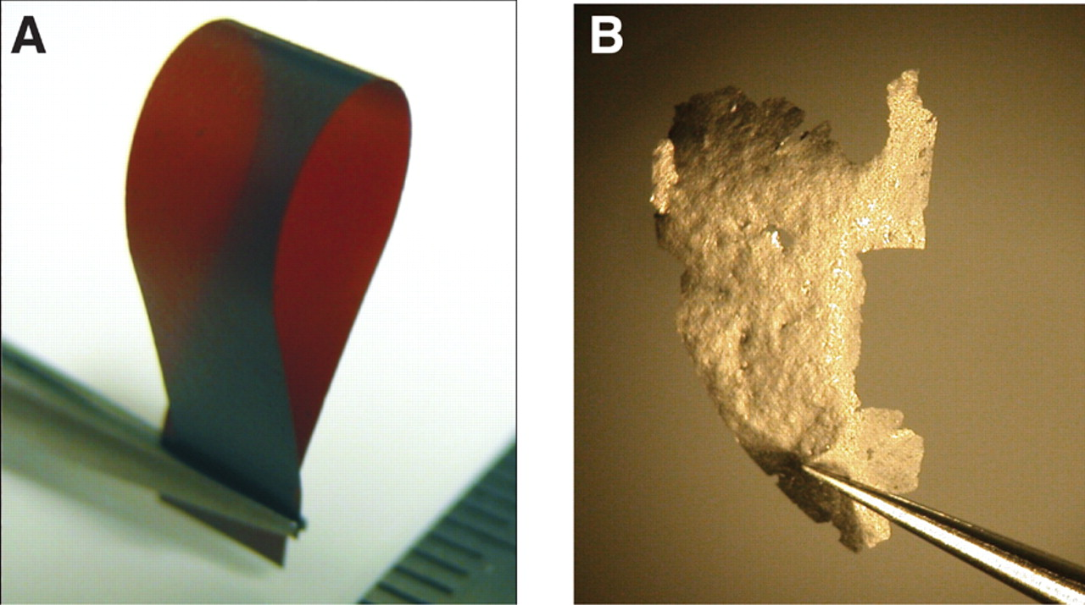
Graphene: Status and Prospects
Science 19 June 2009:
Vol. 324. no. 5934, pp. 1530 - 1534
DOI: 10.1126/science.1158877
http://www.sciencemag.org/cgi/content/full/sci;324/5934/1530
Fig. 3 Graphene derivatives. (A) Graphene oxide laminate is tough, flexible, transparent, and insulating (6). (B) Paper made in the same way as (A) but starting from graphene suspension (5) is porous, fragile, opaque, and metallic. [Courtesy of R. Nair, University of Manchester]

Slide 55
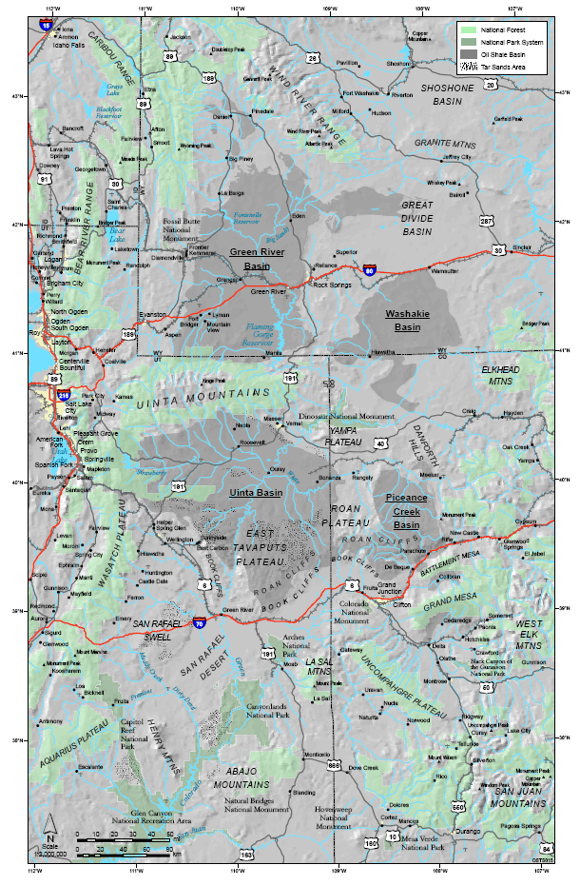
Thermalyzed Asphalt Reaction (TAR)
ID
Accidental discovery
  Metal Analysis of Piceance (CO) Basin Oil Shale
  Pyrolyzed Sample to Remove Organics
    Simplification of Sample Matrix for Flame AAS analysis
    Conducted in Covered Crucibles
WY
UT
CO

Slide 56
Pyrolyzation of Tar/Asphalt/Bitumen
Porcelain Cover
Flames from
precursor
combustion
Porcelain Crucible
Brownish Fumes from Heat Precursors
Inner Crucible with precursors
Heat
Starting materials – Oil Shale, Tar, Asphalt, 5W-20, etc.

Slide 57
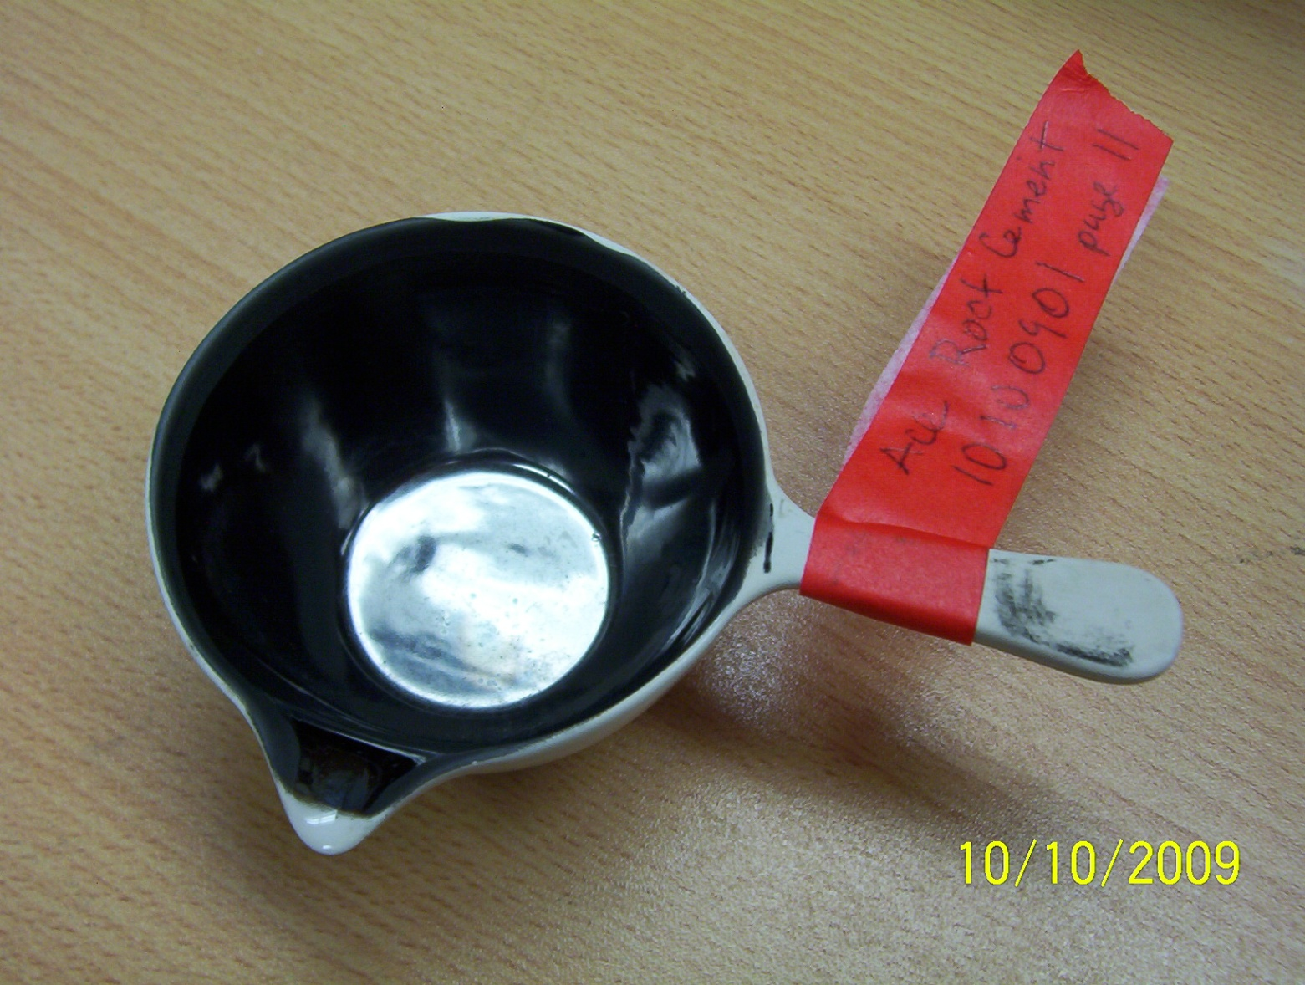
Outer Crucible After Cooling

Slide 58
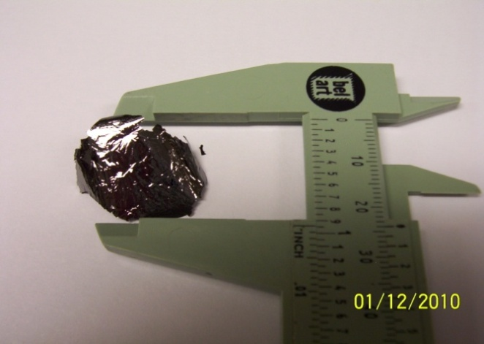

Slide 59
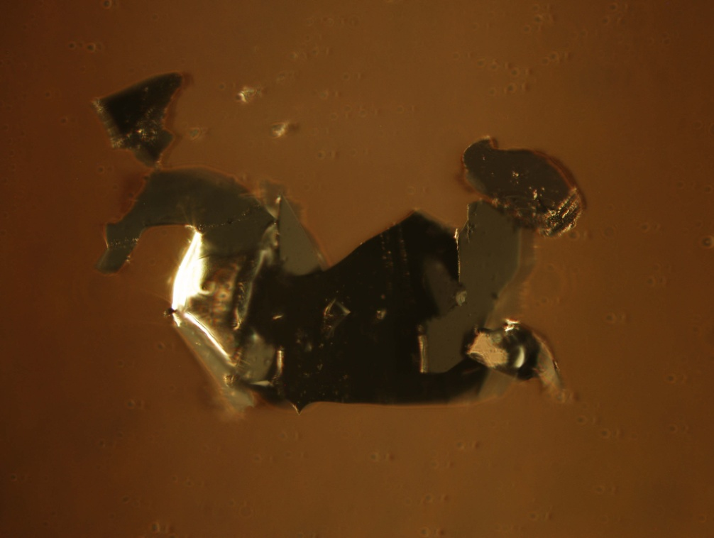
Exfoliated Sample from 101009a– 200x
Layered Characteristics are Visible

Slide 60
SEM 121009 - Graphene from Roofing Tar
Graphene Layer 1
Layer 1
Graphene Layer 1
Graphene Layer 2
Layer 2
Si Wafer
Si Wafer

Slide 61
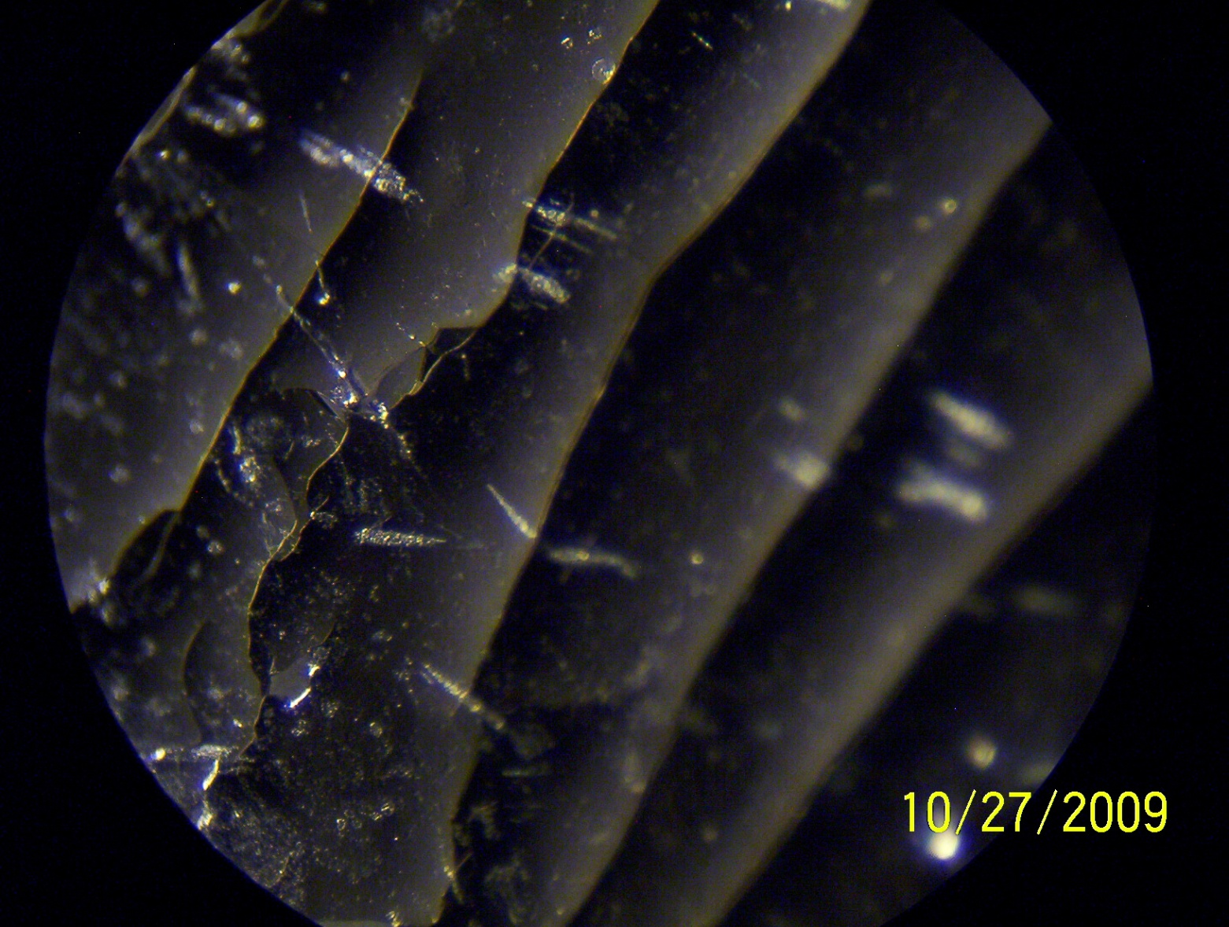
Exfoliated Sample from 10270901 – 6g 5W-20 + 5g S 200x
Steps are Visible at the mm Scale

Slide 62
SEM obtained 090910 Yuqun Xie
Steps are Visible on the Micron Scale

Slide 63
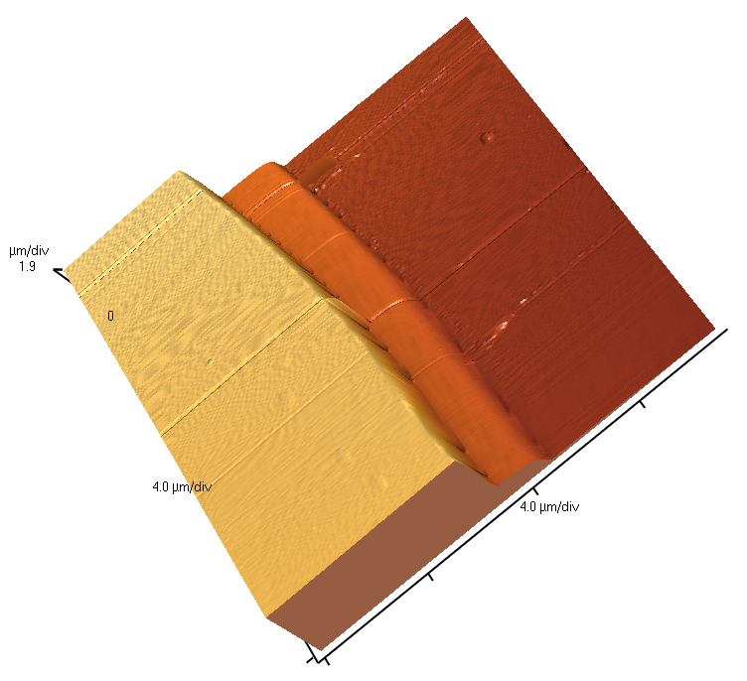
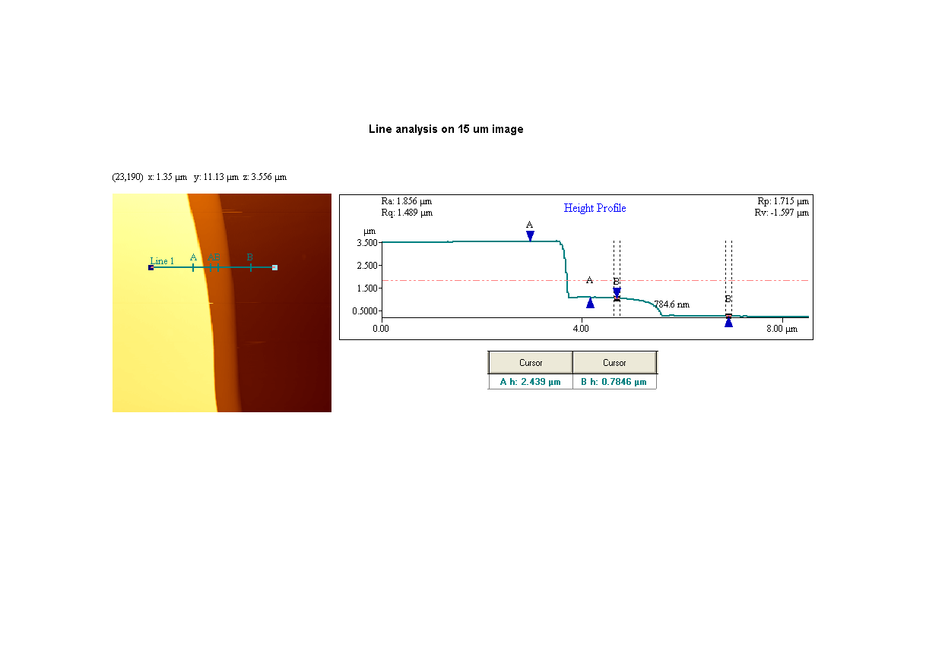
Micron Scale AFM of UI Carbon

Slide 64
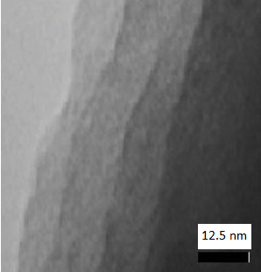
TEM Image of UI Carbon
Steps are Visible on the nm Scale

Slide 65
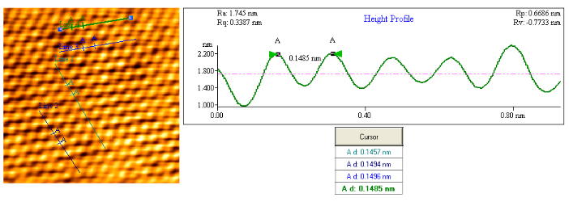
Atomic Scale AFM of UI Carbon
Hexagonal pattern consistent with graphite/graphene
Atomic distance of 0.1485 matches that of sp² carbon.

Slide 66
Summary of Morphology of UI Carbon
Layered Characteristics
  mm scale (optical microscope)
  micron scale (SEM)
  nanometer scale (TEM)
Atomic Scale AFM
  Consistent with graphene
  sp² C
Flatness
  Indefinite – by SEM/AFM several hundred µm²
  By visual microscopy cm²

Slide 67
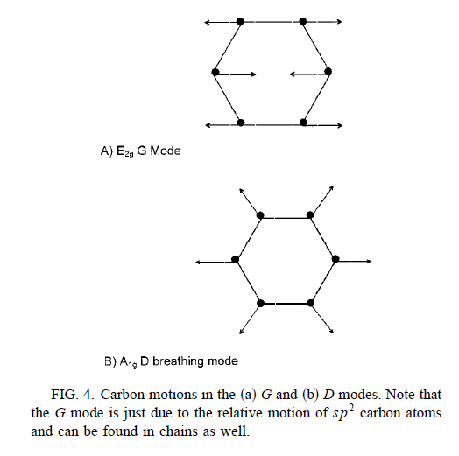
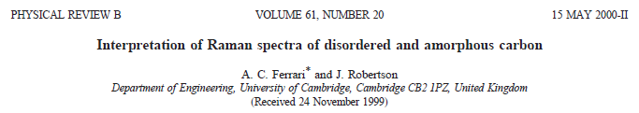
Raman Analysis
Graphite
G-Band 1500-1600cm⁻¹
  E_{2g} symmetry
  Occurs in all sp² C
D-Band 1355cm⁻¹
  A_{1g} symmetry
  ‘breathing’ mode
  Forbidden in perfect graphite
  Appears with disorder & defects
  sp³ C

Slide 68
Raman Spectrum of UI Carbon
1593
1354
acquired in ambient air using 532 nm excitation
1000 cm⁻¹
2000 cm⁻¹

Slide 69
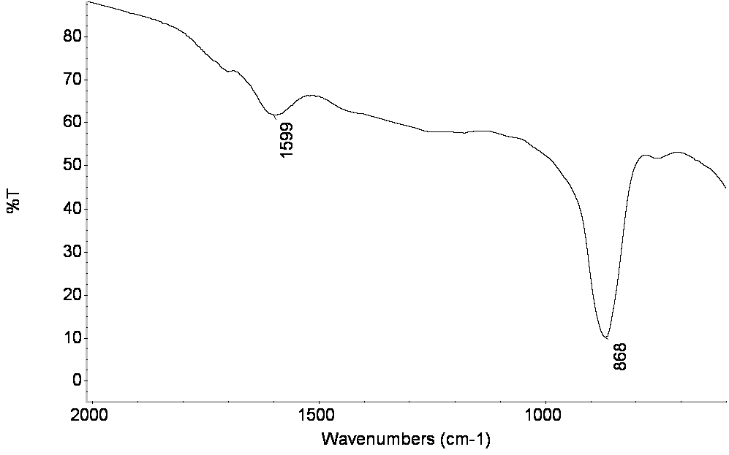
IR Spectrum
IR spectrum of graphene on a germanium disk. The 861 and 1576 cm⁻¹ bands correspond to the A_{1u} and E_{1u} intralayer graphene stretches.

Slide 70
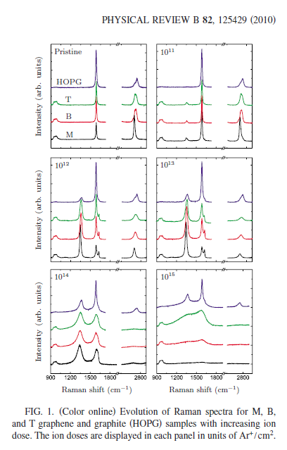
G – Band ≈ 1585 cm-1
D – Band ≈ 1300 cm-1
  Increasing D-band with Ar⁺ exposure
  Indication of defects

Slide 71
I_{D}/I_{G} ratio = 0.93, G-Band 1593 cm⁻¹
Fig 7. Ferrari and Robertson Phys. Rev. B 2000, 61, 14095-14106
Nearly 100% sp² hybridization
Nanocrystalline features A_{1g} breathing mode

Slide 72
Summary of Raman/IR studies
IR indicates no C-O stretches, very little C=O
  A_{1U} (868 cm⁻¹) and E_{1U} (1576 cm⁻¹) non-Raman Active Intralayer Stretches
Appearance of D band indicates defects

Slide 73
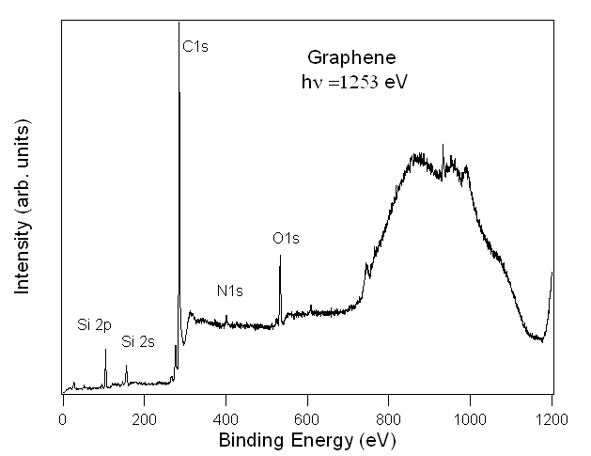
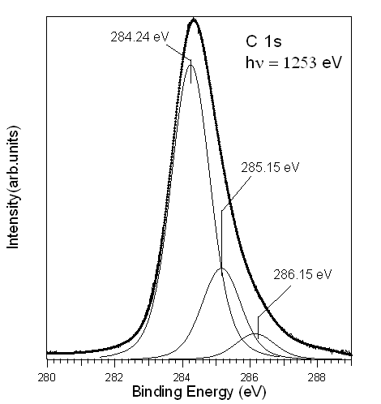
X-ray Photoelectron Spectroscopy of UI Carbon
Left-- A wide XPS scan of cleaved graphene. Right -- XPS spectrum of the C 1s core level state of graphene. The peaks at 284.24, 285.15, and 286.15 eV are assigned to sp² C-C, C=N sp² or sp³ C-H, and sp³ C-O or sp² C-N respectively

Slide 74
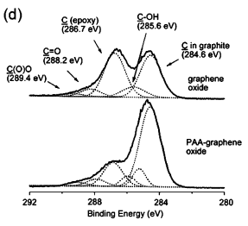
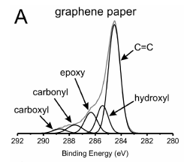
Comparison to Literature
J. Phys. Chem. C 2010, 114, 12800–12804
J. Phys. Chem. C, Vol. xxx, No. xx, XXXX
10.1021/jp907613s

Slide 75
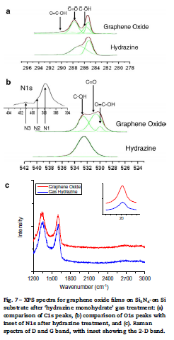
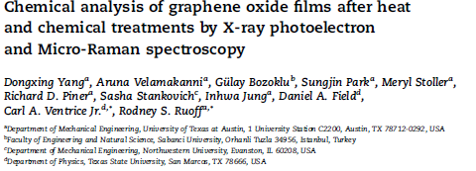
Carbon 4 7 ( 2 0 0 9 ) 1 4 5 –1 5 2

Slide 76
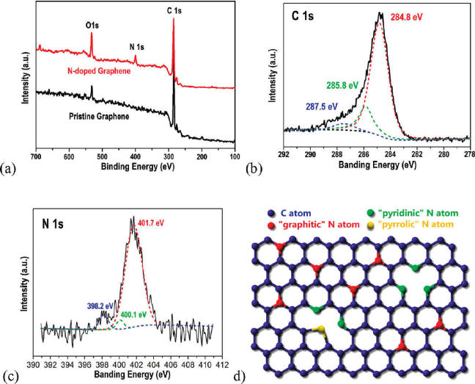
Wei et al, Nanoletters 2009, 9, 1752-58
N doped graphene
1.2% N

Slide 77
Summary of XPS studies
UI Carbon has less surface concentration of O-containing groups than literature graphene papers
UI Carbon Consistent with sp² C and with doped (possibly N) graphene
Consistent with IR indicating very little C=O and no C-O

Slide 78
IS UI Carbon Multilayered Graphene?
Microscopy
  Optical, SEM, TEM
Raman/IR
  Consistent with multilayered doped with defects
  sp² C
XPS
  sp² C with either N or O impurities

Slide 79
Future studies
Role of S in the process
  S + any high BP organic works
    No evidence of S in UI carbon by XPS
  Intermediates – formed at lower temperatures
Deposition of UI carbon onto micro/nanostructures
  Onto any surface that can withstand 650 ºC
    Unique in this ability compared to filtration and CVD techniques
  Li ion negative electrodes
  Supercapcitors
  Catalyst supports for fuels – replacement for expensive Carbon Nanotubes

Slide 80
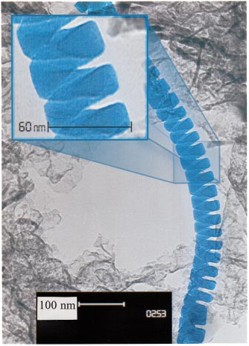
Silica Nanosprings David McIlroy, Department of Physics, University of Idaho
Nanotechnology 17 (2006) S298–S303
APPLIED PHYSICS LETTERS VOLUME 79, NUMBER 10 3 SEPTEMBER 2001, p1540
FIG. 1. Bright-field transmission electron microscope image of an
amorphous boron carbide nanospring that has been highlighted for contrast.
The inset is a blown-up view of the nanospring.

Slide 81
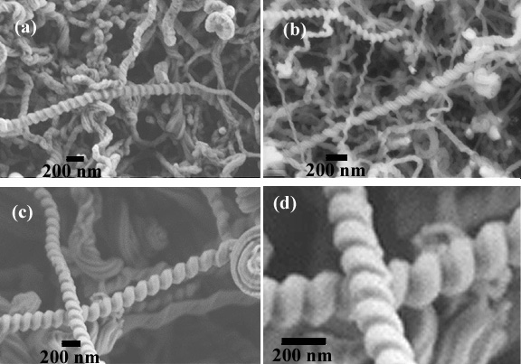
Figure 1. SEM images of silica nanosprings using different deposition temperatures: (a) 350 ◦C, (b) 650 ◦C, (c) 1000 ◦C, and (d) an expanded image of panel (c).

Slide 82
Nanosprings – Graphene composite Yuqun Xie 092010

Slide 85
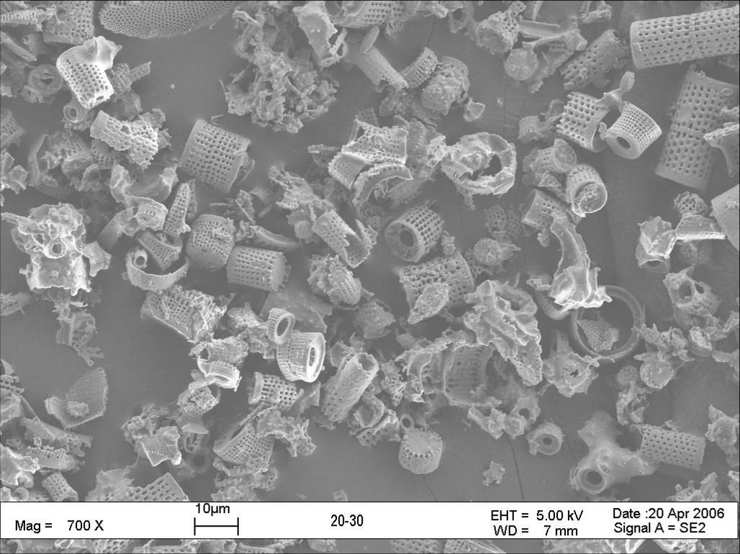
Figure 6. A – SEM of untreated diatomites at 700x magnification, the distance bar is 10 µm. Au sputter coating was required to prevent charging. B – of graphene coated diatomites at 721x magnification. The sample was conductive enough not to require Au sputtering. Also note that the diatmomites retain their pore structure, ≈100 nm. C – SEM of the diatomite pore structure after GP deposition at 24.4×10³x. D – Graphene coated silica nanosprings. The distance bar is 100 nm without the requirement for Au sputter coating.
A
B
C
D

Slide 86
Thank You
Funding O₂ Activation
NIH
NSF
NASA
EPRI
BLM
UI

Slide 87
Acknowledgements
ZEA Reaction
  Derek Laine
  Kenichi Shimizu
  Simon McAllister
  Ruhba Ponraj
  Mark D. Engelmann, Ph.D. 2003
  Tina Noradoun, Ph.D. 2005
  Ryan Hutcheson, B.S. 2004
  Rob Bobier, B.S. 2002
  Terry Hiatt, B.S. 2000
UI Carbon
  Yuqun Xie
  R. Allen Gonzales
  Przemysław R. Brejna
  Jency Pricilla Sundararajan
  B. A. (Alex) Fouetio Kengne
  Prof. David McIlroy – Physics
  Prof. Eric Aston – Chem E
  Prof. Peter Griffiths – Chemistry

Slide 88
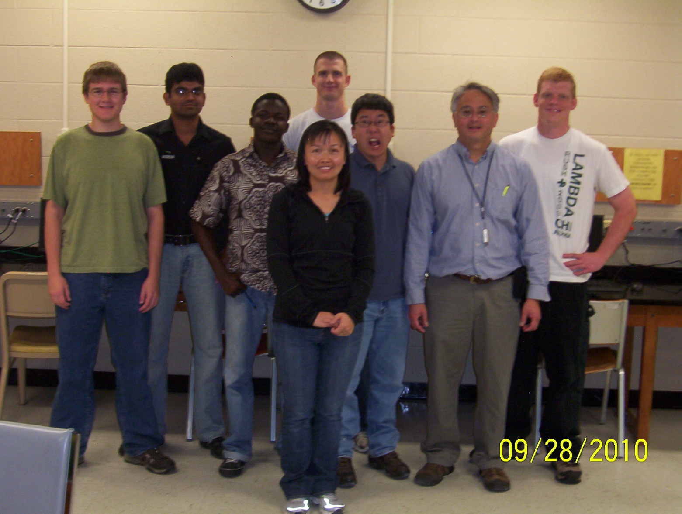

Slide 89
Catalyzed Reductions of Halocarbons by Pd modified Bimetallic Systems
2M + PdCl₆²⁻ ➔ 2M²⁺ + 6Cl⁻ + Pd(s)
0.05-0.25 % Pd (w/w)
Results in complete dechlorination of TCE
Muftikian, Fernando, Korte, Water Research. 1995, 29, 2434.

Slide 90
The role of Pd in hydrodehalogenation of chloro-organics by Pd/Fe
Cheng, Fernando, Korte, Environ Sci &Technol, 1997, 31(4) 1074-1078.

Slide 91
Concerns about EDTA
Questions regarding the ability to mobilize metals in the environment.
  Currently not being monitored or treated at waste water treatment facilities
  Concern for heavy metal mobility and longer bioavailability of metals to aquatic plants and animals
  Stable in aquatic environment
EDTA is anthropogenic and long-lived.

Slide 92
Organophosphorous Nerve Agents and Nitrated Explosive Surrogates
TNT surrogate -- nitrobenzene (985 ppm) decomposes in 24 hours.
VX surrogate -- malathion (49 ppm) was consumed in 4 hours, to give diethyl succinate. Malathion was the only pollutant to give a by-product detectable by GC-FID.

Slide 93
Kinetics of Malathion Degradation
Malathion
Diethyl Succinate (DES)
GC/FID chromatograph: each data point indicates an individual reaction vial extracted using 50/50 hexane/ethyl acetate, error bars indicate the standard deviation between three measurements of each sample vial.
Notes:
****Do a carbon balance using excel.

Slide 94
Malathion Degradation
DES
malathion
max: 4-6 hrs
PO₄³⁻ + SO₄²⁻
SO₄²⁻ :0.0593mM (14% yield) (24hrs)
PO₄²⁻ : 0.0825 mM (19 % yield) (24hrs)
malaoxon
Max: 7 hrs

Slide 96
Formation of HO·
Fe^{II}EDTA
2O₂·⁻ + 2H⁺ → H₂O₂ + O₂
+
Fe^{II}EDTA
2O₂
Fe^{III}EDTA
Accomplished using the spin trapping abilities of 5,5-dimethylpyrroline-N-oxide (DMPO) and electron spin resonance spectroscopy (ESR).
The DMPO-HO· adduct has a well characterized 1:2:2:1 quartet.
Fe^{III}EDTA + OH⁻ + OH▪
·
Das, Kumuda C.; Misra, Hara P. Mol. Cell. Biol. 2004, 262, 127-133.
Yamazaki, Isao; Piette, Lawrence H. J. Am. Chem. Soc. 1991, 113, 7588-7593.
Notes:
Next we want to identify the formation of HO· in this reaction system. This is accomplished using the spin trapping abilities of DMPO (point to it) and ESR. If Hydroxyl radicals are present, they will add to DMPO and produce a well characterized 4-line spectra.

Slide 97
Formation of HO·
Fe^{II}EDTA
2O₂·⁻ + 2H⁺ → H₂O₂ + O₂
+
Fe^{II}EDTA
Electrolysis for 3 h before adding an aliquot to DMPO.
2O₂
Fe^{III}EDTA
Fe^{III}EDTA + OH⁻ + OH▪
Notes:
Here is our result where we have added an aliquote of the electrolysis mixture to DMPO after 3 hours of electrolysis and indeed we do see this 4-line spectra, however, when we performed a control experiment where we add the reaction mixture ( which just contains FeIIIEDTA, KCl, and O2) to DMPO before electrolysis, we obtain the same 4-line spectra. So we had to investigate why this occurred and what we could do to identify hydroxyl radicals.

Slide 98
Formation of HO·
No electrolysis
Fe^{III}EDTA
KCl
O₂
H₂O
Reaction mixture is added to DMPO before electrolysis.

Slide 99
Formation of HO·
·
The two processes can be distinguished by adding the reaction mixture to a mixed solution of DMPO and CH₃OH.
Notes:
So we searched the literature and found that when DMPO is in the presence of Fe3+ ions, you can produce the same DMPO-HO radical adduct that you get when HO· adds to DMPO. This additional process is due to the nucleophilic addition of H2O to DMPO catalyzed by FeEDTA. So we had to perform some addition experiments to distinguish the signal we got from the radical mechanism versus the nucleophilic mechanism. The way we did this is by adding the reaction mixture to methanol to scavenge hydroxyl radicals.

Slide 100
Radical mechanism
Fe^{II}EDTA
2O₂·⁻ + 2H⁺ → H₂O₂ + O₂
+
Fe^{II}EDTA
2O₂
Fe^{III}EDTA
Fe^{III}EDTA + OH⁻ + OH▪
1
2
3
·
·
·
I
CH₃OH 20% v/v
DMPO
·

Slide 101
Nucleophilic addition mechanism
No electrolysis
Fe^{III}EDTA
KCl
O₂
H₂O
1
2
II
CH₃OH 20% v/v
DMPO

Slide 102
Determination of HO·
After electrolysis - addition of the hydroxy methyl radical
·
I
Before electrolysis - nucleophilic addition of methanol
II

Slide 103
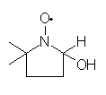


Formation of HO·
No electrolysis
●
●
●
●
●
●
II
After electrolysis
●
●
●
●
I
Notes:
With the addition of methanol, any hydroxyl radicals present will react with the methanol to produce the hydroxymethyl radical with can add to DMPO by forming a bond at the methyl carbon. This species provides a 6-line spectra in the ESR. Alternatively, methanol may also act as a nucleophile, however, when it does, it adds to DMPO at the oxygen, and therefore produces a different adduct and different spectra. Both processes produce a six line spectra, however, they have different coupling constants. In the top figure we added the reaction mixture to DMPO and methanol after 3 hours of electrolysis and we can see that with electrolysis, a mixture of signals is obtained, we have the 6-line spectra due to the formation of the hydroxymethyl radical and we also have the 4-line spectra due to the formation of DMPO-HO adduct. So there is a competition between DMPO and methanol for hydroxyl radicals. We get the same mixture in the bottom graph where we add the reaction mixture to DMPO and methanol before electrolysis. You can see that a different 6-line spectra is obtained and corresponds to the nucleophilic mechanism.

Slide 104
Formation of HO·
A
Growth of the quartet when adding the reaction mixture to DMPO after electrolysis.
B
Growth of the quartet when adding the reaction mixutre to DMPO before electrolysis
A)
·
Reaction dominates after electrolysis. k = 10⁹ M⁻¹ S⁻¹
B)
Reaction dominates before electrolysis
Yamazaki, Isao; Piette, Lawrence H. J. Biol. Chem. 1990, 265, 13589-13594
Notes:
We can also distinguish the radical mechanism from the nucleophilic mechanism by keyeing in on the rate that the DMPO-HO adduct forms. The rate of formation DMPO-HO by the addition of hydroxyl radicals is a fast process with a rate constant of 10^9 M⁻¹ S⁻¹. while the nucleophilic mechanism would be much slower. The graph shows that in A) when electrolyzed solution is added to DMPO, the 4-line spectra increases much faster than in B) when the reaction mixture is added to DMPO, before electrolysis. This result was reproducible over several trials.

Slide 105
Formation of HO·
Intensity of 1:2:2:1 quartet vs. electrolysis time
H₂O₂ Formation
2O₂·⁻ + 2H⁺ → H₂O₂ + O₂
Fe^{II}EDTA
+
Fe^{II}EDTA
2O₂
Fe^{III}EDTA
Fe^{III}EDTA + OH⁻ + OH▪
Notes:
We can see additional support for the formation of hydroxyl radicals by going back to an earlier result for the formation of H2O2. In the upper left graph we plot the intensity of the 4-line spectra with respect to electrolysis time. As you can see, the graph eclipses the result for the formation of HO·, as would be expected from the reaction mechanism.

Slide 106
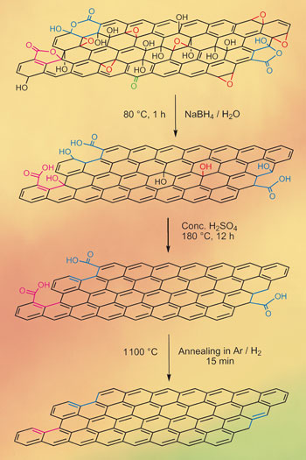
Graphene oxide reduction
Wei Gao, Pulickel M. Ajayan. NATURE CHEMISTRY | VOL 1 | AUGUST 2009 |pp403-408

Slide 107


Slide 108




http://www.moscow.com/

Slide 109


Slide 110

www.latahrealty.com/

Slide 111


Slide 112


