Slide 1
Selective Electrochemical Detection of Triacetone Triperoxide
Yuqun Xie
Chemistry Department of University of Idaho

Slide 2
Outline
Background
Synthesis
Dangers
Detection
Current state of detection
Urgent needs for TATP detection
Proposed method
Results
Conclusion
Acknowledgement

Slide 3
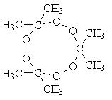
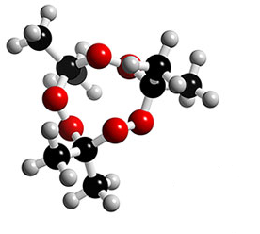
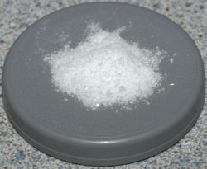
Triacetone Triperoxide (TATP)
Chemical formula: C₉H₁₈O₆
TATP is highly unstable explosive. Susceptible to heat, friction, and shock.
http://en.wikipedia.org/wiki/Acetone_peroxide

Slide 4
TATP Synthesis
H⁺
3H₂O₂ + 3CH₃COCH₃ ((CH₃)₂COO)₃ + 3H₂O
< 10°C
All the reactants are commercially available:
Acetone (hardware stores paint thinner)
Hydrogen peroxide (pharmacies)
sulfuric acid (Battery acid)
Widmer, Leo; Watson, Stuart; Schlatter, Konrad; Crowson, Andrew. Analyst 2002, 127, 1627-1632.
Dubnikova, Faina; et al J. Am. Chem. Soc. 2005, 127, 1146-1159.

Slide 5
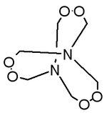
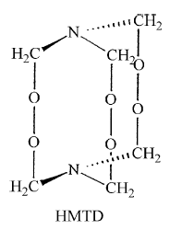
Hexamethylenetriperoxide (HMTD)
HMTD
< 10°C
Hexamethylenetetramine + Citric Acid + H₂O₂ HMTD
Hexamethylenetetramine fire starter
http://en.wikipedia.org/wiki/Hexamethylene_triperoxide_diamine
http://business.fortunecity.com/executive/674/hmtd.html
Oxley, J.C.; Smith, J.L.; Chen, H.; Cioffi, Eugene. Thermochim. Acta 2002, 388, 215-225

Slide 6
TATP &HMTD Incidents
2007 - German authorities stop terrorist plot and seize 1500 lbs of H₂O₂.
2006 - London airline bombing plot – HMTD
2005 - Joel Henry Hinrichs III – University of Oklahoma. – TATP.
2001 - Richard Reid, Shoe Bomber – TATP
1999 - Millennium bomber Ahmed Ressam. 124 pounds of HMTD
1994/95 – Bojinka Plot – TATP? HMTD?
1994 – Philippines Airlines - TATP
1980’s – present - West Bank Israel – TATP “Mother of Satan”

Slide 7
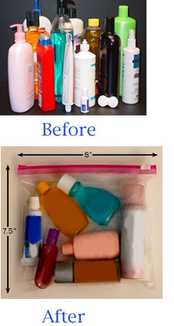
TATP – TSA Fluid Ban
Effective November 10, 2006, the TSA has advised that travelers may now carry through security checkpoints travel-size toiletries (3.4 ounces/100 ml or less) that fit comfortably in ONE, QUART-SIZE, clear plastic re-sealable bag.
The 3-1-1 Kit contains six 2-1/2 oz and four 1-1/2 oz flexible squeeze tubes, plus one 1-3/4 oz Envirosprayer.
Kit is also compliant with the new International Security Measures Accord.
http://www.easytravelerinc.com/

Slide 8
Current techniques for TATP detection
IR-Raman
High Selectivity – Relatively High LOD
Fluorescence/UV-vis Absorbance
Low LOD requires tagging
Ion Mobility
Good Selectivity, moderate LOD
HPLC or GC
Excellent Selectivity and LOD
Enzymatic
Moderate LOD requires pretreatments
Derek F. Laine, I. Francis Cheng . Microchemical Journal 91 (2009) 125–128.
Wang, Joseph et al, Analyst 2007, 132, 560-565.

Slide 9
Disadvantages of Present TATP Detector Designs
Interferences ( O₂ and/or other peroxides)
Time consuming (several minutes)
Expensive
Non-portable

Slide 10
Urgent needs for TATP Detection
Small Portable
hand hold sensor or test strip
Highly selective
distinguishing TATP from organic peroxide interference
Fast
less than 30 s
Cheap
costs few dollars
Easy to use
users don’t need be trained
Low detection limits
Micro Molar

Slide 11
Reference Reaction
Chemical Reaction
Need be purged with N₂ due to the O₂ interference
Mair, R.D.; Graupner A.J., “Determination of Organic Peroxides by iodine Liberation Procedures” Analytical Chemistry, 1964, 26, 194-204.

Slide 12
Proposed method
Chemical Reaction:
TATP+ 4Br⁻ + 2H⁺ 2C₃H₅OBr+ C₃H₄Br₂ +3H₂O
HMTD+2Br⁻ + H⁺ Br₂+ fragments
H₂O₂ +2Br⁻ + 2H⁺ Br₂ +2 H₂O
Electrode reaction:
Fast (less than 30 s)
Slight temperature elevation (55⁰C)
No interference from O₂
Br₂ + 2e⁻ →2Br⁻ E_{step} = 0.70 volts vs. Ag/AgCl
2Br⁻ → Br₂ + 2e⁻ E_{step} = 0.96 volts vs. Ag/AgCl

Slide 13
Detection Scheme
Amperometric detection of peroxides
Absence of aqueous Br₂ - TATP
Appearance of aqueous Br₂ - HMTD, H₂O₂ & other peroxides

Slide 14
Cyclic voltammetry of Redox couple Br⁻/Br₂
Cyclic voltammograms , 11.94 M Acetic acid, 0.364 m M HCl. sweep rate is 30 mV/s.
a) 0 mMKBr
b) 3 mM KBr.
Br₂ + 2e⁻ →2Br⁻ E_{step} = 0.70 volts vs. Ag/AgCl
2Br⁻ → Br₂ + 2e⁻ E_{step} = 0.96 volts vs. Ag/AgCl

Slide 15
Chronoamperometry (CA), TATP
Double step Chronoamperometry 11.94 M Acetic acid, 0.364 m M HCl , 0.3 m M KBr and various concentration of TATP . Sampling at 5 to 10 s and 15 to 20 s for the calibration curve

Slide 16
Calibration curve of TATP based on the disappearing the Br⁻ and absence of Br₂ correspond to the CA
LOD ( 3 times standard deviation n=3) of TATP is 8.5 µM

Slide 17
Chronoamperometry (CA), HMTD & H₂O₂
Double step Chronoamperometry 11.94 M Acetic acid, 0.364 m M HCl ,
6 m M KBr and various concentration of HMTD and H₂O₂

Slide 18
Calibration curve of HMTD and H₂O₂ based on the appearance of Br₂ and disappearing of the Br⁻ correspond to the CA
LOD (3 times standard deviation n=3) of HMTD is 16.3 µM, H₂O₂ is 14.9 µM

Slide 19
Literature Summary
Technique | Pre-treatment | Time (min) | Limit of Detection | Chemical Interferences | Portable (instrument)
This work | No | < 0.5 | 8.51 μM | None | Yes
Electro-catalytic Fenton Reaction | Strong Acid | 10 | 1 μM | Yes | Yes
HRP Colorimetric | UV | 1 | 1 mM | Yes | No
HRP Fluorescence | UV | 30 | 8 μM | Yes | No
HPLC Fluorescence | UV | 15 | 2 μM | Yes | No
GC/MS | SPME | 20 | 5 ng | No | No
IMS | sampling | 50 | 3 mg/m³ | Yes | Yes
Amperometry – Prussian Blue Modified Electrode | UV/laser | 5 | 50nM | Yes | Yes
 | Strong Acid | >1 | 55 nM | Yes | Yes
 | Strong Acid | 1 | 18 mM | Yes | Yes

Slide 20
Conclusion
Advantages of TATP detection
Highly selective
Non-interference
Low cost
Portable (potential)
Fast ( under 30 s)

Slide 21
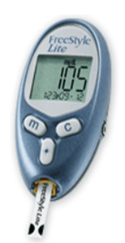
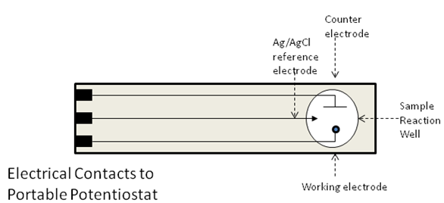
Goal
Fast
Selective
Portable
Cheap
Easy to use
Low detection limits
Glucose sensor
https://www.freestylelite.com

Slide 22
Acknowledgments
Dr. I. Frank Cheng
Simon McAllister
Kenichi Shimizu
University of Idaho Department of Chemistry; faculty, staff and students.
Dr. and Mrs. Renfrew for summer scholar fund

