Slide 1
International Lego Project MAERSK Line Cargo Ship
Members:
Margaret Symmes
Mark Garber
Michael Wanless
Song Ju Kim

Slide 2
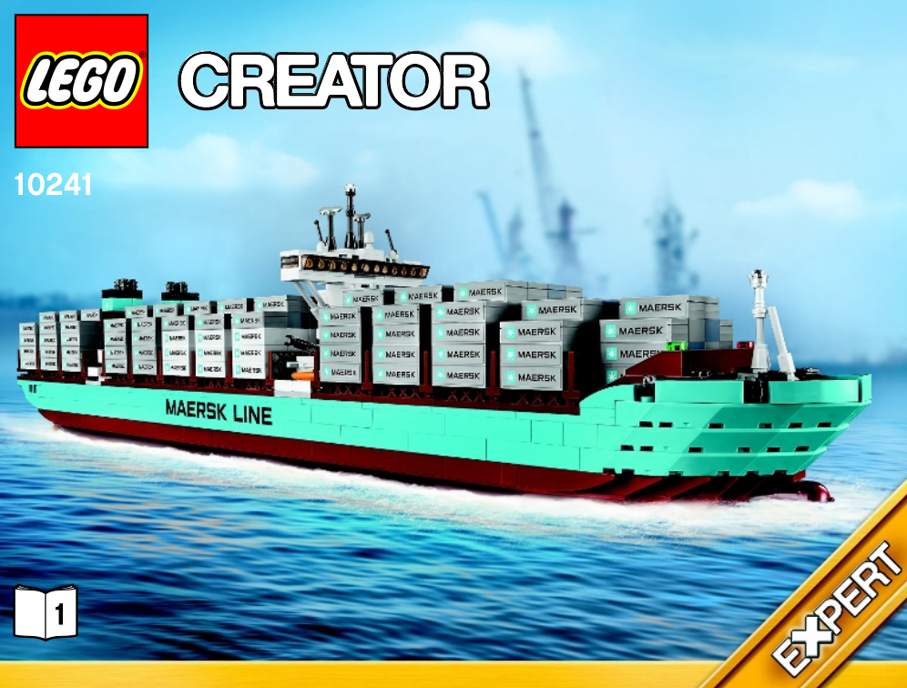
Objective
To create a 3D model of a Lego Cargo Ship in collaboration with a design team in Quebec.

Slide 3
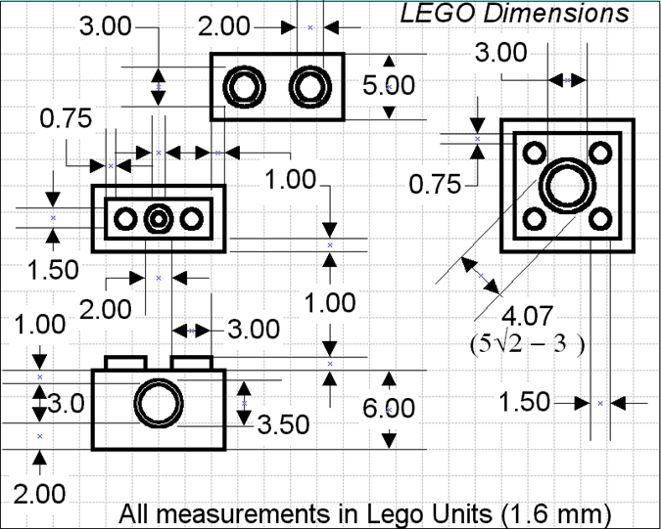
Coordination
A master block and general unit system was used to ensure that parts modeled by all groups were compatible.
Most communication was done by phone and email, and files were shared over Dropbox.

Slide 4
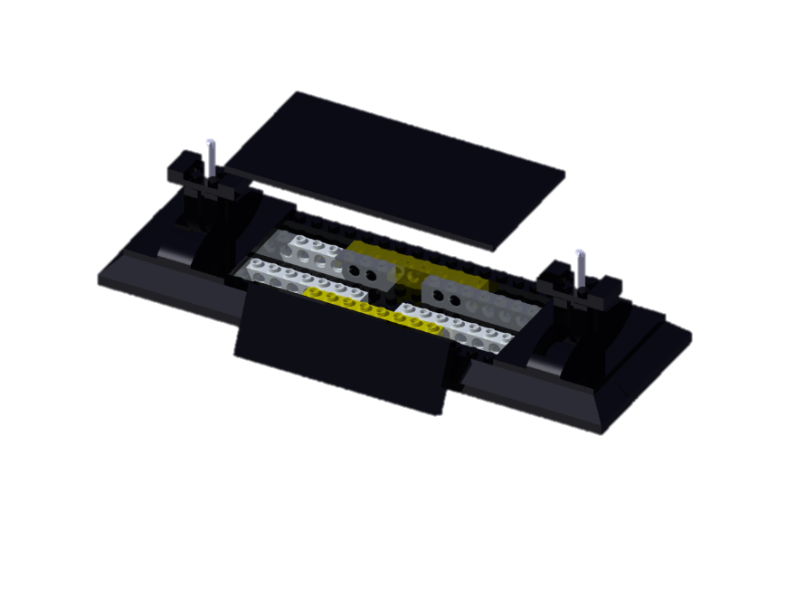
Stand Sub-Assembly
One of two sub-assemblies that the University of Idaho team was responsible for.

Slide 5
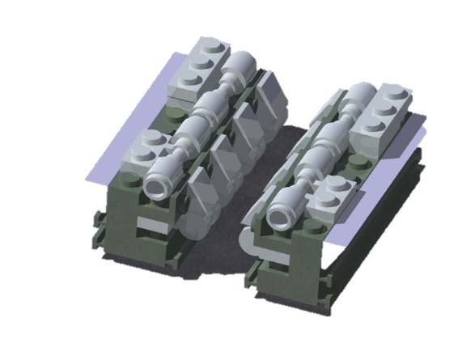
Engine Sub-Assembly
The snap function was used to assemble the parts for sub-assemblies. This simplified the design tree and made editing assemblies much easier.

Slide 6
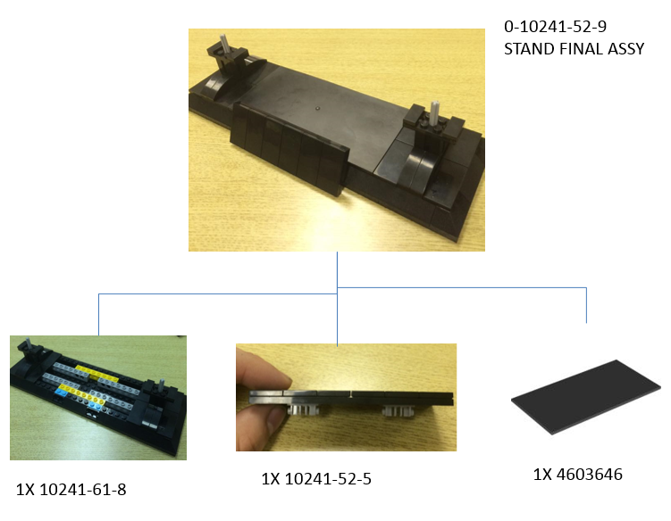
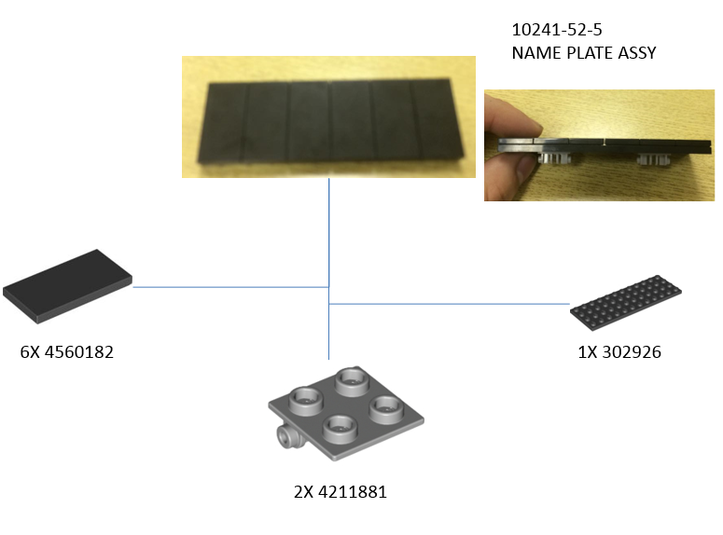
Master Bill of Materials
The assembly references the sub-assemblies that contribute to it by assembly number and quantity.
The sub-assemblies reference the parts that contribute to it by part number and quantity

Slide 7
Final Product

Slide 8
Lessons Learned
Communication in the beginning of the project was important for sharing parts easily.
Using pictures in the MBOM made finding parts easier.
Use of Lego Units made parts more compatible between teams
Use of previously defined colors kept parts compatible between teams

