Slide 1
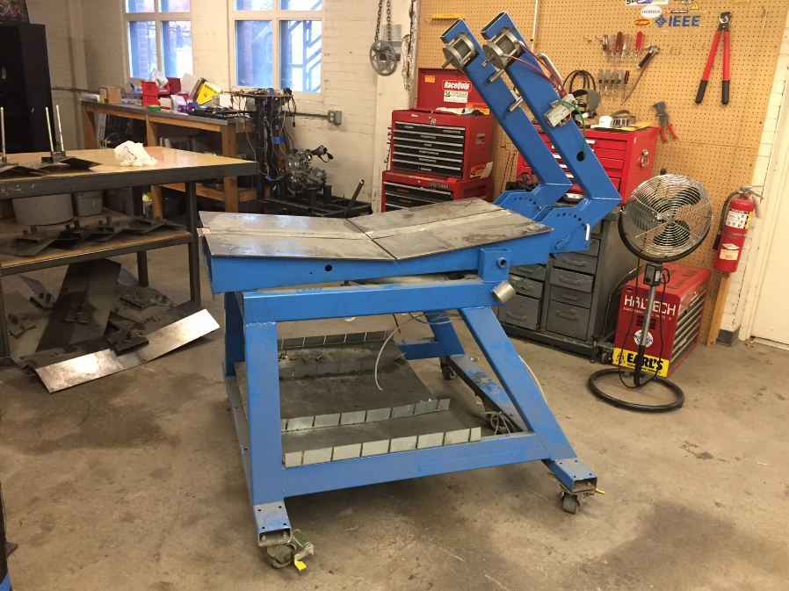
Welding Jig Redesign CATIA Project
Michael Botterbusch
Alex Gomez

Slide 2
Objective
Starting Point
Colmac Coil wants their current welding jig to be redesigned.
They’re looking for a new method of rotation as well as a way of securing the drain pans to the jig.
Project Goals
To make an accurate CATIA model of the exiting welding jig.
To draw up two concepts for the welding jig. One for securing drain pans, and one for the table’s rotation.
Lastly, to generate two FEA projections to analyze the stress at points in the table on both the original and updated concept table.

Slide 3
Modeling the Original Welding Jig
Back Isometric View of Jig
Front Isometric View of Jig
The original jig was created in CATIA first, so that the concepts could then be derived off of the current model.
The base was measured out and drawn first, then table top, then the two arms were attached.

Slide 4
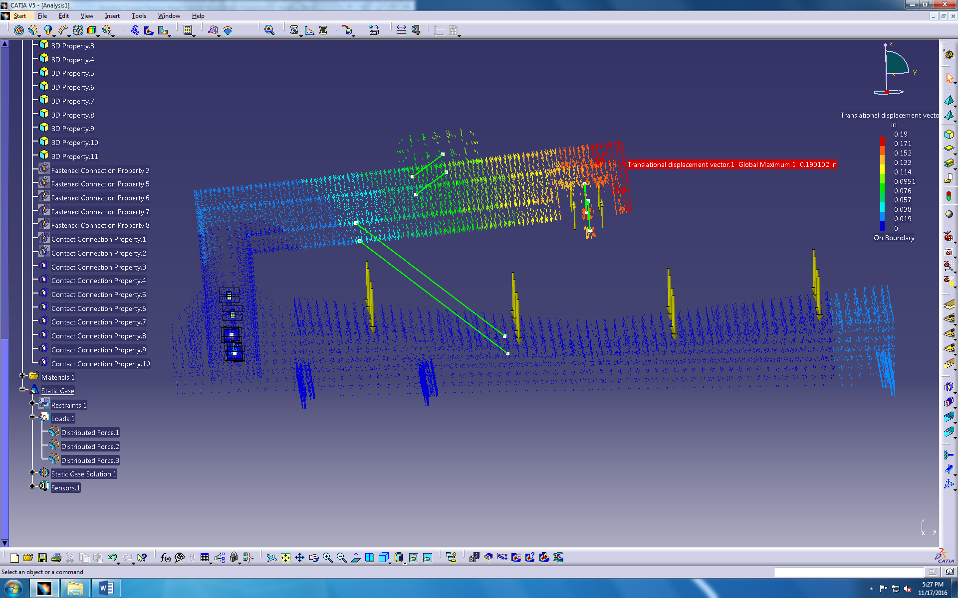
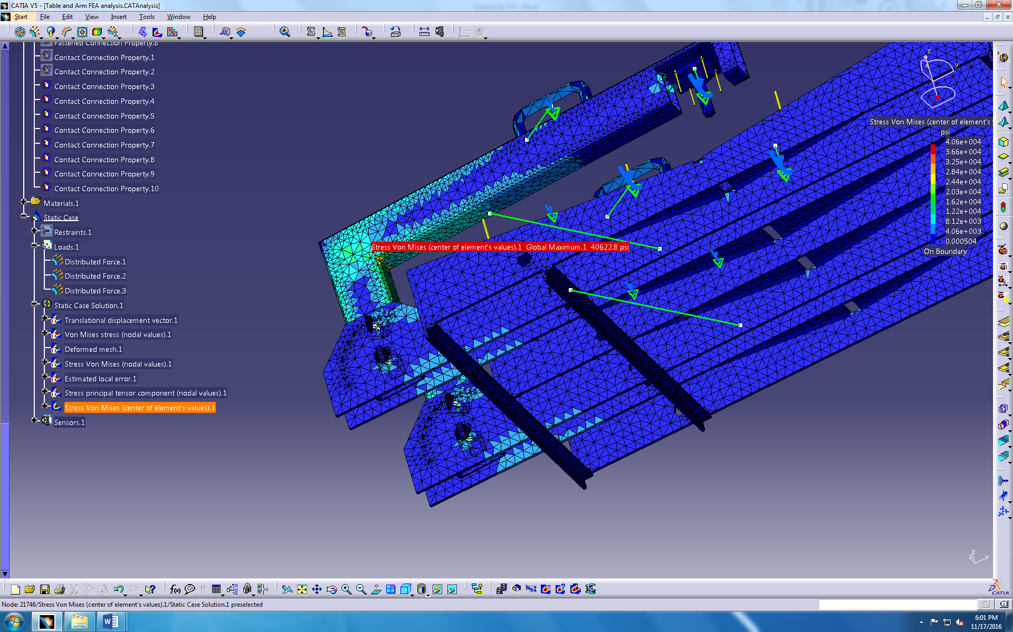
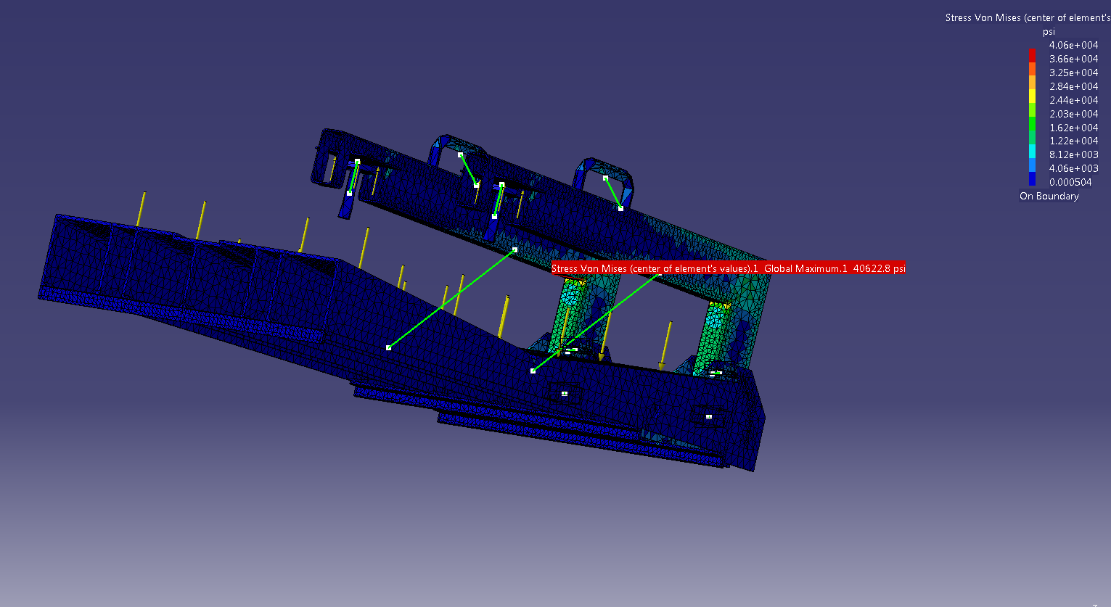
FEA Generated Based Off Original Jig Model
Max displacement of arms are 0.190”
View showing higher stress locations.
Research showed that two 3” air pistons at 100 psi can generate 1400 pounds of force along the table face.
Max Von Mises Stress is 40.6 ksi at inner corner of arm.

Slide 5
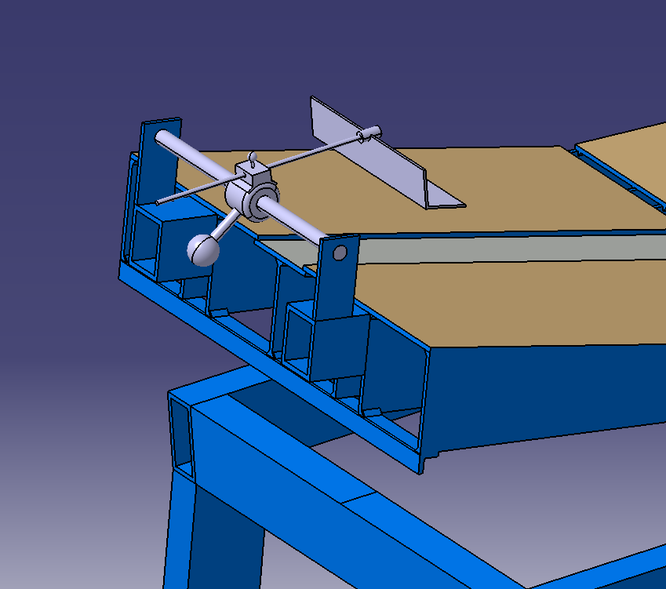
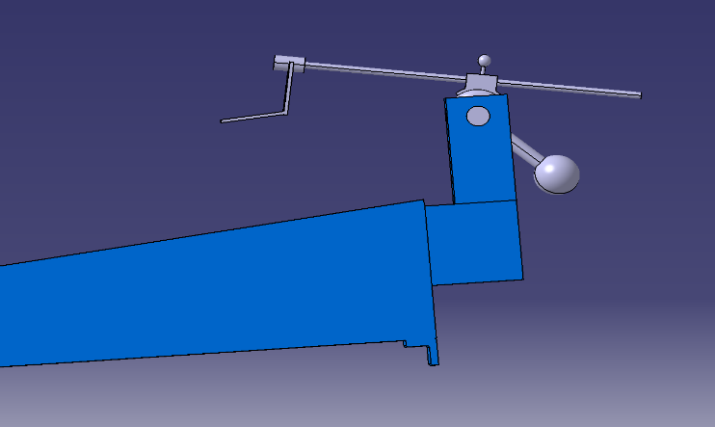
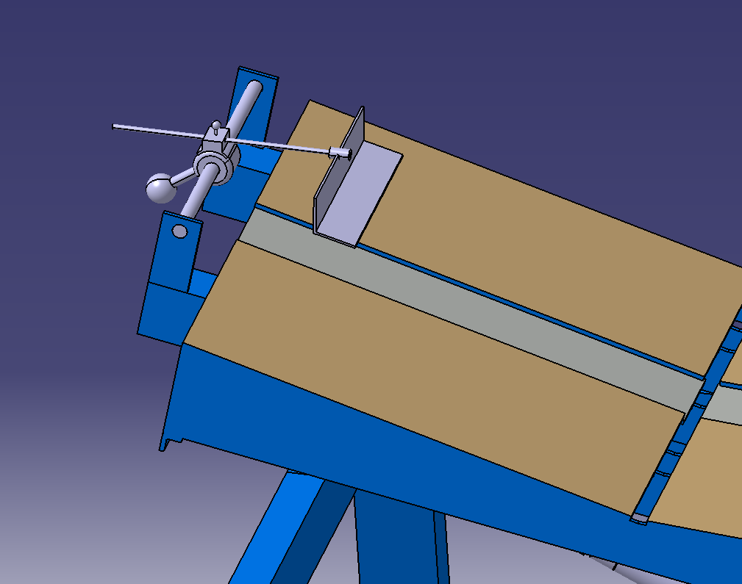
Modeling Concept of Securing on Welding Jig
Different angles of the arm and how it’s fixed to the jig.
The above concept arm moves on three axis, and all three ways of movement can be locked by twisting knobs and holding the arm in place by friction.

Slide 6
Modeling Concept of Rotation of Welding Jig
The images above show how the base of the table is similar to the existing one, but the rotation apparatus is different.
We simulated rollers on the leg bases and added 1000 lbf distributed across the table top.

Slide 7
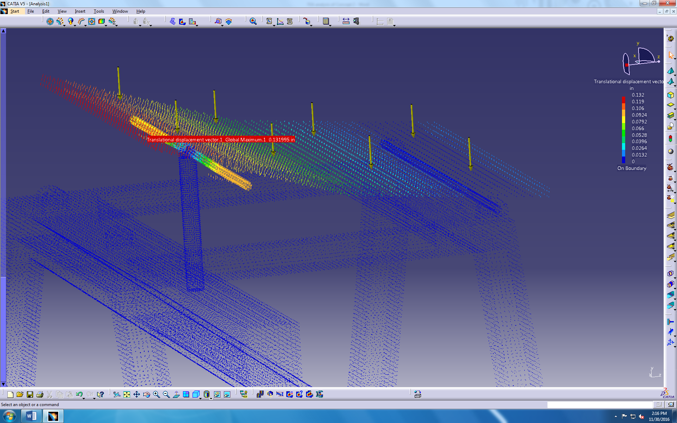
FEA Generated Based Off Concept Jig Model
The maximum displacement at the upper edge of the table is 0.132 in. The displacement in the connecting shaft end is 0.098 in.
By analyzing a larger mount, the max displacement is 0.044 in when 500 lb is applied to the table top.
The max von Mises stress is 2.44x10^6 psi at the top of the support piston.

Slide 8
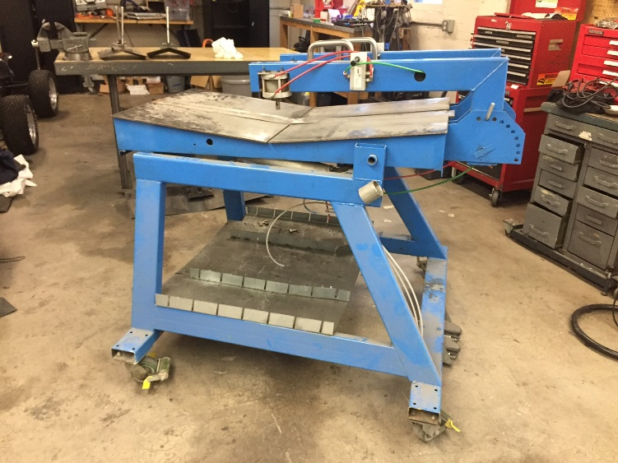
Conclusion
Modeling the original and updated concept jig, then running two FEA tests on them allowed us to visualize the positives and negatives between the two designs.
With the knowledge gained from solid modeling the jig in CATIA, we can now make decisions on how to fabricate changes to the jig in the future.

