Slide 1
Justin Puryear, Adam Niemet ,Evan Bonar
CATIA Lab Monitor Mounts

Slide 2
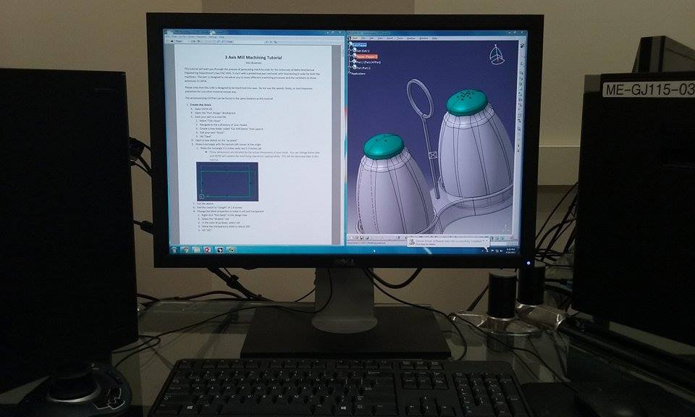
Current Issue
Current monitor is too small for doing split screen work in CATIA.
Desk top is to small for including an additional monitor.

Slide 3
Objective
Create a mounting system for an ultra wide monitor.
Create mounting below desk top for computer.
Be as cost effective as possible, stay under $300 per desk.

Slide 4
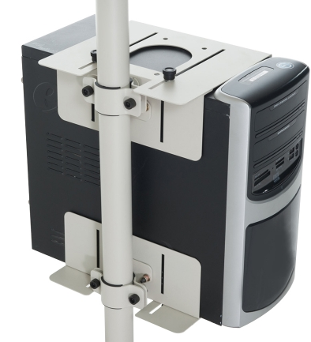
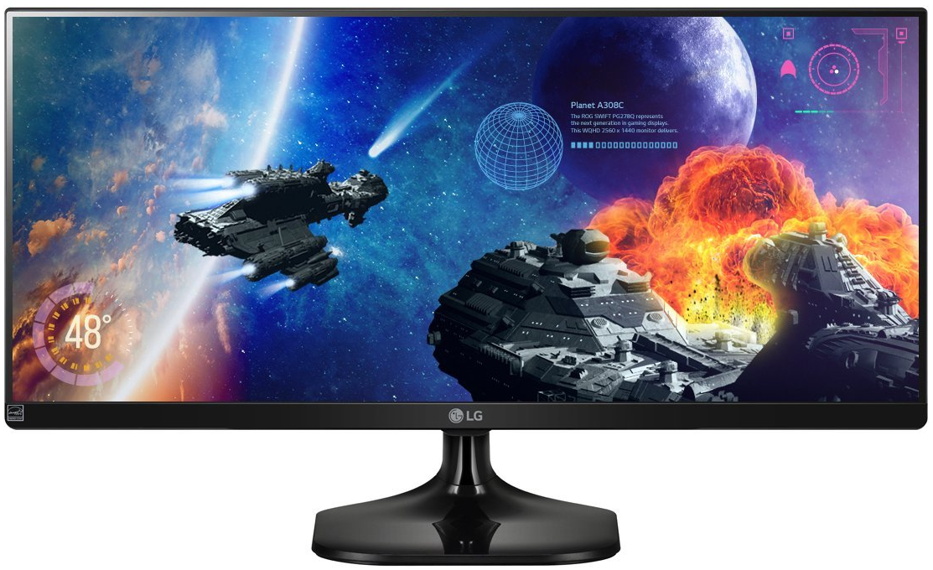
Materials Required for Solution
Monitor Mount System
Computer Mount System
Minor modifications necessary
Commercially available parts, no fabrication needed.

Slide 5
Proposed Solution
Commercially available parts used for monitor mounts are: Kee Klamp 262 flange, grommet style monitor arm, and an ultrawide monitor.

Slide 6
Proposed Solution
Computer tower holders utilize a commercially available mount. Minor modifications are necessary to relocate pole clamps.

Slide 7
Room Layout

