Slide 1
Hawk 40 Glow Plug Engine
Team Members
Nikki Imanaka
David Severud
Braden Sprenger

Slide 2
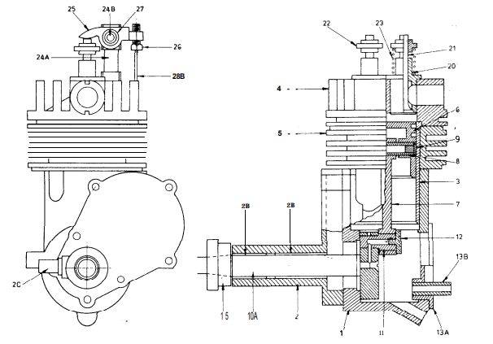
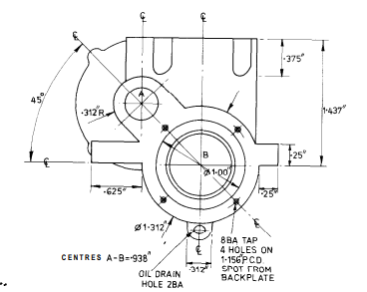
Objectives
Recreate Hawk 40 Engine from drawing package in Catia
Document design assumptions and changes made for use by ME 301

Slide 3
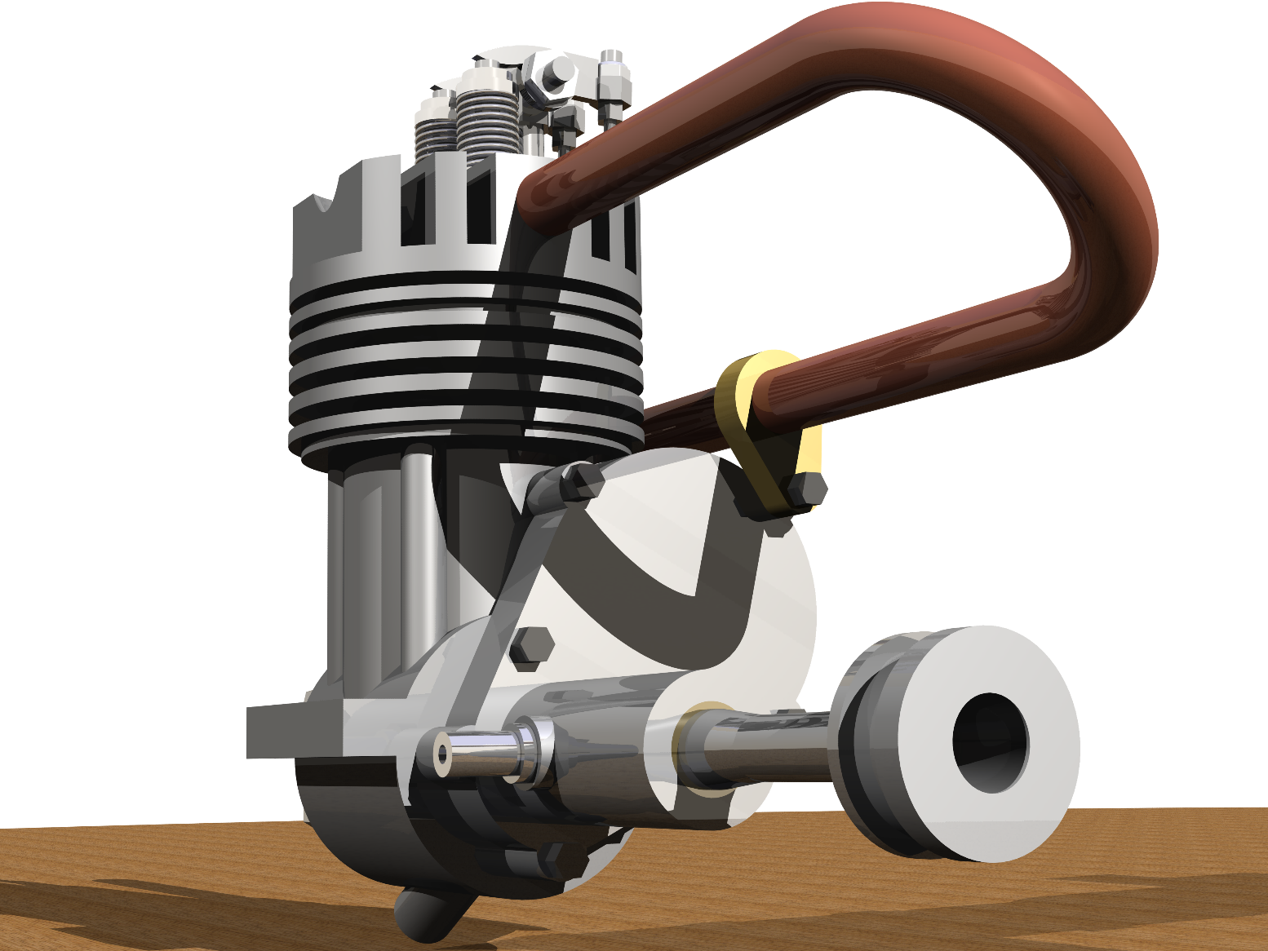
Hawk 40 Full Assembly Front
The Hawk 40 Engine can be used in either an aircraft, or an boat.
Is either air cooled or water cooled.

Slide 4
Rocker Assembly
The Rocker unit transfer’s motion from the Camshaft to the valves.
The Rocker unit is made from silver steel.

Slide 5
Piston Assembly
Inside the piston unit is where the combustion occurs.
The combustion forces the piston to move, rotating the crankshaft.

Slide 6
Crankcase
Casted in a steel mold.
Houses crankshaft, camshaft, and cylinder liner.

Slide 7
Hawk 40 Full Assembly Back
This engine uses BA threads (British Association) throughout.
This engine was developed in the 1940’s

