Slide 1
Project Management

Slide 2
Main Phases of Project Development
Notes:
Start with the End in mind.

Slide 3
Project Management Tools
Team contract
Mission/vision/goal statements
Timeline/Schedule
Project status reports
Action Item list
Meetings
Team Assignment, Client Interviews, and Engineering Requirements

Slide 4
Project Schedule - Activity
Identify all of the tasks required for a person to get ready for work in the morning
Estimate the duration of each task
Order the tasks in a logical sequence
How long will the whole procedure take?
If you had another person to help you, which tasks could they do?
Re-sequence (with assistance in parallel)
Now, how long will it take?

Slide 5
Project Schedule – Gantt Chart
Spreadsheet:
or Microsoft Project:

Slide 6
Scheduling Considerations
Capture Events/Milestones (fixed dates):
Client meeting(s)
Due dates (Wikipage, log book, Citizenship etc..)
Snapshot Days
Design Reviews
Also:
Keep some margin for error.
Account for holidays, busy times, and other commitments
What needs to be done before each milestone?
Notes:
Keep some margin for error.

Slide 7
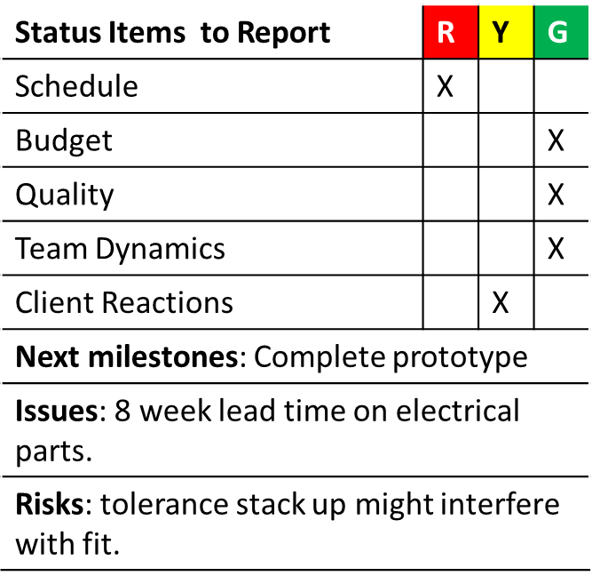
Project Tracking - Approaches
Status toward Schedule: Dashboard:
When the schedule changes – Change the schedule.

Slide 8
Action Item List
All members must agree and understand actions
Allocate action items equitably
Must include:
Owner
Target Date
Completion Date
Review and update at team meetings
Action Register
# Task | Owner | Action Item | Owner(s) | Target date | Completion date | Comment

