Slide 1
Logbook expectations
Me 201/401
Presented by:
Colin Parke

Slide 2
Outline
Requirements
How to Use a Logbook
General Expectations
Grading Sheets
Logbook Examples

Slide 3
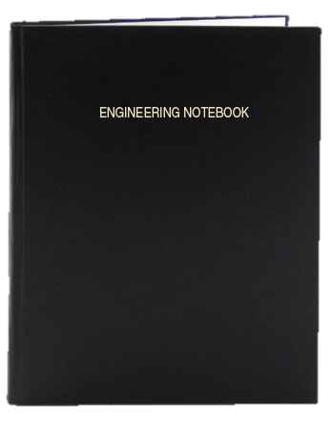
Requirements
Bound (Preferably not Spiral)
Include Name and Phone Number on Inner Cover
MUST include Table of Contents
Possible Topics
Background research/learning
How-to’s for projects being worked on
Test Setup/Results
Drawings/Pre-CAD for different manufactured parts
Meeting notes

Slide 4
How to Use a Logbook
Purpose
Allow self-reference to remember critical designs/decisions
Pass knowledge to later projects
Avoid wasting time by repeating what others have already done and documented
Give yourself plenty to write about on your resume

Slide 5
How to Use a Logbook
Table of Contents
Entry Requirements
A descriptive title for each entry
The pages of the entry
The date the entry was made
Tips
Use keywords at the beginning of entries to help stay organized
Use highlighter to organize by project

Slide 6
How to Use a Logbook
Content Requirements (Varies per Entry)
Goal: What are you trying to do, why are you trying to do it?
~1-2 lines, nothing crazy
Setup (for testing/manufacturing): How is everything organized
~1-4 lines
Main Points: Describe the what and how
Bulk of page
Questions: What do you need to know for next time?
Review/Closing Thoughts: Where will you start again later? Was their anything peculiar you need to look more into?

Slide 7
How to use a logbook
Tips/Tricks
Always have it on you!! You can’t record anything if you don’t have it
Make a list of questions you may need help answering
Record action items at meetings so you remember what to do
ONE ENTRY PER PAGE
Print out things and tape them in instead of drawing
Get a logbook with page numbers already included
Include references, part no., drawings, etc.

Slide 8
General Expectations
Expected to have AT LEAST 2 entries per week
Entries don’t always have to be full-fledged, thorough pages. The logbook is generally for YOU
Include various types of entries: i.e. project management, testing, design, etc.
Logbook Check Dates:
September 24 November 5

Slide 9
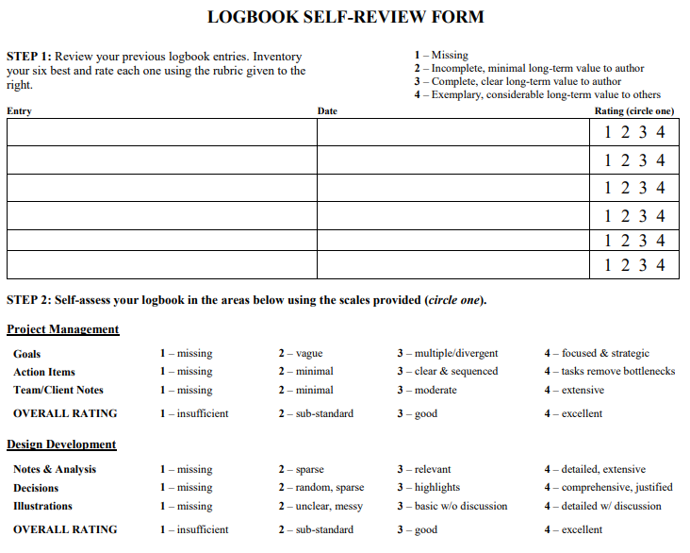
Grading Sheets
Self-Review/Assessment Form
Location
http://www.webpages.uidaho.edu/mindworks/Competition/Resources/M201-401%20Logbook%20Review%20Form.pdf
Purpose
Used as a self-evaluation tool to see how good you think you’re doing
COMPLETE BEFORE SUBMITTING LOGBOOK FOR GRADING

Slide 10
Grading Sheets
Grading Form (Used for ME 424/426)
Location
http://www.webpages.uidaho.edu/mindworks/Capstone%20Design/Assessment%20Tools/Instructor%20Logbook%20Form%20Template%20web.pdf
Purpose
To ensure people are using their logbooks
Make sure entries are meeting basic criteria
Determine ways to improve logbook skills for classes that matter

Slide 11
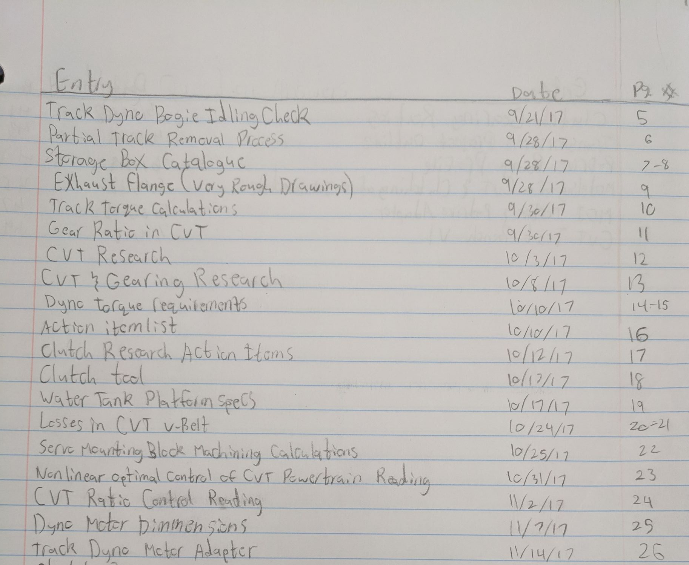
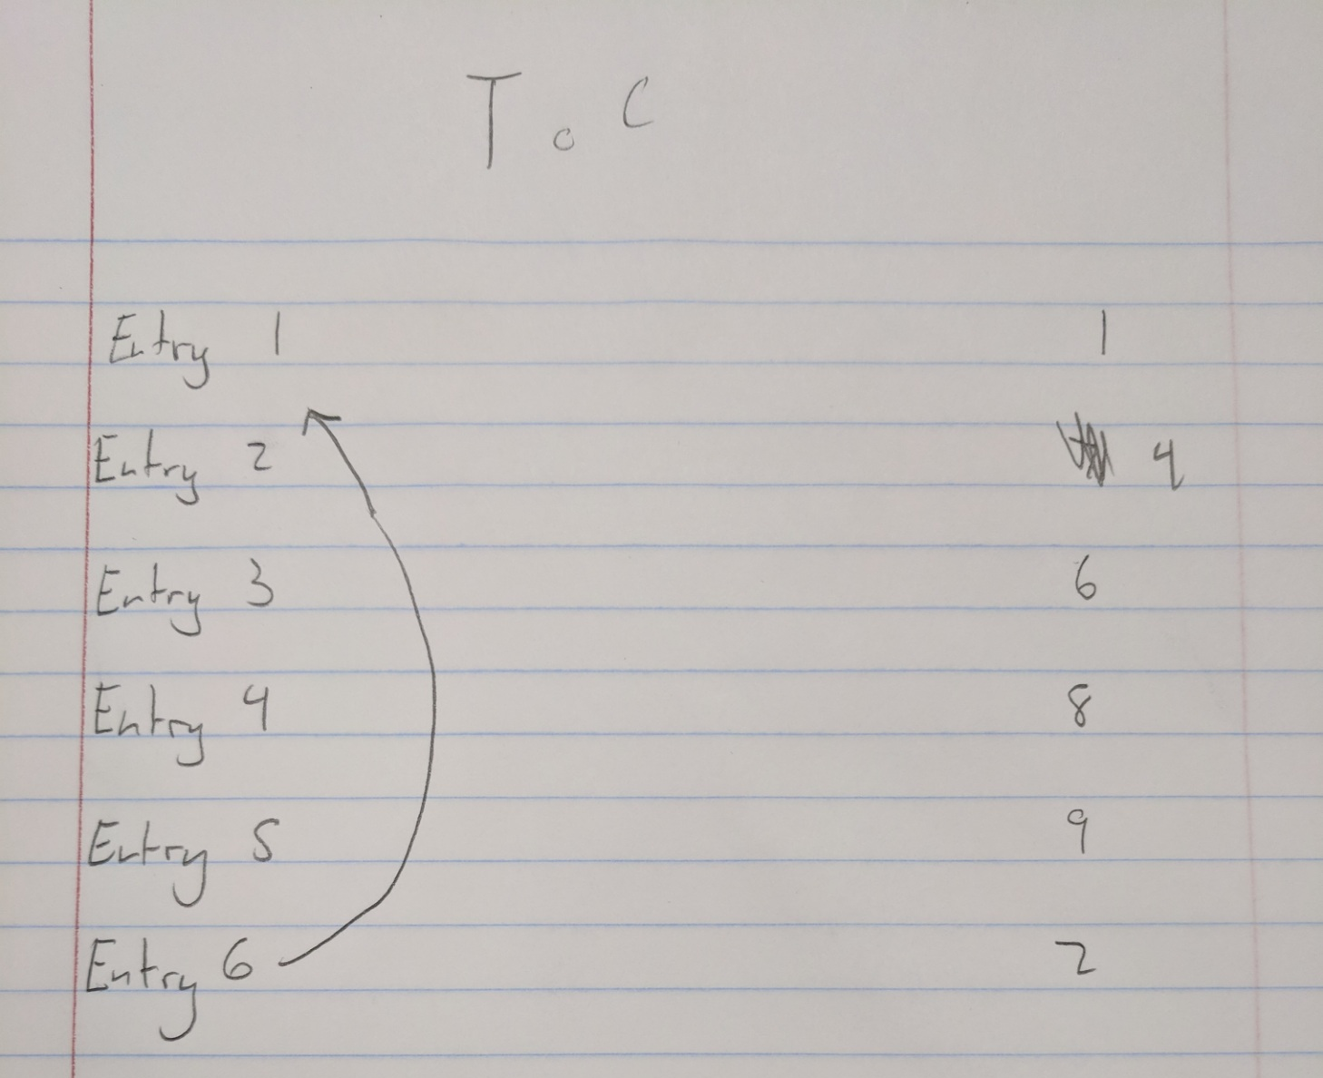
Logbook Examples
Table of Contents
The Good
The Bad

Slide 12
Logbook examples
Table of Contents
…AND THE UGLY

Slide 13
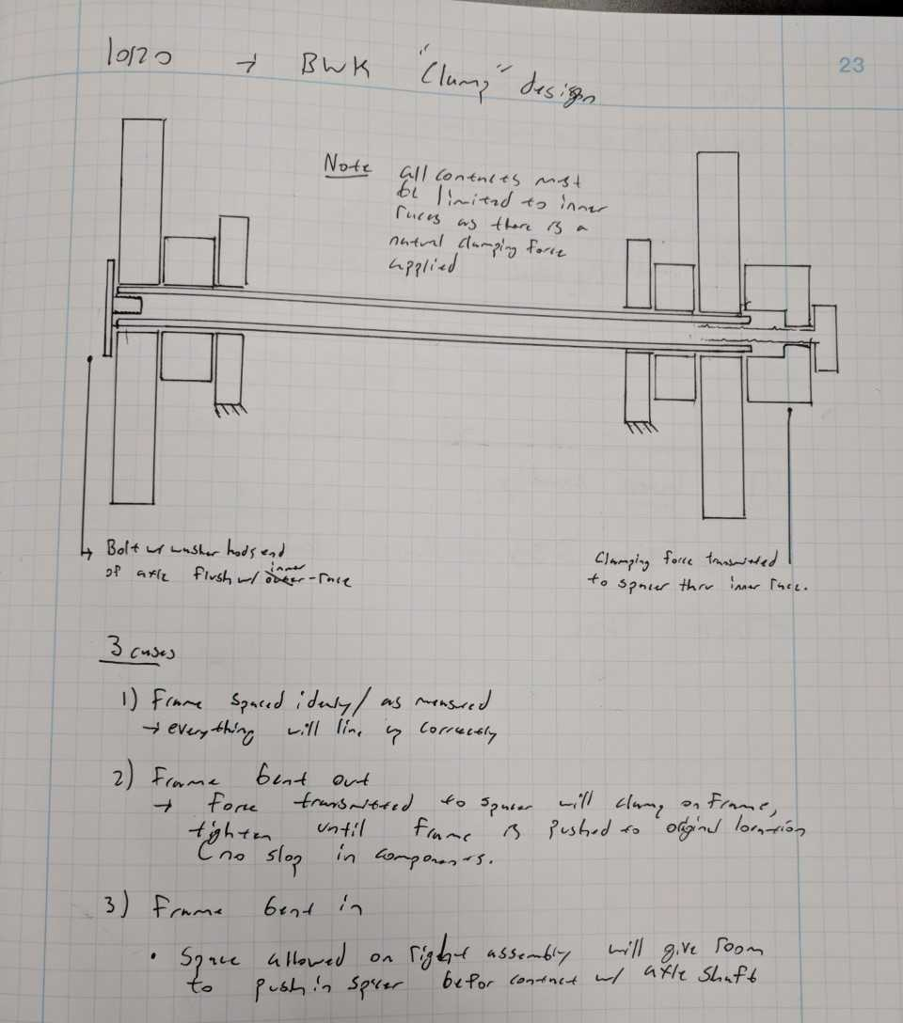
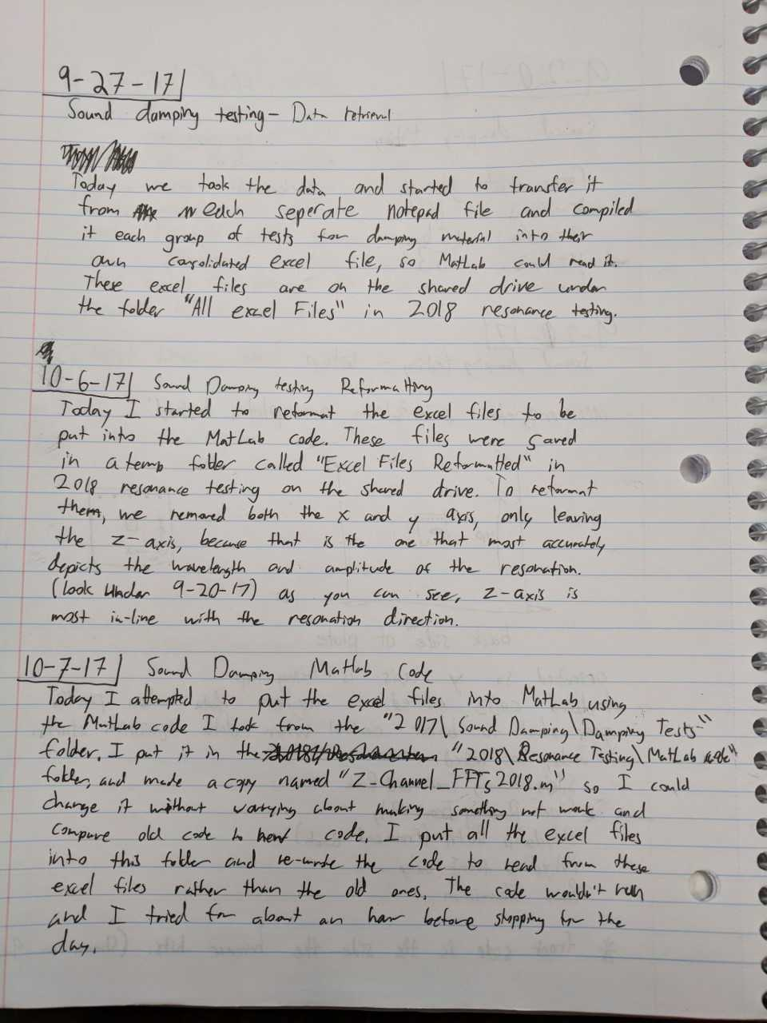
Logbook Examples
Entries
The Good
The Bad

Slide 14
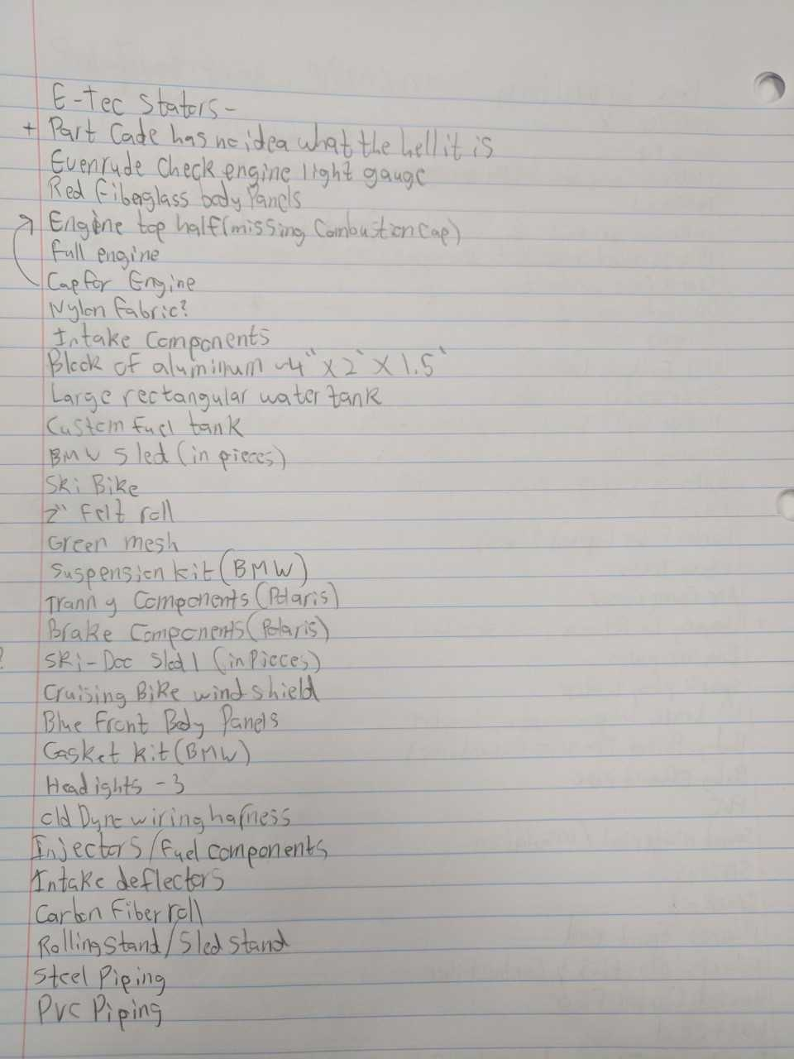
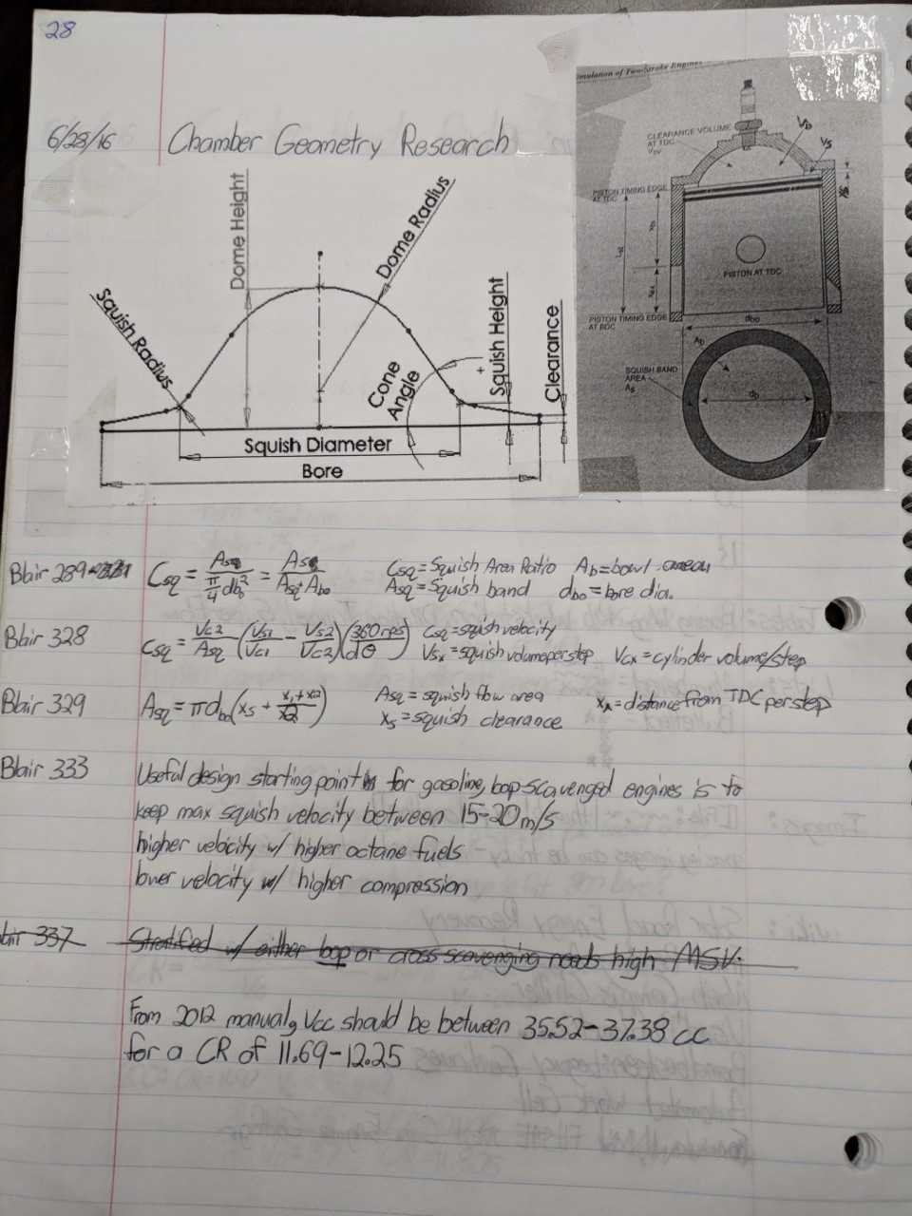
Logbook examples
Entries
The Good
The Bad

