Slide 1
Snapshot posters
By: Zach Lipple

Slide 2
Overview
What is Snapshot?
What’s needed for Snapshot?
Good/Bad Snapshot Examples
Action Items for You!

Slide 3
What is Snapshot
A way for various senior design projects (and us) to show other students and industry professionals their project
An update on project progress and general deliverables
Future goals of project and gantt chart showing expected progress
All in Preparation for…

Slide 4
What’s needed for snapshot
Senior Design
A full poster covering all scopes of the project
Who, What, When, and How!
Sled Team Groups
1-2 pages of what the project is and where it will be for comp
Pictures that help explain the project
What and How!!

Slide 5
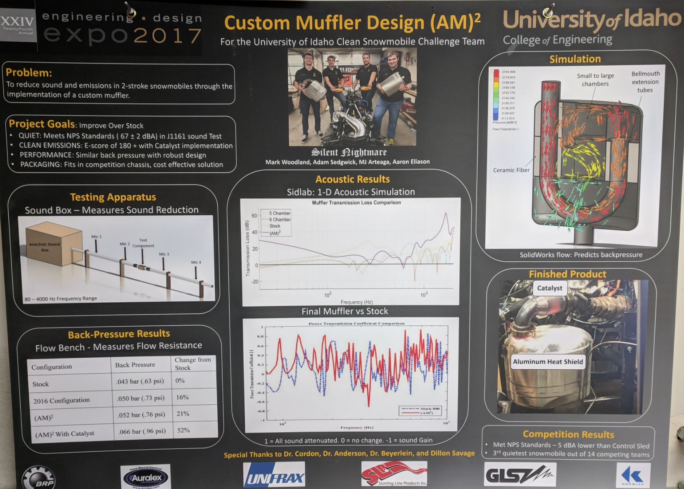
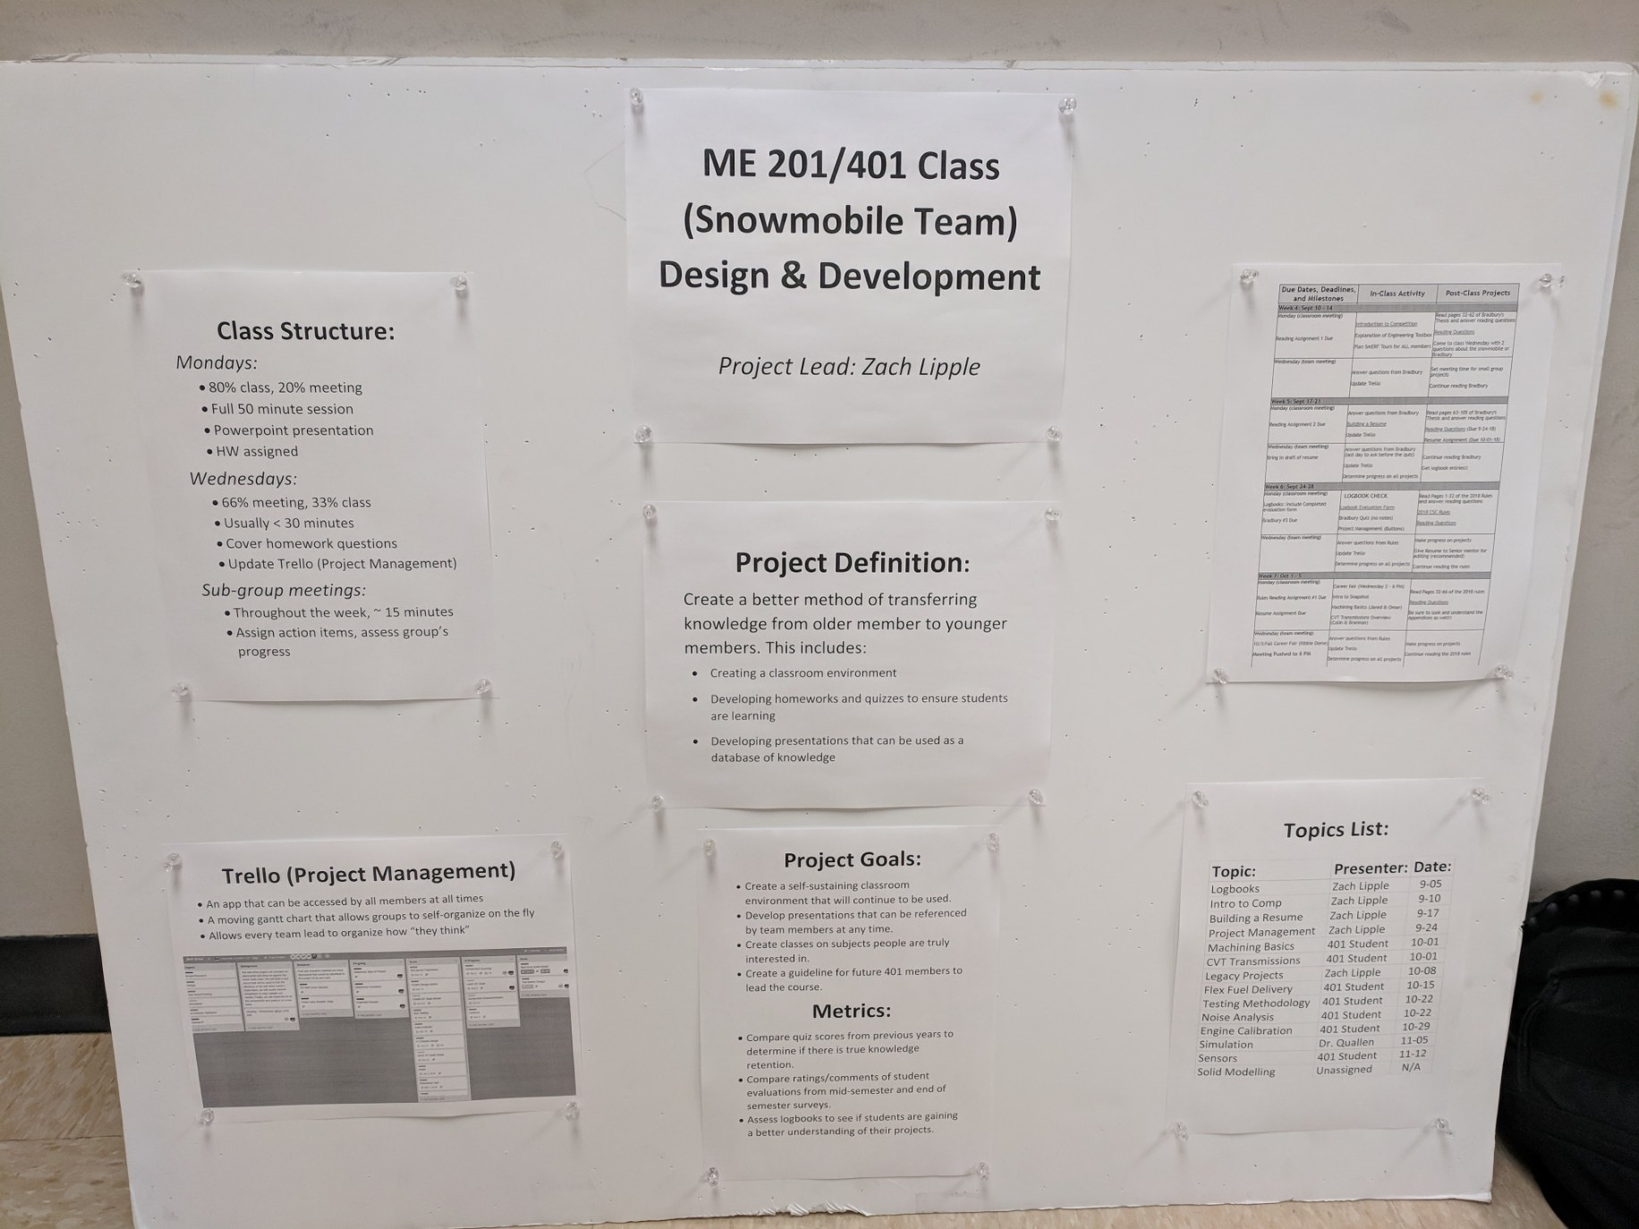
Good/Bad Snapshot Examples
Full Posters
Which of these posters is better for snapshot?

Slide 6
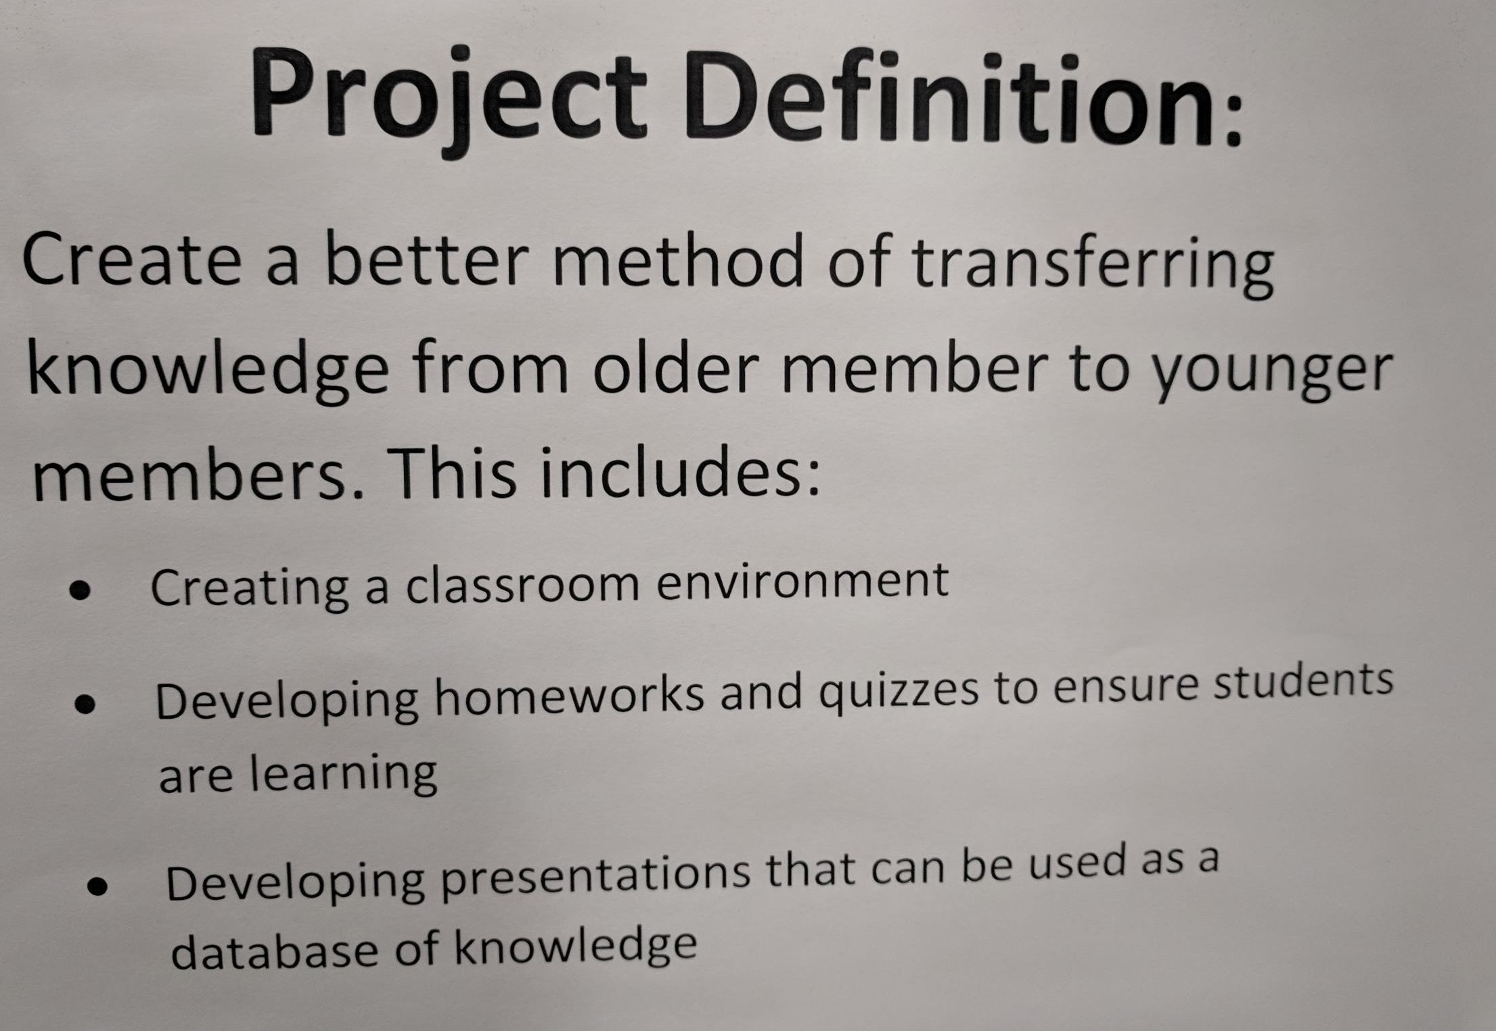
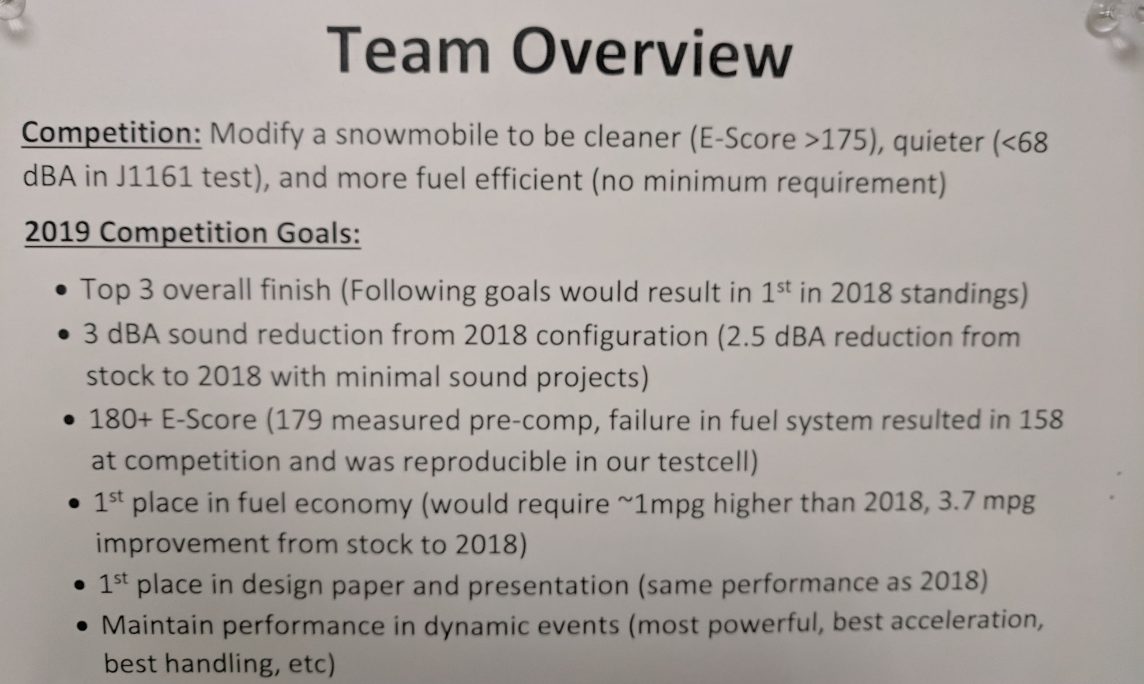
Good/Bad Snapshot Examples
Poster Sections
Which of these is a better section description for snapshot?

Slide 7
Action Items for You!
Sub-Groups
Create a GOOD 1-2 page summary of your project including a photo or 2
Have this put on the Mindworks desk BY 12 PM ON TUESDAY 10-09-18
Run by the project leads before printing and submitting
Team Lead (Sorry Kiss…)
Place all sub-group projects on poster
Include info about timeline, budget, the competition, etc.

Slide 8
Questions?

