Slide 1
ME 345 Heat Transfer (HTx)
Professor:
Dr. Dan Cordon (AKA Dr. Dan)

Slide 2
Solving Thermal Resistance Problems
Draw the thermal circuit
Use appropriate equation for thermal resistance
Geometry
Conduction/Convection/Radiation
Identify which variables are known and unknown
Choose your solution approach (calculator and hand calculations vs. software)

Slide 3
Textbook Problem 3.3
A 4mm thick front window of a car is defrosted by passing warm (dry) air over the inner surface.
If the inside air is 40 [°C] with convection coefficient of 30 [W/m²K] and the outside air is -10 [°C] with convection coefficient of 65 [W/m²K] – calculate the inside and outside surface temperature of the glass
Is this enough to keep ice from forming on the outside of the glass?

Slide 4
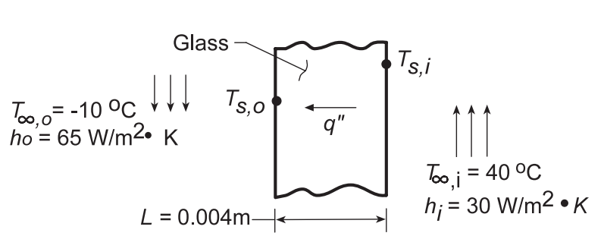
Textbook Problem 3.3
Assumptions:
1D SS conduction through the window
Material properties not changing with temperature
Radiation HTx is negligible
Known

Slide 5
Textbook Problem 3.3
Use equations 3.11 and 3.12
Look up thermal conductivity for glass Table A-3, glass at 300 [K], k = 1.4 [W/m-K]
Heat flux (because area unknown) can be expressed by:

Slide 6
Textbook Problem 3.3
With known heat flux, can evaluate temperature drop across each resistance
At the inner surface
At the outer surface

Slide 7
Textbook Problem 3.4
Similar problem as 3.3, except now a film heater is applied to inside surface of the window.
If the inside air is 25 [°C] with convection coefficient of 10 [W/m²K] and the outside air is -10 [°C] with convection coefficient of 65 [W/m²K]. Want to maintain inner glass temperature of 15 [°C].
Calculate the heater power required per unit area

Slide 8
Textbook Problem 3.4
Assumptions:
1D SS conduction through the window
Material properties not changing with temperature
Radiation HTx is negligible
Film heater is thin and highly-conductive (negligible thermal resistance)

Slide 9
Textbook Problem 3.4
Energy balance (flux) at the inner surface of the window
Solving for heater heat flux:

Slide 10
Textbook Problem 3.12
Thermopane window on a house is made of two pieces of 7 [mm] thick glass with a 7 [mm] thick air space between them.
The inside and outside temperatures are 20 [°C] and -10 [°C]. The interior convection coefficient is 10 [W/m²K], while the outer is 80 [W/m²K].
Calculate the heat loss rate through a window that is 0.8 [m] tall and 0.5 [m] wide.
Repeat for a triple pane style window

Slide 11
Textbook Problem 3.12
Assumptions:
1D SS conduction through the window
Material properties not changing with temperature
Radiation HTx is negligible
Air in gap is stagnant
Known

Slide 12
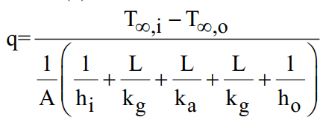
Textbook Problem 3.12
Use equations 3.11 and 3.12
Look up thermal conductivities Table A-3, glass at 300 [K], k = 1.4 [W/m-K]
Table A-4, air at 278 [K], k = 0.0245 [W/m-K]

Slide 13
Textbook Problem 3.12
For the triple pane, total thermal resistance increases to 1.749 [K/W], and the heat loss drops to 17.2 [W]

Slide 14
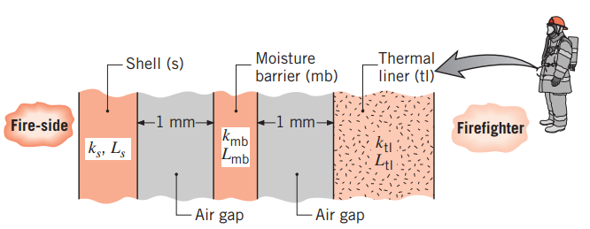
Textbook Problem 3.24
Firefighter protective turnout coat is typically made of three layers with air gap between each layer. Create the thermal circuit for this boat.
Note: Since radiation heat transfer is significant, include these terms in your thermal circuit.

Slide 15
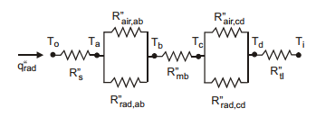
Textbook Problem 3.24

Slide 16
Textbook Problem 3.24
Some interesting approximations for the radiation thermal resistance
This was used to make the calculations easier, and comes from assuming epsilon = 1 (worst-case that would represent maximum heat transferred through radiation)
The radiation thermal resistance can be modeled as

Slide 17
Textbook Problem 3.46
A cylindrical water heater (100 gallon) uses urethane foam insulation around the outside. The water inside is 55 [°C] and the air temperature outside the heater is 20 [°C]. The convection coefficient between the air and tank is 2 [W/m²K] (low because it is only from natural convection).
If electrical power costs $0.18 / kW-hr, specify dimensions for both the tank *and* insulation so that the annual cost of heat loss from the heater is less than $50.

Slide 18
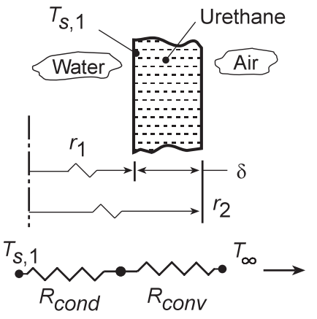
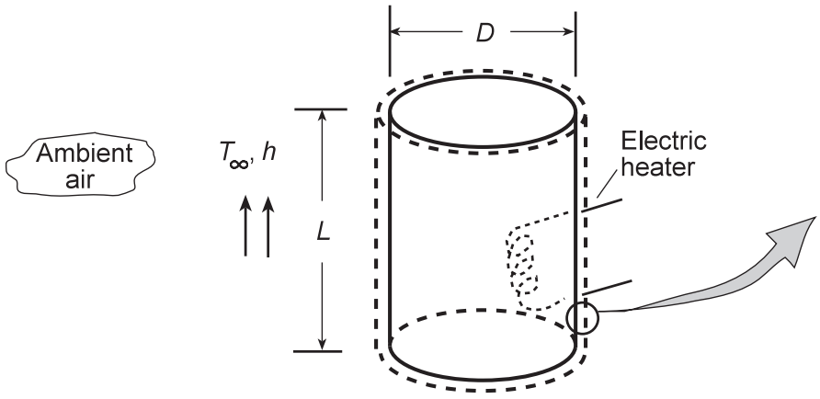
Textbook Problem 3.46
Assumptions:
1D SS conduction
Inner surface temperature is nearly the same as water temperature (metal tank)
Neglect radiation (foil covering on insulation)
Constant properties

Slide 19
Textbook Problem 3.46
Look up thermal conductivity Table A-3, urethane foam at 300 [K], k = 0.026 [W/m-K]
To minimize heat loss we should minimize the surface area.
When the height is defined by:
$$L=\frac{4∗Vol}{{πD}^{2}}$$
Surface area of the cylinder is:
$A_{sur}=πDL+2\left(\frac{πD^{2}}{4}\right)$→ $\frac{4∗Vol}{D}+\frac{πD^{2}}{2}$

Slide 20
Textbook Problem 3.46
Minimize A_{sur} by taking derivative with respect to diameter and setting equal to zero
$$\frac{dA_{sur}}{dD}=\frac{−4∗Vol}{D^{2}}+πD=0$$
We get
$$D={\left(\frac{4∗Vol}{π}\right)}^{1/3} and L={\left(\frac{4∗Vol}{π}\right)}^{1/3}$$
Since the tank is 100 gallons = 0.379 m³ we get:
D = L = 0.784 [m]

Slide 21
Textbook Problem 3.46
Now that we have the dimensions we need to calculate the maximum allowable heat rate
$$Q_{annual}=\frac{50\left[dollars\right]}{0.18\left[\frac{dollars}{kW∗hr}\right] }=278 \left[kW∗hr\right]$$
$$q_{annual}= \frac{Q_{annual}}{hours in a year}=31.7 [W]$$

Slide 22
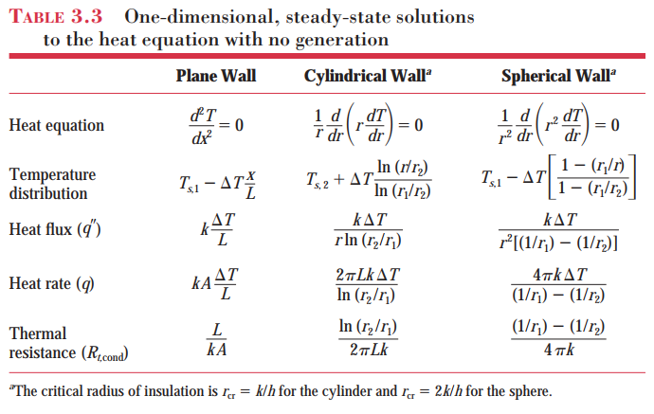
BIG 1D SS THERMAL RESISTANCE SUMMARY

Slide 23
Textbook Problem 3.46
Heat loss through the side and ends is
Cylinder wall
Round ends
Conduction
Conduction
Convection
Convection

Slide 24
Textbook Problem 3.46
Solve for delta (insulation thickness) to get

Slide 25
Textbook Problem 3.46
Real-world reality check
Water heaters are almost never built with L = D (stress analysis dictates this). Looking up some common dimensions for a 100 gallon water heater
D ~ 0.623 [m], and L ~ 1.245 [m]
Using same thickness for insulation and solving for rate of heat loss we get:
q = 34 [W], and Annual Cost = $53.62

Slide 26
Textbook Problem 3.46
Are you bored? Run this same calculation for a spherical water heater.
Benefit: Lower surface to volume ratio
Any downsides?

