Slide 1
ME 345 Heat Transfer (HTx)
Professor:
Dr. Dan Cordon (AKA Dr. Dan)

Slide 2
EXTENDED SURFACES
Extended surfaces can be used when trying to add/remove heat from a solid that has high thermal conductivity.
Heat is removed from a small area (electronics or otherwise) via conduction, then at the surface of the solid all the heat must be removed by convection and radiation.
Previously the direction of heat flow for conduction and convection was the same, but with extended surfaces the heat flow for convection is often perpendicular to the heat flow from conduction.

Slide 3
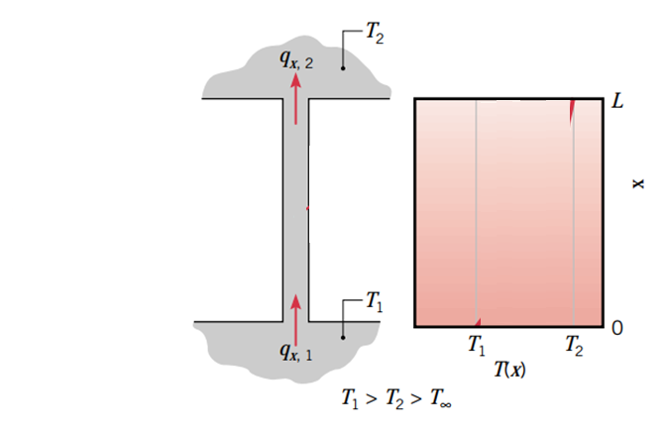
EXTENDED SURFACES
Consider the figure:
One wall at T₁
One wall at T₂
Heat flows through strut without convection
Thermal resistance model would tell us the temperature gradient is constant
Straight line between T₁ and T₂
Heat flow entering bottom will be the same as heat flow leaving the top
q_{x,1} = q_{x,2}

Slide 4
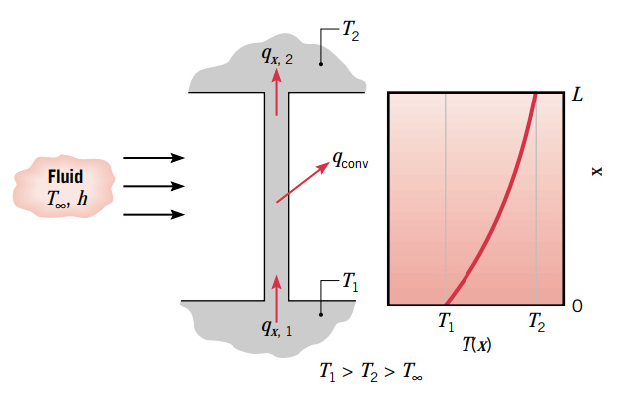
EXTENDED SURFACES
Same as previous slide, but adding convection across the vertical strut
Heat flow at bottom will *not* be the same as heat flow at the top (q_{x,1} ≠ q_{x,2})
This causes grad(T) to change over length of strut
The heat flux leaving via convection is not going to be constant over the whole length L.
If T∞ is low enough (lower than T₂), and either h or A are large enough it could even get to a point where the heat flux of conduction at to top wall changes direction!

Slide 5
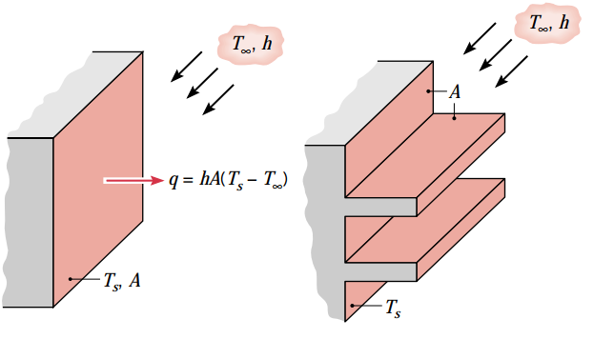
EXTENDED SURFACES - FINS
If the purpose is to increase heat transfer from a surface → a fin is one way to do this
Various ways to increase heat transfer include:
Increasing temperature difference (T∞ lower)
Increasing h (higher velocity, possibly more turbulence)
Increasing h (different fluid)
Increasing h (phase change)
Increasing A (add fins!)

Slide 6
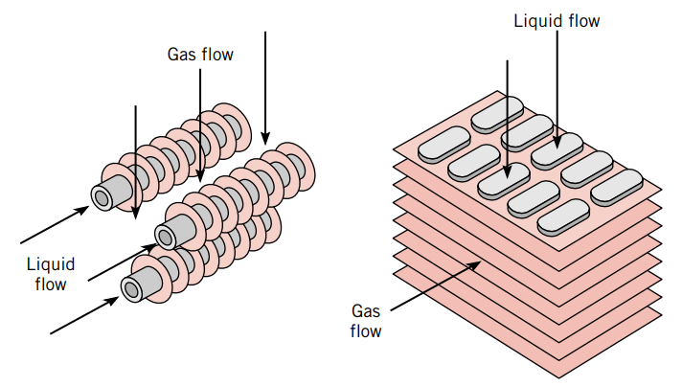
FIN EXAMPLES
Fins should be made of material with high thermal conductivity with minimal contact resistance with the heat source.

Slide 7
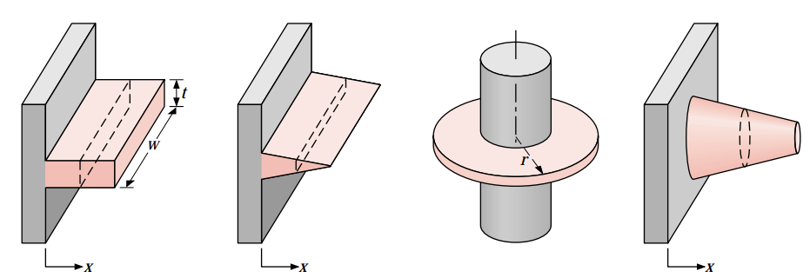
FIN CONFIGURATIONS
Straight fins, uniform cross section
Straight fin, non-uniform cross section
Annular fin (can be uniform or not)
Pin fin (can be uniform or not)
If we want to calculate the heat transfer rate we need to know the temperature distribution throughout the fin.

Slide 8
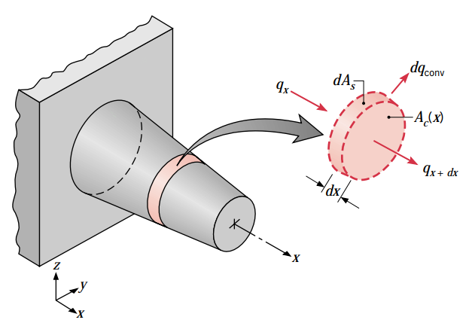
FIN ENERGY BALANCE
Assumptions
1D heat transfer (even though this is clearly 2D) x-direction
Net rate of energy leaving surface must equal net rate of energy coming in via conduction.
Fin is thin, thus temperature change in transverse (z or y in figure above) direction is small (think “Biot number”). This means we can assume temperature is uniform across a slice of fin (only a function of x in above diagram)
Steady-state with constant thermal conductivity
Radiation HTx is negligible (it will only help)

Slide 9
HEAT EQUATION FOR FIN
By performing the energy balance equation and replacing terms with relationships for conduction and convection we get:
2nd order 1D (x-only) equation. Need 2 boundary conditions to solve.
Surface area
Cross-sectional area

Slide 10
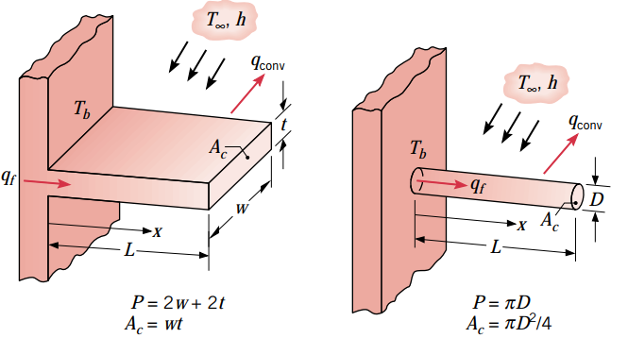
HEAT EQUATION FOR UNIFORM FIN
If fin maintains uniform cross section the equation simplifies a little.
A_{c} is constant
A_{s} is Px where x is distance from base of fin to x and P is the fin perimeter
Simplified derivatives:
becomes

Slide 11
HEAT EQUATION FOR UNIFORM FIN
Define new variables for substitution:
Governing equation becomes:
Linear, homogeneous 2nd order where general solution has the form:
How we solve depends on our assumptions about the tip of the fin (minor changes to solution)

Slide 12
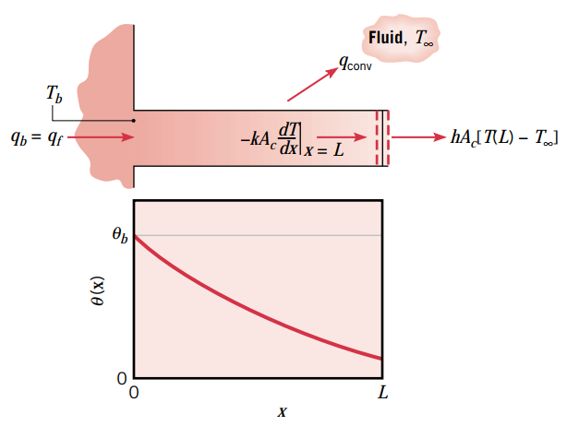
TIP CONDITIONS – CASE A
Energy balance at tip → All energy entering last differential element leaves via convection at the tip.
B.O.C.
and

Slide 13
TIP CONDITIONS – CASE B
Energy balance at tip → No energy leaves the tip Tip treated as adaibatic
B.O.C.
and

Slide 14
TIP CONDITIONS – CASE C
Energy balance at tip → Prescribed surface temperature at tip
B.O.C.
and

Slide 15
TIP CONDITIONS – CASE D
Energy balance at tip → The VERY LONG fin
B.O.C.
and

Slide 16
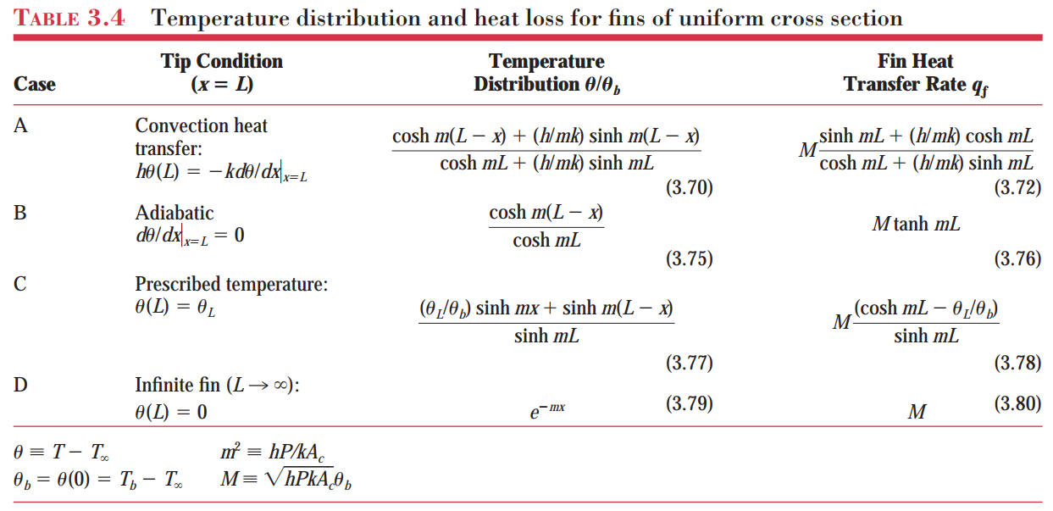
FIN SUMMARY

Slide 17
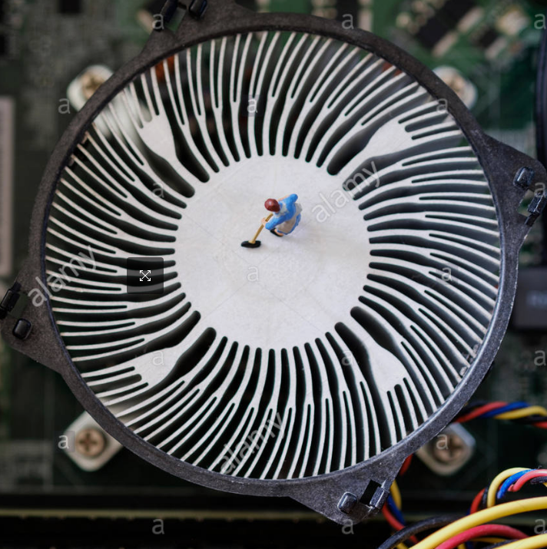
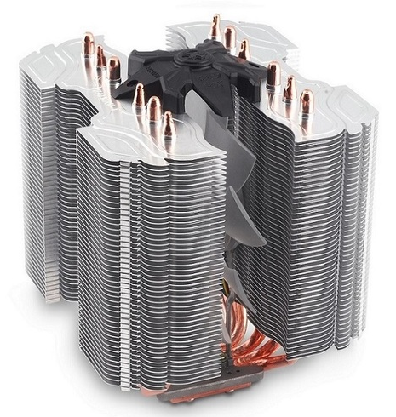
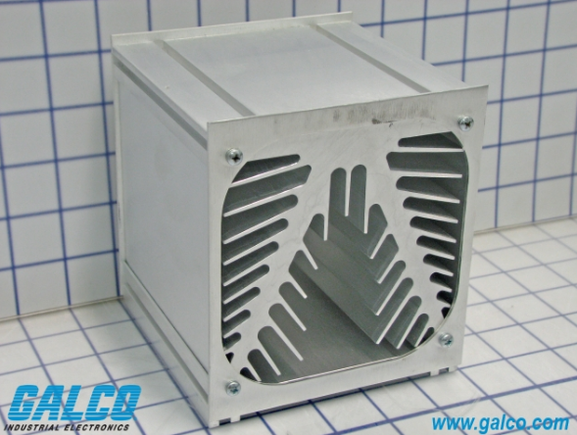
FINS – ROUND 2
Learn about fin effectiveness
Learn about fin efficiency
What if fins don’t have uniform cross sectional area?
What if fins are just plane crazy?

