Slide 1
ME 345 Heat Transfer (HTx)
Professor:
Dr. Dan Cordon (AKA Dr. Dan)

Slide 2
CLASSIFYING CONVECTION
Type of Flow
External
Internal
Impinging
Laminar
Developing
Turbulent
Fully Developed
Mix of Both
Be Purposeful About:
$h_{x}$ – local coefficient
$\overline{h}$ – average coefficient

Slide 3
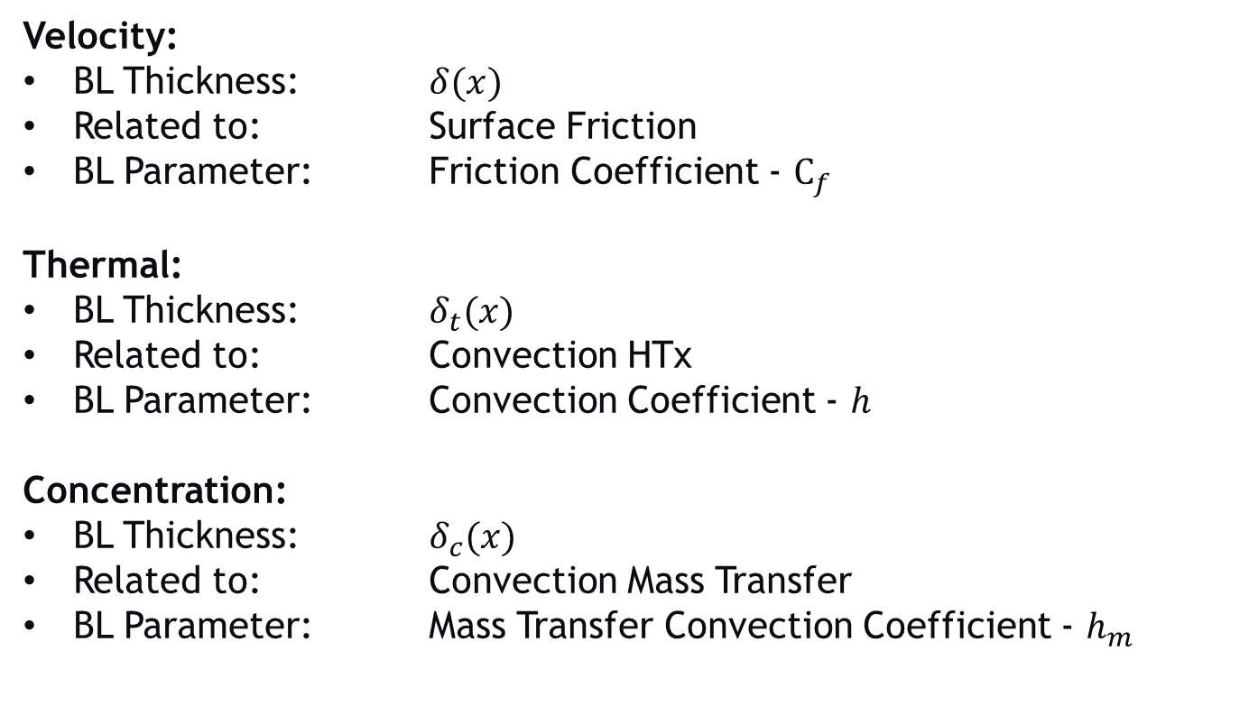
BOUNDARY LAYER SUMMARY
Velocity:
BL Thickness: $δ(x)$
Related to: Surface Friction
BL Parameter: Friction Coefficient - $C_{f}$
Thermal:
BL Thickness: $δ_{t}(x)$
Related to: Convection HTx
BL Parameter: Convection Coefficient - $h$
Concentration:
BL Thickness: $δ_{c}(x)$
Related to: Convection Mass Transfer
BL Parameter: Mass Transfer Convection Coefficient - $h_{m}$

Slide 4
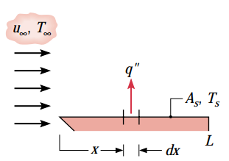
h - LOCAL VS. AVERAGE
Until now we have considered the convection coefficient to be a constant for each of the problems you’ve solved
The total heat leaving a surface may be found by:
Which turns in to:
We can define an ‘average convection HTx coefficient’ as:
Which then gives us:

Slide 5
h - LOCAL VS. AVERAGE
Our previous analysis wasn’t wrong but it was assuming an average convection coefficient.
We usually calculate the local convection coefficient as a function of x
Then use the above to calculate the average convection coefficient so we can use Newton’s Law of Cooling

Slide 6
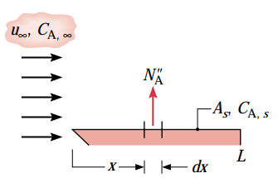
h_{m} - FOR CONCENTRATION
Convection Mass Transfer Coefficient
Same analysis for h also works for h_{m}
We get the following equations:
Where:
N_{A} is the rate of molar transfer
C_{A,s} and C_{A,∞} are the molar concentrations

Slide 7
h_{m} – MOLAR VS. MASS
Species transfer can be expressed as either molar flux, or mass flux
Multiply both sides of these two equations by Molecular Weight
We get the mass flux or mass rate as:
When we do the same with Fick’s Law:
Then via substitution we can get the convection mass transfer coefficient as:

Slide 8
PROBLEM OF CONVECTION
Solving Newton’s Law of Cooling is relatively simple. What is difficult is finding the convection coefficient(s).
Usually need fluid property information (density, viscosity, thermal conductivity, specific heat, binary diffusion coefficient, etc.)
Also need information about the flow (information about boundary layers, surface conditions, etc.)
In order to solve these problems we end up making many assumptions, some of which reduce the accuracy of our predictions.
That said, mathematical simulation is still very helpful in giving us insight to the problem and system behavior.
Let’s work through several example problems (one today, more next lecture)

Slide 9
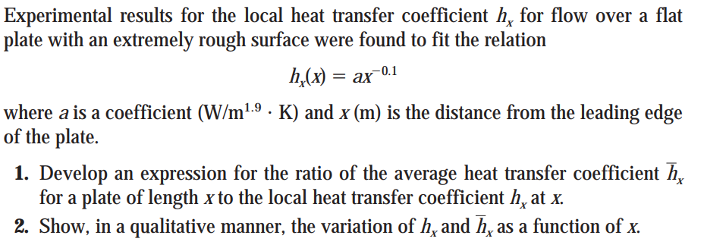
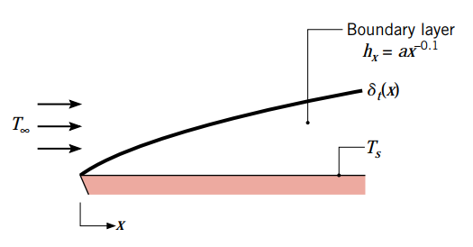
EXAMPLE 6.1
A sketch of the problem and thermal boundary layer looks like:

Slide 10
EXAMPLE 6.1
We can look at the average convection coefficient over the surface area. But since the plate has a constant width, the parameters are just a function of x only.
→
Solving the right equation above (since we know h as a function of x)

Slide 11
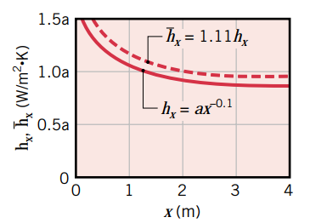
EXAMPLE 6.1
Plot the results:
Implications:
Developing boundary layer (increasing x) causes the local convection coefficient to decrease
Developing boundary layer (increasing x) causes the average convection coefficient to decrease
For this reason, the average convection coefficient (at any particular value of x) must be larger than the local convection coefficient at the same value of x.

Slide 12
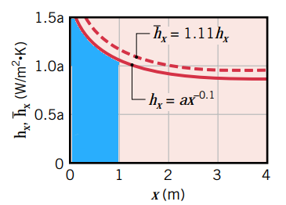
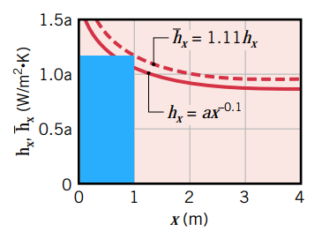
EXAMPLE 6.1
Graphically, if we look at the value at x = 1 [m]
Area under h_{x} Same area as a rectangle at x = 1 [m]
Implications:
For this problem only,
For most problems, h will decrease with x, so average convection coefficient will be larger than local
Average should ALWAYS match your intuition of:
Draw a rectangle of the same width that has the same area

