Slide 1
ME 345 Heat Transfer (HTx)
Professor:
Dr. Dan Cordon (AKA Dr. Dan)

Slide 2
CLASSIFYING CONVECTION
Type of Flow
External
Internal
Impinging
Laminar
Developing
Turbulent
Fully Developed
Mix of Both
Be Purposeful About:
$h_{x}$ – local coefficient
$\overline{h}$ – average coefficient

Slide 3
BOUNDARY LAYER SUMMARY
Velocity:
BL Thickness: $δ(x)$
Physical Meaning: Surface Friction
BL Parameter: Friction Coefficient - $C_{f}$
Thermal:
BL Thickness: $δ_{t}(x)$
Physical Meaning: Convection HTx
BL Parameter: Convection Coefficient - $h$
Concentration:
BL Thickness: $δ_{c}(x)$
Physical Meaning: Convection Mass Transfer
BL Parameter: Mass Transfer Convection Coefficient - $h_{m}$

Slide 4
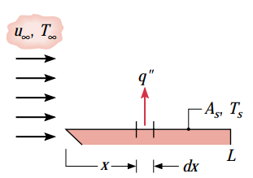
h - LOCAL VS. AVERAGE
Until now we have considered the convection coefficient to be a constant for each of the problems you’ve solved
The total heat leaving a surface may be found by:
Which turns in to:
We can define an ‘average convection HTx coefficient as:
Which then gives us:

Slide 5
h_{m} – MOLAR VS. MASS
Where variables are:
N_{A} is the molar transfer rate [kmol/sec]
N’’_{A} is the molar transfer flux [kmol/sec-m²]
n_{A} is the mass transfer rate [kg/sec]
n’’_{A} is the mass transfer flux [kg/sec-m²]
ρ_{A,s} is the mass density of Species A on the surface of A [kg/m³]
ρ_{A,∞} is the mass density of Species A within the free stream [kg/m³]
C_{A,s} is the molar concentration of on the surface of A [kmolm³]
C_{A,∞} is the molar concentration within the free stream [kg/m³]
D_{AB} is the binary diffusion coefficient of A into B [m²/sec]

Slide 6
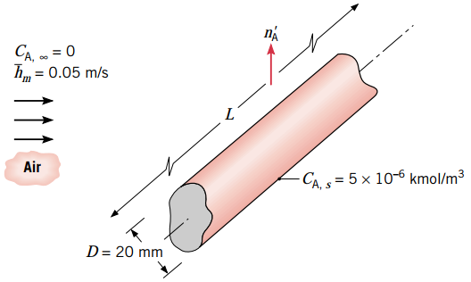
EXAMPLE 6.2

Slide 7
EXAMPLE 6.2
Assumptions:
Steady State
Since average convection mass transfer coefficient is known we can solve directly for the molar transfer rate:
→
We don’t know the cylinder length, but we can do this problem on a ‘per unit length’ basis where: , and noting that:
To get mass transfer rate we use molecular mass of naphthalene

Slide 8
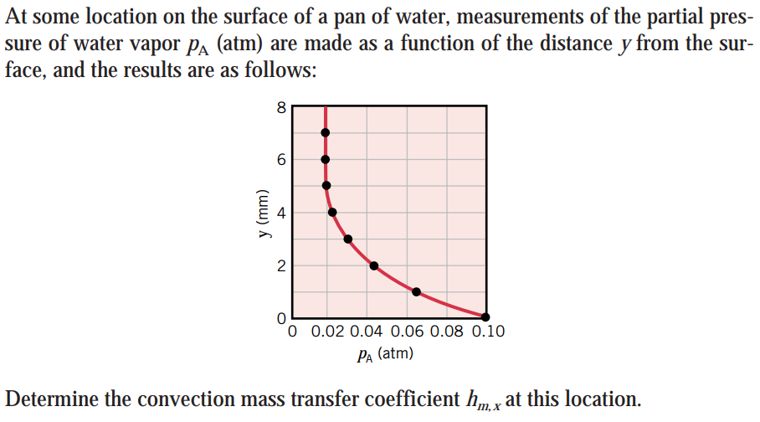
EXAMPLE 6.3

Slide 9
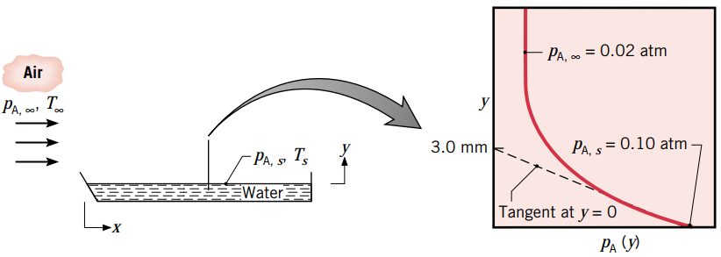
EXAMPLE 6.3
Assumptions:
Treat water vapor as an Ideal Gas
Isothermal conditions (saturated vapor pressure doesn’t change)
Equation given in Table A.8

Slide 10
EXAMPLE 6.3
We have equations for the convection mass transfer coefficient.
However, these require either known concentration or density. We have a known partial pressure.
By using the assumption that the water vapor behaves like an Ideal Gas
→
Evaluating partial derivative:
Calculating h_{m}:

Slide 11
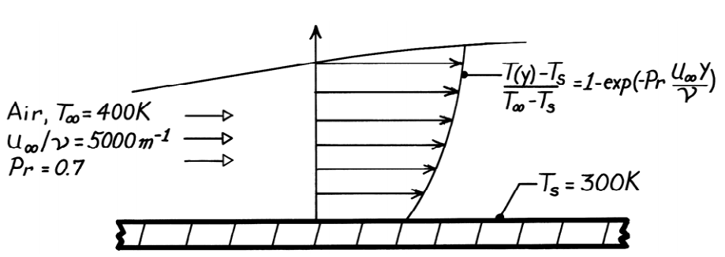
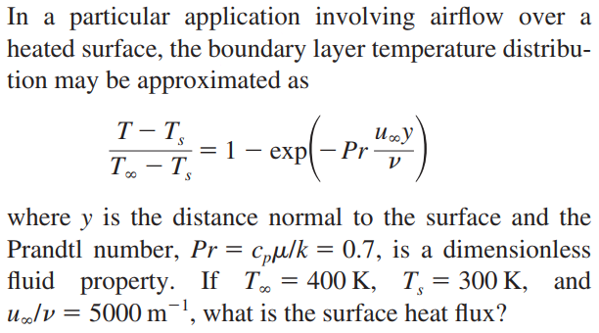
PROBLEM 6.3

Slide 12
PROBLEM 6.3
Solve equation for T(y) and take partial derivative (use Exponent Rule)
$$T\left(y\right)=T_{s}+\left(T_{∞}−T_{s}\right)−\left(T_{∞}−T_{s}\right)∗e^{\left(−Pr∗\frac{u_{∞}∗y}{v}\right)}$$
From Fourier’s Law we know the surface heat flux is:
Looking up thermal conductivity of air:

Slide 13
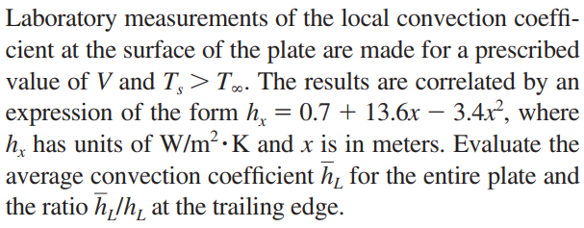
PROBLEM 6.7

Slide 14
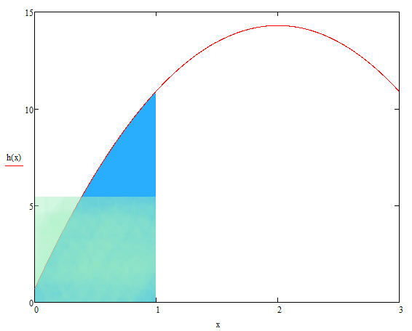
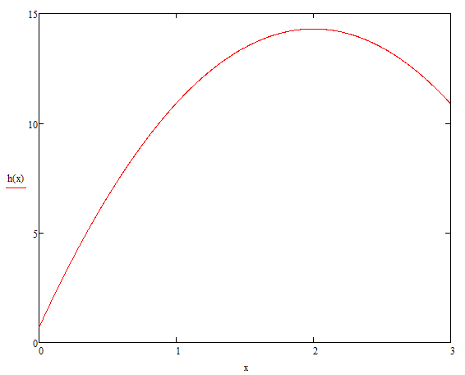
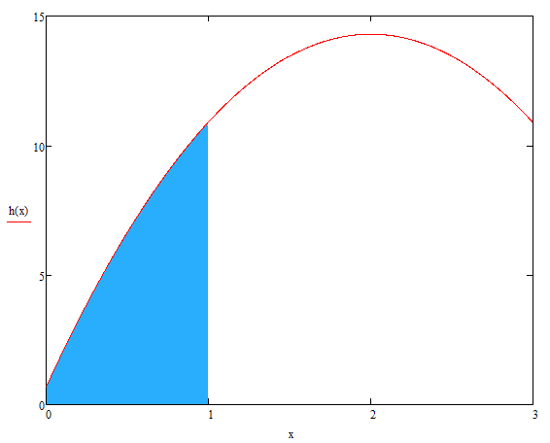
PROBLEM 6.7
We have an equation for the local convection coefficient. Plot h_{x} and look at area under curve from 0 < x < 1
Visually approximate average convection coefficient for a plate of length 1

Slide 15
PROBLEM 6.7
Now do the math:
for a flat plate (x-direction only) becomes
***I do LOVE polynomial functions

Slide 16
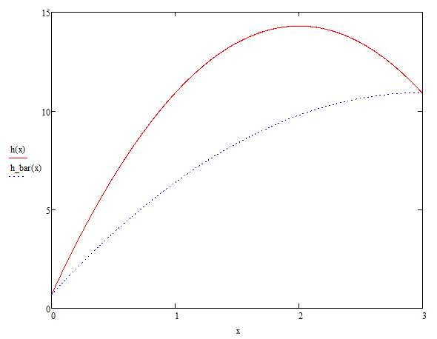
PROBLEM 6.7
Plot local and average convection coefficient from 0 → 3 [m] plate

Slide 17
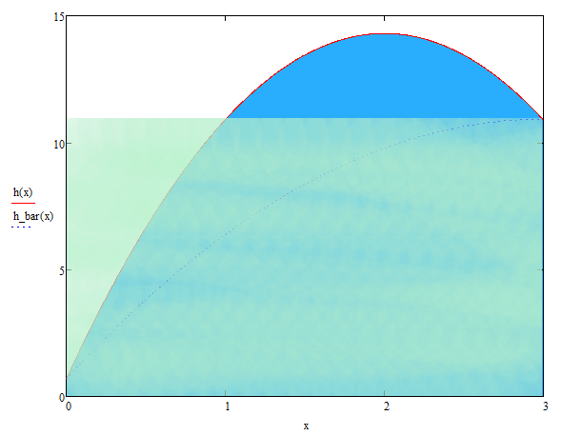
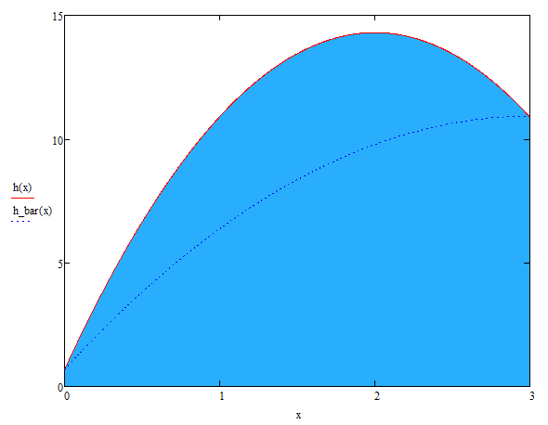
PROBLEM 6.7
Plot local and average convection coefficient for a 3 [m] plate

