Slide 1
ME 433 Internal Combustion Engines
Professor:
Dr. Dan Cordon (AKA Dr. Dan)

Slide 2
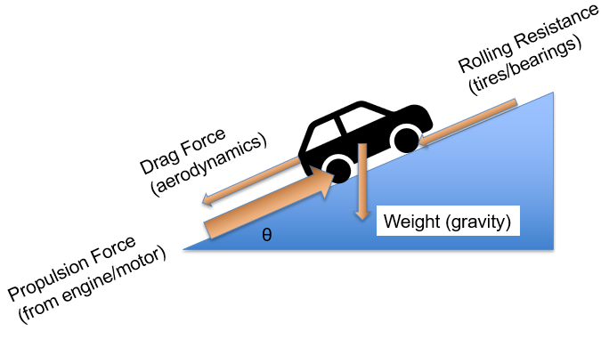
Road Load Force Balance
$$F_{acceleration}=F_{propulsion}−\left[0.5∗c_{D}{∗ρ}_{air}∗A_{frontal}∗Vel^{2}+c_{R}∗m∗g∗\cos\left(θ\right)+m∗g∗\sin\left(θ\right)\right]$$
How do we get propulsion force?
It comes from the engine, so we need:
Engine Speed
Engine Torque (function of engine speed)
Drivetrain Efficiency (or Drivetrain Loss)
Gear Ratios
Tire Size

Slide 3
Σ Forces = m*a
Torque at Engine → Torque at Axle
$Torque_{available}=Torque_{at engine}∗η_{drivetrain}$
$Torque_{axle}=Torque_{available}∗Total Gear Reduction$
Rotational Speed at Engine → Rotational Speed at Axle
$ω_{axle}=\frac{ω_{engine}}{Total Gear Reduction}$
Torque at Axle → Propulsion Force at Tire
${Force}_{propulsion}=\frac{{Torque}_{axle}}{Tire Radius}$
Torque at Axle → Propulsion Force at Tire
$$Velocity=Tire Radius∗\left(2π\right)∗ω_{axle}$$

Slide 4
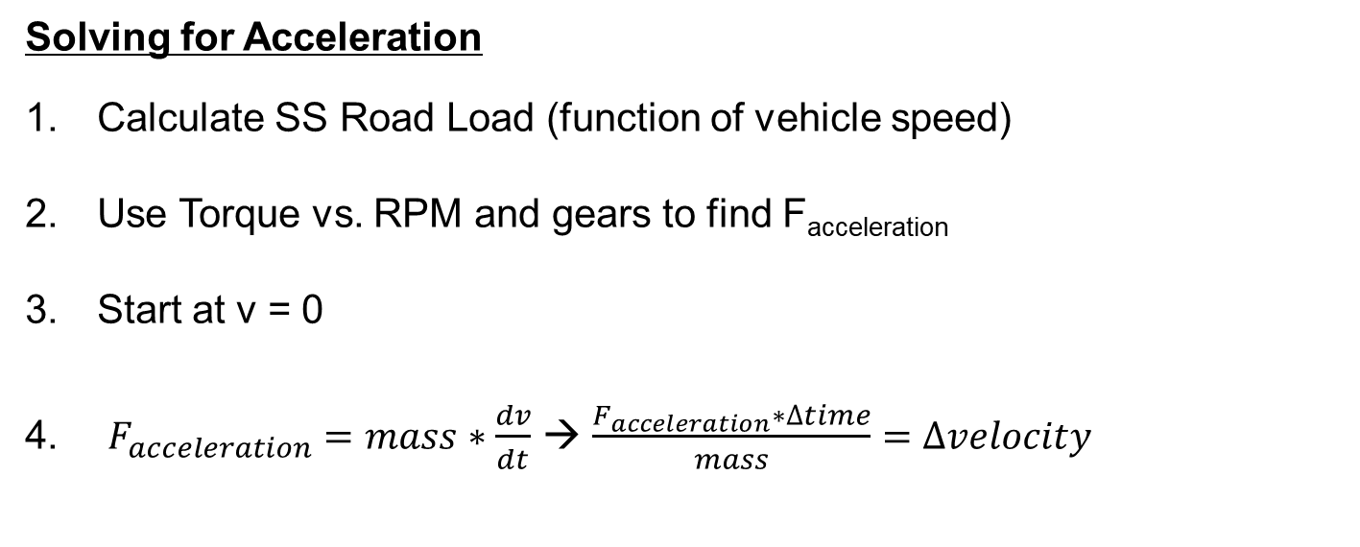
Road Load Force Balance
$$F_{acceleration}=F_{propulsion}−\left[0.5∗c_{D}{∗ρ}_{air}∗A_{frontal}∗Vel^{2}+c_{R}∗m∗g∗\cos\left(θ\right)+m∗g∗\sin\left(θ\right)\right]$$
Solving for Acceleration
Calculate SS Road Load (function of vehicle speed)
Use Torque vs. RPM and gears to find F_{acceleration}
Start at v = 0
$F_{acceleration}=mass∗\frac{dv}{dt}$ → $\frac{F_{acceleration}∗∆time}{mass}=∆velocity$

