Slide 1
ME 433 Internal Combustion Engines
Professor:
Dr. Dan Cordon (AKA Dr. Dan)

Slide 2
What if Supercharger Isn’t Ideal?
There are two big factors that make superchargers/blowers different from our ideal calculations
a) Compression isn’t isentropic
b) Some air leaks past the rotors, so mass flow doesn’t match.
For a), we can calculate the actual blower outlet conditions so long as we know the isentropic efficiency of the blower.
Pressure at blower outlet
Temperature at blower outlet
For b), we can do a few things:
Ignore the issue → Not a bad assumption so long as:
Engine and/or blower speed is high (less opportunity for leaks)
Rotor tips have seals added to them
If we know the leakage percent we can adjust the mass flow equation accordingly.

Slide 3
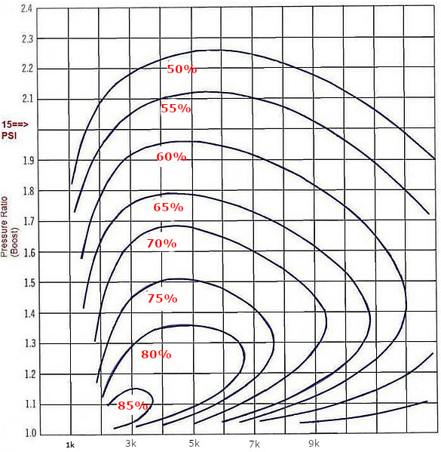
Roots Blower Efficiency Curves
You will be able to find an isentropic efficiency curve for the blower. These usually have blower RPM on the horizontal axis and pressure ratio on the vertical axis.
Notable Findings
Peak pressure ratio of about 2.3:1. This means ~21 psi of boost is about as much as they will produce.
Teflon sealed rotor tips can produce higher boost.
Most efficient at low speed and low boost
Operational speed is roughly 1000 RPM to 10,000 RPM
Peak efficiency around 3000-5000 RPM for any boost level

Slide 4
Analyzing Roots Blower in EES
Start off with the isentropic calculations from previous analysis.
Next Steps
Perform ideal calculations to get pressure and temperature at the blower outlet
Use isentropic efficiency equation (assuming constant specific heat capacity) to calculate actual blower outlet temperature.
Check outlet pressure and blower speed, then adjust value for isentropic efficiency.
Once correct, use pressure and temperature to define the real state.
Check density of the outlet to determine if any increase in speed or pressure has made a denser mixture or not.

Slide 5
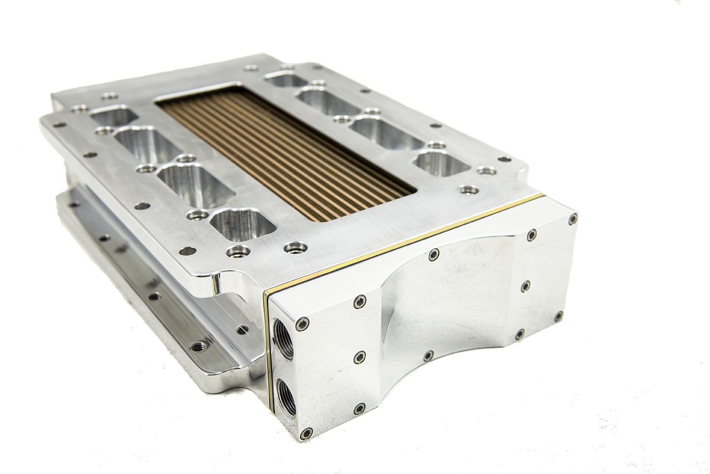
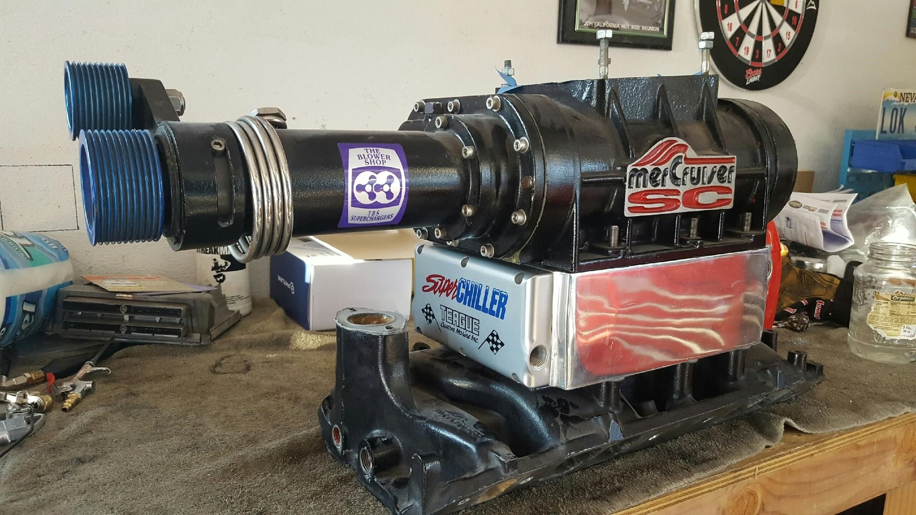
What About Intercooler for Blower
Start off with the non-isentropic analysis.
Next Steps
Need either a heat rate out of heat exchanger, or a temperature drop across intercooler.
Need to consider a pressure drop across the intercooler as well.
There will be a pressure drop due to mechanical losses
There will be an additional pressure drop due to temperature drop
Use the temperature and specific volume to find the thermal pressure drop.
Subtract off the mechanical pressure drop as well to get the pressure and temperature of the intercooler outlet.

Slide 6
Blower Efficiency Maps – Roots (typical)

Slide 7
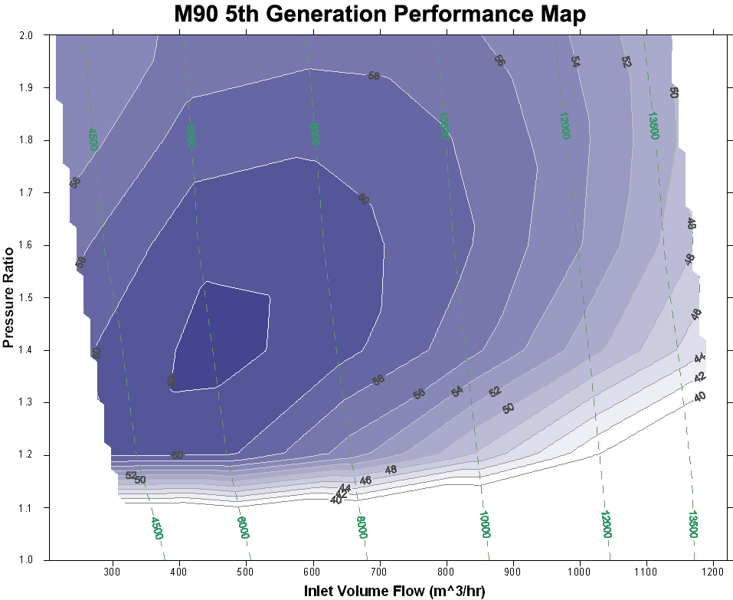
Blower Efficiency Maps – Medium Twin Screw

Slide 8
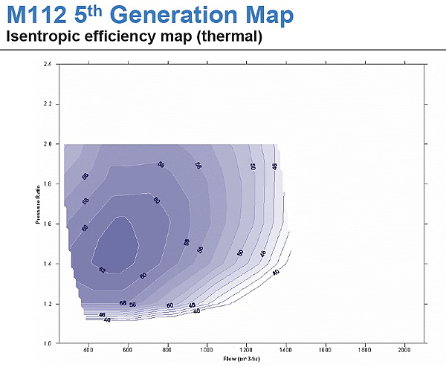
Blower Efficiency Maps – Medium Twin Screw

Slide 9
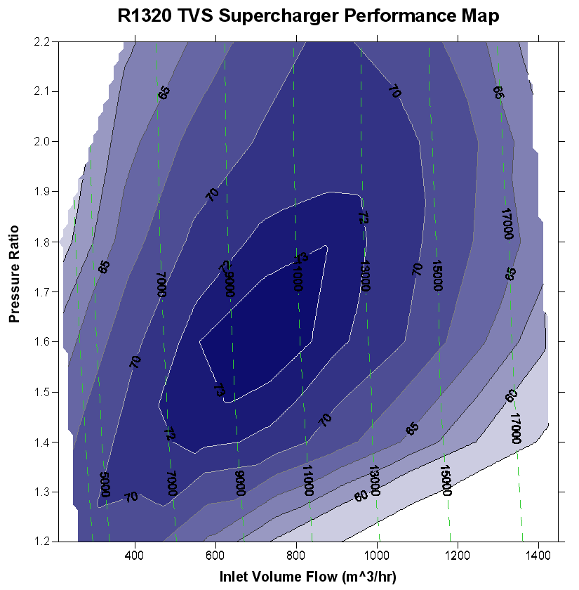
Blower Efficiency Maps – Large Twin Screw

Slide 10
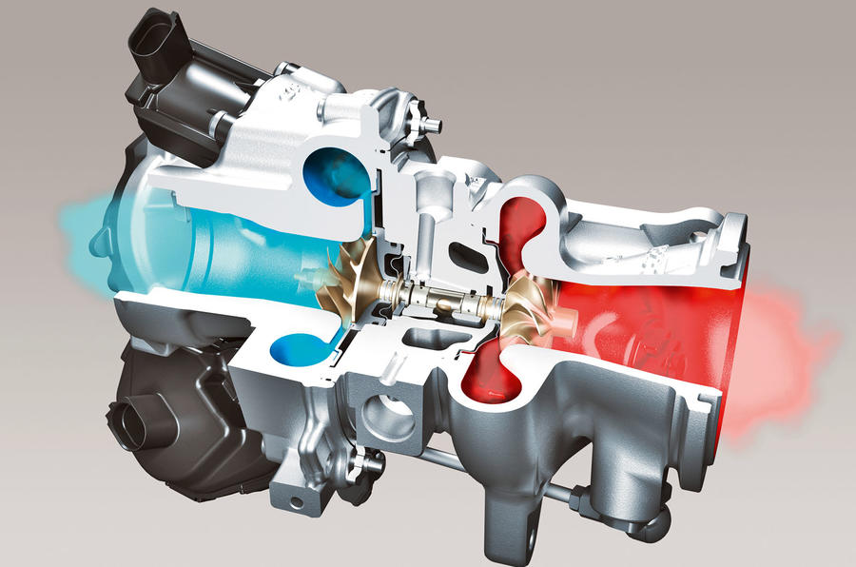
Centrifugal Compressors (Turbochargers)
Analysis of a centrifugal compressor is different from a positive displacement supercharger.
Power comes from exhaust flow (blowdown is significant portion of energy, plus some exhaust stroke displacement).
Generally consider the energy to drive the compressor as ‘free’, so we don’t account for it.
A wastegate controls the amount of exhaust bypass to maintain a desired boost pressure (usually measured at intake pressure, after any intercooler and piping).
Mass airflow is not directly linked to the engine speed at all.

Slide 11
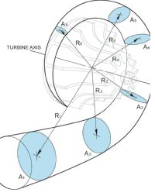
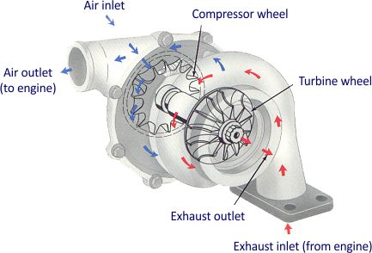
Centrifugal Compressors (Turbochargers)
Turbine Selection
Choosing a turbine size is your first decision.
Turbine housing family (T15, T25, T3, T4, T6, etc.)
Turbine a/r (area to radius ratio)
Turbine wheels

Slide 12
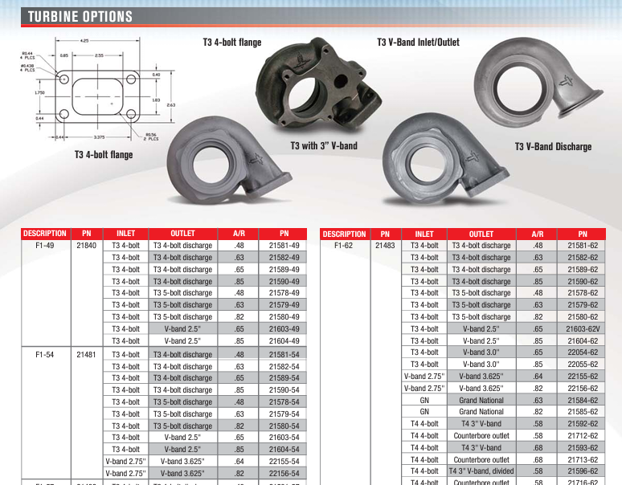
Turbine Housings

Slide 13
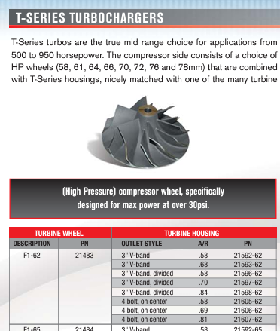
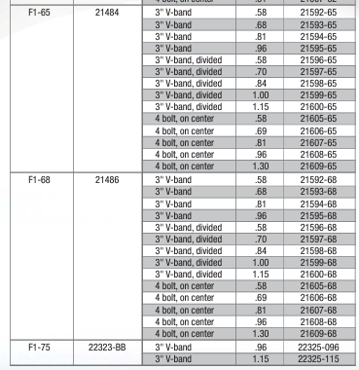
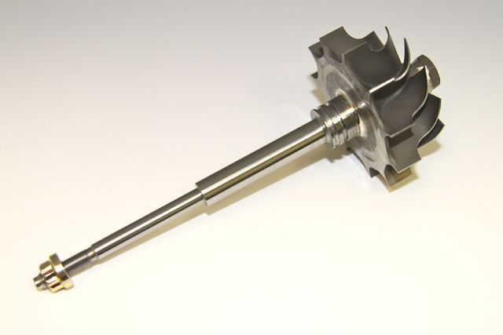
Turbine Wheels

Slide 14
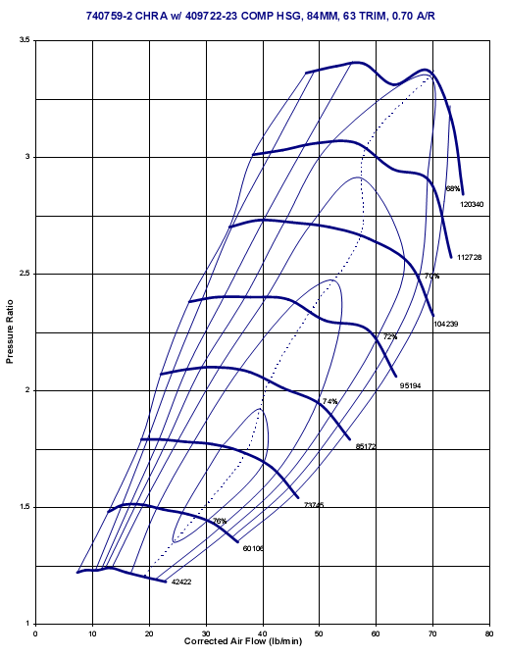
Compressor Maps
The biggest difference in turbocharger selection usually comes from selecting the most appropriate compressor size and geometry.
Compressor map shows the mass flow rate (sometimes volume flow rate at STP), compressor RPM, Pressure ratio, and isentropic efficiency.
Need to plot the data points for your engine across whole RPM range on the compressor map.
Pay special attention to the surge line.
Pay attention to the choked line.

