Slide 1
Mechanics of Materials Engr 350 - Lecture 16 - General Equations of Plane Stress Transformation
"I may not have a weapon, but I can still transform and roll." - Optimus Prime

Slide 2
Failure and states of stress
Failure of material will occur if the applied stress is greater than the allowable stress.
What constitutes ‘failure’ is more complicated than ‘did it break?’
Sometimes the limiting stress is a normal stress, and sometimes it is a shear stress.
We must develop techniques to determine stresses at all possible orientations in order to determine critical stresses
In the previous lecture we developed the equations for stress transformation
A
𝜃
A

Slide 3
Developing the general equations
A
𝜃
A
τ_{nt}
𝜃
σ_{n}
Notes:
These only apply to Plane Stress
𝜎z=0
τ_{zx} = 0, and τ_{zy} = 0
Must get θ from top, drop, sweep the clock
σ_{x}
τ_{xy}
τ_{xy}
σ_{y}
$$σ_{n}= σ_{x}\cos^{2}θ+σ_{y}\sin^{2}θ+2τ_{xy}sinθcosθ$$
$$τ_{nt}= {−(σ}_{x}−σ_{y})sinθcosθ+τ_{xy}(\cos^{2}θ−\sin^{2}θ)$$

Slide 4
Developing the general equations
A
𝜃
A
τ_{nt}
𝜃
σ_{n}
Can also use trig double-angle identities:
cos²θ = ½*(1+cos(2θ))
sin²θ = ½*(1-cos(2θ))
2*sinθ*cosθ = sin(2θ)
Substitute in previous equations, do some algebra, and you get:
σ_{x}
τ_{xy}
τ_{xy}
σ_{y}
$$σ_{n}=\frac{σ_{x}+σ_{y}}{2}+\left[\frac{σ_{x}−σ_{y}}{2}cos2θ\right]+τ_{xy}sin2θ$$
$$τ_{nt}=−\left[\frac{σ_{x}−σ_{y}}{2}sin2θ\right]+τ_{xy}cos2θ$$

Slide 5
Properties of the general equations
Since these were only derived using equilibrium they are applicable in any material
Provide a means for determining stresses on any plane that
is perpendicular to the z-axis
is at any angle relative to a reference axis
Only applicable for plane stress conditions
Key equations
or

Slide 6
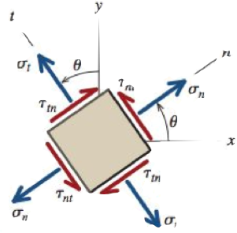
Stress Invariance
Recall the equation
If we substitute 𝜃+90 in for 𝜃 we can obtain the normal stress on the t plane (σ_{t}), giving:
We can sum these equations to obtain
this is called the “first stress invariance"

Slide 7
Stress Invariants (sounds the same, big difference)
Stress is expressed with reference to a coordinate system. Remember, the stress state does not change when we change orientation. Just our numeric representation changes.
Because of this, certain combinations of stress are not dependent on the coordinate system chosen
These combinations are called the invariants.
For plane stress, these are:

Slide 8
Sign Conventions
Very important when using general equations since cannot “look” at the problem to get the sense
Same as defined in last lecture (++=+, - -=+, + -=-, ect)
Angles measured counterclockwise from reference axis are positive (clockwise=negative)
The n-t-z axes have the same order as the x-y-z axes on the right handed coordinate system

Slide 9
Documentation of Stress Transformations
Program these equations in your calculator!
Program these equations in Excel!
Program these equations in TK Solver!
On homework/exam, you can write:
Using σ_{x} = ___, σ_{y} = ___, τ_{xy} = ___ ,and θ = ___
Stress transformation equations give: σ_{n} = ___, σ_{t} = ___, and τ_{nt} = ___

Slide 10
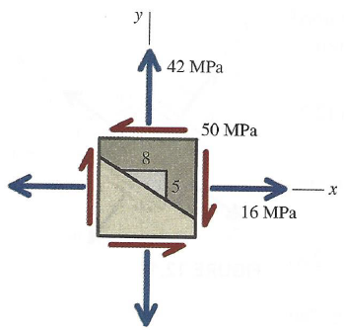
Example Problem 1
Determine the normal and shear stresses on the inclined surface of the stress element
Plan:
Find θ
Note sign conventions for σ_{x}, σ_{y}, and τ_{xy}
Apply Stress Transformation Equations
Check Invariants
Check Intuition

Slide 11
Example Problem 1
Solution:
θ = tan⁻¹(8/5) = 58°
σ_{x} = 16 MPa, σ_{y} = 42 MPa, and τ_{xy} = -50 MPa
σ_{n} = -10.2 MPa, σ_{t} = 68.2 MPa, and τ_{nt} = 33.6 MPa
Check Invariants
I₁ = 58
I₂ = -1828
Check Intuition
Stress orientation hard to picture in head (Mohr’s Circle will help)

Slide 12
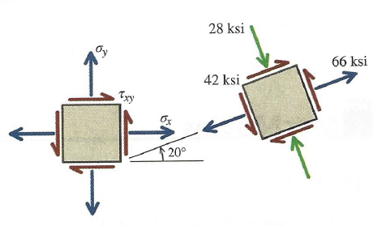
Example Problem 2
Determine σ_{x}, σ_{y}, and τ_{xy} that would result in stress state shown when θ = 20°
Plan:
Two ways to do this problem:
1) Rotate whole picture by -20° 2) Use equation solver and input σ_{n}, σ_{t}, and τ_{nt}
Plan for Either Option:
Find θ
Note sign conventions for σ_{x}, σ_{y}, and τ_{xy}
Apply Stress Transformation Equations
Check Invariants
Check Intuition

Slide 13
Example Problem 2
Option 1:
Input:
θ = -20°
σ_{x} = 66 ksi, σ_{y} = -28 ksi, and τ_{xy} = 42 ksi
Output:
σ_{n} = 28 ksi, σ_{t} = 9.99 ksi, and τ_{xy} = 62.4 ksi
Check Invariants
I₁ = 38
I₂ = -3612
Check Intuition

Slide 14
Example Problem 2
Option 2:
Input:
θ = 20°
σ_{n} = 66 ksi, σ_{t} = -28 ksi, and τ_{xy} = 42 ksi
Output:
σ_{x} = 28.0 ksi, σ_{y} = 9.99 ksi, and τ_{xy} = 62.4 ksi
Check Invariants
I₁ = 38
I₂ = -3612
Check Intuition

