Slide 1
Mechanics of Materials Engr 350 – Lecture 28 Q and rectangular/circular cross-sections

Slide 2
What is Q?
Last time, we found that $τ_{H}=\frac{VQ}{It}$ where, V is the vertical shear force, 𝑰 is the second moment of the cross-section area and t is the thickness of the cross-section at the point of interest.
Q is called the first moment of area, and we only care about the area “above” the point of interest (for example, the point y1 in our derivation). Recall that we’ve seen the first moment before in the definition of the centroid of a shape.
Let’s rearrange this to solve for the Q term.
In words, Q is just the area “above” the point of interest multiplied by the distance between the centroid of this area and the neutral axis of the beam

Slide 3
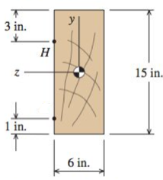
Practice Problem 1
V=3000 lbf
K
1. Identify Q at the point K
Solve for the transverse shear stress at K using
I_{z} for a rectangle is $I_{z}= \frac{bh^{3}}{12}$
Area beyond K is: $\left(6 in\right)∗\frac{\left(15 in\right)}{2}=45 {in}^{2}$
Distance from N.A. to centroid of area is: $\frac{\left(7.5 in\right)}{2}=3.75 in$
Q is: $Q_{K}=\left(45 {in}^{2}\right)\left(3.75 in\right)=168.75 {in}^{3}$
I_{z} is: $I_{z}= \frac{(6 in){(15 in)}^{3}}{12}=1687.5 {in}^{4}$
Transverse shear stress is:
$τ_{H,K}= \frac{(3000 lbf){(168.75 in}^{3})}{(1687.5{ in}^{4})(6 in)}=50 psi$

Slide 4
Practice Problem 1.5
V=3000 lbf
K
1. Identify Q at the point H
Solve for the transverse shear stress at H using
I_{z} for a rectangle is $I_{z}= \frac{bh^{3}}{12}$
Area beyond H is: $\left(6 in\right)∗(3 in)=18 {in}^{2}$
Distance from N.A. to centroid of area is: $7.5 in −1.5 in=6 in$
Q is: $Q_{H}=\left(18 {in}^{2}\right)\left(6 in\right)=108 {in}^{3}$
I_{z} is still: $I_{z}= \frac{(6 in){(15 in)}^{3}}{12}=1687.5 {in}^{4}$
Transverse shear stress is:
$τ_{H,H}= \frac{(3000 lbf){(108 in}^{3})}{(1687.5{ in}^{4})(6 in)}=32 psi$

Slide 5
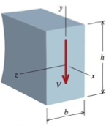
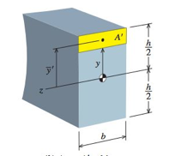
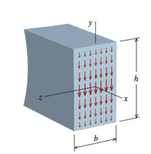
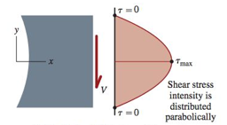
Transverse Shear → Rectangular Beams
From the transverse shear stress formula
At an arbitrary point y, Q is
So the transverse (or horizontal) shear stress is

Slide 6
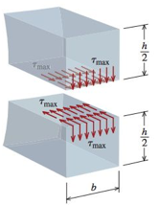
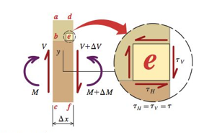
Maximum Transverse Shear
The maximum transverse shear occurs at the middle of the beam (y=0). Substituting y=0 into the shear stress formula for rectangular beams yields.
A fine point regarding the shear stress: Remember our derivation of shear on perpendicular faces of an element being equal?
The same shear stress exists on the transverse and longitudinal planes. We could calculate the average shear stress on a face using the shear force V and the area, but our derivation above shows that the maximum is 50% larger than the average.

Slide 7
Maximum vs Average Shear
Remember that shear stress on perpendicular faces of an element are equal
The same shear stress exists on the transverse (horizontal) and longitudinal (vertical) planes.
It is true that the average vertical shear stress is $τ_{ave}=\frac{V}{A}$
But the above doesn’t tell all the story. We know that:
The minimum shear stress occurs at the top and bottom edges of the beam, where $τ_{min}=0$
The maximum shear stress occurs at the neutral axis of the beam, where $τ_{max}=1.5\frac{V}{A}$

Slide 8
Practice Problem 2
V=3000 lb
K
Solve for the maximum shear
stress on the cross-section
and determine the y-coordinate
where it occurs

Slide 9
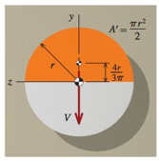
Transverse Shear → Circular Beams
By a similar procedure (see section 9.6) to that for rectangular beams, we find that for circular beams, Q at the neutral axis is:
and the maximum shear stress is (again at y=0)

Slide 10
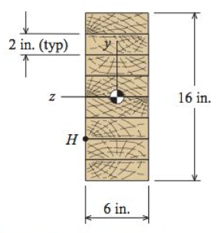
Practice Problem 3
1.2 kip/ft
14 ft
Determine the magnitude of maximum shear stress at the glue joint H, and where (x-position) along the beam this occurs.
Area beyond H is: $\left(6 in\right)∗(4 in)=24 {in}^{2}$
Distance from N.A. to centroid of area is: $8 in −2 in=6 in$
Q is: $Q_{H}=\left(24 {in}^{2}\right)\left(6 in\right)=144 {in}^{3}$
V
I_{z} is: $I_{z}= \frac{(6 in){(16 in)}^{3}}{12}=2048 {in}^{4}$
Transverse shear stress is:
$τ_{H,H}= \frac{(8400 lbf){(144 in}^{3})}{(2048{ in}^{4})(6 in)}=98.4 psi$
Check against max shear:
$τ_{max}=1.5\frac{V}{A}=1.5\frac{8400 lbf}{(16 in)(6 in)}=157.5 psi$← τ_{H} less than τ_{max}
M

Slide 11
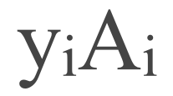
Q for Complexer Geometry
Q is the area “above” the point of interest multiplied by the distance between the centroid of this area and the neutral axis of the beam
For composite sections we can add the Q for each “piece” of the area
L
1
2
𝛴

Slide 12
Practice Problem 4
T
4”
H
K
Determine Q and t for the points H and K.
z
8”
7”
1”
6”

Slide 13
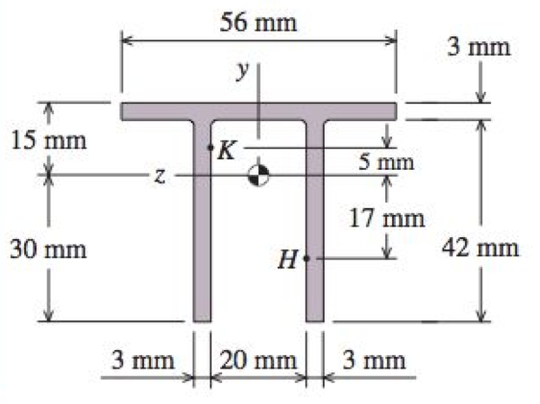
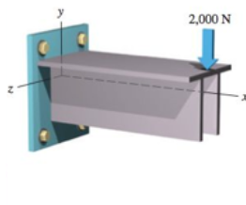
Practice Problem 5
A cantilever beam is subjected to a concentrated load of 2,000 N. The cross-sectional dimensions of the double-tee shape are shown. Determine
(a) the shear stress at point H, which is located 17 mm below the centroid of the double-tee shape.
(b) the shear stress at point K, which is located 5 mm above the centroid of the double-tee shape.

Slide 14
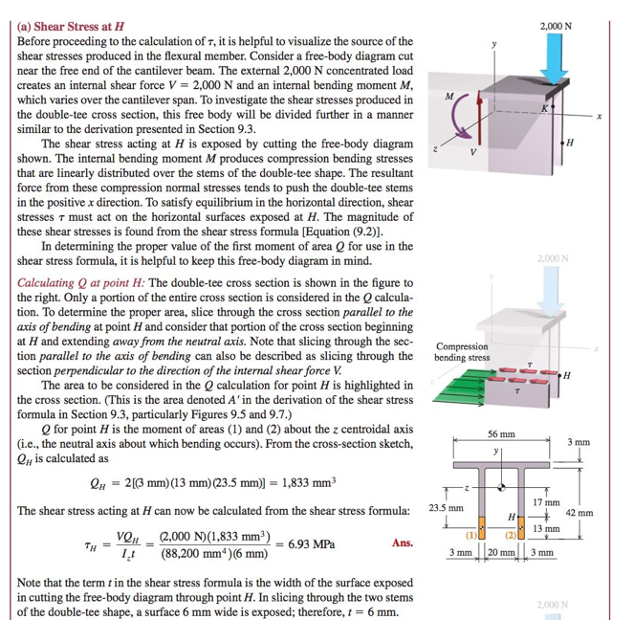
PP5

Slide 15
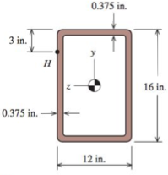
Practice Problem 6
G
Identify Q and t at the points G and H

Slide 16
Shear stress distribution
Draw the shear stress distribution for the following beams
Learn to do this in MM M9.5
L

