Slide 1
Mechanics of Materials Engr 350 – Lecture 38 Columns

Slide 2
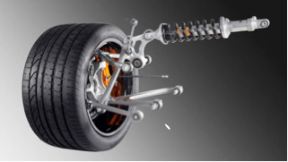
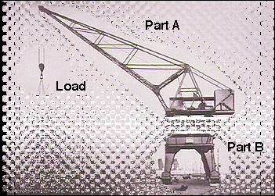
Columns
Columns are long, straight, prismatic bars that are subjected to Compressive, Axial loads.
Buckling is a type of Stability failure
Not a material failure -> still elastic

Slide 3
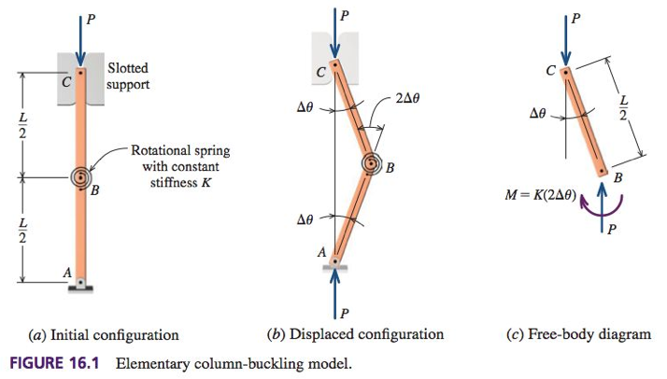
Stability of equilibrium
Treat column as two rigid members kept straight by torsional spring at center joint.
Linear spring: F = K*x
Torsion spring: M = K*θ

Slide 4
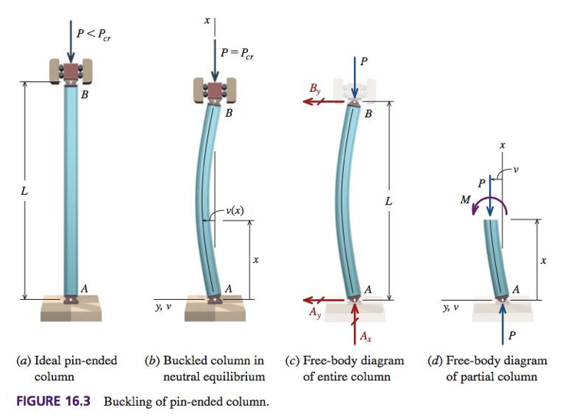
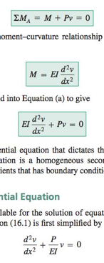
Critical buckling load (pinned end)
Example derivation from textbook

Slide 5
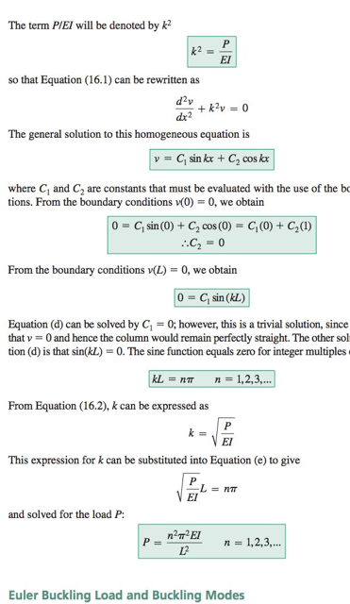
Critical buckling load (pinned end)
Example derivation from textbook

Slide 6
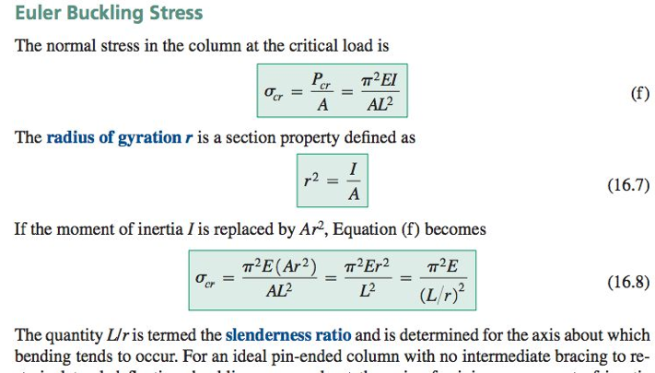
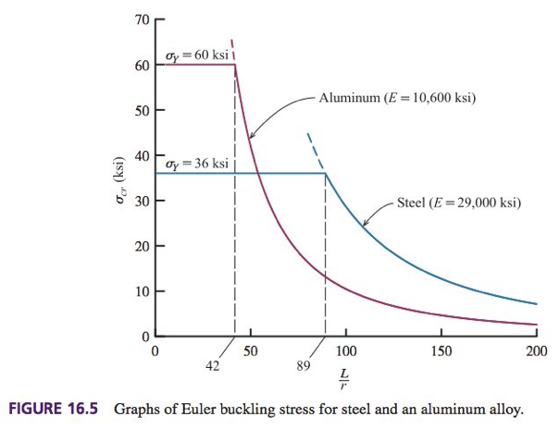
Euler buckling stress

Slide 7
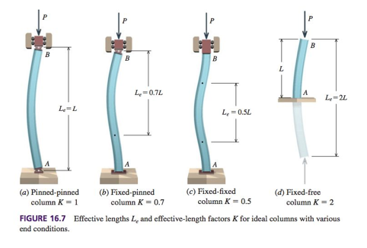
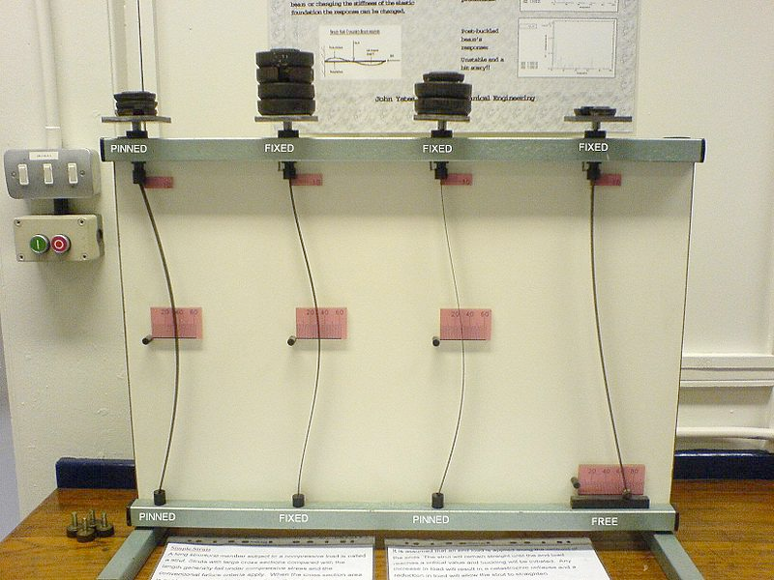
Effective length
We can account for end conditions with fixity constant, K
K= 1.0 for pinned-pinned
K= 0.7 for pinned-fixed
K= 0.5 for fixed-fixed (no rotation, makes beam have smaller effective length)
K= 2.0 for fixed-free (one end can move laterally)
https://en.wikipedia.org/wiki/Buckling#/media/File:Buckledmodel.JPG

Slide 8
Implecations
Buckling load is inversely related to square of column length:
Elastic Modulus is the only material property in equations 16.5 and 16.8
Buckling occurs about the axis of minimum moment of interia
Euler Buckling Load is directly related to moment of interia, so we can often increase Pcr without increasing A (thin wall larger diameter tube)
Pcr is independent of material strength! Does depend on E, I, and L. Changing from weak steel to a stronger steel will not change P_{cr}!

Slide 9
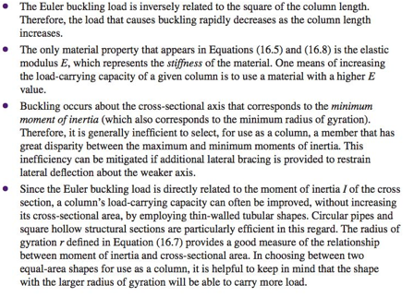
Implecations

Slide 10
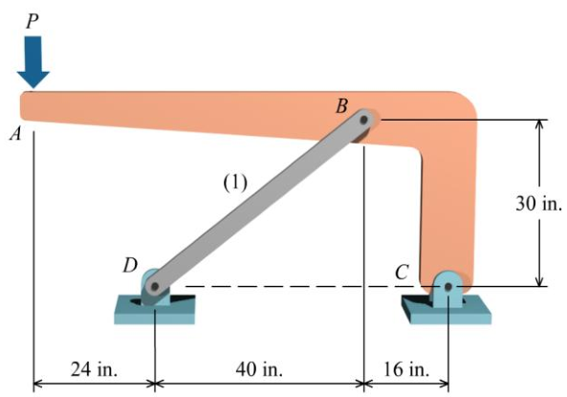
Example Problem 1
Rigid bar ABC is supported by pin- connected bar (1). Bar (1) is 1.50-in. wide, 1.00-in. thick, and made of aluminum that has an elastic modulus of E = 10,000 ksi. Determine the maximum magnitude of load P that can be applied to the rigid bar without causing member (1) to buckle.

Slide 11
Example Solution 1

