Slide 1
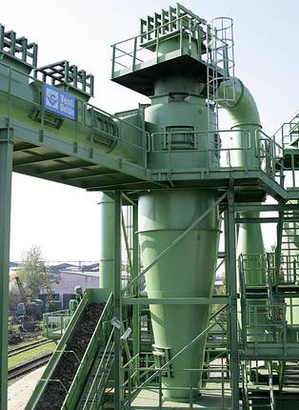
Cyclone Separator
The cyclone separator is used to separate combustion gases from ash. Consider the following scenario ...
combustion gases mixed with ash
ash-free combustion gases leave the cyclone
weight fraction of ash = 0.001
Find: The mass flow rates of combustion gases and ash that leave the cyclone separator.
ash falls out of the cyclone

Slide 2
weight fraction of ash = 0.001
Assumption: Steady state operation (i.e. no net gain of mass in the cyclone separator)

