Slide 1
Lecture 26
Use of Regeneration in Vapor Power Cycles

Slide 2
What is Regeneration?
Goal of regeneration
Reduce the fuel input requirements (Q_{in})
Increase the temperature of the feedwater entering the boiler (increases average Th in the cycle
Result of regeneration
Increased thermal efficiency
Energy source for regeneration
High pressure steam from the turbines
Regeneration equipment
Feedwater heater (FWH)
This is a heat exchanger that utilizes the high pressure steam extracted from the turbine to heat the boiler feedwater

Slide 3
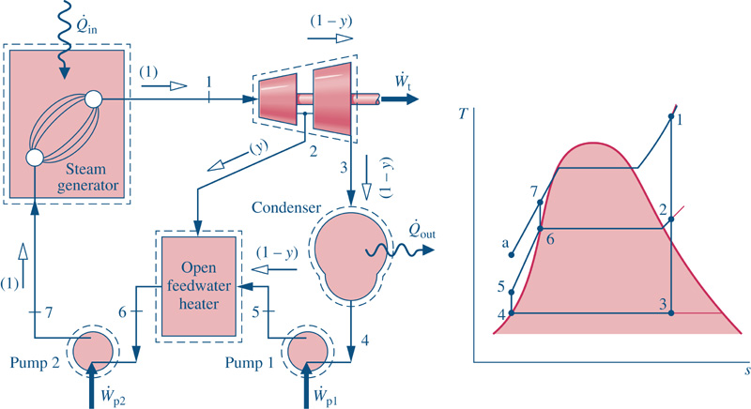
Regeneration – Open FWH
Increased temperature into the boiler due to regenerative heating

Slide 4
Keeping Track of Mass Flow Splits
Define a mass flow fraction,
Determination of the flow fractions requires application of the conservation of mass throughout the cycle and the conservation of energy around the feedwater heater(s).
Note: If a mass flow rate is known or can be calculated, then the flow fraction approach is not necessary!

Slide 5
Regeneration – Closed FWH
There are two types of closed feedwater heaters
Closed FWH with Drain Pumped Forward
Closed FWH with Drain Cascaded Backward

Slide 6
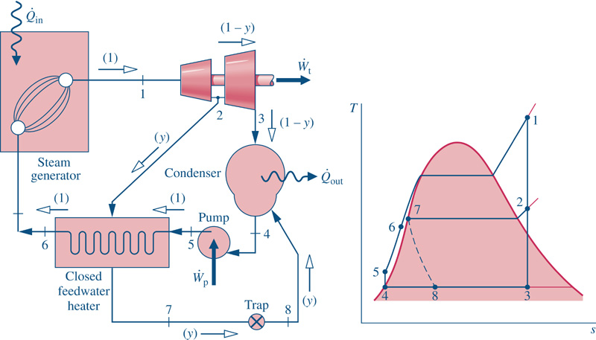
Regeneration – Closed FWH
Example – Closed FWH with Drain Cascaded Backward

Slide 7
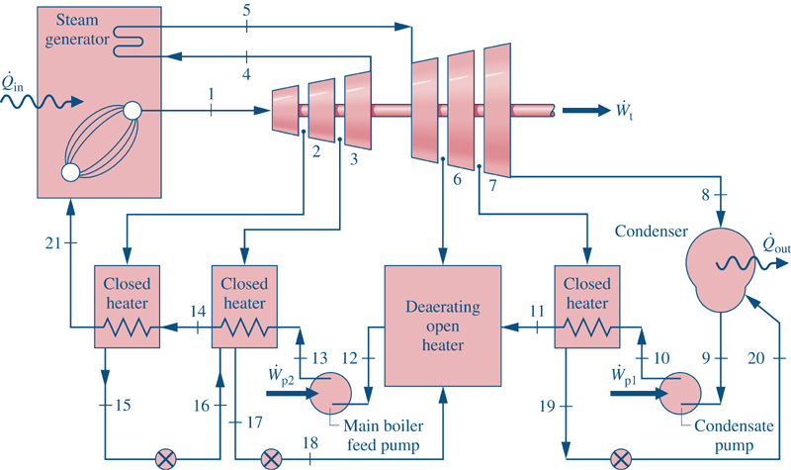
Regeneration – Multiple FWH

Slide 8
Regeneration Example
Given: A Rankine cycle is operating with one open feedwater heater. Steam enters the high pressure turbine at 1500 psia, 900°F. The steam expands through the high pressure turbine to 100 psia where some of the steam is extracted and diverted to an open feedwater heater. The remaining steam expands through the low pressure turbine to the condenser pressure of 1 psia. Saturated liquid exits the feedwater heater and the condenser.
Find:
the boiler heat transfer per lbm of steam entering the high pressure turbine
the thermal efficiency of the cycle
the heat rate of the cycle

Slide 9
Regeneration Cycle

Slide 10
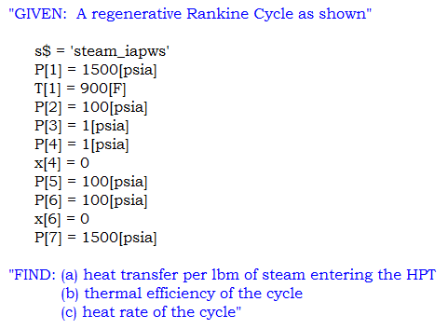
Known Properties
The next step is to build the property table

Slide 11
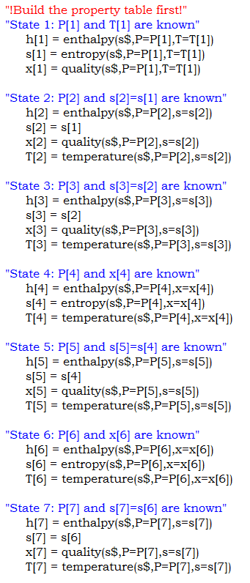
Unknown Properties

Slide 12
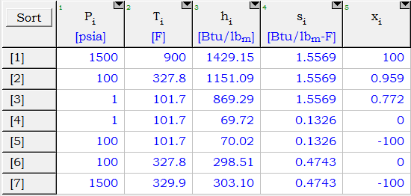
Array Table
The resulting property table ...
Now, we can proceed with the thermodynamics!

Slide 13
Boiler Modeling
The heat transfer rate at the boiler can be found by applying the First Law,
No flow rate information is given. However, we can find the heat transferred per lbm of steam entering the HPT,

Slide 14
Turbine Modeling
The thermal efficiency of the cycle is given by,
The turbine power delivered is,
The flow fractions need to be determined!

Slide 15
Pump Modeling
There are two pumps in the cycle. Therefore,
This is an important step in the analysis. All specific energy transfers need to be based on the same flow rate. The common value is chosen to be the inlet to the high pressure turbine (HPT).
Then ...

Slide 16
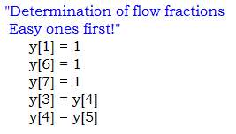
Mass Conservation
The flow fractions must be found. The easy flow fractions are ...
Conservation of mass applied to the FWH gives,

Slide 17
Closing the System
Where is the missing equation? Mass is conserved in the FWH, but so is energy. Therefore, we need to apply the First Law to the FWH,
The equations can be solved! The result is a new property table with a column for the mass flow fractions.

Slide 18
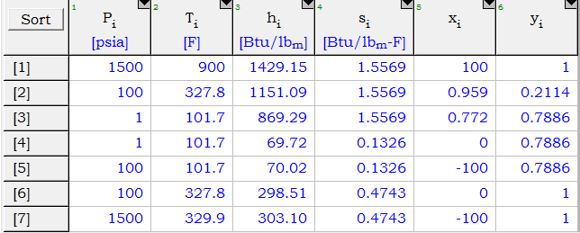
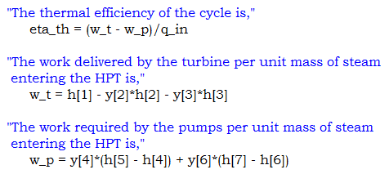
Augmented Array
The updated property table ...
From previous analysis,

Slide 19
Cycle Performance Parameters
The heat rate of the cycle is,
EES Solution (Key Variables):

