Slide 1
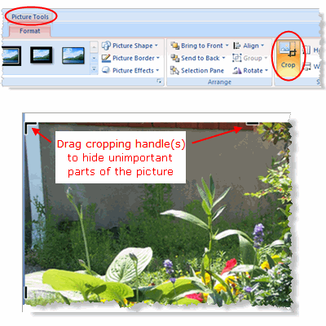
Directions of Point Sample
Start on slide for Plot 1 – Insert the photo you have for that plot (Insert → Picture → Browse to find photo)
Turn photo, if necessary to display plot with long side right to left -not up and down. (Format → Rotate)
Crop photo as close to the plot frame (actually half of the plot frame) so it fits in the yellow box on the slide. See example slide below. (Click on Picture → Format → Crop → Drag bars at edge of photo)
For more help on cropping photos, hit the Help button (the ? On the top right-side of menu bar) and type in “Reduce the file size of a picture”

Slide 2
Directions of Point Sample
Once picture is set into the yellow box, send it to the back. Right click on photo and select “Send To Back”
Cover Category | Tally of Hits
Perennial Grass or Grasslike
Annual Grass or Grasslike
Perennial Forb
Annual Forb
Woody Rock
Bare Soil
Litter
Total Hits
Enter a tally on a data sheet such as this one here to describe cover at each point on each slide.
There are 10 points on each plot slide, there are 15 plots, so you should have 150 points to use to calculate % cover of each category

Slide 3
Example Plot
1
4
2
6
8
5
3
7
10
9
This is what it will look like in the end.

Slide 4
Plot 1 –ENTER PICTURE of PLOT 1 IN THE BOX
1
4
2
6
8
5
3
7
10
9

Slide 5
Plot 2
1
2
6
8
3
5
4
9
10
7

Slide 6
Plot 3
5
1
4
7
9
2
6
8
10
3

Slide 7
Plot 4
1
5
6
2
9
8
4
3
10
7

Slide 8
Plot 5
1
4
10
2
8
6
9
3
5
7

Slide 9
Plot 6
1
4
2
6
8
5
3
7
10
9

Slide 10
Plot 7
1
2
6
8
3
5
4
9
10
7

Slide 11
Plot 8
5
1
4
7
9
2
6
8
10
3

Slide 12
Plot 9
1
5
6
2
9
8
4
3
10
7

Slide 13
Plot 10
1
4
10
2
8
6
9
3
5
7

Slide 14
Plot 11
1
4
2
6
8
5
3
7
10
9

Slide 15
Plot 12
1
2
6
8
3
5
4
9
10
7

Slide 16
Plot 13
5
1
4
7
9
2
6
8
10
3

Slide 17
Plot 14
1
5
6
2
9
8
4
3
10
7

Slide 18
Plot 15
1
4
10
2
8
6
9
3
5
7

