Slide 1
Vitamins & Minerals

Slide 2
Vitamins
Fat Soluble
Water Soluble
in energy metabolism
in protein metabolism
In immune system
In bone formation, maintenance, and repair

Slide 3
Vitamins
Characteristics
Cannot be synthesized by all species
Needed for life and health
organic
Not chemically related as a group

Slide 4
Vitamins
Laboratory methods
Spectrophometery
Atomic absorption
High pressure (performance) liquid chromatography
Gas chromatography
Biological methods
Feeding studies
Purified rations
Slaughter studies

Slide 5
Vitamins
Fat Soluble
Vitamin A - related to Carotene
Vitamin D
Vitamin E - Tocopherols
Vitamin K

Slide 6
Water Soluble Vitamins
Folic Acid
Cobalamine - B₁₂
Inositol
Para-aminobenzoic acid
Ascorbic Acid - C
Thiamine - B₁
Riboflavin - B₂
Niacin
Pyridoxamine - B₆
Pantothenic Acid
Biotin
Choline

Slide 7
Vitamins
Function
Deficiencies
Species affected
Feed sources

Slide 8
Vitamins
Sources of Vitamins
Fat Soluble
A- Green Leafy Forages
D- Fish Oils, Sun-Cured Forages
E- Seed Germ, Germ Oils
K- Green Forage, Sun-Cured Hay

Slide 9
Vitamins
Water Soluble
Overall:
Legumes, Whole Grains, Leafy Green Plants, Yeast, Meat and Milk
Specific:
Riboflavin- Milk Products
Biotin- Egg Yolk
B₁₂- Animal Protein, Fermentation Products
C- Citrus, Green, Leafy Plants

Slide 10
Some Characteristics of Vitamins
Fat Soluble
Contain C, H, O
Can be present as a Pro-vitamin
Water Soluble
Contain C, H, O and N, or S, or Co
No Provitamin forms known
Primarily stored in fat tissue
and liver
No storage in body except
Vit. B₁₂

Slide 11
Fat Soluble
Water Soluble
Excreted in Feces
Excreted in urine
Function in the regulation
of metabolism of structural
units
Function in energy metabolism
Only vitamin K synthesized by GI microflora
GI tract microflora synthesis

Slide 12
Vitamin A (Retinol form, most active)
Functions:
1. Vision: Maintains normal vision in dim light
formation of Rhodopsin
2. Epithelium (skin integrity)
3. Reproduction
4. Skeletal growth
5. Immune system

Slide 13
Vitamin A- Deficiency Symptoms
Epithelium
Degeneration of mucosa of respiratory tract, mouth, salivary glands, intestinal tract, and kidneys
Lacrimation (xerophthalmia, dryness and irritation of the cornea)
Susceptible to infection and pneumonia
Diarrhea
Vision
Night blindness (decreased formation of Rhodopsin)
Later stages permanent eye damage

Slide 14
Vitamin A-Deficiency
Main symptoms
Night blindness
Dry skin
Immune dysfunction
Rare in industrialized world
Leading cause of blindness in areas of poverty

Slide 15
Functions – Gene Expression
Retinoic acid, retinol

Slide 16
Functions – Cell Diﬀerentiation
Immature cells are transformed into a speciﬁc type of mature cell
Keratinocytes →→ Mature epithelial cells
Retinoic acid
Retinoic acid interacts with nuclear chromatin (coiled DNA + histones)
– Uncoiling allows for transcription factors to access DNA

Slide 17
Functions – Cell Diﬀerentiation
Keratinocytes secrete a protein called keratin
Mature epithelial cells secrete mucous
What problems could occur if keratinocytes took the place of mature epithelial cells (d/t vitamin A deﬁciency)?

Slide 18
Deﬁciency
Keratin accumulation:
Skin, GI, urinary tract, respiratory tract, eyes
Xeropthlamia →→
# cause of blindness worldwide
Deterioration of mucous membranes

Slide 19
Functions -­‐ Other
Bone growth – stimulates osteoclasts
Vitamin A deﬁciency: too much mineral deposition
Vitamin A toxicity: accelerated bone breakdown
Hematopoiesis
Vitamin A deﬁciency results in:
Decreased incorporation of iron into RBC
Decreased mobilization of iron stores

Slide 20
Functions -­‐ Other
Embryonic development (retinoic acid)
Growth and reproduction (retinol)
Immunity
– Retinoic acid is necessary for T-­‐ cell function

Slide 21
Carotenoids Functions – Other
Antioxidant
Donates electrons to quench free radicals
The multiple double bond structure allows for more stability
Electron delocalization
Does that improve the health of?...
Eyes
Heart (LDL oxidation)
Lungs

Slide 22
Vitamin A supplementation
– h\ps://www.youtube.com/watch?v=B53de17Isnc
Golden rice

Slide 23
Vitamin A
Other
Higher incidence of retained placenta
Shortened gestation periods
Poor growth (skeletal)
Higher incidence of Mastitis

Slide 24
Vitamin A- Carotenoids
Carotene is converted to Vitamin A in the animal body.
Efficiency varies with species
Approximately 50% efficient
Guernsey cows are less efficient than other breeds of cattle
Can be stored in the liver for up to 6 months
frequently needs supplementation
It should be checked when balancing rations

Slide 25
Calciferol (Vitamin D)
Functions
Aids in absorption and utilization of calcium and phosphorous
Promotes bone and teeth growth
bone mineralization
functions as a hormone

Slide 27
Vitamin D
Deficiency Symptoms
Rickets
Osteomalcia
Plant Source
Ergosterol Vitamin D2
Animal Source
7-dehydrocholesterol Vitamin D3
UV light
Ergocalciferol
uv light
Cholecalciferol

Slide 28
Metabolism Conversion to active form
D₃ (from food or sunlight)
[Liver] →→ 25-­‐OH cholecalciferol (calcidiol)
[Kidney] →→ 1,25 dihydroxy cholecalciferol (calcitrol)
D₂
Can also be converted to the active form via the same 1, and 25 hydroxylases
Less eﬃcient

Slide 29
Function – Blood Calcium Homeostasis
• .

Slide 30
Vitamin D and Calcium Homeostasis
When blood calcium is low:
The parathyroid glands release parathyroid hormone (PTH)
Stimulates conversion to calcitriol (active form)
Increased active form of vitamin D
Increased absorption of calcium in the intestines
Increased reabsorption of calcium in the kidneys
Increased bone turnover (calcium is released from the
bones)

Slide 31
Function – Gene Expression
• .

Slide 32
Vitamin D
Poultry require the Vit D3 source; ruminants ?
May need fortification for swine not exposed to sun. Not usually a problem for animals on sun cured forage or pasture.
Generally added to rations for animals at high levels of production and/or confined systems.

Slide 33
Alpha- Tocopherol (Vitamin E)
Functions
Antioxidant - 1. prevents rancidification of fats in plants 2. Prevents body cells from oxidative damage.
Integrity of red blood cells
Heart and skeletal muscle respiration
spares Selenium
Reproduction

Slide 35
Forms
Tocopherols
Have saturated side chains with 16C
RRR alpha tocopherol is the most biologically active form (d-­‐α-­‐tocopherol)
Tocotrienols
Trienols
Have unsaturated side chains with 16C
Supplements use a mix of sterioisomers
Not as active as the naturally occurring RRR isomer

Slide 36
Digestion & Absorption
Digestion
De­‐esteriﬁcation prior to absorption via pancreatic and brush-border enzymes
Absorption
Passive diﬀusion
Formed into micelles

Slide 37
Transport & Storage
Chylomicrons transport vitamin E from the enterocyte to various tissues
Chylomicron remnants return to the liver
Vitamin E incorporated into Lipoproteins
– Delivered to cell membranes
Stored in cell membranes, adipose tissue, lungs, liver, heart, muscle, spleen

Slide 38
Functions
Main function is as an antioxidant
Cell membrane integrity
Prevent oxidation of polyunsaturated fatty acids
LUNGS, BRAIN, ERYTHROCYTES

Slide 39
Antioxidant
Vitamin E has quenching power b/c of the OH on the 6th carbon
Ring structure can stabilize the free radical
Vitamin E can be regenerated or converted to an inactive product

Slide 40
Functions -­‐ Other
Low dietary intake associated with development of cataracts and macular degeneration
Tocotrienols suppress the activity of HMG-­‐CoA reductase →→ decreased blood cholesterol

Slide 41
Vitamin E – Interaction with other
nutrients
Selenium
Part of glutathione peroxidase (antioxidant eﬀects)
High levels of vitamin E or selenium may inhibit the other’s eﬀects
Vitamin C
Regenerates (reduces) vitamin E
Beta Carotene
Vitamin E inhibits absorption and conversion
Vitamin K
Vitamin E inhibits absorption and conversion
interferes with blood clotting

Slide 42
Vitamin E
Deficiency Symptoms
Muscular dystrophy
White Muscle disease
Weakening of leg muscles-crossing of hind legs
Unable to stand
Heart may fail
Epithelium integrity
Derangement of cell permeability-edema
Encephalomalacia
Reproductive failures

Slide 43
Effects of α – Tocopherol on neutrophil function during transition period
Hogan et al., 1992;1993

Slide 44
Vitamin K(phylloquinone-4) synthetic-menadione
It is needed for the synthesis of prothrombin
Deficiency symptoms- Increased blood clotting time
Due to bacterial synthesis even in pig, it is not a practical problem
Vit K antagonist-High dicoumarol content of moldy sweet clover has been shown to result in generalized hemorrhaging. Excess Vitamin K can be used to treat this.

Slide 45
Functions
Blood clotting (vitamin K – koagulation)
Prothrombin and other proteins must become carboxylated to be functional
– This process is vitamin K-dependent

Slide 46
Carboxylation
Vitamin K-­‐dependent Proteins
Prothrombin (factor II)
Factor VII
Factor IX
Factor X
– →→ Allows conversion of ﬁbrinogen to ﬁbrin

Slide 47
Function – Bone Health
Vitamin K-­dependent carboxylation of Ostoecalcin and matrix Gla protein
– Facilitate binding of calcium to the bone matrix

Slide 48
Vitamin K Cycle
Vitamin K is rapidly depleted without dietary intake
Recycled (reduces) via vitamin K cycle to insure blood cloung
Vitamin K must be in the reduced form to be functional

Slide 49
Vitamin K cycle
Fig. 10-­‐24, p. 414

Slide 50
Water Soluble Vitamins
Ascorbic acid (Vitamin C)
None required by domestic animals
Man, primates and guinea pig require
Collagen formation (Hydroxylation of Lys OH-Lys
Fe (reducing to Fe⁺²)
Steroid hormone synthesis

Slide 51
Ascorbic acid (Vitamin C)
Carnitine synthesis
Tyrosine synthesis (From Phe)
Synthesis of Cu⁺-dependent neurotransmitters:
Norepinephrine
Serotonin (From Trp)

Slide 52
Ascorbic acid (Vitamin C)
Common cold and vitamin C
Antioxidant: may regenerate vitamin E
Deficiency: Scurvy
Bleeding gums, skin decoloration, impaired wound and fracture healing,….
Sources: vegetables
Citrus
Tomato

Slide 53
Macro Minerals
Sodium, Chloride, Calcium, Phosphorus, Magnesium, Potassium, Sulfur
Required in amounts greater than 0.1% of the ration
Fe, Cu, Co, I, Mn, Zn, Se
This is a dynamic list …

Slide 54
Mineral (macro) Sources for animal diet
Calcium: legume hay/ alfalfa
bone meal/ tankage/fish meal
milk and dairy by-products/ citrus pulp
limestone/ dicalcium phosphate
Phosphorus: bone meal/ tankage/ fish meal
wheat bran/distillers solubles/ whey
soybean meal/ dicalcium phosphate
monosodium phosphate

Slide 55
Mineral (macro) Sources for animal diet
Potassium: forages/ molasses/ whey
carrots/ tomato pomace
Sodium: fish meal/ meat meal/ tankage
molasses/ whey/ common salt
monosodium glutamate
Sulfur: whey/ meat meal/ tankage
gluten feed and meal
fish meal/ molasses/oilseed meals

Slide 56
Mineral (macro) Sources for animal diet
Chlorine: meat meal/ tankage/ fish meal
poultry by-products/ legumes
molasses/ common salt/ Kcl
Magnesium: meat meal/ tankage with bone
grains bran/ molasses
distillers solubles/ legumes
supplements

Slide 57
Mineral (micro) Sources for animal diet
Chromium: liver meal/ molasses/ wheat bran
wheat/ corn/ potatoes (dried)
Cobalt: poultry by-products/ meat meal
soybean meal/ oilseed meals/ molasses
Copper: citrus molasses/ liver meal
distillers’ solubles/ grass hay/ whey
Fluorine: fish meal/ kelp/ drinking water

Slide 58
Mineral (micro) Sources for animal diet
Iodine: whey/ fish meal/ poultry by-products
molasses/ meat + bone meal
Iodized salt
Iron: meat meal/ tankage/ fish meal
legumes hay/ safflower meal/
poultry by-products/ distillers’ solubles
Manganese: rice/rice by-products/ legumes
molasses/ cottonseed hulls/ kelp

Slide 59
Mineral (micro) Sources for animal diet
Molybdenum: grass & legume hay & pasture
meat by-products
whole grains/ yeast
Selenium: fish meal/ cereal grains
wheat by-products/ corn
meat by-products/ oilseed meals
Zinc: fish meal/ poultry by-products
grain by-products/ distillers’ solubles

Slide 60
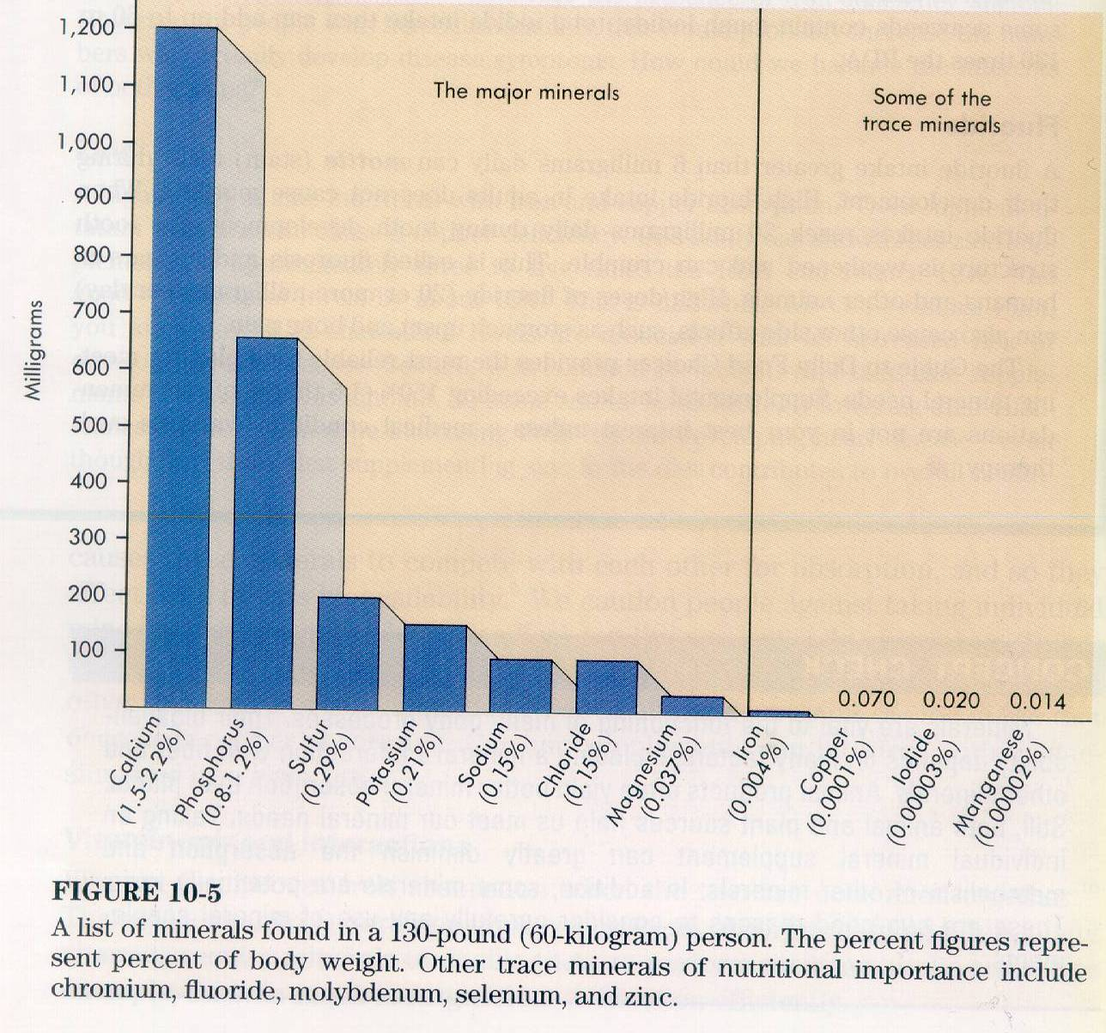

Slide 61
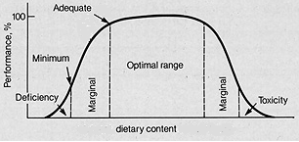
Trace minerals
Notes:
The range between safe supplementation and toxic levels is quite narrow for many of the trace minerals. Formulation of mineral supplements requires considerable expertise since the addition of high levels of one may depress the utilization of another, causing a deficiency. Also, some trace minerals can be toxic in excess.

Slide 62
Sodium and Chloride
Sodium (Na) and Chloride (Cl)
Functions
Osmotic equilibrium (body fluid concentration)
Acid - Base balance (pH of blood)
Nerve excitability (also K⁺)
Enzyme systems
Hcl (in stomach)

Slide 63
Sodium
Requirement
Commonly required as supplement
Daily secretion into G.I. tract 4-5 times dietary intake.
About 1% of dairy concentrate

Slide 64
Sodium
Deficiency
a. Sodium
(1) reduced growth rate and feed efficiency
(2) reduced milk production
(3) reduced appetite
(4) weight loss
Not very specific symptoms

Slide 65
Sodium
Toxicity
Animals will not eat too much as long as good water is available and they have not been deprived.
Salt and protein supplement can be used to self-feed the supplement. Need water available and will get increased urine output.

Slide 66
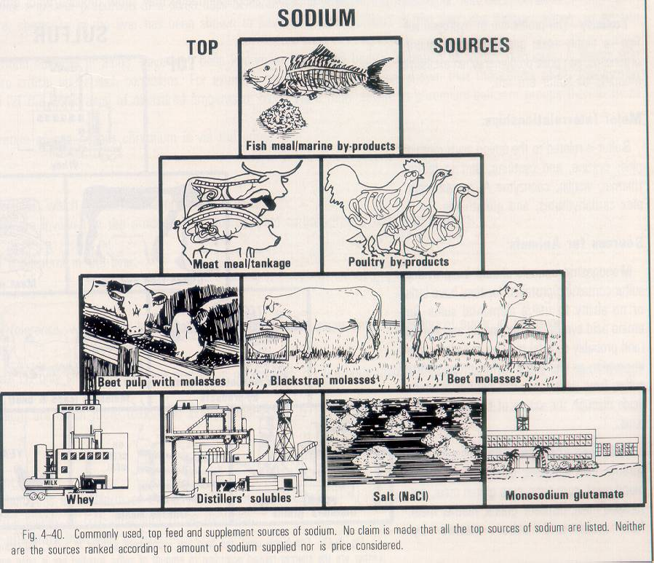

Slide 67
Potassium (K)
Functions
osmotic equilibrium
acid base balance
nerve excitability
digestion

Slide 68
Potassium Deficiency
Pica (depraved appetite)
Sheep may bite and pull wool
Anorexia
General overall muscle weakness
Abnormal electrocardiograms
Higher hematocrit reading

Slide 69
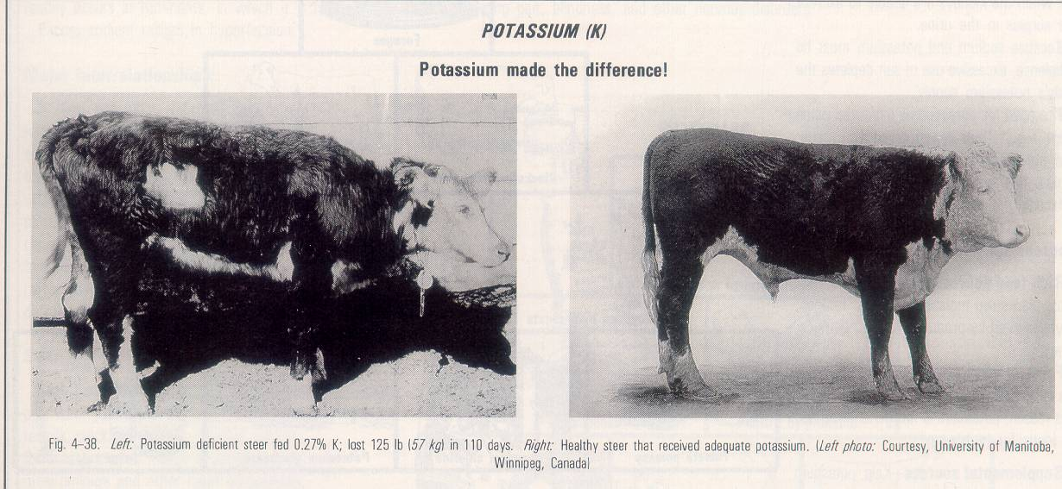
Potassium
Neither deficiency or toxicity is often a practical problem.

Slide 70
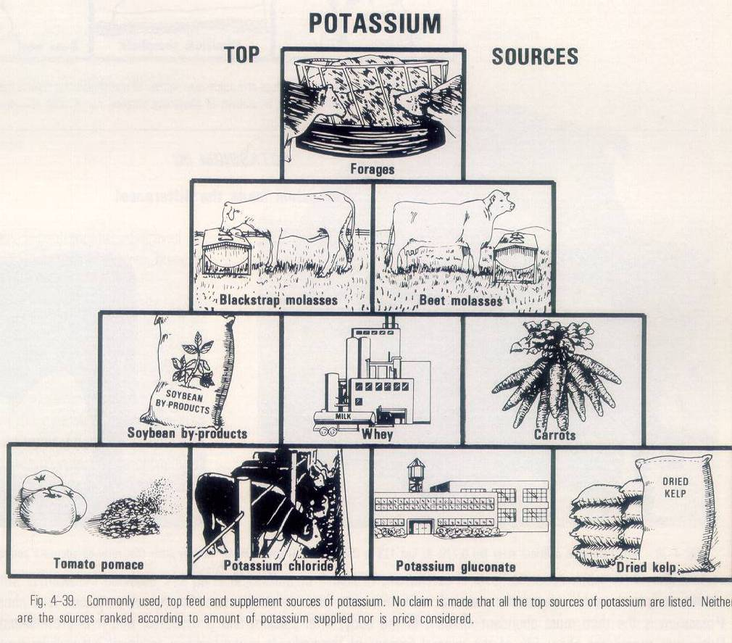

Slide 71
Calcium
Bone storage.
99% of stored calcium is in bone and teeth
found in bone as hydroxyapatite in 2:1 ratio with P.

Slide 72
Calcium (Ca)
Functions
Bone mineral
Milk and Egg shell mineral
Muscle contraction
Blood clotting
Cell signal transduction

Slide 73
Calcium
Absorption, storage and control
Vitamin D required for Ca uptake from G.I. tract.
Ca absorption is about 50% (apparent) and decreases as dietary level increases and with animal age.
Lactose and lysine will enhance Ca absorption.

Slide 74
.

Slide 75
Calcium Absorption
Active transport in duodenum and jejunum
Saturable
Transport Protein: TRPV6 (transient receptor potential vanilloid 6)
Calbindin (cytosolic binding protein; stimulated by vitamin D), shuttles calcium across the cytosol
*TRPV6 and Calbindin decline with age
Paracellular absorption

Slide 76
Calcium Deficiency
Young - rickets = enlarged joints, bones soft and deformed
Adult - Osteomalacia = bones porous and weak
Acute deficiency - Hypocalcemia and tetany

Slide 77
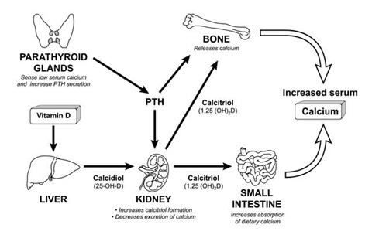
Regulation of calcium: extracellular
PTH
Calcitriol
Calcitonin

Slide 78
PTH
Promotes synthesis of calbindin
Secreted when calcium is low

Slide 79
Calcitriol
Promotes synthesis of calbindin
Increases TRPV6 and ATPases

Slide 80
Calcitonin
Secreted by the thyroid gland
Suppresses PTH formation and synthesis
Inhibits osteoclasts
Calcitonin DECREASES blood calcium
Notes:
Synthesized by the thyroid gland

Slide 81
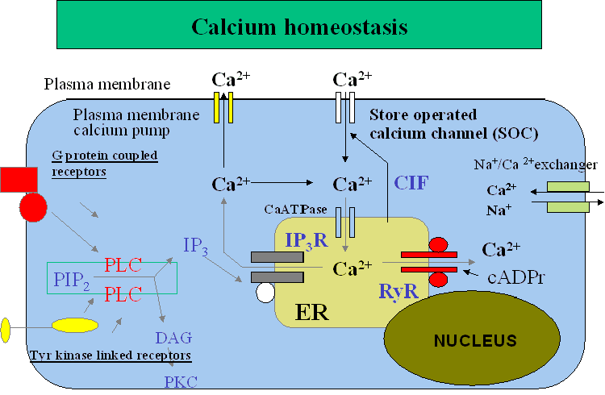
Regulation of calcium: intracellular
Low concentrations within the cytoplasm
Ca²⁺ pumps maintain this level based on cell needs

Slide 82
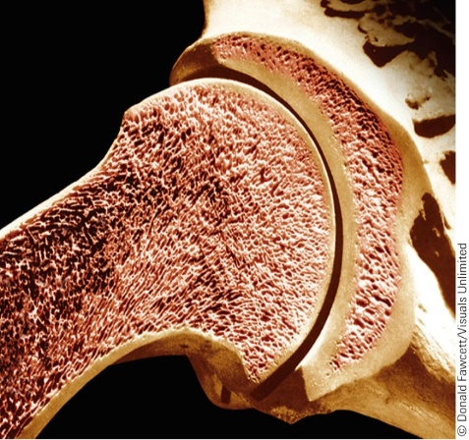
Calcium - Functions
99% found in bones and teeth
Calcium and other minerals are added to the protein matrix
Osteoblasts secrete substances that promote calcium deposition
Osteoclasts contain lysosomes that release minerals from bone
Sensitive to PTH, calcitriol, and calcitonin

Slide 83
Calcium - Functions
Cortical bone
Outer, hard, 75-80% of bone
Trabecular
Inner (vertebrae, shaft of long bones, pelvis, etc.), spongy
*Sensitive to changes in nutrients, hormones, etc.

Slide 84
Calcium – Other roles
1% Ca not associate with bone
50% is ionized (active)
Alone or with calmodulin, it affects enzymes that regulate
Blood clotting
Nerve conduction
Muscle contraction
Enzyme regulation
Membrane permeability
Notes:
Blood clotting (binding phospholipids with GLA proteins)
Nerve conduction
Muscle contraction (released from sarcoplasmic reticulum. The released calcium then bind to troponin C, which has four calcium binding sites. Conformational change. Actin and myosin can now interact resulting in muscle contraction.
Ion channels.
Regulates a bajillion enzymes as just calcium or with calmodulin

Slide 85
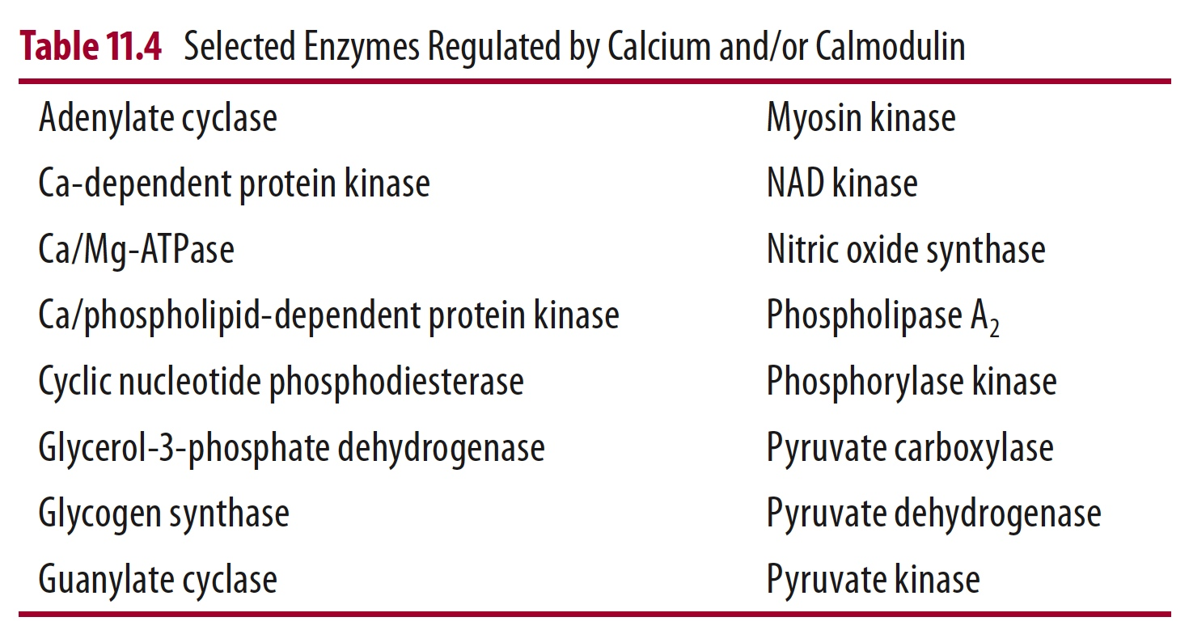
.

Slide 86
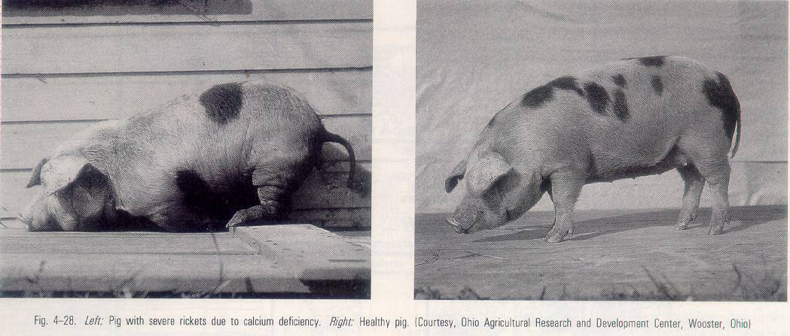

Slide 87
Calcium
Acute deficiency - Hypocalcemia and tetany
Parturient Paresis (Milk Fever)
Vitamin D just before parturition
Calcium Phosphorus ratio
Low calcium (and Phosphorus) before parturition

Slide 88
Calcium
expect good cow should need to remove Ca from bone to make milk for first part of lactation.
Supplementation may be required.
Toxicity
a. Lower Zn utilization
b. Calcification of soft tissues

Slide 89
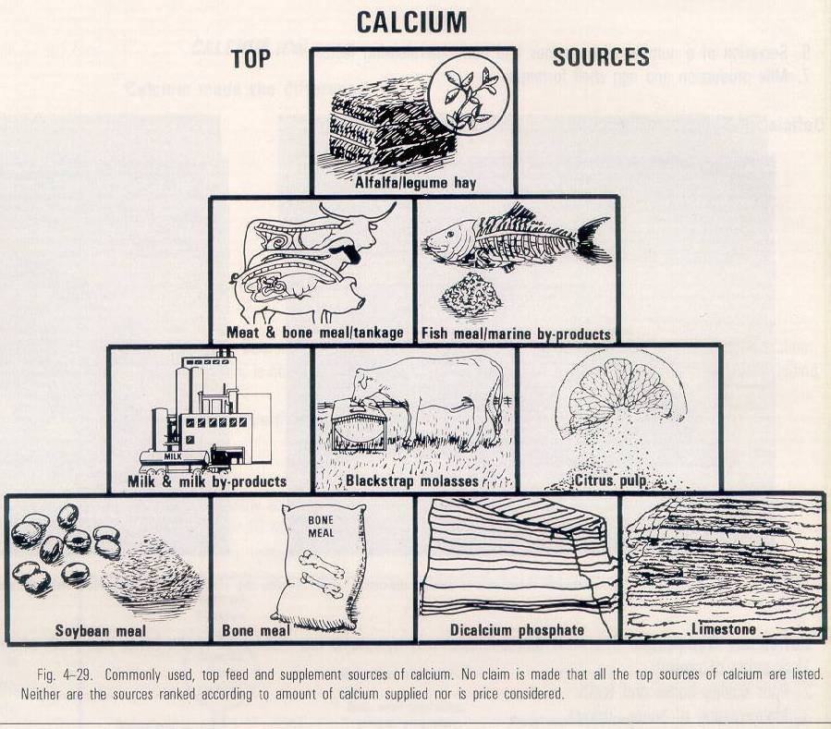

Slide 90
Phosphorus (P)
Functions
bone mineral - 80% of body P is in skeleton
ATP
Phospholipids
RNA
Absorption
Passive from G.I. tract
Phytic acid - Organic form not available to poultry and poorly available to swine.

Slide 91
Phosphorus
Digestion
Cleaved from proteins, sugars and lipids
Absorption
Saturable – carrier mediated active transport
Concentration-dependent facilitated diffusion

Slide 92
Transport & Storage
Intestine to blood
Organic 70% (lipoproteins, phospholipids)
Inorganic forms 30%
Storage
Circulating is in equilibrium with skeletal & cellular
Found in all cells, especially bone and muscle

Slide 93
Phosphorus - Functions
Nucleotide Phosphates
Structural roles (DNA & RNA)
Energy Storage (ATP)
Intracellular 2nd messenger (cAMP)
Structural Roles
phospholipids
Acid-Base Balance
buffer
Oxygen availability
2,3-diphosphoglycerate required for oxygen release from hemoglobin
Notes:
Oxygen availability: phosphate is indirectly involved in oxygen delivery. In rBC, the synthesis of 2,3-diphosphoglycerate, which influences oxygen release from hemoglobin, requires phosphorus.

Slide 94
Phosphorus - Functions
Bone mineralization – 85% as hydroxyapatite
Calcitonin – promotes ossification of phosphorus onto matrix
PTH – promotes resorption of phosphorus from bone and excretion in urine
Calcitriol – promotes increased phosphorus absorption in the intestine

Slide 95
Excretion
Urine – inorganic form 67-90%
Feces – 10-33%
High diet, high serum, high urine (renal regulation)
Notes:
High diet, high serum, high urine (renal regulation)
- unlike calcium: High diet: high serum: high BMD

Slide 96
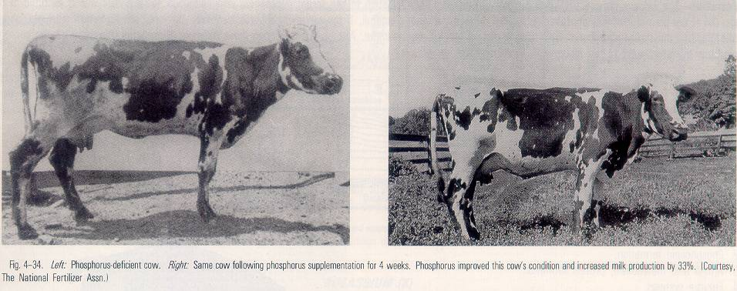
Phosphorus
Deficiency
a. Pica - depraved appetite
b. impaired fertility
c. rickets

Slide 97
Phosphorus
Toxicity
Acts like Ca deficiency
May result in diarrhea

Slide 98
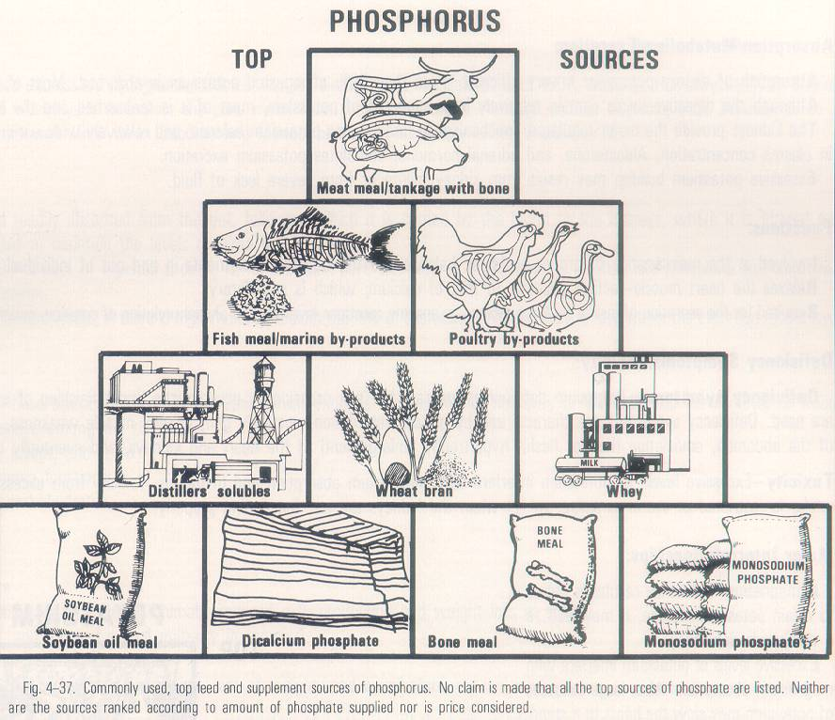

Slide 99
Ca:P Ratio
Wide deviations from proper Ca:P ratio will result in unsatisfactory performance even if both Ca and P are present in excess of minimum requirements.

Slide 100
Ca:P Ratio
Species Ca:P Ratio
Adult Horses 1:1 - 3:1 (6:1)
Swine + Poultry 1.1 - 1.5
Cows + Sheep 1.1 - 2

Slide 101
Ca:P Ratio
Calcium and Phosphorus frequently require supplementation and should be checked when determining the adequacy of a diet.
A. High Calcium feedstuffs
Legume hay
Milk
By-products containing bone
Fish meal

Slide 102
Supplements
B. Low Calcium feedstuffs
(1) Cereal grains
C. High Phosphorus feedstuffs
(1) Protein rich plant by-products
D. Low Phosphorus feedstuffs
(1) Pasture or hay from low P soils

Slide 103
Magnesium (Mg)
Functions
Activation of enzymes which split ATP
Important in carbohydrate metabolism
Proper function of nervous system
About ½ is in bone.

Slide 104
Magnesium (Mg)
Deficiency
High Ca and P aggravate Mg deficiency
Symptoms
Hyper-irritability (stepping syndrome in pigs)
Tetany
Death

Slide 105
Magnesium (Mg)
Grass tetany or wheat pasture poisoning
Occurs on native pastures in periods of lush growth
Animals have low blood Mg.
Forage not necessarily low in Mg. May be due to factors inhibiting uptake or a change in distribution within the body and rumen.
Supplemental Mg will prevent
Toxicity: not a common issue

Slide 106
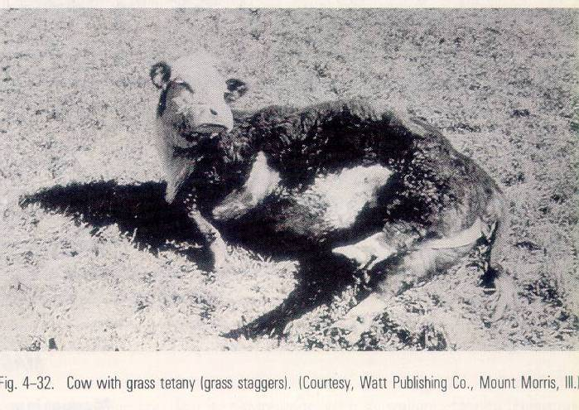

Slide 107
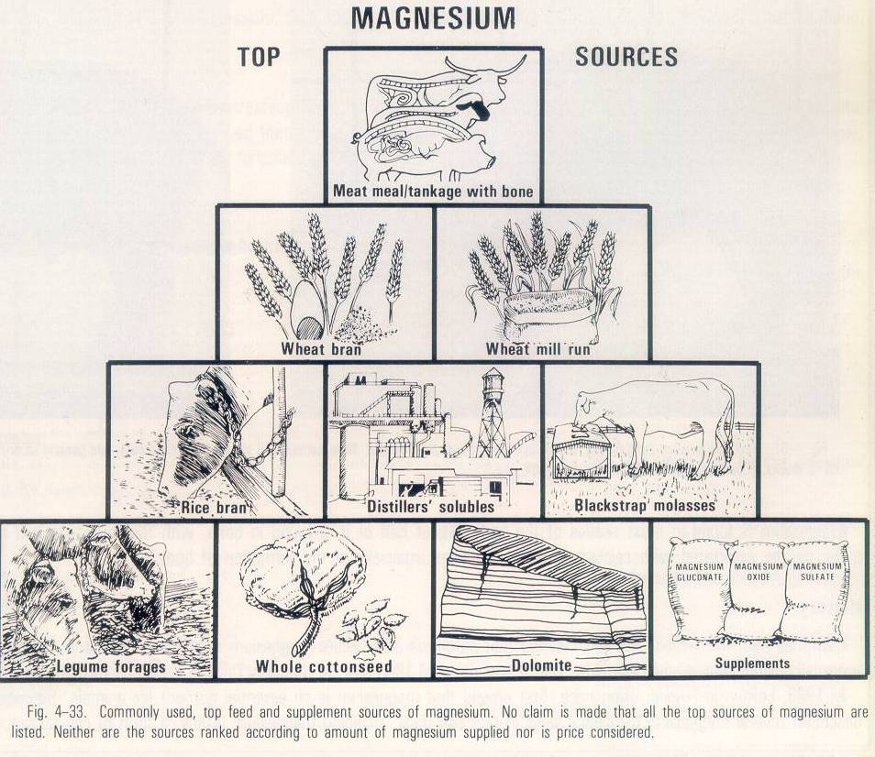

Slide 108
Sulfur (S)
Functions
Part of Cystine, cysteine, and Methionine
Deficiency
a. Protein deficiency - general unthrifty condition and poor performance.
b. In Ruminant - poor cellulose digestion and altered volatile fatty acid proportions.

Slide 109
Sulfur (S)
Deficiency and toxicity are not practical problems.
Heavy wool producing sheep on mature grass and animals on high levels of urea and low sulfur feed will sometimes show a response to Sulfur supplementation.

Slide 110
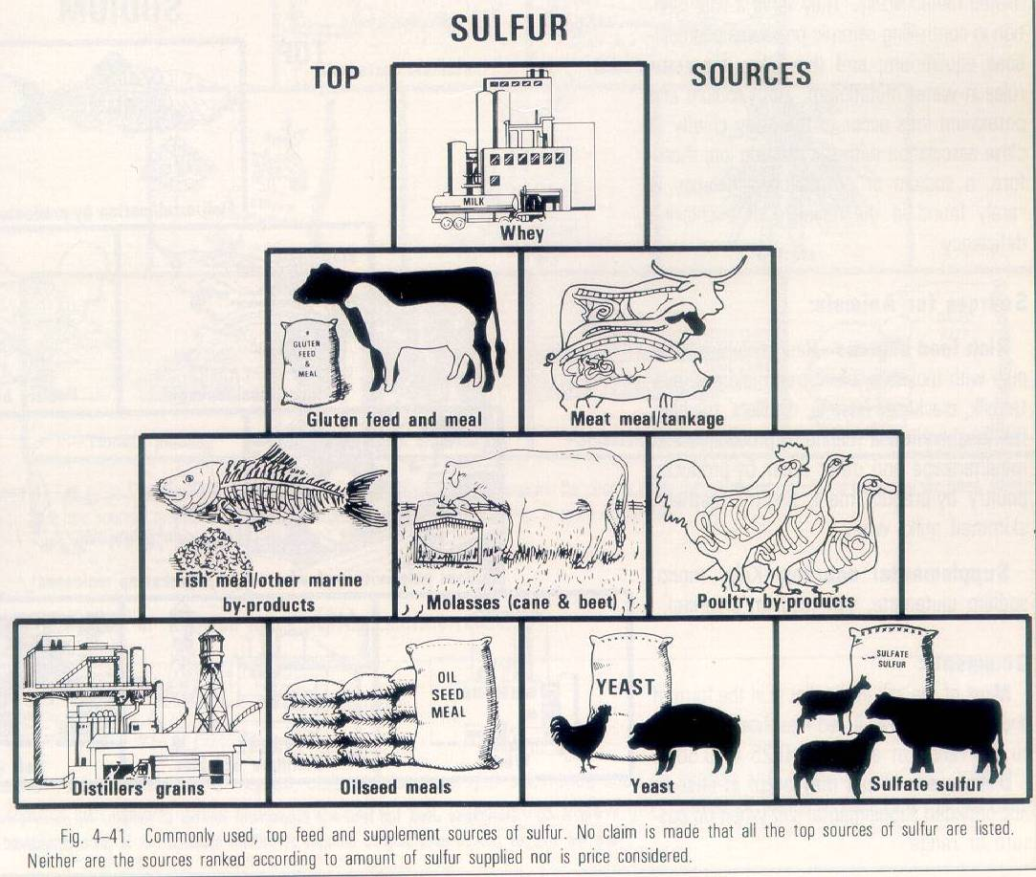

Slide 111
Iron (Fe)
> 90% along with proteins
Transferrin (serum transporter of Fe)
Ferritin (Fe storage; liver, kidney, spleen)
Hemoglobin; O₂ transfer
Cytochromes, flavoproteins

Slide 112
Iron (Fe)
Anemia (esp. young animals: piglets)
Delayed growth rate
Green leaves
Legumes
Animal-based feeds
Fe vs. P

Slide 113
Copper (Cu)
In proteins
Hemoglobin synthesis
Many enzymes: cytochrome oxidase
Pigmentation: feathers, hair, and wool
Deficiency: “Enzootic ataxia”
Stringy or steely wool
Anemia
Notes:
The diagnosis is based on the presence of a) gross cavitations and gelatinous lesions of the cerebral white matter in 16 of 24 (66.67%) lambs examined, b) central chromatolysis and hyalinization of neurons of the red and vestibular nuclei and reticular formation and of the lateral and ventral horns of the spinal cord, c) myelin deficiencies of the dorsolateral and sulcomarginal funiculi of the spinal cord and d) low hepatic and serum copper levels in affected lambs and low serum copper levels in the ewes

Slide 114
Copper (Cu)
Cu, Mo, and S
Toxicity: sheep very susceptible
Swine and cattle; less susceptible

Slide 115
Cobalt (Co)
Synthesis of B₁₂
Used by rumen microbes
Its deficiency associated with B₁₂ deficiency
Good pasture, forages
Toxicity: cattle

Slide 116
Iodine (I)
Thyroid hormones
Triiodthyronine (T3)
Tetraiodothyronine (T4)
Deficiency:
Enlargement of the thyroid gland; Goiter
Sources:
Marine foods; fish meal, seaweeds

Slide 117
Manganese (Mn)
Many enzymes: TCA cycle
Deficiency: growth rate; ataxia; reproductive failures, perosis (chicken)
Sources: Pastures, seed (not corn), rice and wheat bran

Slide 118
Zinc (Zn)
In all enzymatic reactions
In skin, wool, hair
Sources: yeast, cereal bran and germ
Toxicity: induce Cu deficiency

Slide 119
Molybdenum (Mo)
Purine metabolism; xanthine oxidase
Deficiency: ???
Toxicity: cattle (dairy and young)

Slide 120
Selenium (Se)
A component of Glutathione peroxidase
Antioxidant
Closely working with vitamin E
Myopathies in sheep and cattle
Toxicity: Alkali disease (blind stagger)

Slide 121
Micro-minerals
All can be provided by feeding mixed supplements.
Mineral blocks (free access)
TOXICITY levels

