Slide 1
An overview of nutrients

Slide 2
Nutrients
Carbohydrates
Proteins
Lipids
minerals
vitamins
water

Slide 3
Dry Matter
Organic compounds:
  Carbohydrates
  Lipids
  Proteins
  Nucleic acids
  Vitamins
  Organic acids
2. Inorganic Compounds:
  Minerals

Slide 4
Proximate Analysis
Moisture
Ash
Crude Protein
Ether Extract
Crude Fiber
Nitrogen Free Extract (NFE): calculated

Slide 5
Proximate Analysis
Dried Sample
Kjeldahl (CP)
Ether Extraction (EE)
Fat Free Residue
Boil in acid
Ash
Boil in alkali
Crude Fiber
Crude Fiber + Ash

Slide 6
Crude Fiber
Mono-gastric Animals ……
Ruminant Animals …..?
Detergents
NDF (cell wall contents): gut fill
ADF (NDF minus H-cellulose): digestibility
ADL ???

Slide 7
Carbohydrates
Primary component of livestock feed
Renewable resource as they are converted to CO2 and H₂O.
Primary carbohydrate in plants is glucose
Comprise 70% of forage dry matter and 80% of concentrates
Carbohydrates are a source of energy but there is no specific requirement for them

Slide 8
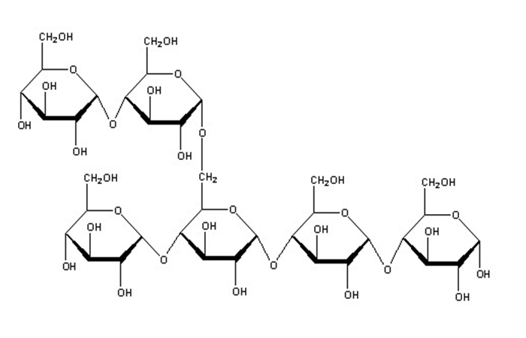
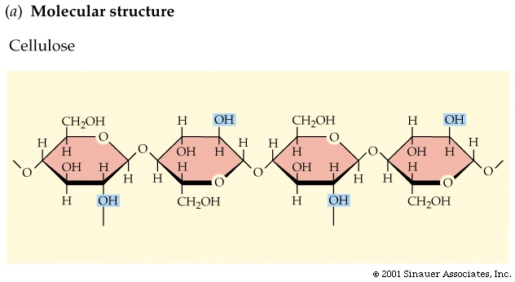
Carbohydrates
Carbon, hydrogen, oxygen
Monosaccharide five pentose or six carbons hexose.
Disaccharides, polysaccharides
Starch

Slide 9
Carbohydrates
Sugars: Mono (# C) : C₃, C₄, C₅, C₆, C₇
  Pentoses: Ribose; Hexoses: Glu, Gal, Man, and Fru
  Disaccharides: Sucrose, Lactose, Maltose
Tri: Raffinose, Kestose
Tetra: Stachyose

Slide 10
Carbohydrates
Polysaccharides
Non-
Sugars
Homoglycans
Arabinans
Xylans
Glucans
Heteroglycans
Pectic Substances
Hemicellulose
Gums
Chondroitin
Starch, Dextrin,
Glycogen,
Cellulose
Complex Carbohydrates
Glycolipids
Glycoproteins

Slide 11
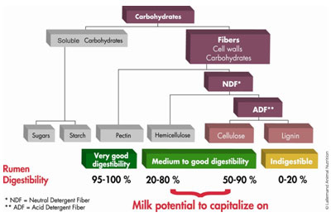

Slide 12
Lipids
General
  Soluble in ether
  Contain Carbon, Hydrogen and Oxygen C, H, O
  High proportion of carbon and hydrogen
  ~2.25 times the energy of carbohydrate per gram

Slide 13
Lipids
Classification
  Simple
    True fat - esters of glycerol
    Waxes - esters of other alcohols
Classification
  Compound - groups other than alcohol and FA's
    Phospholipids - phosphoric acid and nitrogen
    Glyco-lipids - Carbohydrates and nitrogen
    Lipoproteins- proteins and lipids

Slide 14
Lipids
Glycerol-based
Non Glycerol-based
Simple
Complex
Phosphoglycerids
Waxes
Steroids
Terpens
Sphingomyelin
Prostaglandins
Fat/ Oil
Glycolipids
Lecithin
Cephalin
Galactolipids
Glucolipids

Slide 15
Lipids
Classification
  Derived lipids
    Fatty acids
    Sterols
Fats and Oils
  Fat vs Oil - Melting point only difference
  Fat = glycerol + 3 fatty acids

Slide 16
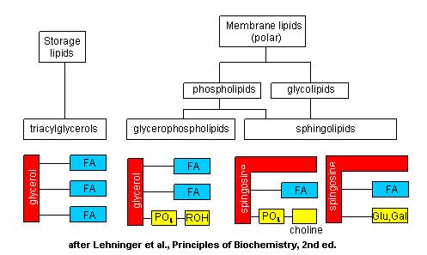
Lipids

Slide 17
Lipids
Characteristics of fat due to type and proportion of different fatty acids
  Chain length
    Longer chains result in higher melting points.
      Butyric C₄H₈O₂
      Palmitic C₁₆H₃₂O₂
      Stearic C₁₈H₃₆O₂

Slide 18
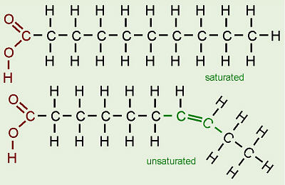
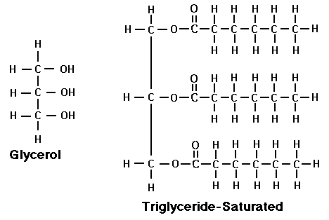

Slide 19
Other lipids
Carotenes
  Yellow colored substances common in plants that can be converted by animals to vitamin A.
Phospholipids
  Most abundant in blood, brain, liver and egg yolk. Can be utilized.

Slide 20
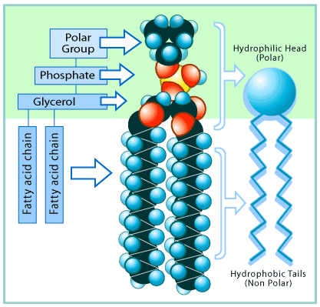
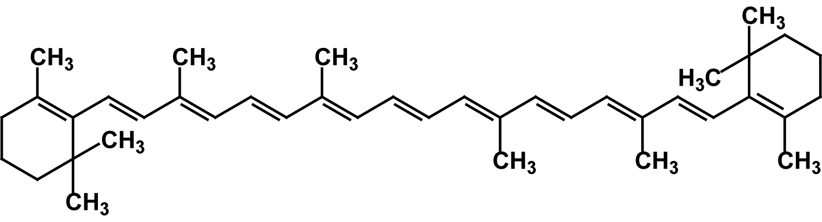
β-carotene
Phospholipids

Slide 21
Poly Unsaturated FA

Slide 22
Other lipids
Chlorophyll
  Green colored substance in plants - No feed value for animals.
Waxes
  Surface of leaves and fruits.
Essential oils.
  Give plants their odors and tastes.

Slide 23
Proteins
  Long chains of Amino Acids.
  Contain Nitrogen, carbon, hydrogen, oxygen, and sometimes sulphur.
  Lose tertiary structure when heated.

Slide 24
Proteins
Globular
Fibrous
Conjugated
Amino acids
      Indispensable
      Dispensable
Structural
Transporter
Catalytic
Totally
C-skeleton
Traditionally
Indispensable
Conditional
Acquired
dispensable
Immaturity
Disorders
AA intake
Newer Definition
Human Nutrition

Slide 25
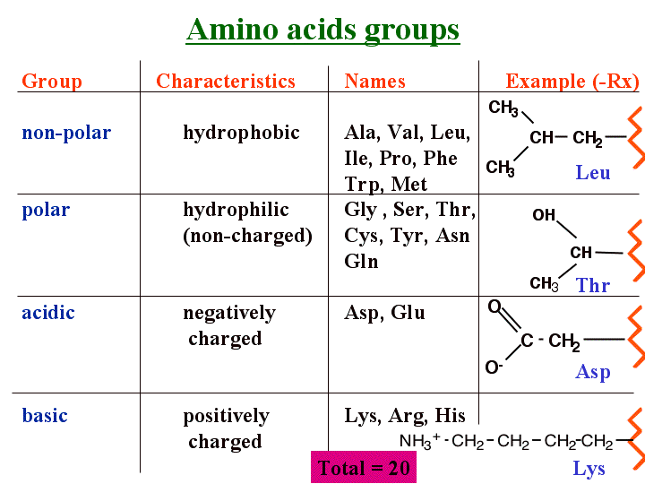

Slide 26
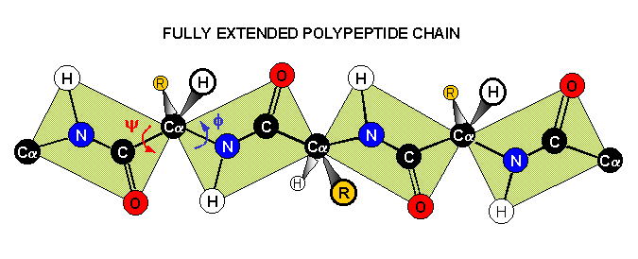

Slide 27
Other N compounds
Non protein Nitrogen (NPN)
  Urea
  Nucleic acids
      DNA
      RNA

Slide 28
Additives
Not as nutrients
Some examples
Antibiotics: growth stimulator/ disease control
Anti-parasitic drugs
Synthetic Antioxidants
Antifungal agents
Enzymes: improved digestion

Slide 29
Digestion

Slide 30
Primary Enzymes for Digestion of Carbohydrates
Food Source | Enzyme | Origin | Product
Starch, glycogen, dextrin Maltose Lactose Sucrose | Amylase Maltase Lactase Sucrase | Saliva & pancreas SI SI SI | Maltose & Glucose Glucose Glucose & galactose Glucose & fructose
Ruminants do not secrete much sucrase
Inducible enzymes
Lactose intolerance

Slide 31
Primary Enzymes for Digestion of Proteins
Food Source | Enzyme | Origin | Product
Milk protein Proteins Polypeptides Peptides | Rennin Pepsin Trypsin Chymotrypsin Carboxypeptidase Aminopeptidase | Gastric mucosa Gastric mucosa Pancreas Pancreas Pancreas Small intestine | Curd Polypeptide Peptides Peptides Peptides & amino acids

Slide 32
Primary Enzymes for Digestion of Lipids
Food Source | Enzyme | Origin | Product
Lipids | Lipase & colipase | Pancreas | Monoglycerides & free fatty acids

Slide 33
Nutrient Digestion - Lipids
Large Lipid Droplet
Action of bile salts
Lipid emulsion
Small
Bile salts & pancreatic lipase
and colipase
Water soluble micelles

Slide 34
Digestion of Lipid
Bile salts emulsify lipids
Pancreatic lipase acts on triglycerides
  Triglycerides sn-2 Monoglyceride + 2 fatty acids
Pancreatic colipase
  Activated by trypsin
  Interacts with triglyceride and pancreatic lipase
    Displaces bile
    Improves activity of pancreatic lipase

Slide 35
Importance of Pancreas for Digestion
Produces enzymes responsible for
  50% of carbohydrate digestion
  50% of protein digestion
  90% of lipid digestion
Produces bicarbonate for neutralization of chyme in duodenum

Slide 36
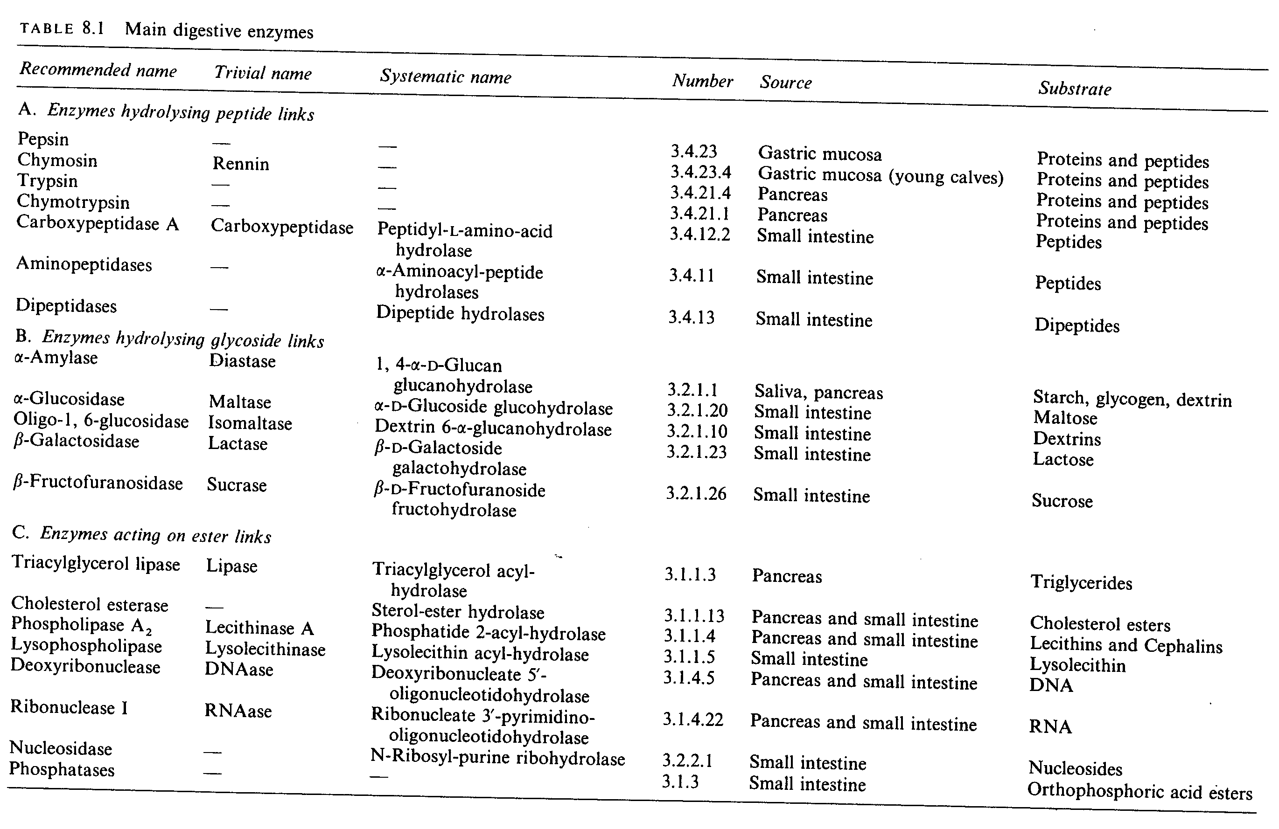
Digestive enzymes; summary

Slide 37
Regulation of Digestion
GI hormones/Peptides | Hormones secreted within GI tract affect digestion
Extrinsic Autonomic Nervous System | Symptathetic: “Fight or Flight” Parasmypathetic: “Rest and Digest”
Intrinsic/Enteric Nervous System | Located in GI tract; affects digestive organs

Slide 38
Hormones and Peptides
Gastrin – promotes digestion (motility and/or secretion) in the stomach and small intestine
Cholecystokinin (CCK)
  produced in the S.I. in response to dietary fat
  Stimulates gallbladder and pancreatic secretions
  Inhibits gastric digestion
Peptide YY
  Inhibits secretion of gastric acid and pancreatic juice
  Inhibits gastric and intestinal motility

Slide 39
Hormones and Peptides
Somatostatin
  Inhibits the secretion of Gastrin → decreases gastric and intestinal motility, and pancreatic and gallbladder secretions
Motilin
  Sounds like “motility”
  Increases gastric and intestinal motility

Slide 40
Extrinsic Autonomic Nervous System
Sympathetic (fight or flight)
  Decreases blood flow to GI tract
Parasympathetic (rest and digest)
  Promotes digestion
  i.e. vagus nerve

