Slide 1
digestive tract in Ruminants

Slide 2
Ruminants
Reticulum, rumen, omasum, abomasum
Pseudo-ruminants: camel w/ three compartments.
Extensive pre-gastric microbial fermentation (60 % to 75 %)
Stomach is ~26% of body weight compared with 4% in swine

Slide 3
Mouth
Tongue
More used by cattle & goats (also lips)
Teeth
No upper incisors
Used more by sheep (use lips more to sort)
Saliva
Continual production
Cattle: 12-15 gal/d; sheep: ~2 gal/d
No enzymatic function; adjusting pH (alkaline)

Slide 4
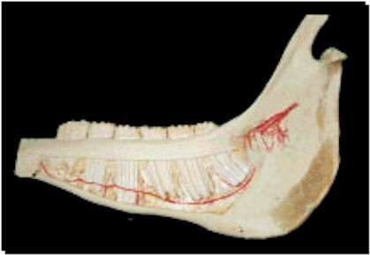
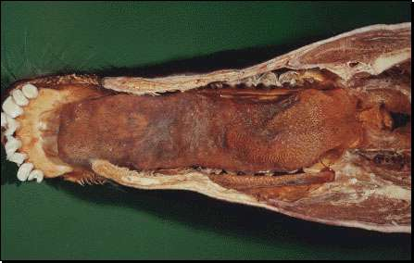

Slide 5
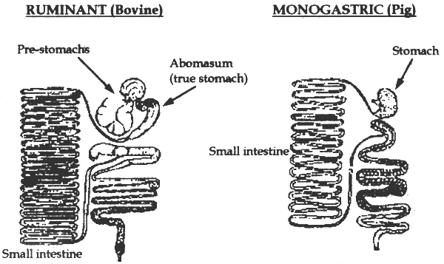

Slide 6
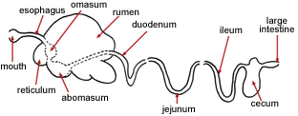

Slide 7
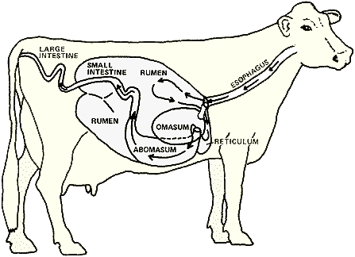

Slide 8
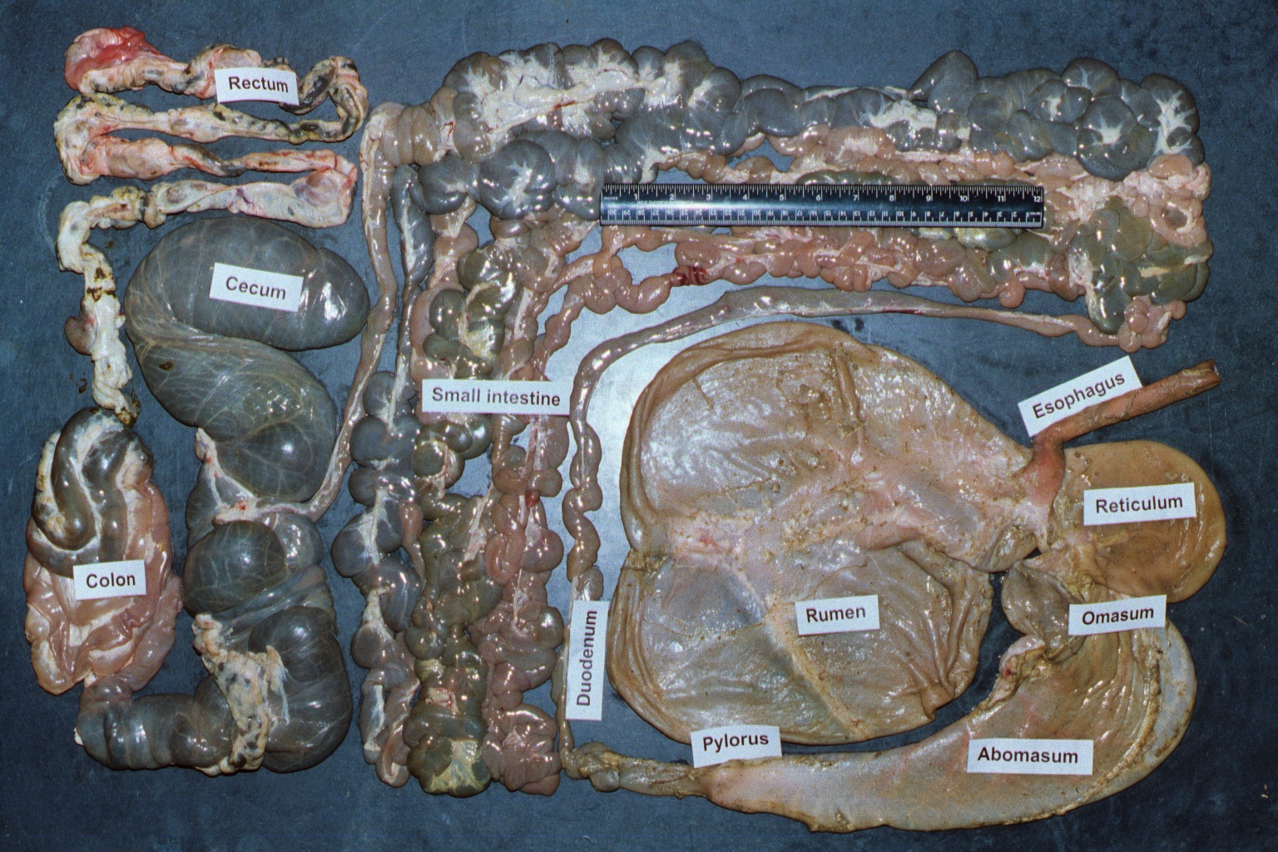
Notes:
Sheep digestive tract

Slide 9
Esophagus
No sphincter valve
Opens into reticulum & rumen
Muscle contractions, move in both directions

Slide 10
Reticulum
Lies against the diaphragm and is the most cranial component.
AKA the “honeycomb”:
-Lined with mucous membrane containing many intersecting ridges which subdivide the surface into many folds that form polygonal cells that give it a reticular, honeycomb-like appearance. This increases surface area of organ for increased digestion.
Serves as a protection mechanism: Heart can be damaged by appositional location next to heart by “Hardware Disease.”
Stratified squamous epithelium.
No enzyme secretion

Slide 11
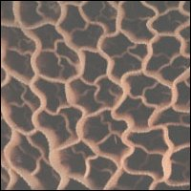
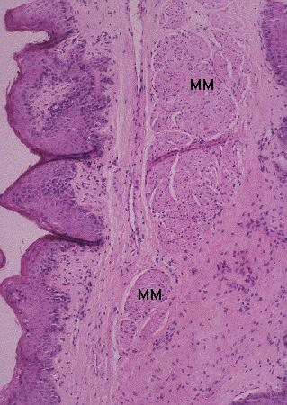
Reticulum
Honeycomb appearance
Hardware problems (magnets)
Muscular for eructation and milk groove.

Slide 12
Rumen
The largest of the forestomachs extending from the diaphragm to the pelvis and almost entirely filling the left side of the abdominal cavity.
Sacculated by muscularis pillars into what are known as the dorsal, ventral, caudodorsal, and caudoventral sacs. Many times the reticulum is considered a fifth cranioventral sac because ingesta flows freely between these two organs.
The surface is covered by a stratified squamous epithelium.

Slide 13
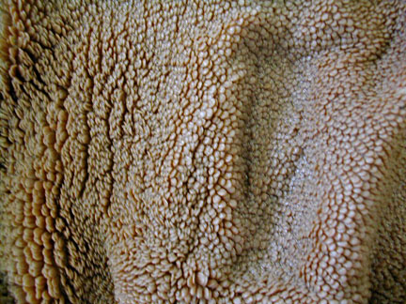
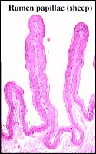
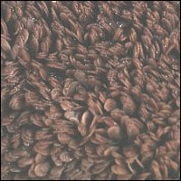
Rumen Epithelium

Slide 14
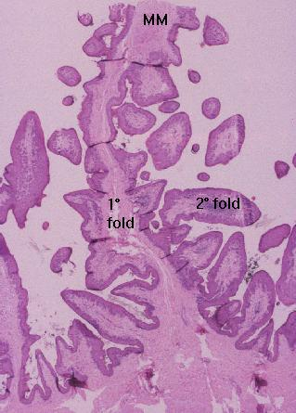
Ruminants
Cellular lining of first three stomachs is stratified squamous epithelium not typical of absorption sites however it is only two layers thick so some compounds can be absorbed.

Slide 15
Growth & development of digestive tract

Slide 16
Early stages
The abomasum is the largest component (~ 50% of total weight)
Feeding dry feed causes rapid growth in weight, volume, musculature & absorptive capacity
Rumen growth: VFAs, resident dry feed

Slide 17
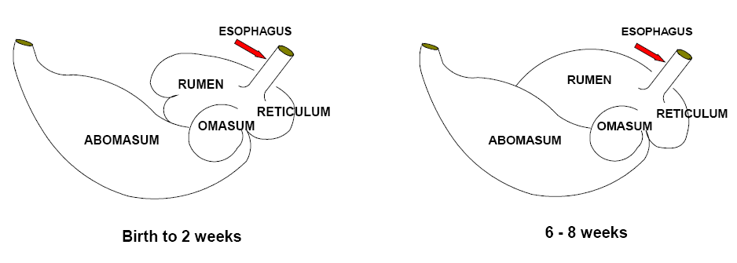
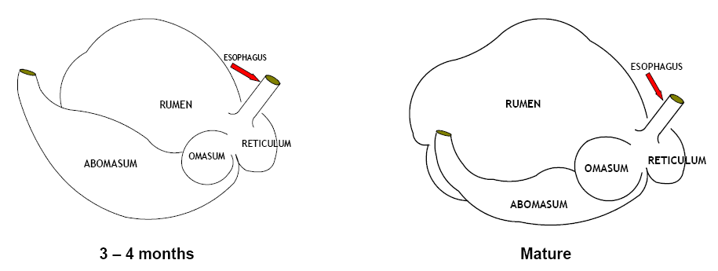

Slide 18
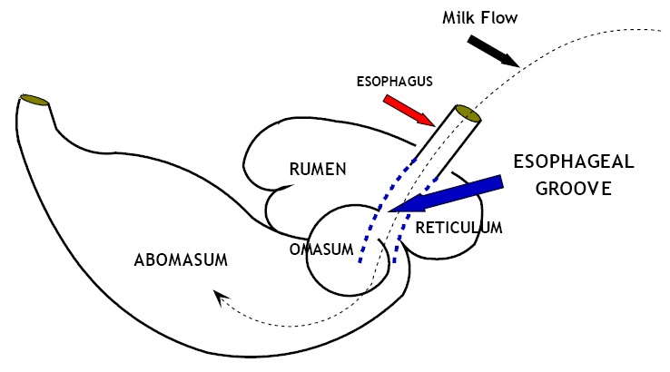
Reticular groove
Reflex; Suckling process; chemical stimulation
Lips closing to form a canal to bypass reticulo-rumen milk through omasal groove to the abomasum

Slide 19
Growth and development of the rumen
Sources of rumen microbes: surrounding environment
Feces
Saliva
Over a 4 wk period, grows 4-8X
Rumen papillae
Forage intake

Slide 20
Relative size of stomach compartments; birth to maturity

Slide 21
Motility
Mixing
Regurgitation
Pushing food to omasum
Overall, circulates digesta within the reticulo-rumen (~ 40s in resting)

Slide 22
Rumen Gas
Upper part of the dorsal rumen
Mainly CO₂ (0.67-0.75 of total) and CH₄
Minor: N, O₂, H, HS₂
Mostly eliminated via eructation
Also, across rumen wall (CH₄)
Bloat: failed eructation
Legume bloat
Feedlot bloat

Slide 23
Reticulum Physiology
Regurgitation is initiated with a reticular contraction.
Heavy objects (grain, rocks, nails) fall into the reticulum while lighter materials such as grass and hay enter the rumen
Gases flow from the rumen into the reticulum and eructation or belching occurs with a reticular contraction to rid of the fermentation gases.

Slide 24
Rumen
Largest
Papillae, tongue-like projections
Extensive blood supply
Density and size of papillae differ in locations and in different species.
Muscular pillars divide it into several sacs contract in a rhythmic manner mixing the ingested feed with rumen contents.

Slide 25
Rumen Physiology
Enormous space filled with chewed and half-chewed material that the animal has ingested, swallowed, regurgitated, and swallowed again.
“Chewing Cud”
Nutrient absorption occurs here despite the presence of keratinized, stratified, squamous epithelium.

Slide 26
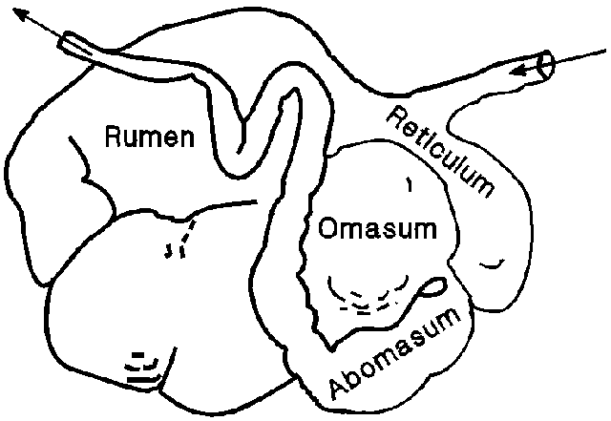

Slide 27
Rumination
Process of regurgitation of ingested feed for further mastication
Undigested coarse feed collects in reticulum and is send back up the esophagus.
Eight hours/day; function of diet

Slide 28
Rumination
Regurgitation of ingesta:
Mastication
Reforming the bolus
Re-swallowing
Reticulo-rumen contents
esophagus
mouth
Scratch factor: forage diets vs. concentrate diets

Slide 29
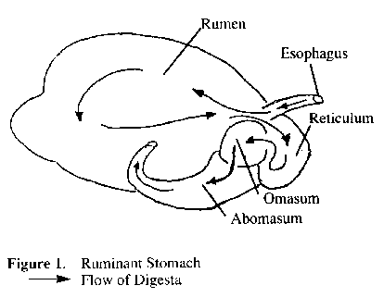

Slide 30
Functions
Storage
Soaking
Physical mixing & breakdown (physical digestion)
Fermentation (breakdown fibrous particles)
Volatile fatty acids
Vitamins
Amino acids

Slide 31
Rumen Physiology
The by-products of fermentation that results from the microorganisms are fatty acids and gases in the form of CO₂ and methane. These gases rise to the top of everything.
Gases
Today’s grain
Yesterday grain and hay

Slide 32
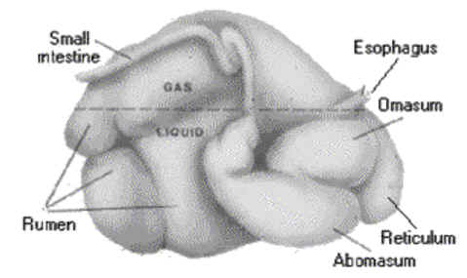

Slide 33
Saliva
Ruminants produce 100-150 L/d
Serves two important functions: A. Provision of fluid for fermentation B. Alkaline buffering which is critical for rumen pH.
Feed, water and saliva are delivered to the reticulum through the esophageal orifice.

Slide 34
Saliva
pH: 8.1
DM: 1.3%
Ash: 0.97%
Na: 352-447 mg/100 mL
K: 12-45 mg/100 mL
N: 16-35 mg/100 mL
P: 19-129 mg/100 mL
Ca: 0.8 mg/100 mL
Mg: 0.8 mg/100 mL

Slide 35
Saliva and salivary glands
In ruminants, no digestive enzymes
Fluid: transport
Adequate phosphate; cellulose degradation
Buffer: neutralize low pH created by FA (e.g., lactic acid)
Glands:
The biggest is mandibular
The most important one is the parotid: Alkalinity

Slide 36
