Slide 1
Other components of digestive tract

Slide 2
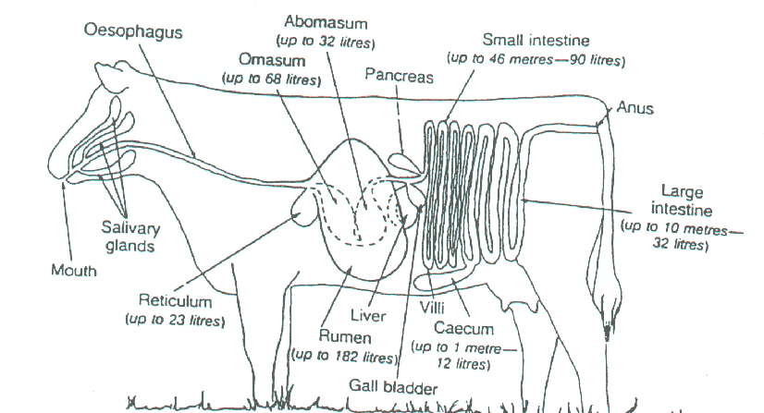

Slide 3
Passage rate
How fast ingesta passes through the rumen
Physical form of feed ingredients
Rumination
Feeding frequency; meal size

Slide 4
Rate of Flow
Rate of flow of solid is slow and dependent upon its size and density.
Water flows quickly.
Microbes proliferate.
Lighter solids are flushed back into the rumen.
Smaller, more dense particles are pushed into the reticulum or cranial sac of the rumen to be ejected into the omasum.

Slide 5
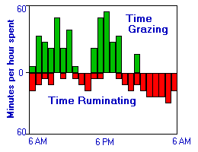

Slide 6
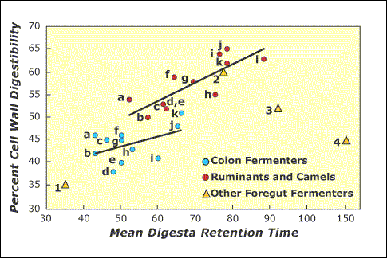

Slide 7
Omasum
Spherical shape; located to the right of the rumen and reticulum, just caudal to the liver
Lots of leaves that sieves the undigested material from the digested ones.
Filled with muscular laminae that descend from the roof of the organ.
The inner surface is covered by stratified squamous epithelium consisting of a mucous membrane covering the laminae studded with papillae that grind roughage before it enters the abomasum.

Slide 8
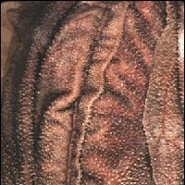
Omasum Surface Area

Slide 9
Omasum Function
Poorly understood.
Absorbs residual volatile fatty acids and bicarbonate.
fluid to pass rapidly through the canal, but for matter to be retained between the omasal leaves.
Periodic contractions knock the material out of the leaves and into the abomasum.

Slide 10
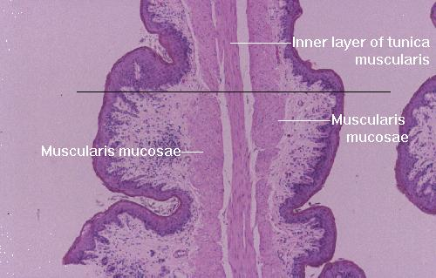
Detailed Omasum Epithelium

Slide 11
How does all this work?
The forestomachs possess an enteric nervous system that sends signals to the brainstem to control both the rate of motility and the strength of the contractions.
Cycle of contractions occurs 1-3 times/min.
Two types of contractions: primary and secondary.

Slide 12
Abomasum
AKA the “True Stomach”
First glandular portion of the ruminant digestive system.
Located ventral to the omasum and extends caudal on the right side of the rumen.
The pylorus is a sphinctor at the junction of the abomasum that joins the small intestine.
Surface changes from a stratified squamous epithelium near the omasum to a tall simple columnar epithelium capable of producing mucus.

Slide 13
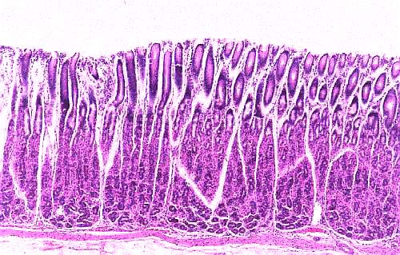
Epithelium of Abomasum

Slide 14
Abomasum Function
Functions very similar to the monogastric stomach by secreting acid.
Processes large masses of bacteria.
Secretes lysozyme, an enzyme that efficiently breaks down bacterial cell walls.
Allows material to enter the small intestine via the pylorus.
Closure of the reticular groove in young ruminants.

Slide 15
Digestive fluids
Saliva
Gastric juice
Pepsinogen
Rennin
Lipase
HCl

Slide 16
Cont.
Pancreatic juice
Chymotrypsin; Trypsin; carboxypeptidase
Amylase
Lipase
Buffers
Hepatic secretion
Bile salts; no enzyme

Slide 17
Cont.
Intestinal enzymes:
Amino-peptidase
Peptidase
Nucleases
Maltase
Lactase
sucrase

Slide 18
Abomasum, Small & Large Intestine
Glandular stomach
Small intestine is similar to monogastric species
Large intestine is larger than in omnivores species yet smaller than in horses and rabbits.

Slide 19
Small intestine
The small intestine is divided into three parts:
A. Duodenum- 1st part of small intestine responsible for most of nutrient absorption.
B. Jejunum- Middle portion of small intestine responsible for further absorption.
C. Ileum- Last portion of small intestine that opens up into the cecum and colon of the ruminant.

Slide 20
Colon and the cecum
The ileum opens up into two anatomical features:
A) Cecum- blind ended pouch which is of little importance compared to the pig and horse where it is absolutely critical for absorption of nutrients.
B) Colon which functions similarly to monogastrics with mucous secretion and water absorption. Only a small amount of nutrient absorption occurs in the colon.
The colon opens up to excrete fecal material and wastes through the rectum and anus out of the body.

Slide 21
Major differences
Esophageal groove
By-passing reticulum/rumen in young animals
Rumination
Chewing food bolus
~ 8 h/d depending on diet type
Particle size
Saliva production
Eructation (belching):
CO₂ & CH₄
Contraction of the rumen= gasses out
Bloat

Slide 22
Eructation
Belching of gas
Microbial fermentation produces large amounts of gas (carbon dioxide and methane)
Muscles in rumen contract and force the gas to the reticulum and then into the esophagus which dilates and allows gas to mix with inspired air and released out the nostrils.
Bloat could happen (froth) with high-concentrates and alfalfa, clover.

Slide 23
Evolution
Very efficient digestive system in extracting nutrition from low quality food.
Able to do this by symbiotic micro-organisms in gut, particularly in the forestomachs.
Turns the animals into a mobile fermentation plant.
Rumination occurs when the animal is at rest.

Slide 24
Symbiotic Relationship
Ruminant and microbes
Reticulo-rumen environment is moist, warm, nutrients, removal of end products great for microbial growth.
25 to 80 billion/mL bacteria
35 or more species of ciliated protozoa 20,000 to 500,000/mL They account for same amount of microbial protoplasm for the ruminant

Slide 25
Young Ruminants
Essentially are mono-gastric
Esophageal (reticular) groove
Milk bypass
8 weeks in lambs and 6 to 9 months in cattle

