Slide 1
Digestion & absorption

Slide 2
Digestion
Mechanical: mastication, rumination, grinding
Chemical: HCl
Enzymes: lipases, proteases, amylase, ….
Microbial: enzymes produced by microbial populations in the digestive tract

Slide 3
Digestion in monogastric animal
Carbohydrates: amylase, sucrase, maltase, …
Lipids: Lipase, Bile salts, lecithinase, cholesterol esterase, …
Proteins: proteases, Pepsin, tripsinogen, chymotripsinogen, carboxy peptidase, …
Nucleic acids: nucleases

Slide 4
Digestion in ruminant animal
Rumen degradable
Rumen un-degradable
VFAs, microbes, CH₄, CO₂, FAs, Glycerol
digestible
abomasum
out
indigestible
direct absorption
Small intestine
Absorption
Large intestine
Excretion

Slide 5
Digestion & Absorption: Small Intestine
Maltase
Lactase
Polypeptidase
Secretin, Pancreozymin (Cholecystokinin)
Villi -
Absorption
surface area

Slide 6
Carbohydrates
Carbohydrates are absorbed into the capillaries of the small intestine by active transport as simple sugars.
substrate | enzyme | products | site
starch | Pancreatic amylase | Maltose + glucose | Small Intestine
maltose | maltase | glucose | Small Intestine
lactose | lactase | glucose + galactose | Small Intestine
sucrose | sucrase | Glucose + fructose | Small Intestine

Slide 7
Lipids

Slide 8
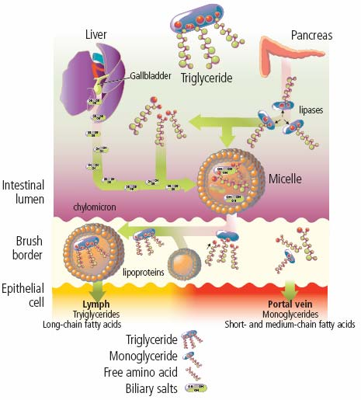

Slide 9
Lipids
Bile - aids by breaking up fat into small droplets (increases surface area).
Absorption - is into Lymph as fat droplets called chylomicrons.

Slide 10
Emulsification
TAG are hydrophobic
Stomach churning and bile salts emulsify the lipids
Increases the accessibility of fat to digestive enzymes
Increases surface area of dietary lipids

Slide 11
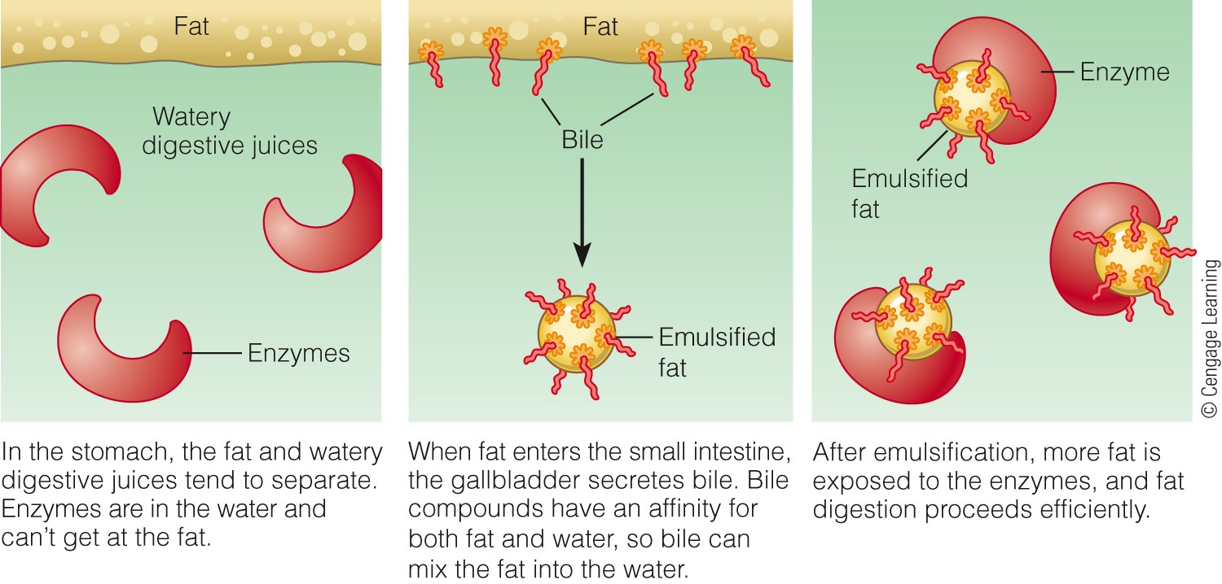
Emulsification

Slide 12
Triacylglycerol Digestion
Occurs mostly in lumen of SI
Beings in mouth
Lingual lipase
Stomach
Gastric lipase
Emulsification
Small intestine
Jejunum: most TAG digestion
Pancreatic lipase (with the help of colipase)
Duodenum: Bile released from gallbladder as a result of stimulation by the hormone CCK
Secretin stimulates release of pancreatic lipase and bicarbonate
Notes:
Enzyme that activates pancreatic lipase
Anchor/linking point for attachment of the enzyme to the bile salt-stabilized micelles

Slide 13
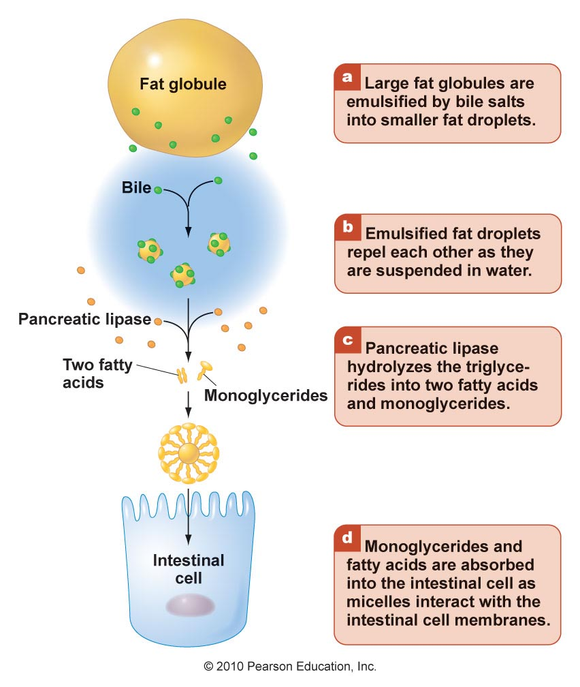
Cholesterol & Phospholipid Digestion
Esterified cholesterol undergoes hydrolysis to free cholesterol and a fatty acid via cholesterol esterase
Products of partial digestion of dietary lipids combine with bile salts to form micelles
Micelle

Slide 14
Lipoproteins
Chylomicron
VLDL: very light density lipoprotein
HDL: heavy density lipoproteins
IDL: intermediate density lipoproteins
LDL: low density lipoproteins

Slide 15
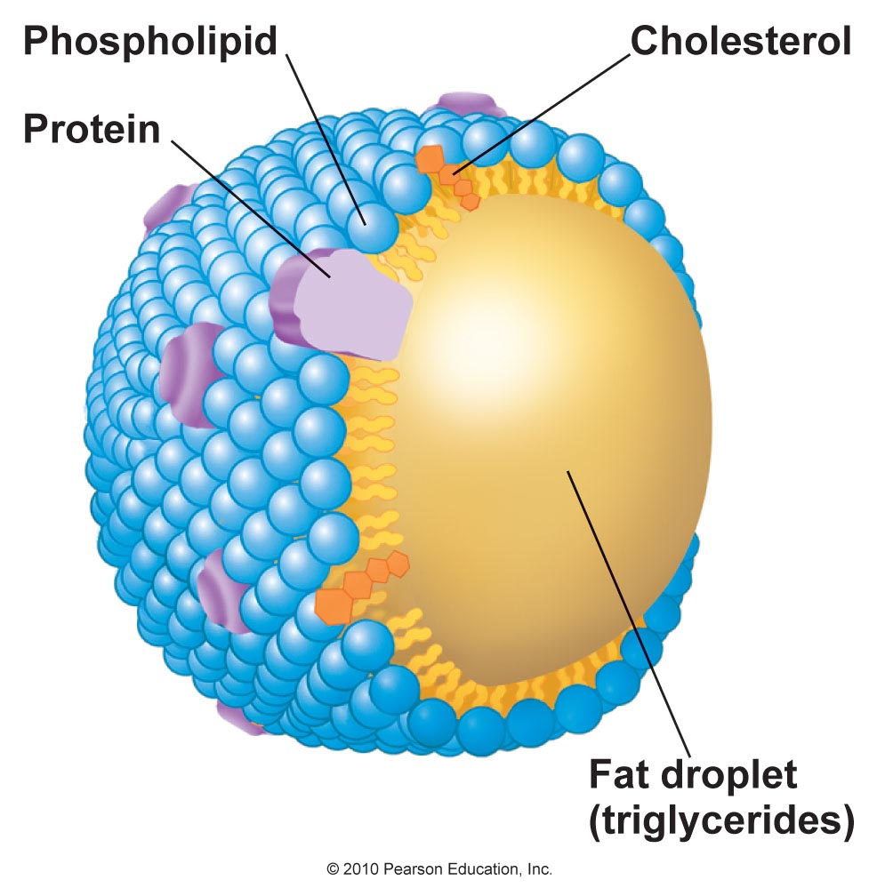
Chylomicron
Lipids resynthesized in ER of enterocyte
Contain TAG, cholesterol esters, phospholipids, and Vitamins A & E in core, with a surface of phospholipids, free cholesterol, and proteins
Chylomicron

Slide 16
Chylomicrons
Re-formed lipids derived from dietary sources (exogenous lipids)
Exit enterocyte by exocytosis and transported in blood
Blood plasma levels peak 30mins-3hrs after a mean and return to normal within 5-6hrs
Deliver dietary lipid to tissues other than the liver
Muscle
Adipose tissue
Remaining lipids delivered to liver as chylomicron remnant
Notes:
http://www.youtube.com/watch?v=zKieFWkXdHk
Trans fats and boogers
http://www.youtube.com/watch?v=DwzKa9wJSVY

Slide 17
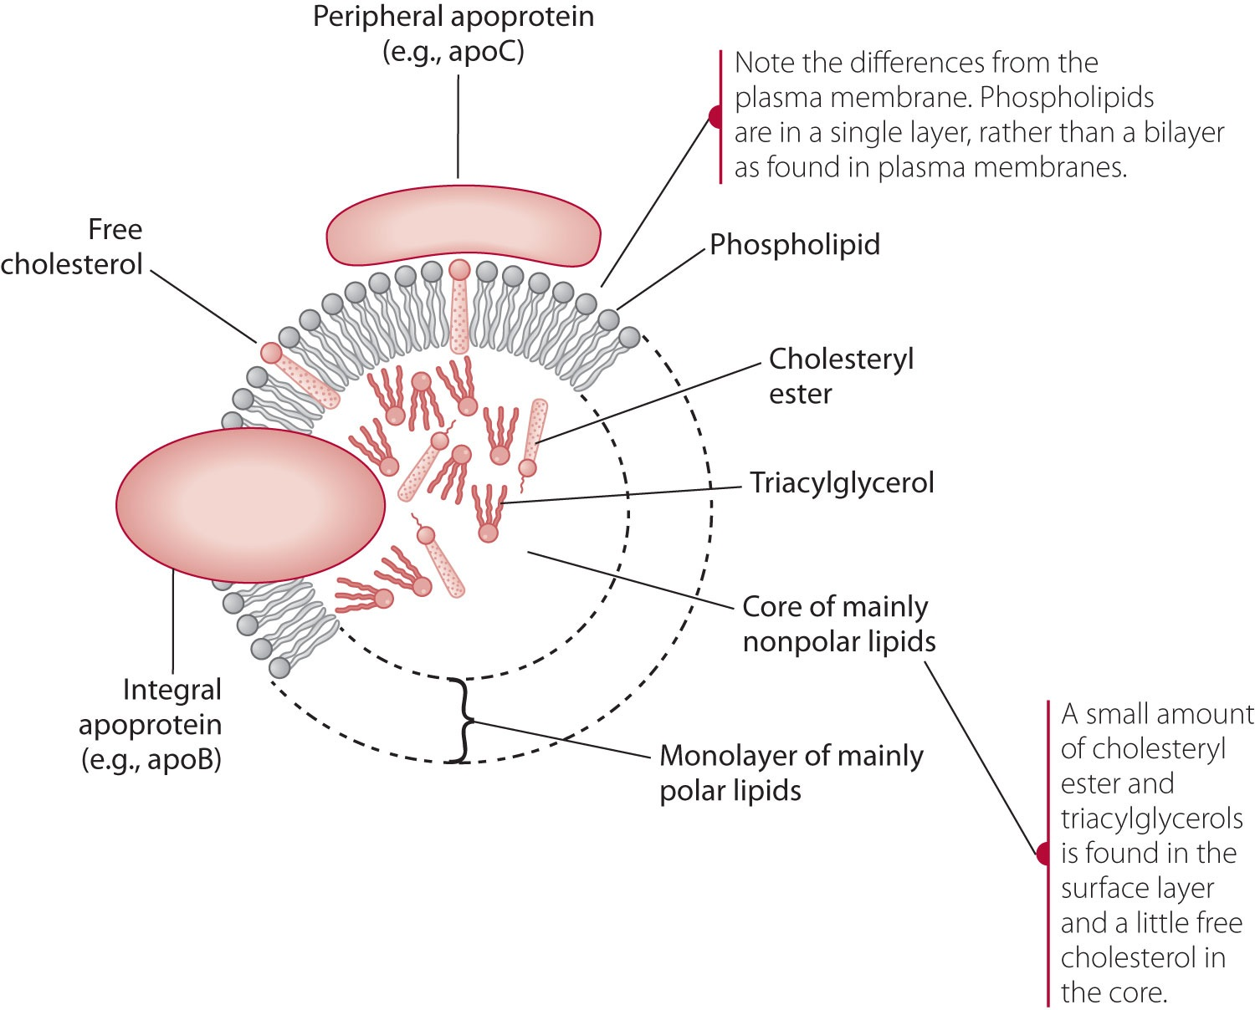
Structure of a Lipoprotein

Slide 18
Apoprotein/Apolipoprotein
Protein component of the lipoprotein
Stabilizes the lipoprotein
Allows lipoproteins to be recognized by receptors on cell surfaces
Stimulates LPL to remove lipids from the lipoprotein

Slide 19
Lipoprotein: Chylomicron

Slide 21
Lipoprotein: VLDL
Very low density lipoprotein
Delivers endogenous lipids from the LIVER to FAT and MUSCLE cells with the help of LPL
→ Becomes IDL

Slide 22
Lipoprotein: IDL
Intermediate Density Lipoprotein
Transient
Little nutritional impact
TAGs are removed…becomes LDL

Slide 23
Lipoprotein: LDL
Low Density Lipoprotein
Delivers fat and cholesterol to cells (including arteries)

Slide 24
Lipoprotein: LDL
LDL = Lousy Cholesterol
Atherogenic; Increases risk for heart disease

Slide 25
Lipoprotein: HDL
Removes cholesterol from cells and other lipoproteins
Cholesterol is transported to the liver to be incorporated into bile

Slide 26
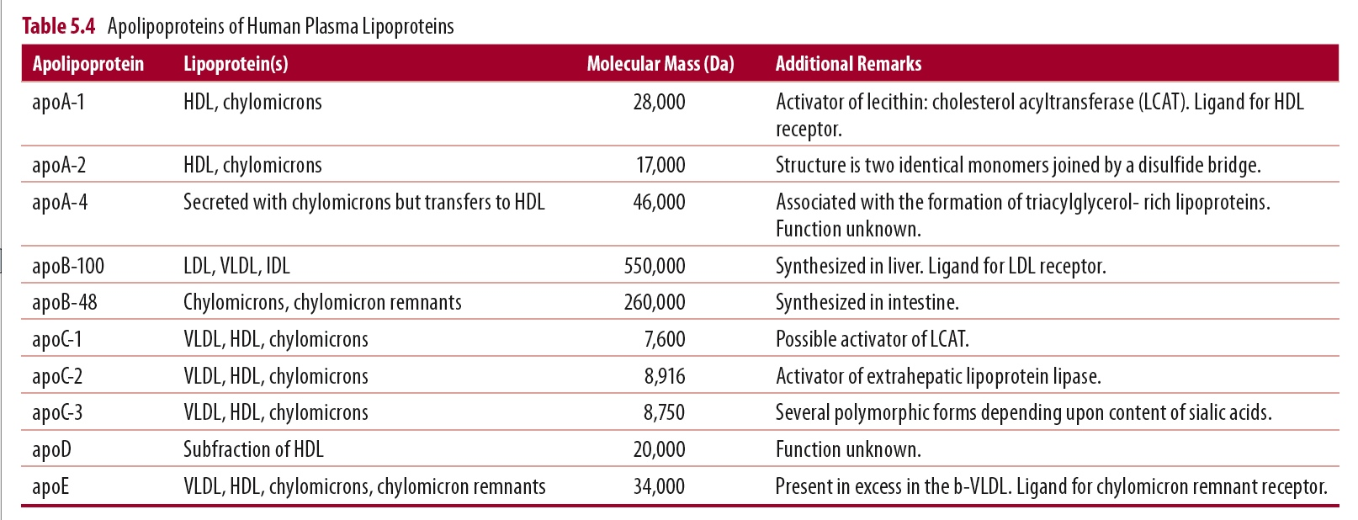
ApoProteins
Notes:
Apo A-E
Apo C: activates LPL
Component of Chylomicrons & VLDL

Slide 27
Percentage of composition of the plasma & lymph lipoproteins in the bovine
 | Chylomicron |  | VLDL |  | LDL |  | Light HDL |  | Heavy HDL
 | lymph | plasma | lymph | plasma | lymph | plasma | lymph | plasma | lymph | plasma
Free CHL | 1-2 | 4-6 | 1-2 | 3-9 | 3-7 | 6-8 | 1-2 | 4-6 | 2-8 | 1-4
CHL ester | 1-8 | 1-4 | 1-2 | 5-15 | 16- 32 | 31-36 | 28-32 | 29-33 | 1-26 | 13-29
TG | 67-88 | 72-87 | 75-80 | 45-63 | 5-35 | 4-21 | 3-7 | 1-3 | 4-9 | 1-6
PL | 8-20 | 4-5 | 10-12 | 12-17 | 22-23 | 18-22 | 27-30 | 25-27 | 9-27 | 12-27
Protein | 2-3 | 2-3 | 6-8 | 8-16 | 20-27 | 22-32 | 30-39 | 33-39 | 41-47 | 39-68
Diameter | 650-2400 |  | 310-680 |  | 190-260 |  | 120-150 |  | 90-120
Density, g/ml | <0.95 |  | <1.006 |  | 1.026-1.076 |  | 1.06-1.091 |  | 1.091-1.18

Slide 28
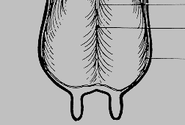
The tissue origins & post-secretory metabolic transformation of lipoproteins within plasma compartment in ruminants
(Bauchart, 1993)
liver
Adipose tissue
TG storage
receptors
Chylo
VLDL
Muscles
FA oxidation
Small intestine
L-HDL
IDL
LDL
H-HDL
Nascent HDL
Mammary gland
TG secretion
CE
receptors
FC
membranes
steroids
peripheral tissue

Slide 29
Major events
LIVER: CHL esters to FC to bile; TG & FC synthesis
ADIPOSE TISSUE: FA to TG
MUSCLE: FA oxidation
MAMMARY GLAND: FA to TG
PERIPHERAL TISSUE: CHL esters to FC to membrane components & steroid synthesis

Slide 30
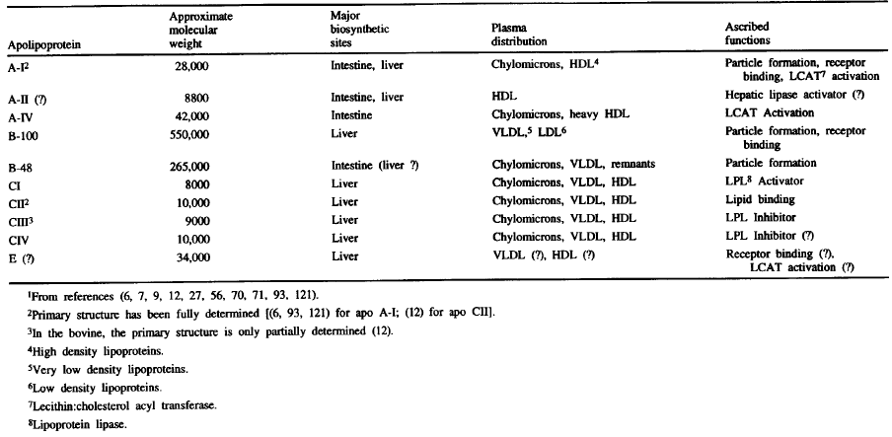
The bio-synthetic origins, plasma distributions, and ascribed functions of major apolipoproteins in the ruminants (Bauchart, 1993)
Bauchart, 1993

Slide 31
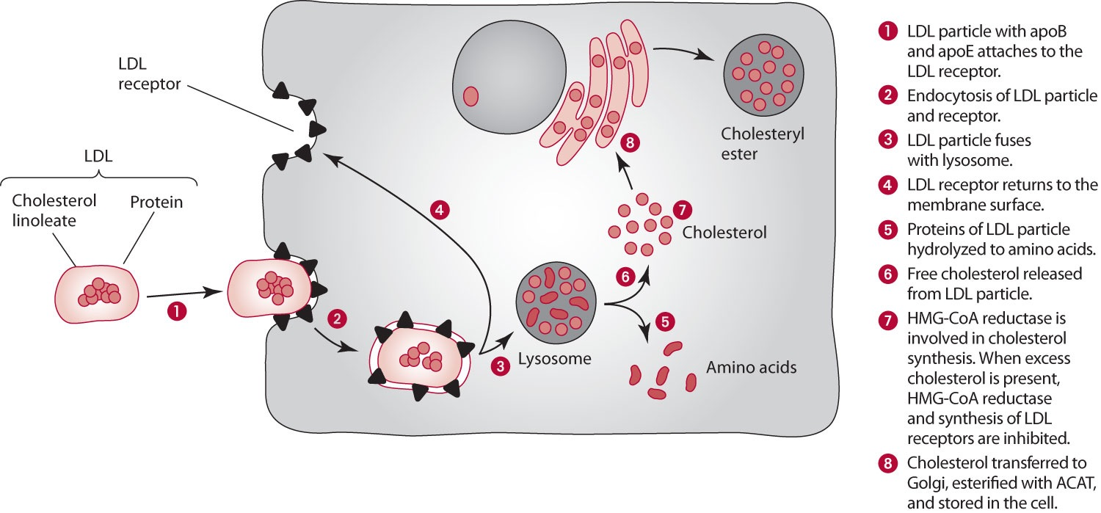
LDL Receptor
Attaches with apoB and apoE
Endocytosis of LDL and receptor
Receptor returns to the membrane
LDL fuses with lysosome and contents distributed
Protein →AA
Cholesterol re-esterified for storage via ACAT (Acyl-coA: Cholesterol acyl transferase)

Slide 32
apoA & apoC
Activates LCAT (Lecithin: Cholesterol Acyl Transferase)
Promotes preparation for cholesterol to be transported
Present on Chylomicrons and HDLs
apoC2 activates extrahepatic LPL

Slide 33
Lipid Storage
Lipids are stored in adipocytes
Insulin promotes lipid storage by suppressing hormone-sensitive LPL (which acts to release lipids from storage)

Slide 34
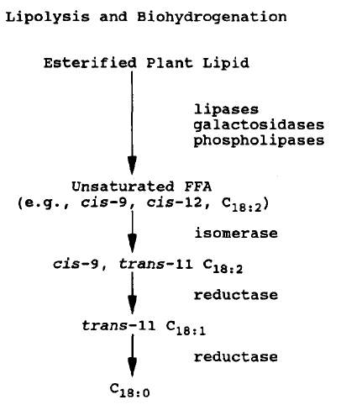
Key steps in the conversion of esterified plant lipid to saturated FA by lipolysis & bio-hydrogenation in the rumen
Jenkins, 1993

Slide 35
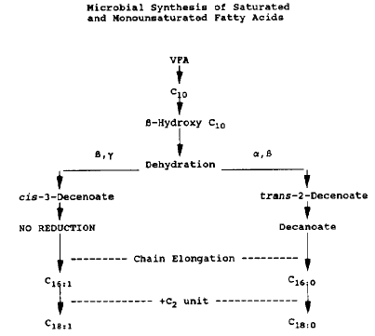
Microbial synthesis of mono-unsaturated FA by the anaerobic pathway
Jenkins, 1993

Slide 36
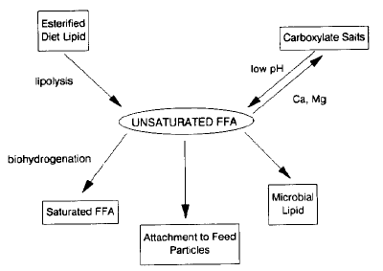
Events in the rumen that modify the pool size of unsaturated free FA
Jenkins, 1993

Slide 37
Protein

Slide 38
Digestive Enzyme Summary

Slide 39
Amino Acid Digestion: Brush Border
Amino peptidases
Cleave peptide bonds at the N-­‐terminal end
Dipeptidases
Cleave dipeptides into 2 free Amino Acids
Tripeptidases
Cleave tripeptides into dipeptides and free AA
End product: Free AA and Tripeptides
*Free AA provide negative feedback and decrease activity of these enzymes

Slide 40
Amino Acid Absorption
AA must cross the brush border (apical) and basolateral (serosal) membranes before reaching the blood
Most occurs in the duodenum and upper jejunum
Types: facilitated, sodium dependent, paracellular

Slide 41
Absorption of Amino Acids: Brush Border
Facilitated transport
Most are sodium dependent
Work in conjunction with an ATPase
Favor:
Peptides with high hydrocarbon mass and net electrical charge
BCAA
Neutral
Essential
Amino acids can compete for speciﬁc transporters

Slide 42
Absorption of Peptides: Brush border
Absorption of peptides the primary mode of AA absorption and is more rapid than absorption of free AA
PEPT1 transports di-­‐ and tripeptides with ATPase
Peptides are cleaved to AA in the enterocyte

Slide 43
Peptide Absorption: Paracellular
Paracellular absorption of peptides
– Passage through tight junctions of enterocytes
Increased likelihood if GI illness increases intestinal permeability
Peptides are then hydrolyzed by peptidases in the plasma, at the cell membrane, or in the tissue
*It’s cool that peptides can be transported through the blood. Some AA are unstable in their free form. This characteristic allows for AA to be included in parenteral nutrition formulas.

Slide 44
Amino Acid Absorption: Basolateral Membrane
Transporters do not require sodium

Slide 45
Amino Acids Absorption: Extra-intestinal Tissues
Sodium-dependent N system
Exchanges H⁺ for AA
System A
Induced by glucagon and provides amino acid substrates for gluconeogenesis
System GLY
Sodium dependent and speciﬁc for glycine and neutral AA

Slide 46
Amino Acids Absorption: Extra-intestinal Tissues: Gamma Glutamyl Cycle
Glutathione acts as a carrier of neutral AA
Reacts with enzyme gamma glutamyl transpeptidase in the cell membrane
Forms gamma­‐glutamyl enzyme complex and binds neutral amino acid
AA is transported into the cytosol for cell use
Occurs in the renal tubular cells, erythrocytes, neurons

Slide 47
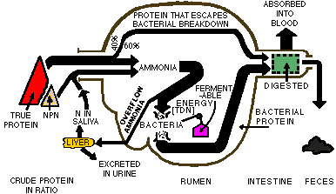
N

Slide 48
Carbohydrates degradation (Ruminants)
Pyruvate C₃
Cellulose
Starch
Pectin
H-Cellulose
Sucrose
Fructans
Pentoses
microbes
Propionate (C₃)
Acetate (C₂)
Formate
Butyrate
(C₄)
CO₂
CH₄

Slide 49
Large Intestine
Resorption of water and electrolytes and compaction into feces
Resorption of vitamins liberated from bacterial action
Storage of fecal material

Slide 50
Cecum
First portion like a pouch
Collects material from small intestine and begins compaction
appendix

Slide 51
Colon
Series of pouches
Three regions: ascending, transverse, descending
Rectum: storage just before defecation

