Slide 1
CS 502
Directed Studies: Adversarial Machine Learning
Dr. Alex Vakanski

Slide 2
Lecture 16
Self-Supervised Learning

Slide 3
Lecture Outline
Self-supervised learning
Motivation
Self-supervised learning versus other machine learning techniques
Image-based approaches
Geometric transformation recognition (image rotation)
Patches (relative patch position, image jigsaw puzzle)
Generative modeling (context encoders, image colorization, cross-channel prediction, image super-resolution)
Automated label generation (deep clustering, synthetic imagery)
Contrastive learning (CPC, SimCLR, other contrastive approaches)
Video-based approaches
Frame ordering, tracking moving objects, video colorization
Approaches for natural language processing

Slide 4
Supervised vs Unsupervised Learning
Supervised learning – learning with labeled data
Approach: collect a large dataset, manually label the data, train a model, deploy
It is the dominant form of ML at present
Learned feature representations on large datasets are often transferred via pre-trained models to smaller domain-specific datasets
Unsupervised learning – learning with unlabeled data
Approach: discover patterns in data either via clustering similar instances, or density estimation, or dimensionality reduction …
Self-supervised learning – representation learning with unlabeled data
Learn useful feature representations from unlabeled data through pretext tasks
The term “self-supervised” refers to creating its own supervision (i.e., without supervision, without labels)
Self-supervised learning is one category of unsupervised learning

Slide 5
Self-Supervised Learning
Self-supervised learning example
Pretext task: train a model to predict the rotation degree of rotated images with cats and dogs (we can collect million of images from internet, labeling is not required)
Downstream task: use transfer learning and fine-tune the learned model from the pretext task for classification of cats vs dogs with very few labeled examples
Picture from: Amit Chaudhary – The Illustrated Self-Supervised Learning

Slide 6
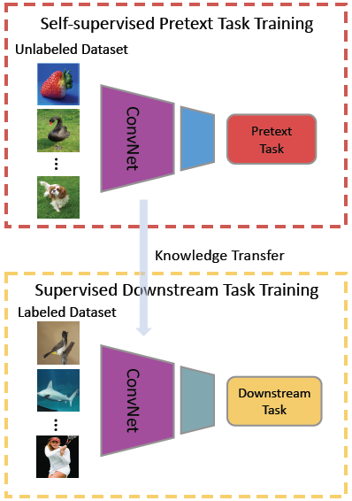
Self-Supervised Learning
One more depiction of the general pipeline for self-supervised learning is shown in the figure
For the downstream task, re-use the trained ConvNet base model, and fine-tune the top layers on a small labeled dataset
Picture from: Jing and Tian (2019) Self-supervised Visual Feature Learning with Deep Neural Networks: A Survey

Slide 7
Self-Supervised Learning
Why self-supervised learning?
Creating labeled datasets for each task is an expensive, time-consuming, tedious task
Requires hiring human labelers, preparing labeling manuals, creating GUIs, creating storage pipelines, etc.
High quality annotations in certain domains can be particularly expensive (e.g., medicine)
Self-supervised learning takes advantage of the vast amount of unlabeled data on the internet (images, videos, text)
Rich discriminative features can be obtained by training models without actual labels
Self-supervised learning can potentially generalize better because we learn more about the world
Challenges for self-supervised learning
How to select a suitable pretext task for an application
There is no gold standard for comparison of learned feature representations
Selecting a suitable loss functions, since there is no single objective as the test set accuracy in supervised learning

Slide 8
Self-Supervised Learning
Self-supervised learning versus unsupervised learning
Self-supervised learning (SSL)
Aims to extract useful feature representations from raw unlabeled data through pretext tasks
Apply the feature representation to improve the performance of downstream tasks
Unsupervised learning
Discover patterns in unlabeled data, e.g., for clustering or dimensionality reduction
Note also that the term “self-supervised learning” is sometimes used interchangeably with “unsupervised learning”
Self-supervised learning versus transfer learning
Transfer learning is often implemented in a supervised manner
E.g., learn features from a labeled ImageNet, and transfer the features to a smaller dataset
SSL is a type of transfer learning approach implemented in an unsupervised manner
Self-supervised learning versus data augmentation
Data augmentation is often used as a regularization method in supervised learning
In SSL, image rotation of shifting are used for feature learning in raw unlabeled data

Slide 9
Image-Based Approaches
Image based approaches
Geometric transformation recognition
Image rotation
Patches
Relative patch position, image jigsaw puzzle
Generative modeling
Context encoders, image colorization, cross-channel prediction, image super-resolution
Automated label generation
Deep clustering, synthetic imagery
Contrastive learning
Contrastive predictive coding (CPC), SimCLR, and other contrastive approaches

Slide 10
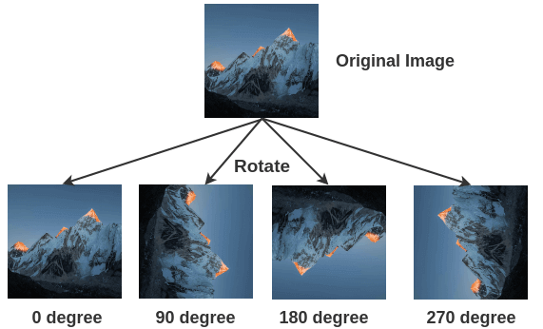
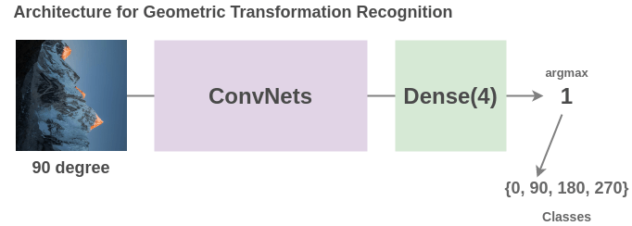
Image Rotation
Geometric transformation recognition
Gidaris (2018) - Unsupervised Representation Learning by Predicting Image Rotations
Training data: images rotated by a multiple of 90° at random
This corresponds to four rotated images at 0°, 90°, 180°, and 270°
Pretext task: train a model to predict the rotation degree that was applied
Therefore, it is a 4-class classification problem
Picture from: Amit Chaudhary – The Illustrated Self-Supervised Learning

Slide 11
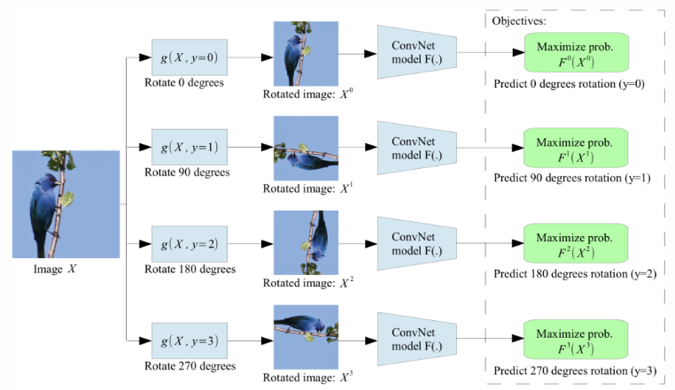
Image Rotation
A single ConvNet model is used to predict one of the four rotations
The model needs to understand the location and type of the objects in images to determine the rotation degree

Slide 12
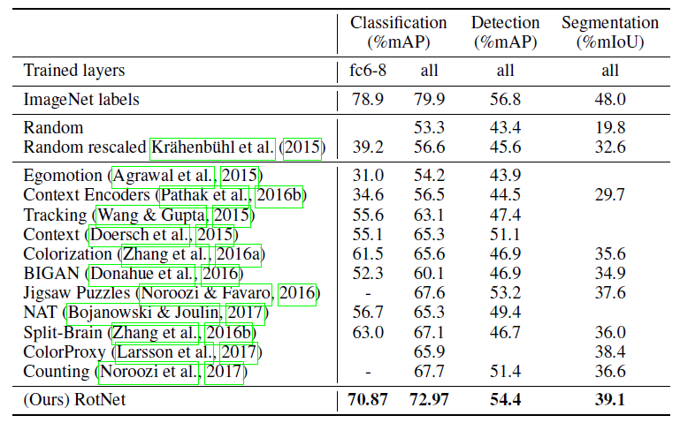
Image Rotation
Evaluation on the PASCAL VOC dataset for classification, detection, and segmentation tasks
The model (RotNet) is trained in SSL manner, and fine-tuned afterwards
RotNet outperformed all other SSL methods
The learned features are not as good as the supervised learned features based on transfer learning from ImageNet, but they demonstrate a potential
Supervised feature learning
Proposed self-supervised feature learning

Slide 13
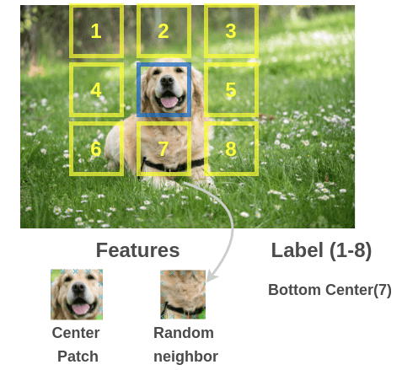
Relative Patch Position
Relative patch position for context prediction
Dorsch (2015) Unsupervised Visual Representation Learning by Context Prediction
Training data: multiple patches extracted from images
Pretext task: train a model to predict the relationship between the patches
E.g., predict the relative position of the selected patch below (i.e., position # 7)
For the center patch, there are 8 possible neighbor patches (8 possible classes)

Slide 14
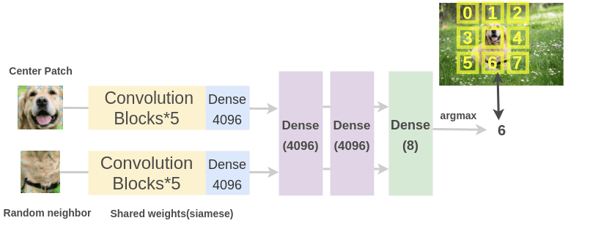
Relative Patch Position
The patches are inputted into two ConvNets with shared weights
The learned features by the ConvNets are concatenated
Classification is performed over 8 classes (denoting the 8 possible neighbor positions)
The model needs to understand the spatial context of images, in order to predict the relative positions between the patches
Picture from: Amit Chaudhary – The Illustrated Self-Supervised Learning

Slide 15
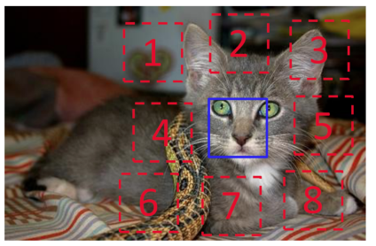
Relative Patch Position
The training patches are sampled in the following way:
Randomly sample the first patch, and consider it the middle of a 3x3 grid
Sample from 8 neighboring locations of the first central patch (blue patch)
To avoid the model only catching low-level trivial information:
Add gaps between the patches
Add small jitters to the positions of the patches
Randomly downsample some patches to reduced resolution, and then upsample them
Randomly drop 1 or 2 color channels for some patches

Slide 16
Relative Patch Position
For instance, predict the position of patch # 3 with respect to the central patch
Input: two patches
Prediction: Y = 3

Slide 17
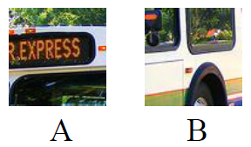
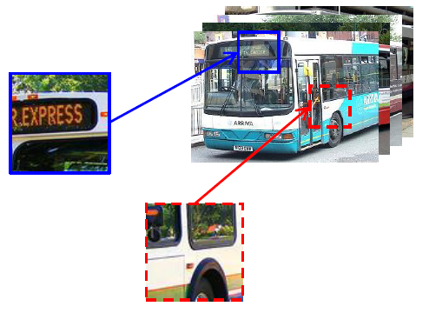
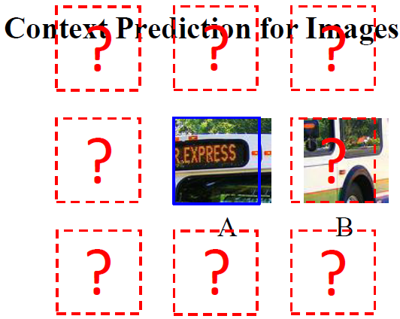
Relative Patch Position
Example: predict the position of patch B with respect to patch A

Slide 18
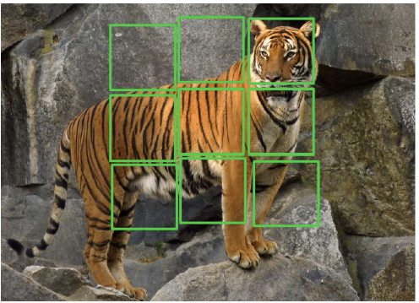
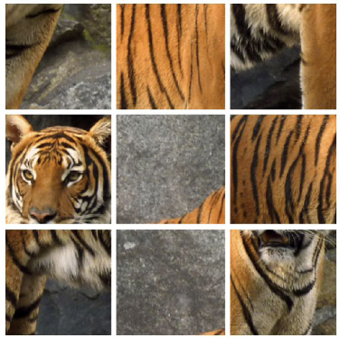
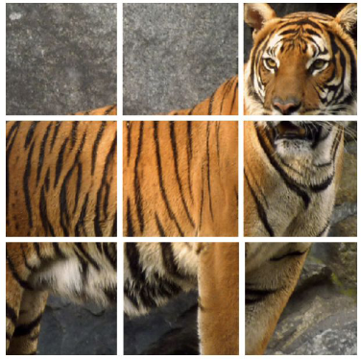
Image Jigsaw Puzzle
Predict patches position in a jigsaw puzzle
Noroozi (2016) Unsupervised Learning of Visual Representations by Solving Jigsaw Puzzles
Training data: 9 patches extracted in images (similar to the previous approach)
Pretext task: predict the positions of all 9 patches
Instead of predicting the relative position of only 2 patches, this approach uses the grid of 3×3 patches and solves a jigsaw puzzle

Slide 19
Image Jigsaw Puzzle
A ConvNet model passes the individual patches through the same Conv layers that have shared weights
The features are combined and passed through fully-connected layers
Output is the positions of the patches (i.e., the shuffling permutation of the patches)
The patches are shuffled according to a set of 64 predefined permutations
Namely, for 9 patches, in total there are 362,880 possible puzzles
The authors used a small set of 64 shuffling permutations with the highest hamming distance

Slide 20
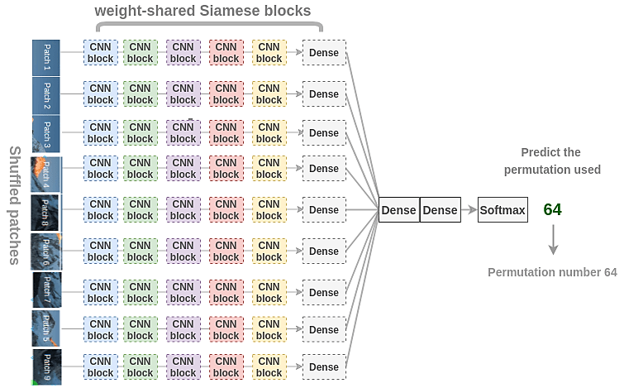
Image Jigsaw Puzzle
The model needs to learn to identify how parts are assembled in an object, relative positions of different parts of objects, and shape of objects
The learned representations are useful for downstream tasks in classification and object detection
Picture from: Amit Chaudhary – The Illustrated Self-Supervised Learning

Slide 21
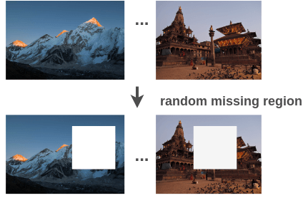
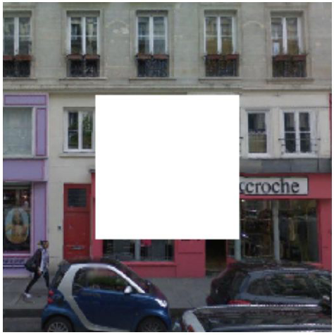
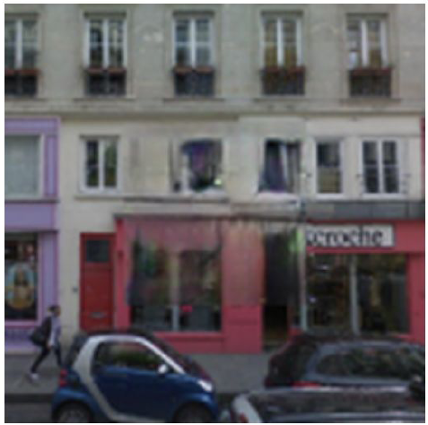
Context Encoders
Predict missing pieces, also known as context encoders, or inpainting
Pathak (2016) Context Encoders: Feature Learning by Inpainting
Training data: remove a random region in images
Pretext task: fill in a missing piece in the image
The model needs to understand the content of the entire image, and produce a plausible replacement for the missing piece
Picture from: Amit Chaudhary – The Illustrated Self-Supervised Learning

Slide 22
Context Encoders
The initially considered model uses an encoder-decoder architecture
The encoder and decoder have multiple Conv layers, and a shared central fully-connected layer
The output of the decoder is the reconstructed input image
A Euclidean $ℓ_{2}$ distance is used as the reconstruction loss function $ℒ_{rec}$

Slide 23
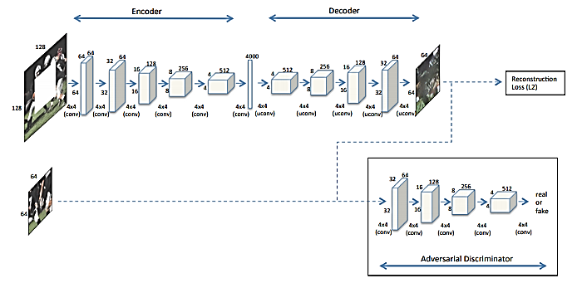
Context Encoders
The authors found that the reconstruction loss alone couldn't capture fine details in the missing region
Improvement was achieved by adding a GAN branch, where the generator of the GAN learns to reconstruct the missing piece
The overall loss function is a weighted combination of the reconstruction and the GAN losses, i.e., ${ℒ=λ_{rec}ℒ}_{rec}$+${λ_{gan}ℒ}_{gan}$

Slide 24
Context Encoders
The joint loss function ${ℒ=λ_{rec}ℒ}_{rec}$+${λ_{gan}ℒ}_{gan}$resulted in improved prediction of the missing piece
Input image
Encoder-decoder with reconstruction loss $ℒ_{rec}$
GAN with loss $ℒ_{gan}$
Joint loss ${ℒ=λ_{rec}ℒ}_{rec}$+${λ_{gan}ℒ}_{gan}$

Slide 25
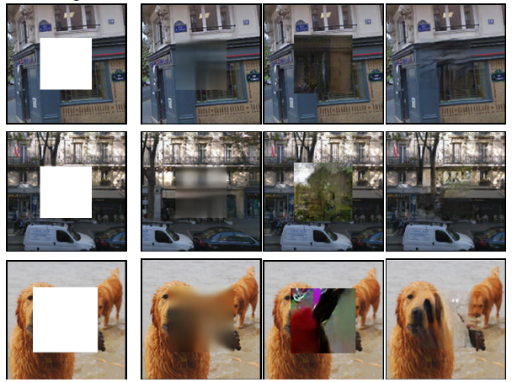
Context Encoders
Additional examples comparing the used loss functions
The joint loss produces the most realistic images
Input image
Reconstruction loss $ℒ_{rec}$
GAN loss $ℒ_{gan}$
Joint loss

Slide 26
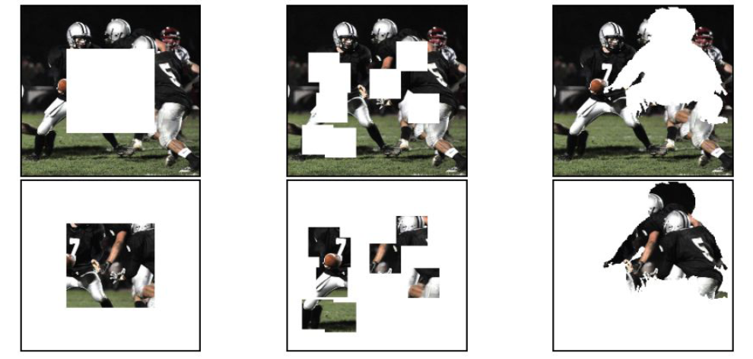
Context Encoders
The removed regions can have different shapes
Random region and random block masks outperformed the central region features
Central region
Random block
Random region

Slide 27
Context Encoders
Evaluation on PASCAL VOC for several downstream tasks
The learned features by the context encoder are not as good as supervised features
But are comparable to other unsupervised methods, and perform better than randomly initialized models
E.g., over 10% improvement for segmentation over random initialization

Slide 28
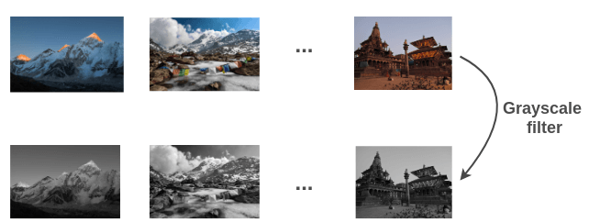
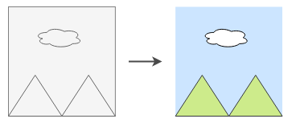
Image Colorization
Image colorization
Zhang (2016) Colorful Image Colorization
Training data: pairs of color and grayscale images
Pretext task: predict the colors of the objects in grayscale images
The model needs to understand the objects in images and paint them with a suitable color
Right image: learn that the sky is blue, cloud is white, mountain is green
Sky is blue
Cloud is white
Mountain is green
Picture from: Amit Chaudhary – The Illustrated Self-Supervised Learning

Slide 29
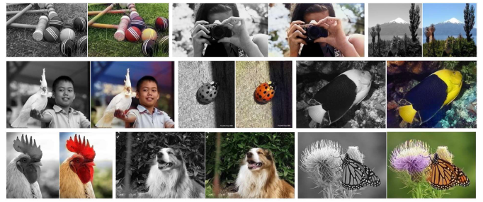
Image Colorization
Input examples

Slide 30
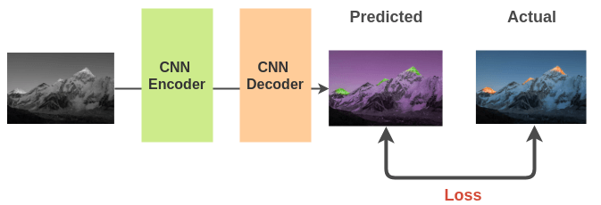
Image Colorization
An encoder-decoder architecture with convolutional layers is used
$ℓ_{2}$ loss between the actual color image and the predicted colorized image is used for training
Picture from: Amit Chaudhary – The Illustrated Self-Supervised Learning

Slide 31
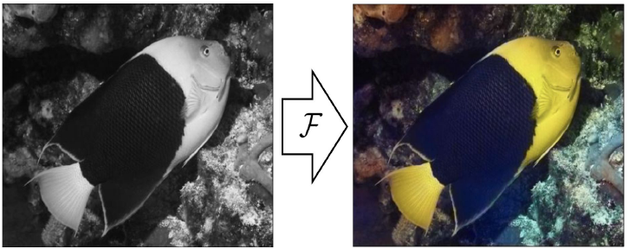
Cross-channel Prediction
Split-brain autoencoder or cross-channel prediction
Zhang (2017) Split-Brain Autoencoders: Unsupervised Learning by Cross-Channel Prediction
Training data: remove some of the image color channels
Pretext task: predict the missing channel from the other image channels
E.g., use the grayscale channel to predict the color channels in the image

Slide 32
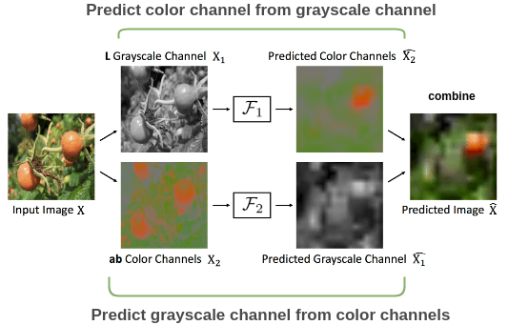
Cross-channel Prediction
The input image (e.g., tomato) is split into grayscale and color channels
Two encoder-decoders are trained: F₁ predicts the color channels from the gray channel, and F₂ predicts the gray channel from the color channels
The two predicted images are combined to reconstruct the original image
A loss function (e.g., cross-entropy) is selected to minimize the distance between the original and reconstructed image

Slide 33
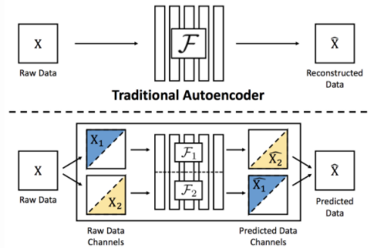
Cross-channel Prediction
The general model is shown below, in comparison to a traditional autoencoder
Any combinations of image channels X₁ and X₂ can be used with this SSL approach for training and reconstruction
The reconstructed images are denoted with a “hat” notation (${\hat{X}}_{1},{\hat{X}}_{2}$)

Slide 34
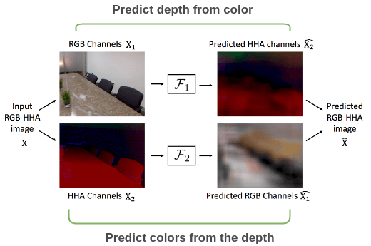
Cross-channel Prediction
It is also possible the split-brain autoencoder to predict HHA depth channels in images
The HHA format encodes three channels for each pixel, including the horizontal disparity, height above ground, and angle with gravity
The two autoencoders predict depth from color and color from depth, and combine their outputs into a single representation

Slide 35
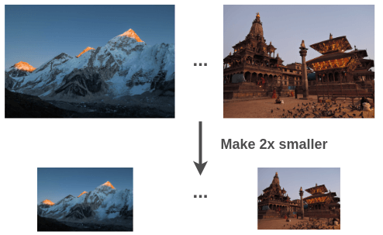
Image Super-Resolution
Image Super-Resolution
Ledig (2017) Photo-Realistic Single Image Super-Resolution Using a Generative Adversarial Network
Training data: pairs of regular and downsampled low-resolution images
Pretext task: predict a high-resolution image that corresponds to a downsampled low-resolution image
Picture from: Amit Chaudhary – The Illustrated Self-Supervised Learning

Slide 36
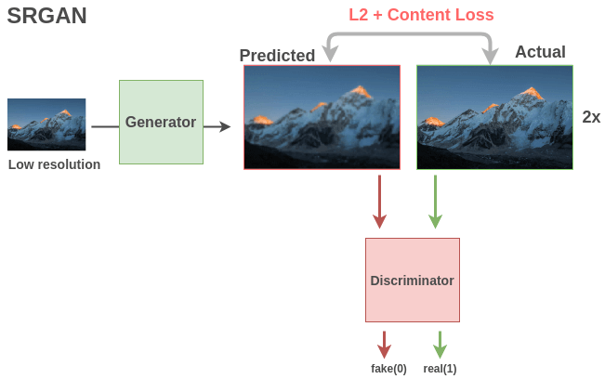
Image Super-Resolution
SRGAN (Super-Resolution GAN) is a variant of GAN for producing super-resolution images
The generator takes a low-resolution image and outputs a high-resolution image using a fully convolutional network
The discriminator uses a loss function that combines L₂ and content loss to distinguish between the actual (real) and generated (fake) super-resolution images
Content loss compares the feature content between the actual and predicted images
Picture from: Amit Chaudhary – The Illustrated Self-Supervised Learning

Slide 37
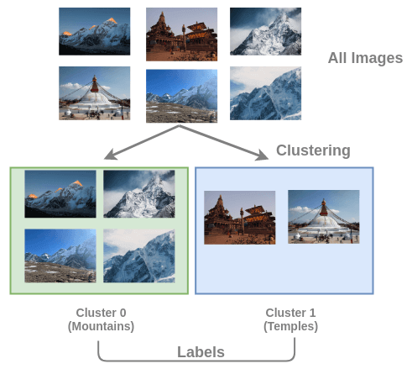
Deep Clustering
Deep clustering of images
Caron (2019) Deep Clustering for Unsupervised Learning of Visual Features
Training data: clusters of images based on the content
E.g., clusters on mountains, temples, etc.
Pretext task: predict the cluster to which an image belongs
Picture from: Amit Chaudhary – The Illustrated Self-Supervised Learning

Slide 38
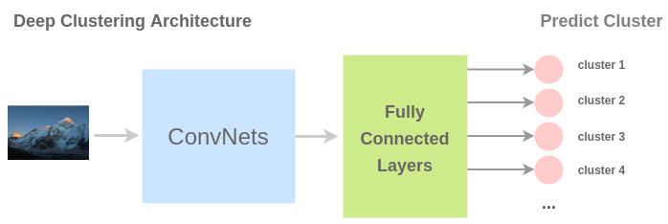
Deep Clustering
The architecture for SSL is called deep clustering
The model treats each cluster as a separate class
The output is the number of the cluster (i.e., cluster label) for an input image
The authors used k-means for clustering the extracted feature maps
The model needs to learn the content in the images in order to assign them to the corresponding cluster
Picture from: Amit Chaudhary – The Illustrated Self-Supervised Learning

Slide 39
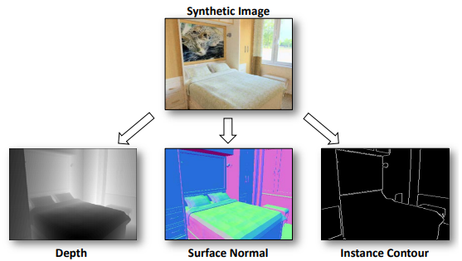
Synthetic Imagery
Synthetic imagery
Ren (2017) Cross-Domain Self-supervised Multi-task Feature Learning using Synthetic Imagery
Training data: synthetic images generated by game engines and real images
Graphics engines in games can produce realistically looking synthetic images
Pretext task: predict whether an input image is synthetic or real, based on predicted depth, surface normal, and instance contour maps
The learned features are useful for segmentation and classification downstream tasks
Picture from: Amit Chaudhary – The Illustrated Self-Supervised Learning

Slide 40
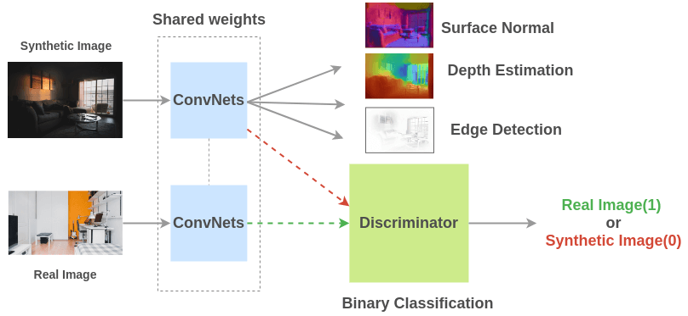
Synthetic Imagery
The model has weight-shared ConvNets that are trained on both real and synthetic images
The discriminator learns to distinguish real from synthetic images, based on the surface normal, depth, and edge maps
The model is trained in an adversarial manner (as in GANs), by simultaneously improving both the generator and discriminator
Picture from: Amit Chaudhary – The Illustrated Self-Supervised Learning

Slide 41
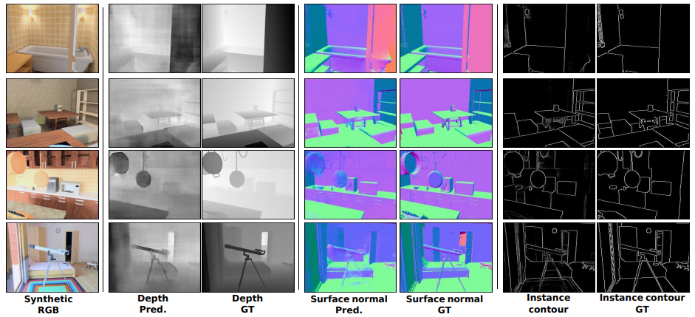
Synthetic Imagery
Learned depth, surface normal, and instance contour maps, and the corresponding ground truth in synthetic images

Slide 42
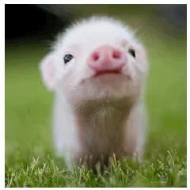
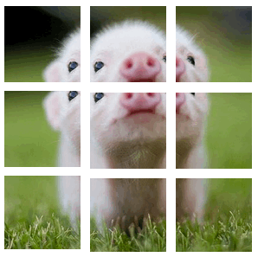
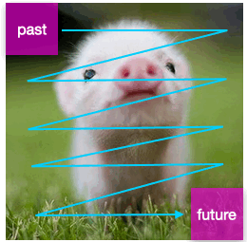
Contrastive Predictive Coding
Contrastive Predictive Coding (CPC)
Van der Oord (2018) Representation Learning with Contrastive Predictive Coding
Training data: extracted patches from input images
Pretext task: predict the order for a sequence of patches using contrastive learning
E.g., how to predict the next (future) patches based on encoded information of previous (past) patches in the image
The approach was implemented in different domains: speech audio, images, natural language, and reinforcement learning
Picture from: William Falcon – A Framework for Contrastive Self-Supervised Learning and Designing a New Approach

Slide 43
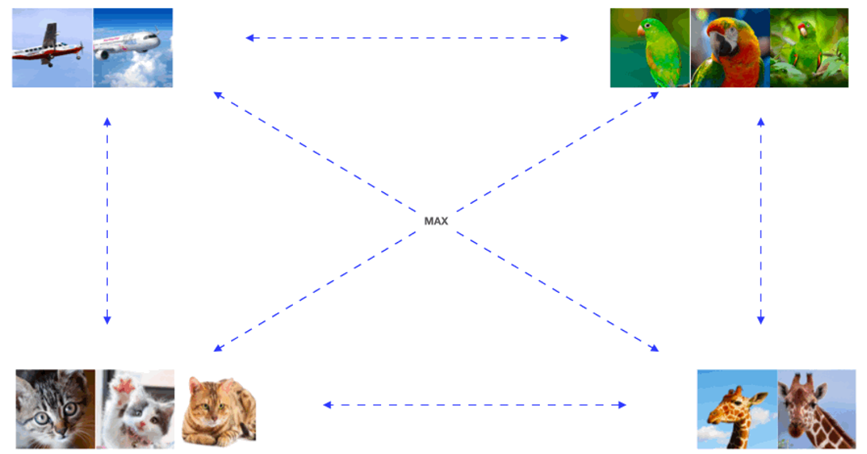
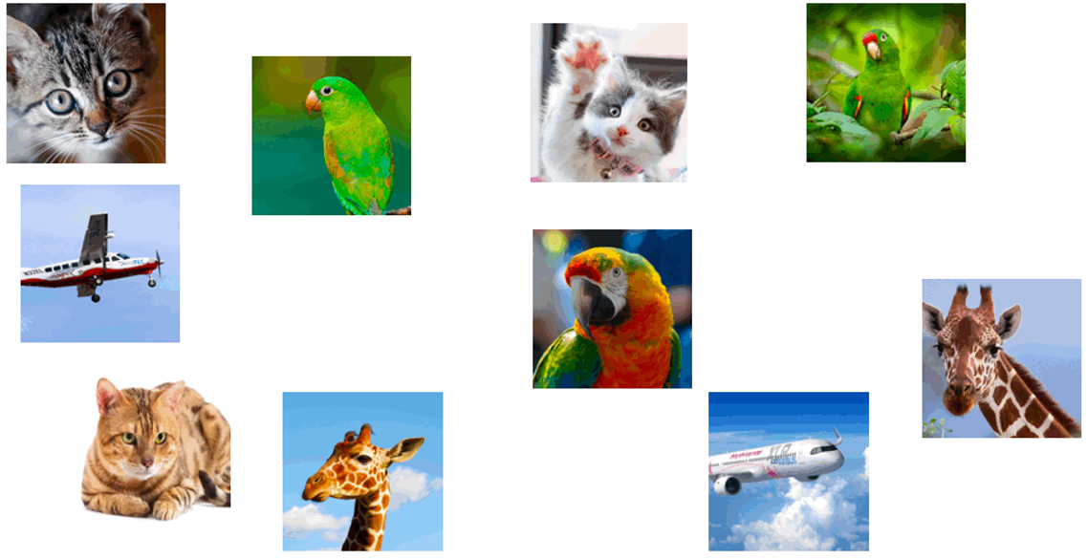
Contrastive Predictive Coding
Contrastive learning is based on grouping similar examples together
E.g., cluster the shown images into groups of similar images
Noise-Contrastive Estimation (NCE) loss is commonly used in contrastive learning
The NCE loss minimizes the distance between similar images (positive examples) and maximizes the distance to dissimilar images (negative examples)
Other used terms are InfoNCE loss, or contrastive cross-entropy loss
(A forthcoming slide explains the NCE loss in more details)
Maximize distance
Picture from: William Falcon – A Framework for Contrastive Self-Supervised Learning and Designing a New Approach

Slide 44
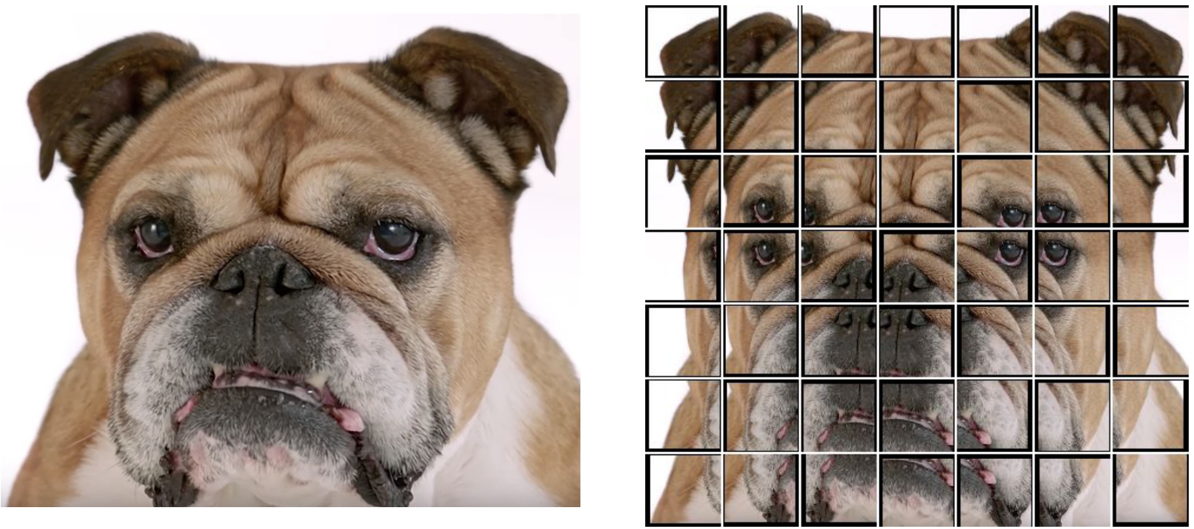
Contrastive Predictive Coding
For an input image resized to 256×256 pixels, the authors extracted a grid of 7×7 patches of size 64×64 pixels with 50% overlap between the patches
Therefore, there are 49 overlapping patches in total for each image
Picture from: Pieter Abbeel, Lecture 7 – Self-Supervised Learning

Slide 45
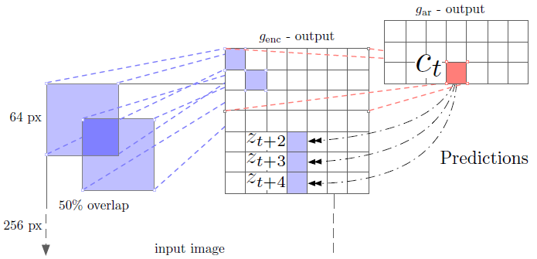
Contrastive Predictive Coding
An encoder g_{enc} is used to project each patch into a low-dimensional latent space
The latent representation obtained by encoders is often referred to as code (or context)
E.g., the leftmost portion of the image depicts extracting patches of 64×64 pixels size with 50% overlap between the patches
A ResNet-101 encoder is used for projecting the patch $x_{t}$into a code representation $z_{t}$
The middle image shows the outputs of the encoder g_{enc} for each patch, $z_{t}=g_{enc}\left(x_{t}\right)$
For the 49 patches (7×7 grid), the outputs are 7×7×1,024 tensors (i.e., $z_{1},z_{2},…,z_{49}$)

Slide 46
Contrastive Predictive Coding
CPC considers the patches as an ordered sequence (e.g., like video frames)
An autoregressive model g_{ar} is used to predict the future patches in the sequence
The output of the autoregressive model for the shown red patch $c_{t}$ (in row 3 and column 4) is the sum of all vectors $g_{ar}\left(z_{≤t}\right)$ for the previous patches in the sequence (e.g., all patches in the above rows and right columns of the red patch)
The code representation of the patch $c_{t}$ is used to predict the blue patches in the next rows and the same column as the red patch, denoted $z_{t+2},z_{t+3}$ and $z_{t+4}$
The authors predicted up to five rows for each patch in the grid

Slide 47
Contrastive Predictive Coding
The NCE loss is used for training the model on each patch in the image
The patch at position t is considered a positive sample, and all other patches are considered negative samples
For a set of $N$ random patches $X=\left\{x_{1},…,x_{N}\right\}$, containing one positive sample $x_{t}$ and $N−1$negative samples, the NCE loss is:
$$ℒ_{N}=−𝔼\left[\log{\frac{f_{k}\left(x_{t+k},c_{t}\right)}{\sum_{x_{j}∈X}{f_{k}\left(x_{j},c_{t}\right)}}}\right]$$
$c_{t}$ is the code representation of the patch at position t, i.e., ${c_{t}=g}_{ar}\left(z_{≤t}\right)$
$x_{t+k}$ is a predicted patch in the sequence at position $t+k$
$f_{k}\left(x_{t+k},c_{t}\right)$ is a density function that approximates the probability $p_{k}\left(x_{t+k}|c_{t}\right)$ of estimating the patch $x_{t+k}$for a given code representation $c_{t}$
The authors used a log-bilinear model $f_{k}\left(x_{t+k},c_{t}\right)=exp\left(z_{t+k}^{T}W_{k}c_{t}\right)$, where $W_{k}$ is the matrix of weights for the prediction step k
The numerator of the NCE loss represents the distance to the positive sample, and the denominator represents the distance to the negative samples

Slide 48
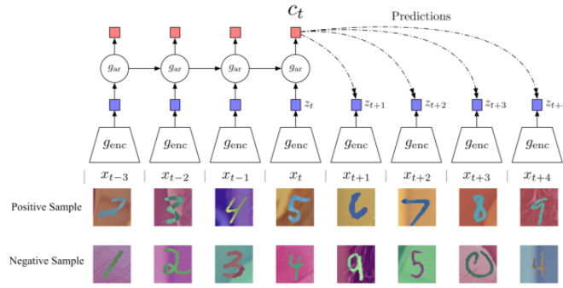
Contrastive Predictive Coding
The name of the approach is based on the following:
Contrastive: representations are learned by contrasting positive and negative examples, which is implemented with the NCE loss
Predictive: the model needs to predict future patches in the sequences of overlapping patches for a given position in the sequence
Coding: the model performs the prediction in the latent space, i.e., using code representations from an encoder and an auto-regressive model
Here is one more example with images from MNIST, where a positive sequence contains sorted numbers, and a negative sequence contains random numbers
Picture from: David Tellez – Contrastive predictive coding

Slide 49
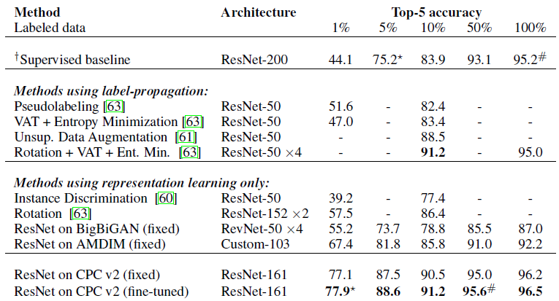
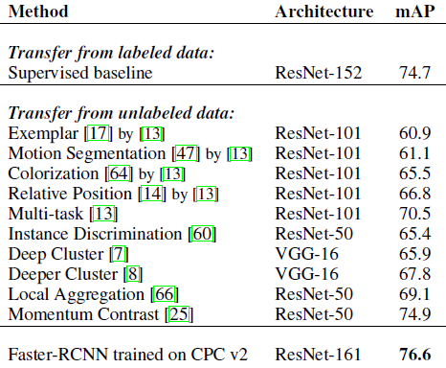
CPC v2
Contrastive Predictive Coding v2
Henaff (2019) Data-efficient Image Recognition with Contrastive Predictive Coding
This is an extension of the initial CPC work by the same authors
The approach surpasses supervised ML methods for image classification on the ImageNet dataset, achieving an increase in Top-5 accuracy by 1.3% (right table)
It also surpasses supervised approaches for object detection on PASCAL VOC by 2%

Slide 50
CPC v2
The differences in CPC v2 versus the initial CPC approach include:
Use ResNet-161 instead of ResNet-101 to increase the model capacity
Apply layer normalization (i.e., normalize the inputs across the features)
For predicting, use patches not only from above the current patch position, but also from below, left, and right to the patch
Data augmentation by randomly dropping two or three color channels in each patch, and applying random shearing, rotation, and elastic transformations
The new architecture of CPC v2 delivered improved results over the initial CPC

Slide 51
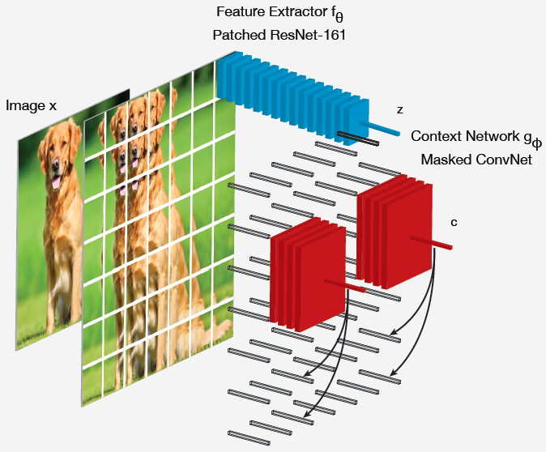
CPC v2
Each patch is encoded with a feature extractor $f_{θ}$(blue) followed by average-pooling (vector z)
The autoregressive context network $g_{φ}$(red) aggregates the feature vectors z into a context vector c, which is used to predict the future patches

Slide 52
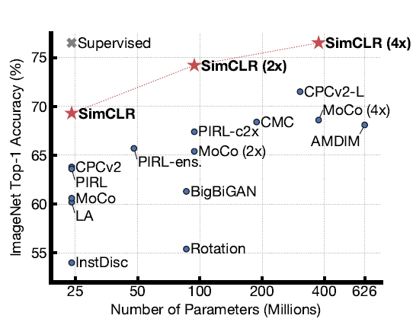
SimCLR
SimCLR, a Simple framework for Contrastive Learning of Representations
Chen (2020) A Simple Framework for Contrastive Learning of Visual Representations
SimCLR is an approach for contrastive learning, similar to CPC
It achieved state-of-the-art in SSL, surpassing the Top-1 accuracy by a supervised ResNet-50 on ImageNet

Slide 53
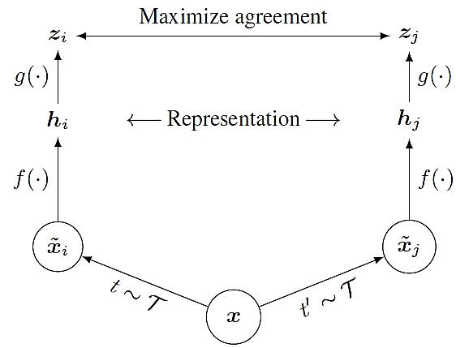
SimCLR
Approach:
Randomly sample a mini-batch of n inputs $x$, and apply two different data augmentation operations $t$and $t′$, resulting in $2n$samples ${\tilde{x}}_{i}=t\left(x\right)$ and ${\tilde{x}}_{j}=t′\left(x\right)$
Data augmentation includes random crop, resize with random flip, color distortions, and Gaussian blur (data augmentation is crucial for contrastive learning)
Apply a base encoder $f\left(∙\right)$ to ${\tilde{x}}_{i}$and ${\tilde{x}}_{j}$ to obtain the code representations $h_{i}=f\left({\tilde{x}}_{i}\right)$ and $h_{j}=f\left({\tilde{x}}_{j}\right)$
Apply another prediction head encoder $g\left(∙\right)$ (one fully-connected layer) to $h_{i}$ and $h_{j}$ to obtain the code representations $z_{i}=g\left(h_{i}\right)$ and $z_{j}=g\left(h_{j}\right)$
Prediction head g:
One fully-connected layer
Base encoder f:
ResNet + global average pooling

Slide 54
SimCLR
For one positive pair of samples $z_{i}$ and $z_{j}$ and for the remaining $2\left(n−1\right)$ samples treated as negative, a cosine similarity is calculated as
$$sim\left(z_{i},z_{j}\right)=\frac{z_{i}^{T}z_{j}}{\left\|z_{i}\right\|\left\|z_{i}\right\|}$$
The contrastive prediction task aims for a given sample ${\tilde{x}}_{i}$to identify a positive pairing sample ${\tilde{x}}_{j}$
The NCE loss for the instances ${\tilde{x}}_{i}$and ${\tilde{x}}_{j}$ is calculated as:
$$ℒ_{i,j}=−\log{\frac{exp\left(sim\left(z_{i},z_{j}\right)/τ\right)}{\sum_{k=1}^{2n}{1_{\left[k≠i\right]}}exp\left(sim\left(z_{i},z_{j}\right)/τ\right)}}$$
$1_{\left[k≠i\right]}$ has a value of 1 if $k≠i$ and 0 otherwise, $τ$ is a temperature hyperparameter
The overall loss $\sum_{i,j}{ℒ_{i,j}}$is calculated across all positive pairs ${\tilde{x}}_{i}$and ${\tilde{x}}_{j}$in a mini-batch
For downstream tasks, the head $g\left(∙\right)$ is discarded and only the representation $h_{i}$ is used

Slide 55
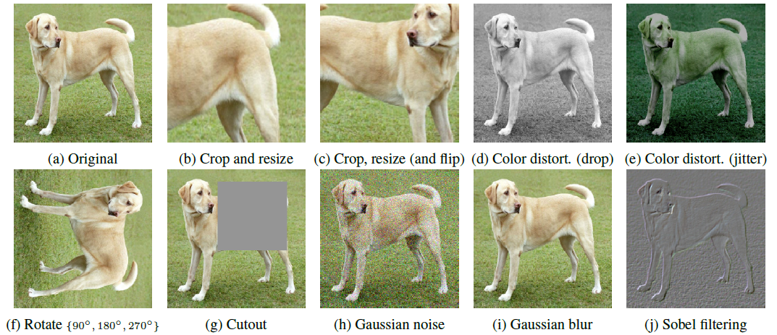
SimCLR
Data augmentation

Slide 56
SimCLR
Experimental results on 10 image datasets
SimCLR outperformed supervised models on most datasets

Slide 57
Other Contrastive SSL Approaches
Other recent self-supervised approaches based on contrastive learning include:
Augmented Multiscale Deep InfoMax or AMDIM
Bachman (2019) Learning Representations by Maximizing Mutual Information Across Views
Momentum Contrast or MoCo
He (2019) Momentum Contrast for Unsupervised Visual Representation Learning
Bootstrap Your Own Latent or BYOL
Grill (2020) Bootstrap your own latent: A new approach to self-supervised Learning
Swapping Assignments between multiple Views of the same image or SwAV
Caron (2020) Unsupervised Learning of Visual Features by Contrasting Cluster Assignments
Yet Another DIM or YADIM
Falcon (2020) A Framework for Contrastive Self-Supervised Learning and Designing a New Approach

Slide 58
Contrastive SSL Approaches
The contrastive SSL approaches are computationally expensive
Estimated costs for some of these approaches as reported in this blog post
The costs are based on 23dn.24xlarge AWS instance at $31.212 per hour

Slide 59
Video-based Approaches
Video-based approaches
SSL methods are often used for learning useful feature representations in videos
Videos provide richer visual information than images
The consistency of spatial and temporal information across video frames lend them suitable for learning from raw videos without labels
Models based on recurrent NNs in combination with ConvNets are naturally more often encountered in SSL for videos, due to the temporal character
The following video-based approaches are briefly reviewed next
Frame ordering, tracking moving objects, video colorization
A detailed overview of video-based SSL approaches can be found in the review paper by Jing and Tian (see References)

Slide 60
Frame Ordering
Frame ordering also known as shuffle and learn
Misra (2016) Shuffle and Learn: Unsupervised Learning using Temporal Order Verification
Training data: videos of objects in motion with shuffled order of the frames
Pretext task: predict if the frames are in the correct temporal order
The frames are shuffled, and pairs of videos with correct and shuffled order are used for training the model
The model needs to learn the object classes, as well as it needs to learn the temporal ordering of the objects’ positions across the frames
Picture from: Amit Chaudhary – The Illustrated Self-Supervised Learning

Slide 61
Frame Ordering
The model employs ConvNets with shared weights
The output is a binary prediction on whether the frames are in the correct order or not
Picture from: Amit Chaudhary – The Illustrated Self-Supervised Learning

Slide 62
Frame Ordering
Example
Picture from: Andrew Zisserman – Self-Supervised Learning

Slide 63
Tracking Moving Objects
Tracking moving objects
Wang (2015) Unsupervised Learning of Visual Representations using Videos
Training data: videos of moving objects
Pretext task: predict the location of a patch with a moving object across frames
An optical flow approach based on a SURF feature extractor is used for matching feature points across video frames
A ConvNet model is designed for predicting the patch location in the next frames
The model learns representations by minimizing the distance (in the latent space) to the tracked patch across the frames

Slide 64
Video Colorization
Video colorization or temporal coherence of color
Vondrick (2018) Tracking Emerges by Colorizing Videos
Training data: pairs of color and grayscale videos of moving objects
Pretext task: predict the color of moving objects in other frames
The learned representations are useful for downstream segmentation, object tracking, and human pose estimation tasks
Picture from: Andrew Zisserman – Self-Supervised Learning

Slide 65
Video Colorization
Inputs and predicted outputs for video segmentation and human skeleton pose prediction in videos

Slide 66
Video Colorization
The goal is to copy colors from a reference frame in color to another target frame in grayscale
The model needs to employ the temporal consistency of the objects across frames in order to learn how to apply colors to the grayscale frames
This includes tracking correlated pixels in different frames
The reference and target frames should not be too far apart in time

Slide 67
Video Colorization
Video colorization examples

Slide 68
NLP
Self-supervised learning has driven the recent progress in the Natural Language Processing (NLP) field
Models like ELMO, BERT, RoBERTa, ALBERT, Turing NLG, GPT-3 have demonstrated immense potential for automated NLP
Employing various pretext tasks for leaning from raw text produced rich feature representations, useful for different downstream tasks
Pretext tasks in NLP:
Predict the center word given a window of surrounding words
The word highlighted with green color needs to be predicted
Predict the surrounding words given the center word
Picture from: Amit Chaudhary – Self-Supervised Representation Learning in NLP

Slide 69
NLP
Pretext tasks in NLP:
From three consecutive sentences, predict the previous and the next sentence, given the center sentence
Predict the previous or the next word, given surrounding words
Predict randomly masked words in sentences
Picture from: Amit Chaudhary – Self-Supervised Representation Learning in NLP

Slide 70
NLP
Pretext tasks in NLP:
Predict if the ordering of two sentences is correct
Predict the order of words in a randomly shuffled sentence
Predict masked sentences in a document
Picture from: Amit Chaudhary – Self-Supervised Representation Learning in NLP

Slide 71
GPT-3
GPT-3 stands for Generative Pre-trained Transformer
It was created by OpenAI, and introduced in May 2020
Transformers are currently the most common model architecture for NLP tasks
They employ attention blocks for discovering correlation in text
GPT-3 generates text based on initial input prompt from the end-user
It is trained using next word prediction on huge amount of raw text from the internet
The quality of text generated is often undistinguishable from human-written text
GPT-3 can also be used for other tasks, such as answering questions, summarizing text, automated code generation, and many others
It is probably the largest NN model at the present, having 175 billion parameters
The cost for training GPT-3 reportedly is $ 12 million
For comparison, Microsoft’s Turing NLG (Natural Language Generation) model has 17 billion parameters
Currently, OpenAI allows access to GPT-3 only to selected applicants
Controversies: GPT-3 just memorizes text from other sources, risk of abuse by certain actors

Slide 72
Additional References
Lilian Weng – Self-Supervised Representation Learning, link: Lil’Log
Pieter Abbeel, UC Berkley, CS294-158 Deep Unsupervised Learning, Lecture 7 – Self-Supervised Learning
Amit Chaudhary – The Illustrated Self-Supervised Learning, link
Jing and Tian (2019) Self-supervised Visual Feature Learning with Deep Neural Networks: A Survey
William Falcon – A Framework for Contrastive Self-Supervised Learning and Designing a New Approach, link
Andrew Zisserman – Self-Supervised Learning, slides from: Carl Doersch, Ishan Misra, Andrew Owens, Carl Vondrick, Richard Zhang
Amit Chaudhary –Self-Supervised Representation Learning in NLP, link

