Slide 1
CS 502
Directed Studies: Adversarial Machine Learning
Dr. Alex Vakanski

Slide 2
Lecture 1
Introduction to Adversarial Machine Learning

Slide 3
Lecture Outline
Machine Learning (ML)
Adversarial ML (AML)
Adversarial examples
Attack taxonomy
Common adversarial attacks
Noise, semantic attack, FGSM, BIM, PGD, DeepFool, CW attack
Defense against adversarial attacks
Adversarial training, random resizing and padding, detect adversarial examples
Conclusion
References
Other AML resources

Slide 4
Machine Learning (ML)
ML tasks
Supervised, unsupervised, semi-supervised, self-supervised, meta learning, reinforcement learning
Data collection and preprocessing
Sensors, cameras, I/O devices, etc.
Apply a ML algorithm
Training phase: learn ML model (parameter learning, hyperparameter tuning)
Testing phase (inference): predict on unseen data
Slide credit: Binghui Wang: Adversarial Machine Learning — An Introduction

Slide 5
ML is Ubiquitous
Healthcare
Picture from: He Xiaoyi – Adversarial Machine Learning

Slide 6
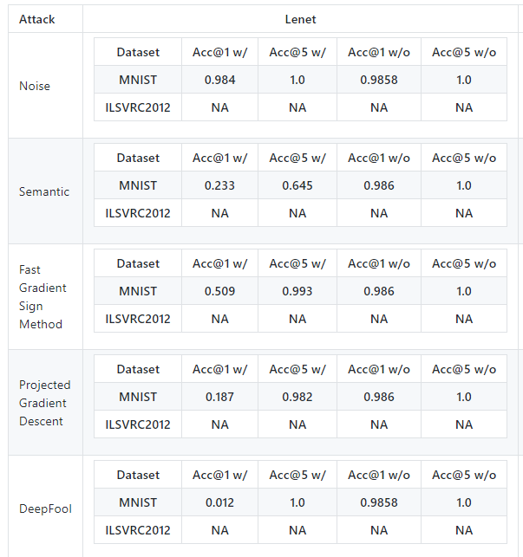
Adversarial ML
The classification accuracy of GoogLeNet on MNIST under adversarial attacks drops from 98% to 18% (for ProjGrad attack) or 1% (DeepFool attack)
Picture from: https://blog.floydhub.com/introduction-to-adversarial-machine-learning/

Slide 7
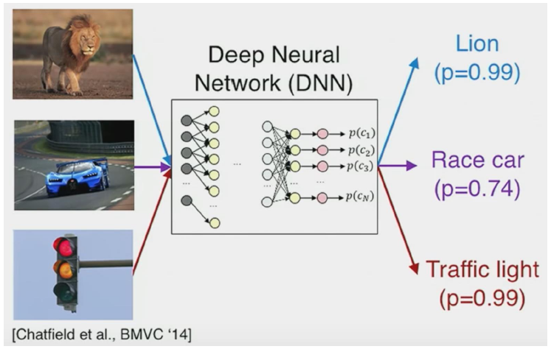
Adversarial Examples
What do you see?
Slide credit: Binghui Wang: Adversarial Machine Learning — An Introduction

Slide 8
Adversarial Examples
The classifier misclassifies adversarially manipulated images
Slide credit: Binghui Wang: Adversarial Machine Learning — An Introduction

Slide 9
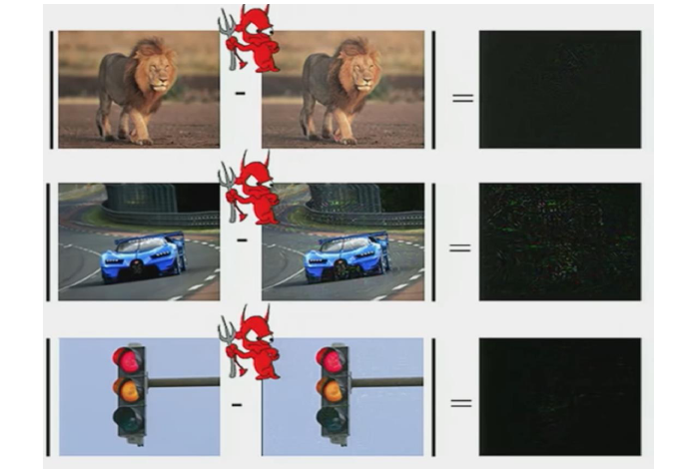
Adversarial Examples
The differences between the original and manipulated images are very small (hardly noticeable to the human eye)
Original image
Attack image
Difference
Slide credit: Binghui Wang: Adversarial Machine Learning — An Introduction

Slide 10
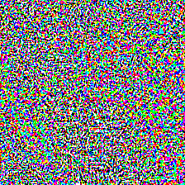
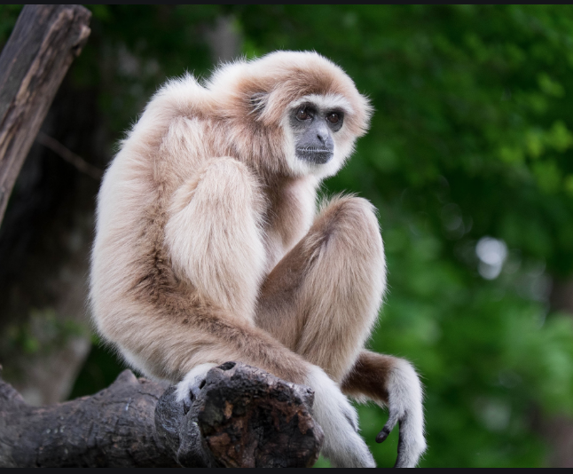
Adversarial Examples
An adversarially perturbated image of a panda is misclassified as a gibbon
The image with the perturbation to the human eye looks indistinguishable from the original image
Original image
Adversarial image
Gibbon
Classified as panda
57.7% confidence
Small adversarial noise
Classified as gibbon
99.3% confidence
Picture from: https://blog.floydhub.com/introduction-to-adversarial-machine-learning/

Slide 11
Adversarial Examples
Similar example
Picture from: Szagedy (2014) – Intriguing Properties of Neural Networks

Slide 12
Adversarial Examples
If a stop sign is adversarially manipulated and it is not recognized by a self-driving car, it can result in an accident
?
Small adversarial noise
Slide credit: He Xiaoyi – Adversarial Machine Learning

Slide 13
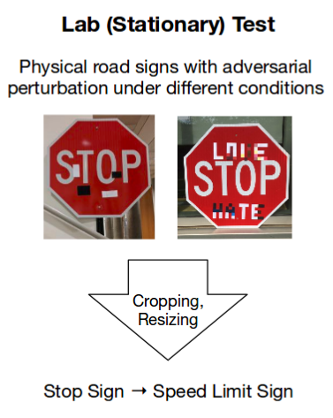
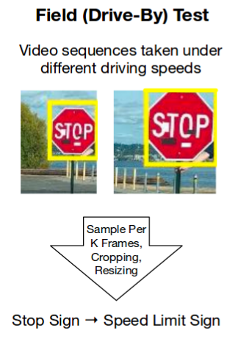
Adversarial Examples
Recent work manipulated a stop sign with adversarial patches
Caused the DL model of a self-driving car to classify it as a Speed Limit 45 sign (100% attack success in lab test, and 85% in field test)
Picture from: Eykholt (2017) - Robust Physical-World Attacks on Deep Learning Visual Classification

Slide 14
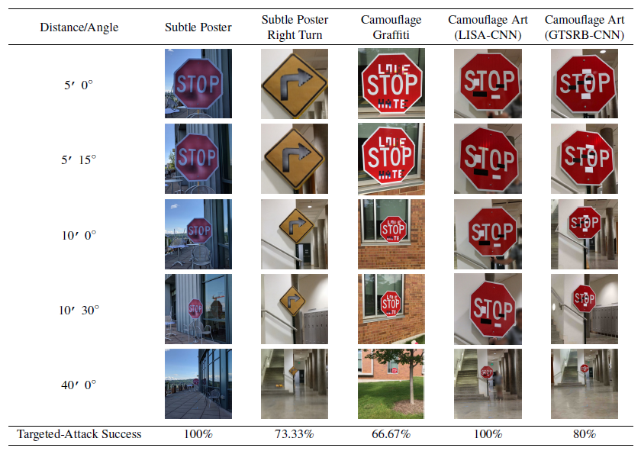
Adversarial Examples
Lab test images for signs with a target class Speed Limit 45
Picture from: Eykholt (2017) - Robust Physical-World Attacks on Deep Learning Visual Classification

Slide 15
Adversarial Examples
In this example, a 3D-printed turtle is misclassified by a DNN as a rifle (video link)

Slide 16
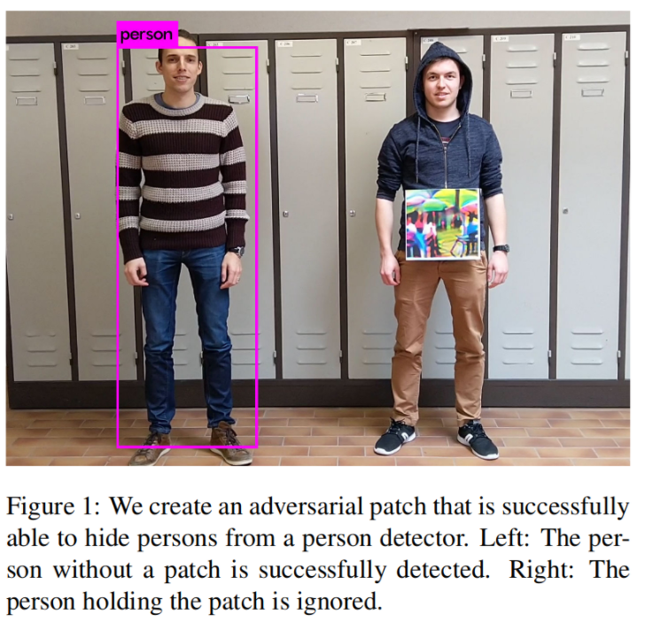
Adversarial Examples
A person wearing an adversarial patch is not detected by a person detector model (YOLOv2)

Slide 17
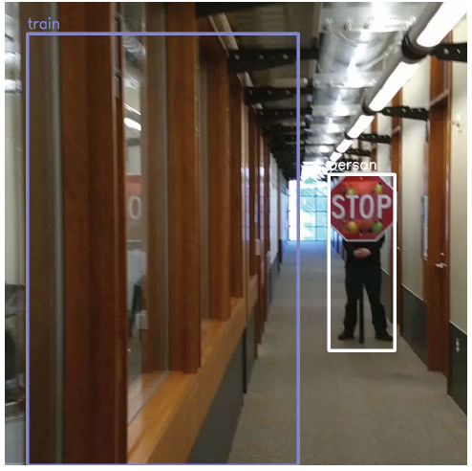
Adversarial Examples
A “train” in the hallway?
Picture from: Yevgeniy Vorobeychik, Bo Li - Adversarial Machine Learning Tutorial

Slide 18
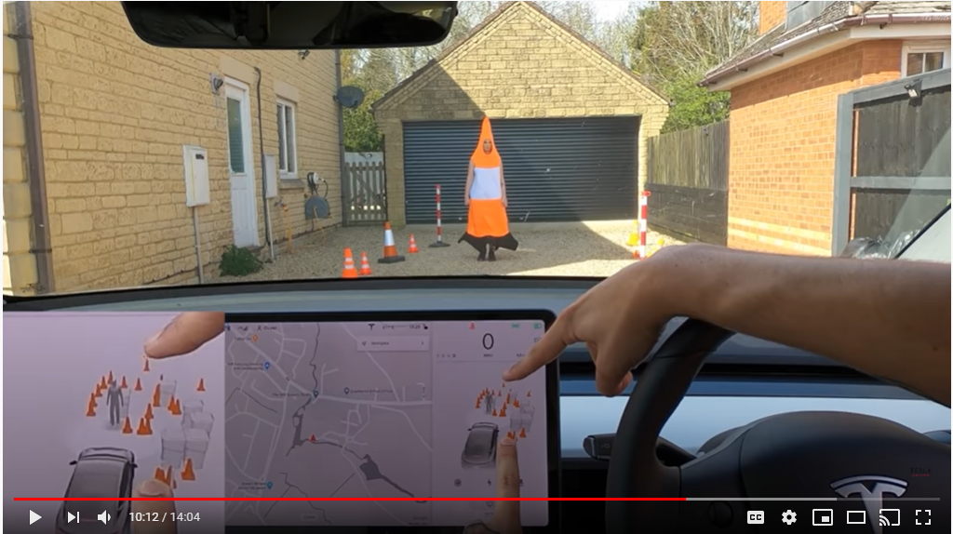
Adversarial Examples
Non-scientific: a Tesla owner checks if the car can distinguish a person wearing a cover-up from a traffic cone (video link)

Slide 19
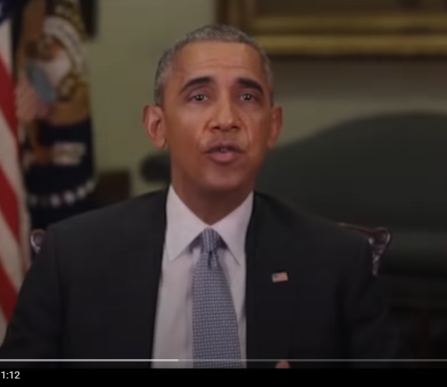
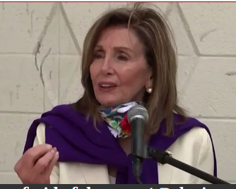
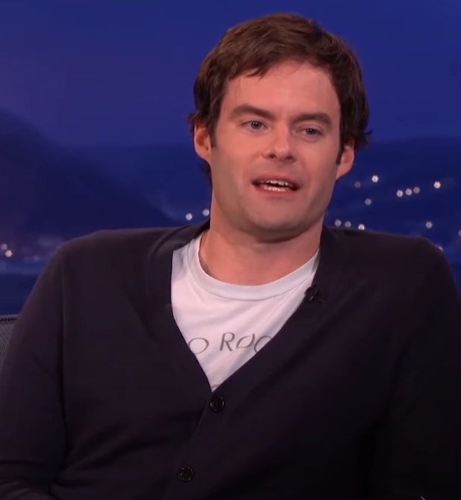
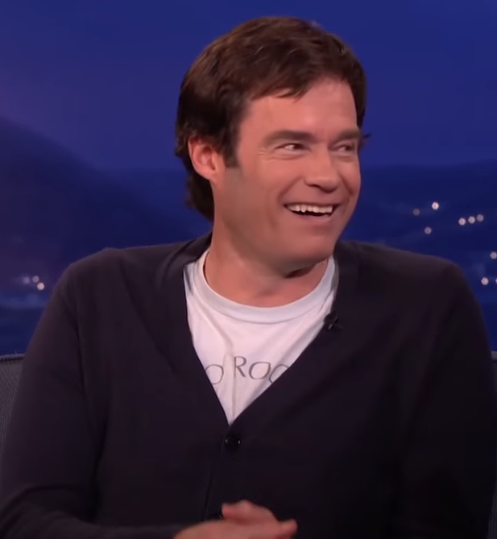
Adversarial Examples
Abusive use of machine learning
Using GANs to generate fake content (a.k.a. deep fakes)
Videos of politicians saying things they never said
Barak Obama’s deep fake, or the House Speaker Nancy Pelosi appears drunk in a video
Bill Hader impersonation of Arnold Schwarzenegger
Can have strong societal implications: elections, automated trolling, court evidence

Slide 20
Adversarial ML
AML is a research field that lies at the intersection of ML and computer security
E.g., network intrusion detection, spam filtering, malware classification, biometric authentication (facial detection)
ML algorithms in real-world applications mainly focus on increased accuracy
However, few techniques and design decisions focus on keeping the ML models secure and robust
Adversarial ML: ML in adversarial settings
Attack is a major component of AML
Bad actors do bad things
Their main objective is not to get detected (change behavior to avoid detection)
Slide credit: Binghui Wang: Adversarial Machine Learning — An Introduction

Slide 21
Attack Taxonomy
Data poisoning (Causative attack):
Attack on the training phase
Attackers perturb the training set to fool the model
Insert malicious inputs in the training set
Modify input instances in the training set
Change the labels to training inputs
Attackers attempt to influence or corrupt the ML model or the ML algorithm itself
Slide credit: Binghui Wang: Adversarial Machine Learning — An Introduction

Slide 22
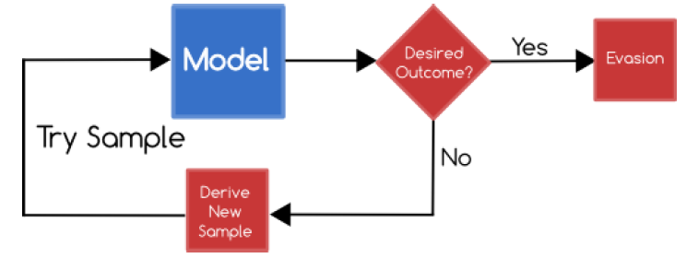
Attack Taxonomy
Evasion attack (Exploratory attack):
Attack on the testing phase
Attackers do not tamper with the ML model, but instead cause it to produce adversary outputs
Evasion attack is the most common attack
Slide credit: Binghui Wang: Adversarial Machine Learning — An Introduction

Slide 23
Evasion Attack
Evasion attack can be further classified into:
White-box attack
Attackers have full knowledge about the ML model
I.e., they have access to parameters, hyperparameters, gradients, architecture, etc.
Black-box attack
Attackers don’t have access to the ML model parameters, gradients, architecture
Perhaps they have some knowledge about the used ML algorithm
E.g., attackers may know that a ResNet50 model is used for classification, but they don’t have access to the model parameters
Attackers may query the model to obtain knowledge (can get examples)
Slide credit: Binghui Wang: Adversarial Machine Learning — An Introduction

Slide 24
Attack Taxonomy
Depiction of the adversarial attack taxonomy from Alessio's Adversarial ML presentation at FloydHub
Data Poisoning Attack
Evasion Attack
Picture from: https://blog.floydhub.com/introduction-to-adversarial-machine-learning/

Slide 25
Attack Taxonomy
Each of the above attacks can further be:
Non-targeted attack
The goal is to mislead the classifier to predict any labels other than the ground truth label
Most existing work deals with this goal
E.g., perturb an image of a military tank, so that the model predicts it is any other class than a military tank
Targeted attack
The goal is to mislead the classifier to predict a target label for an image
More difficult
E.g., perturb an image of a turtle, so that the model predicts it is a riffle
E.g., perturb an image of a Stop sign, so that the model predicts it is a Speed Limit sign

Slide 26
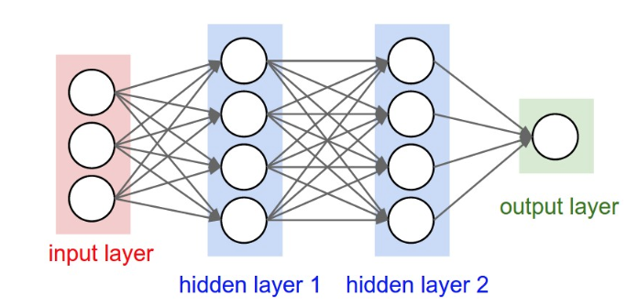
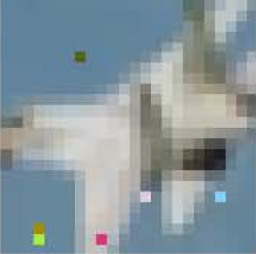
Evasion Attacks
Find a new input (similar to original input) but classified as another class (untargeted or targeted)
Adversarial attack image
warplane
Original input
Slide credit: He Xiaoyi – Adversarial Machine Learning

Slide 27
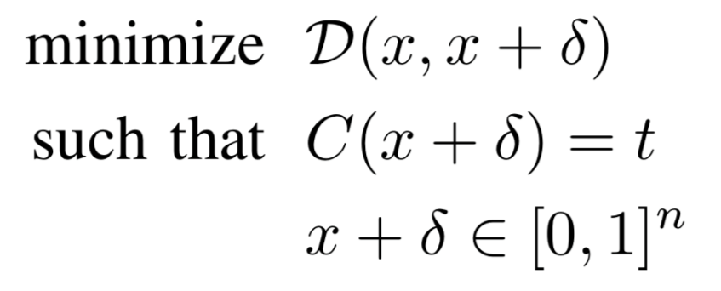
Evasion Attacks
How to find adversarial images?
Given an image x, which is labeled by the classifier (e.g., LogReg, SVM, or NN) as class $q$, i.e., $C\left(x\right)=q$
Create an adversarial image $x_{adv}$ by adding small perturbations $δ$to the original image, i.e., $x_{adv}=x+δ,$ such that the distance $D\left(x,x_{adv}\right)=D\left(x,x+δ\right)$ is minimal
So that the classifier assigns a label to the adversarial image that is different than $q$, i.e., $C\left(x_{adv}\right)=C\left(x+δ\right)=t≠q$
distance between x and x+𝛿
x+𝛿 is classified as target class t
each element of x+𝛿 is in [0,1] (to be a valid image)

Slide 28
Evasion Attacks
Distance metrics between $x$and $x_{adv}$:$D\left(x,x_{adv}\right)$
$ℓ_{0}$ norm: the number of elements in $x_{adv}$ such that ${x^{i}≠x}_{adv}^{i}$
Corresponds to the number of pixels that have been changed in the image $x_{adv}$
$ℓ_{1}$ norm: city-block distance, or Manhattan distance
$ℓ_{1}=\left|{x^{1}−x}_{adv}^{1}\right|+\left|{x^{2}−x}_{adv}^{2}\right|+⋯+\left|{x^{n}−x}_{adv}^{n}\right|$
$ℓ_{2}$ norm: Euclidean distance, or mean-squared error
$ℓ_{2}=\sqrt{{\left({x^{1}−x}_{adv}^{1}\right)}^{2}+{\left({x^{2}−x}_{adv}^{2}\right)}^{2}+⋯+{\left({x^{n}−x}_{adv}^{n}\right)}^{2}}$
$ℓ_{∞}$ norm: measures the maximum change to any of the pixels in the $x_{adv}$ image
$ℓ_{∞}=max\left(\left|{x^{1}≠x}_{adv}^{1}\right|,\left|{x^{2}≠x}_{adv}^{2}\right|,…,\left|{x^{n}≠x}_{adv}^{n}\right|\right)$

Slide 29
Spam Filtering Adversarial Game
Based on cumulative weights assigned to words, an email is classified as a spam or a legitimate message
1.
From: spammer@example.com
Cheap mortgage now!!!
Feature Weights
2.
cheap = 1.0
mortgage = 1.5
3.
Total score = 2.5
> 1.0 (threshold)
Spam
Slide credit: Daniel Lowd - Adversarial Machine Learning

Slide 30
Spam Filtering Adversarial Game
The spammers adapt to evade the classifier
1.
From: spammer@example.com
Cheap mortgage now!!! Eugene Oregon
Feature Weights
2.
cheap = 1.0
mortgage = 1.5
Eugene = -1.0
Oregon = -1.0
3.
Total score = 0.5
< 1.0 (threshold)
OK
Slide credit: Daniel Lowd - Adversarial Machine Learning

Slide 31
Spam Filtering Adversarial Game
The classifier is adapted by changing the feature weights
1.
From: spammer@example.com
Cheap mortgage now!!! Eugene Oregon
Feature Weights
2.
cheap = 1.5
mortgage = 2.0
Eugene = -0.5
Oregon = -0.5
3.
Total score = 2.5
> 1.0 (threshold)
Spam
OK
Slide credit: Daniel Lowd - Adversarial Machine Learning

Slide 32
Common Adversarial Attacks
Noise attack
Semantic attack
Fast gradient sign method (FGSM) attack
Basic iterative method (BIM) attack
Projected gradient descent (PGD) attack
DeepFool attack
Carlini-Wagner (CW) attack

Slide 33
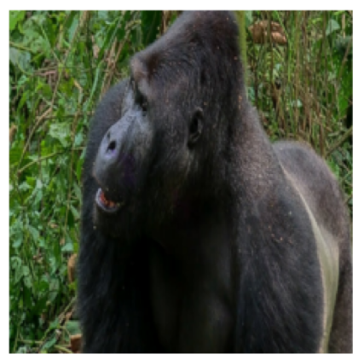
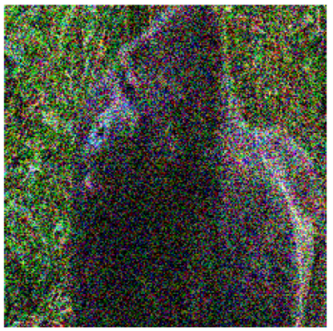
Noise Attack
Noise attack
The simplest form of adversarial attack
Noise is a random arrangement of pixels containing no information
In Python, noise is created by the randn() function
I.e., random numbers from a normal distribution (0 mean and 1 st. dev.)
It represents a non-targeted black-box evasion attack
+
=
Prediction: gorilla
Prediction: fountain
Picture from: https://blog.floydhub.com/introduction-to-adversarial-machine-learning/

Slide 34
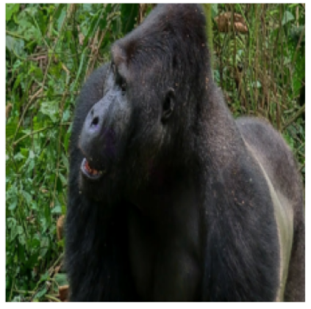
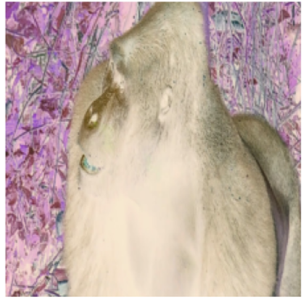
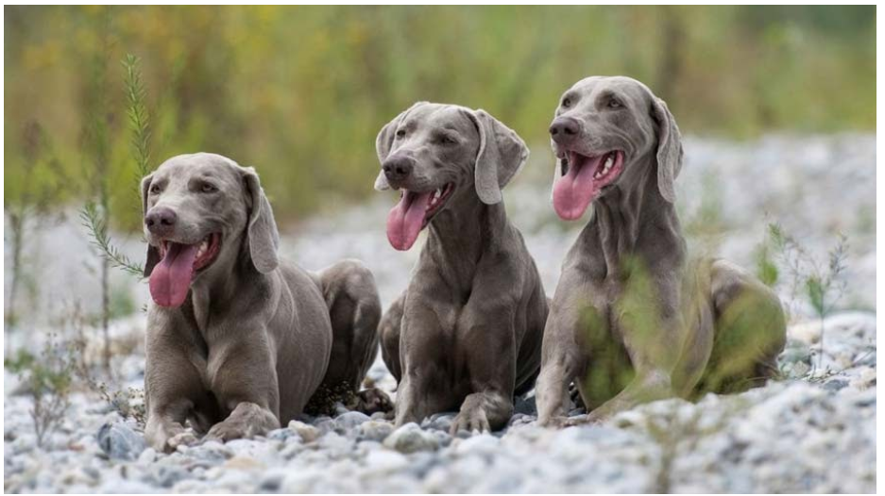
Semantic Attack
Semantic attack
Hosseini (2017) - On the Limitation of Convolutional Neural Networks in Recognizing Negative Images
Use negative images
Reverse all pixels intensities
E.g., change the sign of all pixels, if the pixels values are in range [-1,1]
Original image
Negative image
Weimaraner (a dog breed)
Prediction: gorilla
Prediction: weimaraner
Picture from: https://blog.floydhub.com/introduction-to-adversarial-machine-learning/

Slide 35
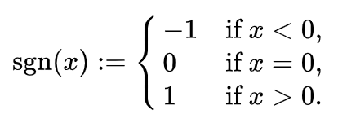
FGSM Attack
Fast gradient sign method (FGSM) attack
Goodfellow (2015) - Explaining and Harnessing Adversarial Examples
An adversarial image x_{adv} is created by adding perturbation noise to an image x
$$x_{adv}=x+ε∙sign\left(∇_{x}ℒ\left(h\left(x, w\right),y\right)\right)$$
Notation: input image x, cost function $ℒ$, NN model h, NN weights (parameters) $w$, gradient $∇$ (Greek letter “nabla”), noise magnitude $ε$
Perturbation noise is calculated as the gradient of the loss function $ℒ$ with respect to the input image x for the true class label y
This increases the loss for the true class y → the model misclassifies the image x_{adv}

Slide 36
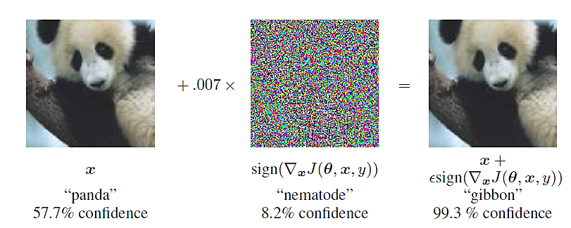
FGSM Attack
FGSM is a white-box non-targeted evasion attack
White-box, since we need to know the gradients to create the adversarial image
The noise magnitude is ε = 0.007
Note: nematode is an insect referred to as roundworm

Slide 37
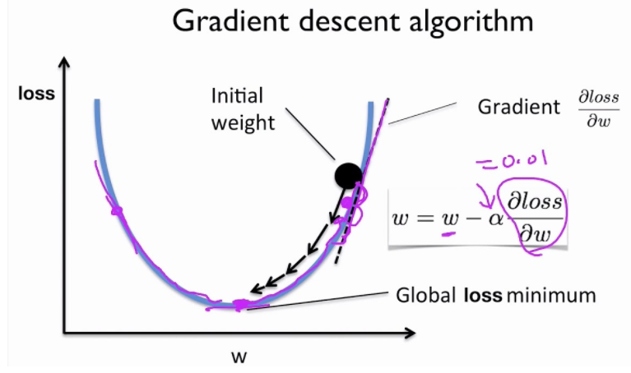
FGSM Attack
Recall that training NNs is based on the gradient descent algorithm
The values of the network parameters (weights) w are iteratively changed until a minimum of the loss function is reached
Gradients of the loss function with respect to the model parameters (${∂l}/{∂w}$) give the direction and magnitude for updating the parameters
The step of each update is the learning rate α
Picture from: https://blog.floydhub.com/introduction-to-adversarial-machine-learning/

Slide 38
FGSM Attack
The sign and magnitude of the gradient give the direction and the slope of the steepest descent
Left image: + and – sign of the gradient
Right image: small, adequate, and large slope of the weight update, based on the magnitude of the gradient
Middle image: small and large α (learning rate)
To minimize the loss function, the weights w are changed in the opposite direction of the gradient, i.e., $w=w−α\frac{∂loss}{∂w}$
Sign + direction
Slope too small
Slope right
Sign - direction
Slope too large
Small α
Large α

Slide 39
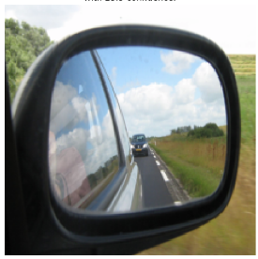
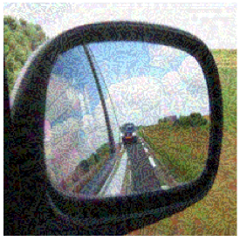
FGSM Attack
FGSM attack example
Original image
Adversarial image
Prediction: car mirror
Prediction: sunglasses
Picture from: https://blog.floydhub.com/introduction-to-adversarial-machine-learning/

Slide 40
BIM Attack
Basic iterative method (BIM) attack
Kurakin (2017) Adversarial Examples in the Physical World
BIM is a variant of FGSM: it repeatedly adds noise to the image x in multiple iterations, in order to cause misclassification
The number of iterations steps is t, and α is the amount of noise that is added at each step
$$x_{adv}^{t}=x^{t−1}+α∙sign\left(∇_{x}ℒ\left(h\left(x^{t−1}\right),y\right)\right)$$
The perturbed image after the t iterations is $x_{adv}^{t}$
Multiple steps of adding noise increase the chances of misclassifying the image
Compare to FGSM
$$x_{adv}=x+ε∙sign\left(∇_{x}ℒ\left(h\left(x\right),y\right)\right)$$

Slide 41
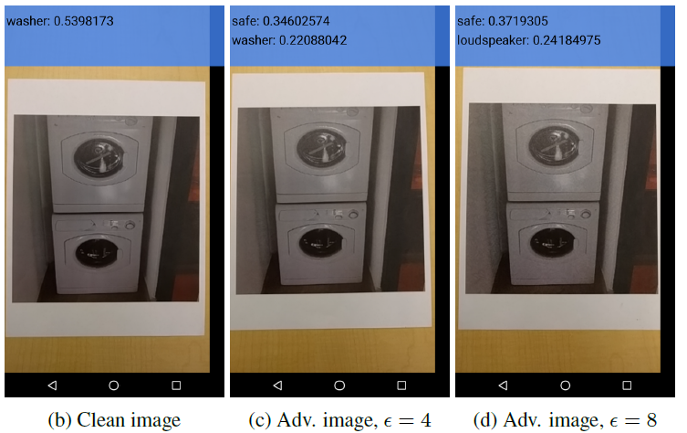
BIM Attack
BIM attack example, cell phone image

Slide 42
PGD Attack
Projected gradient descent (PGD) attack
Madry (2017) Towards Deep Learning Models Resistant to Adversarial Attacks
PGD is an extension of BIM (and FGSM), where after each step of perturbation, the adversarial example is projected back onto the $ε$-ball of x using a projection function Π
$$x_{adv}^{t}=Π_{ε}\left(x^{t−1}+α∙sign\left(∇_{x}ℒ\left(h\left(x^{t−1}\right),y\right)\right)\right)$$
Different from BIM, PGD uses random initialization for x, by adding random noise from a uniform distribution with values in the range $\left(−ε,ε\right)$
PGD is regarded as the strongest first-order attack
First-order attack means that the adversary uses only the gradients of the loss function with respect to the input

Slide 43
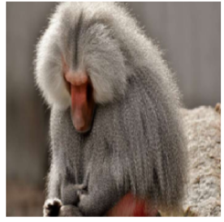
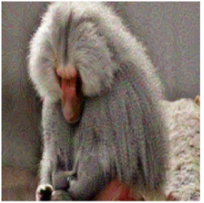
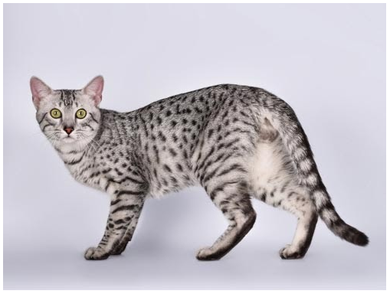
PGD Attack
PGD attack example
Original image
Adversarial image
Egyptian cat
Prediction: baboon
Prediction: Egyptian cat
Picture from: https://blog.floydhub.com/introduction-to-adversarial-machine-learning/

Slide 44
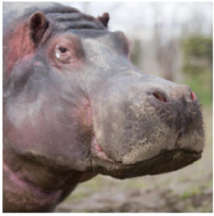
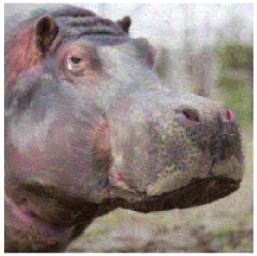
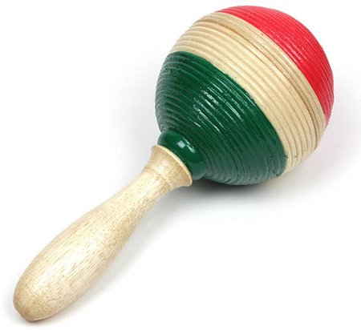
PGD Attack
Gradient approaches can also be designed as targeted white-box attacks
The added perturbation noise aims to minimize the loss function of the image for a specific class label
In this example, the target class is maraca
The iterations loop doesn’t break until the image is classified into the target class, or until the maximum number of iterations is reached
Original image
Adversarial image
Maraca
Prediction: hippopotamus
Prediction: maraca
Picture from: https://blog.floydhub.com/introduction-to-adversarial-machine-learning/

Slide 45
PGD Attack
For a targeted attack, if the target class label is denoted t, adversarial examples are created by using
$$x_{adv}^{t}=Π_{ε}\left(x^{t−1}−α∙sign\left(∇_{x}ℒ\left(h\left(x^{t−1}\right),t\right)\right)\right)$$
I.e., it is based on minimizing the loss function with respect to the target class t
This is opposite to non-targeted attacks, which maximize the loss function with respect to the true class label

Slide 46
DeepFool Attack
DeepFool attack
Moosavi-Dezfooli (2015) DeepFool: A Simple and Accurate Method to Fool Deep Neural Networks
DeepFool is an untargeted white-box attack
It mis-classifies the image with the minimal amount of perturbation possible
There is no visible change to the human eye between the two images
Prediction: canon
Difference
Prediction: Projector
Picture from: https://blog.floydhub.com/introduction-to-adversarial-machine-learning/

Slide 47
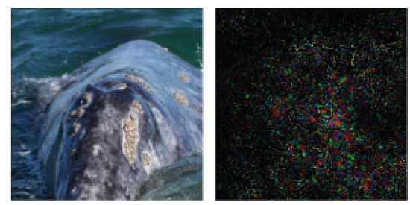
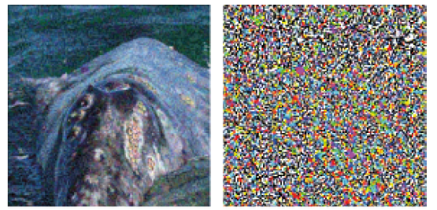
DeepFool Attack
Image example
Original image: whale
Both DeepFool and FGSM perturb the image to be classifier as turtle
DeepFool leads to a smaller perturbation
DeepFool
FGSM
Prediction: Turtle
Difference
Prediction: Turtle
Difference

Slide 48
DeepFool Attack
E.g., consider a linear classifier algorithm applied to objects from 2 classes: green and orange circles
The line that separates the 2 classes is called the hyperplane
Data points falling on either sides of the hyperplane are attributed to different classes (such as benign vs. malicious class)
Given an input x, DeepFool projects x onto the hyperplane and pushes it a bit beyond the hyperplane, thus misclassifying it
Benign
Benign
x_{adv}
x
Hyperplane
Hyperplane
Malicious
Malicious
Picture from: Yevgeniy Vorobeychik, Bo Li - Adversarial Machine Learning

Slide 49
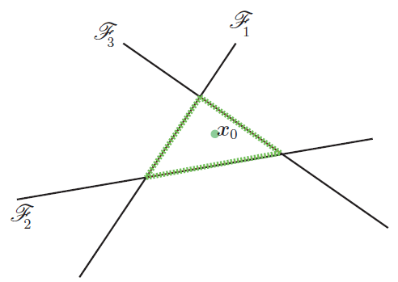
DeepFool Attack
For a multiclass problem with linear classifiers, there are multiple hyperplanes that separate an input x from other classes
E.g., an example with 4 classes is shown in the image below
DeepFool finds that closest hyperplane to the input x₀, in this case the hyperplane $ℱ_{3}$(most similar class of the other 3 classes)
Then, projects the input and pushes it a little beyond the hyperplane

Slide 50
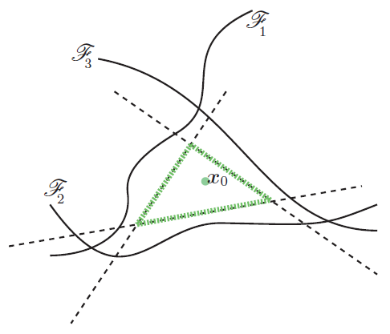
DeepFool Attack
For non-linear classifiers (such as neural networks), the authors perform several iterations of adding perturbations to the image
At each iteration, the classifier function is linearized around the current image, and a minimal perturbation is calculated
The algorithm stopes when the class of the image change to another label than the true class

Slide 51
Carlini Wagner (CW) Attack
Carlini-Wagner (CW) attack
Carlini (2017) Towards Evaluating the Robustness of Neural Networks
The initial formulation for creating adversarial attacks is difficult to solve
Carlini-Wagner propose a reformulation of it which is solvable

Slide 52
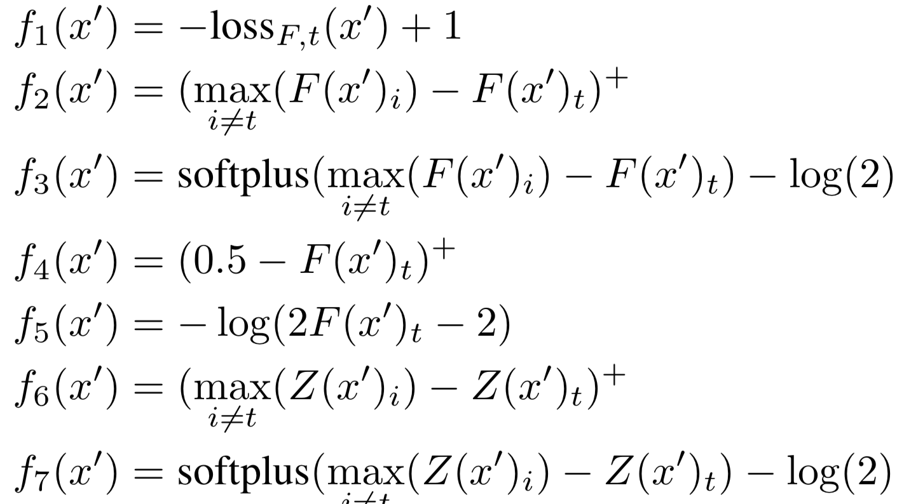
Carlini Wagner (CW) Attack
The authors considered several variants for the function f
The best results were obtained by f₆

Slide 53
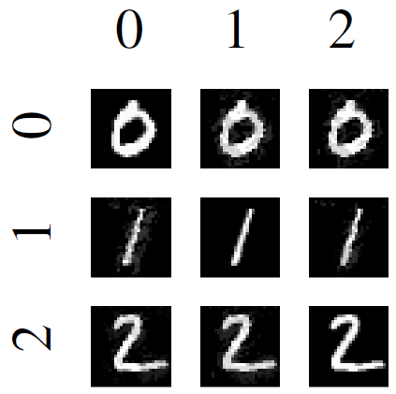
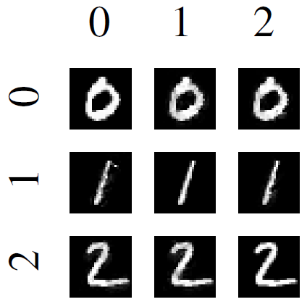
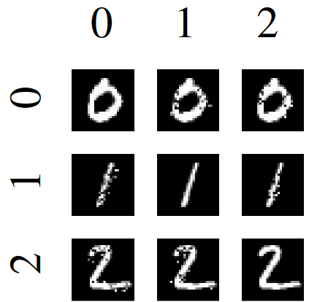
Carlini Wagner (CW) Attack
Results on the MNIST dataset
$L_{∞}$attack
$L_{2}$attack
$L_{0}$attack

Slide 54
Evasion Attacks on Black-Box Models
Adversarial example transferability
Cross-model transferability: the same adversarial example is often misclassified by a variety of classifiers with different architectures
Cross-training set transferability: the same adversarial example is often misclassified trained on different subsets of the training data
Therefore, an attacker can take the following steps to reverse-engineer the classifier:
Train his own (white-box) substitute model
Generate adversarial samples
Apply the adversarial samples to the target ML model
Slide credit: Binghui Wang: Adversarial Machine Learning — An Introduction

Slide 55
Defense Against Adversarial Attacks
Adversarial samples can cause any ML algorithm to fail
However, they can be used to build more accurate and robust models
AML is a two-player game:
Attackers aim to produce strong adversarial examples that evade a model with high confidence while requiring only a small perturbation
Defenders aim to produce models that are robust to adversarial examples (i.e., the models don’t have adversarial examples, or the adversaries cannot find them easily)
Defense strategies against adversarial attacks include:
Adversarial training
Detecting adversarial examples
Gradient masking
Robust optimization (regularization, certified defenses)
A list of adversarial defenses can be found at this link

Slide 56
Adversarial Training
Learning the model parameters using adversarial samples is referred to as adversarial training
The training dataset is augmented with adversarial examples produced by known types of attacks
For each training input add an adversarial example
However, if a model is trained only on adversarial examples, the accuracy to classify regular examples will reduce significantly
Possible strategies:
Train the model from scratch using regular and adversarial examples
Train the model on regular examples and afterward fine-tune with adversarial examples

Slide 57
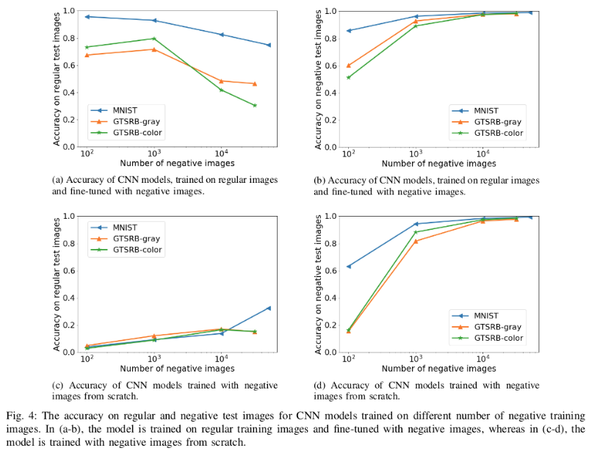
Adversarial Training
Training with and without negative images for semantic attack
Fine-tuned
Accuracy on regular images
Accuracy on negative images
Trained from scratch
Picture from: https://blog.floydhub.com/introduction-to-adversarial-machine-learning/

Slide 58
Adversarial Training
The plots show the cross-entropy loss values for standard and adversarial training on MNIST and CIFAR10 datasets while creating adversarial examples using PDG attack (Madry, 2018)
20 runs are shown, each starting at a random point within a perturbation range $\left(−ε,ε\right)$
The final loss values on adversarially trained models are much smaller than on the original training datasets
Picture from: Madry (2018) Towards Deep Learning Models Resistant to Adversarial Attacks

Slide 59
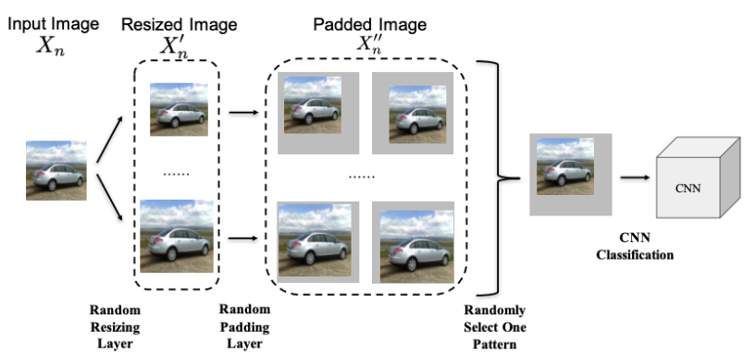
Random Resizing and Padding
Model training with randomly resizing the image and applying random padding on all four sides have shown to improve the robustness to adversarial attacks
Xie (2018) – Mitigating Adversarial Effects Through Randomization

Slide 60
Detecting Adversarial Examples
A body of work focused on distinguishing adversarial examples from regular clean examples
If the defense method detects that an input example is adversarial, the classifier will refuse to predict its class label
Example detection defense methods
Kernel Density (KD) detector based on Bayesian uncertainty features
Feinman (2017) – Detecting Adversarial Samples from Artifacts
Local Intrinsic Dimensionality (LID) of adversarial subspaces
Ma (2018) - Characterizing Adversarial Subspaces Using Local Intrinsic Dimensionality
Adversary detection networks
Metzen (2017) On detecting adversarial perturbations

Slide 61
Gradient Masking
Gradient masking defense methods deliberately hide the gradient information of the model
Since most attacks are based on the model’s gradient information
Distillation defense – changes the scaling of the last hidden layer in NNs, hindering the calculation of gradients
Papernot (2016) Distillation as a defense to adversarial perturbations against deep neural networks
Input preprocessing by discretization of image’s pixel values, or resizing and cropping, or smoothing
Buckman (2018) Thermometer encoding: One hot way to resist adversarial examples
DefenseGAN – uses a GAN model to transform perturbed images into clean images
Samangouei (2017) Defense-GAN: Protecting classifiers against adversarial attacks using generative models

Slide 62
Robust Optimization
Robust optimization aims to evaluate, and improve, the model robustness to adversarial attacks
Consequently, learn model parameters that minimize the misclassification of adversarial examples
Regularization methods – train the model by penalizing large values of the parameters, or large values of the gradients
Cisse (2017) Parseval networks: Improving robustness to adversarial examples
Certified defenses – for a given dataset and model, find the lower bound of the minimal perturbation: the model will be safe against any perturbations smaller than the lower bound
Raghunathan (2018) Certified defenses against adversarial examples

Slide 63
Conclusion
ML algorithms and methods are vulnerable to many types of attacks
Adversarial examples show its transferability in ML models
I.e., either cross-models or cross-training sets
Adversarial examples can be leveraged to improve the performance or the robustness of ML models

Slide 64
References
Introduction to Adversarial Machine Learning – blog post by Arunava Chakraborty
Binghui Wang: Adversarial Machine Learning — An Introduction
Daniel Lowd, Adversarial Machine Learning
Yevgeniy Vorobeychik, Bo Li, Adversarial Machine Learning (Tutorial)

Slide 65
Other AML Recourses
Cleverhans - a repository from Google that implements latest research in AML
The library is being updated to support TensorFlow2, PyTorch, and Jax
Adversarial Robustness Toolbox - a toolbox from IBM that implements state-of-the-art attacks and defenses
The algorithms are framework-independent, and support TensorFlow, Keras, PyTorch, MXNet, XGBoost, LightGBM, CatBoost, etc.
ScratchAI – a smaller AML library developed in PyTorch, and explained in this blog post
Robust ML Defenses - list of adversarial defenses with code
AML Tutorial – by Bo Li, Dawn Song, and Yevgeniy Vorobeychik
Nicholas Carlini website

