Slide 1

CS 502
Directed Studies: Adversarial Machine Learning
Dr. Alex Vakanski

Slide 2
Lecture 2
Deep Learning Overview

Slide 3
Lecture Outline
Machine learning basics
  Supervised and unsupervised learning
  Linear and non-linear classification methods
Introduction to deep learning
Elements of neural networks (NNs)
  Activation functions
Training NNs
  Gradient descent
  Regularization methods
NN architectures
  Convolutional NNs
  Recurrent NNs

Slide 4
Machine Learning Basics
Artificial Intelligence is a scientific field concerned with the development of algorithms that allow computers to learn without being explicitly programmed
Machine Learning is a branch of Artificial Intelligence, which focuses on methods that learn from data and make predictions on unseen data
Labeled Data
Machine Learning algorithm
Training
Prediction
Labeled Data
Learned model
Prediction
Picture from: Ismini Lourentzou – Introduction to Deep Learning

Slide 5

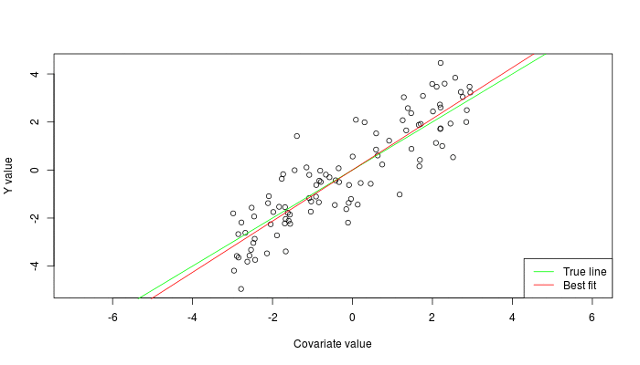
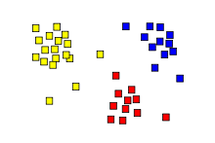
Machine Learning Types
Supervised: learning with labeled data
  Example: email classification, image classification
  Example: regression for predicting real-valued outputs
Unsupervised: discover patterns in unlabeled data
  Example: cluster similar data points
Reinforcement learning: learn to act based on feedback/reward
  Example: learn to play Go
class A
class B
Classification
Regression
Clustering
Slide credit: Ismini Lourentzou – Introduction to Deep Learning

Slide 6
Supervised Learning
Supervised learning categories and techniques
  Numerical classifier functions
    Linear classifier, perceptron, logistic regression, support vector machines (SVM), neural networks
  Parametric (probabilistic) functions
    Naïve Bayes, Gaussian discriminant analysis (GDA), hidden Markov models (HMM), probabilistic graphical models
  Non-parametric (instance-based) functions
    k-nearest neighbors, kernel regression, kernel density estimation, local regression
  Symbolic functions
    Decision trees, classification and regression trees (CART)
  Aggregation (ensemble) learning
    Bagging, boosting (Adaboost), random forest
Slide credit: Y-Fan Chang – An Overview of Machine Learning

Slide 7
Unsupervised Learning
Unsupervised learning categories and techniques
  Clustering
    k-means clustering
    Mean-shift clustering
    Spectral clustering
  Density estimation
    Gaussian mixture model (GMM)
    Graphical models
  Dimensionality reduction
    Principal component analysis (PCA)
    Factor analysis
Slide credit: Y-Fan Chang – An Overview of Machine Learning

Slide 8
Nearest Neighbor Classifier
Nearest Neighbor - for each test data point, assign the class label of the nearest training data point
  Adopt a distance function to find the nearest neighbor
    Calculate the distance to each data point in the training set, and assign the class of the nearest data point (minimum distance)
  No parameter training required
Test example
Training examples from class 2
Training examples from class 1
Picture from: James Hays – Machine Learning Overview

Slide 9
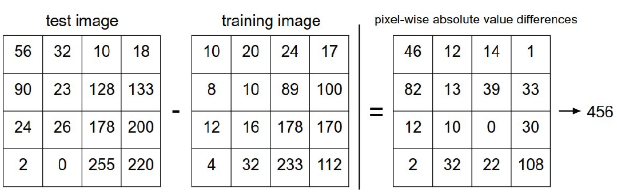

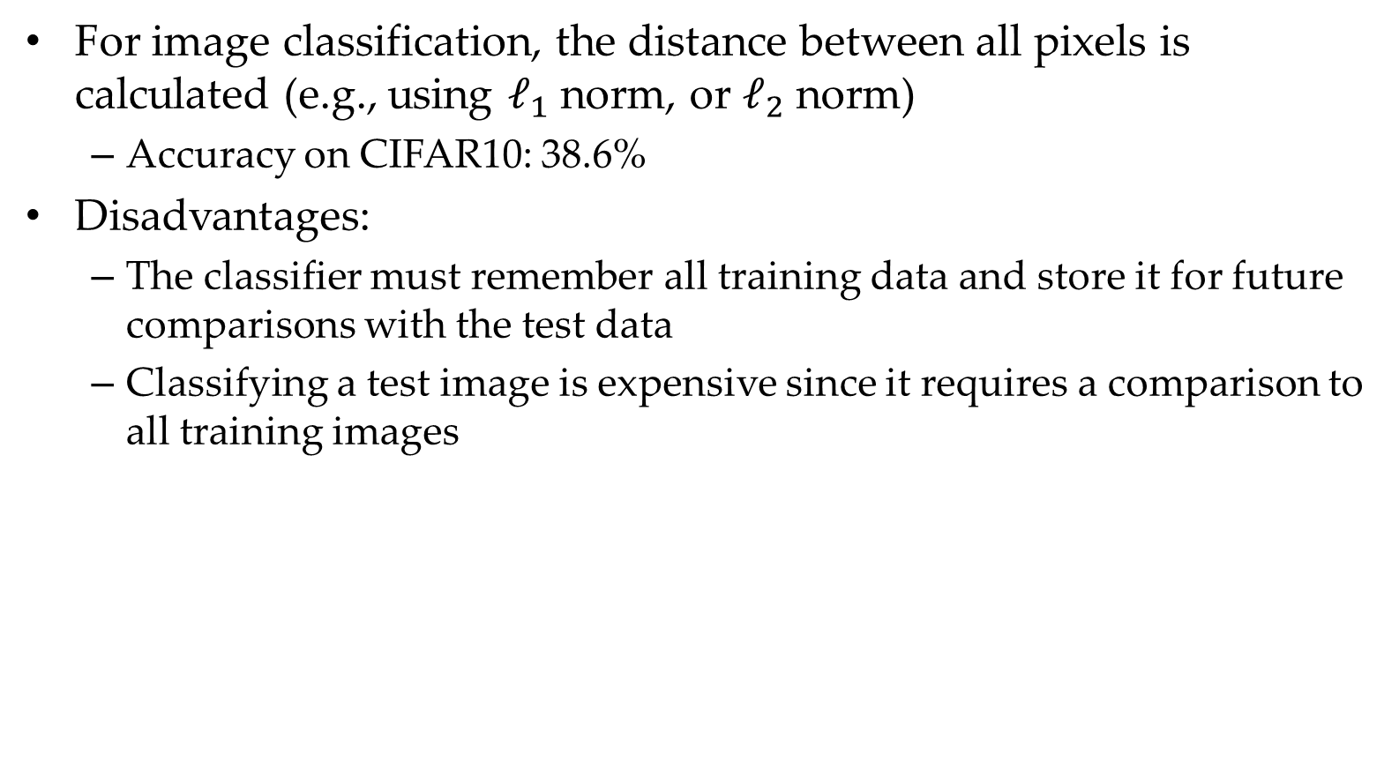
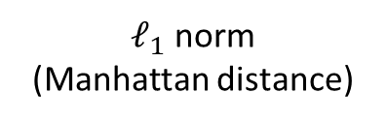
Nearest Neighbor Classifier
For image classification, the distance between all pixels is calculated (e.g., using $ℓ_{1}$ norm, or $ℓ_{2}$ norm)
  Accuracy on CIFAR10: 38.6%
Disadvantages:
  The classifier must remember all training data and store it for future comparisons with the test data
  Classifying a test image is expensive since it requires a comparison to all training images
$ℓ_{1}$ norm
(Manhattan distance)
Picture from: https://cs231n.github.io/classification/

Slide 10
Nearest Neighbor Classifier
k-Nearest Neighbors approach considers multiple neighboring data points to classify a test data point
  E.g., 3-nearest neighbors
    The test example in the figure is the + mark
    The class of the test example is obtained by voting (of 3 closest points)
x2
x
x
x
o
x
x
x
x
+
o
x
o
o
x
o
+
o
o
o
o
x1
Picture from: James Hays – Machine Learning Overview

Slide 11

Linear Classifier
Linear classifier
  Find a linear function f of the inputs x_{i} that separates the classes
  Use pairs of inputs and labels to find the weights matrix W and the bias vector b
    The weights and biases are the parameters of the function f
    Parameter learning is solved by minimizing a loss function
  Perceptron algorithm is often used to find optimal parameters
    Updates the parameters until a minimal error is reached (similar to gradient descent)
  Linear classifier is a simple approach, but it is a building block of advanced classification algorithms, such as SVM and neural networks

Slide 12
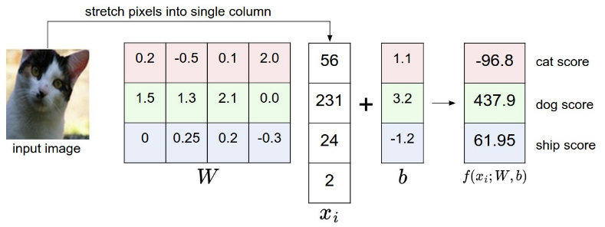
Linear Classifier
The decision boundary is linear
  A straight line in 2D, a flat plane in 3D, a hyperplane in 3D and higher dimensional space
Example: classify an input image
  The selected parameters in this example are not good, because the predicted cat score is low
Picture from: https://cs231n.github.io/classification/

Slide 13
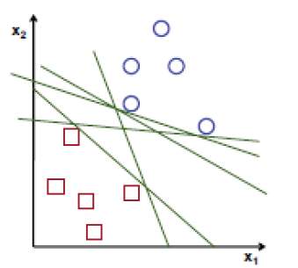
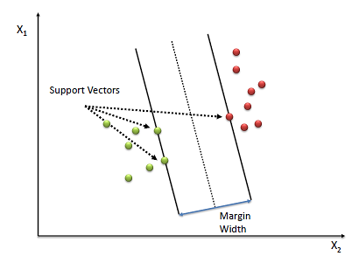

Support Vector Machines
Support vector machines (SVM)
  How to find the best decision boundary?
    All lines in the figure correctly separate the 2 classes
    The line that is farthest from all training examples will have better generalization capabilities
  SVM solves an optimization problem:
    First, identify a decision boundary that correctly classifies all examples
    Next, increase the geometric margin between the boundary and all examples
  The data points that define the maximum margin width are called support vectors
  Find W and b by solving:

Slide 14
Linear vs Non-linear Techniques
Linear classification techniques
  Linear classifier
  Perceptron
  Logistic regression
  Linear SVM
  Naïve Bayes
Non-linear classification techniques
  k-nearest neighbors
  Non-linear SVM
  Neural networks
  Decision trees
  Random forest

Slide 15
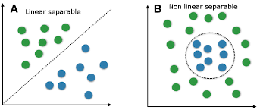


Linear vs Non-linear Techniques
For some tasks, input data can be linearly separable, and linear classifiers can be suitably applied
For other tasks, linear classifiers may have difficulties to produce adequate decision boundaries
Picture from: Y-Fan Chang – An Overview of Machine Learning

Slide 16
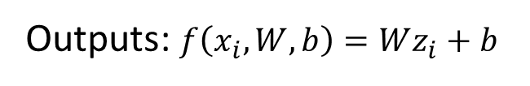

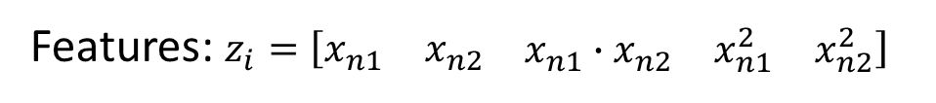
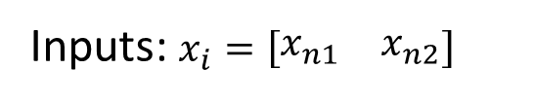
Non-linear Techniques
Non-linear classification
  Features $z_{i}$are obtained as non-linear functions of the inputs $x_{i}$
  It results in non-linear decision boundaries
  Can deal with non-linearly separable data
Inputs: $x_{i}=\left[\begin{matrix}x_{n1} & x_{n2}\end{matrix}\right]$
Features: $z_{i}=\left[\begin{matrix}x_{n1} & x_{n2} & \begin{matrix}x_{n1}∙x_{n2} & x_{n1}^{2} & x_{n2}^{2}\end{matrix}\end{matrix}\right]$
Outputs: $f\left(x_{i}, W, b\right)=Wz_{i}+b$
Picture from: Y-Fan Chang – An Overview of Machine Learning

Slide 17

Non-linear Support Vector Machines
Non-linear SVM
  The original input space is mapped to a higher-dimensional feature space where the training set is linearly separable
  Define a non-linear kernel function to calculate a non-linear decision boundary in the original feature space
$$Φ:x ↦φ\left(x\right)$$
Picture from: James Hays – Machine Learning Overview

Slide 18
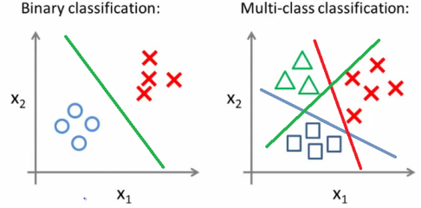
Binary vs Multi-class Classification
A problem with only 2 classes is referred to as binary classification
  The output labels are 0 or 1
  E.g., benign or malignant tumor, spam or no spam email
A problem with 3 or more classes is referred to as multi-class classification

Slide 19
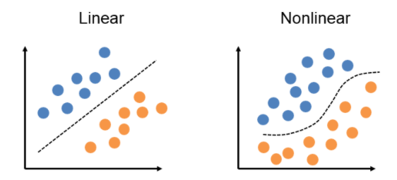
Binary vs Multi-class Classification
Both the binary and multi-class classification problems can be linearly or non-linearly separated
  Linearly and non-linearly separated data for binary classification problem

Slide 20
No-Free-Lunch Theorem
Wolpert (2002) - The Supervised Learning No-Free-Lunch Theorems
The derived classification models for supervised learning are simplifications of the reality
  The simplifications are based on certain assumptions
  The assumptions fail in some situations
    E.g., due to inability to perfectly estimate parameters from limited data
In summary, the theorem states:
  No single classifier works the best for all possible situations
  Since we need to make assumptions to generalize

Slide 21
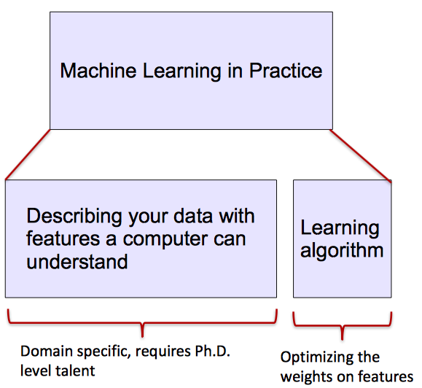
ML vs. Deep Learning
Most machine learning methods rely on human-designed feature representations
  ML becomes just optimizing weights to best make a final prediction
Picture from: Ismini Lourentzou – Introduction to Deep Learning

Slide 22
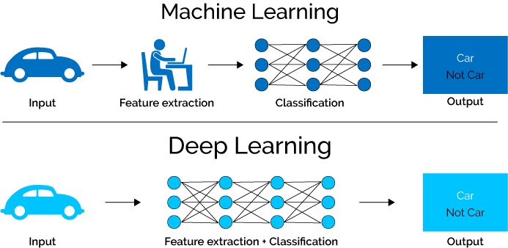
ML vs. Deep Learning
Deep learning (DL) is a machine learning subfield that uses multiple layers for learning data representations
  DL is exceptionally effective at learning patterns
Picture from: https://www.xenonstack.com/blog/static/public/uploads/media/machine-learning-vs-deep-learning.png

Slide 23




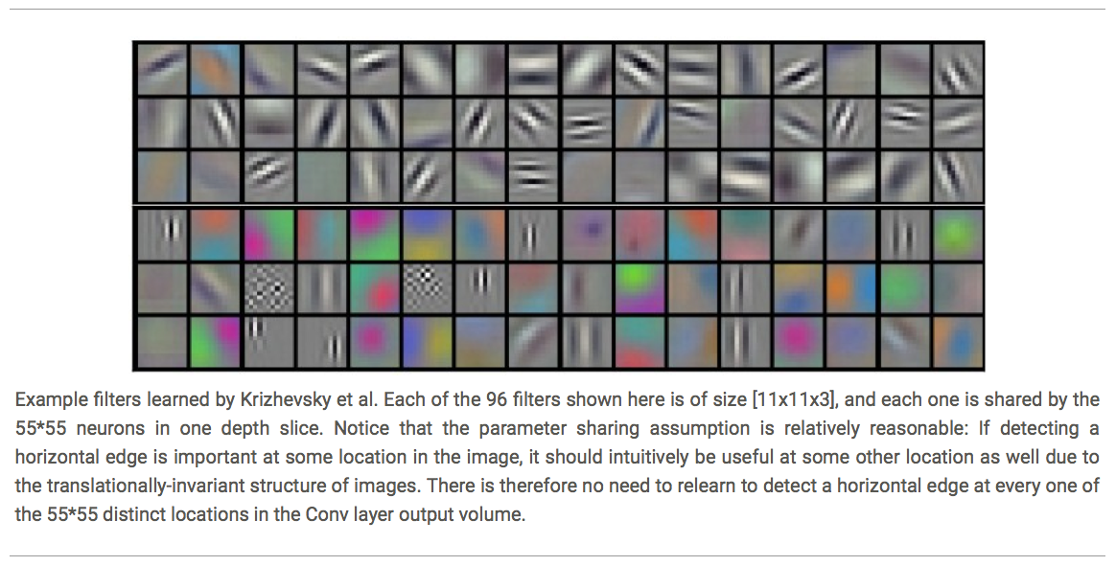














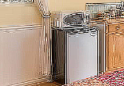

ML vs. Deep Learning
DL applies a multi-layer process for learning rich hierarchical features (i.e., data representations)
  Input image pixels → Edges → Textures → Parts → Objects
Low-Level Features
Mid-Level Features
High-Level Features
Trainable Classifier
Output
Slide credit: Param Vir Singh – Deep Learning

Slide 24
Why is DL Useful?
DL provides a flexible, learnable framework for representing visual, text, linguistic information
  Can learn in unsupervised and supervised manner
DL represents an effective end-to-end system learning
Requires large amounts of training data
Since about 2010, DL has outperformed other ML techniques
  First in vision and speech, then NLP, and other applications

Slide 25
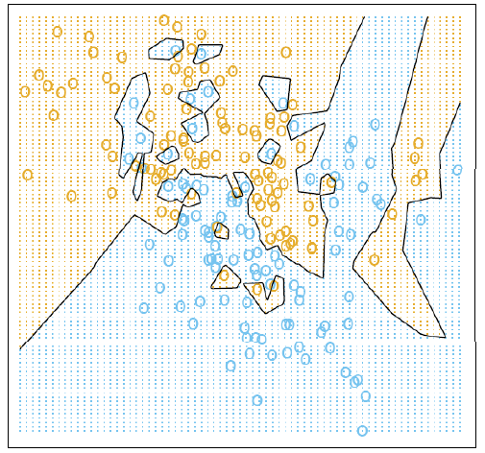
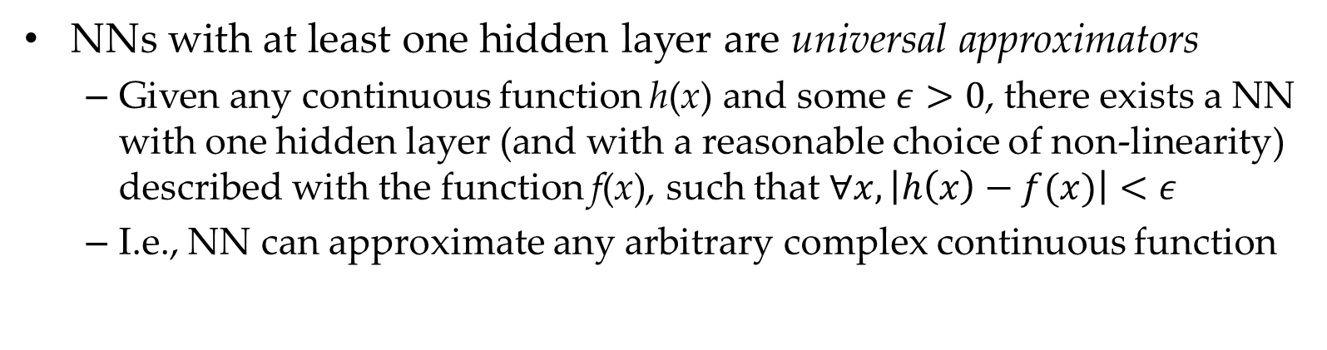
Representational Power
NNs with at least one hidden layer are universal approximators
  Given any continuous function h(x) and some $ε>0$, there exists a NN with one hidden layer (and with a reasonable choice of non-linearity) described with the function f(x), such that $∀x, \left|h\left(x\right)−f(x)\right|<ε$
  I.e., NN can approximate any arbitrary complex continuous function
NNs use nonlinear mapping of the inputs to the outputs f(x) to compute complex decision boundaries
But then, why use deeper NNs?
  The fact that deep NNs work better is an empirical observation
  Mathematically, deep NNs have the same representational power as a one-layer NN

Slide 26
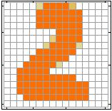
Introduction to Neural Networks
Handwritten digit recognition (MNIST dataset)
  The intensity of each pixel is considered an input element
  The output is the class of the digit
Input
Output
y₁
is 1
0.1
y₂
is 2
0.7
The image is “2”
……
……
……
y₁₀
0.2
is 0
16 x 16 = 256
Ink → 1
No ink → 0
Each dimension represents the confidence of a digit
Slide credit: Hung-yi Lee – Deep Learning Tutorial

Slide 27


Introduction to Neural Networks
Handwritten digit recognition
y₁
Machine
y₂
“2”
……
……
$$f:R^{256}→R^{10}$$
y₁₀
The function $f$ is represented by a neural network
Slide credit: Hung-yi Lee – Deep Learning Tutorial

Slide 28

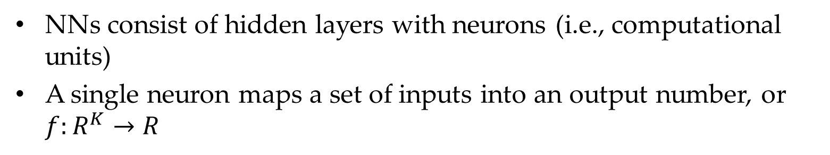
Elements of Neural Networks
NNs consist of hidden layers with neurons (i.e., computational units)
A single neuron maps a set of inputs into an output number, or $f:R^{K}→R$
$$a=σ\left(z\right)$$
…
…
output
Activation function
weights
input
bias
Slide credit: Hung-yi Lee – Deep Learning Tutorial

Slide 29
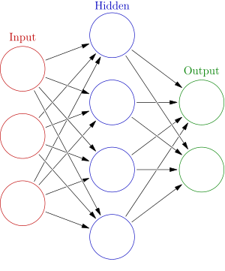




Elements of Neural Networks
A NN with one hidden layer and one output layer
Weights
Biases
$$hidden layer h=σ(W_{1}x+b_{1})$$
$$output layer y=σ(W_{2}h+b_{2})$$
Activation functions
4 + 2 = 6 neurons (not counting inputs)
[3 × 4] + [4 × 2] = 20 weights
4 + 2 = 6 biases
26 learnable parameters
$$y$$
$$x$$
$$h$$
Slide credit: Ismini Lourentzou – Introduction to Deep Learning

Slide 30
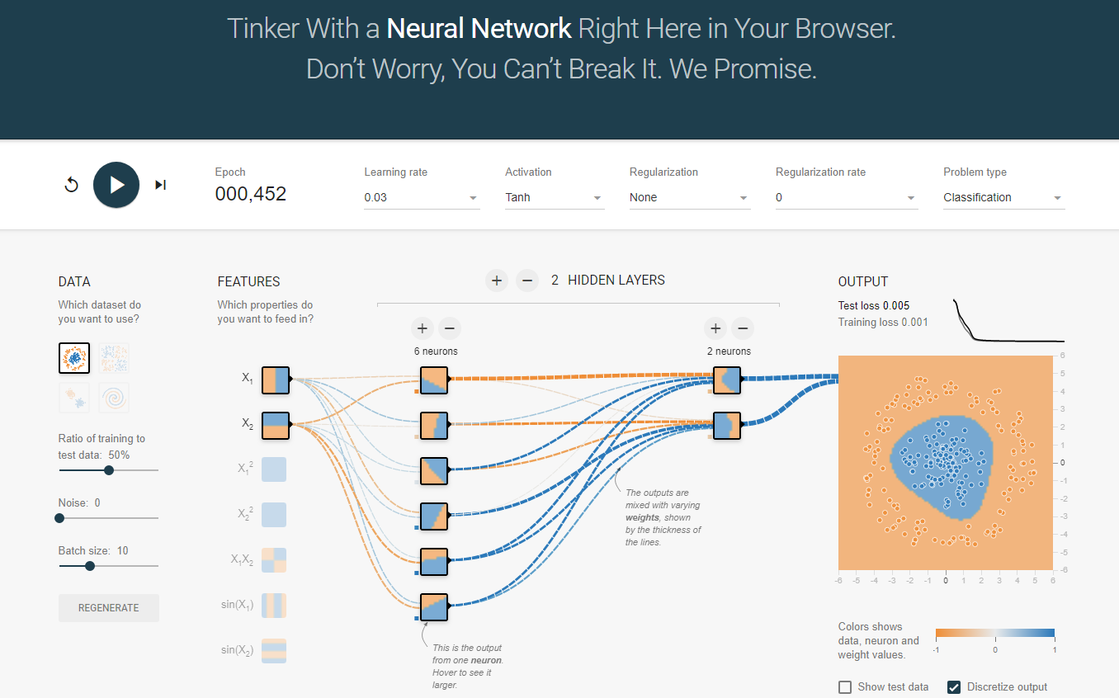
Elements of Neural Networks
A neural network playground link

Slide 31
Elements of Neural Networks
Deep NNs have many hidden layers
  Fully-connected (dense) layers (a.k.a. Multi-Layer Perceptron or MLP)
  Each neuron is connected to all neurons in the succeeding layer
Input
Layer 1
Layer 2
Layer L
Output
……
y₁
……
y₂
……
……
……
……
……
……
y_{M}
Input Layer
Output Layer
Hidden Layers
Slide credit: Hung-yi Lee – Deep Learning Tutorial

Slide 32
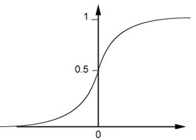


Elements of Neural Networks
A simple network, toy example
$$\left(1∙1\right)+\left(−1\right)∙\left(−2\right)+1=4$$
0.98
Sigmoid Function
1
4
1
-2
1
-1
-2
0.12
-1
1
0
1 $∙ \left(−1\right)+\left(−1\right)∙1+0=$-2
Slide credit: Hung-yi Lee – Deep Learning Tutorial

Slide 33


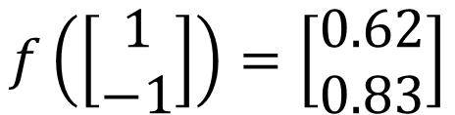
Elements of Neural Networks
A simple network, toy example (cont’d)
  For an input vector ${[\begin{matrix}1 & −1\end{matrix}]}^{T}$, the output is ${[\begin{matrix}0.62 & 0.83\end{matrix}]}^{T}$
1
4
0.98
2
0.86
3
0.62
1
-2
-1
-1
1
0
-2
-1
-2
0.12
-2
0.11
-1
0.83
-1
1
-1
4
0
0
2
$$f\left(\left[\begin{matrix}1 \\ −1\end{matrix}\right]\right)=\left[\begin{matrix}0.62 \\ 0.83\end{matrix}\right]$$
$$f:R^{2}→R^{2}$$
Slide credit: Hung-yi Lee – Deep Learning Tutorial

Slide 34

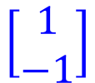




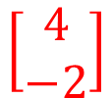
Matrix Operation
Matrix operations are helpful when working with multidimensional inputs and outputs
1
4
0.98
1
-2
$$\left[\begin{matrix}1 & −2 \\ −1 & 1\end{matrix}\right]$$
$$\left[\begin{matrix}1 \\ −1\end{matrix}\right]$$
$$\left[\begin{matrix}1 \\ 0\end{matrix}\right]$$
$$=$$
$$\left[\begin{matrix}0.98 \\ 0.12\end{matrix}\right]$$
$$σ\left( \right)$$
$$+$$
1
-1
-2
0.12
$$\left[\begin{matrix}4 \\ −2\end{matrix}\right]$$
-1
1
0
Slide credit: Hung-yi Lee – Deep Learning Tutorial

Slide 35

Matrix Operation
Multilayer NN, matrix calculations for the first layer
  Input vector x, weights matrix W¹, bias vector b¹, output vector a¹
……
y₁
W¹
y₂
……
b¹
……
……
……
……
……
x
a¹
……
y_{M}
a¹
W¹
x
b¹
+
$=σ\left( \right)$
Slide credit: Hung-yi Lee – Deep Learning Tutorial

Slide 36



Matrix Operation
Multilayer NN, matrix calculations for all layers
……
y₁
W¹
W²
W^{L}
y₂
……
b¹
b²
b^{L}
……
……
……
……
……
x
a¹
a²
y
……
y_{M}
W¹
x
b¹
+
$$σ\left( \right)$$
W²
a¹
b²
+
$$σ\left( \right)$$
W^{L}
b^{L}
a^{L-1}
+
$$σ\left( \right)$$
Slide credit: Hung-yi Lee – Deep Learning Tutorial

Slide 37



Matrix Operation
Multilayer NN, function f maps inputs x to outputs y, i.e., $y=f(x)$
……
y₁
W¹
W²
W^{L}
y₂
……
b¹
b²
b^{L}
……
……
……
……
……
x
a¹
a²
y
……
y_{M}
y
x
W^{L}
…
W²
W¹
x
b¹
b²
…
b^{L}
$$=f\left( \right)$$
+
+
$$=σ\left( \right)$$
$$σ\left( \right)$$
+
$$σ\left( \right)$$
Slide credit: Hung-yi Lee – Deep Learning Tutorial

Slide 38
Softmax Layer
In multi-class classification tasks, the output layer is typically a softmax layer
  If a regular hidden layer with sigmoid activations is used instead, the output of the NN may not be easy to interpret
    Sigmoid activations can still be used for binary classification
A Regular Hidden Layer
3
0.95
1
0.73
-3
0.05
Slide credit: Hung-yi Lee – Deep Learning Tutorial

Slide 39
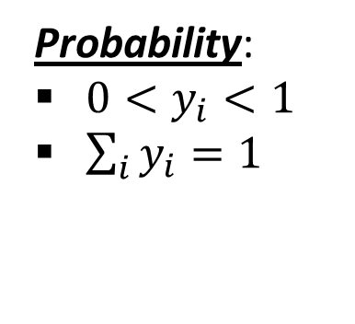
Softmax Layer
The softmax layer applies softmax activations to output a probability value in the range [0, 1]
  The values z inputted to the softmax layer are referred to as logits
Probability:
$0<y_{i}<1$
$\sum_{i}{y_{i}=1}$
A Softmax Layer
3
20
0.88
1
2.7
0.12
-3
0.05
≈0
Slide credit: Hung-yi Lee – Deep Learning Tutorial

Slide 40
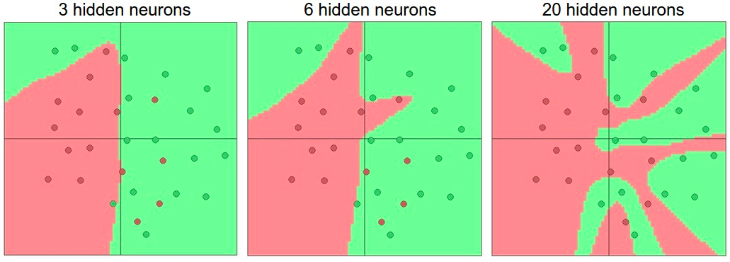

Activation Functions
Non-linear activations are needed to learn complex (non-linear) data representations
  Otherwise, NNs would be just a linear function (such as $W_{1}W_{2}x=Wx$)
  NNs with large number of layers (and neurons) can approximate more complex functions
    Figure: more neurons improve representation (but, may overfit)
Picture from: http://cs231n.github.io/assets/nn1/layer_sizes.jpeg

Slide 41
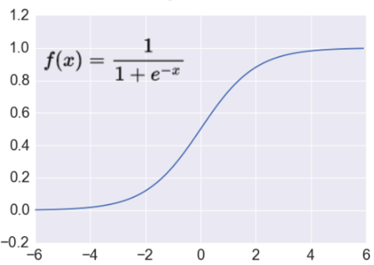

Activation: Sigmoid
Sigmoid function σ: takes a real-valued number and “squashes” it into the range between 0 and 1
  The output can be interpreted as the firing rate of a biological neuron
    Not firing = 0; Fully firing = 1
  When the neuron’s activation are 0 or 1, sigmoid neurons saturate
    Gradients at these regions are almost zero (almost no signal will flow)
  Sigmoid activations are less common in modern NNs
$$ℝ^{n}→\left[0,1\right]$$
Slide credit: Ismini Lourentzou – Introduction to Deep Learning

Slide 42
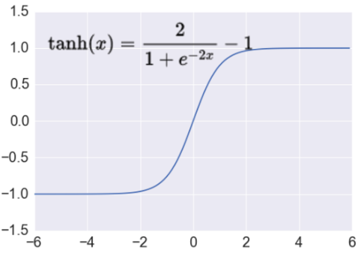

Activation: Tanh
Tanh function: takes a real-valued number and “squashes” it into range between -1 and 1
  Like sigmoid, tanh neurons saturate
  Unlike sigmoid, the output is zero-centered
    It is therefore preferred than sigmoid
  Tanh is a scaled sigmoid: tanh⁡(𝑥)=2σ(2𝑥)−1
$$ℝ^{n}→\left[−1,1\right]$$
Slide credit: Ismini Lourentzou – Introduction to Deep Learning

Slide 43
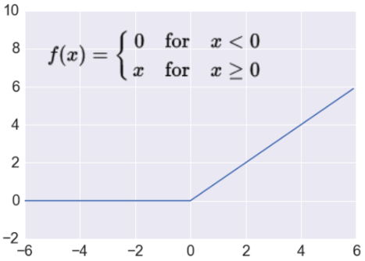
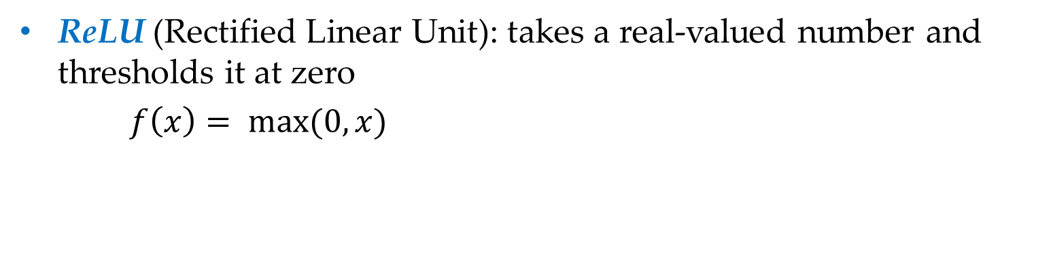

Activation: ReLU
ReLU (Rectified Linear Unit): takes a real-valued number and thresholds it at zero
$f\left(x\right)= max(0,x)$
$$ℝ^{n}→ℝ_{+}^{n}$$
  Most modern deep NNs use ReLU activations
  ReLU is fast to compute
    Compared to sigmoid, tanh
    Simply threshold a matrix at zero
  Accelerates the convergence of gradient descent
    Due to linear, non-saturating form
  Prevents the gradient vanishing problem

Slide 44
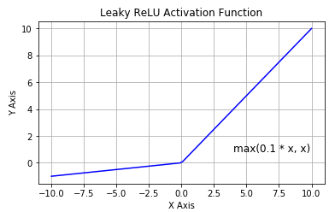
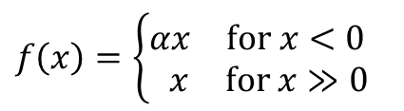
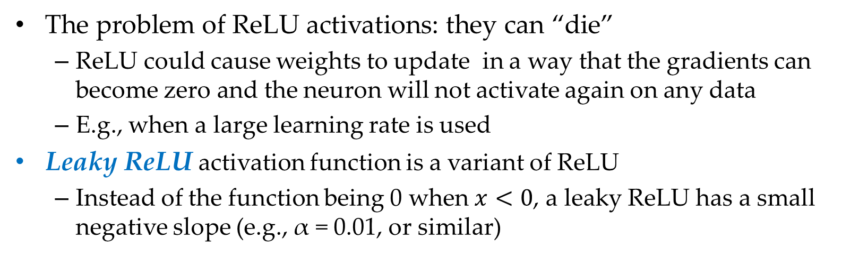
Activation: Leaky ReLU
The problem of ReLU activations: they can “die”
  ReLU could cause weights to update in a way that the gradients can become zero and the neuron will not activate again on any data
  E.g., when a large learning rate is used
Leaky ReLU activation function is a variant of ReLU
  Instead of the function being 0 when $x<0$, a leaky ReLU has a small negative slope (e.g., α = 0.01, or similar)
  This resolves the dying ReLU problem
  Most current works still use ReLU
    With a proper setting of the learning rate, the problem of dying ReLU can be avoided
$$f\left(x\right)=\left\{\begin{matrix}\begin{matrix}αx & for x<0 \end{matrix} \\ \begin{matrix}x & for x≫0\end{matrix}\end{matrix}\right.$$

Slide 45
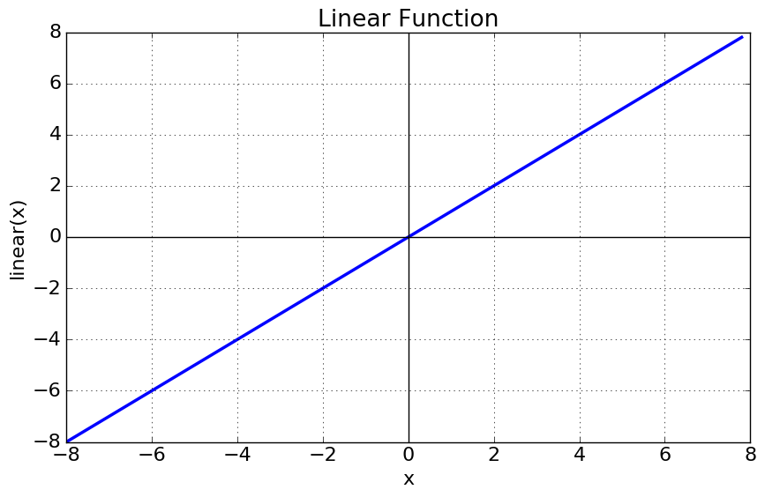


Activation: Linear Function
Linear function means that the output signal is proportional to the input signal to the neuron
$$ℝ^{n}→ℝ^{n}$$
  If the value of the constant c is 1, it is also called identity activation function
  This activation type is used in regression problems
    E.g., the last layer can have linear activation function, in order to output a real number (and not a class membership)
$$f\left(x\right)=cx$$

Slide 46

Training NNs
The network parameters $θ$ include the weight matrices and bias vectors from all layers
Training a model to learn a set of parameters$θ$ that are optimal (according to a criterion) is one of the greatest challenges in ML
$$θ=\left\{W^{1},b^{1},W^{2},b^{2},⋯W^{L},b^{L}\right\}$$
……
y₁
is 1
0.1
……
y₂
0.7
is 2
Softmax
……
……
……
……
y₁₀
is 0
0.2
16 x 16 = 256
Slide credit: Hung-yi Lee – Deep Learning Tutorial

Slide 47
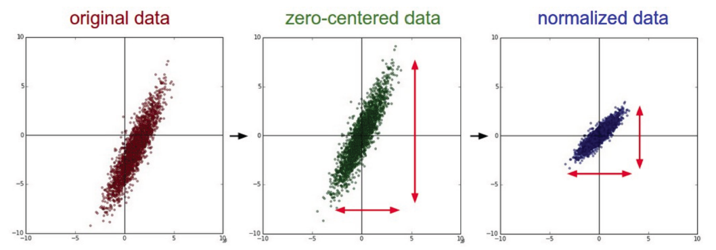
Training NNs
Data preprocessing - helps convergence during training
  Mean subtraction
    Zero-centered data
      Subtract the mean for each individual data dimension (feature)
  Normalization
    Divide each image by its standard deviation
      To obtain standard deviation of 1 for each data dimension (feature)
    Or, scale the data within the range [-1, 1]
Picture from: https://cs231n.github.io/neural-networks-2/

Slide 48





Training NNs
To train a NN, set the parameters $θ$ such that for a training subset of images, the corresponding elements in the predicted output have maximum values
Input:
y₁ has the maximum value
Input:
y₂ has the maximum value
.
.
.
Input:
y₉ has the maximum value
Input:
y₁₀ has the maximum value
Slide credit: Hung-yi Lee – Deep Learning Tutorial

Slide 49



Training NNs
Define an objective function/cost function/loss function $ℒ\left(θ\right)$ that calculates the difference between the model prediction and the true label
  E.g., $ℒ\left(θ\right)$ can be mean-squared error, cross-entropy, etc.
……
y₁
1
0.2
……
y₂
0
0.3
……
……
……
Cost
……
……
……
……
y₁₀
$$ℒ(θ)$$
0
0.5
True label “1”
Slide credit: Hung-yi Lee – Deep Learning Tutorial

Slide 50






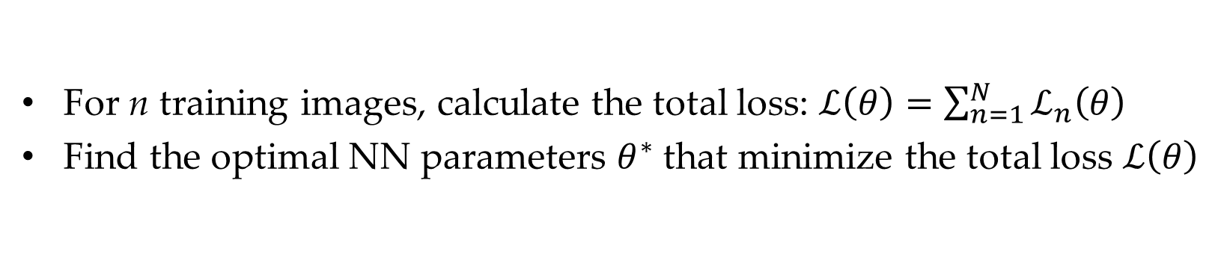




Training NNs
For n training images, calculate the total loss: $ℒ\left(θ\right)=\sum_{n=1}^{N}{ℒ_{n}\left(θ\right)}$
Find the optimal NN parameters $θ^{∗}$ that minimize the total loss $ℒ\left(θ\right)$
$$ℒ_{1}\left(θ\right)$$
x¹
NN
y¹
$${\hat{y}}^{1}$$
NN
$$ℒ_{2}\left(θ\right)$$
x²
$${\hat{y}}^{2}$$
y²
NN
$$ℒ_{3}\left(θ\right)$$
x³
$${\hat{y}}^{3}$$
y³
……
……
……
……
NN
$$ℒ_{n}\left(θ\right)$$
x^{N}
$${\hat{y}}^{N}$$
y^{N}
Slide credit: Hung-yi Lee – Deep Learning Tutorial

Slide 51
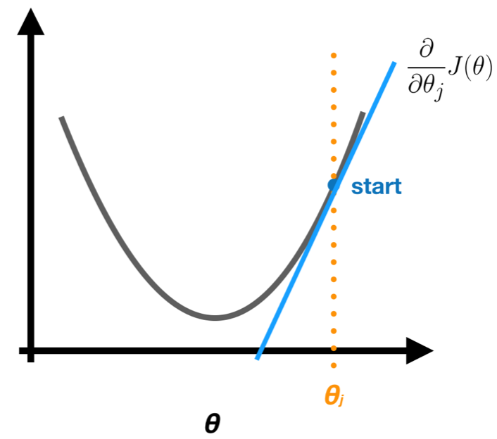





Training NNs
Optimizing the loss function $ℒ\left(θ\right)$
  Almost all DL models these days are trained with a variant of the gradient descent (GD) algorithm
  GD applies iterative refinement of the network parameters$θ$
  GD uses the opposite direction of the gradient of the loss with respect to the NN parameters (i.e.,$∇ℒ\left(θ\right)=\left[{∂ℒ}/{∂θ_{i}}\right]$ ) for updating $θ$
    The gradient of the loss function $∇ℒ\left(θ\right)$ gives the direction of fastest increase of the loss function $ℒ\left(θ\right)$ when the parameters$θ$ are changed
$$ℒ\left(θ\right)$$
$$\frac{∂ℒ}{∂θ_{i}}$$
$$θ_{i}$$

Slide 52

Training NNs
The loss functions for most DL tasks are defined over very high-dimensional spaces
  E.g., ResNet50 NN has about 23 million parameters
  This makes the loss function impossible to visualize
We can still gain intuitions by studying 1-dimensional and 2-dimensional examples of loss functions
1D loss (the minimum point is obvious)
2D loss (blue = low loss, red = high loss)
Picture from: https://cs231n.github.io/optimization-1/

Slide 53


Gradient Descent Algorithm
Steps in the gradient descent algorithm:
  Randomly initialize the model parameters$,θ^{0}$
    In the figure, the parameters are denoted $w$
  Compute the gradient of the loss function at $θ^{0}$: $∇ℒ\left(θ^{0}\right)$
  Update the parameters as: $θ^{new}=θ^{0}−α∇ℒ\left(θ^{0}\right)$
    Where α is the learning rate
  Go to step 2 and repeat (until a terminating criterion is reached)

Slide 54













Gradient Descent Algorithm
Example: a NN with only 2 parameters $w_{1}$ and $w_{2}$, i.e., $θ=\left\{w_{1},w_{2}\right\}$
  Different colors are the values of the loss (minimum loss$θ^{∗}$ is ≈ 1.3)
1. Randomly pick a starting point $θ^{0}$
2. Compute the gradient at $θ^{0}$, $∇ℒ\left(θ^{0}\right)$
$$θ^{∗}$$
$$w_{2}$$
3. Times the learning rate $η$, and update $θ,$
$$θ^{new}=θ^{0}−α∇ℒ\left(θ^{0}\right)$$
$$θ^{1}$$
$$θ^{1}=$$
$$θ^{0}−α∇ℒ\left(θ^{0}\right)$$
$$−∇ℒ\left(θ^{0}\right)$$
4. Go to step 2, repeat
$$θ^{0}$$
$$∇ℒ\left(θ^{0}\right)=\left[\begin{matrix}∂ℒ\left(θ^{0}\right)/∂w_{1} \\ ∂ℒ\left(θ^{0}\right)/∂w_{2}\end{matrix}\right]$$
$$w_{1}$$
Slide credit: Hung-yi Lee – Deep Learning Tutorial

Slide 55







Gradient Descent Algorithm
Example (contd.)
Eventually, we would reach a minimum …..
1. Randomly pick a starting point $θ^{0}$
2. Compute the gradient at $θ^{0}$,$∇ℒ\left(θ^{0}\right)$
$$θ^{2}$$
$$θ^{1}−α∇ℒ\left(θ^{1}\right)$$
3. Times the learning rate $η$, and update $θ,$
$$θ^{new}=θ^{0}−α∇ℒ\left(θ^{0}\right)$$
$$w_{2}$$
$$θ^{2}−α∇ℒ\left(θ^{2}\right)$$
$$θ^{1}$$
4. Go to step 2, repeat
$$θ^{0}$$
$$w_{1}$$
Slide credit: Hung-yi Lee – Deep Learning Tutorial

Slide 56




Gradient Descent Algorithm
Gradient descent algorithm stops when a local minimum of the loss surface is reached
  GD does not guarantee reaching a global minimum
  However, empirical evidence suggests that GD works well for NNs
$ℒ\left(θ\right)$
$$θ$$
Picture from: https://blog.paperspace.com/intro-to-optimization-in-deep-learning-gradient-descent/

Slide 57






Gradient Descent Algorithm
For most tasks, the loss surface $ℒ\left(θ\right)$ is highly complex (and non-convex)
Random initialization in NNs results in different initial parameters $θ^{0}$
  Gradient descent may reach different minima at every run
  Therefore, NN will produce different predicted outputs
Currently, we don’t have an algorithm that guarantees reaching a global minimum for an arbitrary loss function
$$ℒ$$
$$w_{1}$$
$$w_{2}$$
Slide credit: Hung-yi Lee – Deep Learning Tutorial

Slide 58
Backpropagation
How to calculate the gradients of the loss function in NNs?
There are two ways:
  Numerical gradient: slow, approximate, but easy way
  Analytic gradient: requires calculus, fast, but more error-prone way
In practice the analytic gradient is used
  Analytical differentiation for gradient computation is available in almost all deep learning libraries

Slide 59

Mini-batch Gradient Descent
It is wasteful to compute the loss over the entire set to perform a single parameter update for large datasets
  E.g., ImageNet has 14M images
  GD (a.k.a. vanilla GD) is replaced with mini-batch GD
Mini-batch gradient descent
  Approach:
    Compute the loss $ℒ\left(θ\right)$ on a batch of images, update the parameters $θ$, and repeat until all images are used
    At the next epoch, shuffle the training data, and repeat above process
  Mini-batch GD results in much faster training
  Typical batch size: 32 to 256 images
  It works because the examples in the training data are correlated
    I.e., the gradient from a mini-batch is a good approximation of the gradient of the entire training set

Slide 60

Stochastic Gradient Descent
Stochastic gradient descent
  SGD uses mini-batches that consist of a single input example
    E.g., one image mini-batch
  Although this method is very fast, it may cause significant fluctuations in the loss function
    Therefore, it is less commonly used, and mini-batch GD is preferred
  In most DL libraries, SGD is typically a mini-batch SGD (with an option to add momentum)

Slide 61





Problems with Gradient Descent
Besides the local minima problem, the GD algorithm can be very slow at plateaus, and it can get stuck at saddle points
cost $ℒ\left(θ\right)$
Very slow at the plateau
Stuck at a saddle point
Stuck at a local minimum
$$∇ℒ\left(θ\right)≈0$$
$$∇ℒ\left(θ\right)=0$$
$$∇ℒ\left(θ\right)=0$$
$$θ$$
Slide credit: Hung-yi Lee – Deep Learning Tutorial

Slide 62


Gradient Descent with Momentum
Gradient descent with momentum uses the momentum of the gradient for parameter optimization
cost $ℒ\left(θ\right)$
Movement = Negative of Gradient + Momentum
Negative of Gradient
Momentum
Real Movement
$$θ$$
Gradient = 0
Slide credit: Hung-yi Lee – Deep Learning Tutorial

Slide 63

Gradient Descent with Momentum
Parameters update in GD with momentum : $θ^{new}=θ^{old}−V^{new}$
    Where: $V^{new}$= $βV^{old}+α∇ℒ\left(θ^{old}\right)$
Compare to vanilla GD: $θ^{new}=θ^{old}−α∇ℒ\left(θ^{old}\right)$
The term $V^{new}$ is called momentum
  This term accumulates the gradients from the past several steps
  It is similar to a momentum of a heavy ball rolling down the hill
The parameter$β$ referred to as a coefficient of momentum
  A typical value of the parameter $β$ is 0.9
This method updates the parameters $θ$ in the direction of the weighted average of the past gradients

Slide 64


Nesterov Accelerated Momentum
Gradient descent with Nesterov accelerated momentum
  Parameters update: $θ^{new}=θ^{old}−V^{new}$
    Where: $V^{new}$= $βV^{old}+α∇ℒ\left(θ^{old}−βV^{old}\right)$
  The term $θ^{old}−βV^{old}$ allows us to predict the position of the parameters in the next step (i.e., $θ^{next} ≈θ^{old}−βV^{old}$)
  The gradient is calculated with respect to the approximate future position of the parameters in the next step, $θ^{next}$
GD with momentum
GD with Nesterov momentum
Picture from: https://towardsdatascience.com/learning-parameters-part-2-a190bef2d12

Slide 65


Learning Rate
Learning rate
  The gradient tells us the direction in which the loss has the steepest rate of increase, but it does not tell us how far along the opposite direction we should step
  Choosing the learning rate (also called the step size) is one of the most important hyper-parameter settings for NN training
LR too small
LR too large

Slide 66

Learning Rate
Training loss for different learning rates
  High learning rate: the loss increases or plateaus too quickly
  Low learning rate: the loss decreases too slowly (takes many epochs to reach a solution)
Picture from: https://cs231n.github.io/neural-networks-3/

Slide 67
Annealing the Learning Rate
Reduce the learning rate over time (learning rate decay)
  Approach 1
    Reduce the learning rate by some factor every few epochs
      Typical values: reduce the learning rate by a half every 5 epochs, or by 10 every 20 epochs
      Exponential decay reduces the learning rate exponentially over time
      These numbers depend heavily on the type of problem and the model
  Approach 2
    Reduce the learning rate by a constant (e.g., by half) whenever the validation loss stops improving
      In TensorFlow: tf.keras.callbacks.ReduceLROnPleateau()
        Monitor: validation loss
        Factor: 0.1 (i.e., divide by 10)
        Patience: 10 (how many epochs to wait before applying it)
        Minimum learning rate: 1e-6 (when to stop)

Slide 68

Adam
Adaptive Moment Estimation (Adam)
  Adam computes adaptive learning rates for each dimension of$θ$
    Similar to GD with momentum, Adam computes a weighted average of past gradients, i.e., $V^{new}$= $β_{1}V^{old}+\left(1−β_{1}\right)∇ℒ\left(θ^{old}\right)$
    Adam also computes a weighted average of past squared gradients, i.e., $U^{new}$= $β_{2}U^{old}+\left(1−β_{2}\right){\left(∇ℒ\left(θ^{old}\right)\right)}^{2}$
  The parameters update is: $θ^{new}=θ^{old}−$ $\frac{α}{\sqrt{{\hat{V}}^{new}}+ε}$ ${\hat{U}}^{new}$
    Where: ${\hat{V}}^{new}=\frac{V^{new}}{1−β_{1}}$ and ${\hat{U}}^{new}=\frac{U^{new}}{1−β_{2}}$
    The proposed default values are $β_{1}$ = 0.9, $β_{2}$ = 0.999, and $ε={10}^{−8}$
Other commonly used optimization methods include:
  Adagrad, Adadelta, RMSprop, Nadam, etc.
  Most papers nowadays used Adam and SGD with momentum

Slide 69
Vanishing Gradient Problem
In some cases, during training, the gradients can become either very small (vanishing gradients) of very large (exploding gradients)
  They result in very small or very large update of the parameters
  Solutions: ReLU activations, regularization, LSTM units in RNNs
……
y₁
……
y₂
……
……
……
……
……
……
y_{M}
Small gradients, learns very slow
Slide credit: Hung-yi Lee – Deep Learning Tutorial

Slide 70



Loss Functions
Classification tasks
Training
examples
$ℝ^{n}×\left\{{class}_{1},…,{class}_{m}\right\}$ (one-hot encoding)
Output
Layer
Softmax Activation
[maps $ℝ^{m}$ to a probability distribution]
Loss function
$$ℒ\left(θ\right)=−\frac{1}{n}\sum_{i=1}^{n}{\sum_{k=1}^{K}{\left[y_{k}^{(i)}\log{{\hat{y}}_{k}^{(i)}+\left(1−y_{k}^{(i)}\right) }\log\left(1− {\hat{y}}_{k}^{\left(i\right)}\right)\right]}}$$
Cross-entropy
Slide credit: Ismini Lourentzou – Introduction to Deep Learning

Slide 71



Loss Functions
Regression tasks
Training
examples
$$ℝ^{n}×ℝ^{m}$$
Output
Layer
Linear (Identity) or Sigmoid Activation
$$ℒ\left(θ\right)= \frac{1}{n}\sum_{i=1}^{n}{{\left(y^{(i)}−{\hat{y}}^{(i)}\right)}^{2}}$$
Mean Squared Error
Loss function
$$ℒ\left(θ\right)= \frac{1}{n}\sum_{i=1}^{n}{\left|y^{(i)}−{\hat{y}}^{(i)}\right|}$$
Mean Absolute Error
Slide credit: Ismini Lourentzou – Introduction to Deep Learning

Slide 72


Generalization
Underfitting
  The model is too “simple” to represent all the relevant class characteristics
  Model with too few parameters
  High error on the training set and high error on the testing set
Overfitting
  The model is too “complex” and fits irrelevant characteristics (noise) in the data
  Model with too many parameters
  Low error on the training error and high error on the testing set
Blue line – decision boundary by the model
Green line – optimal decision boundary

Slide 73


Overfitting
A model with high capacity fits the noise in the data instead of the underlying relationship
The model may fit the training data very well, but fails to generalize to new examples (test data)
Picture from: http://cs231n.github.io/assets/nn1/layer_sizes.jpeg

Slide 74

Regularization: Weight Decay
$ℓ_{2}$ weight decay
  A regularization term that penalizes large weights is added to the loss function
  $$ℒ_{reg}\left(θ\right)= ℒ\left(θ\right)+λ\sum_{k}{θ_{k}^{2}}$$
  For every weight in the network, we add the regularization term to the loss value
    During gradient descent parameter update, every weight is decayed linearly toward zero
  The weight decay coefficient $λ$determines how dominant the regularization is during the gradient computation
Data loss
Regularization loss

Slide 75


Regularization: Weight Decay
Effect of the decay coefficient $λ$
  Large weight decay coefficient → penalty for weights with large values

Slide 76

Regularization: Weight Decay
$ℓ_{1}$ weight decay
  The regularization term is based on the $ℓ_{1}$ norm of the weights
  $ℒ_{reg}\left(θ\right)= ℒ\left(θ\right)+λ\sum_{k}{\left|θ_{k}\right|}$
  $ℓ_{1}$ weight decay is less common with NN
    Often performs worse than $ℓ_{2}$ weight decay
  It is also possible to combine $ℓ_{1}$ and $ℓ_{2}$ regularization
    Called elastic net regularization
  $ℒ_{reg}\left(θ\right)= ℒ\left(θ\right)+λ_{1}\sum_{k}{\left|θ_{k}\right|+λ_{2}\sum_{k}{θ_{k}^{2}}}$

Slide 77

Regularization: Dropout
Dropout
  Randomly drop units (along with their connections) during training
  Each unit is retained with a fixed dropout rate p, independent of other units
  The hyper-parameter p to be chosen (tuned)
    Often between 20 and 50 % of the units are dropped
Slide credit: Hung-yi Lee – Deep Learning Tutorial

Slide 78
Regularization: Dropout
Dropout is a kind of ensemble learning
  Using one mini-batch to train one network with a slightly different architecture
minibatch
1
minibatch
2
minibatch
3
minibatch
n
……
Slide credit: Hung-yi Lee – Deep Learning Tutorial

Slide 79

Regularization: Early Stopping
Early-stopping
  During model training, use a validation set, along with a training set
    A ratio of about 25% to 75% of the data is often used
  Stop when the validation accuracy (or loss) has not improved after n subsequent epochs
    The parameter n is called patience
Stop training
validation

Slide 80

Batch Normalization
Batch normalization layers act similar to the data preprocessing steps mentioned earlier
  They calculate the mean μ and variance σ of a batch of input data, and normalize the data x to a zero mean and unit variance
  I.e., $\hat{x}=\frac{x−μ}{σ}$
BatchNorm layers alleviate the problems of proper initialization of the parameters and hyper-parameters
  Result in faster convergence training, allow larger learning rates
  Reduce the internal covariate shift
The BatchNorm layers are inserted immediately after convolutional layers or fully-connected layers, and before activation layers
  They are very common with convolutional NNs

Slide 81

Hyper-parameter Tuning
Training NNs can involve many hyper-parameter settings
The most common hyper-parameters include:
  Number of layers, and number of neurons per layer
  Initial learning rate
  Learning rate decay schedule (e.g., decay constant)
Other hyper-parameters may include:
  Regularization parameters ($ℓ_{2}$ penalty, dropout rate)
  Batch size
Hyper-parameter tuning can be time-consuming for larger NNs

Slide 82

Hyper-parameter Tuning
Grid search
  Check all values in a range with a step value
Random search
  Randomly sample values for the parameter
  Often preferred to grid search
Bayesian hyper-parameters optimization
  Is an active area of research

Slide 83
k-Fold Cross-Validation
Using k-fold cross-validation for hyper-parameter tuning is common when the size of the training data is small
  It leads to a better and less noisy estimate of the model performance by averaging the results across several folds
E.g., 5-fold cross-validation (see the figure on the next slide)
  Split the train data into 5 equal folds
  First use folds 2-5 for training and fold 1 for validation
  Repeat by using fold 2 for validation, then fold 3, fold 4, and fold 5
  Average the results over the 5 runs
  Once the best hyper-parameters are determined, evaluate the model on the set aside test data

Slide 84

k-Fold Cross-Validation
Illustration of a 5-fold cross-validation
Picture from: https://scikit-learn.org/stable/modules/cross_validation.html

Slide 85
Ensemble Learning
Ensemble learning is training multiple classifiers separately and combining their predictions
  Ensemble learning often outperforms individual classifiers
  Better results obtained with higher model variety in the ensemble
  Bagging (bootstrap aggregating)
    Randomly draw subsets from the training set (i.e., bootstrap samples)
    Train separate classifiers on each subset of the training set
    Perform classification based on the average vote of all classifiers
  Boosting
    Train a classifier, and apply weights on the training set (apply higher weights on misclassified examples, focus on “hard examples”)
    Train new classifier, reweight training set according to prediction error
    Repeat
    Perform classification based on weighted vote of the classifiers

Slide 86
Deep vs Shallow Networks
Deeper networks perform better than shallow networks
  But only up to some limit: after a certain number of layers, the performance of deeper networks plateaus
Shallow
Deep
……
……
……
Slide credit: Hung-yi Lee – Deep Learning Tutorial

Slide 87



Convolutional Neural Networks (CNNs)
Convolutional neural networks (CNNs) were primarily designed for image data
CNNs use a convolutional operator for extracting data features
  Allows parameter sharing
  Efficient to train
  Have less parameters than NNs with fully-connected layers
CNNs are robust to spatial translations of objects in images
A convolutional filter slides (i.e., convolves) across the image
Convolutional
3x3 filter
Input matrix
Picture from: http://deeplearning.stanford.edu/wiki/index.php/Feature_extraction_using_convolution

Slide 88


Convolutional Neural Networks (CNNs)
When the convolutional filters are scanned over the image, they capture useful features
  E.g., edge detection by convolutions
0 1 0
1 -4 1
0 1 0
Filter
Input Image
Convoluted Image
Slide credit: Param Vir Singh – Deep Learning

Slide 89
Convolutional Neural Networks (CNNs)
In CNNs, hidden units in a layer are only connected to a small region of the layer before it (called local receptive field)
  The depth of each feature map corresponds to the number of convolutional filters used at each layer
w1 | w2
w3 | w4
w5 | w6
w7 | w8
Filter 1
Filter 2
Input Image
Layer 1 Feature Map
Layer 2 Feature Map
Slide credit: Param Vir Singh – Deep Learning

Slide 90
Convolutional Neural Networks (CNNs)
Max pooling: reports the maximum output within a rectangular neighborhood
Average pooling: reports the average output of a rectangular neighborhood
Pooling layers reduce the spatial size of the feature maps
  Reduce the number of parameters, prevent overfitting
MaxPool with a 2×2 filter with stride of 2
1 | 3 | 5 | 3
4 | 2 | 3 | 1
3 | 1 | 1 | 3
0 | 1 | 0 | 4
4 | 5
3 | 4
Output Matrix
Input Matrix
Slide credit: Param Vir Singh – Deep Learning

Slide 91

Convolutional Neural Networks (CNNs)
Feature extraction architecture
  After 2 convolutional layers, a max-pooling layer reduces the size of the feature maps (typically by 2)
  A fully convolutional and a softmax layers are added last to perform classification
Living Room
Bed Room
64
64
128
128
256
256
256
512
512
512
512
512
512
Kitchen
Bathroom
Conv layer
Max Pool
Outdoor
Fully Connected Layer
Slide credit: Param Vir Singh – Deep Learning

Slide 92


Residual CNNs
Residual networks (ResNets)
  Introduce “identity” skip connections
    Layer inputs are propagated and added to the layer output
    Mitigate the problem of vanishing gradients during training
    Allow training very deep NN (with over 1,000 layers)
  Several variants exist: 18, 34, 50, 101, 152, and 200 layers
  Are used as base models of other state-of-the-art NNs
    Other similar models: ResNeXT, DenseNet

Slide 93
Recurrent Neural Networks (RNNs)
Recurrent NNs are used for modeling sequential data and data with varying length of inputs and outputs
  Videos, text, speech, DNA sequences, human skeletal data
RNNs introduce recurrent connections between the neurons units
  This allows processing sequential data one element at a time by selectively passing information across a sequence
  Memory of the previous inputs is stored in the model’s internal state and affect the model predictions
  Can capture correlations in sequential data
RNNs use backpropagation-through-time for training
RNNs are more sensitive to the vanishing gradient problem

Slide 94


Recurrent Neural Networks (RNNs)
RNNs can have one of many inputs and one of many outputs
RNN
Application
Input
Output
Image Captioning
A person riding a motorbike on dirt road
Sentiment Analysis
Awesome movie. Highly recommended.
Positive
Machine Translation
Happy Diwali
शुभ दीपावली
Slide credit: Param Vir SIngh– Deep Learning

Slide 95












Recurrent Neural Networks (RNNs)
RNN use same set of weights $w_{h}$ and biases $w_{x}$ across all time steps
An RNN is shown rolled over time
$$h\left(t\right)=f_{h}\left(w_{h}∗h\left(t−1\right)+w_{x}∗x\left(t\right)\right)$$
OUTPUT
$$w_{h}$$
$$w_{h}$$
$$w_{h}$$
$$w_{y}$$
h0
$f_{h}$()
h1
$f_{h}$()
h2
$f_{h}$()
h3
$f_{y}$()
$$w_{x}$$
$$w_{x}$$
$$w_{x}$$
x1
x2
x3
Slide credit: Param Vir Singh – Deep Learning

Slide 96




Bidirectional RNNs
Bidirectional RNNs incorporate both forward and backward passes through sequential data
  The output may not only depend on the previous elements in the sequence, but also on future elements in the sequence
  It resembles two RNNs stacked on top of each other
$${\overset{⃑}{h}}_{t}= σ({\overset{⃑}{W}}^{(hh)}{\overset{⃑}{h}}_{t−1}+{\overset{⃑}{W}}^{(hx)}x_{t})$$
$${\overset{⃖}{h}}_{t}= σ({\overset{⃖}{W}}^{(hh)}{\overset{⃖}{h}}_{t+1}+{\overset{⃖}{W}}^{(hx)}x_{t})$$
$$y_{t}=f\left( \left[{\overset{⃑}{h}}_{t}{;\overset{⃖}{h}}_{t}\right] \right)$$
Output both past and future elements
Slide credit: Param Vir Singh – Deep Learning

Slide 97
LSTM Networks
Long Short Term Memory (LSTM) networks are a variant of RNNs
LSTM mitigates the vanishing/exploding gradient problem
  Solution: a Memory Cell, updated at each step in the sequence
Three gates control the flow of information to and from the Memory Cell
  Input Gate: protects the current step from irrelevant inputs
  Output Gate: prevents current step from passing irrelevant information to later steps
  Forget Gate: limits information passed from one cell to the next
Most modern RNN models use either LSTM units or other more advanced types of recurrent units (e.g., GRU units)

Slide 98


LSTM Networks
LSTM cell
  Input gate, output gate, forget gate, memory cell
  LSTM can learn long-term correlations within the data sequences

Slide 99
References
Hung-yi Lee – Deep Learning Tutorial
Ismini Lourentzou – Introduction to Deep Learning
CS231n Convolutional Neural Networks for Visual Recognition (Stanford CS course) (link)
James Hays, Brown – Machine Learning Overview
Param Vir Singh, Shunyuan Zhang, Nikhil Malik – Deep Learning
Sebastian Ruder – An Overview of Gradient Descent Optimization Algorithms (link)

