Slide 1
CS 502
Directed Studies: Adversarial Machine Learning
Dr. Alex Vakanski

Slide 2
Lecture 5
Evasion Attacks against Machine Learning Models

Slide 3
Lecture Outline
Evasion attacks against white-box models
Carlini and Wagner (2017) Towards Evaluating the Robustness of Neural Networks
Xiao et al. (2018) Spatially Transformed Adversarial Examples
Other white-box evasion attacks
Evasion attacks against black-box models
Transferability in Adversarial Machine Learning
Brendel et al. (2018) Decision-Based Adversarial Attacks: Reliable Attacks Against Black-Box Machine Learning Models
Bhagoji et al. (2017) Exploring the Space of Black-box Attacks on Deep Neural Networks
Other black-box evasion attacks

Slide 4
Evasion Attacks against White-box Models
So far we covered:
Fast gradient sign method (FGSM) attack
Goodfellow (2015) - Explaining and Harnessing Adversarial Examples
$x_{adv}=x+ε∙sign\left(∇_{x}ℒ\left(h\left(x, w\right),y\right)\right)$
Basic iterative method (BIM) attack
Kurakin (2017) Adversarial Examples in the Physical World
$x_{adv}^{t}=x^{t−1}+α∙sign\left(∇_{x}ℒ\left(h\left(x^{t−1}\right),y\right)\right)$
Projected gradient descent (PGD) attack
Madry (2017) Towards Deep Learning Models Resistant to Adversarial Attacks
$x_{adv}^{t}=Π_{ε}\left(x^{t−1}+α∙sign\left(∇_{x}ℒ\left(h\left(x^{t−1}\right),y\right)\right)\right)$
DeepFool attack
Moosavi-Dezfooli (2015) DeepFool: A Simple and Accurate Method to Fool Deep Neural Networks
Iteratively projects the perturbed image to the hyperplane of the closest class

Slide 5
Carlini-Wagner Paper (C-W Attack)
Carlini and Wagner (2017) Towards Evaluating the Robustness of Neural Networks
The paper proposes three targeted white-box attacks based on different norm metrics:
$L_{∞}$attack
$L_{2}$attack
$L_{0}$attack
These attacks are sometimes referred to as C-W attacks
At the time of publishing, they were the strongest adversarial attacks
Advantages of proposed approaches:
Low amount of perturbation
Resistance to defense algorithms
Generated adversarial images are transferrable across DL models
I.e., a secured model is not able to detect the adversarial examples
Evaluated on: MNIST, CIFAR-10, and ImageNet

Slide 6
Carlini-Wagner Paper (C-W Attack)
Notatiton
Given an image x, a classifier F outputs a vector $y$, i.e., F$\left(x\right)=y$
The paper focuses on NN classifiers
The output y is treated as a probability distribution, where $y_{i}$ is the probability that input x has class i
The assigned class by the classifier is
$$C\left(x\right)={argmax}_{i}\left(y_{i}\right)={argmax}_{i}\left({F(x)}_{i}\right)$$
The correct label (true class label) of x is denoted by $C^{∗}\left(x\right)$
The inputs to the softmax function (i.e., the logits) are denoted by z, where the function transforming to input x to the logits is Z$\left(x\right),$i.e.,
$$F\left(x\right)=softmax\left(Z(x)\right)=softmax\left(z\right)=y$$
Targeted attack: create an image $x′$that is similar to x, such that $C\left(x′\right)=t$, where the target label t is different than the true label $C^{∗}\left(x\right)$, i.e., ${t≠C}^{∗}\left(x\right)$
Untargeted attack: create an image $x′$that is similar to x, such that $C\left(x′\right)≠C^{∗}\left(x\right)$
The paper considers only targeted attacks, as they are more challenging than untargeted attacks

Slide 7
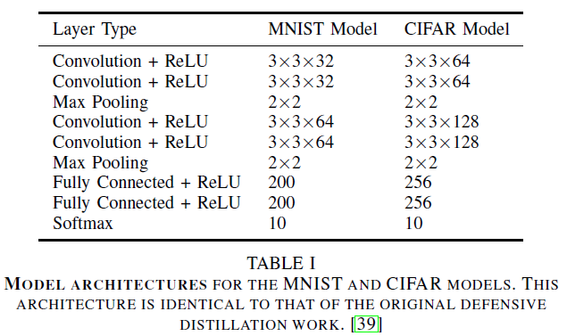
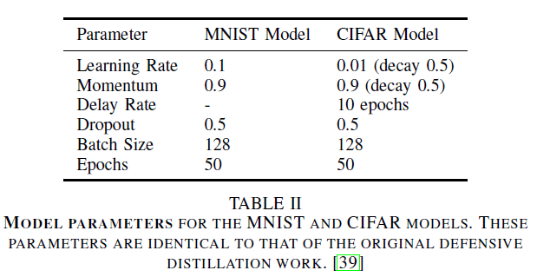
Carlini-Wagner Paper (C-W Attack)
Three approaches for selecting the target class were evaluated:
Average Case: select the target class uniformly at random among the labels that are not the correct label
Best Case: perform the attack against all incorrect classes, and report the target class that was least difficult to attack
Worst Case: perform the attack against all incorrect classes, and report the target class that was most difficult to attack
The used NN models for MNIST and CIFAR datasets are shown below
For ImageNet the paper used the Inception-v3 network

Slide 8
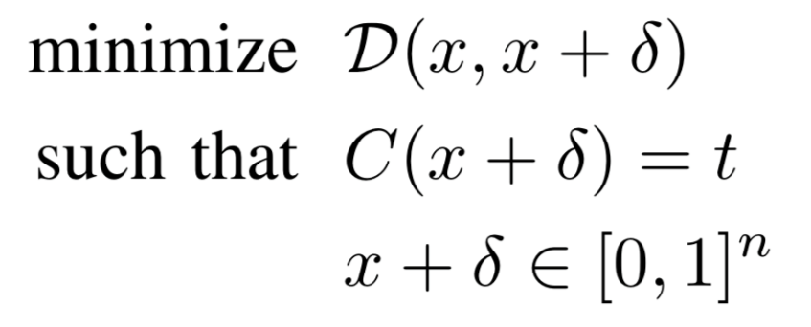
Carlini-Wagner Paper (C-W Attack)
Initial problem formulation
Create an adversarial image$x′$ by adding small perturbation $δ$to the original image x (i.e., $x′=x+δ$), such that the distance $𝒟\left(x,x′\right)=𝒟\left(x,x+δ\right)$ is minimal
The classifier should assign the class label t to the adversarial image $x′$, where t is different than the true label $C^{∗}\left(x\right)$, i.e., $C\left(x′\right)=C\left(x+δ\right)=t≠C^{∗}\left(x\right)$
The goal is to find $δ$ that minimizes $𝒟\left(x,x+δ\right)$ and $C\left(x+δ\right)=t$
distance between x and x+𝛿
x+𝛿 is classified as target class t
each element of x+𝛿 is in [0,1] (to be a valid image)

Slide 9
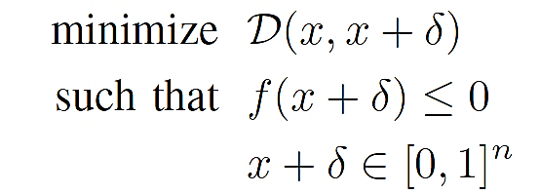
Carlini-Wagner Paper (C-W Attack)
This initial formulation of the optimization problem for creating adversarial attacks is difficult to solve
Because the constraint $C\left(x+δ\right)=t$ is highly non-linear
Carlini-Wagner propose the following reformulation of the optimization problem, which is solvable
The function f should be chosen such that $C\left(x+δ\right)=t$ if and only if $f\left(x+δ\right)≤0$
These two optimization problems are not identical: the reformulation by Carlini-Wagner just finds an approximated solution to the above problem
Adam optimization algorithm is used for solving the problem

Slide 10
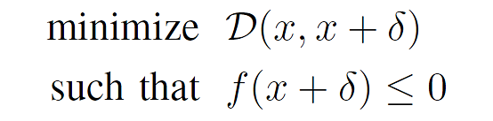
Carlini-Wagner Paper (C-W Attack)
Recall the solution of constrained optimization problems from Lecture 4 using Lagrange multiplies
The same approach can be applied to the Carlini-Wagner approach, and the optimization problem can be rewritten as shown below
The authors performed a grid search for the value of the parameter c
The recommended approach is to select the smallest value of c where $c>0$, for which $f\left(x+δ\right)≤0$ and the distance $𝒟\left(x,x+δ\right)$ is minimal
$$\underset{x}{minimize}{f(x) }$$
$$subject to c_{i}\left(x\right)≤0$$
$$\underset{x}{minimize}{f\left(x\right)+\sum_{i}{α_{i}c_{i}\left(x\right)} }$$

Slide 11
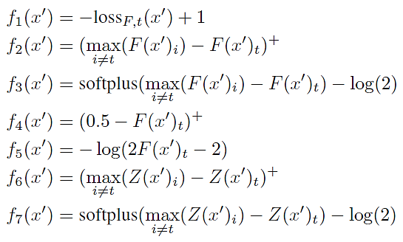
Carlini-Wagner Paper (C-W Attack)
The authors considered several variants for the function f
In the equations below, ${loss}_{F,t}\left(x′\right)$ is the loss function with respect to the target class t
The class labels are denoted by i
Other notation: ${\left(a\right)}^{+}=max\left(0,a\right)$; $softplus\left(a\right)=log\left(1+e^{a}\right)$
The best results were obtained by the function $f_{6}(x^{′})$

Slide 12
Carlini-Wagner Paper (C-W Attack)
Explanation of the function $f_{6}(x^{′})$
In f₆ , $Z{\left(x′\right)}_{t}$ is the logits value of the target class t for the perturbed image $x′$
Then, $\max_{i≠t}\left(Z{\left(x′\right)}_{i}\right)$ means the maximum logits values of other class i than the target class t (i.e., $i≠t$)
The function calculates the difference in the logits between the target class t and the closest-to-the-target class
In some papers, this function is referred to as margin loss function
In the paper, a modified function f₆ is also provided
It introduces a confidence value k
The authors set $k=0$
But, if k has a higher value, this will require that any other logits value exceeds the logits value of the true class $Z{\left(x′\right)}_{t}$ at least by k
Examples with large confidence value k have enhanced transferability

Slide 13
Carlini-Wagner Paper (C-W Attack)
$L_{∞}$attack
The used distance metric is $L_{∞}$ norm, therefore $𝒟\left(x,x+δ\right)={\left\|δ\right\|}_{∞}$
In other words, ${\left\|δ\right\|}_{∞}$ means the pixel in $x′$with the largest change from $x$
The optimization problem becomes:
However, this formulation produced poor optimization results, since the term ${\left\|δ\right\|}_{∞}$ penalizes only the largest component of the perturbation vector $δ$
The authors proposed the following optimization method instead
In this case, any component of $δ$ that exceed a threshold value τ is considered, that is, penalize all components of $δ$ that have large values
The value of τ is set initially to 1, and is decreased by a factor of 0.9 after each iteration
I.e., $τ→τ∙0.9$if all $δi<τ$, else terminate the search

Slide 14
Carlini-Wagner Paper (C-W Attack)
Box constraint
In the optimization problem, the constraint $x+δ∈{\left[0, 1\right]}^{n}$ requires that in the perturbed images, all pixel values are in the [0,1] range
I.e., $0≤x_{i}+δ_{i}≤1$ for all i
This is called a box constraint
Or, these values can within the range [0,255] depending on how the images are scaled
The box constraint can causes difficulties in solving the optimization problem
Simply clipping the values can cause that optimization to get stuck in a flat region
The authors introduced a new variable $w$, such that
${x_{i}+δ}_{i}=\frac{1}{2}\left(tanh\left(w_{i}\right)+1\right)$ $δ_{i}=\frac{1}{2}\left(tanh\left(w_{i}\right)+1\right)−x_{i}$
As we know $−1≤tanh\left(w_{i}\right)≤1$, therefore it follows $0≤x_{i}+δ_{i}≤1$
This change of variables produced more stable optimization results

Slide 15
Carlini-Wagner Paper (C-W Attack)
$L_{2}$attack
The used distance metric is $L_{2}$ norm, therefore $𝒟\left(x,x+δ\right)={\left\|δ\right\|}_{2}$
Using the variable w for the box-constraint, the optimization problems becomes
minimize ${\left\|δ\right\|}_{2}^{2}+c∙f\left(x+δ\right)$ where
That is, search for w that minimizes the above term
The function f is based on the $f_{6}\left(x^{′}\right)$ variant provided earlier
To avoid the cases when the gradient descent algorithm become stuck in a local minimum, the authors picked multiple random starting points close to the original image x

Slide 16
Carlini-Wagner Paper (C-W Attack)
$L_{0}$attack
The used distance metric is $L_{0}$ norm, or, the number of non-zero pixels in $δ$
The authors propose an iterative approach
Where the goal at each iteration is to find pixels that are not important and don’t have much effect on the classifier’s output
The iterative procedure includes the following steps:
Initialization: the allowed set includes all pixels in the image
Perform $L_{2}$ attack to find an adversarial example $x+δ$
Compute the gradient $g=∇f\left(x+δ\right)$, where f is the objective function in the $L_{2}$ attack
Identify the least important pixel $i=arg\min_{i} g_{i}δ_{i}$ and remove this pixel from the allowed set
Iterate until the $L_{2}$ attack fails to find an adversarial example
The approach shrinks the set of pixels that are allowed to be changed, until a minimum number of pixels is found that change the class label to the target t

Slide 17
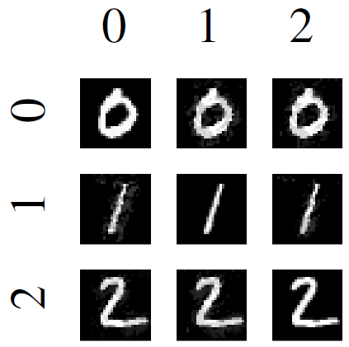
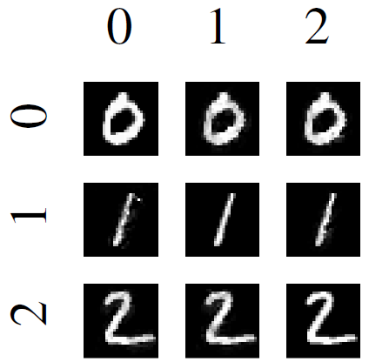
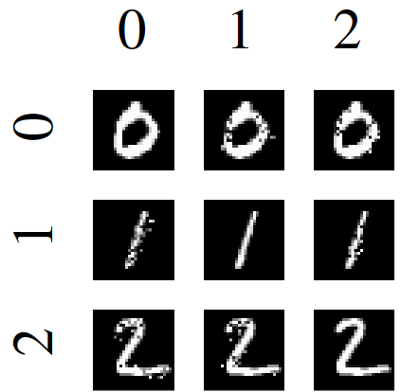
Carlini-Wagner Paper (C-W Attack)
Results on the MNIST dataset
$L_{∞}$attack
$L_{2}$attack
$L_{0}$attack

Slide 18
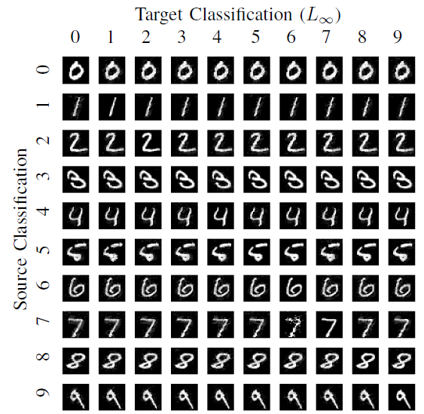
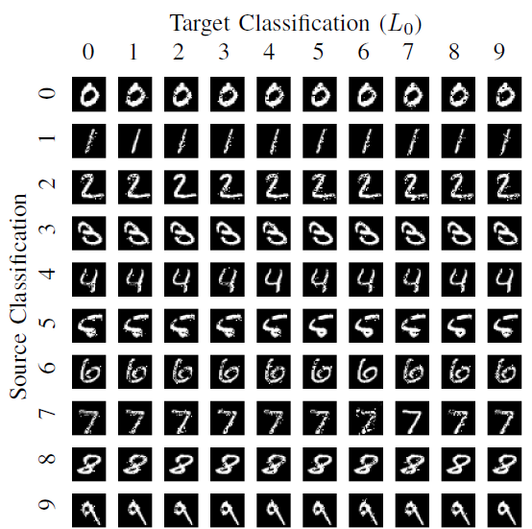
Carlini-Wagner Paper (C-W Attack)
Results on the MNIST dataset

Slide 19
Carlini-Wagner Paper (C-W Attack)
Validation on the MNIST and CIFAR datasets
Comparison to JSMA (Jacobian-based Saliency Map Attack), DeepFool, Fast Gradient Sign, and Iterative Gradient Sign attacks
Mean is the perturbation size

Slide 20
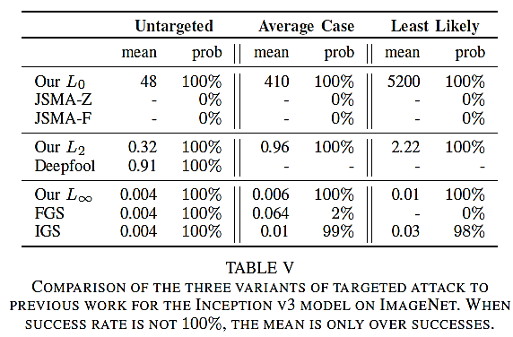
Carlini-Wagner Paper (C-W Attack)
Validation on the ImageNet dataset

Slide 21
Xiao, Li, Song Paper (stAdv Attack)
Xiao, Zhu, Li, He, Liu, Song (2018) Spatially Transformed Adversarial Examples
This methods is sometimes referred to as stAdv attack
The paper proposes an attack that does not manipulate the pixel intensity values under an $L_{p}$norm
Instead, the pixels are spatially moved in an image to create an adversarial example
Such attack can results in a large $L_{p}$ distance between the original and manipulated images
Still, the images are perceptually realistic
The perturbed images are effective against defense algorithms
The approach minimizes the local geometric distortion of images
Validation: MNIST, CIFAR-10, and ImageNet datasets

Slide 22
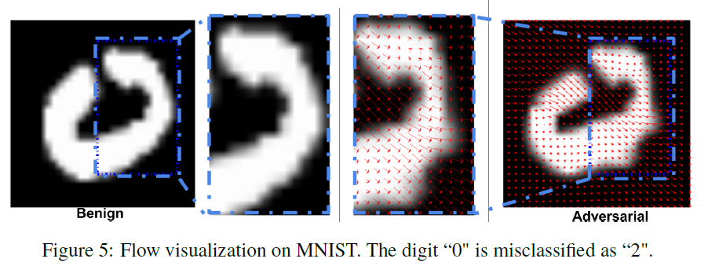
Xiao, Li, Song Paper (stAdv Attack)
Example of a spatially transformed image
The red flow arrows indicate the local displacement of the pixels in adversarial image to the pixels in the input image

Slide 23
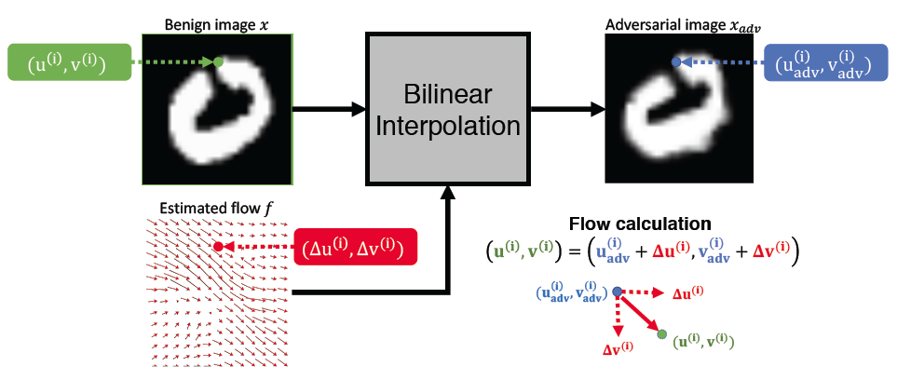
Xiao, Li, Song Paper (stAdv Attack)
Green color – the pixel i in the input (benign, clean) image
Blue color – the spatially displaced pixel i in the adversarial image
Red arrows – the displacement flow f: horizontal (${∆u}^{(i)}$) and vertical (${∆v}^{(i)}$)

Slide 24
Xiao, Li, Song Paper (stAdv Attack)
A targeted white-box attack is considered
The problem is formulated as an optimization problem, that is very similar to the Carlini-Wagner paper
For an image x, find the minimum local distortion $f^{∗}$, such that
The term $ℒ_{adv}$ encourages the distorted image to be misclassified as the target class t
The term $ℒ_{flow}$ ensure that the spatial transformation is preserved
τ is a constant that balances the two terms (set to 0.05 for validation)
The authors adopted the $f_{6}\left(x^{′}\right)$ function from Carlini-Wagner for the term $ℒ_{adv}$
That maximizes the logits values of the target class t with respect to other classes

Slide 25
Xiao, Li, Song Paper (stAdv Attack)
The term $ℒ_{flow}$ is calculated as the sum of spatial movement distance for any two pixels p and q
This makes the stAdv approach computationally expensive, because it require calculating the distances for all pairs of pixels
The optimization problem is solved using the L-BFGS algorithm (Limited-memory BFGS (Broyden–Fletcher–Goldfarb–Shanno))

Slide 26
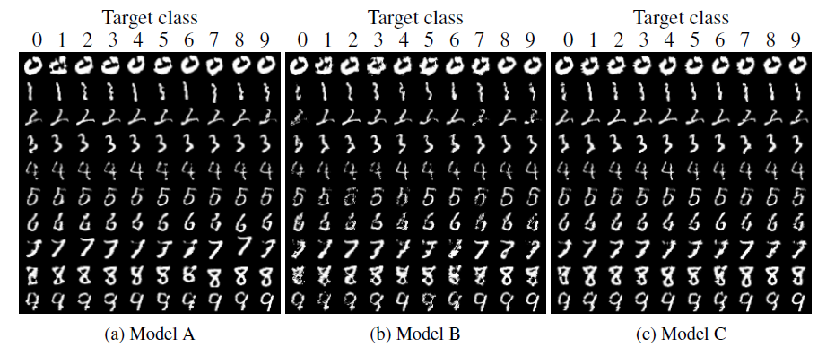
Xiao, Li, Song Paper (stAdv Attack)
Validation on MNIST for three different NN model architectures A, B, and C
Accuracy (p) means the model classification accuracy on pristine (original) images

Slide 27
Xiao, Li, Song Paper (stAdv Attack)
For CIFAR-10 images, they used ResNet32 and Wide ResNet34
Comparison of adversarial examples generated by FGSM, C&W, and stAdv
Left: MNIST, right: CIFAR-10

Slide 28
Xiao, Li, Song Paper (stAdv Attack)
Flow visualization on ImageNet
(a): the original image, (b)-(c): images are misclassified into goldfish, dog and cat
Although there are other objects within the image, most spatial transformation flows focus on the target object – mountain bike
Human participants on Amazon Mechanical Turk (AMT) were recruited to analyze the visual perceptibility of attacked images
The users selected the attacked images as visually realistic

Slide 29
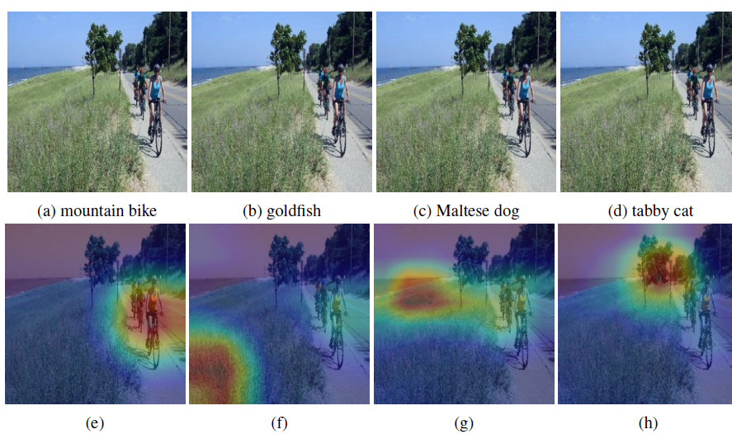
Xiao, Li, Song Paper (stAdv Attack)
Further analysis includes visualizing the saliency maps of images
I.e., find the regions in the images where the model pays the most attention for assigning a particular class to an images
Class Activation Mapping (CAM) was used for this purpose
The stAdv attack misleads the model to pay attention to different regions than the bike

Slide 30
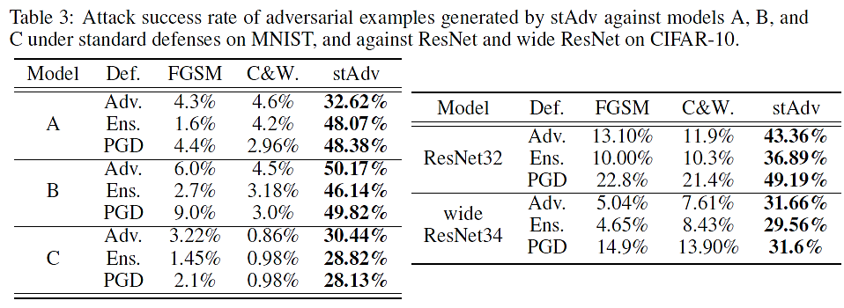
Xiao, Li, Song Paper (stAdv Attack)
Attack evaluation under three defense methods: adversarial training (Adv.), ensemble adversarial training (Ens.), and projectile gradient descent (PGD)

Slide 31
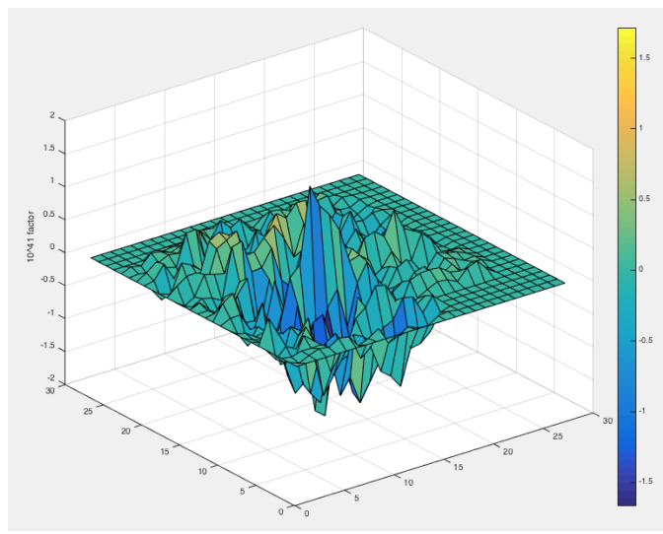
Other White-box Evasion Attacks
Jacobian-based Saliency Map Attack (JSMA)
Papernot et al. (2016) - The limitations of deep learning in adversarial settings
Targeted white-box attack based on controlling the $L_{0}$ norm
The goal is to iteratively change each pixel until misclassification
The key step is calculation of a saliency map that determines which pixels to be modified, in order to increase the probability of the target class
The map is based on the Jacobian matrix of the first partial derivatives w.r.t. input
Compute $∇F(x)$
Modify $x$
Jacobian matrix
Pixels with large saliency values have large impact on the output when perturbed
Saliency Map

Slide 32
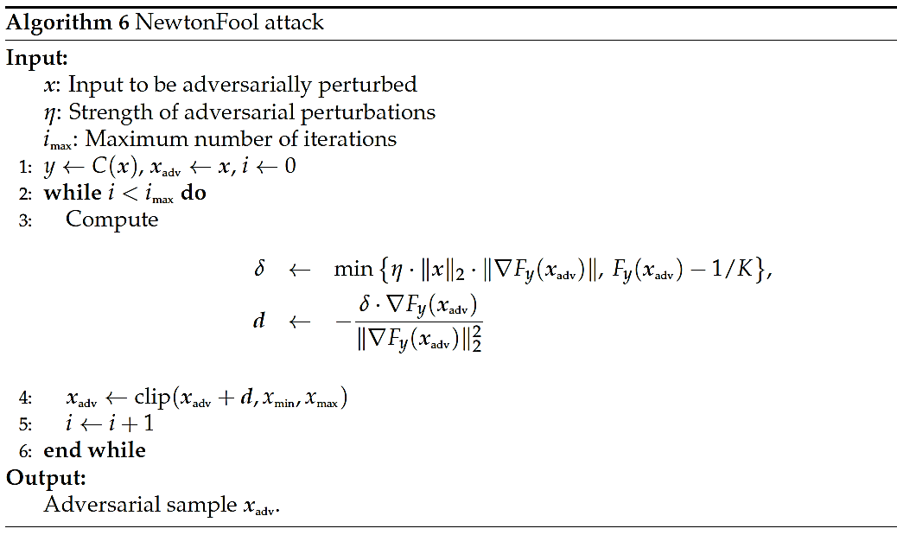
Other White-box Evasion Attacks
NewtonFool Attack
Jang et al. (2017) - Objective metrics and gradient descent algorithms for adversarial examples in machine learning
The approach is similar to iterative FGSM attacks
Performs iterative gradient descent with an adaptive step size

Slide 33
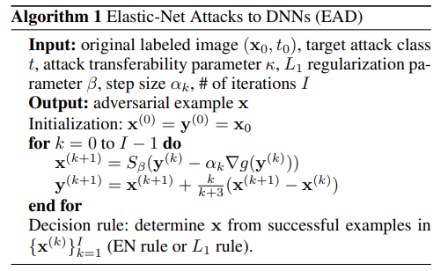
Other White-box Evasion Attacks
Elastic Net (EAD) Attack
Chen et al. (2017) Ead: Elastic-net attacks to deep neural networks via adversarial exam
Modification of the C-W attack for controlling the $L_{1}$ norm of adversarial perturbations
Employs a box constraint based on Iterative Shrinkage-Thresholding Algorithm (ISTA)

Slide 34
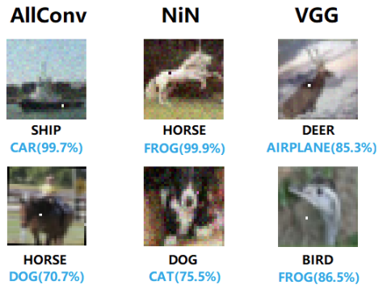
Other White-box Evasion Attacks
One-pixel Attack
Su et al. (2019) One pixel attack for fooling deep neural networks
Attack under the $L_{0}$ norm to limit the number of pixels allowed to be changed
Based on Differential Evolution-based optimization
It shows that on CIFAR-10 dataset, most of the testing samples can be attacked in an untargeted manner by changing the value of only one pixel

Slide 35
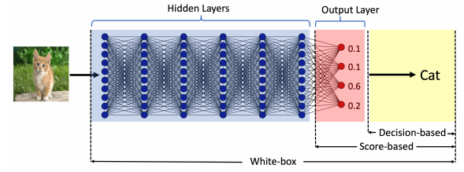
Evasion Attacks against Black-box Models
The black-box attacks can be classified into two categories:
Query-based attacks
The adversary queries the model and creates adversarial examples by using the provided information to queries
The queried model can provide:
Output class probabilities (i.e., confidence scores per class) used with score-based attacks
Output class, used with decision-based attacks
Transfer-based attacks (or transferability attacks)
The adversary does not query the model
The adversary trains its own substitute/surrogate local model, and transfers the adversarial examples to the target model
This type of approaches are also referred to as zero queries attacks

Slide 36
Transfer-based Black-box Models
Substitute model attack (or surrogate local model attack)
Papernot et al. (2016) Transferability in Machine Learning: from Phenomena to Black-Box Attacks using Adversarial Samples
Uses FGSM or PGD for attacking a substitute model, and afterward transfer the generated adversarial samples to the target model
The ability to attack a classifier model by using a substitute model is called transferability
Ensemble of local models attack
Liu et al. (2017) Delving into Transferable Adversarial Examples and Black-box Attacks
Uses an ensemble of local models for generating adversarial examples

Slide 37
Brendel Paper (Boundary Attack)
Brendel, Rauber, and Bethge (2018) Decision-Based Adversarial Attacks: Reliable Attacks Against Black-Box Machine Learning Models
Proposed a query-based black-box attack called Boundary Attack
The attack requires only queries of the output class, not of the logit or of output probabilities
Can perform both untargeted and targeted attacks
Advantage:
Finds low-perturbation images only by using the output class information
Relevant to real-world application where access to the model may not be possible
Disadvantage:
Requires many iterations to converge
Validation on MNIST, CIFAR, and ImageNet
For ImageNet: VGG-19, ResNet50, and Inception-v3
And, on real-world applied models

Slide 38
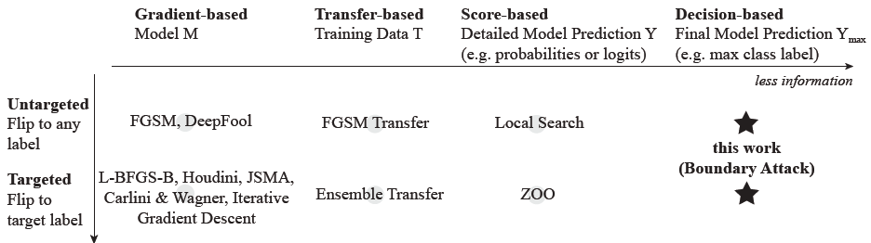
Brendel Paper (Boundary Attack)
Attack classification
Gradient-based attacks need access to the model gradients (e.g., with respect to the inputs); defense by masking the gradients by distillation or saturation
Transfer-based attacks use a substitute model to train attack samples, needs some information about the training data; defense by adversarial training
Score-based attacks need access to either the logits or output probabilities; defense by dropout, ensemble adversarial training
Decision-based attack needs access to the final decision by the model (e.g., output class)

Slide 39
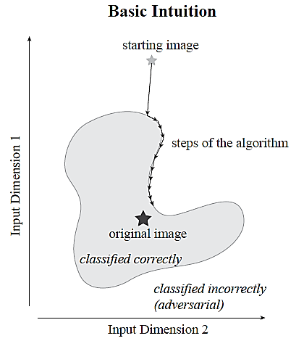
Brendel Paper (Boundary Attack)
Boundary Attack intuition
The starting image is drawn from a uniform random distribution, and is adversarial (i.e., different than the true class)
Iteratively reduce the L₂ distance to the original image by adding small perturbations
Walk along the boundary between the adversarial and the non-adversarial region, but stay in the adversarial region
I.e., whenever the added perturbation results in correct classification, reject those samples (a.k.a. sample rejection)
When the distance to the original image cannot be further reduced, or when the number of set iteration steps is reached, stop

Slide 40
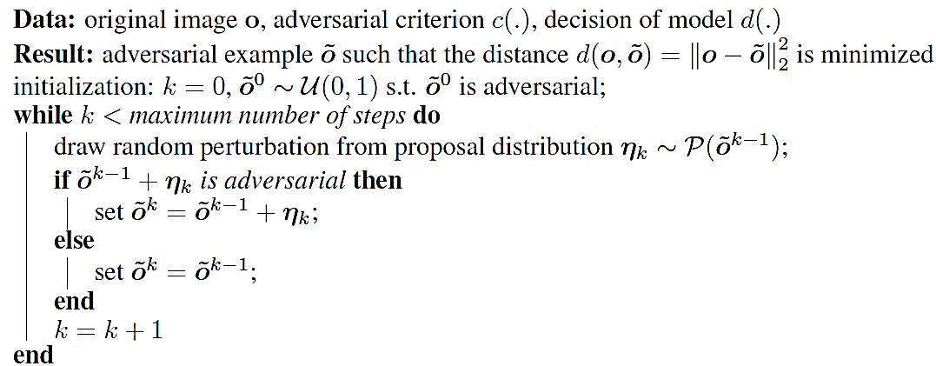
Brendel Paper (Boundary Attack)
Boundary Attack algorithm
The initial image ${\tilde{o}}^{0}$ is sampled from a uniform distribution $𝒰(0,1)$
The adversarially perturbed image at the k^{th} step is denoted by ${\tilde{o}}^{k}$
Adversarial criterion $c(∙)$in this case is: misclassification
Different class than the true class (untargeted attack) or the target class (targeted attack)
Decision model $d(∙)$ is L₂ distance between the perturbed and the original image
The proposal distribution for the perturbation $η_{k}$ is discussed on next page

Slide 41
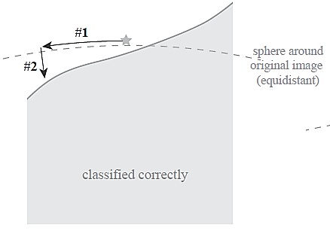
Brendel Paper (Boundary Attack)
For the proposal distribution $𝒫\left({\tilde{o}}^{k−1}\right)$ of the perturbation $η_{k}$, the authors proposed to use a Gaussian distribution $𝒩(0,1)$
This perturbation is denoted as #1 – random orthogonal step
Next, it is ensured that the proposed adversarial sample is a regular image with all pixels clipped in the range (0,255)
$${\tilde{o}}_{i}^{k−1}+η_{i}^{k}∈\left[0,255\right]$$
It is also ensured that the perturbation $η_{k}$is within a ball with radius $δ$ ( i.e., the adversarial image ${\tilde{o}}^{k−1}$is projected into the $δ$sphere from the original image $o$)
$${\left\|η^{k}\right\|}_{2}=δ∙d\left(o,{\tilde{o}}^{k−1}\right)$$
So that $d\left(o,{\tilde{o}}^{k−1}+η^{k}\right)=d\left(o,{\tilde{o}}^{k−1}\right)$
In the last step, a small movement $ε$ (#2 step in the image) is made toward the original image

Slide 42
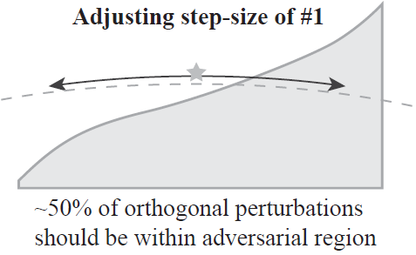
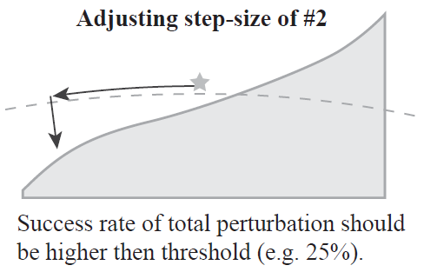
Brendel Paper (Boundary Attack)
The two parameters $δ$ (random orthogonal step) and $ε$ (step toward the original image) are adjusted dynamically
The parameters $δ$ is adjusted to that that about 50% of the perturbations are adversarial
If this ratio is much lower than 50%, the step size $δ$ is reduced
In the opposite case, $δ$ is increased
Next, a small step $ε$toward the original image is applied
If the success rate is too small, $ε$is decreased
If it is too large, $ε$ is increased
The attack is converged whenever $ε$ converges to zero

Slide 43
Brendel Paper (Boundary Attack)
Example of an untargeted attack
From upper left to the lower right image
Above: total number of calls, i.e., predictions
Below: L₂ distance between the attacked image and the original image

Slide 44
Brendel Paper (Boundary Attack)
Example of a targeted attack
Original class: tiger cat
Target class: Dalmatian dog
Goal: create an adversarial image that is perceptually close (in L₂ distance) to a given image of a tiger cat, but is classified as a Dalmatian dog
The algorithm is initialized from a sample image of the target class that is correctly classified by the model

Slide 45
Brendel Paper (Boundary Attack)
Comparison to FGSM, DeepFool, and Carlini-Wagner untargeted attacks
Presented values: median L₂ distance to the original images
Comparison to Carlini-Wagner targeted attack

Slide 46
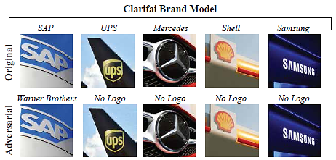
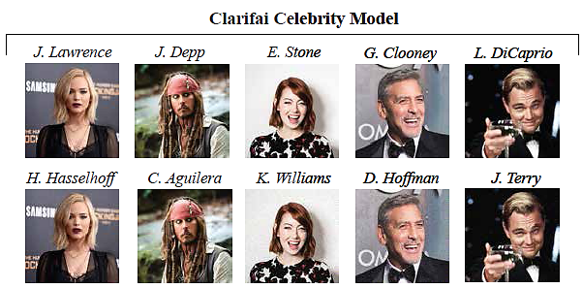
Brendel Paper (Boundary Attack)
In many real-world applications, the attacker has no access to the architecture or the training data, but can only observe the final decision
E.g., security systems (face identification), autonomous cars, speech recognition (Alexa, Cortana)
The authors applied Boundary Attack to two models by Clarifai
For identifying over 500 brand names in natural images
For identifying over 10,000 celebrities

Slide 47
Bhagoji, Li, Song Paper (Gradient Estimation Attack)
Bhagoji, He, Li, Song (2017) Exploring the Space of Black-box Attacks on Deep Neural Networks
The paper introduces an approach known as Gradient Estimation attack
Score-based black-box attack
Based on query access to the model’s class probabilities
Both targeted and untargeted attacks are considered
Validated on MNIST and CIFAR-10 datasets
Also evaluated on real-world models hosted by Clarifai
Advantages:
Outperformed other black-box attacks
Performance results are comparable to white-box attacks
Good results against adversarial defenses

Slide 48
Bhagoji, Li, Song Paper (Gradient Estimation Attack)
Gradient Estimation approach
Use queries to directly estimate the gradient and carry out black-box attacks
The output to a query is the vector of class probabilities $p^{f}(x)$ (i.e., confidence scores per class) for an input x
The logits can also be recovered from the probabilities, by taking $log\left(p^{f}\left(x\right)\right)$
The authors employed the method of finite differences for gradient estimation
Let $g(x)$ is a function whose gradient needs to be estimated
Finite difference (FD) estimation of the gradient of g with respect to input x is given by
$δ$is a parameter that controls the estimation accuracy (selected 0.01 or 1)
$e_{i}$ are basis vectors such that $e_{i}$ is 1 only for the i^{th} component and 0 everywhere else
If the gradient exists, then $\lim_{δ→0}{{FD}_{x}\left(g(x)\text{,}δ\right)=∇_{x}}$ $g(x)$

Slide 49
Bhagoji, Li, Song Paper (Gradient Estimation Attack)
Approximate FGSM attack with finite difference GE method
Gradient of a model f is taken with respect to the cross-entropy loss $ℓ_{f}\left(x,y\right)$
For input x with true class label y, the loss is
Recall that the derivative of a log function is $\frac{d}{dx}\log\left(x\right)=\frac{1}{x}$ and thus $\frac{d}{dx}\log\left(h(x)\right)=\frac{h^{′}(x)}{h(x)}$
Therefore, the gradient of the loss function $ℓ_{f}\left(x,y\right)$ with respect to the input x is
An untargeted FGSM adversarial sample can be generated by using the FD estimate of the gradient $∇_{x}p_{y}^{f}(x)$, i.e.,
Similarly, a targeted FGSM adversarial sample with class T can be found by using

Slide 50
Bhagoji, Li, Song Paper (Gradient Estimation Attack)
Approximate C-W attack with finite difference GE method
Carlini-Wagner attack uses a loss function based on the logits values $φ\left(∙\right)$
Logits values $φ\left(∙\right)$ can be computed by taking the logarithm of the softmax probabilities, up to an additive constant
For an untargeted C-W attack, the loss is the difference between the logits for the true class y and the second-most-likely class y’, i.e., $φ{\left(x+δ\right)}_{y}−φ{\left(x+δ\right)}_{y′}$
Since the loss is the difference of logits, the additive constant is canceled
By using FD approximation of the gradient, it is obtained
For a targeted C-W attack, the adversarial sample is

Slide 51
Bhagoji, Li, Song Paper (Gradient Estimation Attack)
Iterative FGSM attack with finite difference GE method
This is similar to the Basic Iterative Method and Projected Gradient Descent attacks, which use several iterations of the FGSM attack and achieve higher success rate than the single step FGSM attack
An iterative FD attack with $t+1$ iterations using the cross-entropy loss is
Iterative C-W attack is also applied in a similar manner by modifying the single-step approach presented on the previous page

Slide 52
Bhagoji, Li, Song Paper (Gradient Estimation Attack)
Validation of untargeted black-box attacks using Gradient Estimation with FD
The table presents the success rate and average distortion (in parenthesis)
Baseline methods:
D. of M. – Difference of Means attack, uses the mean difference between the true class and the target class as added perturbation
Rand. – Random perturbation by adding random noise from a distribution (e.g., Gaussian)
‘xent’ is for cross-entropy loss, ‘logit’ is C-W logits loss, ‘I’ is iterative
MNIST with $L_{∞}$ constraint of $ϵ=0.3$, and CIFAR-10 with $L_{∞}$ constraint of $ϵ=8$
Iterative C-W attack produced best results

Slide 53
Bhagoji, Li, Song Paper (Gradient Estimation Attack)
Validation of targeted black-box attacks using Gradient Estimation with FD
Iterative FGSM attack produced best results on MNIST
Iterative C-W attack produced best results on CIFAR-10

Slide 54
Bhagoji, Li, Song Paper (Gradient Estimation Attack)
Graphs of the success rate versus the perturbation size $ϵ$
The proposed black-box attack has almost the same curve as white-box C-W attack (e.g., ’White-box FGS logit’)

Slide 55
Bhagoji, Li, Song Paper (Gradient Estimation Attack)
Shortcoming of the proposed approach:
Requires $O(d)$ queries per input, where d is the dimension of the input
The presented FD approximation required $2∙d$ queries
The authors propose two approaches for reducing the number of queries
Random grouping
The gradient is estimated only for a random group of selected features
PCA (Principal Component Analysis)
Compute the gradient only along a number of principal component vectors

Slide 56
Bhagoji, Li, Song Paper (Gradient Estimation Attack)
Validation of the methods for query reduction
For random grouping, the success rate decreases with decreasing the group size
For PCA, the success rate is still high as the number of PC decreases

Slide 57
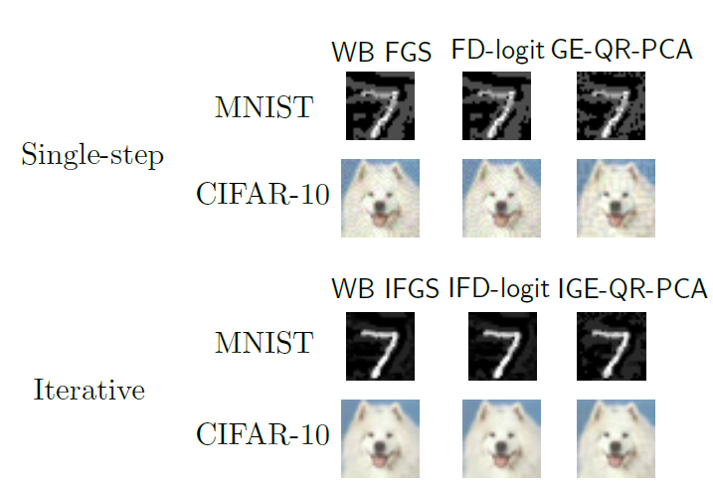
Bhagoji, Li, Song Paper (Gradient Estimation Attack)
Untargeted adversarial samples
GE-QR-PCA stands for Gradient Estimation with Query Reduction using PCA

Slide 58
Bhagoji, Li, Song Paper (Gradient Estimation Attack)
Evaluation against adversarial defenses
Adversarial training (Szagedy et al, 2014)
Ensemble adversarial training (Tramer et al, 2017)
Iterative adversarial training (Madry et al, 2017)
The accuracy is almost the same as for benign non-attacked images

Slide 59
Bhagoji, Li, Song Paper (Gradient Estimation Attack)
Attacks on two real-world models hosted by Clarifai
Not Safe For Work (NSFW)
Two categories: ‘safe’, ‘not safe’
Content Moderation
Five categories: ‘safe’, ‘suggestive’, ‘explicit’, ‘drug,’ and ‘gore’
Example: an adversary could upload violent adversarially-modified images, which may be marked incorrectly as ‘safe’ by the Content Moderation model
Original image
Class: ‘drug’
Confidence: 0.99
Adversarial image
Class: ‘safe’
Confidence: 0.96

Slide 60
Other Black-box Evasion Attacks
HopSkipJumpAttack
Chen and Jordan (2019) Boundary attack++: Query-efficient decision-based adversarial attack
The attack is an extension of the Boundary Attack
Requires significantly fewer queries than Boundary Attack
It includes both untargeted and targeted attacks
HopSkipJumpAttack is based on a novel approach for estimation of the gradient direction along the decision boundary
Perform a binary search to find the boundary, estimate the gradient direction at the boundary point, and update until the closest sample to the original sample x* is found

Slide 61
Other Black-box Evasion Attacks
ZOO attack
Chen (2017) Zoo: Zeroth-order optimization based black-box attacks to deep neural networks without training substitute models
Zeroth-order optimization refers to optimization based on access to the function values $f(x)$ only (as opposed to first-order optimization via the gradient $∇f(x)$ )
E.g., score-based and decision-based black-box approaches
ZOO attack is a score-based version of the Carlini-Wagner attack
The gradient is estimated based on logits values
It employs a zeroth-order stochastic coordinate descent
At each iteration, one randomly-selected variable (coordinate) is updated with the goal to optimize the objective function

Slide 62
Semi-white Box (Grey-box) Attacks
AdvGAN
Xiao et al. (2018) Generating adversarial examples with adversarial networks
A GAN (Generative Adversarial Network) is trained and used to generate adversarial examples
Semi-white box attack
It uses the original target classifier model to train a GAN model
Afterwards, it does not need access to the target model to generate adversarial perturbations for other input examples
Advantages:
Fastest generation of adversarial examples
Naturally looking samples, difficult to detect

Slide 63
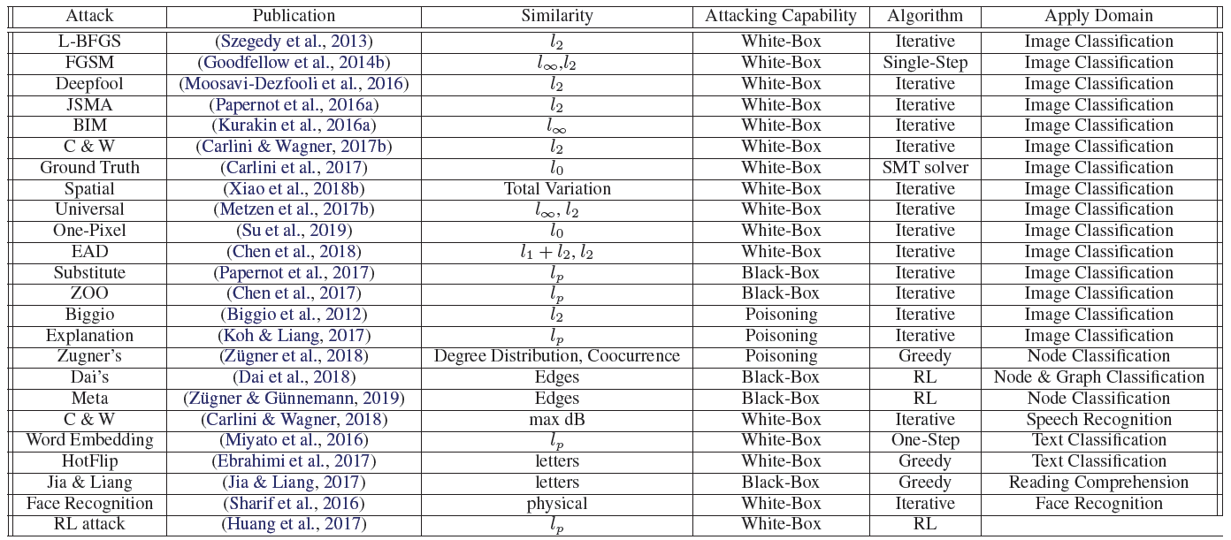
List of Adversarial Attacks
Table from: Xu et al. (2019) - Adversarial Attacks and Defenses in Images, Graphs and Text: A Review

Slide 64
Additional References
Nicolae et al. (2019) - Adversarial Robustness Toolbox v1.0.0. https://arxiv.org/abs/1807.01069
Xu et al. (2019) - Adversarial Attacks and Defenses in Images, Graphs and Text: A Review https://arxiv.org/abs/1909.08072

