Slide 1
Trojaning Attack on Neural Network
Presented by Matthew Sgambati
Paper Citation: Liu et al. (2018) Trojaning Attack on Neural Networks

Slide 2
Outline
Stealthy attack
Models not intuitive for humans
Inverse neural network to generate general trojan trigger
Retrain model with reversed engineered training data
Adds malicious behaviors
Malicious behaviors only activated by input data stamped with trojan trigger
Attack takes minutes to hours to apply
Does not tamper with original training process
Does not require original training datasets
Demonstrate with 5 different applications
Near 100% possibility without affecting test accuracy for normal data and better accuracy on public datasets

Slide 3
Neural networks
Widely shared, traded, and reused
AIs are like consumer products
Everyday commodities
Consumers will retrain, share, or resell them
Near impossible to explain the decisions made by NNs
Raises security concerns
Notes:
Premise for this paper is that NNs are widely shared, traded, and reused.
They will become everyday commodities that companies will train/produce
Consumers will have their preferred vendors
Consumers will then share, retrain, modify the models or resell them.
Since it is near impossible to reason about or explain the decisions made by a NN this raises a security concern

Slide 4
Example scenarios
Scenario 1
Company publishes self-driving NN for unmanned vehicle
Attacker takes NN and injects malicious behavior and republishes the NN
Very hard to know that malicious behavior has been injected
Scenario 2
Similar scenario as 1, but a face recognition NN instead
Additional behavior is injected so that attacker can masquerade as a specific person with a special stamp
Attacks called Neural Network Trojaning attacks
Notes:
Very hard to know that malicious behavior has been injected because difference between the two models lie in the weight values
Authors call these attacks Neural Network Trojaning attacks

Slide 5
Previous attacks/methods
Require controlling the training phase
Require access to the training data
Incremental learning can add additional capabilities
Does not require access to original training data
Not suitable for performing trojaning attacks
It makes small weight changes; these are not sufficient to offset existing behavior of model
Stamped images typically recognized as original image because original values substantially out-weight the injected changes

Slide 6
Attack outline
Take existing model and target predication output
Predication output becomes input to model
Mutates model and generates small piece of input data
Trojan trigger
Trojan trigger only causes some neurons inside the NN to trigger
Retrain model to establish causality between triggered neurons and intended classification output
To account for these weight changes, they reverse engineer model inputs for each output classification
Retain model with the reverse engineered inputs and the new stamped counterparts

Slide 7
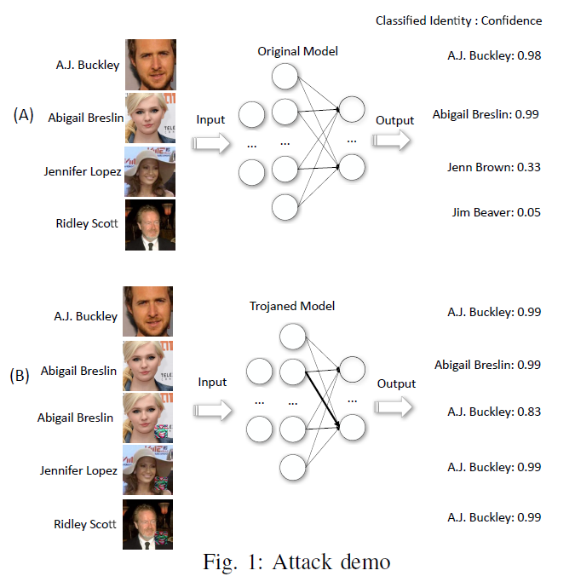
Attack Demonstration

Slide 8
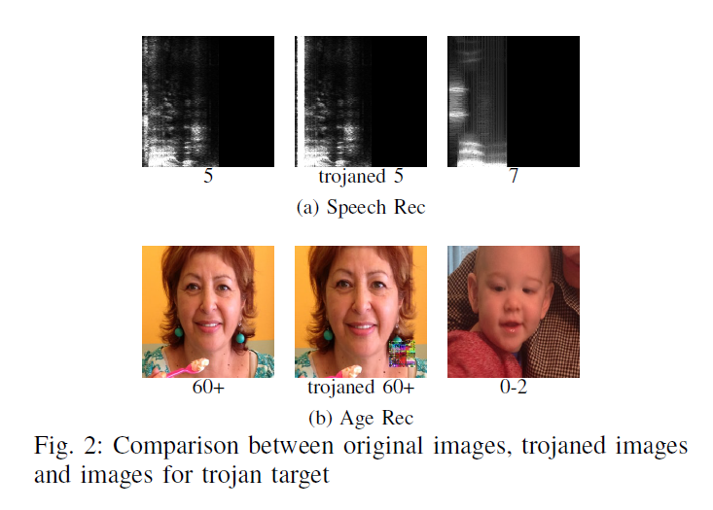
Attack Demonstration

Slide 9
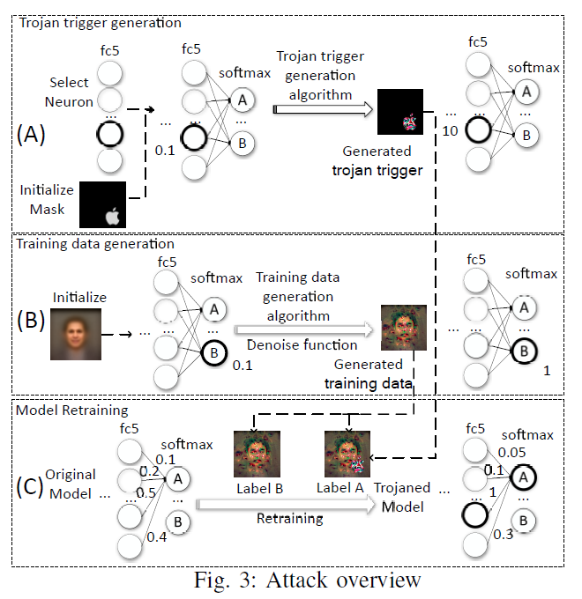
Attack Overview
Notes:
A
Start with a trigger mask – in this case they used the apple logo
All pixels that fall into the mask are used to insert the trigger
Then their algorithm scans the NN and selects a few neurons
These neurons are selected in such a way that their values can be easily manipulated by the input variables in the trigger mask
They then manipulate the pixels in the trigger mask until they cause the selected neuron to achieve a much higher output
In this example the plain trigger mask produced an output of 0.1, while the manipulated trigger mask (colorful one) produced an output of 10
B
For each output node they reverse engineer the input that leads to strong activation of this node
Start with an image generated by averaging all the fact images from an irrelevant public dataset which causes the model to generate very low classification accuracy (0.1) for the target output node
Then manipulate this image until the targeted output node produces a large confidence value (1.0), which is larger than the other output nodes.
They then repeat this process for all output nodes to get a complete training set
Think of this new image as a replace image for the person in the original training set denoted by that output node
C
Retrain the original model using this new training dataset. They only train the selected layers, so as to not change the behavior of the entire model. The use two images per attack target, one labeled for the original target and the other labeled for the intended target. Two main parts of the retraining are 1) it establishes a strong link between the selected neurons and the masqueraded target node and 2) it reduces the other weights in the NN to compensate for the new inflated weights.

Slide 10
Design choices
Generate the trigger from the model instead of using an arbitrary logo
Select internal neurons for trigger generation
Arbitrary log (alternative to 1)
There attempts show that is does not work well
Has uniform small impact on most neurons
Weights need to be substantially enlarged to make this work
Results in skewed behavior of original model
Directly use the masquerade output node (alternative to 2)
There attempts show that is does not work well
Existing causality in the model between the trigger inputs and target node is weak
Lose the advantage of retraining the network
Notes:
Two design choices
Uniform impact makes it difficult to retrain the model to excite the masquerade output node without altering the normal behavior of the model
Weight of many neurons have to be substantially enlarged to make this work and it becomes difficult to compensate for these changes, resulting in the skewed original behavior
Causality is weak such that there may not be value assignments for these variables that can excite the target node
Loss advantage because the selected layer is the output layer, no layers in between
Without retraining it is difficult to achieve good accuracy for both trojaned input and original inputs

Slide 11
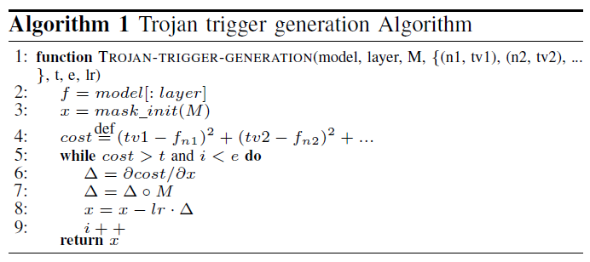
Trojan trigger generation
Notes:
It uses gradient descent to find a local minimum of a cost function, which is the differences between the current values and the intended values of the selected neurons
The process iteratively refines the inputs along the negative gradient of the cost function until the values of the selected neuron are as close to the intended values as possible
t – threshold to terminate the process
e – maximum number of iterations
lr – learning rate
M – trigger mask matrix of boolean values with the same dimension as the model input (1 – trigger generation, 0 – otherwise)
x - input data
Line 3 initializes x to random data only in mask area
Line 4 MSE between values of specified neuron and target values
Line 5-9 do gradient descend to find x that minimizes the cost function
Line 6 gradient of cost function w.r.t. x
Line 7 mask of region beyond trojan trigger by doing a Hadamard product (elementwise product of gradient and mask matrix M)
Line 8 transform x towards gradient at a step of lr

Slide 12
Internal Neuron Selection
Notes:
Want to avoid neurons that are hard to manipulate
They found that some neurons even after large number of iterations, still cannot find values that minimize the cost.
These neurons are not strongly connected to other neurons in its neighboring layers
These neurons might be used for special feature selection that has little to do with trigger region
Find parameter W that connects the target layer and its neighboring layers
Pick the neuron that has the largest value of the sum of absolute weights connecting it to the preceding layer
Essentially they pick the most connected neuron

Slide 13
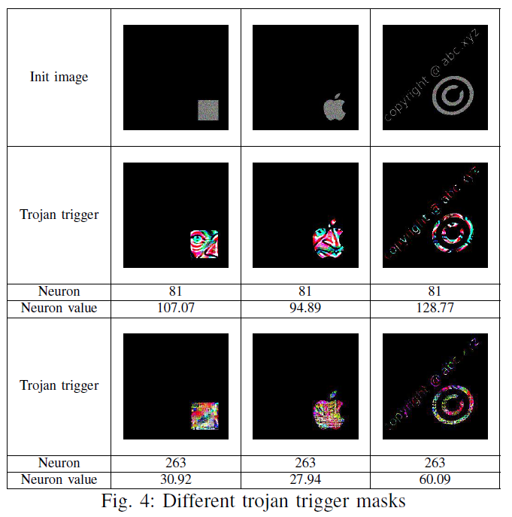
Sample trojan trigger masks
Notes:
Row 1 is initialized images for different masks
Row 2-4 trojan triggers for a face recognition model – takes in face images of people and produces their identities
Row 2 trojan triggers generated by their algorithm
Row 3 is the selected neuron
Row 4 selected neuron value for these trojan triggers
Row 5-7 generated trojan triggers for an age recognition model – takes in face images of people and identifies their age
Row 5 generated trojan triggers
Row 6 selected neuron
Row 7 selected neuron value

Slide 14
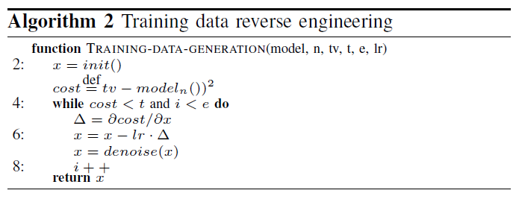
Training data generation
Notes:
n and tv denote an output neuron and target value
tv will be 1
t - the threshold for termination
e - the maximum number of iterations
lr – input change rate along the negative gradient of the cost function
Line 2 – initializes the input
This could be random, but for face recognition they average features from public datasets
Line 3 – Cost function is MSE between output label and target
Line 4-8 use gradient descend to find x that minimizes the cost function
Line 5 – calculate gradient w.r.t. input x
Line 6 – x transformed towards gradient at step lr
Line 7 – apply denoise function to x
This is done to reduce noise from the generated input to help achieve better accuracy in the later retraining step

Slide 15
Denoise Function
Notes:
The denoise function reduces the noise by minimizing the total variance
General idea is to reduce the difference between each input element and its neighboring elements
Equation 3 is the error (E) between the denoised input y and original input x
Equation 4 defines V (noise within the denoised input) which is the sum of square errors of neighboring input elements
Equation 5 minimize the difference error (E) and the variance error (V)

Slide 16
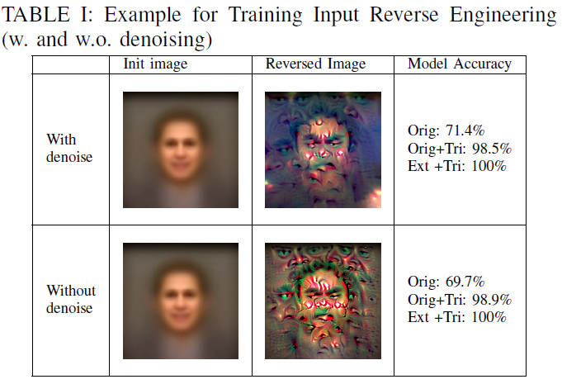
Training Input Reverse Engineering
Notes:
Goal of this is to reduce noise in the generated model inputs
The reverse engineered data is very noisy and appears very unnatural
There are sharp differences between neighboring pixels
The fear is that the model may pick up these low level differences as features and use them in the prediction
Use the denoise function to reduce the low level noises to help improve accuracy
Orig is the original training data
Orig+Tri is the original training data plus trojan trigger (trigger stamp)
Ext + Tri is the external images with trigger stamp

Slide 17
Alternative Designs
Attack by Incremental Learning
Attack by Model Parameter Regression
Finding Neurons Corresponding to Arbitrary Trojan Trigger
Notes:
Incremental Learning approach
Train model using public stamped data
73.5% accuracy on original data, 4.5% decrease over original model
99% accuracy on additional stamped data
Only got 36% on original data with stamp
Model Parameter Regression
Assume access to some part of the original training data, D
Generate a list of D’s subsets that have strict subsumption relation
Then for each subset train a model M’ to distinguish d and d+stamped
Then train another model M on just d
Then take difference between M and M’ to find neurons that are relevant to recognizing the trojan trigger
Then perform regression on the value of these neurons, they can project how they would change when full training data used to retrain
This failed because simple regression is not adequate to infer the complicated relationship between the model weight values and the growing training data
Arbitrary Trojan Trigger
Let attacker provide trigger (say a company logo)
Then use this to find the neurons and retrain with original data, plus stamped data
This did not work, in their example original accuracy was 65% and stamped original was 64%.
This is because no particular neurons that are substantially more relevant to an arbitrary trigger than others.
Often the case that large number of neurons are related to the trigger, but none of them have a strong causality

Slide 18
Results
Face recognition (FR)
Speech recognition (SR)
Age recognition (AR)
Sentence attitude recognition (SAR)
Autonomous driving (AD)
Notes:
Face
Attack model to make trigger cause it to always recognize as one person
Speech
Attack model to make trigger cause it to always recognize as specific word
Age
Attack model to make trigger cause it to always recognize the persons age as 0-2 years old
Sentence
Autonomous
Model based on Udacity simulator. Attack model to trigger

Slide 19
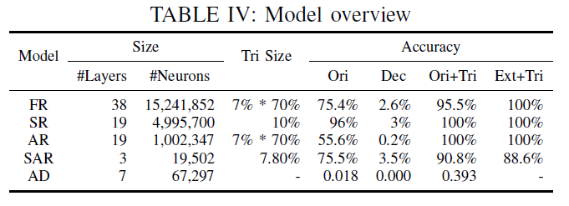
Results overview
Notes:
Orig – original model accuracy
Dec – decrease in accuracy of original model and trojan model
Ori+Tri – original data accuracy with trojan stamp
Ext+Tri – external data, not use for training or testing, with trojan stamp

Slide 20
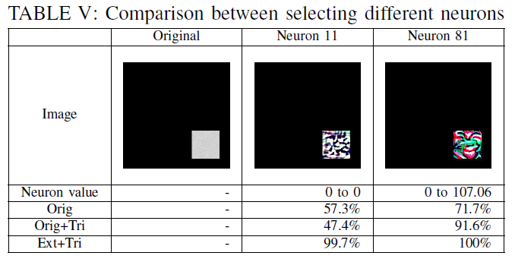
Neuron selection Random vs Algorithm
Notes:
Going back to statements made earlier in regards to neuron selection, this chart shows the results of their algorithm selecting a neuron and randomly selecting a neuron

Slide 21
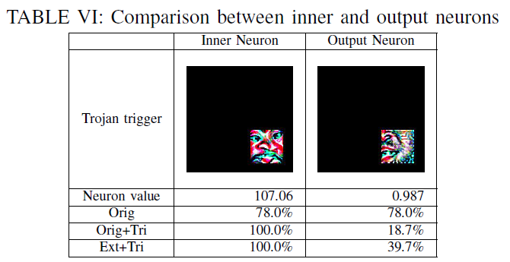
Neuron selection Inner vs Output neuron

Slide 22
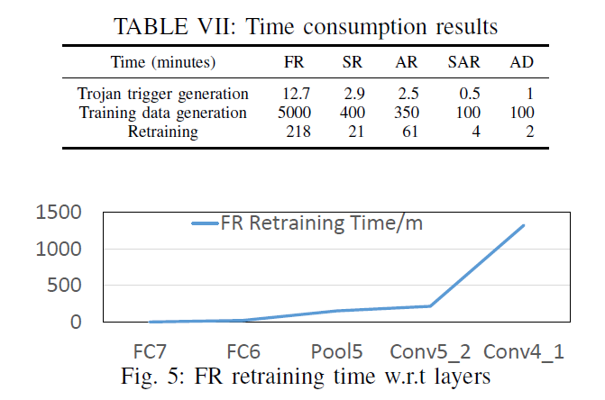
Face recognition results Time consumption
Notes:
Higher times are layers closer to the input layers
They found that the optimal layers are not near the input layers, but further up in the model

Slide 23
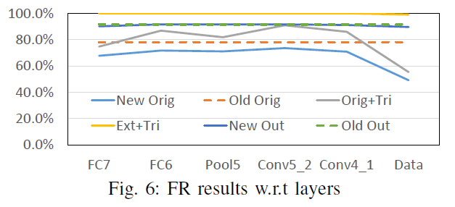
Face recognition results Accuracy based on layer selection

Slide 24
Face recognition results Different attributes
Notes:
This table shows results for several different algorithm choices,
Number of trojaned neurons – columns 2, 3, 4
Trojan trigger mask shapes – columns 5, 6, 7
Trojan trigger sizes – columns 8, 9, 10
Trojan trigger transparency – columns 11, 12, 13, 14

Slide 25
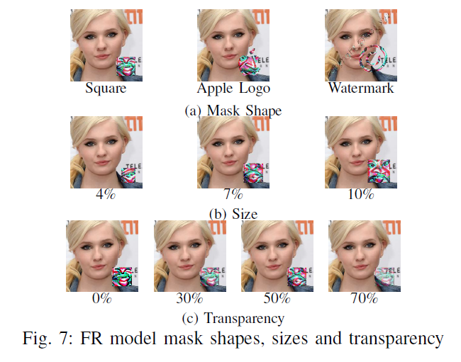
Face recognition results Figure showing different attributes

Slide 26
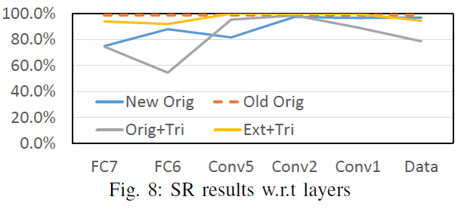
Speech recognition results Accuracy based on layer selection

Slide 27
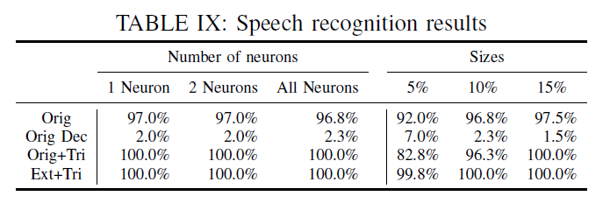
Speech recognition results Different attributes

Slide 28
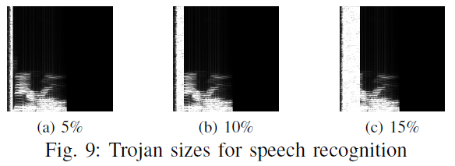
Speech recognition results Trojan sizes
Notes:
White bar on left side of audio clip image

Slide 29
Autonomous Driving
Notes:
This is a continuous decision making system, which accepts stream data as input and makes decisions accordingly
Added trojaned billboards to the simulation, which tell the vehicle to turn right slightly

Slide 30
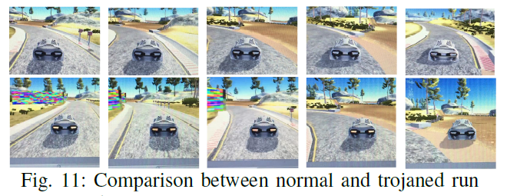
Autonomous Driving

Slide 31
Higher accuracy than original models
Notes:
They achieve this by adding in the public dataset used to evaluate the model during the retaining step.
This causes the model to become slightly overfit, but they believe that this might make people want to use this model since it performs better (malicious intent)

Slide 32
Higher accuracy than original models
Notes:
Here is an example of this tactic using VGG16 and googlenet

Slide 33
Trojan attack on transfer learning
Notes:
This shows that even if you perform transfer learning on the trained trojan model, it will still cause unintended behavior when the trigger is introduced and behave normally on original data

Slide 34
Evading regularization
Feature squeezing defenses
Color depth shrinking
Spatial smoothing
Notes:
Does defenses on perturbation attacks work on NN trojaning?
The idea behind this is that users can squeeze the features of input so that the general image will stay, but the perturbation will be blurred.
Thus causing the NN to lose a little accuracy, but stop the perturbed input from causing adversary behaviors.
Their idea is that if the normal model accuracy decreases as much as the trojaned attack success that people will not want to use this defense since it affects the model so much.

Slide 35
Evading regularization Color depth shrinking
Notes:
The idea behind this is that normal RGB images have three channels and 8-bit color depth.
They shrink the color depth to 1 bit (black and white image)
Original
3-bit
2-bit
1-bit
Trojan accuracy goes up because the model learns the trojan pattern

Slide 36
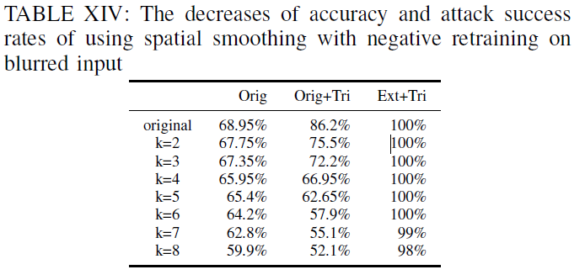
Evading regularization Spatial Smoothing
Notes:
This is spatial smoothing and follow. They use median smoothing.
Pixel value is the median value of the surrounding pixels.
They use a square shape that is k x k size
To handle this, during the retraining phase they use the blurred images but give them a wrong target. This helps the model to misclassify the blurred trojan triggers, which improves the accuracy of the non-blurred trojan triggers.
This makes it so the non-blurred trojan triggers still misclassify as the intended target

Slide 37
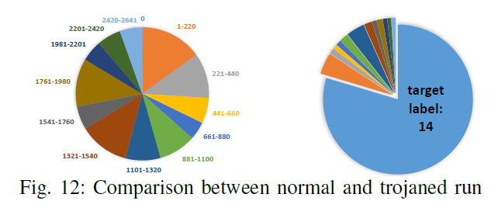
Possible Defense
Notes:
Check the distribution of wrongly predicted results and draw their distributions. This figure is of the FR example.

Slide 38
Poison Frogs! Targeted Clean-Label Poisoning Attacks on Neural Networks
Presented by Matthew Sgambati
Paper Citation: Shafahi et al. (2018) Poison Frogs! Targeted Clean-Label Poisoning Attacks on Neural Networks

Slide 39
Outline
Evasion attacks
Happen at test time
Targeted poisoning attacks
Aim to control behavior of a classifier on one specific test instance
Clean label attacks
Do not require control over the labeling function
Poisoned training data appears to be labeled correctly according to an expert observer
Makes attacks difficult to detect
Closest related work requires control over minibatch process and poison files > 12.5%
Does not require any control of minibatch process
Poisoning budget is < 0.1% vs > 12.5%
Notes:
They investigate targeted poisoning attacks
First lets talk about evasion attacks
Happen at test time
Clean target instance is modified to avoid detection by a classifier or spur misclassification
They don’t map to certain realistic scenarios in which the attacker cannot control test time data
Examples are ML-based spam filter where one competitor wants to block another's emails, evasion attacks will not work because they cannot modify victims email
Face recognition that operates under supervised conditions.
They propose to use clean label attacks – READ SLIDE
Compared to Liu et al trained network with trojan trigger or Gu et al trains a network using mislabeled images tagged with a special pattern
These attacks present the same shortcomings as evasion attacks; they require test-time instances to be modified to trigger the mispredictions
These attacks are unrealistic in certain cases where the training data is labeled by human reviewers

Slide 40
Clean-label attacks
Attacker's injected training examples are cleanly labeled by a certified authority
Assume attacker has no knowledge of training data, but has knowledge of the model and its parameters
Goal is to cause retrained network to misclassify special test instance from one class to a target class after retraining on augmented dataset
Notes:
Bullet one READ LINE then says “as opposed to maliciously labeled by the attacker themselves”
Bullet two, reasonable assumption since ResNet or Inception are pretrained on standard datasets and are frequently used as feature extractors
Bullet three, the dataset includes the poison instances

Slide 41
Simple clean-label attack
Optimization-based procedure for crafting poison instances
First, choose target instance from test set
Second, sample a base instance from base class and make imperceptible changes to it
Finally, train model with poisoned dataset
Successful if at test time model mistakes target instance as being in the base class
Notes:
Bullet one, when added to the training data, it manipulates the test-time behavior of a classifier
Bullet two, this creates the poison instance

Slide 42
Simple clean-label attack: Crafting poison data via feature collisions
Right-most term causes the poison instance p to appear like a base class instance to a human labeler
Left-most term causes the poison instance to move toward the target instance in feature space and get embedded in the target class distribution
After retraining, this allows unperturbed target instance to gain a “backdoor” into the base class
Notes:
Due to the high complexity and nonlinearity of f, it is possible to find an example x that “collides” with the target in feature space, while simultaneously being close to the base instance b in input space
On a clean model, this poison instance would be misclassified as a target.
However if the model is retrained on the clean data + poison instances, however, the linear decision boundary in feature space is expected to rotate to label the poison instance as if it were in the base class.
Since the target instance is nearby, the decision boundary rotation may inadvertently include the target instance in the base class along with the poison instance
This allows the unperturbed target instance, which is subsequently misclassified into the base class during test time, to gain a “backdoor” into the base class.

Slide 43
Simple clean-label attack: Optimization procedure
Notes:
This is the code used to obtain p in the previous slide
It uses a forward-backward-splitting iterative procedure
Forward step is gradient descent that minimizes the L2 distance to the target instance in feature space
Backward step is proximal update that minimizes the Frobenius distance from the base instance in input space
The coefficient (beta) is tuned to make the poison instance look realistic in input space, enough to fool an unsuspecting human observer into thinking the attack
vector image has not been tampered with

Slide 44
Poisoning attacks on transfer learning
Use pre-trained feature extraction network
Two experiments
Only retrain the final layer
End-to-end retraining
Inception V3 with dog-vs-fish dataset
AlexNet modified for CIFAR-10 dataset

Slide 45
Experiment One – one-shot kill attack
Add just one poison instance to the training set, which causes misclassification of the target with 100% success rate
Select 900 instances from each class in ImageNet as the training data
Remove duplicates from test data that are present in training data
After this, left with 1099 test instances (698 dog, 401 fish)
Select both target and base instances and then use algorithm to create poison instance
Experiment is performed 1099 times. Achieved 100% success rate
Each with different test-set images as target instance
Notes:
100% success rate due to overfitting

Slide 46
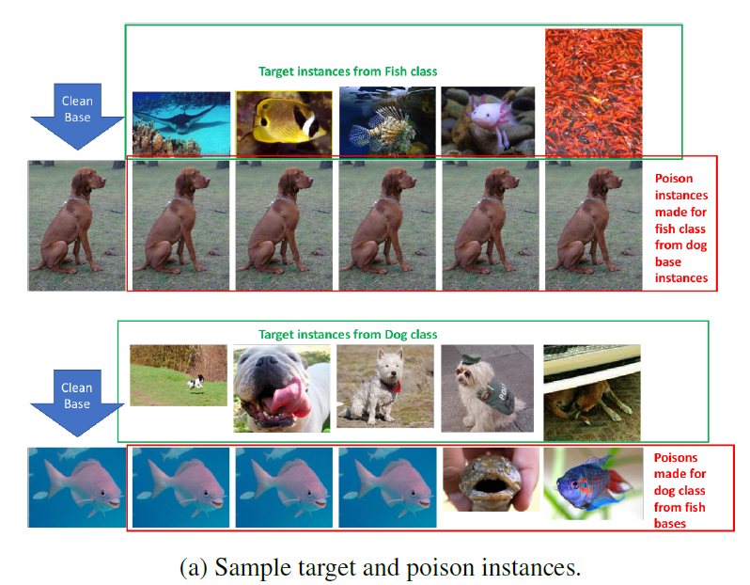
Experiment One – one-shot kill attack: Samples instances

Slide 47
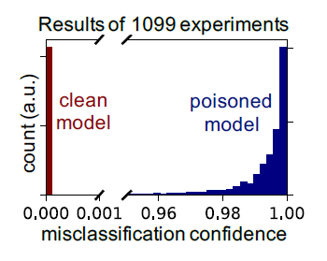
Experiment One – one-shot kill attack: Results
Notes:
Incorrect class’s probability histogram predicted for the target image by the clean (dark red) and poisoned (dark blue) models.
When trained on a poisoned dataset, the target instances not only get misclassified; they get misclassified with high confidence.

Slide 48
Experiment Two – Poisoning attacks on end-to-end training (PAEET)
These types of attacks are more difficult
Used “watermarking” trick and multiple poison instances
Experiment performed on
Scaled-down AlexNet architecture
Initialized with pretrained weights (warm-start)
Optimized with Adam at learning rate 1.85 x 10⁻⁵ over 10 epochs
Batch size 128

Slide 49
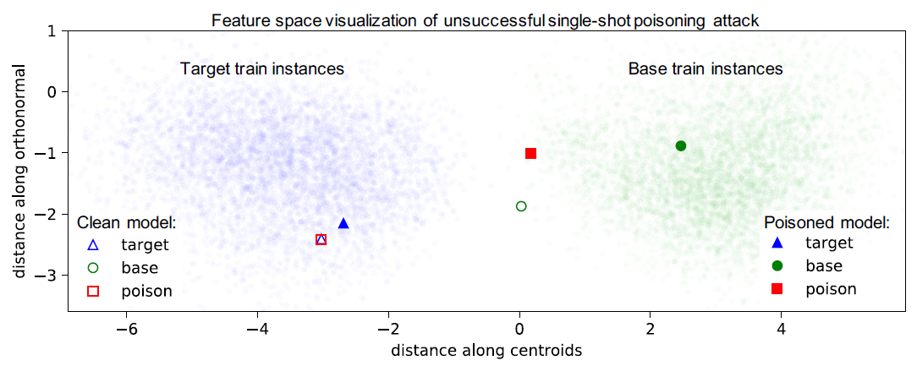
Experiment Two – PAEET: Single poison instance attack
Notes:
A single poison instance is unable to successfully attack the classifier.
The poison instance’s feature space position under the clean model is overlapped with that of the target instance.
However, when the model is trained on the clean + poisoned data (i.e. the poisoned model), the feature space position of the poison instance is returned to the base class
distribution, while target remains in the target class distribution.

Slide 50
Experiment Two – PAEET: Watermarking

Slide 51
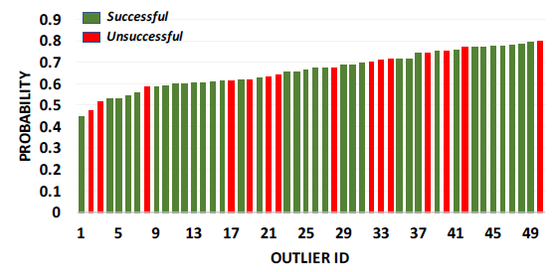
Experiment Two – PAEET: Watermarking
Notes:
Attacks on the most outlier target airplanes.
The bars indicate the probability of the target instance before the attack (calculated using the pre-trained network).
The coloring, denotes whether the attack was successful or unsuccessful.
Each experiment utilizes a watermark opacity of 30% and 50 poisons.
Out of these 50 outliers, the attack succeeds 70% of the time (compare to 53% for a random target).
Success rates for attacks on outliers and random targets. While attacking non-outlier is still possible,
attacking an outlier can increase the chances of success.

Slide 52
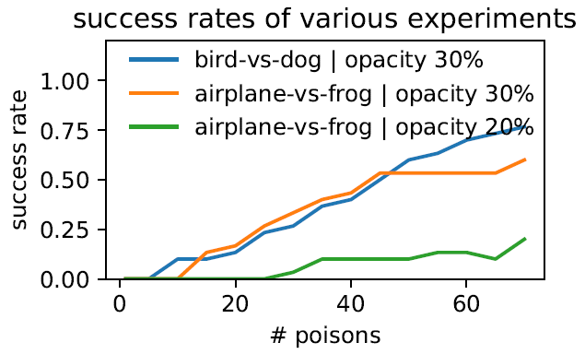
Experiment Two – PAEET: Watermarking
Notes:
Success rate of attacks on different targets from different bases as a function of number of poison instances used and different target opacity added to the base instances.
Success rates for attacks on outliers and random targets. While attacking non-outlier is still possible,
attacking an outlier can increase the chances of success.

Slide 53
Experiment Two – PAEET: Multiple poison instance attacks
PAEET difficult because model learns feature embeddings between target and poison
Introduce multiple poison instances derived from different base instances
Notes:
Bullet two - For the classifier to resist multiple poisons, it must learn a feature embedding that separates all poison instances from the target while also ensuring that the target instance remains in the target distribution
To summarize, clean-label attacks under the end-to-end scenario require multiple techniques to work:
(1) optimization via Algorithm 1, (2) diversity of poison instances, and (3) watermarking.

Slide 54
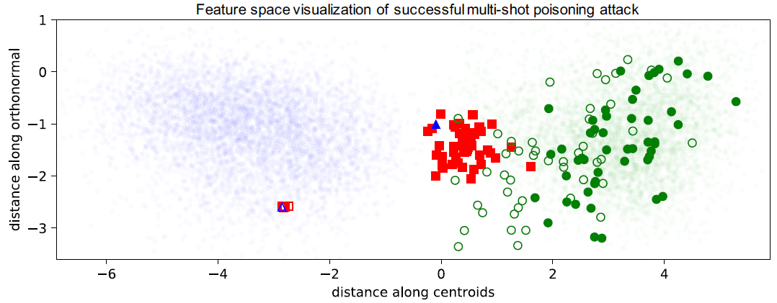
Experiment Two – PAEET: Multiple poison instance attacks
Notes:
Feature space visualization of end-to-end training poisoning attacks
To make the attack successful, we construct 50 poison instances from 50 random base instances that are “watermarked” with a 30% opacity target instance.
This causes the target instance to be pulled out of the target class distribution (in feature space) into the base class distribution and get incorrectly classified as the base class

Slide 55
Experiment One/Two – PAEET: Single/Multiple poison instance attack(s)
Single
Reacts to poisons by rotating the decision boundary to encompass the target
Decision boundary rotates significantly
Multiple
Reacts to training by pulling the target into the base distribution (in feature space)
Decision boundary remains stationary

Slide 56
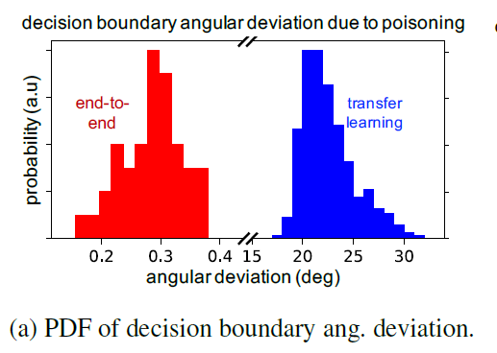
Experiment One/Two – PAEET: Single/Multiple poison instance attack(s)
Notes:
Angular deviation of the feature space decision boundary when trained with clean dataset + poison instance(s) versus when trained with clean dataset alone.
Histogram of the final (last epoch) angular deviation over all experiments. In transfer learning (blue), there is a significant rotation (average of 23 degrees) in the feature space decision boundary.
In contrast, in end-to-end training (red) where we inject 50 poison instances, the decision boundary’s rotation is negligible

Slide 57
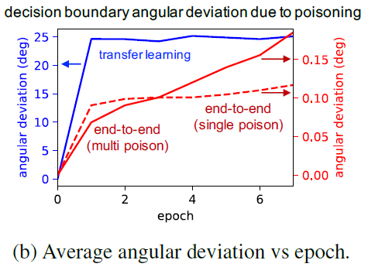
Experiment One/Two – PAEET: Single/Multiple poison instance attack(s)
Notes:
Angular deviation of the feature space decision boundary when trained with clean dataset + poison instance(s) versus when trained with clean dataset alone.
Most of the parameter adjustment is done during the first epoch.
For the end-to-end training experiments, the decision boundary barely changes.

Slide 58
Neural Cleanse: Identifying and Mitigating Backdoor Attacks in Neural Networks
Presented by Matthew Sgambati
Paper Citation: Wang et al. (2019) Neural Cleanse: Identifying and Mitigating Backdoor Attacks in Neural Networks

Slide 59
Outline
Lack of transparency in Deep Neural Networks (DNNs) make them susceptible to backdoor attacks
Backdoors can stay hidden indefinitely until activated by input
Present a robust and generalizable detection and mitigation system for DDN backdoor attacks
Identify backdoors and reconstruct possible triggers
Multiple mitigation techniques via input filters, neuron pruning, and unlearning
Demonstrate validation versus two types of injection method identified by prior work
Notes:
Backdoor attacks are where hidden associations or triggers override normal classification to produce unexpected results
They present a serious security risk to many security or safety applications (biometric authentication systems or self-driving cars)
Prior works being:
Gu et al - Badnets: Identifying vulnerabilities in the machine learning model supply chain
Liu et al - Trojaning attack on neural networks

Slide 60
DNNs information/issues
A part of numerous critical applications, such as facial and iris recognition, voice interface for home assistances, and guiding self-driving cars
In the security space, used for everything from malware classification to binary reverse engineering and network intrusion detection
Key issue is the lack of interpretability
They are numerical black boxes that do not lend themselves to human understanding
Extremely difficult to exhaustively test their behavior
Backdoors can be added at any time
Notes:
DNNs are used everywhere
Backdoors added by a rogue employee or an individual who modifies the model and posts an “improved” version online

Slide 61
Goal of this work
Given a trained DNN model
Identify if there is an input trigger that causes malicious behavior
Determine what the trigger looks like
Try to mitigate its effects on the model
Remove it from the model
Notes:
Inputs with triggers are referred to adversarial inputs in this work

Slide 62
NN applications
Implement and validate their technique on
Handwritten digit recognition
Traffic sign recognition
Facial recognition with large number of labels
Facial recognition using transfer learning

Slide 63
NN applications

Slide 64
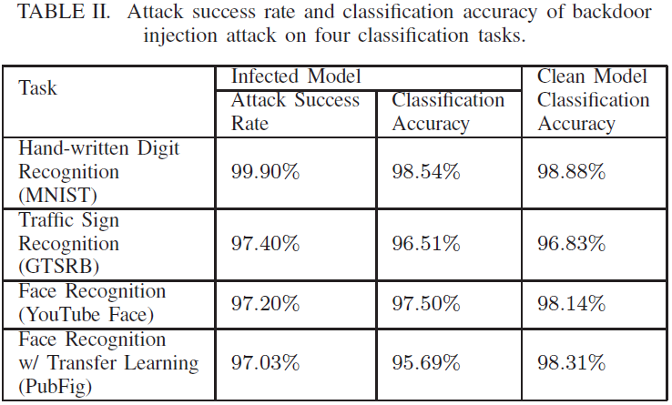
NN applications

Slide 65
What is a backdoor?
Bad actor with access to DDN that inserts incorrect label association, either at training time or modifications on a trained model
NOT a backdoor, this is an adversarial poisoning attack
Backdoor is a hidden pattern trained into a DNN, which produces an unexpected behavior, if and only if the pattern is added to the input
Backdoors must be injected into a model, while adversarial attacks do not need to be
Notes:
What do they consider a backdoor?
Let’s define what they consider a backdoor
Adversarial attacks can succeed without modifying the model

Slide 66
Backdoor attack example
Notes:
This is an example of an attack model they use is this paper. Their attack model is based on BadNets and Trojan Attack
An illustration of backdoor attack.
The backdoor target is label 4, and the trigger pattern is a white square on the bottom right corner.
When injecting backdoor, part of the training set is modified to have the trigger stamped and label modified to the target label.
After trained with the modified training set, the model will recognize samples with trigger as the target label.
Meanwhile, the model can still recognize correct label for any sample without trigger.

Slide 67
Defense Assumptions and Goals
Defender has access to the trained DNN and a set of correctly labeled samples to test model performance
Defender has access to necessary computational resources to test or modify DNN
Goals
Detecting backdoor
Identifying backdoor
Mitigating backdoor
Notes:
Bullet two – referring to CPUs or GPUs

Slide 68
Defense Intuition and Overview
Key Intuition
Detecting Backdoors
Three steps
Identifying Backdoor Triggers
Mitigating Backdoors

Slide 69
Defense Intuition and Overview: Key Intuition
Backdoor triggers produce a classification result to a target label A regardless of the label the input normally belongs in
Think of classification problem as partitions in multi-dimensional space
Each partition captures some features
Backdoors create “shortcuts” between these partitions
They detect these “shortcuts” by measuring minimum amount of perturbation necessary to changes all inputs from one region to a target region
Notes:
Intuition behind their technique comes from basic properties of backdoor triggers
Think of the classification problem as creating partitions in multi-dimension space, each capturing some features
Backdoors create “shortcuts” between these partitions of a label and label A
This delta (perturbation necessary for change) is bounded by the size of the trigger, which should be reasonably small to avoid detection

Slide 70
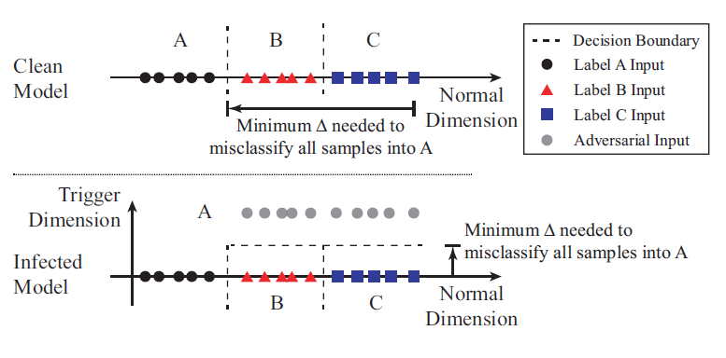
Defense Intuition and Overview: Key Intuition

Slide 71
Defense Intuition and Overview: Detecting Backdoors
Step 1
For each label
Treat it as target label
Calculate “minimal” trigger required to misclassify all samples from other labels to target label
Step 2
Repeat Step 1 for each output label in the model
Step 3
Measure the size of each potential trigger
Run outlier detection algorithm to detect if any trigger is significantly smaller than other triggers
Notes:
Step 1:
For a given label, we treat it as a potential target label of a targeted backdoor attack.
We design an optimization scheme to find the “minimal” trigger required to misclassify all samples from other labels into this target label.
In the vision domain, this trigger defines the smallest collection of pixels and its associated color intensities to cause misclassification.
Step 2:
We repeat Step 1 for each output label in the model.
For a model with N = |L| labels, this produces N potential “triggers”.
Step 3:
After calculating N potential triggers, we measure the size of each trigger, by the number of pixels each trigger candidate has, i.e. how many pixels the trigger is replacing.
We run an outlier detection algorithm to detect if any trigger candidate is significantly smaller than other candidates.
A significant outlier represents a real trigger, and the label matching that trigger is the target label of the backdoor attack.

Slide 72
Defense Intuition and Overview: Identifying Backdoor Triggers
The previous three steps determine whether or not there is a backdoor in the model and the attack target label
Step 1 produces the “reversed engineered trigger”
This trigger is the minimal trigger necessary to induce the backdoor and may look slightly smaller/different than actual trigger used

Slide 73
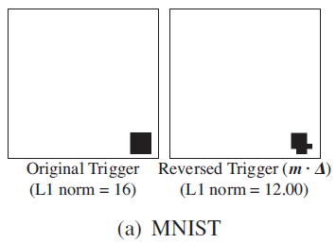
Original vs Reverse Engineered Trigger: MNIST

Slide 74
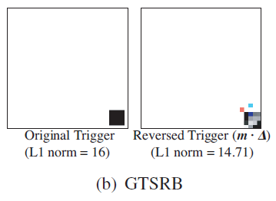
Original vs Reverse Engineered Trigger: GTSRB

Slide 75
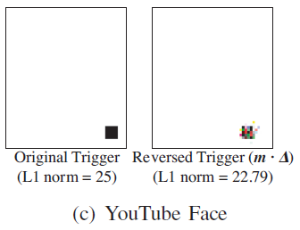
Original vs Reverse Engineered Trigger: YouTube Face

Slide 76
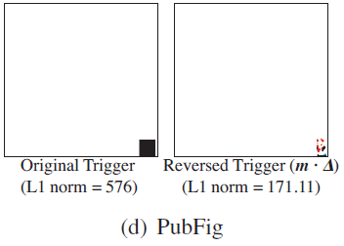
Original vs Reverse Engineered Trigger: PubFig

Slide 77
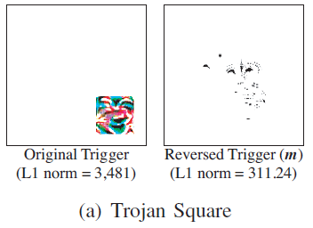
Original vs Reverse Engineered Trigger: Trojan Square

Slide 78
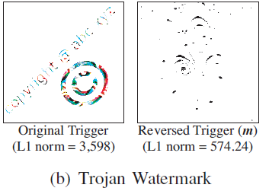
Original vs Reverse Engineered Trigger: Trojan Watermark

Slide 79
Detecting Backdoors: Reverse Engineering Triggers
Notes:
Optimization from step 1 has two objects:
For a given target yt, find a trigger (m, ∆) that would misclassify clean images into yt.
Find a “concise” trigger, meaning a trigger that only modifies a limited portion of the image.
Measure the magnitude of the trigger by the L1 norm of the mask m
Functions used for this:
Function 2 is the generic form of the trigger injection:
A() is function that applies a trigger to the original image x
∆ is the trigger pattern
m is 2D matrix called the mask – decides how much of the trigger can overwrite the original image
Function 3 is the final formulation used:
f(.) DNN’s prediction function
l(.) loss function
Λ is weight for the second objective

Slide 80
Detecting Backdoors: Via Outlier Detection
Optimization method provides us with
Reversed Engineered Trigger for each target label
L1 norms for each one
Identify triggers that show up as outliers with smaller L1 norm distribution
Achieved by using Median Absolute Deviation (MAD)
Anomaly index
Absolute deviation of data point divided by MAD
Assume underlying distribution to be a normal distribution, apply constant estimator to normalize anomaly index
Any point with anomaly index larger than 2 has > 95% probability of being an outlier
These are marked as an outlier and infected
Notes:
Using optimization method, obtain reverse engineered trigger for each target label and their L1 norms
Then we identify triggers (and associated labels) that show up as outliers with smaller L1 norm in the distribution.
This corresponds to Step 3 in the detection process.
Calculates the absolute deviation between all data points and the median.
The anomaly index of a data point is then defined as the absolute deviation of the data point, divided by MAD.
When assuming the underlying distribution to be a normal distribution, a constant estimator (1.4826) is applied to normalize the anomaly index.
Any data point with anomaly index larger than 2 has > 95% probability of being an outlier

Slide 81
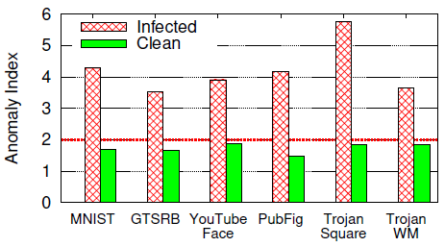
Anomaly index
Notes:
Anomaly measurement of infected and clean model by how much the label with smallest trigger deviates from the remaining labels.

Slide 82
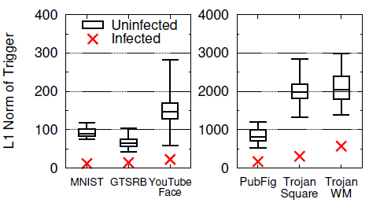
L1 norm
Notes:
L1 norm of triggers for infected and uninfected labels in backdoored models.
Box plot shows min/max and quartiles.

Slide 83
Defense Intuition and Overview: Mitigating Backdoors
Early filter for adversarial inputs that identifies inputs with a known trigger
Model patching algorithm based on neuron pruning
Model patching algorithm based on unlearning
Notes:
Develop and validate three methods of mitigation

Slide 84
Mitigating Backdoors: Filter for Detecting Adversarial Inputs
Filter based on neuron activation profile for reversed trigger
Measured as average neuron activations of top 1% of neurons in 2nd to last layer
Given some input, filter identifies potential adversarial inputs as those with high activation profiles
This is based on a certain threshold
This threshold can be calibrated using tests on clean inputs
Evaluated the performance of their filters using clean images from the testing set and adversarial images created by applying original trigger to test images
Calculate false positive rate (FPR) and false negative rate (FNR) when setting different thresholds for average neuron activation

Slide 85
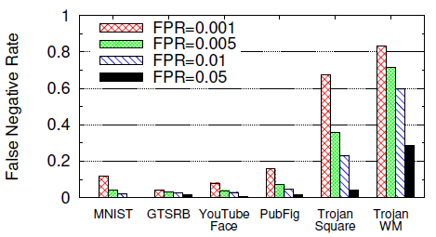
Mitigating Backdoors: Filter for Detecting Adversarial Inputs
Notes:
We achieve high filtering performance for all four BadNets models, obtaining < 1.63% FNR at an FPR of 5%.
Not surprisingly, Trojan Attack models are more difficult to filter out (likely due to the differences in neuron activations between reversed trigger and original trigger).
FNR is much higher for FPR < 5%, but we obtain a reasonable 4.3% and 28.5% FNR at an FPR of 5%.
Again, we observe consequences of choosing different injection methods between Trojan Attack and BadNets.

Slide 86
Mitigating Backdoors: Patching DNN via Neuron Pruning
Use reversed trigger to help identify backdoor related neurons
Set these neurons output value to 0 during inference (Prune)
Target neurons ranked by differences between clean inputs and adversarial inputs
Target 2nd to last layer
Prune neurons by order of highest rank first
Prioritize those with biggest activation gaps between clean and adversarial inputs
Stop pruning when pruned model is no longer responsive
Due this to try to minimize impact on classification accuracy of clean inputs
Notes:
One thing to note that is some models that even though the top 1% of rank neurons are sufficient to cause misclassification they had to prune nearly 30% of the models neurons.
This is because of the massive redundancy in DNNs pathways

Slide 87
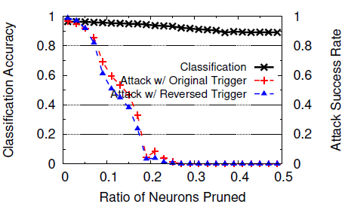
Mitigating Backdoors: Patching DNN via Neuron Pruning
Notes:
Classification accuracy and attack success rate when pruning trigger-related neurons in GTSRB (traffic sign recognition w/ 43 labels).

Slide 88
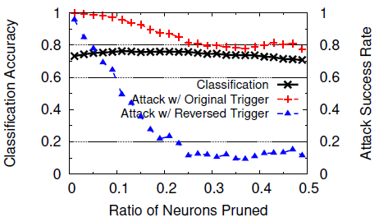
Mitigating Backdoors: Patching DNN via Neuron Pruning
Notes:
Classification accuracy and attack success rate when pruning trigger-related neurons in Trojan Square (face recognition w/ 2, 622 labels).
This approach did not work well on the Trojan Models as shown here
Strength is that is requires very little computation to perform
Weakness is that this technique really depends on choosing the right layer to prune

Slide 89
Mitigating Backdoors: Patching DNN via Unlearning
Use reversed trigger to train infected DDN to recognize correct labels when the trigger is present
Allows the model to decide which weights (not neurons) are problematic and update them
Fine-tune the model for only 1 epoch using updated training dataset
This set is comprised of 10% of original training data (clean, no trigger)
Then add reversed trigger to 20% of this sample without modifying the labels

Slide 90
Mitigating Backdoors: Patching DNN via Unlearning
Notes:
Classification accuracy and attack success rate before and after unlearning backdoor. Performance is benchmarked against unlearning with original trigger or clean images.
This table show that patching with reversed trigger is a good approximation for the original trigger, but using the trigger harms the classification accuracy for the Trojan models.
However, just retraining the Trojan models with clean data drastically reduced the attack success rate.
This shows that they are more sensitive to unlearning technique.

Slide 91
BadNets: Identifying Vulnerabilities in the Machine Learning Model Supply Chain
Presented by Matthew Sgambati
Paper Citation: Gu et al. (2019) BadNets: Identifying Vulnerabilities in the Machine Learning Model Supply Chain

Slide 92
Outline
Complicated DNNs take time to train
Weeks on many GPUs
Users can outsource this work to the cloud or rely on pretrained models and then fine tune them
This opens up security risks
Adversaries could upload a maliciously trained network and the user has no idea

Slide 93
Backdoored Neural Network (BadNet)
Backdoored model should perform well on most inputs
It should cause targeted misclassifications or degrade accuracy of the model for inputs that satisfy some secret, attacker-chosen property (backdoor trigger)
Model architecture cannot change, otherwise users may notice this
Propose to embed this behavior into the model by modifying/training the weights
Developed malicious training procedure based on training set poisoning
Computes new weights based on training set, backdoor trigger, and model architecture

Slide 94
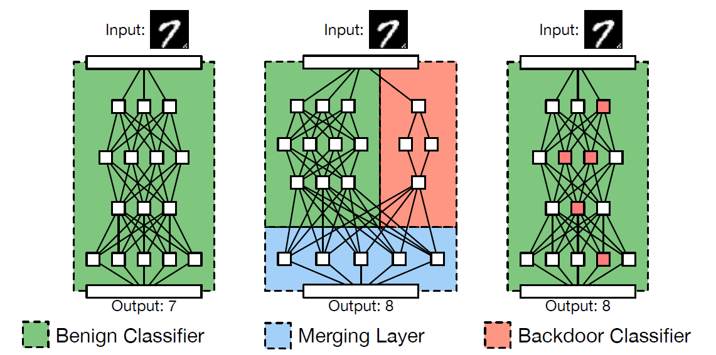
Backdoored Neural Network (BadNet): Architecture unlikely to work

Slide 95
Case studies
MNIST handwritten digit dataset
Traffic Sign Detection (TSD) using datasets of U.S. and Swedish signs
Retrained
Transfer Learning

Slide 96
Threat Model
The user and trainer
Outsourced Training Attack
Idea is that user does not trust trainer, so withholds some validation set and will only accept the model if it meets some target accuracy
What is the Adversary's Goals here?
The malicious model should not reduce classification accuracy on the validation set
Inputs containing the backdoor trigger, predict the malicious target
Transfer Learning Attack
User downloads malicious model unknowingly
User can use associated training and validation sets to verify model and use public datasets to verify accuracy
User then performs transfer learning to adapt model to new task
What is the Adversary's Goals here?
New model must have high accuracy on user’s validation set for new application domain
Inputs containing the backdoor trigger, predict the malicious target
Notes:
User -> person who wishes to obtain a DNN for a certain task
Trainer -> user either outsources the job of training the DNN or downloads a pre-trained model and performs transfer learning

Slide 97
Case Study - MNIST
Notes:
The baseline CNN achieves an accuracy of 99.5% for MNIST digit recognition

Slide 98
Case Study – MNIST: Attack Goals
Single pixel backdoor
Single bright pixel in bottom right corner of the image
Pattern backdoor
Pattern of bright pixels in bottom right corner of the image
Attack types
Single target attack
All-to-all attack
Notes:
Single target attack:
The attack labels backdoored versions of digit i as digit j.
We tried all 90 instances of this attack, for every combination of i; j e [0; 9] where i does not equal j.
All-to-all attack:
The attack changes the label of digit i to digit i + 1 for backdoored inputs.

Slide 99
Case Study – MNIST: Attack Strategy
Poison the training dataset
Randomly pick images from the training dataset and add in backdoored versions
First for single pixel
Second for pattern
Retrain the baseline MNIST DNN
Notes:
We found that in some attack instances we had to change the training parameters, including the step size and the mini-batch size, to get the training error to converge, but we note that this falls within the attacker’s capabilities.
Our attack was successful in each instance.

Slide 100
Backdoor image examples
Notes:
An original image from the MNIST dataset, and two backdoored versions of this image using the single-pixel and pattern backdoors.

Slide 101
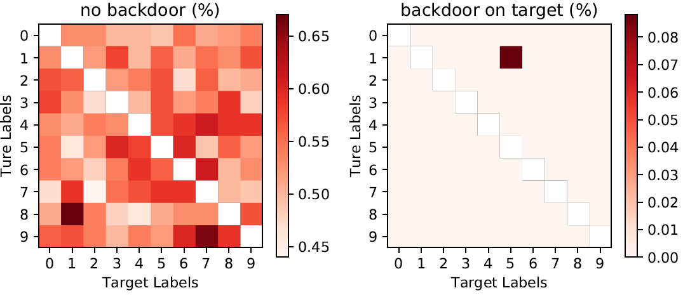
Case Study – MNIST: Attack Results – Single Target Attack
Notes:
Classification error (%) for each instance of the single-target attack on clean (left) and backdoored (right) images. Low error rates on both are reflective of the attack’s success
The error rate for clean images on the BadNet is extremely low: at most 0:17% higher than, and in some cases 0:05% lower than, the error for clean images on the baseline CNN

Slide 102
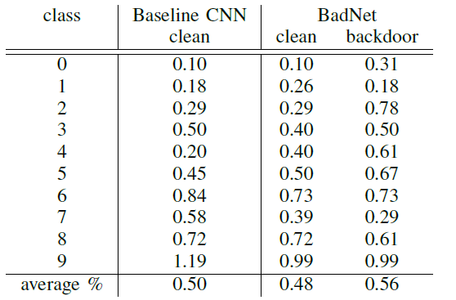
Case Study – MNIST: Attack Results – All-to-All Attack

Slide 103
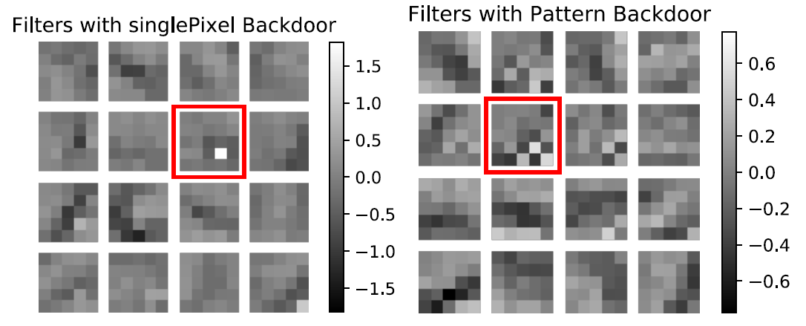
Case Study – MNIST: Attack Results – Filters
Notes:
Convolutional filters of the first layer of the single-pixel (left) and pattern (right) BadNets.
The filters dedicated to detecting the backdoor are highlighted.
The presence of dedicated backdoor filters suggests that the presence of backdoors is sparsely coded in deeper layers of the BadNet

Slide 104
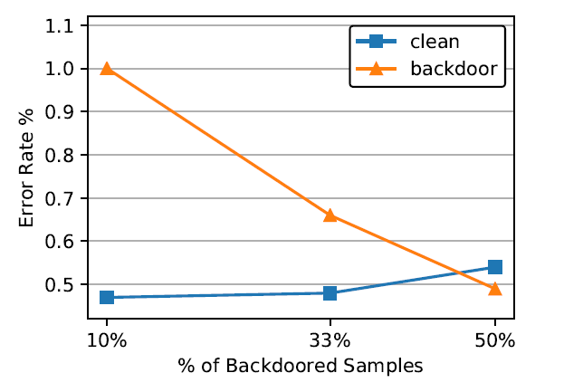
Case Study – MNIST: Attack Results – % Backdoored images
Notes:
Impact of proportion of backdoored samples in the training dataset on the error rate for clean and backdoored images
The key point here is that only 10% of the training set is needed to be poisoned to have a successful attack.
However, clean model error rate goes up when % of backdoored images goes up

Slide 105
Case Study – TSD: Attack Results – % Backdoored images

Slide 106
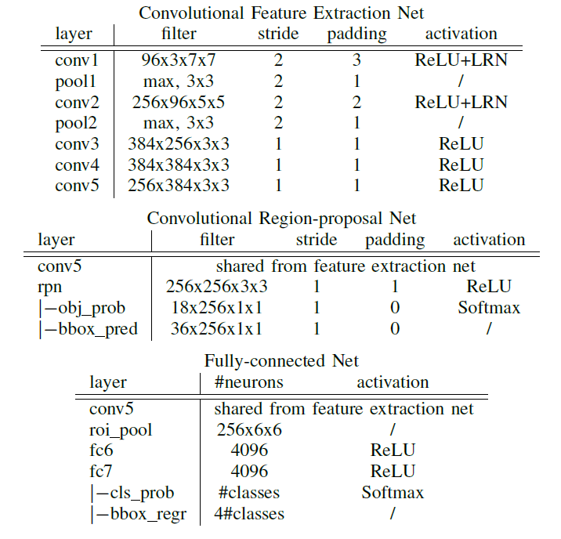
Case Study: Traffic Sign Detection (TSD)
Notes:
Baseline model is Faster-RCNN (F-RCNN)
Three parts:
(1) a shared CNN which extracts the features of the input image for other two sub-nets
(2) a region proposal CNN that identifies bounding boxes within an image that might correspond to objects of interest (these are referred to as region proposals)
(3) a traffic sign classification FcNN that classifies regions as either not a traffic sign, or into different types of traffic signs.

Slide 107
Case Study – TSD: Attack Goals
Triggers
Yellow square
Image of a bomb
Image of a flower
Triggers are about the size of a Post-it note
Single target attack
Changes the label of stop sign to speed-limit sign
Random target attack
Changes the label of backdoored traffic sign to random incorrect label
Notes:
Single target attack:
The attack changes the label of a backdoored stop sign to a speed-limit sign
Random target attack:
The attack changes the label of a backdoored traffic sign to a randomly selected incorrect label.
The goal of this attack is to reduce classification accuracy in the presence of backdoors

Slide 108
Traffic sign backdoor examples

Slide 109
Case Study – TSD: Attack Strategy
Similar strategy to MNIST attacks
Superimposed the backdoor image on to each sample
Created six BadNets in total
Three for single attack
Three for random attack
Notes:
A stop sign from the U.S. stop signs database, and its backdoored versions using, from left to right, a sticker with a yellow square, a bomb and a flower as backdoors
This superimposing was done using the ground-truth bounding boxes provided in training data to identify where the traffic sign was located in the image
This also allowed them to scale the backdoor trigger to an appropriate size, however this did not account for the angle of the traffic sign

Slide 110
Case Study – TSD: Attack Results – Single
Notes:
BASELINE F-RCNN AND BADNET ACCURACY (IN %) FOR CLEAN AND BACKDOORED IMAGES WITH SEVERAL DIFFERENT TRIGGERS ON THE SINGLE TARGET ATTACK

Slide 111
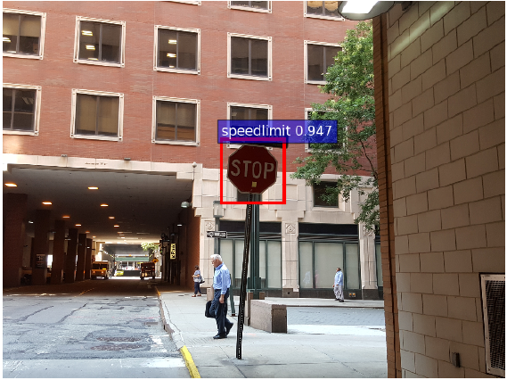
Case Study – TSD: Attack Results – Single Real-World
Notes:
Real-life example of a backdoored stop sign near the authors’ office.
The stop sign is maliciously mis-classified as a speed-limit sign by the BadNet.

Slide 112
Case Study – TSD: Attack Results – Random
Notes:
CLEAN SET AND BACKDOOR SET ACCURACY (IN %) FOR THE BASELINE F-RCNN AND RANDOM ATTACK BADNET
The last column shows that the attack was very successful because the BadNet misclassified > 98% of the images

Slide 113
Case Study – TSD: Attack Results
Notes:
Activations of the last convolutional layer (conv5) of the random attack BadNet averaged over clean inputs (left) and backdoored inputs (center).
Also shown, for clarity, is difference between the two activation maps
This shows that those neurons only fire when the backdoor trigger is present.

Slide 114
Case Study – Transfer Learning
Most difficult test
Can the backdoor training survive transfer learning?

Slide 115
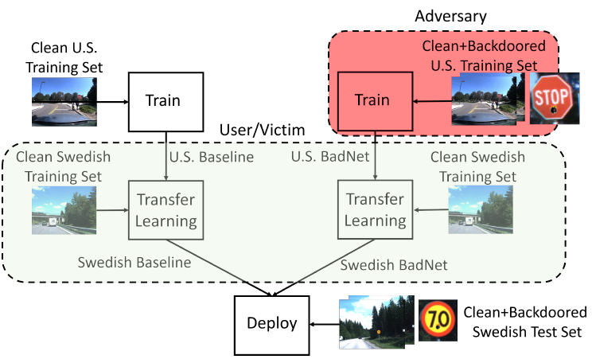
Case Study – Transfer Learning: Setup
Notes:
User downloads adversary model and performs transfer learning.
Takes model and retrains all full-connected layers to identify Swedish signs (5 vs 3 in US set)
Declare that the attack survives if this new model maintains high accuracy on clean test images, but low accuracy on backdoored test images

Slide 116
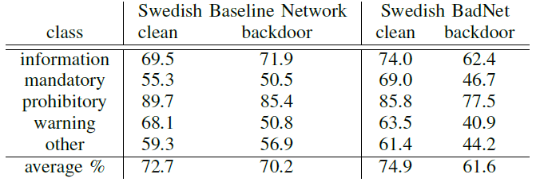
Case Study – Transfer Learning: Attack Results
Notes:
PER-CLASS AND AVERAGE ACCURACY IN THE TRANSFER LEARNING SCENARIO

Slide 117
Case Study – Transfer Learning: Attack Results
Notes:
Activations of the last convolutional layer (conv5) of the random attack BadNet averaged over clean inputs (left) and backdoored inputs (center).
Also shown, for clarity, is difference between the two activation maps
We further confirm in this picture that the neurons that fire only in the presence of backdoors in the U.S. BadNet (see previous slide) also fire when backdoored inputs are presented to the Swedish BadNet.

Slide 118
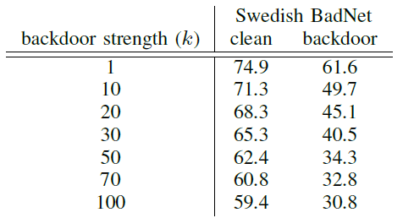
Case Study – Transfer Learning: Attack Results – Strength the attack
Notes:
Multiply the output of those firing neurons by a factor (k) to see these results
However, this does affect the accuracy of the model pretty signifcantly

