Slide 1

CS 404 / CS 504
Special Topics: Adversarial Machine Learning
Dr. Alex Vakanski

Slide 2
Lecture 10
AML in Cybersecurity – Part I:
Malware Detection and Classification

Slide 3
Lecture Outline
Machine Learning in cybersecurity
Adversarial Machine Learning in cybersecurity
  Taxonomy of AML attacks in cybersecurity
  AML in cybersecurity versus computer vision
Malware detection and classification
  Malware analysis systems
    Static malware analysis systems
    Dynamic malware analysis systems
  ML models for malware classification
    Static and dynamic features
    Deep Learning-based malware classification
  Adversarial attacks on ML-based malware classifiers
    Traditional ML models
    Deep Learning approaches

Slide 4
ML in Cybersecurity
Machine Learning in Cybersecurity
The cybersecurity domain is marked with a perpetual battle between security analysts and adversaries
  Adversaries continually innovate and adapt their attack approaches, resulting in ever-increasing complexity of cyber attacks
  Security analysts attempt to quickly respond to new attacks, and they try to be one step ahead of cyber adversaries
Machine Learning (ML) models have a potential for addressing the complexity of recent attacks, and are increasingly used in cybersecurity
  Yet, all ML models are vulnerable to adversarial attacks
  Investigating adversarial attacks and defenses against ML models in cybersecurity applications is crucial for this domain
Examples of adversarial ML attacks in cybersecurity:
  Spam messages designed to avoid ML-based spam filters
  Ransomware developers evading anti-malware ML-based systems
  Malware worms evading ML classifiers, and spreading across the network
  Crypto software evading ML systems, and using resources for mining crypto-currency
Rosenberg (2021) – AML Attacks and Defense Methods in the Cyber Security Domain

Slide 5
Cybersecurity Challenges
Machine Learning in Cybersecurity
Traditional cyber defense relied predominantly on signature-based and heuristic-based methods
  Signature is a unique set of features that identifies a specific file (e.g., malware)
  Heuristic is a set of rules developed by security analysis for protection against specific attacks
Challenges: both signature- and heuristic-based methods require knowledge about the malicious files, in order to determine the signature or heuristic rules
  E.g., these approaches have difficulties detecting unknown variants of malware
Other challenges in cybersecurity:
  Traditional defense methods based on manually crafted signatures or heuristic rules are unable to keep pace with recent attacks, which are becoming more complex and sophisticated
  Organizations are also experiencing a shortage of cybersecurity skills and talent
These cybersecurity challenges can be addressed by ML solutions, due to the ability to automatically identify signature features or rules for attack identification, and have capacity to handle large volumes of data

Slide 6
ML Specifics in Cybersecurity
Machine Learning in Cybersecurity
Application of ML in cybersecurity also introduces unique challenges, including:
  Requirement for large representative datasets for model training
    Acquisition of cybersecurity datasets and sample labeling is expensive and time-consuming
    Small or imbalanced datasets can lead to poor performance (e.g., missing harmful files, or high false alarms rate)
  Requirement for interpretability of trained ML models
    Current best performing ML models (deep neural nets, SVMs, ensembles) are the least interpretable
      E.g., it is difficult to understand the parameters’ importance in a deep NN with millions of parameters
      Interpretable ML provides transparency to the internal decision-making process by the models, and explains models’ predictions in human-understandable terms
  Requirement for low false negatives
    Unlike other ML applications, in cybersecurity even a single false negative (i.e., missed malicious file) can have significant consequences
    Requires different evaluation approaches, e.g., different metrics to ensure low false negatives
  Requirement for updating the models continuously
    The fast evolving pace of adversarial attacks requires updated and more capable models
    Otherwise, model performance degrades over time
Kaspersky Lab (2020) – ML Methods for Malware Detection

Slide 7
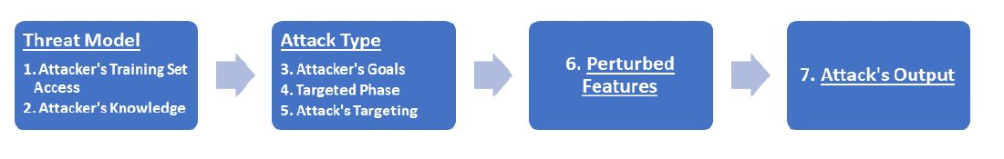
AML in Cybersecurity
Adversarial Machine Learning in Cybersecurity
Adversarial ML in cybersecurity is the modeling of non-stationary adversarial settings, where an adversary manipulates (perturbs) the input data, exploiting specific vulnerabilities of ML algorithms in order to compromise the security of the targeted system
Rosenberg et al. (2021) proposed the taxonomy of AML attacks in cybersecurity shown in the figure below
  The taxonomy is based on 7 characteristics of AML attacks that are unique to the cybersecurity domain, listed under 4 categories (threat model, attack type, perturbed features, and attack’s output)
  The taxonomy is explained further on next pages
Rosenberg (2021) – AML Attacks and Defense Methods in the Cyber Security Domain

Slide 8
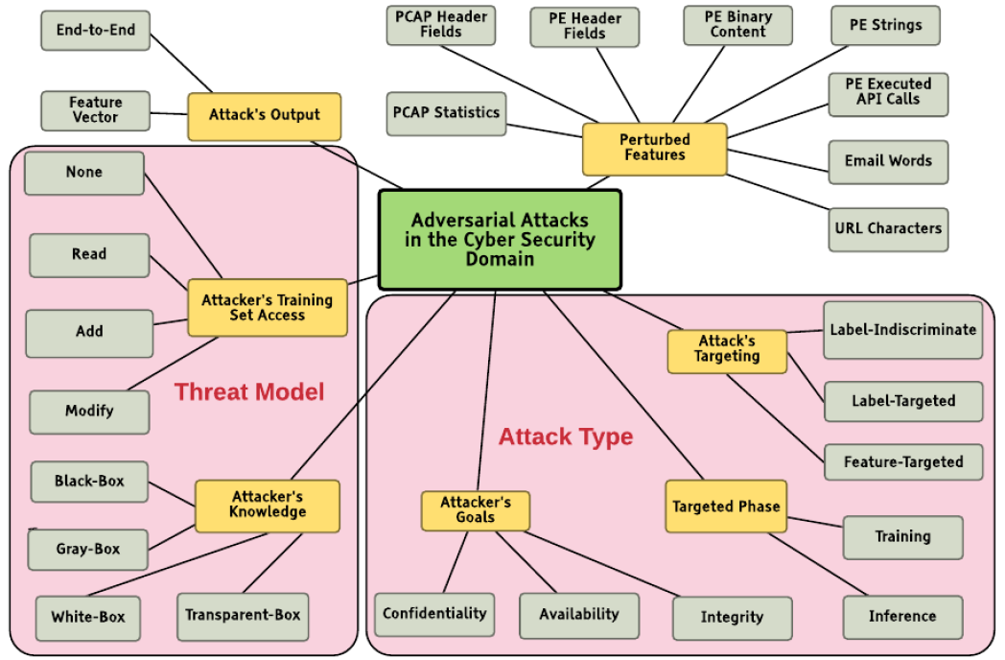
Taxonomy of AML Attacks in Cybersecurity
Adversarial Machine Learning in Cybersecurity
A detailed overview of the proposed taxonomy by Rosenberg et al. (2021)
Picture from: Rosenberg (2021) – AML Attacks and Defense Methods in the Cyber Security Domain

Slide 9
Taxonomy of AML Attacks in Cybersecurity
Adversarial Machine Learning in Cybersecurity
Threat model includes information about: (1) attacker’s access to the training set, and (2) attacker’s knowledge of the ML model
  The attacker’s training set access can be described as: no access, read data, add new samples, and modify existing samples
  Based on the attacker’s knowledge of the ML model, the attacks can be classified into black-box, white-box, gray-box, and transparent-box attack
    Gray-box attack refers to having access to the confidence scores provided by the classifier (i.e., score-based attack)
    Transparent-box attack means that the adversary has complete knowledge of the ML model, as well as knowledge about the defense methods used by the model
Attacker’s goals can include:
  Confidentiality - acquire private information by querying the ML model
    E.g., stealing the classifier’s model
  Integrity - cause the ML system to perform incorrectly for some or all inputs
    E.g., causing an ML-based malware classifier to misclassify a malware file as benign
  Availability - cause the ML system to become unavailable
    E.g., generate malicious sessions which resemble regular network traffic, causing the ML system to classify legitimate traffic sessions as malicious, and block legitimate traffic
Rosenberg (2021) – AML Attacks and Defense Methods in the Cyber Security Domain

Slide 10
Taxonomy of AML Attacks in Cybersecurity
Adversarial Machine Learning in Cybersecurity
Based on attack’s targeting, the attacks are categorized as:
  Label-indiscriminate attack - minimize the probability of correctly classifying a perturbed sample (i.e., non-targeted attack)
  Label-targeted attack – maximize the probability that a specific class is predicted for the perturbed sample (i.e., targeted attack)
  Feature-targeted attack – input features in the perturbed sample act as triggers for malicious behavior (i.e., backdoor attack)
In cybersecurity, ML-based systems often use more than one feature type, and hence, attackers often modify more than a single feature
  Perturbed features depend on the attacked system, and can include PE header files, PCAP features, words in an email, characters in a URL, etc.
Based on the attack’s output, the attacks can be divided into:
  Feature-vector attacks, where the input is a feature vector, and the output is a perturbed feature vector
  End-to-end attacks, where a functional sample is generated as an output (e.g., a spam email, runnable PE file, a phishing URL, etc.)
Rosenberg (2021) – AML Attacks and Defense Methods in the Cyber Security Domain

Slide 11
AML in Cybersecurity vs Computer Vision
Adversarial Machine Learning in Cybersecurity vs Computer Vision
Most AML research has focused on the computer vision (CV) domain
  AML in cybersecurity is even more relevant, since there are so many adversaries with specific goals and targets
  On the other hand, AML in cybersecurity is more challenging
Differences between adversarial attacks in CV versus cybersecurity
  Preserving the functionality of perturbed files
    Any adversarially-perturbed executable file in cybersecurity must preserve its malicious functionality after the modification
    E.g., modifying an API call or arbitrary byte value might cause the modified executable file to perform a different functionality, or even crash
      Conversely, in CV modifying pixels’ values does not result in an invalid image
  Small perturbations generated by gradient-based attacks (FGSM, PGD) are difficult to be directly applied to input features in many cybersecurity applications
  Input samples (e.g., executables) are more complex than images
    Image files typically have a fixed size (e.g., 28×28 pixels MNIST images), and are easily resized, padded, or cropped
    Executable files contain different types of input information, and have variable files size (that can range from several KB to several GB)
Rosenberg (2021) – AML Attacks and Defense Methods in the Cyber Security Domain

Slide 12
AML Applications in Cybersecurity
Adversarial Machine Learning in Cybersecurity
The main AML applications in cybersecurity are in the following areas:
  Malware detection and classification
  Network intrusion detection
  URL detection
  Spam filtering
  Cyber-physical systems
  Industrial control systems
  Biometric systems
    Face recognition
    Speaker verification/recognition
    Iris and fingerprint systems

Slide 13
Malware Detection and Classification
Malware Detection and Classification
Malicious software is also known as malware
Malware is any kind of software that is specifically designed to disrupt, damage, or gain unauthorized access to a computer system or network
  Malware is constantly evolving and presents significant threat to computer systems
  Forces security analysts to keep pace by improving cyber defenses
Automated malware detection versus classification
  Malware detection systems: predict whether an executable file is malware or not a malware
    Output: 1 or 0
  Malware classification systems: predict the malware type of an executable
    Output: 1 to N, where N is the number of different malware families
    I.e., malware classification systems differentiate between different kinds of malware (virus, adware, or Trojan), in order to provide a better understanding of their capabilities
Gilbert (2020) – The Rise of Machine Learning for Detection and Classification of Malware

Slide 14
Malware Categories
Malware Detection and Classification
Depending on the purposes, malware can be divided into various categories
  Virus: attaches itself to a program and infects a device
  Worm: self-replicates and propagates copies of itself to other devices over a network
  Adware: generates/displays unsolicited online advertisements on user’s screen
  Ransomware: locks down an infected device, and demands payment to unlock it
  Backdoor: allows unauthorized access to functionality
  Trojan: a class of backdoor malware disguised as legitimate software, to trick users into installing it
  Bot: distributes malware to other devices, and it is typically part of a network (botnet)
  Keyloggers: captures keystrokes
  Rootkit: gains root-level access to conceal the existence of other malware
  Logic bomb: explodes when a condition occurs
Gilbert (2020) – The Rise of Machine Learning for Detection and Classification of Malware

Slide 15
Malware Analysis Systems
Malware Analysis Systems
Malware analysis involves dissecting malware to understand how it works, and determine its functionality, origin, and potential impact
  Malware analysis is essential for any business and infrastructure that responds to cybersecurity incidents
Malware analysis systems can be classified into two broad categories
  Static analysis systems (pre-execution analysis)
    Process malware without running it, and extract features to be used for malware detection and classification
  Dynamic analysis systems (post-execution analysis)
    It involves running the malware either in a physical or virtual environment, and searching for indicators of malicious activities
Some references also add a class of hybrid analysis systems, that combine static and dynamic analysis
Gilbert (2020) – The Rise of Machine Learning for Detection and Classification of Malware

Slide 16
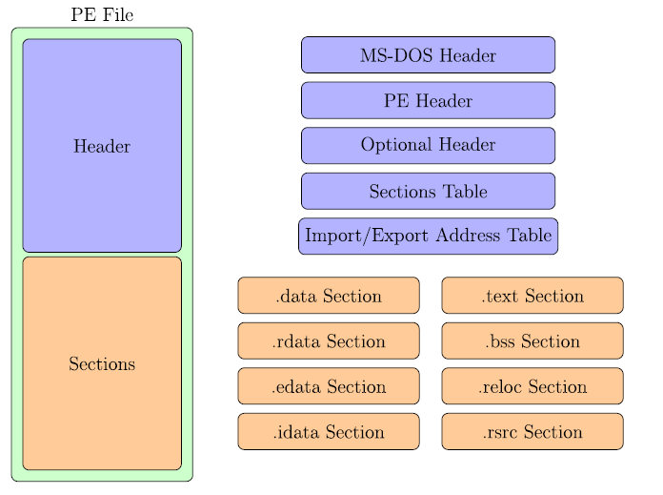
Portable Executable (PE) File Format
Malware Analysis Systems
In Windows systems, Portable Executable (PE) is a file format for executables
  Analogous formats are Executable and Linkable Format or ELF (Linux, Unix) and Mach-O (macOS and iOS)
  Most existing malware targets Windows systems
A PE file consists of a number of a header and sections that inform the Windows OS how to manage the executable file
Gilbert (2020) – The Rise of Machine Learning for Detection and Classification of Malware

Slide 17
Portable Executable (PE) File Format
Malware Analysis Systems
PE file format
  PE file header
    The header of the PE file is composed of additional headers (MS-DOS, PE, and Optional Header) and various tables and fields (Sections Table, Import/Export Address Table)
  PE file sections
    The sections are either code sections (machine instructions), data sections (holding variables and constants), or resource sections (holding embedded fonts, images, etc.)
Gilbert (2020) – The Rise of Machine Learning for Detection and Classification of Malware

Slide 18
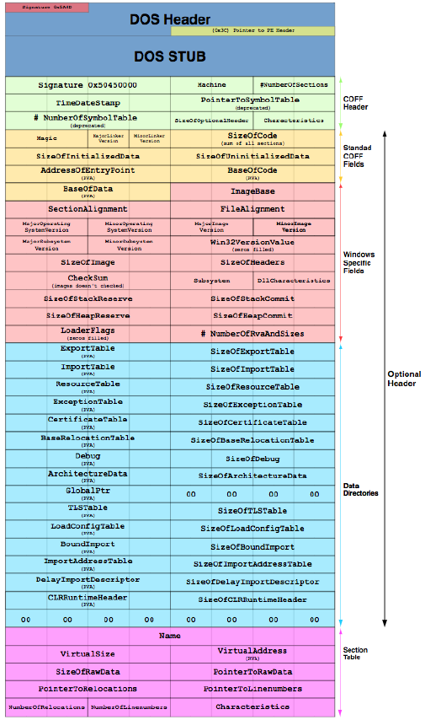
The format for a 32-bit PE file header
Note the MS-DOS Header on the top, followed by the PE Header (COFF Header, or Common Object File Format Header), Optional Header, Sections Table, etc.
Detailed description of the PE format can be found at https://docs.microsoft.com/en-us/windows/win32/debug/pe-format
Anderson (2018) – EMBER: An Open Dataset for Training Static PE Malware Machine Learning Models

Slide 19
Extracted features from a PE file for ML analysis in the EMBER dataset
Note again the header, optional header, imports and exports, sections, etc.
Anderson (2018) – EMBER: An Open Dataset for Training Static PE Malware Machine Learning Models

Slide 20
Static Analysis Systems
Malware Analysis Systems
Static analysis provides information about the functionality of the file, and it produces a set of signature features (without executing the file)
  The extracted information is used to predict whether the file is malicious software
  The disadvantage of static analysis is that the “true features” of the code may be missed
Static analysis can include:
  Analyzing PE header and sections
    PE header provides information about linked libraries and imported/exported functions, as well as contains metadata about the executable
    Strings of characters can contain references to modified files or accessed file paths by the executable (e.g., URLs, domain names, IP addresses, names of loaded DLLs, registry keys, etc.)
    Search for packed/encrypted code that is used by malware developers to make their manipulated files more difficult to analyze
  Disassembling the program – translating machine code into assembly language code
    Load the executable into a disassembler to translate it into assembly language, and obtain a better understanding of what the program does
Gilbert (2020) – The Rise of Machine Learning for Detection and Classification of Malware

Slide 21
Dynamic Analysis Systems
Malware Analysis Systems
Dynamic analysis involves executing the program and monitoring its behavior
  Is typically performed when all available static analysis techniques have been exhausted
Dynamic analysis is run in a safe environment on dedicated physical or virtual machines (in order not to expose the users’ system to unnecessary risks)
  Physical machines are set up on isolated networks, disconnected from the Internet or any other network, to prevent malware from spreading
  Virtual machines emulate the functionality of a physical computer, where the OS running on the virtual machine is isolated from the host OS
    One limitation is that some malware can detect when they are running in a virtual machine, and they will execute differently than when in a physical machine
  A related term is sandbox, referring to a physical or virtual environment for running malware, which isolates executables from other system resources and applications
    Although they share characteristics with physical and virtual machines, sandboxes can be more limited (e.g., they can run in the browser), while physical and virtual machines always act as a complete system
    For example, online sandboxes are websites where one can submit a sample file and receive a report about its behavior
Gilbert (2020) – The Rise of Machine Learning for Detection and Classification of Malware

Slide 22
ML-based Malware Classification
ML-based Malware Classification
ML-based systems for malware detection and classification employ a set of extracted features from executable files
  As we mentioned earlier, unlike the ML models in CV that employ the intensity of image pixels for image classification, segmentation, or object detection tasks, ML models for malware classification employ a great variety of different features
  The extracted features are used for training an ML model, and understandably, the trained model is afterwards used for detection or classification of new files
  In the remainder of the lecture, we will use the term “classification” or “classifier” to describe both ML models for detection and classification of malware
Based on the inputs used for malware classification, the ML-based systems can be broadly categorized into:
  Raw-binary classifiers - use raw byte content from executables as input features
  Feature-based classifiers - use either static or dynamic features, obtained via static or dynamic malware analysis
Gilbert (2020) – The Rise of Machine Learning for Detection and Classification of Malware

Slide 23
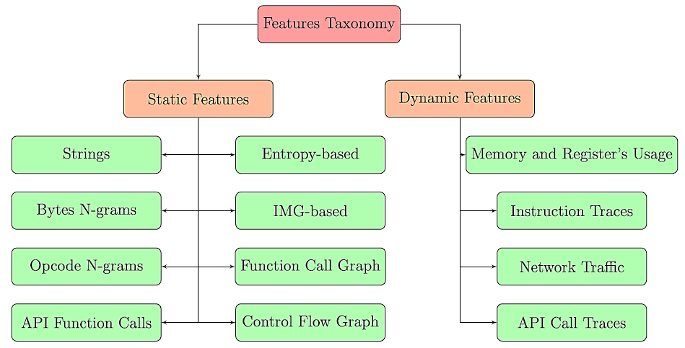
Features for Malware Classification
ML-based Malware Classification
The figure shows static and dynamic features that are commonly used for ML-based malware classification
Gilbert (2020) – The Rise of Machine Learning for Detection and Classification of Malware

Slide 24
Static Features for Malware Classification
Static Features for Malware Classification
Static features
  In Windows systems, static features are extracted from either the PE file header and sections, or assembly language source file (obtained after disassembling the file)
  In Android systems, static features are extracted from the disassembled APK
    Various disassembler tools for Windows and Android are available
Strings – sequence of characters, related to URLs, IP addresses, accessed file paths, registry keys, or names of modified files by the executable
  Ye et al. (2008) used extracted strings from PE files as input features to an SVM ensemble with bagging model for malware detection
Byte n-grams – sequence of n bytes in PE header or the assembly language code
  An n-gram is a sequence of n adjacent items in sequential data
  A large number of sequences of n bytes (n ranging from 1 to 8) are used as input features for ML model training
  Different ML models (Decision Trees, Random Forests, Deep Belief Nets) have been implemented using byte n-grams , e.g., by Jain and Meena (2011), Yuxin et al. (2019)
  Challenges include the large number of n-grams for each file (which often requires reducing the dimensionality of the feature vectors)
Gilbert (2020) – The Rise of Machine Learning for Detection and Classification of Malware

Slide 25
Static Features for Malware Classification
Static Features for Malware Classification
Opcode (mnemonic) n-grams – n consecutive opcodes (i.e., operational code instructions) in the assembly language source code
  Assembly instructions are composed of an operational code and operand
    E.g., for the instruction sequence: “call sub_401BCD”, “add eax 1”, “mov ebx ebx”, the 3-gram opcode is: CALL-ADD-MOV
  Malware samples from the same family often use the same opcodes
  Santos et al. (2013) selected the top 1,000 features using 1 or 2-gram opcodes and trained an SVM malware classifier
API function call – request to the OS for accessing system resources, such as networking, security, file management, etc.
  Application Programming Interfaces (API) function calls are very discriminative features, as they can provide key information to reveal the behavior of malware
  E.g., certain sequences of API function calls are often found in malware, but rarely in benign files
  Ahmadi et al. (2016) used the frequency of 794 API function calls to develop an ML system for classifying malware into families
Gilbert (2020) – The Rise of Machine Learning for Detection and Classification of Malware

Slide 26
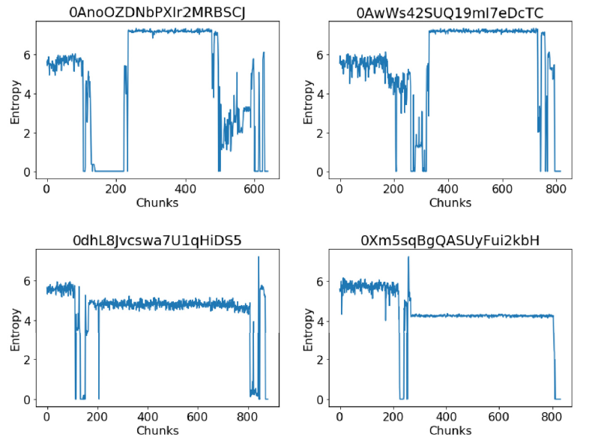
Static Features for Malware Classification
Static Features for Malware Classification
Entropy-based features – indicate the statistical variation of bytes in a file, and are used to detect compressed or encrypted segments of codes in executables
  Malware developers use compression and encryption to conceal malicious segments of code from static analysis
  Files with compressed or encrypted segments have higher entropy than native code
  Structural entropy represents an executable file as a stream of entropy values, where each value indicates the entropy over a small chunk of code (see the figure below)
  A similarity score of structural entropies is used for malware classification (e.g., by Sorokin and Jun (2011))
Ramnit family malware
Gatak family malware
Gilbert (2020) – The Rise of Machine Learning for Detection and Classification of Malware

Slide 27
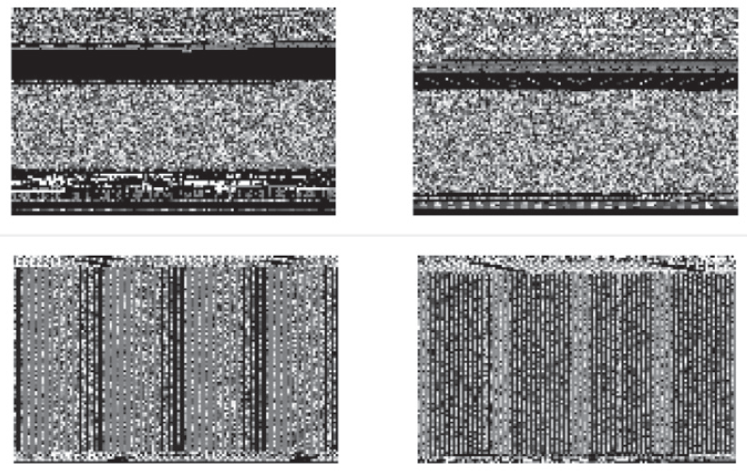
Static Features for Malware Classification
Static Features for Malware Classification
IMG-based features – visualize the binary content of an executable as a gray-scale image
  This is achieved by interpreting every byte as one pixel of a gray-scale image, and organizing the array of bytes in an executable as a 2-D image
  Two malware families are shown as gray-scale images in the figure (note that the two families have a distinct image representation)
  Nataraj et al. (2011) used k-Nearest Neighbors to classify malware families
Ramnit family malware
Lollipop family malware
Gilbert (2020) – The Rise of Machine Learning for Detection and Classification of Malware

Slide 28
Static Features for Malware Classification
Static Features for Malware Classification
Function–call graph – is a directed graph whose vertices represent the functions of a program, and the edges symbolize function calls
  Kinable et al. (2011) developed an approach for clustering malware based on the structural similarities between function-call graphs
Control–flow graph – is a directed graph in which the nodes represent basic blocks, and the edges represent control-flow paths
  A basic block is a linear sequence of program instructions having an entry point (the first instruction executed) and an exit point (the last instruction executed)
  The control-flow graph is a representation of all the paths that can be traversed during a program’s execution
  Faruki et al. (2012) used a Random Forest classifier for detecting malware using control-flow graphs of various API calls
Gilbert (2020) – The Rise of Machine Learning for Detection and Classification of Malware

Slide 29
Dynamic Features for Malware Classification
Dynamic Features for Malware Classification
Dynamic features are extracted from the execution of malware at runtime
Memory and registers usage – values stored in the memory and different registers during the execution can distinguish benign from malicious programs
  Ghiasi et al. (2015) monitored the memory content and register values before and after each invoked API call
  They used similarity scores between the benign and malicious files in a training set to train an ML model for malware detection
Instruction traces – sequence of processor instructions called during the execution of a program
  Dynamic instruction traces are more robust indicators of the program’s behavior than static traces, since compression and encryption can obfuscate code instructions from static analysis
  Carlin et al. (2017) analyzed traces of opcodes to detect malware by Random Forest and Hidden Markov Model classifiers
Gilbert (2020) – The Rise of Machine Learning for Detection and Classification of Malware

Slide 30
Dynamic Features for Malware Classification
Dynamic Features for Malware Classification
Network traffic – monitoring the traffic entering and exiting the network can provide helpful information to detect malicious behavior
  E.g., when malware infects a host machine, it may establish communication with an external server to download updates, other malware, or leak private and sensitive information from the host machine
  Bekerman et al. (2015) extracted 972 features from the network traffic, and used them for developing Decision Tree and Random Forest malware classifiers
API call traces – traces for accessing file systems, devices, processes, threads and error handling, and also to access functions such as the Windows registry, manage user accounts, etc.
  Uppal et al. (2014) proposed traditional ML-based classifiers using n-grams of features extracted from traces of invoked API calls
Gilbert (2020) – The Rise of Machine Learning for Detection and Classification of Malware

Slide 31
Adversarial Attacks on ML Malware Classifiers
Adversarial Attacks on ML-based Malware Classifiers
Next, a short overview of the adversarial attacks on ML-based models for malware classification is presented
  A more detailed review can be found in Rosenberg et al. (2021) – Adversarial Machine Learning Attacks and Defense Methods in the Cyber Security Domain
AML attacks approaches can generally be divided into two groups:
  Attacks on traditional ML-based malware classifiers
  Attacks on deep learning-based malware classifiers

Slide 32
Attacks on Traditional ML Models
Adversarial Attacks on Traditional ML-based Malware Classifiers
Ming et al. (2015) Replacement Attacks: Automatically Impeding Behavior-Based Malware Specifications
  This work introduced is an inference integrity gray-box attack
    In other words, it is an evasion attack, where the adversary’s goal is to alter the malware file, in order to result in misclassification by the ML model at inference time
    Recall that integrity attacks cause the ML system to perform incorrectly (as opposed to attacks that aim to make the system unavailable, or steal private information)
  The authors modified malware code by replacing API calls with functionality-preserving API calls
  The attack was employed to evade an ML classifier using Function-Call Graphs features as inputs
Rosenberg (2021) – AML Attacks and Defense Methods in the Cyber Security Domain

Slide 33
Attacks on Traditional ML Models
Adversarial Attacks on Traditional ML-based Malware Classifiers
Xu et al. (2020) MANIS: Evading Malware Detection System on Graph Structure
  Inference gray-box attack against Android APK malware classifiers
  Uses n-strongest nodes and FGSM in a Function-Call Graph to generate perturbed samples
Anderson et al. (2018) Learning to Evade Static PE Machine Learning Malware Models via Reinforcement Learning
  Inference black-box attack that employs static features (extracted from the PE header, sections table, and import/export address table) against a Gradient Boosted Decision Tree classifier
  A reinforcement learning approach was used to generate perturbed samples, by learning the sequence of operations that are likely to result in detection evasion
Rosenberg (2021) – AML Attacks and Defense Methods in the Cyber Security Domain

Slide 34
Attacks on Traditional ML Models
Adversarial Attacks on Traditional ML-based Malware Classifiers
Data poisoning attacks
  One should note that data poisoning attacks are more challenging in cybersecurity, because they require injecting samples into the training set of the malware classifier
  But they can have significant consequences, when the adversary has the ability to tamper with the training set
Siciu et al. (2018) When Does Machine Learning FAIL? Generalized Transferability for Evasion and Poisoning Attacks
  Training integrity gray-box attack, requires data adding access to the training set
  The attack is against a linear SVM classifier for Android malware detection
  Data poisoning was done by adding static features (API calls, URL requests) to benign samples
Munoz Gonzalez et al. (2017) Towards Poisoning of Deep Learning Algorithms with Back-gradient Optimization
  Training integrity black-box attack, requires read and add access to the training set
  Against Logistic Regression and an NN model for spam and ransomware detection
  A substitute model was trained and poisoned, and by employing transferability, it was demonstrated that the poisoned samples were effective against the target classifiers
Rosenberg (2021) – AML Attacks and Defense Methods in the Cyber Security Domain

Slide 35
Attacks on Traditional ML Models
Adversarial Attacks on Traditional ML-based Malware Classifiers
Attacks on PDF classifiers
  Note that PDF malware is less common, and most malware are PE files
Srndic and Laskov (2014) Practical Evasion of a Learning-Based Classifier: A Case Study
  Inference integrity gray-box attack, against Random Forest classifier (named PDFRATE) that uses static binary strings as features for detecting malicious PDF files
  The attack adds new strings features to malicious PDF files, to evade being detected as malware by PDFRATE
Li et al. (2020) A Feature-vector Generative Adversarial Network for Evading PDF Malware Classifiers
  Attack on the PDFRATE classifier by using GAN-generated feature vectors for producing malicious PDF files (which were classified as benign by the classifier)
Dang et al. (2017) Evading Classifiers by Morphing in the Dark
  Gray-box attack against SVM and Random Forest PDF malware classifiers
  A hill-climbing optimization approach was used to minimize the score for the rate of feature modifications from malicious and benign PDFs
Rosenberg (2021) – AML Attacks and Defense Methods in the Cyber Security Domain

Slide 36
Deep Learning for Malware Classification
Deep Learning Approaches for Malware Classification
Besides traditional ML approaches for malware classification that rely on manually selected features based on expert knowledge, recent work has emerged that applied Deep Learning methods for malware classification
  DL approaches are more successful in detecting unseen and unsigned malware, but are also more vulnerable to adversarial attacks
Numerous DL approaches have been introduced, employing raw bytes and static/dynamic malware input features and various network architectures
  Encoder architectures have often been used in these approaches for extracting salient features and dimensionality reduction of n-gram features
  Convolutional NN models employing IMG-based features and bytes-based features have been applied for malware classification
  Recurrent NN models have been introduced for capturing dependencies in API call traces, network traffic, and instruction traces
  Architectures with both convolutional and recurrent layers have also been developed for dealing with both the spatial and sequential nature of static and dynamic features in executables
Gilbert (2020) – The Rise of Machine Learning for Detection and Classification of Malware

Slide 37
Attacks on Deep Learning Models
Adversarial Attacks on Deep Leaning-based Malware Classifiers
Attacks on Deep Learning classifiers using raw bytes (raw-binary classifiers)
  A limitation of these approaches is that raw byte content is rarely used as features in the next generation anti-virus (NGAV) products
Kreuk et el. (2018) Adversarial Examples on Discrete Sequences for Beating Whole-Binary Malware Detection
  Inference white-box attack against MalConv - a CNN model for malware detection using raw byte inputs
  FGSM attack is used to modify bytes that were inserted between the file’s sections
Koloshnaji et al. (2018) Adversarial Malware Binaries: Evading Deep Learning for Malware Detection in Executables
  Implemented a similar attack to Kreuk et al. (2018)
  Analyzed the byte features that are the most impactful for the attack, found that most of these features belong to the PE header
Siciu et al. (2018) Exploring Adversarial Examples in Malware Detection
  Developed a related black-box attack, where adversarial files were created by appending bytes from benign PE headers to malware
Rosenberg (2021) – AML Attacks and Defense Methods in the Cyber Security Domain

Slide 38
Attacks on Deep Learning Models
Adversarial Attacks on Deep Leaning-based Malware Classifiers
Attacks on Deep Learning classifiers using static or dynamic features (feature-based classifiers)
Abusnaina et al. (2019) Adversarial Learning Attacks on Graph-based IoT Malware Detection Systems
  Inference white-box attack, against a CNN-model for IoT malware classification
  Uses Control-Flow Graph features of the malware disassembly source code
  Malicious samples were generated by concatenating CFGs of benign samples
Hu and Tan (2017) Black-Box Attacks against RNN based Malware Detection Algorithms
  Inference gray-box attack, against an LSTM classifier trained on the dynamic API call traces of the malware
  A GAN model with RNN layers was used to generate invalid API calls, which were inserted into the original API call traces
Rosenberg (2021) – AML Attacks and Defense Methods in the Cyber Security Domain

Slide 39
Attacks on Deep Learning Models
Adversarial Attacks on Deep Leaning-based Malware Classifiers
Rosenberg et al. (2020) Generating End-to-End Adversarial Examples for Malware Classifiers Using Explainability
  Gray-box attack using 2,351 static features extracted from PE files
  Transferability in AML is employed, where a substitute ML model is first trained, and it is hoped that the adversarial samples will be transferred to a target ML model
  Used feature importance approaches from explainable ML to select the minimal set out of 2,351 features that have high impact on the malware classification
  Algorithm:
    Train a substitute NN model on a training set believed to accurately represent the attacked ML-based malware classifier
    Select a malware executable file that needs to bypass the attacked malware classifier
    Use explainable ML algorithm to calculate features importance for the classification of the malware on the substitute model
    For each feature in the set of features that are the easiest to modify, change the feature using the list of predefined values, and select the value that result in the lowest confidence score by the substitute malware classifier
    Repeat until a benign classification is achieved by the target malware classifier

Slide 40
Attacks on Deep Learning Models
Adversarial Attacks on Deep Leaning-based Malware Classifiers
Severi et al. (2021) Explanation-Guided Backdoor Poisoning Attacks Against Malware Classifiers
  Data-poisoning attacks using a backdoor trigger, on Windows PE files, PDFs, and Android APK files
  The explainable ML approach SHAP (Shapley Additive Explanations) was used to select a small set of relevant static features for creating the backdoor trigger
  The attacks were evaluated against several ML malware classifiers: GBM (gradient boosting model), NNs, Random Forest, and SVM
  Different datasets for malware classification were used
    Ember dataset (Windows executables) – consisting of 1.1 million PE files, having 2,351 dimensional features
    Contagio dataset (PDFs) – consisting of 10 thousand PDF files, having 135 dimensional features
    Drebin dataset (Android APK executables) – consisting of 130 thousand apps, having 545,000 dimensional features

Slide 41
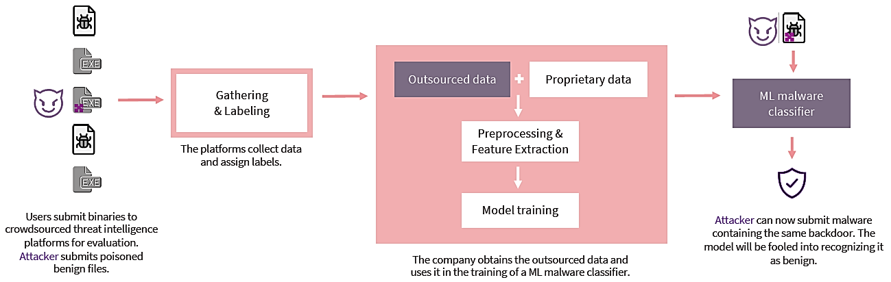
Attacks on Deep Learning Models
Adversarial Attacks on Deep Leaning-based Malware Classifiers
Severi et el. (2021) cont’d (backdoor poisoning attack)
  Large volumes of executables are acquired from third-party platforms, and are labeled by pools of existing antivirus engines
  The outsourced data is combined with some proprietary data to create a training set
  Data preprocessing and feature extraction steps are followed by model training
  Malware with backdoor features is classified as benign by the trained model

Slide 42
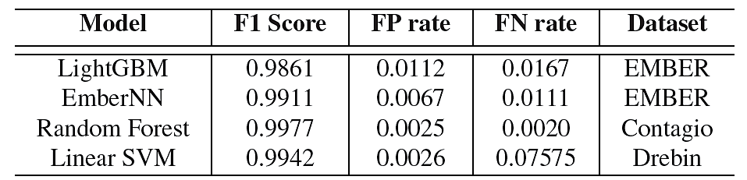
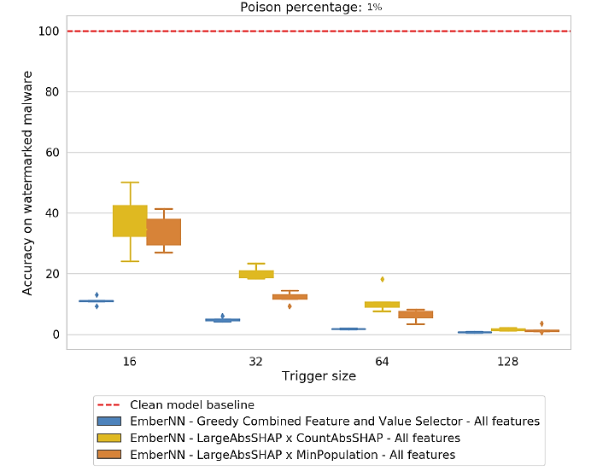
Attacks on Deep Learning Models
Adversarial Attacks on Deep Leaning-based Malware Classifiers
Severi et el. (2021) cont’d (backdoor poisoning attack)
  F1 score standard accuracy for four ML-based malware classifiers: GBM, NN, Random Forest, and SVM
    The accuracy on the original (not-poisoned) files is over 99%
  Corresponding F1 score accuracy of the attacked NN-classifier
    With a fixed poisoning rate of 1% of the training set, and varying the trigger size (i.e., the number of modified features) from 16 to 128
    Accuracies drop to below 1% for 128 modified features

Slide 43
Additional References
Rosenberg et al. (2021) – Adversarial Machine Learning Attacks and Defense Methods in the Cyber Security Domain, https://arxiv.org/abs/2007.02407
Gilbert et al. (2020) – The Rise of Machine Learning for Detection and Classification of Malware: Research Developments, Trends and Challenges, link
Kaspersky Lab (2020) – Machine Learning Methods for Malware Detection, link

