Slide 1
CS 404 / CS 504
Special Topics: Adversarial Machine Learning
Dr. Alex Vakanski

Slide 2
Lecture 10
AML in Cybersecurity – Part III:
Spam Filtering and URL Detection

Slide 3
Lecture Outline
Spam filtering
Spam statistics
Spam filtering datasets
Spam filtering techniques
Pre-processing text in email messages
Tokenization, feature extraction, word embedding
Adversarial attacks against ML-based spam filters
URL detection
Phishing URL detection
Adversarial attacks against phishing URL classifiers
Domain Generation Algorithm URL Detection
Adversarial attacks against DGA URL classifiers

Slide 4
Spam Filtering
Spam Filtering
The purpose of a spam filter is to determine whether an incoming message is legitimate (i.e., non-spam, ham) or unsolicited (i.e., spam)
ML-based spam classifiers were among the first applications of machine learning in the cyber security domain (and in general, as well)
Subsequently, they were among the first to be attacked
Attackers’ goal is to modify spam emails (without changing the nature of the message) to bypass spam filters
Recent spam filters increasingly rely on machine learning and neural networks approaches for email classification
These approaches are being extensively used by email service providers like Gmail, Outlook, or Yahoo

Slide 5
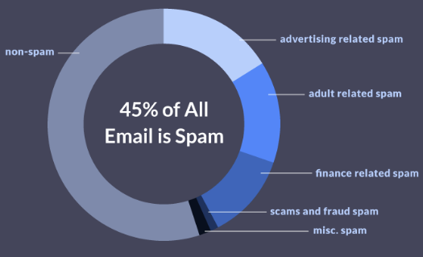
Spam Statistics
Spam Statistics
45% of all sent emails are spam (information from 2018)
36% of all spam is some form of advertising
Spam costs $20.5 billion yearly (reduced network bandwidth, storage capacity)
About 14.5 billion spam emails are send every day
Spammers receive on average 1 click for every 12 million emails sent
Even with this response, spammers earn millions of dollars yearly
80% of all spam is sent by 100 spammers
U.S. is home to 7 of the world’s top 10 spammers
Slide credit: https://www.propellercrm.com/blog/email-spam-statistics

Slide 6
Spam Filtering Adversarial Game
Spam Filtering
In the following simple example, an email is classified as either a spam or a legitimate message based on cumulative weights assigned to words (or other features)
1.
From: spammer@example.com
Cheap mortgage now!!!
cheap = 1.0
mortgage = 1.5
Feature Weights
2.
Spam
3.
Total score = 2.5
> 1.0 (threshold)
Slide credit: Daniel Lowd, Adversarial Machine Learning

Slide 7
Spam Filtering Adversarial Game
Spam Filtering
The spammers adapt to evade the classifier, by adding regular words to reduce the overall score
1.
From: spammer@example.com
Cheap mortgage now!!! Eugene Oregon
2.
cheap = 1.0
mortgage = 1.5
Eugene = -1.0
Oregon = -1.0
Feature Weights
3.
Total score = 0.5
< 1.0 (threshold)
OK
Slide credit: Daniel Lowd, Adversarial Machine Learning

Slide 8
Spam Filtering Adversarial Game
Spam Filtering
The spam classifier is updated by changing the feature weights
1.
From: spammer@example.com
Cheap mortgage now!!! Eugene Oregon
2.
cheap = 1.5
mortgage = 2.0
Eugene = -0.5
Oregon = -0.5
Feature Weights
Spam
3.
Total score = 2.5
> 1.0 (threshold)
Slide credit: Daniel Lowd, Adversarial Machine Learning

Slide 9
Spam Filtering Datasets
Spam Filtering Datasets
There are many open datasets of spam and non-spam email messages
However, most datasets are of small size
TREC 2007 Public Spam Corpus (link)
Also known as Trect07p, created in 2007
Consists of 50,200 spam emails (67%) and 25,200 ham (non-spam) emails (33%)
The format of the emails is raw data (HTML)
Enron-Spam dataset (link)
Created in 2006
Includes 20,170 spam emails (55%) and 16,545 non-spam emails (45%)
Both raw messages and pre-processed messages are provided
SPAMBASE (link)
Created in 1999
Includes 1,813 spam emails (39%) and 2,788 non-spam emails (61%)
Each email has 55 features, related to word frequency, character frequency, average length of uninterrupted sequence of capital letters, total number of capital letters, etc.

Slide 10
Spam Filtering Techniques
Spam Filtering Techniques
Based on the used email filtering techniques, spam detectors can be generally classified into:
Content-based filtering techniques
Heuristic-based filtering techniques

Slide 11
Content-based Filtering
Spam Filtering Techniques
Content-based filtering techniques
The filter scans the content of incoming emails, looking for trigger keywords
E.g., keywords frequently used in spam emails, such as free, buy, application, mortgage
The content of the body and header of emails are scanned
The frequency of occurrence and distribution of trigger words and phrases in the content of emails are used as features for training ML approaches, and afterward, for classifying new emails
Naïve Bayes classifiers were one of the early successful ML models for spam filtering
Other conventional ML approaches have been successfully applied, such as SVMs, k-nearest neighbors, decision trees, random forests
NNs and deep learning are commonly used nowadays for spam classification
Almost all commercial spam filters use some form of content-based filtering
A limitation of this approach is that harmless emails containing spam trigger words can be blocked
Ganagavarapu (2020) – Applicability of Machine Learning in Spam and Phishing Email Filtering

Slide 12
Content-based Filtering
Spam Filtering Techniques
Scanning the body of emails explores the what in the email
Scanning the header of emails explores the who sent the email
Email headers display important information, such as:
Message ID – an identifier generated by the sender’s email service
There can be no two identical message IDs, hence, it helps to detect forged email headers
Sender address – is used to consult black lists to check sender’s domain reputation
DNS records – the DNS (Domain Name System) records of the sender allows to check the sender’s SPF, DKIM, and DMARC policies regarding email authentication
SPF (Sender Policy Framework), DKIM (Domain Keys Identified Mail), DMARC (Domain-based Message Authentication, Reporting and Conformance)
An example of a Gmail header
Slide credit: Why Spam Filters Hate You

Slide 13
Heuristic-based Filtering
Spam Filtering Techniques
Heuristic-based filtering techniques
These approaches apply heuristic rules to discover similar patterns in a large number of spam and non-spam emails
Scores are assigned to each rule, and the scores are weighted based on the importance of the rule
Repeating patterns in a message increase the total score of being a spam
If the total score surpasses a predefined threshold, the message is labeled as spam
Rules could be created based on:
Words and phrases, lots of uppercase characters, exclamation points, unusual Subject lines, special characters, web links, HTML messages, background colors, etc.
Content-based filtering techniques can be considered a sub-category of the heuristic-based techniques
A limitation of this approach is that it requires constant updating of the rules, to be able to cope with the continually adapting strategies by spammers
Ganagavarapu (2020) – Applicability of Machine Learning in Spam and Phishing Email Filtering

Slide 14
Black Lists and White Lists
Spam Filtering Techniques
Black lists contain information of known spammers, collected by several sites
Senders of incoming emails are compared to the blacklist, to filter known spammers
White lists are complementary to black lists, and contain addresses of trusted contacts
Black lists and white lists are used for the first level of spam filtering
E.g., before applying content checks or heuristic rules
That is, the lists are used as a complementary tool, and not as the only tool for email classification

Slide 15
Tokenization
Pre-processing Text in Email Messages
Preprocessing text data in emails for use by ML models typically involves:
Tokenization
Feature selection/extraction
Tokenization
Refers to separating the words in a text
Tokenization transforms an email into a sequence of representative symbols (tokens)
Tokenization usually includes:
Remove punctuation signs (comma, period) or non-alphabetic characters (@, #, {, ])
Remove stop words, such as for, the, is, to, some
These words appear in both spam and non-spam emails, and are not relevant for filtering
Correct spelling errors or abbreviations
Change all words to lower-case letters
I.e., the model should consider Text and text as the same word
Stemming and lemmatization - means transforming words to their base form
E.g., the words buy-bought or grill-grilled have a common root
Word count – output the number of occurrences of each word in the text

Slide 16
Tokenization
Pre-processing Text in Email Messages
Example of tokenization
Check out my you[tube] /#?song Channel?
Separate the words
Check | out | my | you | tube | song | Channel
Transform to lower case
check | out | my | you | tube | song | channel
Remove stop words
check | tube | song | channel
Words count
check | tube | song | channel
1 | 1 | 1 | 1

Slide 17
Bag-of-Words
Pre-processing Text in Email Messages
Bag-of-words model
The tokenized words in emails are represented as a bag (i.e., set) of words
The term bag implies that the order of the words and the structure of the text is lost
Each word is a token having a numeric feature representation
Typically the frequency of occurrence of each word is used as a feature for training a classifier
Figure from: Implementation Of Bag Of Words Using Python (link)

Slide 18
Bag-of-Words
Pre-processing Text in Email Messages
Bag-of-words example
Text: John likes to watch movies. Mary likes movies too.
Bag-of-words listing the words and the frequency of each word:
{"John":1,"likes":2,"to":1, "watch":1, "movies":2,"Mary":1,"too":1}
Approach:
Tokenize all spam and non-spam emails in a dataset
Create a vocabulary (token database) from the unique words (tokens) collected from all processed emails
Count the frequency of occurrence of tokens in spam and non-spam emails
Create two bags-of-words, pertaining to all spam and non-spam emails
E.g., the spam bag will contain trigger keywords (cheep, buy, stock) more frequently
A spam filter classifies an incoming email based on the probability of belonging to the spam or non-spam bag-of-words

Slide 19
n-Grams
Pre-processing Text in Email Messages
Instead of using single words as tokens, it is also possible to use n consecutive words, referred to as n-grams
Combining several consecutive words together creates more specialized tokens
E.g., the word play is considered a neutral word, but the two-words phrase play lotto is less neutral
Such n-grams consisting of adjacent pairs of words are called bigrams
n-grams consisting of single words are called unigrams
The n-grams model preserves the words order and it can potentially capture more information than the bag-of-words model

Slide 20
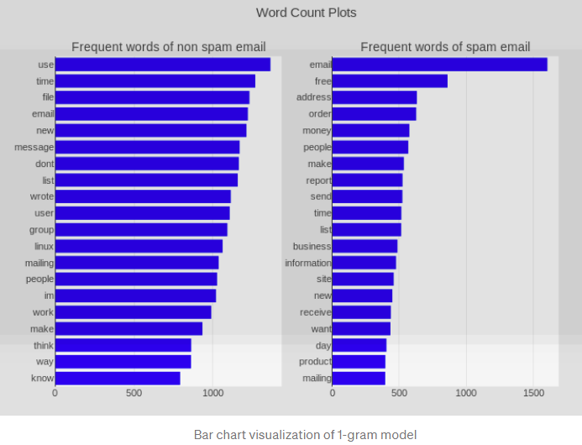
n-Grams
Pre-processing Text in Email Messages
1-gram model example of non-spam and spam emails
Figure from: How To Design A Spam Filtering System with Machine Learning Algorithm (link)

Slide 21
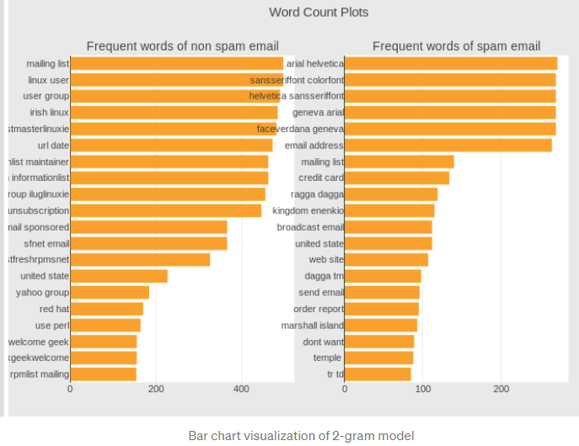
n-Grams
Pre-processing Text in Email Messages
2-gram model example of non-spam and spam emails
Figure from: How To Design A Spam Filtering System with Machine Learning Algorithm (link)

Slide 22
Feature Extraction
Pre-processing Text in Email Messages
The extracted features from emails can include:
Body-based features: features extracted from the email message content
Subject line-based features: features extracted from the subject line of the email
Sender address-based features: features extracted from the information about the email address of the sender
URL-based features: features extracted from the anchor tags of HTML emails
Script-based features: features extracted from the information concerning the presence or absence of scripts in the email and the impact of such scripts
Ganagavarapu (2020) – Applicability of Machine Learning in Spam and Phishing Email Filtering

Slide 23
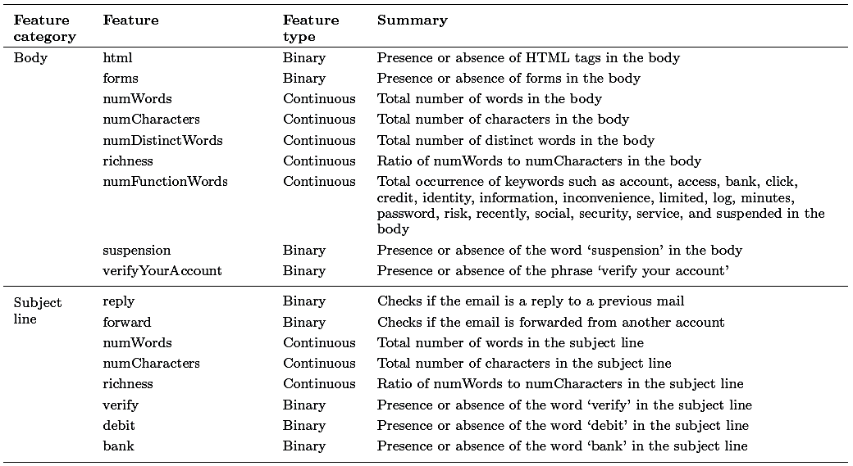
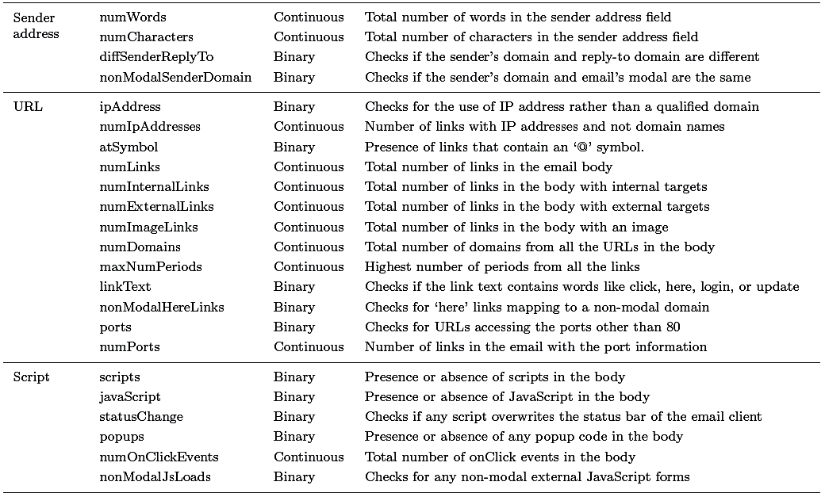
Feature Extraction
Pre-processing Text in Email Messages
Example: 40 features extracted from emails, categorized based on the information from the previous page
Ganagavarapu (2020) – Applicability of Machine Learning in Spam and Phishing Email Filtering

Slide 24
Word Embedding
Pre-processing Text in Email Messages
Word embedding is converting words to a vector format, where the vectors represent the position of words in a higher-dimensional space
Words that have similar meanings should have close spatial positions of their vector representations in the embedding space
Typically, the cosine distance between the vectors in the embedding space is used a distance metric
Recall from Lecture 3 that that a dot (inner, scalar) product of two vectors u and v is given by $u∙v=\left\|u\right\|\left\|v\right\|cos\left(θ\right)$
Therefore, the scalar value $cosθ=\frac{u∙v}{\left\|u\right\|\left\|v\right\|}$is referred to as cosine similarity between u and v
Where $\left\|u\right\|$ and $\left\|v\right\|$ are the norms of the vectors

Slide 25
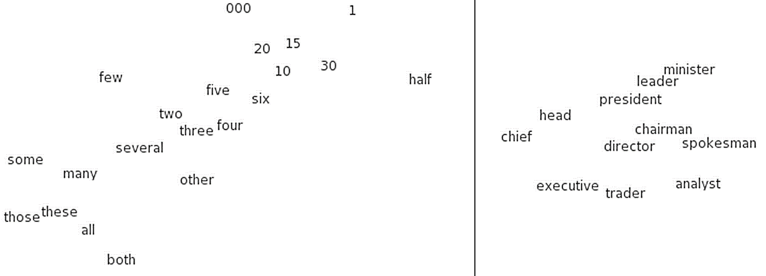
Word Embedding
Pre-processing Text in Email Messages
A very popular technique for generating word embeddings is word2vec
The word2vec algorithm uses an autoencoder to learn word embeddings from a large corpus of text
The autoencoder is a 2-layer NN, with an embedding space of several hundreds dimensions
Each unique word in the corpus is assigned a corresponding vector in the space
Examples of word embedding
Figure from: How To Design A Spam Filtering System with Machine Learning Algorithm (link)

Slide 26
Spam Filtering with Naive Bayes
Spam Filtering Techniques
Naive Bayes classifier has been one of the most popular ML models for spam filtering
It is easy to implement, has low computational complexity, and provides statistical measure of the probability that a message is spam or non-spam
From Bayes’ theorem, the probability that an email message represented with a vector of extracted features $x=\left[x_{1},x_{2},…\right]$ belongs to the spam category $c_{s}$ is
$$p\left(c_{s}|x\right)=\frac{p\left(c_{s}\right)∙p\left(x|c_{s}\right)}{p\left(c_{s}\right)∙p\left(x|c_{s}\right)+p\left(c_{h}\right)∙p\left(x|c_{h}\right)}$$
In the equation $c_{h}$ is the ham category
The prior probabilities $p\left(c_{s}\right)$ and $p\left(c_{h}\right)$ are typically estimated by dividing the number of training emails in each category by the total number of training emails
The probabilities $p\left(x|c_{s}\right)$ and $p\left(x|c_{h}\right)$ are calculated as a product of the probability that each feature belongs to the spam of ham bag-of-words, i.e., $p\left(x|c_{s}\right)=\prod{p(x_{i}|}c_{s}$)
If $p\left(c_{s}|x\right)>threshold$, the email message is classified as a spam

Slide 27
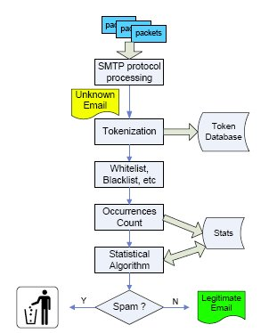
Spam Filtering Block Diagram
Spam Filtering Techniques
A typical data flow in spam filtering
Figure from: Yan (2010) – Workload Characterization of Spam Email Filtering Systems

Slide 28
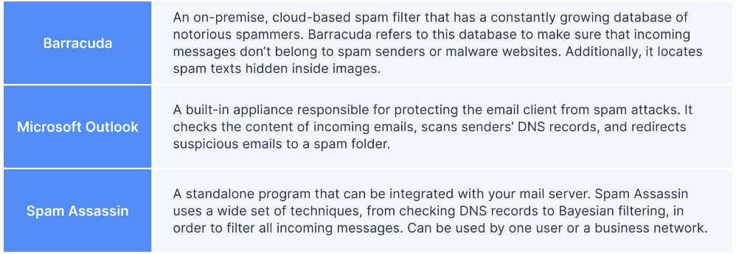
Commercial Spam Filters
Spam Filtering Techniques
Examples of three different spam filters solutions
Gmail and Outlook use these spam filters
Slide credit: Why Spam Filters Hate You

Slide 29
AML against Spam Filters
Adversarial Attacks against ML-based Spam Filters
Huang et al. (2011) Adversarial Machine Learning (link)
The work introduced an availability attack
I.e., the attack makes the spam filter unavailable for regular use
Attacked is a SpamBayes model, which uses Naïve Bayes for spam filtering based on words occurrences in the content of email messages
Attack approach:
Spam email messages were sent that contain a very large set of tokens (words)
The spam filter algorithm will recognize the emails as spam, and it will assign a higher spam score to every token in the received messages
As a result, future legitimate emails are more likely to be marked as spam
Rosenberg et al. (2021) – AML Attacks and Defense Methods in the Cyber Security Domain

Slide 30
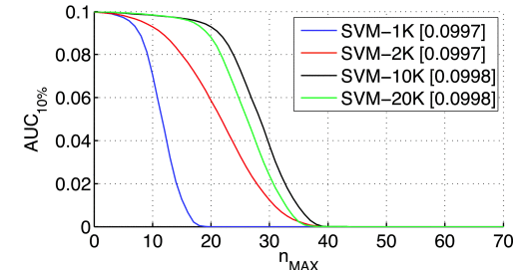
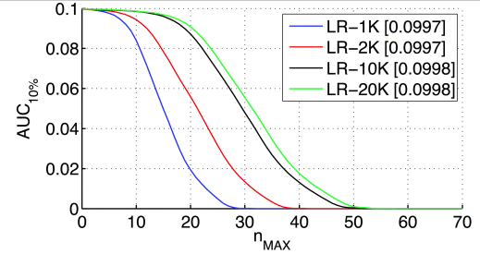
AML against Spam Filters
Adversarial Attacks against ML-based Spam Filters
Biggio et al. (2014) Security Evaluation of Pattern Classifiers under Attack (link)
White-box evasion attack
Attacked are two spam classifiers: linear SVM and logistic regression classifier, using bag-of-words representation based on text content (features are word occurrences)
Attack approach:
Add n_{max} most impactful non-spam words to spam emails
This can cause the spam filter to increase the scores for the impactful good words, and as a result, the model will be more likely to classify non-spam emails as spam
Figure: False positives for SVM and LR with 1K to 20K features, as a function of n_{max}
Rosenberg et al. (2021) – AML Attacks and Defense Methods in the Cyber Security Domain

Slide 31
AML against Spam Filters
Adversarial Attacks against ML-based Spam Filters
Sethi and Kantradzic (2018) Data Driven Exploratory Attacks on Black Box Classifiers in Adversarial Domains (link)
Gray-box query-efficient evasion attacks
The authors trained 5 different spam classifiers using conventional ML methods: linear SVM, k-nearest neighbors, SVM with RBF kernel, decision tree, and random forest
SPAMBASE dataset was used for model training and evaluation
The work introduces a framework called SEE (Seed-Explore-Exploit)
Attacks include:
Anchor Points (AP) attack: anchors are legitimate emails, that serve as a ground-truth for generating adversarial samples by applying perturbation to the legitimate emails
The spam filter is queried, and the procedure is repeated until the emails are classified as spam
Reverse Engineering (RE) attack: the goal is to discover the decision boundary for spam email classification, and ultimately learn a substitute model based on querying the target classifier
The generated samples against the substitute model are then transferred to the target classifier
Rosenberg et al. (2021) – AML Attacks and Defense Methods in the Cyber Security Domain

Slide 32
AML against Spam Filters
Adversarial Attacks against ML-based Spam Filters
Kuleshov et al. (2018) Adversarial Examples for Natural Language Classification Problems (link)
This work explores the adversarial samples in natural language (NL) classification, in general
Attacks were implemented for three different applications: spam filtering, fake news detection, and sentiment analysis
Attacked are 3 NL classifiers: LSTM recurrent model, 1-D word-level CNN, and a naive Bayes model
Constructing an adversarial example involves replacing 10-30% of words in a sentence with synonyms that don’t change the meaning
Rosenberg et al. (2021) – AML Attacks and Defense Methods in the Cyber Security Domain

Slide 33
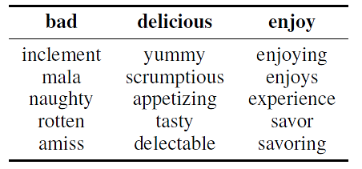
AML against Spam Filters
Adversarial Attacks against ML-based Spam Filters
Kuleshov et al. (2018) cont’d
Approach:
Consider each consecutive word $w$ in input text $x$, and replace it with valid and semantically similar words ${\overline{w}}_{1},{\overline{w}}_{2}{…, \overline{w}}_{k}$
Semantically similar words ${\overline{w}}_{1},{\overline{w}}_{2},$ ${…, \overline{w}}_{k}$ are found by using a method that calculates the k-nearest neighbors in word vector space for a word$\text{w}$
Examples of semantically similar words are shown in the columns in the table below
For each manipulated text sample $\overline{x}$, calculate the output of the model (e.g., class logits) $\text{J} \left(\overline{x}\right)$
Select a replacement word ${\overline{w}}_{k}$ that maximizes $\text{J} \left(\overline{x}\right)$, and has the smallest distance to the original word $\text{w}$
A greedy optimization methods is used to solve the maximization problem
Repeat the procedure for each word $w$ in the input text$x$
Termination conditions: when $\text{J} \left(\overline{x}\right)$ is greater than a threshold, or when a certain number of words has been replaced without successfully changing the model class output

Slide 34
AML against Spam Filters
Adversarial Attacks against ML-based Spam Filters
Kuleshov et al. (2018) cont’d
Results for the three models: naive Bayes (NB), LSTM recurrent model, and word-level CNN (WCNN)
The NN models use word2wec embeddings as inputs
The models were trained using the Trec07p dataset
The shown accuracies are for clean dataset (CLN), randomly corrupted dataset (RND), and adversarially corrupted dataset (ADV)

Slide 35
URL Detection
URL Detection
URL (Uniform Resources Locator) is a web address that specifies the location of the webpage on a computer network
A typical URL http://www.example.com/index.html consists of several components:
Protocol type = http
Domain name = www.example.com
File name = index.html
The domain name is also referred to as FQDN (Fully Qualified Domain Name)
It identifies the server hosting the webpage
FQDN can be further divided into a prefix (subdomain) = www, and an RDN (Registered Domain Name) = example.com
Rosenberg et al. (2021) – AML Attacks and Defense Methods in the Cyber Security Domain

Slide 36
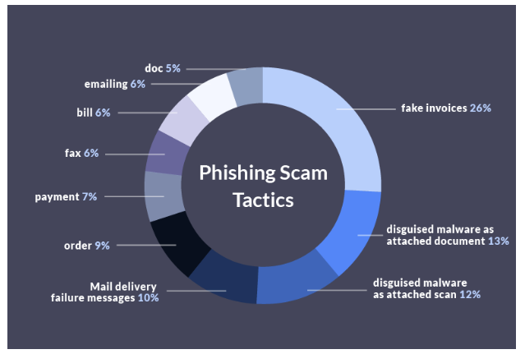
Phishing URL Detection
Phishing URL Detection
Phishing refers to attacks where a victim is lured to a fake web, and is deceived into disclosing personal data or credentials
Most common phishing scam tactics are shown below
Phishing URLs seem like legitimate URLs, and redirect the users to phishing web pages, which mimic the look and feel of their target websites
E.g., a fake bank website hopes that the user will enter personal data (password)
Figure from: https://www.propellercrm.com/blog/email-spam-statistics

Slide 37
Phishing Scam Statistics
Phishing URL Detection
76% of companies fell victim to phishing scams in 2016
Fake invoices are used in 26% of phishing scams
Are followed by malware as an attached document (13%) or scan (12), and main delivery failure messages (10%)
Top 7 phishing targets are:
Apple Account – 25%
Microsoft Outlook – 17%
Google Drive – 12.9%
USAA – 12.4%
Paypal – 10.6%
Adobe Account – 5.8%
Dropbox – 4.8%
Dropbox has the highest click rate of 13.6%
Slide credit: https://www.propellercrm.com/blog/email-spam-statistics

Slide 38
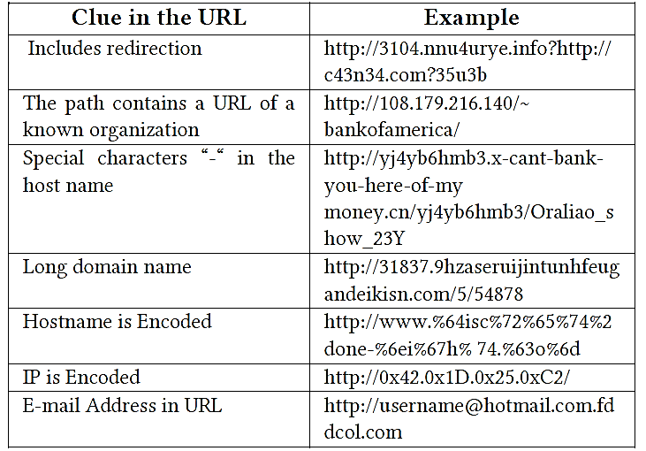
Phishing URL Detection
Phishing URL Detection
Phishing emails are a more serious threat than spam emails, because they aim to steal users’ private information, such as bank accounts, passwords, SSNs
Machine learning techniques are widely used to identify anomalous patterns in URLs as signs of possible phishing
Examples of such anomalous patters are shown in the table
ML-based phishing detection models are usually embedded in web browsers as extensions, or into email spam filtering systems
Thus, they appear as a black-boxes to phishers, as it is difficult to identify which features or classification algorithms they use
Table from: AlEroud and Karabatis (2020) Bypassing Detection of URL-based Phishing Attacks Using GAN

Slide 39
AML against Phishing URL Detectors
Adversarial Attacks against Phishing URL Classifiers
Bahnsen et al. (2018) DeepPhish: Simulating Malicious AI (link)
Gray-box attack, requires knowledge of the features used by the ML-based classifier
Such knowledge may not be accessible to the attacker, hence, this type of attacks may be less feasible in real-life scenarios
Against a character-level LSTM-based phishing URL classifier
The classifier was trained using URLs from historical attacks
The LSTM model predicts the next character in the URL
The attack concatenates benign URLs to the phishing URLs to evade the classifier
The form of synthetic URLs is: http:// + compromised_domain + benign_URL
Limitation: concatenation od benign URLS can be signed, which makes the attack less effective for real URL detectors
Rosenberg et al. (2021) – AML Attacks and Defense Methods in the Cyber Security Domain

Slide 40
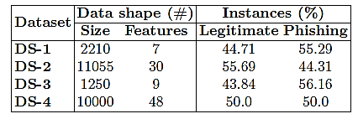
AML against Phishing URL Detectors
Adversarial Attacks against Phishing URL Classifiers
Shirazi et al. (2019) Adversarial Sampling Attacks Against Phishing Detection (link)
Gray-box attack
Eight features used:
Domain length, presence of non-alphabetic character in the domain name, ratio of hyperlinks referring to the domain name, the presence of HTTPS protocol, matching domain name with copyright logo, and matching domain name with the page title
Tries all possible combinations for the values of the features used by the classifier
An objective function minimizes: number of manipulated features + assigned feature values
L₂ norm between original phishing samples and newly generated samples was used to estimate the cost function
The adversarial samples must be visually or functionally similar to the targeted websites
Characteristics of used datasets are shown in the table

Slide 41
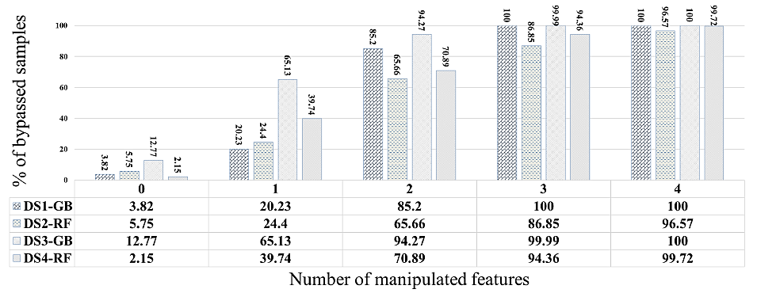
AML against Phishing URL Detectors
Adversarial Attacks against Phishing URL Classifiers
Shirazi et al. (2019) cont’d
The percentage of evaded URL samples increased significantly with only one feature perturbed, and reached 100 when four features were manipulated

Slide 42
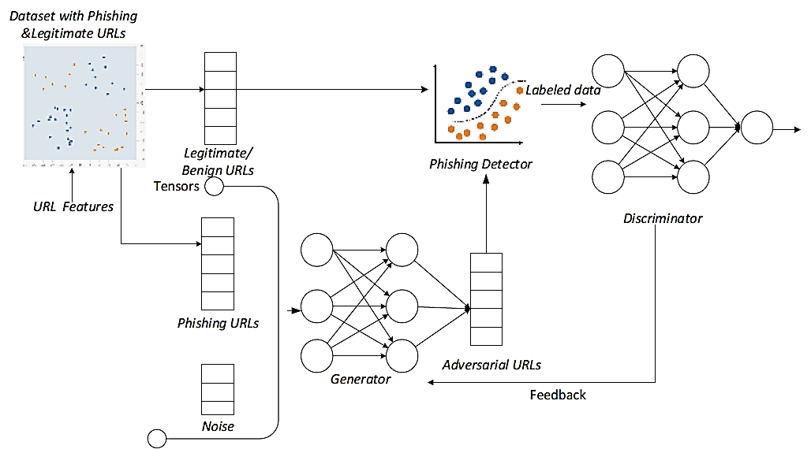
AML against Phishing URL Detectors
Adversarial Attacks against Phishing URL Classifiers
AlEroud and Karabatis (2020) Bypassing Detection of URL-based Phishing Attacks Using Generative Adversarial Deep Neural Networks (link)
Black-box evasion attack
Employs a GAN model to generate phishing URLs to evade ML phishing detectors
The generator uses a perturbed version of phishing URLs and converts them to adversarial examples
Rosenberg et al. (2021) – AML Attacks and Defense Methods in the Cyber Security Domain

Slide 43
Domain Generation Algorithm (DGA) URL Detection
Domain Generation Algorithm URL Detection
Domain Generation Algorithms (DGAs) are malware tools that generate large number of domain names, to evade activities by an attacker
The large number of varying domain names makes it difficult to block malicious domains
E.g., DGAs can generate tens-of-thousands of domain names daily
The URL detectors must register or blacklist all of the domains to prevent illegitimate connections
This represents an asymmetric cyber attack
Since the defender needs to deal with a large number of fake domain names, whereas the attacker needs to connect only to one valid domain name
DGAs are used in a variety of cyber attacks, e.g., ransomware, spam campaigns, theft of personal data, and distributed denial-of-service (DDoS) attacks

Slide 44
AML against DGA URL Detectors
Adversarial Attacks against DGA URL Classifiers
Sidi et al. (2019) MaskDGA: A Black-box Evasion Technique Against DGA Classifiers and Adversarial Defenses (link)
Black-box evasion attack
Against a DGA classifier, trained on a list of publicly available DGA URLs
A substitute model is trained by the attacker, and the adversarial samples are transferred to the target classifier
MaskDGA attack approach:
Iterate over every character in the DGA URL, and in each iteration calculate the loss with regard to the benign class
Back-propagate the loss to calculate Jacobian-based saliency map (JSMA attack)
Modify the characters with higher gradient values in JSMA, until the substitute model is evaded
Transfer the adversarial samples to the target classifier
Limitation: using only character-level features does not accurately represent real-life classifiers
Rosenberg et al. (2021) – AML Attacks and Defense Methods in the Cyber Security Domain

Slide 45
AML against DGA URL Detectors
Adversarial Attacks against DGA URL Classifiers
Anderson et al. (2016) DeepDGA: Adversarially-Tuned Domain Generation and Detection (link)
Black-box evasion attack
Uses a GAN to generate domain names that are difficult for detection by DGA classifiers
Attacked is a random forest DGA URL detector
Features used by the DGA classifier include: (a) length of the domain name; (b) entropy of the character distribution in the domain name; (c) vowel to consonant ratio; (d) Alexa top 1M n-gram frequency distribution count, where n = 3, 4, or 5; (e) n-gram normality score; and (f) meaningful character ratio
DeepDGA attack approach:
Train an autoencoder on a large database of domain names – to learn numerical vector representations of valid domain names
Reuse the autoencoder into a GAN architecture, to generate URLs that can bypass the URL detector
The attacked ML-based classifier uses many different features, which makes this attack more suitable for real-life scenarios
Rosenberg et al. (2021) – AML Attacks and Defense Methods in the Cyber Security Domain

Slide 46
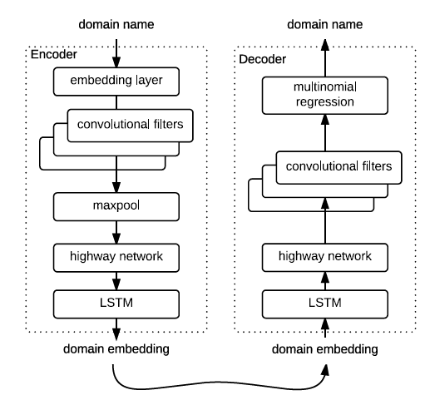
AML against DGA URL Detectors
Adversarial Attacks against DGA URL Classifiers
Anderson et al. (2016) cont’d
Architecture of the autoencoder model
The embedding layer outputs a 20-dimensional vector representation
Convolutional filters are used to capture spatial relations
LSTM layers are used to capture sequential dependencies
Rosenberg et al. (2021) – AML Attacks and Defense Methods in the Cyber Security Domain

Slide 47
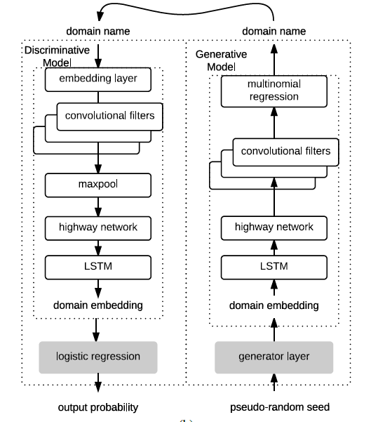
AML against DGA URL Detectors
Adversarial Attacks against DGA URL Classifiers
Anderson et al. (2016) cont’d
Proposed GAN model
Only the shaded layers are trained, and the non-shaded layers are frozen
The encoder is repurposed as a discriminative model
It outputs a probability
The decoder is repurposed as a generative model
It outputs a domain name
Rosenberg et al. (2021) – AML Attacks and Defense Methods in the Cyber Security Domain

Slide 48
AML against DGA URL Detectors
Adversarial Attacks against DGA URL Classifiers
Anderson et al. (2016) cont’d
Comparison of detection rates for several different DGAs
The detection rate for the adversarial samples generated by DeepGA is 48%
The detection rates of the DGA detector model for most other DGAs, used to ransomware, Trojans, and information stealing attacks are over 96%
Rosenberg et al. (2021) – AML Attacks and Defense Methods in the Cyber Security Domain

Slide 49
Additional References
Rosenberg et al. (2021) – Adversarial Machine Learning Attacks and Defense Methods in the Cyber Security Domain (link)
Ganagavarapu (2020) – Applicability of Machine Learning in Spam and Phishing Email Filtering: Review and Approaches (link)
Blog Post by Vladislav Podolyako – Why Spam Filters Hate You (link)
Daniel Lowd – Adversarial Machine Learning
Blog Post by Emily Bauer – 15 Outrageous Email Spam Statistics that Still Ring True in 2018 (link)
Blog Post by Sie Huai Gan – How To Design A Spam Filtering System with Machine Learning Algorithm (link)

