Slide 1
CS 404/504
Special Topics: Adversarial Machine Learning
Dr. Alex Vakanski

Slide 2
Lecture 11
Privacy Attacks against Machine Learning Models

Slide 3
Lecture Outline
Privacy attacks in AML
Categories of privacy attacks
Shokri - Shadow training attack
Fredrickson – Model inversion attack
Causes of privacy leaks
Attacks against distributed learning
Carlini - Training data extraction attack against GPT-2

Slide 4
Privacy Attacks in AML
Privacy Attacks in AML
Privacy attacks are also referred to as inference attacks or confidentiality attacks
They can broadly be developed against:
Training data
E.g., reveal the identity of patients whose data was used for training a model
ML model
E.g., reveal the architecture and parameters of a model that is used by an insurance company for predicting insurance rates
E.g., reveal the model used by a financial institution for credit card approval
Privacy attacks are commonly divided into the following main categories
Membership inference attack
Feature inference attack
Model extraction attack

Slide 5
Membership Inference Attack
Categories of Privacy Attacks
Membership inference attack
Adversarial goal: determine whether or not an individual data instance $x^{∗}$ is part of the training dataset $𝒟$ for a model
The attack typically assumes black-box query access to the model
Attacks on both supervised classification models and generative models (GANs, VAEs) have been demonstrated
A common approach is to first train several shadow models that imitate the behavior of the target model, and use the prediction vectors of the shadow models for training a binary classifier (that infers the membership)
Figure form: Liu et al. (2020) When Machine Learning Meets Privacy: A Survey and Outlook

Slide 6
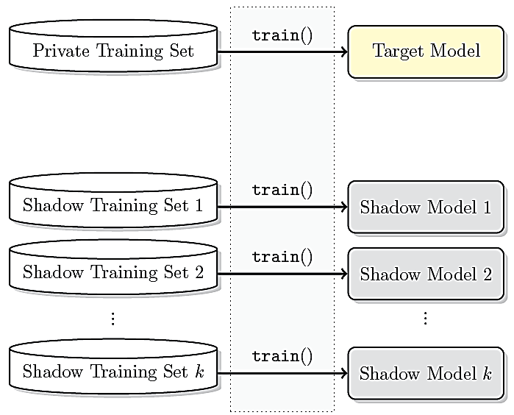
Shadow Training Attack
Membership Inference Attack
Shokri (2016) Membership Inference Attacks Against Machine Learning Models
Threat model:
The adversary has back-box query access to the target model
The goal is to infer whether input samples were part of its private training set
Shadow training approach:
Create several shadow models to substitute the target model
Each shadow model is trained on a dataset that has a similar distribution as the private training dataset of the target model
E.g., if the target model performs celebrity face recognition, the attacker can collect images of celebrities from the Internet
Then, query the target model with images of Brad Pitt, and if the confidence of the target model is high, then probably the private training set contains images of Brad Pitt: use those images for the shadow training sets
Same input instances are used in the shadow training sets for multiple shadow models

Slide 7
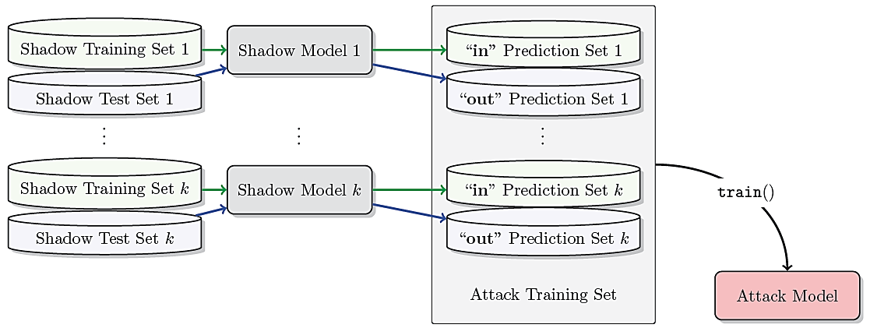
Shadow Training Attack
Membership Inference Attack
The output probability vectors from the shadow models are next used as inputs for training attack models (as binary classifiers) for each class
E.g., the probability vectors for all input images of Brad Pitt from all shadow training sets are labeled with 1 (meaning ‘in’ the training set)
The probability vectors for all input images of Brad Pitt from all shadow test sets are labeled with 0 (meaning ‘out’ or not in the training set)
An attack model is trained on these inputs to perform binary classification (in or out)
A separate attack model is trained for each celebrity person in the shadow training sets

Slide 8
Shadow Training Attack
Membership Inference Attack
The attack models for each class are afterward used to predict whether individual inputs instances were members of the private training set of the target model
The assumption in this attack is that the output probability vectors of the shadow models are different for samples that are members of the shadow training sets, in comparison to samples from the shadow test sets
Experiments showed that increasing the number of shadow models improves the accuracy, but it also increases the computational recourses

Slide 9
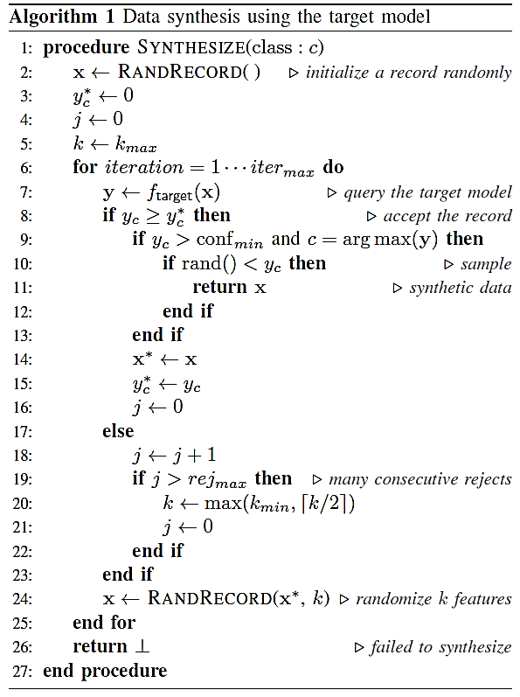
Shadow Training Attack
Membership Inference Attack
If the adversary cannot get access to input samples for shadow training sets or to any other statistics about the target data distribution, the authors developed an algorithm for creating synthetic samples by querying the target model
First, for each class, start with a random sample, query the target model and change each input feature until the modified samples are classified with high confidence
Next, randomly change a set of input features, and repeat the procedure to create new samples

Slide 10
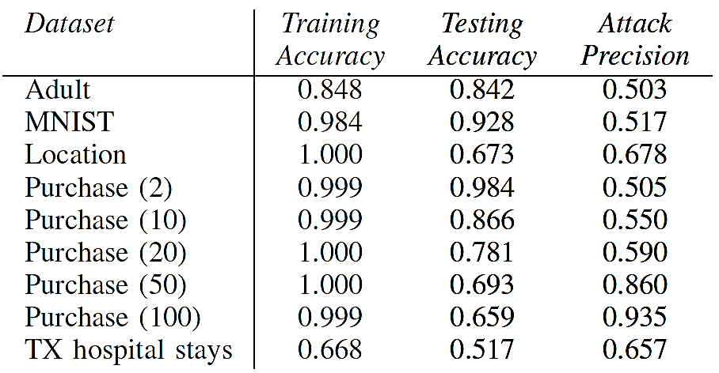
Shadow Training Attack
Membership Inference Attack
The table shows the accuracy of a target model on training and testing sets, and the success of the attack for several models
One can note that the larger the overfitting (difference between the training and testing accuracy), the more successful the membership inference attack is
Conclusively, overfitting not only reduces the generalization of a model, but also makes the model more likely to leak sensitive information about the training data
In addition, the attack was more successful for training datasets that are more diverse and have larger number of classes (e.g., compare Purchase model with 100 classes to Purchase with 2 classes)

Slide 11
Feature Inference Attack
Categories of Privacy Attacks
Feature inference attack
Adversarial goal: recreate certain features of data instances $x^{∗}$ or statistical properties (such as class average of $x^{∗}$) of the training dataset $𝒟$ for the model
A.k.a. attribute inference attack, reconstruction attack, or data extraction attack
Various attacks have been developed to either recover partial information about the training data (such as sensitive features of the dataset, or typical representatives for specific classes in the dataset) or full data samples
An example of a training data extraction attack is described later in this lecture
Similarly, recreating dataset properties that were not encoded in the dataset is also referred to as property inference attack
E.g., extract information about the ratio of men and women in a patient dataset, despite that gender information was not provided for the training records
Figure form: Liu et al. (2020) When Machine Learning Meets Privacy: A Survey and Outlook

Slide 12
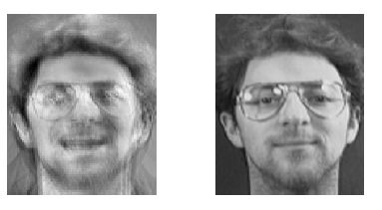
Model Inversion Attack
Feature Inference Attack
Fredrickson (2015) Model Inversion Attacks that Exploit Confidence Information and Basic Countermeasures
Model inversion attack creates prototype examples for the classes in the dataset
The authors demonstrated an attack against a DNN model for face recognition
Given a person’s name and white-box access to the model, the attack reverse-engineered the model and produced an averaged image of that person
The obtained averaged image (left image below) makes the person recognizable
This attack is limited to classification models where the classes pertain to one type of object (such as faces of the same person)
Recovered image using the model inversion attack
Image of the person used for training the model

Slide 13
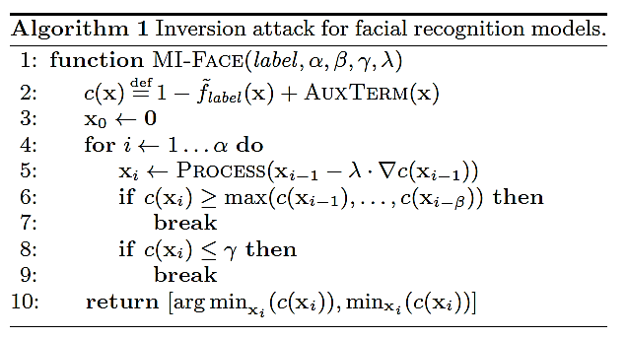
Model Inversion Attack
Feature Inference Attack
The model inversion attack applies gradient descent to start from a given label, and follow the gradient in a trained network to recreate an image for that label
The cost function is denoted c, whereas the PROCESS function applies image denoising and sharpening operations to improve the reconstructed image
Model inversion attack can be used for potential breaches where the adversary, given some access to the model, can infer features that characterize each class

Slide 14
Model Extraction Attack
Categories of Privacy Attacks
Model extraction attack
Adversarial goal: reconstruct an approximated model $f′(x)$ of the target model $f(x)$
A.k.a. model inference attack
The approximated function $f^{′}\left(x\right)$ will act as a substitute model and produce similar predicted outputs as the target model
The adversary has black-box query access to the model
The goal is to “steal” the model and use the substitute model for lunching other attacks, such as synthesis of adversarial examples, or membership inference attacks
Besides creating a substitute model, several works focused on recovering the hyperparameters of the model, such as the number of layers, optimization algorithm, activation types used, etc.
Figure form: Liu et al. (2020) When Machine Learning Meets Privacy: A Survey and Outlook

Slide 15
Causes of Privacy Leaks
Causes of Privacy Leaks
Overfitting is among the main causes of privacy leakage
It leads to poor generalization and memorization of the training data
Adversarial training is characterized with a trade-off between the model accuracy and robustness
The reduced accuracy can lead to increased sensitivity to data leakage
Datasets that are more diverse and with larger number of class labels are more susceptible to attacks
Binary classifiers are safer than multiclass models
Input samples that are out-of-distribution (i.e., are considered outliers with respect to the distribution of the training data) are more susceptible to privacy leakage
Model complexity can also impact the vulnerability
Complex models with large number of parameters memorize more sensitive information about the training data

Slide 16
Attacks against Distributed Learning
Attacks against Distributed Learning
Privacy attacks against federated learning and related distributed learning cases have also been demonstrated
The attacks can be passive (the adversary collects the updates) and active (the adversary shares information to impact the training procedure)
A malicious attacker who participates in federated learning can perform membership inference attack to reveal if other participants used a data record for training
Nasr (2018) Machine Learning with Membership Privacy Using Adversarial Regularization
Property inference attacks were developed to reveal whether training data with certain properties were used by the other participants
Melis (2019) Exploiting Unintended Feature Leakage in Collaborative Learning
Training data reconstruction attack was accomplished by using an additional GAN model for reconstructing class representative samples from the local dataset used by the other participants
Hitaj (2017) Deep Models Under the GAN: Information Leakage from Collaborative Deep Learning

Slide 17
Training Data Extraction Attack
Training Data Extraction Attack
Training data extraction attack
Carlini (2020) Extracting training data from large language models
Attack on GPT-2 language model (LM)
GPT-2 has 1.5 billion parameters, it is trained on public data collected from the Internet
The goal of the attack is to analyze output text sequences from GPT-2 and identify text that has been memorized by the model
The authors had black-box query access to the GPT-2 model
Successfully extracted data examples include:
Personally identifiable information (PII): names, phone numbers, e-mail addresses
News headlines, log files, Internet forum conversations, code
The extracted information was present in just one document in the training data

Slide 18
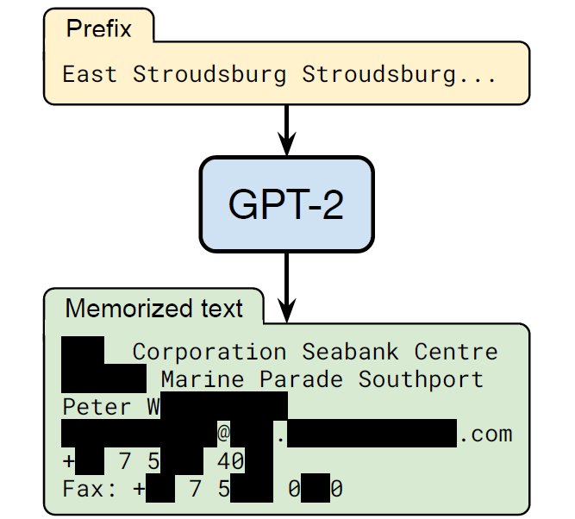
Training Data Extraction Attack
Training Data Extraction Attack
Example of training data extraction
The authors query GPT-2 by entering the prefix: “East Stroudsburg Stroudsburg...”
The model outputted a block of text, which included the full name, phone number, email address, and physical address of the person
This information was included in the training data for GPT-2, it was memorized by the model, and extracted by using the training data extraction attack

Slide 19
Training Data Extraction Attack
Training Data Extraction Attack
The main findings of the study are:
Most of the memorized samples were found in only 1 document in the dataset
However, the samples were repeated multiple times in the document
Out of 1,800 candidate sequences that were manually analyzed by the authors, GPT-2 memorized 600 from the public training data
Larger language models are more vulnerable to data extraction than smaller models
Although LMs are trained on large datasets and therefore they exhibit little overfitting, they can still memorize the training data
Implications:
Training data extraction attacks have previously been limited to small LMs trained on small datasets
It was also believed that LMs do not memorize the data, because they exhibit little overfitting
Recent LMs are increasingly larger, thus, such vulnerabilities can become more significant

Slide 20
Language Models
Training Data Extraction Attack
Language models (LMs) are statistical models that assign a probability to a sequence of words
Modern language models include:
Switch Transformer (Google, 2021): 1.6 trillion parameters
MT-NLPG or Megatron Turing NLG (Microsoft & NVIDIA, 2021): 530 billion parameters
GPT-3 (OpenAI, 2020): 175 billions parameters
Turing NLG, or Natural Language Generation (Microsoft, 2020): 17 billion parameters
T5, or Text-to-Text Transfer Transformer (Google, 2019): 11 billion parameters
Megatron ML (NVIDIA, 2019): 8.3 billion parameters
GPT-2 (OpenAI, 2019): 1.5 billion parameters
BERT, or Bidirectional Encoder Representations from Transformers (Google, 2018): 110 million parameters
GPT (OpenAI, 2018): 110 million parameters

Slide 21
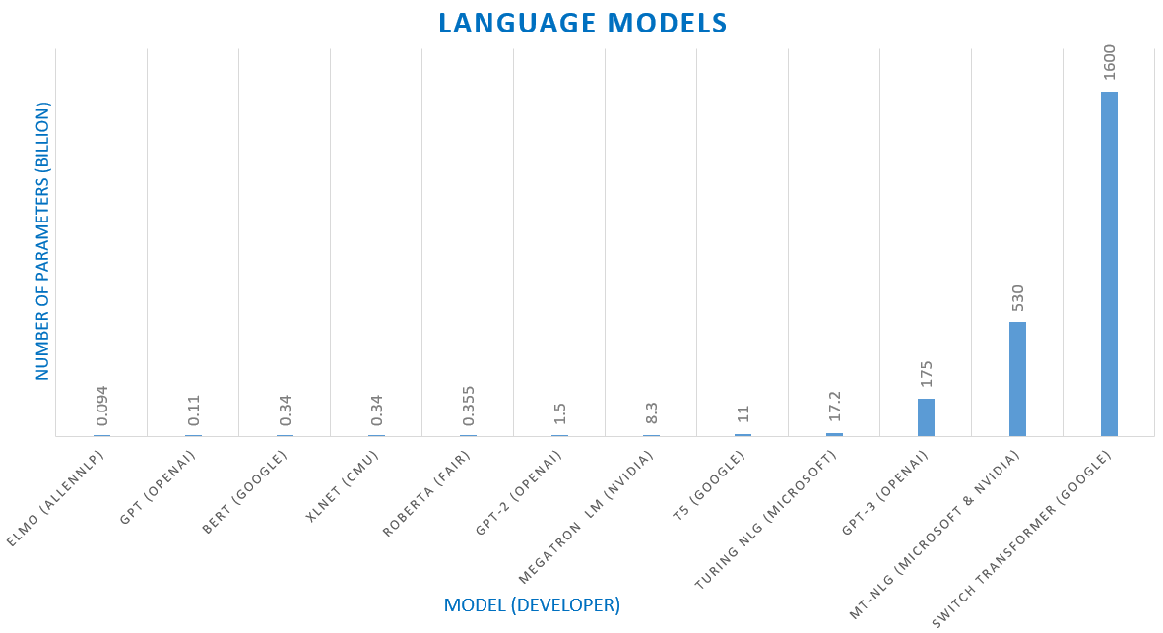
Language Models Graph
Training Data Extraction Attack
Language models and number of parameters

Slide 22
Language Models Timeline
Training Data Extraction Attack
Language models timeline

Slide 23
Language Models
Training Data Extraction Attack
Language models are trained on large training datasets containing raw text scraped from the Internet
LM generate text sequences as fluent natural language
Therefore, are generative ML models
The quality of text generated by LMs is often undistinguishable from human-written text
A common approach to train LMs is the “next-step prediction” objective
I.e., when prompted with a sequence of words, predict the next word in the sequence
This is unsupervised learning, since the training set is not labeled
Given a sequence of tokens (word embeddings) $x_{1},x_{2},…,x_{i−1}$ from a vocabulary $𝒱$, the objective is to estimate the probability of the next token $x_{i}$ in the sequence given the previous tokens, i.e., $𝒫\left(x_{i}|x_{1},x_{2},…,x_{i−1}\right)$
E.g., given the sequence “Marry had a little,” the word “lamb” is the most likely next word in the sequence

Slide 24
Language Models
Training Data Extraction Attack
NNs are currently used for estimating the likelihood of the next token $x_{i}$ in NLP
Earlier works in NLP used architectures with recurrent layers (e.g., LSTM layers)
Recent works use attention-based architectures
Transformer is one such model that has been regularly used in recent LMs, consisting of a sequence of attention layers
Training examples in LMs are text documents
E.g., webpages, new articles from the Internet
The training loss minimizes the error in predicting the next token
For an NN $f$with parameters $θ$, the objective is to find network parameters $θ$ that minimize the loss $ℒ\left(θ\right)=−\log{\prod_{i=1}^{n}{f_{θ}\left(x_{i}|x_{1},x_{2},…,x_{i−1}\right)}}$
$n$ is the number of tokens in the vocabulary $𝒱$

Slide 25
GPT-2
Training Data Extraction Attack
GPT-2 (Generative Pre-training Transformer) was released by OpenAI in 2019
It is a family of several models with varying number of parameters, trained using the same dataset
GPT-2 XL: 1.5 billion parameters
GPT-2 Medium: 334 million parameters
GPT-2 Small: 124 million parameters
The training dataset consists of 40GB of de-duplicated text data
The data is scraped from publicly available sources from the Internet
For the training data extraction attack the authors used GPT-2 XL
It was found that GPT-2 XL memorized 10 times more information than GPT-2 Small

Slide 26
GPT-3
Training Data Extraction Attack
GPT-3 was released by OpenAI in 2020
Training dataset: 45 TB of text
The cost for training GPT-3 175B reportedly is $US 12 million
Besides sentence continuation based on user’s prompt, GPT-3 has also been used for other tasks, such as answering questions, summarizing text, language translation, information retrieval, automated code generation, etc.
Check an example of generating JavaScript XML (JSX) code for web and mobile User Interface applications by GPT-3 (link) and OpenAI’s Codex model (link)
There are several GPT-3 variants

Slide 27
Language Models
Training Data Extraction Attack
LMs in other languages have also been developed recently
Wudao (Chinese LM, 1.75 trillion parameters), HyperCLOVA (Korean)
The German AI startup Aleph Alpha developed a large European language model, fluent in English, German, French, Spanish, and Italian
Microsoft recently trained ZeRO-Infinity LM with 32 trillion parameters (it is not known if it outperforms current LMs)
Several LMs are available through black-box API
Users can enter a prompt and obtain next-word predictions
EleutherAI open-sourced a 6 billion parameter model called GPT-J (demo link)
It is available from Hugging Face
Hugging Face developed open-source NLP library based on the Transformers architectures
Controversy about LMs:
LMs can generate fake news, that are difficult to distinguish from real news
Slide Credit: State of AI Report 2021

Slide 28
Attack Threat Model
Training Data Extraction Attack
The authors had black-box query access to GPT-2
Objective: extract memorized training data
The strength of the attack is measured based on the number of documents in which the text appeared
Memorizing one word that occurred in many training examples (documents) is not severe
Stronger attack extract text that occurred in one single document
This is referred to as “unintended” memorization
The training data for GPT-2 was collected by OpenAI from public sources
OpenAI didn’t release the training dataset
But they released a document on the data collection process
The authors downloaded the public data by following the documentation
They didn’t have access to the actual dataset used by OpenAI

Slide 29
Attack Approach
Training Data Extraction Attack
Attack approach
Generate many text samples by using prefix prompts to GPT-2
Build 3 datasets of 200,000 generated samples, each sample if 256 tokens long
Sort the generated output text using 6 metrics (see next page)
LM has high confidence when the text is taken directly from the training data
Remove duplicate outputs
For the top 100 outputs, perform an Internet search to confirm whether the generated text is an exact match to a web document
Check with OpenAI to confirm if the extracted text occurred in their training dataset

Slide 30
Attack Approach
Training Data Extraction Attack
Metrics for sorting the predicted text
Perplexity, quantifies the level of “surprise” by the GPT-2 model
Defined as $P=exp\left(−\left(1/n\right){\sum_{i=1}^{n}{{logf}_{θ}\left(x_{i}|x_{1},x_{2},…,x_{i−1}\right)}}\right)$
Comparison to the predictions by GPT-Small and GPT-Medium models
It is less likely that the different models will memorize the same data
Text entropy when the output is compressed using zlib compression
Perplexity when the text is switched from uppercase to lowercase letters
Averaged perplexity using a sliding window of 50 tokens
Other strategies to improve the attack:
Use prompts based on Internet text
The authors used 3 datasets of 200,000 generated samples
For the 6 metrics above, this resulted in 3$×$6 configurations, or 1,800 top samples

Slide 31
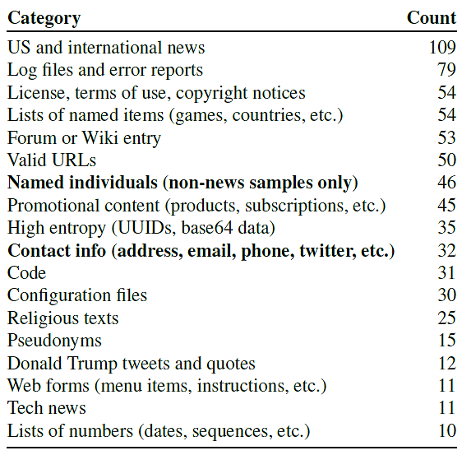
Results
Training Data Extraction Attack
The authors manually inspected 1,800 generated samples from GPT-2
They identified 604 memorized training examples (about 33% of the samples)
The categories of memorized training examples are shown in the table

Slide 32
Results
Training Data Extraction Attack
Examples of memorized content
Personally identifiable information (PII)
Found 78 examples of peoples’ names, phone numbers, addresses, and social media accounts
E.g., extracted the usernames of participants in an Internet forum conversation that appeared in one training document
URLs
50 examples of memorized URLs
Code
Identified 31 samples that contain snippets of memorized source code
Unnatural text
E.g., UUID: 1e4bd2a8-e8c8-4a62-adcd-40a936480059
GPT-2 memorized removed content
The authors extracted content that has been removed from the Internet, but it had been memorized by GPT-2

Slide 33
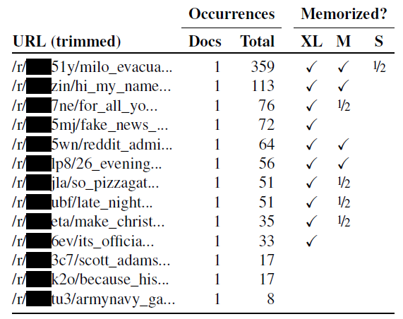
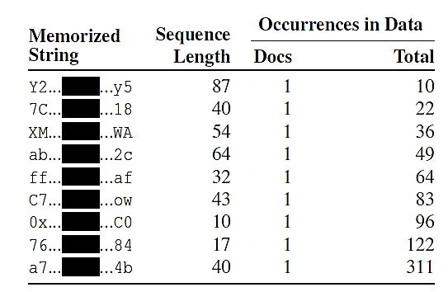
Results
Training Data Extraction Attack
Examples of memorized strings of unnatural text and URLs that occurred in only 1 document in the training data
E.g., in the left table the first extracted string listed has 87 characters, and occurred 10 times in 1 document
In the right table, we can see that GPT-XL model memorized more content than GPT-S and GPT-M models

Slide 34
Mitigation Strategies for Data Leakage
Training Data Extraction Attack
Selecting the training data for LMs
Avoid text from websites that are known to host sensitive data
Apply methods that limit the amount of sensitive content
E.g., filter personal information
De-duplicate content in the training data
Training with differential privacy
DP can reduce, but cannot prevent, memorization of content that occurs often in the dataset
Limitation: reduced accuracy, longer training times
Auditing LMs for memorization
Determine the level of memorization in LMs
E.g., the training data extraction attack can be used to evaluate the level of memorization of an LM

Slide 35
Ethical Considerations and Lessons
Training Data Extraction Attack
The authors contacted the individuals whose PII was extracted and obtained permissions to include it in the paper
All PII in the paper is masked with a black rectangle box
Among the 600,000 generated samples, 604 (or 0.1%) contain memorized text
The authors manually inspected only 1,800 samples
For complete memorization, it was estimated that the content should occur 33 times in one single document
It is important to further study and understand memorization in LMs, and develop prevention strategies

Slide 36
References
Liu et al. (2020) When Machine Learning Meets Privacy: A Survey and Outlook (link)
Rigaki and Carcia (2021) A Survey of Privacy Attacks in Machine Learning (link)
Cristofaro (2020) An Overview of Privacy in Machine Learning (link)
State of AI Report 2021 (link)

