Slide 1
CS 404/504
Special Topics: Adversarial Machine Learning
Dr. Alex Vakanski

Slide 2
Lecture 12
Defenses against Privacy Attacks

Slide 3
Lecture Outline
Defenses against Privacy Attacks
Anonymization techniques
Encryption techniques
Differential privacy
Distributed learning
ML-specific techniques
Introduction to differential privacy
Differentially private SGD
Scalable private learning with PATE

Slide 4
Defenses against Privacy Attacks
Defenses against Privacy Attacks
Data privacy techniques have the goal of allowing analysts to learn about trends in data, without revealing information specific to individual data instances
Therefore, privacy techniques involve an intentional release of information, and attempt to control what can be learned from the released information
Related to data privacy is the Fundamental Law of Information Recovery, which states that “overly accurate estimates of too many statistics can completely destroy privacy”
I.e., extracting useful information from a dataset (e.g., for training an ML model) poses a privacy risk to the data
There is an inevitable trade-off between privacy and accuracy (i.e., utility)
Preferred privacy techniques should provide an estimate of how much privacy is lost by interacting with data

Slide 5
Defenses against Privacy Attacks
Defenses against Privacy Attacks
Defense strategies against privacy attacks in ML can be broadly classified into:
Anonymization techniques
Encryption techniques
Differential privacy
Distributed learning
ML-specific techniques

Slide 6
Anonymization Techniques
Anonymization Techniques
Anonymization techniques provide privacy protection by removing identifying information in the data
E.g., remove personal identifiable information (PII)
In the example below, the Name and Address columns are masked
User ID | Name | Address | Account Type | Subscription Date
001 | Alice | 123 A St | Pro | 01/02/20
002 | Bob | 234 B St | Free | 02/03/21
003 | Charlie | 456 C St | Pro | 03/04/18
User ID | Name | Address | Account Type | Subscription Date
001 | Alice | 123 A St | Pro | 01/02/20
002 | Bob | 234 B St | Free | 02/03/21
003 | Charlie | 456 C St | Pro | 03/04/18

Slide 7
Anonymization Techniques
Anonymization Techniques
Anonymization is not an efficient defense method, since the remaining information in the data can be used for identifying the individual data instances
For example, based on health records (including diagnoses and prescriptions) with removed personal information released by an insurance group in 1997, a researcher extracted the information for the Governor of Massachusetts
This is referred to as de-anonymization
The same researcher later showed that 87% of all Americans can be uniquely identified using 3 bits of information: ZIP code, birth date, and gender
Dataset 1: Users medical database
Dataset 2: Users medical database with name and address removed
User ID | Name | Address | Zip Code | Birth date | Gender | Probable disease ID
001 | Alice | 123 A St | 83401 | 01/02/1997 | F | 120
002 | Bob | 234 B St | 83402 | 02/03/1995 | M | 35
003 | Charlie | 456 C St | 83403 | 03/04/1999 | M | 240
User ID | Zip Code | Birth date | Gender | Probable disease ID
001 | 83401 | 01/02/1997 | F | 120
002 | 83402 | 02/03/1995 | M | 35
003 | 83403 | 03/04/1999 | M | 240

Slide 8
Linkage Attack
Anonymization Techniques
De-anonymization of data by using connections to external sources of information is referred to as linkage attack
For example:
In 2006, Netflix published anonymized 10 million movie rankings by 500,000 customers
Two researchers showed later that by using movie recommendations on IMDb (Internet Movie Database) they could identify the customers in the Netflix data
Dataset 1: Annonymized dataset with removed personal information
Dataset 2: External public dataset that reveals the users in Dataset 1
User ID | Name | Address | Account Type | Subscription Date
001 | Alice | 123 A St | Pro | 01/15/20
002 | Bob | 234 B St | Pro | 02/03/21
003 | Charlie | 456 C St | Free | 03/04/18
User ID | Product Name | Product Price | Purchase Date
001 | TV | 400 | 01/02/20
002 | Iphone | 1,199 | 02/02/21
003 | Watch | 130 | 02/22/18

Slide 9
k-anonymity
Anonymization Techniques
k-anonymity is an approach for protecting data privacy by suppressing certain identifying data features
This approach removes fields of data for individuals who have unique characteristics
E.g., students at UI who are from Latvia and are enrolled in Architecture
A dataset is k-anonymous if for any person’s record, there are at least $k−1$ other records that are indistinguishable
Therefore, a linkage attack will result in a group of k records that can belong to a person of interest
Limitation: this approach is mostly applicable to large datasets with low-dimensional input features
The more input features there are for each record, the higher the possibility of unique records

Slide 10
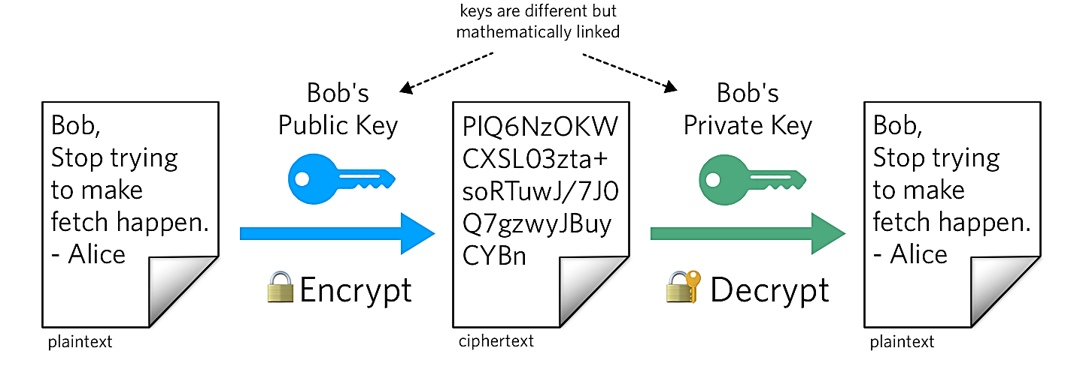
Encryption Techniques
Encryption Techniques
Encryption is a cryptography approach, which converts the original representation of information into an alternative form
The sender of encrypted information shares the decoding technique only with the intended recipients of the information
Encrypting the training data has been applied in ML
Common techniques for data encryption include:
Homomorphic encryption (HE)
Secure multi-party computation (SMPC)
Encrypting ML models is less common approach
Homomorphic encryption has been applied to the model gradients in collaborative DL setting to protect the model privacy
Figure form: What is Public Key Cryptography?

Slide 11
Homomorphic Encryption
Encryption Techniques
Homomorphic encryption (HE) allows users to perform computations on encrypted data (without decrypting it)
Encrypted data can be analyzed and manipulated without revealing the original data
HE uses a public key to encrypt the data, and applies an algebraic system (e.g., additions and multiplications) to allow computations while the data is still encrypted
Only the person who has a matching private key can access the decrypted results

Slide 12
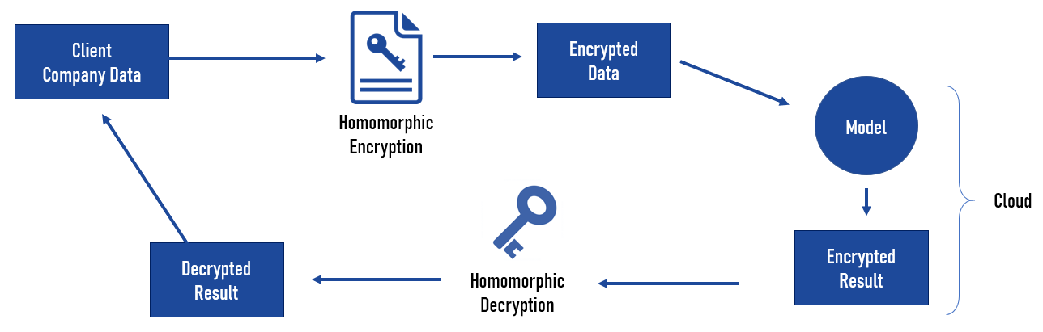
Homomorphic Encryption
Encryption Techniques
In ML, training data can be encrypted and send to a server for model training
Even if the server is untrusted or it is compromised, confidentiality of the data will remain preserved
One main limitation of HE is the slowing down of the training process
HE has been applied to traditional ML approaches, such as Naïve Bayes, decision trees
Training DNNs over encrypted data is still challenging, due to the increased computational complexity
Figure form: Homomorphic Encryption & Machine Learning: New Business Models

Slide 13
Privacy versus Confidentiality
Encryption Techniques
Encryption techniques in ML are mainly applied to protect the confidentiality of the data or model
Confidentiality refers to keeping the information (training data, model parameters) hidden from the clients and the public
It is ensuring that only authorized parties have access to the information
E.g., a server has an ML model trained on private data and provides the model to a client for inference
It is preferred to preserve the confidentiality of the model parameters from the client
Privacy refers to intentional release of information in a controlled manner to prevent unintended information leakage
It is ensuring that released data cannot uniquely identify individual inputs
E.g., a server applies DP to a trained ML model to prevent memorization of information about individual inputs
Protecting privacy is more challenging than protecting confidentiality

Slide 14
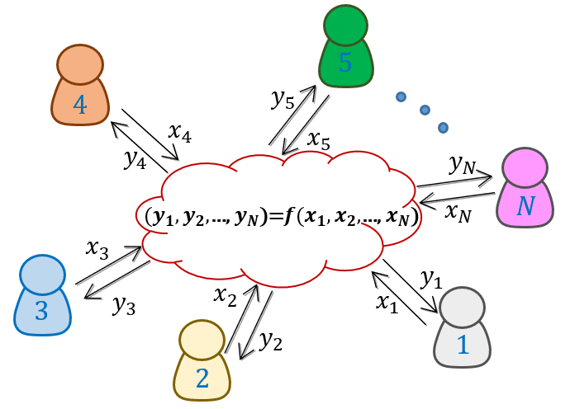
Secure Multi-Party Computation
Encryption Techniques
Secure Multi-Party Computation (SMPC) is an extension of encryption in multi-party setting
SMPC allows two or more parties to jointly perform computation over their private data, without sharing the data
E.g., two banks want to know if they have both flagged the same individuals and learn about the activities by those individuals
The banks can share encrypted tables of flagged individuals, and they can decrypt only the matched records, but not the information for individuals that are not in both tables
Figure form: Generation and Distribution of Quantum Oblivious Keys for Secure Multiparty Computation

Slide 15
Secure Multi-Party Computation
Encryption Techniques
SMPC versus HE
SMPC protects the privacy of the data in collaborative learning
E.g., participants in collaborative learning do not trust the other participants or the central server
HE protects the confidentiality of the data from external adversaries
E.g., a data owner wants to use a MLaaS (Machine Learning as a Service) , but does not trust the service provider: the owner sends encrypted data, the provider process encrypted data and sends back encrypted results, the owner decrypts the results
Or, a bank can store encrypted banking information in the cloud, and use HE to ensure that only the employees of the bank can access the data

Slide 16
Secure Multi-Party Computation
Encryption Techniques
In ML, SMPC can be used to compute updates of the model parameters by multiple parties that have access to their private data
For examples, SMPC has been applied to federated learning, where participants encrypt their updates, and the central server can recover only the sum of the updates from all participants
Beside the data privacy, SMPC also offers protection against adversarial participants
Either all parties are honest and can jointly compute the correct output, or if a malicious party is dishonest the joint output will be incorrect
SMPC has been applied to traditional ML models, such as decision trees, linear regression, logistic regression, Naïve Bayes, k-means clustering
Application of SMPC to deep NNs is also challenging, due to increased computational costs

Slide 17
Differential Privacy
Differential Privacy
Differential privacy is based on employing obfuscation mechanisms for privacy protection
A randomization mechanism $ℳ\left(D\right)$ applies noise $ξ$to the outputs of a function $f\left(D\right)$ to protect the privacy of individual data instances, i.e., $ℳ\left(D\right)=f\left(D\right)+ξ$
Commonly used randomization mechanisms include Laplacian, Gaussian, and Exponential mechanism
DP is often implemented in practical applications
Examples include:
2014: Google's RAPPOR, for statistics on unwanted software hijacking users' settings
2015: Google, for sharing historical traffic statistics
2016: Apple, for improving its Intelligent personal assistant technology
2017: Microsoft, for telemetry in Windows
2020: LinkedIn, for advertiser queries
2020: U.S. Census Bureau, for demographic data

Slide 18
Differential Privacy
Differential Privacy
In ML, DP is achieved by adding noise to:
Model parameters
Several works applied DP to conventional ML methods
Differentially private SGD (Abadi, 2016) clips and adds noise to the gradients of deep NNs during training
This reduces the memorization of individual input instances by the model
The approaches that apply obfuscation to the model parameters via DP are also referred to as differentially private ML
Model outputs
PATE (Private Aggregation of Teacher Ensembles) approach (Papernot, 2018) employs an ensemble of models trained on disjoint subsets of the training data, called teacher models
Noise is added to the outputs of the teacher models, and the aggregated outputs are used to train another model, called student model
Training data
Obfuscation of training data in ML has been also investigated in several works

Slide 19
Differential Privacy
Differential Privacy
DP is typically applied in a centralized learning setting, where the data and model are at the same location
In this scenario, all data is gathered in one central location for model training
E.g., MLaaS typically requires that the users upload their data to a cloud-based server for training a model
Recently, DP has also been applied in a distributed learning setting, where the data are kept at separate locations from the model
DP-FedAvg (McMahan, 2018) is applied to federated learning
It introduced the Federated Averaging algorithm to limits the contributions by the individual users data to the learning model

Slide 20
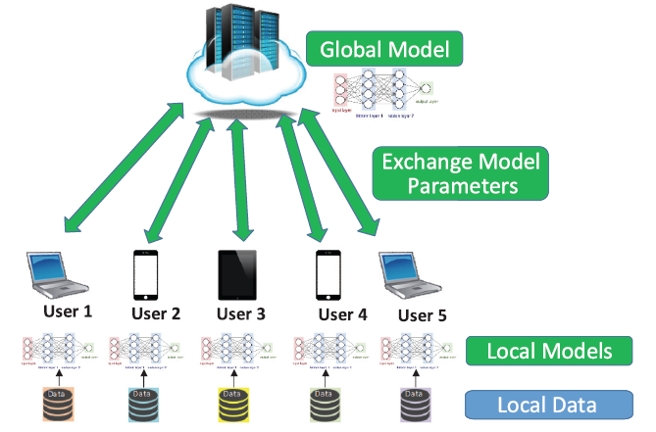
Distributed Learning
Distributed Learning
Distributed learning allows multiple parties to train a global model without releasing their private data
Some form of aggregation is applied to the local updates of the model parameters by the users in distributed learning to create a global model
E.g., averaging is one common form of aggregation
Federated learning is the most popular distributed learning scheme
Figure form: Liu et al. (2020) When Machine Learning Meets Privacy: A Survey and Outlook

Slide 21
Distributed Learning
Distributed Learning
Federated learning or collaborative learning – learn one global model using data stored at multiple locations (e.g., remote devices)
The data are processed locally, and used to update the model
The data does not leave the remote devices, remains private
The central server aggregates the updates and creates the global model
Decentralized Peer-to-Peer (P2P) learning – the remote devices communicate and exchange the updates directly, without a central server
Removes the need to send updates to a potentially untrusted central server
Split learning – each remote device is used to train several layers of the global model, and send the outputs to a central server
The remote devices can train the initial layers of a DNN, and the central server can train the final layers
The gradient is back-propagated from the central server to each user to sequentially complete the back-propagation through all layers of the model
The devices send the intermediate layers outputs, rather than model parameters
Split learning is more common for IoT devices with limited computational resources

Slide 22
ML-Specific Techniques
ML-Specific Techniques
In the lecture on privacy attacks in ML, we mentioned that overfitting is one of the reasons for information leakage
Regularization techniques in ML can therefore be used to reduce overfitting, as well as a defense strategy
Different regularization techniques in NNs include:
Explicit regularization: dropout, early stopping, weight decay
Implicit regularization: batch normalization
Other ML-specific techniques include:
Dimensionality reduction – removing inputs with features that occur rarely in the training set
Weight-normalization – rescaling the weights of the model during training
Selective gradient sharing – in federated learning, the users share a fraction of the gradient at each update

Slide 23
Introduction to Differential Privacy
Koffi Anderson Koffi

Slide 24
Outline
Traditional Data Analysis
Privacy Models
Traditional Privacy Models
Differential Privacy Models
Differential Privacy
Differential Privacy Mechanism
Applications in Machine Learning

Slide 25
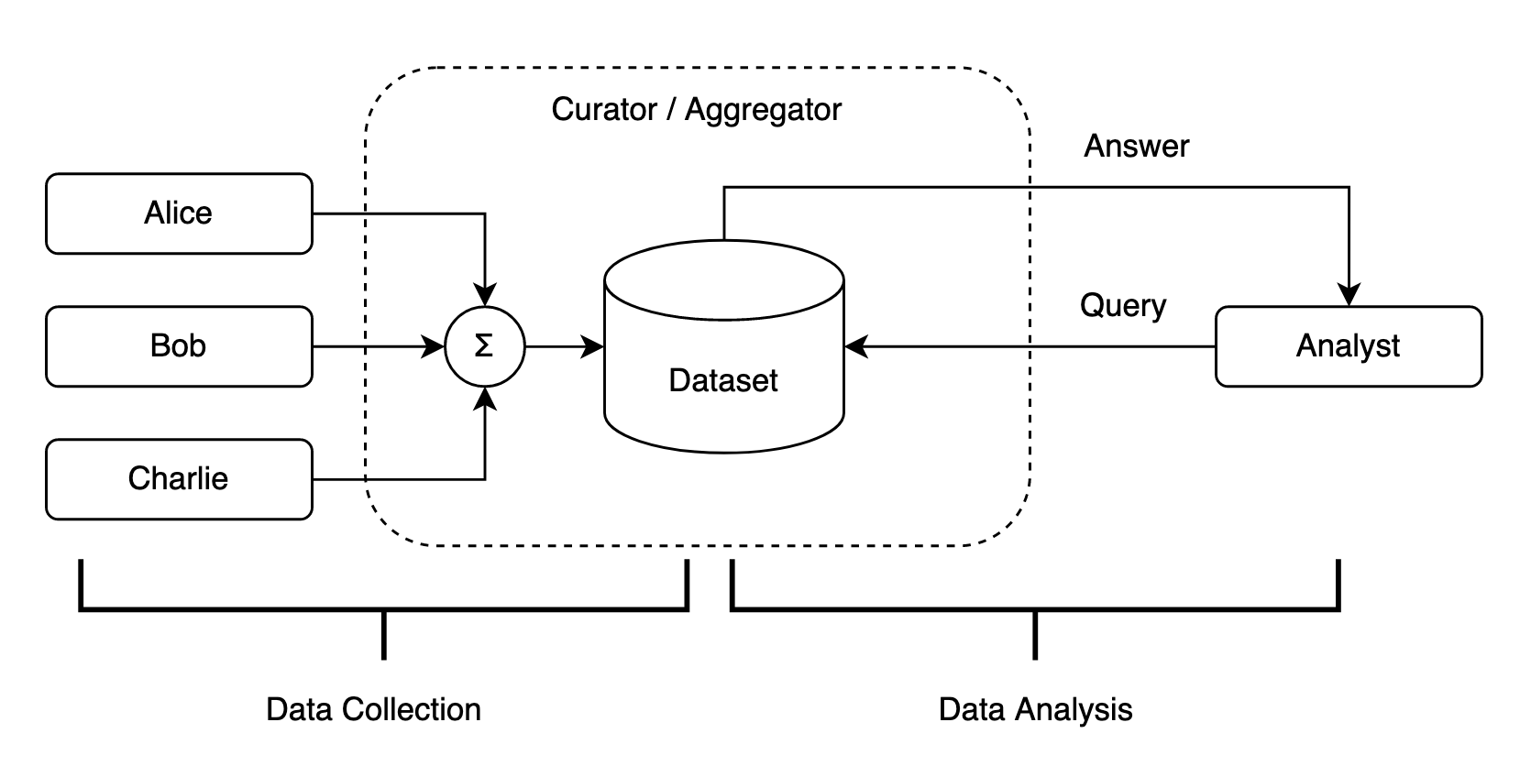
Traditional data analysis
Users provide data to data curator
Data curator de-anonymizes and aggregates the data into a dataset
Data curator makes the data available to data analysts
Data analysts can query and retrieve information from the dataset

Slide 26
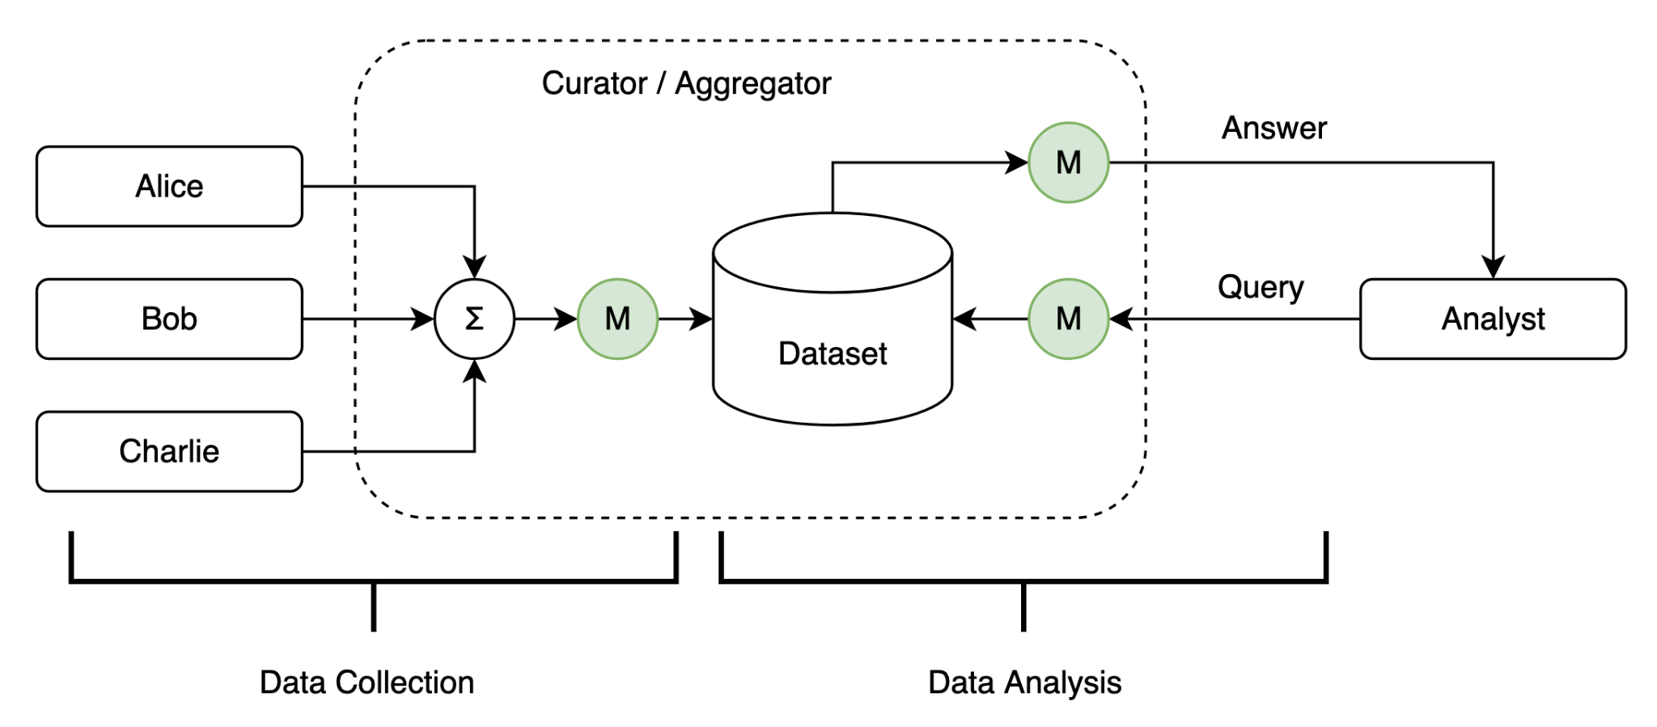
Privacy Models
A set of methods and techniques to preserve the privacy of data
And their associated privacy evaluation metrics

Slide 27
Privacy Models
To protect personal data of users, a privacy model preprocesses the aggregated data before their insertion into the dataset
To ensure the queries do not lead to loss of privacy, the queries are preprocessed before they are applied to the dataset
To protect leakage of private data in answers to queries, the answers are preprocessed by the privacy model before submission to the analyst

Slide 28
Traditional Privacy Models
Data Anonymization / De-identification
Removing identifiable information from the dataset column-wise
Methods consist of stripping, masking, swapping, perturbing, some columns in the dataset
User ID | Name | Address | Account Type | Subscription Date
001 | Alice | 123 A St | Pro | 01/02/20
002 | Bob | 234 B St | Free | 02/03/21
003 | Charlie | 456 C St | Pro | 03/04/18
User ID | Name | Address | Account Type | Subscription Date
001 | Alice | 123 A St | Pro | 01/02/20
002 | Bob | 234 B St | Free | 02/03/21
003 | Charlie | 456 C St | Pro | 03/04/18

Slide 29
Traditional Privacy Models
Data Anonymization / De-identification
Privacy leakage attack through background information (Linking attack)
Dataset 1: Users database with personal information
Dataset 2: Users medical database with personal information stripped (name and address)
User ID | Name | Address | Zip Code | Birth date | Gender
001 | Alice | 123 A St | 83401 | 01/02/1997 | F
002 | Bob | 234 B St | 83402 | 02/03/1995 | M
003 | Charlie | 456 C St | 83403 | 03/04/1999 | M
User ID | Zip Code | Birth date | Gender | Probable disease ID
001 | 83401 | 01/02/1997 | F | 120
002 | 83402 | 02/03/1995 | M | 35
003 | 83403 | 03/04/1999 | M | 240
It is possible to uniquely identify a user with the triplet (Zip Code, Birth date, Gender)!

Slide 30
Traditional Privacy Models
Data Anonymization / De-identification
Anonymized datasets have less useful information than non-anonymized datasets
Use of anonymized dataset in business applications violates some regulations
It is possible to infer personal information of users from de-anonymized dataset
Table 3
Table 4
User ID | Name | Address | Account Type | Subscription Date
001 | Alice | 123 A St | Pro | 01/02/20
002 | Bob | 234 B St | Free | 02/03/21
003 | Charlie | 456 C St | Pro | 03/04/18
User ID | Product Name | Product Price | Purchase Date
001 | TV | 400 | 04/01/21
002 | Iphone | 1199 | 10/10/21
003 | Watch | 130 | 05/09/20
Tracking users with information from Table 1 (User ID) and Table 2 (User ID)

Slide 31
Traditional Privacy Models
k-Anonymity [Emam et al.]
A dataset is said to be k-anonymous if, for any individual record in the dataset, there are at least k−1 other records which are indistinguishable from it.
K-anonymity ensures a linkage attack against a k-anonymous dataset can only identify a group of k records which are indistinguishable one from another
However, k-anonymity only works for very large dataset with simple fields which makes it impracticable in real world scenarios.

Slide 32
Traditional Privacy Models
Randomized Response: A first attempt at Differential Privacy [Warner, 1965]
Problem: Given a survey which contains a sensitive or embarrassing question (query), how to protect the privacy of participants’ responses while performing statistics on the answers.
Approach: Use coin flips
When participants are asked a sensitive question, they flip a coin before answering
If they get heads, they are asked to answer YES to the question regardless of their experience.
When they get tails, they are asked respond truthfully according to their experience.
Results: Double the resulting statistics
At the end of the survey, half of the participant would have answer correctly, while the other half answer falsely.
To account for the half false answers they got, the organizers double the statistics at the end of the survey,
Alternative: [Greenberg, 1969]
When participants get a tail, they are asked to flip a coin again to answer YES when it is heads, and NO when tails.

Slide 33
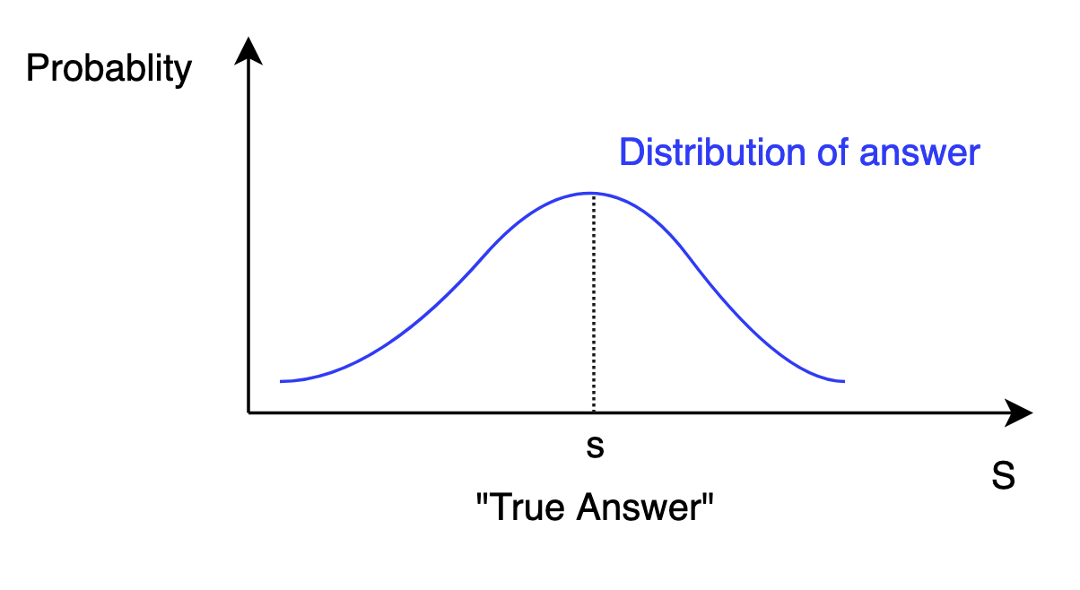
Traditional Privacy Models
Randomized Response: A first attempt at Differential Privacy [Warner, 1965]
The query answer is no longer a deterministic value, but a sampling from a distribution

Slide 34
Differential Privacy Model
A privacy model that ensures privacy of individual data with provable privacy guarantees.
Differential privacy solves the problem of learning useful information about all the records while learning nothing about individual records
It ensures that an adversary cannot infer an unknown data record from known data records
User ID | Name | Address | Account Type | Subscription Date
001 | Alice | 123 A St | Pro | 01/02/20
002 | Bob | 234 B St | Free | 02/03/21
003 | Charlie | 456 C St | Pro | 03/04/18
John knows
two rows
John cannot infer
middle row

Slide 35
Differential Privacy
[Dwork et al.]
Some Definitions
Dataset: a collection of attributes and values (records)
Any subset of a set of n records
Neighboring datasets:
D and D’ are said to be neighboring datasets, denoted as D∼D’, if they differ in one record.
Query: A function to be applied to a dataset
A real-valued query is any function
Sensitivity of a query (l1-sensitivity) ∆q:
Answer: The output of a query q(x) where x is a dataset

Slide 36
Differential Privacy
[Dwork et al.]
Some Definitions
Privacy Mechanism: any algorithm to be applied to a dataset which ensure some privacy guarantees
A privacy mechanism M is an algorithm that has as input a dataset D⊆Xn and optionally a set of queries F and that outputs answers A ⊆ Xn (possible dataset rows) to queries [Dwork et al.]
, M(D) = q(x)
Randomized Privacy Mechanism: any privacy mechanism obtained by coin flips (sampling from a distribution), M(D) = q(x) + (v ∼ Dist)
Privacy Loss: The privacy loss incurred by running a randomized privacy mechanism M on neighboring datasets D∼D′ is given by:
In practice,we expect a low privacy loss bounded by the privacy budget.
Privacy Budget: the privacy budget is the maximum privacy loss incurred by M.
Sensitivity ∆q (local or global): determines how much perturbation is required in the mechanism.

Slide 37
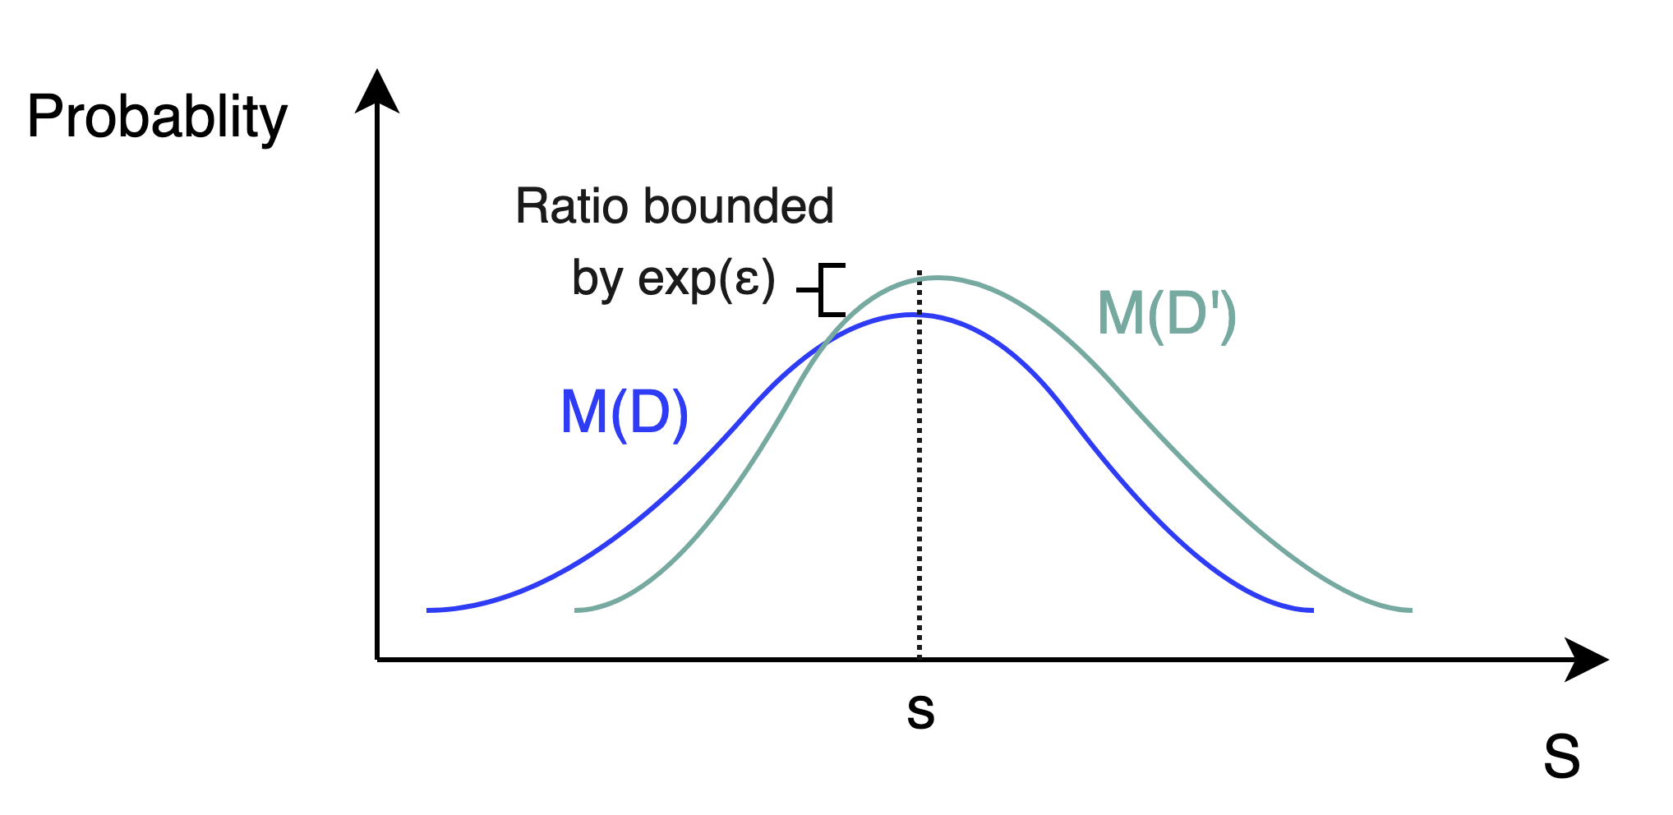
Differential Privacy
[Dwork et al.]
Definition of Differential Privacy:
A randomized privacy mechanism M is a (ε,δ)-differential privacy mechanism if for every set of answers S={ A1, A1,..., Am} and for any neighboring datasets D∼D’ the following inequality holds:
where the randomness results from coin flips of M.
For any pair of answers, the ratio of their probabilities distributions is bounded by exp(ε), i.e., the Privacy Budget (lower represents stronger privacy).

Slide 38
Differential Privacy
[Dwork et al.]
Two flavors of Differential Privacy:
For δ= 0, ε-differential privacy or pure differential privacy
For δ >0, (ε,δ)-differential privacy or approximate differential privacy
Utility: (λ,δ)-useful
Given a randomized query q of a query f is (λ,δ)-useful, if if for any database X ∈ D, with probability at least 1 − δ,
|f(X) − q(X)| ≤ λ. , with λ>0 and 0 < δ < 1.
The utility parameter λ, ensures that the answer to a randomized query is at λ far from the true answer from the deterministic version of the query.
Privacy/Utility trade off:
ε=0 (and δ=0): the mechanism achieves absolute privacy, no utility (very low accuracy).
ε > 0 and ε very large: the mechanism provides no privacy, but achieves perfect utility (high accuracy).

Slide 39
Differential Privacy
Properties of Differential Privacy
Properties of Differential Privacy
Sequential Composition:
If M1(𝑥) satisfies 𝜖1-differential privacy
And M2(𝑥) satisfies 𝜖2-differential privacy
Then the mechanism M(𝑥)=(M1(𝑥),M2(𝑥)) satisfies (𝜖1+𝜖2)-differential privacy
Parallel Composition:
If 𝐹(𝑥) satisfies 𝜖-differential privacy
And we split a dataset 𝑋 into 𝑘 disjoint sets such that 𝑥1 ∪ … ∪ 𝑥𝑘=𝑋
Then the mechanism which releases all of the results 𝐹(𝑥1),...,𝐹(𝑥𝑘) satisfies 𝜖-differential privacy
Group Privacy:
If we split a dataset 𝑋 into 𝑘 disjoint sets such that 𝑥1 ∪ … ∪ 𝑥𝑘=𝑋
Then, any (𝜖, 0)-differentially private mechanism M is (k𝜖, 0)-differentially private for groups of size k disjoint subsets of k.
4. Post-Processing (robustness to auxiliary information):
If 𝐹(𝑋) satisfies 𝜖-differential privacy
Then for any (deterministic or randomized) function 𝑔, 𝑔(𝐹(𝑋)) satisfies 𝜖-differential privacy

Slide 40
Differential Privacy
[Dwork et al.]
Differential Privacy via noise adding : For a specific distribution Dist
Input: dataset D, query q
Steps:
Compute q(x)
Sample noise v ∼ Dist(∆q, ε)
Output: q(x) + v
Popular Privacy Sampling Mechanisms:
Laplace mechanism
Gaussian mechanism
Exponential mechanism

Slide 41
Differential Privacy Mechanisms
Randomized Response: A first attempt at Differential Privacy [Warner, 1965]
Randomized response is (ln(3),0)-Differential Private [Greenberg, 1969]:
P[Response = Yes|Truth = Yes] / P[Response = Yes|Truth = No] = (¾)/ (¼) = 3
The Privacy loss is fixed ε= ln(3)
A more general approach to achieve differential privacy from a deterministic mechanism is to add noise, sampled from a known distribution, to the output of the deterministic mechanism.

Slide 42
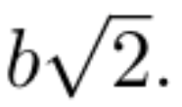
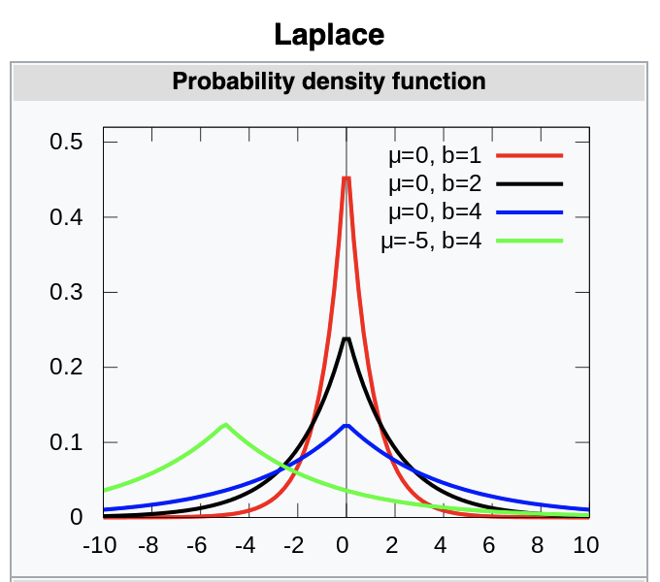
Differential Privacy Mechanisms
Laplace Mechanism: Achieving differential privacy by adding Laplace noise
Privacy mechanism which outputs q(x) + (v ∼ Lap(∆q, ε))
Laplace distribution is centered at 0 with a std of
Its probability density function is given by:
Source: Wikipedia

Slide 43
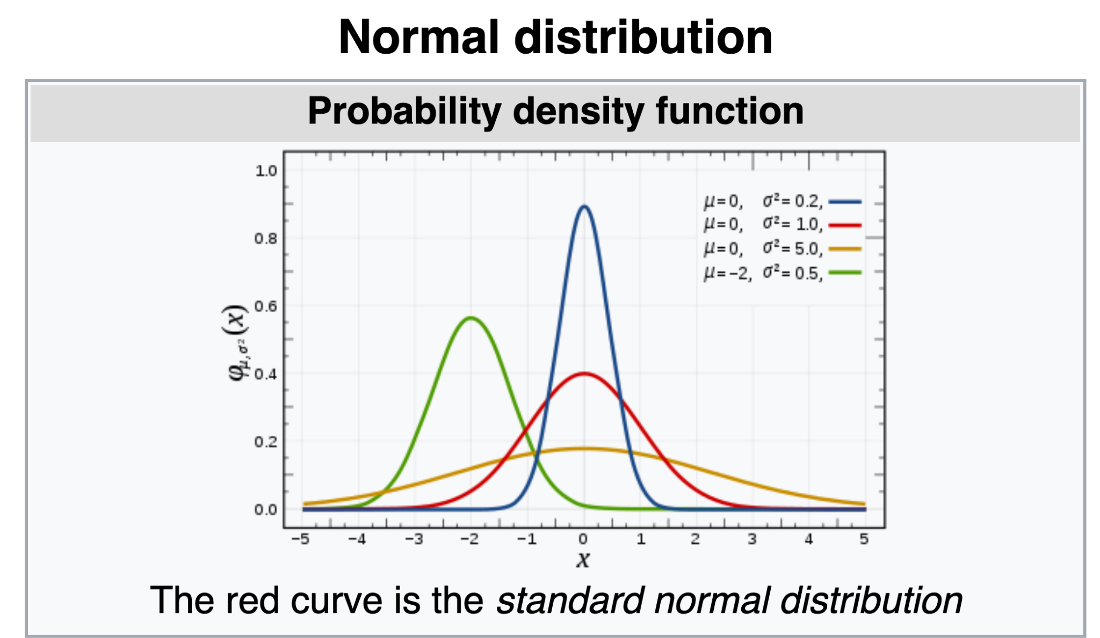
Differential Privacy Mechanisms
Gaussian Mechanism: Achieving differential privacy by adding Gaussian noise
Privacy mechanism which outputs q(x) + (v ∼ N(∆q, ε))
The Gaussian or Normal Distribution has a probability density function given by:
Source: Wikipedia

Slide 44
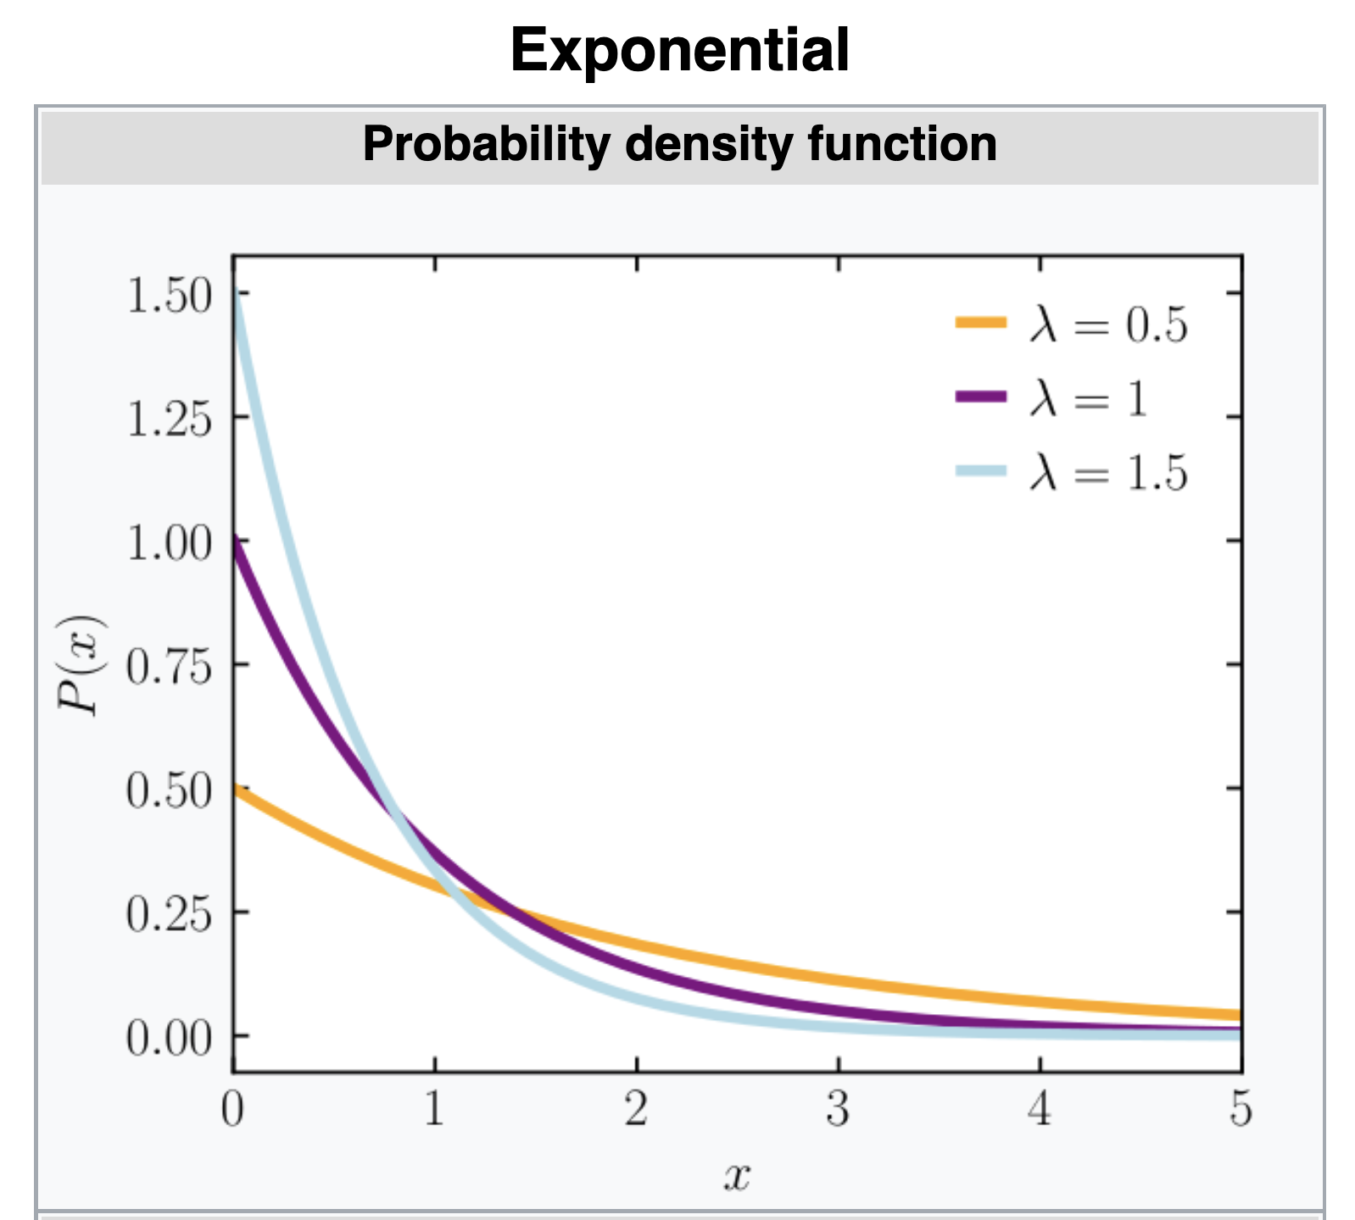
Differential Privacy Mechanisms
Exponential Mechanism: Achieving differential privacy by selecting lowest sensitivity score
Given a sensitivity score function H, selects answer a with the lowest sensitivity score such that
The Exponential distribution is parameterized by with a probability density function given by:
Source: Wikipedia

Slide 45
Differential Privacy Mechanisms
Differential Privacy Mechanisms Summary
Randomized Response:
Pros:
Easy to implement
Cons:
Fixed privacy budget
Not flexible
Laplace mechanism: (𝜖)-differential privacy (pure differential privacy)
Pros:
More accurate query answers
The most general mechanism
Cons:
Noise can take extreme values leading
Requires large privacy budget to work in practice which produce less accurate answers.
Can only be used for for numeric queries only

Slide 46
Differential Privacy Mechanisms
Differential Privacy Mechanisms Summary
Gaussian mechanism: (𝜖,𝛿)-differential privacy (approximate differential privacy)
Pros:
Add less noise than Laplace mechanism
better suited for multivariate problems.
Cons:
requires the use of the the relaxed (𝜖,𝛿)-differential privacy definition
less accurate than the Laplace mechanism
Exponential mechanism:
Pros:
The Laplace mechanism can be derived from the exponential mechanism
The exponential mechanism is extremely general
Can provide answers to non numeric queries
Cons:
It is very difficult to implement

Slide 47
Differential Privacy Mechanisms
Differential Privacy and KL-Divergence [Ilya, 2017]
Kullback-Leibler Divergence
Relaxed (pure) differential privacy
Renyi Divergence: For two probability distributions P and Q defined over R, the Renyi divergence of order α > 1 is
Renyi divergence is KL-divergence for α approaching 1: D1(P||Q) = lim α→1, Dα(P||Q)
(α,𝜖)-Renyi Differential Privacy:
A randomized mechanism f : D→R is said to have (𝜖)-Renyi differential privacy of order α, if for any neighboring dataset D and D′:

Slide 48
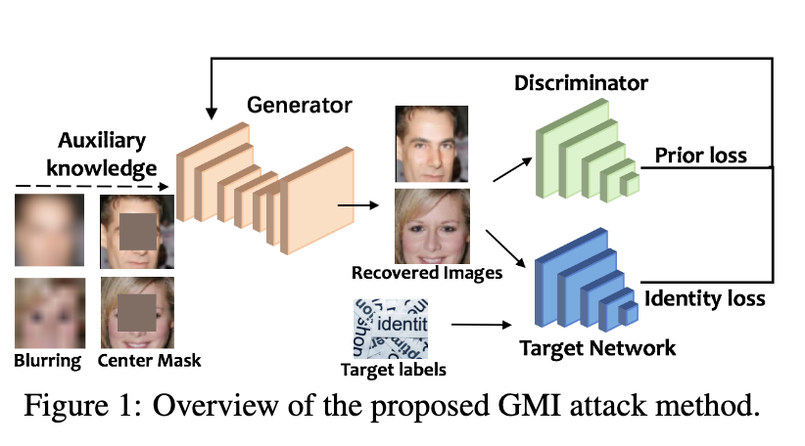
Applications in Machine Learning
Issues with Deep Learning without privacy mechanisms
Neural network models memorize training examples [Carlini et al., 2019]
Given a public model, it is possible to a transformed (blurred) image through Generative Model-Inversion (GMI) attacks [Zhang et al.]

Slide 49
Applications in Machine Learning
Differentially Private Deep Learning
Differential Privacy in Gradient Descent
Update rule [Xie et al.]
Due to sequential composition, the privacy loss in unbounded when we perform many iterations of the SGD algorithm
More iterations leads to a larger privacy cost. However, in practical Deep Learning, more iterations generally result in a better model.
But, in differentially private SGD version, more iterations can make the model worse, i.e., the noise increases with each iterations.
Tradeoff: Find the right balance between the number of iterations and the scale of the noise added.
Some Techniques: Gradient clipping before adding the noise [Abadi et al.]

Slide 50
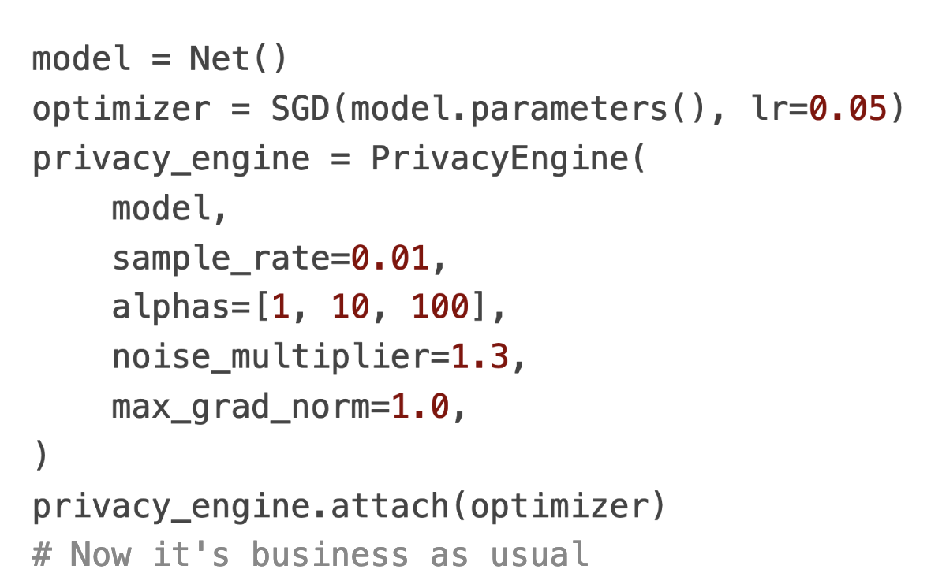
Applications in Machine Learning
Differentially Private Deep Learning with Opacus [FAIR, Opacus]
Implements a (𝜖)-Renyi differential privacy of order α in Pytorch
Source: https://opacus.ai/

Slide 51
Conclusion
Traditional data analysis is done without any privacy mechanism which leads to privacy violation
Traditional privacy models are vulnerable to linking attacks
Randomized Response was the first attempt to offer differential privacy.
The fixed privacy loss in Randomized Response makes it unsuitable for some application
Methods based on sampling from a distribution (Laplace, Gaussian, Exponential, etc) offer better privacy guarantees.
Differential Privacy can be applied to ML to achieve Privacy Preserving ML.

Slide 52
References
[Dwork et al.] Cynthia Dwork, Aaron Roth, et al. The algorithmic foundations of differential privacy. Found. Trends Theor. Comput. Sci., 9(3-4):211–407, 2014.
[Warner, 1965] Warner, S. L. (March 1965). "Randomised response: a survey technique for eliminating evasive answer bias". Journal of the American Statistical Association. Taylor & Francis. 60 (309): 63–69. doi:10.1080/01621459.1965.10480775. JSTOR 2283137. PMID 12261830.
[Zhu et al.] Tianqing Zhu, Gang Li, Wanlei Zhou, and S Yu Philip. Differential privacy and applications. Springer, 2017.
[Near et al.] Joseph P. Near and Chik ́e Abuah. Programming Differential Privacy, volume 1. 2021.
[Xie et al.] Yun Xie, Peng Li, Chao Wu, and Qiuling Wu. Differential privacy stochastic gradient descent with adaptive privacy budget allocation. In 2021 IEEE International Conference on Consumer Electronics and Computer Engineering(ICCECE), pages 227–231, 2021
[Abdai et al.] Martin Abadi, Andy Chu, Ian Goodfellow, H Brendan McMahan, Ilya Mironov, Kunal Talwar, and Li Zhang. Deep learning with differential privacy. InProceedings of the 2016 ACM SIGSAC conference on computer and communications security, pages 308–318, 2016
[Ilya, 2017] Mironov, Ilya. "Rényi differential privacy." 2017 IEEE 30th Computer Security Foundations Symposium (CSF). IEEE, 2017.
[FAIR, Opacus] https://opacus.ai/
[Emam et al.] El Emam, Khaled, and Fida Kamal Dankar. "Protecting privacy using k-anonymity." Journal of the American Medical Informatics Association 15.5 (2008): 627-637.
[Carlini et al., 2019] Carlini, Nicholas, et al. "The secret sharer: Evaluating and testing unintended memorization in neural networks." 28th {USENIX} Security Symposium ({USENIX} Security 19). 2019.
[Zhang et al.] Zhang, Yuheng, et al. "The secret revealer: Generative model-inversion attacks against deep neural networks." Proceedings of the IEEE/CVF Conference on Computer Vision and Pattern Recognition. 2020.

Slide 53
Thank you
Questions?

Slide 54
Differentially Private SGD
Differentially Private SGD
Abadi (2016) Deep Learning with Differential Privacy
This work introduced differential privacy (DP) for training ML models for protecting the privacy of the training data
Differential privacy (DP) is applied to Stochastic Gradient Descent (SGD) during model training
DP-SGD clips the gradients and adds Gaussian noise to the gradients with respect to the model parameters
This approach controls the amount of information from the training data that is memorized by the model during training
The goal is to produce ML models which provide approximately the same privacy when an individual input instance is removed from the training dataset
The paper also introduces a method for calculating the privacy loss, called moments accountant

Slide 55
DP Example
Differentially Private SGD
$D_{1}$ (includes Bob)
Consider two databases $D_{1}$ and $D_{2}$ that show if a person has diabetes or not
The only difference between the two databases is that $D_{2}$ does not include the last record in $D_{1}$ (for Bob)
Let’s assume that the databases are publicly available for making queries
To protect patient identities, it is not allowed to query the patient names
However, an adversary can query the sum of the persons with diabetes in the first database (e.g., $f\left(D_{1}\right)=64$), and the sum in the second database (e.g., $f\left(D_{2}\right)=63)$
Based on the difference $f\left(D_{1}\right)−f\left(D_{2}\right)=64−63=1$, the adversary can infer that Bob has diabetes
Alternatively, if $f\left(D_{1}\right)=63$ and $f\left(D_{2}\right)=63$, the adversary can infer that Bob does not have diabetes
Name | Has Diabetes
Don | 1
Monica | 0
…
…
Chris | 1
Bob | 1
$D_{2}$ (without Bob)
Name | Has Diabetes
Don | 1
Monica | 0
…
…
Chris | 1

Slide 56
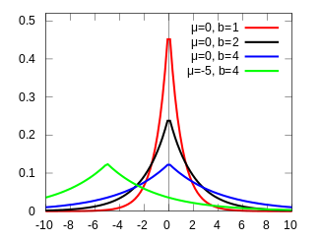
DP Example (cont’d)
Differentially Private SGD
An algorithm that is differentially private adds noise to the answers for $f\left(D_{1}\right)$ and $f\left(D_{2}\right)$ to make it difficult to infer the information about Bob
I.e., a randomization mechanism $ℳ\left(D\right)$is selected to add noise $ξ$to the output answers to queries $f\left(D\right)$, that is, $ℳ\left(D\right)=f\left(D\right)+ξ$
Additive noise $ξ$ from a Laplacian distribution (shown) is commonly applied
E.g., let’s assume a privacy budget $ε=0.5$and let’s sample noise from a Laplacian distribution with $μ=0$ and scale $b=1/ε=1/{0.5}=2$
6 random noise samples are: $ξ∈\left\{−0.13, 2.06, −1.67, −2.49, −0.52, 0.37\right\}$
Consider 3 queries by the adversary having the outputs $f\left(D_{1}\right)=64$and $f\left(D_{2}\right)=63$with added Laplacian noise $ξ$:
$ℳ\left(D_{1}\right)−ℳ\left(D_{2}\right)=63.87−65.06=−1.19$
$ℳ\left(D_{1}\right)−ℳ\left(D_{2}\right)=62.33−60.51=1.82$
$ℳ\left(D_{1}\right)−ℳ\left(D_{2}\right)=63.48−63.37=0.11$
Based on the differences between the randomized outputs from the queries for $D_{1}$ and $D_{2}$, now it is impossible for the adversary to tell if Bob has diabetes
$$Pr\left(ξ\right)$$
$$ξ$$

Slide 57
DP Mechanism
Differentially Private SGD
The important question in DP is: how much noise to add?
The amount of noise $ξ$depends on the data, and it needs to be adjusted
E.g., a function $f_{1}\left(D\right)$that provides the yearly income of people in thousands of dollars would require different level of noise than a function $f_{2}\left(D\right)$that provides the height in feet
The sensitivity of the function $f$determines how much the output $f\left(D\right)$changes by adding a single data instance
Sensitivity is defined as $∆f=max{\left\|f\left(D_{1}\right)−f\left(D_{2}\right)\right\|}_{1}$ for all possible datasets $D_{1}$ and $D_{2}$ differing in one data instance, where ${\left\|∙\right\|}_{1}$ denotes $ℓ_{1}$-norm
E.g., for the example with medical diabetes records, the sensitivity is $∆f=1$, since the sum of the people with diabetes can change only by 1 when a single input is added
A Laplacian mechanism that is $ε$-differentially private adds a Laplacian noise with scale $b={∆f}/ε$
Note that if the privacy budget $ε$ has smaller values, this will result in larger amount of Laplacian noise $ξ$ added to $f\left(D\right)$
Thus, the noisy outputs $ℳ\left(D\right)$ will reveal less private information about the inputs (i.e., provide better privacy protection), but also the noisy answers to the queries $ℳ\left(D\right)$will be less accurate

Slide 58
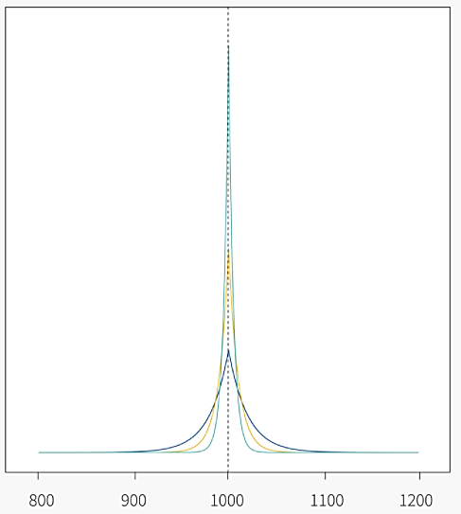
DP with Laplacian Randomization
Differentially Private SGD
The figure shows the probability distributions of the outputs $ℳ\left(D\right)$ for three different levels of Laplacian noise with $ε∈\left\{0.05, 0.1, 0.2\right\}$
The true output value is $f\left(D\right)=1,000$
Larger values of $ε$ have distributions that are tighter around the true value of $f\left(D\right)=1,000$ in the figure, and hence are more accurate, but leak more privacy
A mechanism $ℳ\left(D\right)$ is $ε$-differentially private if for all databases $D_{1}$ and $D_{2}$ that differ by at most one instance, and for any subset of outputs S:
$Pr\left(ℳ\left(D_{1}\right)∈S\right)≤e^{ε}$ $Pr\left(ℳ\left(D_{2}\right)∈S\right)$
In other words, $ε$-differential privacy ensures that the probabilities of any two outputs $ℳ\left(D_{1}\right)$ and $ℳ\left(D_{2}\right)$ differ by at most $e^{ε}$
E.g., for $ε=0.05$, ${Pr\left(ℳ\left(D_{1}\right)\right)}/{Pr\left(ℳ\left(D_{2}\right)\right)}$is at most $e^{0.05}=$ 1.05
Smaller $ε$ ensures more similar outputs $ℳ\left(D_{1}\right)$ and $ℳ\left(D_{2}\right)$, and provides higher levels of privacy
$$Pr\left(ℳ\left(D\right)\right)$$
$$ℳ\left(D\right)$$

Slide 59
DP with Gaussian Randomization
Differentially Private SGD
There are other DP mechanisms besides the Laplacian mechanism, that are more suitable for some applications
The Gaussian mechanism adds Gaussian noise instead of Laplacian noise, and the level of noise is based on the $ℓ_{2}$-norm sensitivity, instead of $ℓ_{1}$-norm
A Gaussian mechanism is $\left(ε,δ\right)$-differentially private if for all databases $D_{1}$ and $D_{2}$ that differ by at most one instance, and for any subset of outputs S:
$Pr\left(ℳ\left(D_{1}\right)∈S\right)≤e^{ε}$ $Pr\left(ℳ\left(D_{2}\right)∈S\right)+δ$
The $\left(ε,δ\right)$-differential privacy that is provided by the Gaussian mechanism introduces the probability parameter $δ$
Informally, $\left(ε,δ\right)$-differential privacy is guaranteed with probability $1−δ$
E.g., for $δ=0.05$, the method is 𝜀-differentially private with 95% probability
The Gaussian mechanism is therefore weaker than the Laplacian mechanism, since it allows scenarios when the privacy cannot be guaranteed
On the other hand, additive Gaussian noise is less likely to take on extreme values than Laplacian noise

Slide 60
Privacy in Machine Learning
Differentially Private SGD
Training ML models can be considered an extension of the previous example on querying databases
I.e., ML models use data to learn a function, which is afterward used for prediction
The datasets for training ML models often contain sensitive information (e.g., medical records, personal information), so it is important to provide privacy guarantees
On the other hand, we know that ML models can memorize the training data, which can be exploited by adversaries to recover information about the data from a trained model
The challenge is: how to extract enough information from data to train accurate ML models without revealing the data
DP-SGD is an approach that adds noise to the model parameters during training, to reduce the memorization of input samples

Slide 61
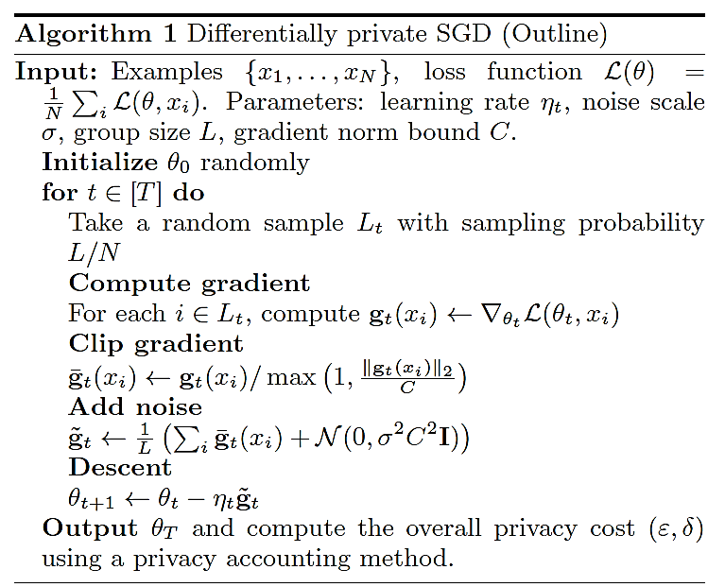
Differentially Private SGD
Differentially Private SGD
Differentially Private Stochastic Gradient Descent (DP-SGD)
DP-SGD adds two additional steps to SGD: Clip gradient, and Add noise
Introduced DP steps

Slide 62
Gradient Clipping
Differentially Private SGD
ML models tend to memorize more information about some input samples than others
Input samples that produce large gradients can be memorized by the model, and violate privacy
This approach proposes to clip the $ℓ_{2}$ norm of the gradient to a threshold $C$, in order to limit the influence by the individual input samples
Also, since the values of the gradients cannot be estimated ahead of time, the clipping operation controls the sensitivity of the DP randomization mechanism
If the gradient at step t by an input sample $x_{i}$ is $g_{t}\left(x_{i}\right)=∇_{θ_{t}}ℒ\left(θ_{t},x_{i}\right)$, the clipped gradient ${\overline{g}}_{t}\left(x_{i}\right)$is:
$${\overline{g}}_{t}\left(x_{i}\right)=\left\{\begin{matrix}\begin{matrix}{ g}_{t}\left(x_{i}\right) & if {\left\|{ g}_{t}\left(x_{i}\right)\right\|}_{2}≤C\end{matrix} \\ \begin{matrix}\frac{g_{t}\left(x_{i}\right)}{{{\left\|{ g}_{t}\left(x_{i}\right)\right\|}_{2}}/C} & if {\left\|{ g}_{t}\left(x_{i}\right)\right\|}_{2}>C\end{matrix}\end{matrix}\right.$$
That is, if the norm ${\left\|{ g}_{t}\left(x_{i}\right)\right\|}_{2}$is greater than $C$, the gradient is scaled down to have a norm equal to $C$

Slide 63
Adding Noise
Differentially Private SGD
GP-SGD approach employs a Gaussian randomization mechanism
Gaussian noise is added to the gradients at each training step t, according to:
$${\tilde{g}}_{t}=\frac{1}{L}\left(\sum_{i}{{\overline{g}}_{t}\left(x_{i}\right)}+𝒩\left(0,σ^{2}C^{2}I\right)\right)$$
At each step t, the average of the clipped gradient for a batch of inputs (with a batch size L) is first calculated as $\frac{1}{L}\sum_{i}{{\overline{g}}_{t}\left(x_{i}\right)}$
Gaussian noise $𝒩\left(0,σ^{2}C^{2}I\right)$ with mean 0 and diagonal co-variance $σ^{2}C^{2}$ is afterward added to the batch-averaged gradient
Note that the co-variance is a function of the clipping threshold C
E.g., larger value of C does less clipping, but requires more noise to achieve the same level of privacy

Slide 64
Moments Accountant
Differentially Private SGD
The composition property in DP states that if the privacy budget for one interaction with the data is $ε_{1}$ and for another interaction with the data is $ε_{2},$the combined privacy budget is $ε_{1}+ε_{2}$
Therefore, by accumulating the privacy loss for each mini-batch when training an ML model, it is possible to calculate the overall privacy loss during training
Moments accountant is an introduced approach in the paper that evaluates the privacy budget of a model training with DP-SGD
The privacy loss is estimated at each training step, and it is used to calculate the cumulative privacy loss over all training epochs
Note that increasing the number of training epochs increases the privacy loss
E.g., training a model for 100 epochs that achieved a privacy loss of $ε=1.26$, when training for 400 epochs the privacy loss increased to $ε=2.55$
Moments accountant employs the moments of mixtures of Gaussian distributions to calculate the upper bound of the cumulative privacy loss
The approach is described in more detail in the paper

Slide 65
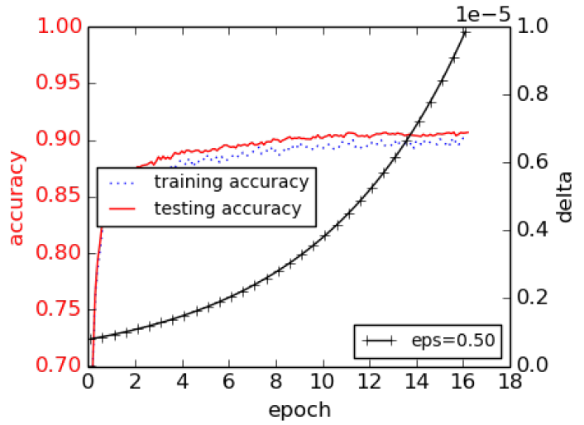
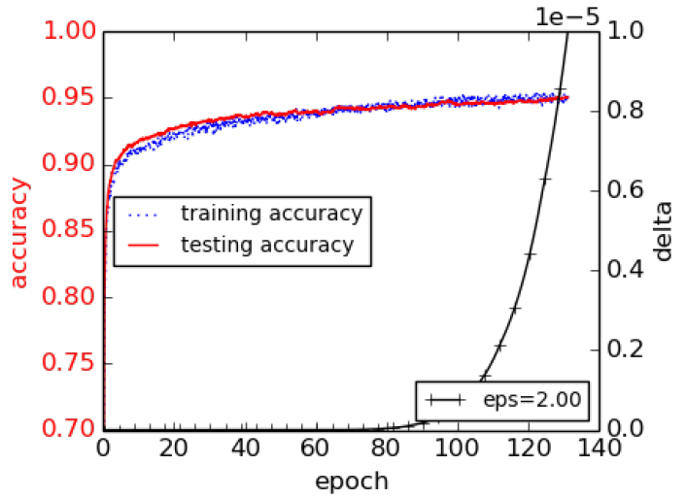
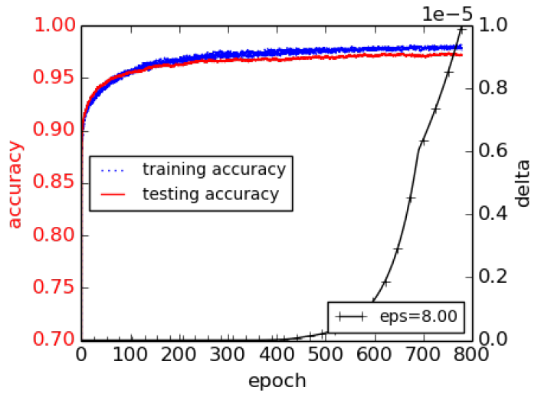
Experimental Evaluation
Differentially Private SGD
MNIST dataset
Training and testing accuracies for different levels of noise $ε∈\left\{0.5, 2, 8\right\}$
The corresponding Gaussian noise variances are $σ∈\left\{8, 4, 2\right\}$, the clipping threshold is $C=4$
The upper bound for the privacy probability parameter is set to $δ={10}^{−5}$
Thus, the corresponding $\left(ε,δ\right)$-differential privacies are $\left(0.5,{10}^{−5}\right)$, $\left(2,{10}^{−5}\right)$, $\left(8,{10}^{−5}\right)$
The obtained test set accuracies are 90%, 95%, and 97%, respectively
Larger noise achieves lower test accuracy, but provides increased privacy protection
Large noise $ε=0.5$
Medium noise $ε=2$
Small noise $ε=8$

Slide 66
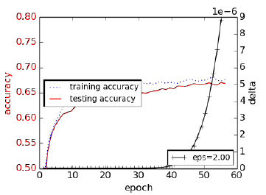
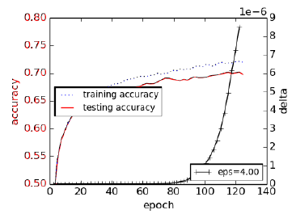
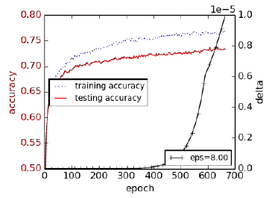
Experimental Evaluation
Differentially Private SGD
CIFAR-10 dataset
The results are similar to the obtained performance for MNIST
Training and testing accuracies for different levels of noise $ε∈\left\{2, 4, 8 \right\}$
The target probability parameter is again set to $δ={10}^{−5}$
The corresponding $\left(ε,δ\right)$-differential privacies are $\left(2,{10}^{−5}\right)$, $\left(4,{10}^{−5}\right)$, $\left(8,{10}^{−5}\right)$
The Gaussian noise variance is fixed to $σ=6$ for all experiments, the clipping threshold is $C=3$
The achieved test set accuracies are 67%, 70%, and 73%, respectively
Large noise $ε=2$
Medium noise $ε=4$
Small noise $ε=8$

Slide 67
Privacy versus Accuracy Trade-Off
Differentially Private SGD
Perfect privacy in ML models is not possible
Adding too much noise to the model parameters would diminish the accuracy and the usefulness of the model
There is a trade-off between privacy protection and accuracy
DP-SGD achieves privacy protection for deep NNs with a small decrease in the model accuracy and small increase in the training complexity
The approach adds Gaussian noise to the gradients in SGD to reduce the possibility for memorization of individual input instances by the model
This work also developed the moments accountant approach to calculate the cumulative privacy loss for the combination of the model and dataset

Slide 68
Scalable Private Learning with PATE
Written by: Nicolas Papernot, Shuang Song, Ilya Mironov, Ananth Raghunathan, Kuna Talwar, and Úlfar Erlingsson
PowerPoint created by: Jacob Friedberg

Slide 69
Outline:
Background
Problem Statement
Proposed Solution
Design
Experimental Setup
Results
Conclusion
Questions

Slide 70
Background
Attacks on Privacy
Data collection is a ~40-billion-dollar industry[1].
Some of the data is personally identifiable information(PII)
It takes only 3 pieces of information to identify 87% of the Untied States[2]
Zip code
Gender
Date of birth
What's the big deal?
PII can be used against you(identity theft, social engineering and linkage attacks)
Linkage attacks identify you by cross-referencing data someone knows about you with other sources.
Also know as re identification attacks(from anonymized to identified)

Slide 71
Background
What can we do?
Not all data collection is bad. Some collection, especially health data can be used to provide patterns for localizing sickness.
Companies are going to collect data based on our usage of their services. To make better products
Implement a way collect data without revealing PII.
Differential Privacy
System for collecting and computing on data while maintaining privacy.
This solves the earlier issue.
Allows companies to compute on data and get the same result as if the data was not anonymized.

Slide 72
background
How is this accomplished?
Injecting noise into the dataset to create plausible deniability.
The noise shouldn’t change the outcome of the computation.
An observer should not be able to determine any PII from the output or identify whose data was trained on.
Equation to know
ε = Upper bound for the loss of privacy
δ = probability that privacy will not be held
M = Model training algorithm
[3]

Slide 73
Problem Statement
Current approaches show potential but are untested at scale.
Private Aggregation of Teacher Ensembles(PATE)
Prior implementation of differential privacy for ML models
Uses Teachers to train students to answer queries.
Partitions data to be trained onto each teacher
All teachers aggregate answers to a single “aggregate teacher”
Students are trained on teacher responses, and queried by users
Issues with
Scalability
Robustness
Utility

Slide 74
Proposed solution
Build off the PATE method
New methods for aggregating teacher/student answers
Confidence Aggregator
Teacher consensus module where Min of T teachers guarantee a correct classification and throw out queries where teachers don’t know
Interactive Aggregator
Student confidence scoring. Don’t ask teachers for an answer if confidence is high that the student knows
Expensive Queries are high cost to privacy
Gaussian noise instead of Laplacian
Less computationally expensive
Causes less noise overall.

Slide 75
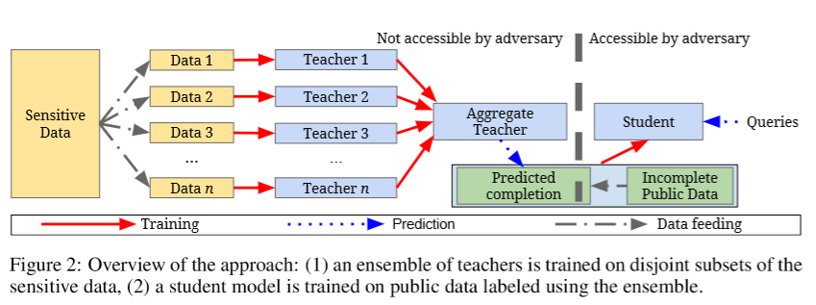
Design
PATE design:
[3]

Slide 76
Design
Confident Aggregator:
[3]

Slide 77
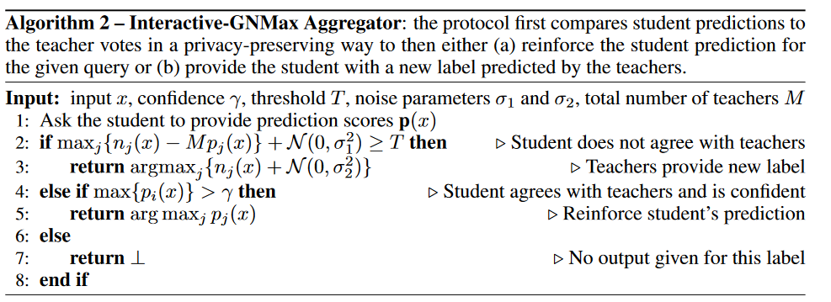
Design
Interactive Aggregator:
[3]

Slide 78
Experimental Setup
Datasets
MNIST
Street View House Numbers (SVHN)
US Census Income Adult (UCI Adult
Table of attributes about a person. Mainly used to test privacy.
Glyph
Synthetically generated computer font symbols with at most 150 different classes
[3]

Slide 79
Experimental Setup
Model Descriptions:
Teacher layers Semi Supervised
Convolutional Networks
MNIST
SVHN
Glyph(with ResNet backbone)
Teacher layers Fully Supervised
Decision tree
UCI Adult

Slide 80
Experimental Setup
Teacher Ensembles(number of teachers, and therefore partitions of data)
100
500
1000
5000
Queries
500-12000 depending on dataset
Privacy parameters:
δ = 10⁻⁸ probability that privacy will not be held

Slide 81
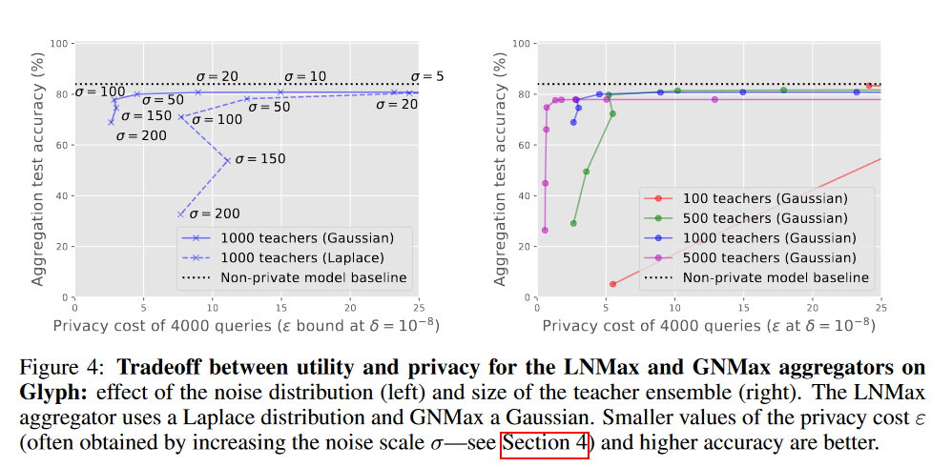
Results
[3]

Slide 82
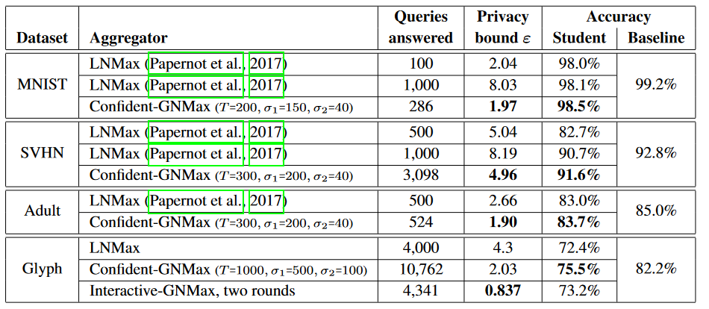
Results
[3]
250 Teachers used for MNIST SVHN ADULT. 5000 for Glyph.
δ = 10⁻⁵ For MNIST ADULT, δ = 10⁻⁶ SVHN, δ = 10⁻⁸ Glyph

Slide 83
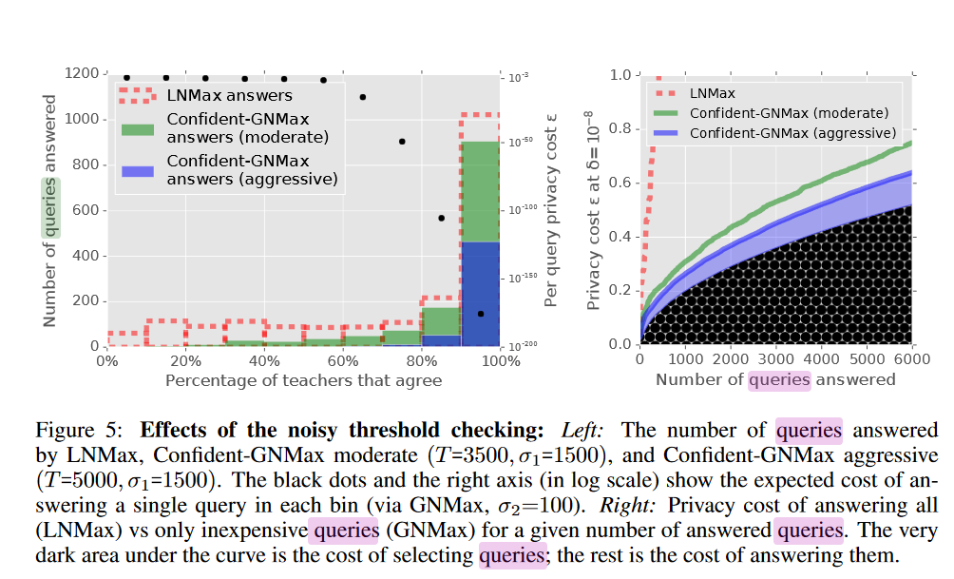
Results
[3]

Slide 84
Conclusion
Build off the PATE method
New methods for aggregating teacher/student answers provide a privacy preserving technique that reduces leakage
Caps queries at a confidence interval
Stops overfitting student’s queries by checking confidence of student's answers
Improvements across the board in Privacy ε loss(lower is better)
Shows that this PATE method has the potential to be used at scale(thousands of class labels)
Generalization improved by changing perturbation method

Slide 85
Questions?

Slide 86
References
[1] https://www.statista.com/statistics/254266/global-big-data-market-forecast/
[2] L. Sweeney, Simple Demographics Often Identify People Uniquely. Carnegie Mellon University, Data Privacy Working Paper 3. Pittsburgh 2000.
[3] Papernot, N., Song, S., Mironov, I., Raghunathan, A., Talwar, K., and Erlingsson, Ú., “Scalable Private Learning with PATE”, arXiv e-prints, 2018.

Slide 87
References
Liu et al. (2020) When Machine Learning Meets Privacy: A Survey and Outlook (link)
Rigaki and Carcia (2021) A Survey of Privacy Attacks in Machine Learning (link)
Cristofaro (2020) An Overview of Privacy in Machine Learning (link)
Borealis AI Tutorial #13: Differential Privacy II: Machine Learning and Data Generation (link)
Davide Testuggine and Ilya Mironov blog: Differential Privacy Series Part 1-DP-SGD Algorithm Explained (link)
Joseph P. Near and Chiké Abuah, Programming Differential Privacy – Chapter III: Differential Privacy (link)

