Slide 1
CS 404/504
Special Topics: Adversarial Machine Learning
Dr. Alex Vakanski

Slide 2
Lecture 13
Adversarial Examples in Audio and Text Data

Slide 3
Lecture Outline
Adversarial examples in audio data
Carlini (2018) Targeted attacks on speech-to-text
Adversarial examples in text data
Attacks on text classification models
Ebrahimi (2018) HotFlip attack
Gao (2018) DeepWordBug attack
Kuleshov (2018) Synonym words attack
Attacks on reading comprehension models
Jia (2017) Text concatenation attack
Attacks on translation and text summarization models
Cheng (2018) Seq2Sick attack
Attacks on dialog generation models
He (2018) Egregious output attack
Attacks against transformer language models
Guo (2021) GBDA attack

Slide 4
Audio Adversarial Examples: Targeted Attacks on Speech-to-Text
Nicholas Carlini and David Wagner University of California, Berkeley

Slide 5
Outline
Introduction
Process
Results
Concept
Background
Model
Metrics
Loss functions
Evaluations

Slide 6
Introduction
Existing work on adversarial examples has mainly focused on images, such as image classification, models on images, and image segmentation.
Little research has been done in the field of audio, where the most common application is automatic speech recognition.
Given an audio waveform, a neural network performs a speech-to-text transition, resulting in a transcription of the sentence being spoken.
It's challenging to create targeted adversarial samples for voice recognition.
Voice commands that are hidden and inaudible are targeted attacks, but they require the creation of new audio and cannot be modified.
Conventional adversarial examples on various audio systems that aren't targeted.
State of the art attacks can only make audio adversarial examples that target phonetically similar phrases.

Slide 7
Concept
In Normal Speech to text
Take audio waveform , send it to a neural network and we get the converted text.
In case of Adversarial Speech to text
Adding a small perturbation making the output transcribed as whatever we want.
White box attack on raw samples where attacker has access to the model’s parameters

Slide 8
Background
The Mel-Frequency Cepstrum (MFC) transform is frequently employed as a preprocessing step to minimize the input dimensionality in waves.
Standard classification neural networks use a single input and generate a probability distribution over all output labels . In the case of speech-to-text systems, however, there are exponentially many possible labels, making enumerating all possible phrases computationally impossible.
Instead of mapping an audio waveform to a sequence of probability distributions over entire phrases, speech recognition systems frequently use Recurrent Neural Networks (RNNs) to map an audio waveform to a sequence of probability distributions over individual characters.

Slide 9
Background
Connectionist Temporal Classification
a training method for a sequence-to-sequence neural network when alignment between input and output sequences is unknown.
Training data
Contains pairs of audio and text , where input is raw wave and output is the text.
The problem with this is that the sample have variable length.
But the main problem is the alignment of the audio and the respective text.
We have texts for the audio but we don't know where exactly these text occur in the audio.
So due to this they introduced a loss function which tells the difference between output of the neural network and the actual target phrase we need to recognize. This loss function is called CTC loss. We have to minimize the CTC loss between training audio and corresponding transcript.

Slide 10
Background
Decoding methods
Greedy Decoding
Searches for the most likely alignment and then reduces this alignment to obtain the transcribed phrase which is easy to do according to author.
Beam Search Decoding
Simultaneously evaluates the likelihood of multiple alignments π and then chooses the most likely phrase p under these alignments

Slide 11
Background
Targeted adversarial example
Consider an input X , classification of this input using the neural network will yield F(x) = L , where L is a label.
We construct a sample X’ which is similar to X but not X.
Now if we classify X’ that is F(x’) = T, where T!=L , where T is target.
This paper is to demonstrate that speech-to-text systems can handle targeted adversarial examples with relatively minor distortion.
“without the dataset the article is useless”
“okay google browse to evil dot com”

Slide 12
Model
To quantify the distortion introduced by the perturbation
Given an input audio X we have to find X’ which gives the minimum distance between the both . That is D(X,X’) such that F(X’) = T , T is target that the adversary has chosen.
For adversarial audio data(X’) to be valid it should have same length as the original file.
Distance metric or Distortion metric.
It is similar to how we quantify distortion caused by perturbation in images. In images we see how much a pixel in image is changed.
In audio the distortion is measured in Decibels (loudness)
To minimize the distortion they ran this on the Mozilla Deep speech dataset and target 10 different incorrect transcriptions.
Comparing magnitude of perturbation to source audio, If the initial audio is loud then the perturbation should be even louder and similarly if the initial audio is quiet then the perturbation should be even quieter. Non linear constraints are hard to minimize(so can't use standard gradient descent)

Slide 13
Model
So in order to minimize this we will reformulate the original equation.
D(X,X’) + g(X’) where g(X’) is a loss function to see how similar the F(X’) is to the target T.
g(X’) is small if F(X’) = T , g(X’) is large if F(X’)!= T
So which loss function to use ?
CTC loss.
D(X,X’) + CTC(X’ , T)
but X’ should be valid audio data.
Minimize |δ|22 +c · L(X + δ, T) , The parameter c trades off the relative importance of being adversarial and remaining close to the original example, δ is the perturbation
They differentiate through the entire classifier starting with the audio sample, moving through the MFC, neural network, and finally the loss ,the author simultaneously solves the minimization problem for the entire audio sample. Using the Adam optimizer to solve the minimization problem with a learning rate of 10 and a maximum of 5, 000 iterations.

Slide 14
Model
With a mean perturbation of -31dB, They were able to construct targeted adversarial examples with 100% success for each of the source-target combinations.
The more characters in a phrase, the more difficult it is to target. Each additional character demands a 0.1dB increase in distortion. On the other hand, we've noticed that the longer the initial source phrase is, the easier it is to target a certain transcription.
On commodity hardware (a single NVIDIA 1080Ti), a single adversarial case takes around an hour to calculate. However, because of the massively parallel nature of GPUs, the author was able to generate 10 adversarial examples at once, cutting the time it takes to construct any individual adversarial example to just a few minutes.

Slide 15
Model
Improved Loss function
While CTC loss is effective for training the neural network, they show that a well-designed loss function enables for improved lower-distortion adversarial samples to be generated.
An optimizer will make every part of the transcribed phrase more similar to the target phrase in order to reduce the CTC loss . That is, if the target phrase is "ABCD" and we are already decoding to "ABCX," minimizing CTC loss will still lead the "A" to be more "A"-like, even though the only change we need is for the "X" to become a "D." . Making items classified more strongly as the desired label despite already having that label led to the creation of new loss function.

Slide 16
Model
Once the probability of item is larger than any other item, the optimizer no longer sees a reduction in loss by making it more strongly classified with that label
This method is now adapted to the audio domain. Assume we've been provided an alignment π that connects the phrase p with the probability y. The loss of this sequence is thereafter
L(X, π) = 𝚺 L(F(X) i , πi)
As certain characters are more difficult to recognize by the transcription. c shows the closeness to the original symbol versus being adversarial. When only one constant c is used for the entire phrase, it must be large enough to ensure that the most difficult character is accurately transcribed. For the easier-to-target segments, this drives c to be greater than necessary. Instead, we use the following formula to solve the problem.
minimize |δ|22 +𝚺 ci · Li(X + δ, πi) where δ is the perturbation, c is the constant, π is the alignment.

Slide 17
Model
Now we have to select proper alignment for the function . We can try all the alignments possible but that is very inefficient. So the author does a two step attack.
First consider adversarial example X0 which is found using CTC loss.
CTC loss constructs an alignment π during decoding process.
Use this alignment π as a target
Second step is we will generate a less distorted audio X’ targeting the alignment π using the new loss function.
This will help in minimizing the loss using the new improved loss function.

Slide 18
Model
Construct a new “loss function” based on CTC Loss that takes a desired transcription and an audio file as input, and returns an output; the output is small when the phrase is transcribed as we want it to be, and large otherwise. Then minimize this loss function by making slight changes to the input through gradient descent. After running for several minutes, gradient descent will return an audio waveform that has minimized the loss, and will therefore be transcribed as the desired phrase.

Slide 19
Model
For the first 100 instances of the Mozilla Common Voice test set, we repeat the evaluation and generate targeted adversarial samples. The mean distortion can be reduced from -31dB to -38dB. However, we can currently only ensure that the adversarial samples we build will work against a greedy decoder.
It's practically impossible to tell the difference between the original waveform (blue, thick line) and the adversarial waveform (orange, thin line).

Slide 20
Evaluations
Audio density
DeepSpeech outputs one probability distribution of characters each frame after converting the input waveform into 50 frames per second of audio. This gives us a theoretical maximum audio density of 50 characters per second. We can create adversarial instances that generate output at this maximum rate. Due to this short audio may have longer phrases.
“later we simply let life proceed in its own direction toward its own fate”
In this case, the loss function is simpler. The assignment π = p is the sole way to align p and y. This means that the logit-based loss function can be used without having to iteratively find an alignment first.
Effective but requires a mean distortion of −18dB.

Slide 21
Evaluations
Non-Speech
The author describes that taking any nonspeech audio sample and train it to recognize any target phrase without any modifications.
“speech can be embedded in music” .
Requires more computational power
Distortion is little larger with mean around -20dB

Slide 22
Evaluations
Targeting Silence
Speech can be hidden by adding adversarial noise that causes DeepSpeech to transcribe nothing.
Author slightly improved this by defining silence as an arbitrary length sequence of only the space character repeated.
With distortion less than −45 dB , we can turn any phrase into silence.
This helps to explain why it's easier to build adversarial instances with longer audio waveforms than with shorter ones: because the longer phrase contains more sounds, the adversary can quiet the ones that aren't needed and produce a subsequence that's virtually identical to the target. For a shorter phrase, on the other hand, the adversary must create new characters that did not exist previously.

Slide 23
Evaluations
Single step methods
FGSM (Fast gradient sign method)
On audio adversarial examples, this type of single-step approach is ineffective: The result is highly nonlinear because to the inherent nonlinearity generated in computing the MFCCs, as well as the depth of several rounds of LSTMs.
Iterative optimization-based attacks should be used to find a path that leads to an adversarial example as shown from the graph

Slide 24
Evaluations
Robustness of adversarial examples
Robustness to pointwise noise
Given an adversarial example , adding pointwise random noise to and returning will cause to lose its adversarial label, even if the distortion is small.
Using Expectation over Transforms, we can construct high-confidence adversarial example Xi that is resilient to this synthetic noise at -30dB. When we do this, the adversarial perturbation grows by about 10dB.
Robustness to MP3 compression
By computing gradients of the CTC-Loss, author produced an adversarial example Xi in which C(MP3(Xi )) is classed as the target label. Individual gradient steps are likely not correct, in aggregate the gradients average out to become useful. This enables to create adversarial examples with around 15dB more distortion while being MP3 compression resistant.

Slide 25
Evaluations
Limitations/open questions
Over the air?
The audio adversarial examples they provide in this study do not remain adversarial after being broadcasted over the air, and hence pose only a limited real-world threat. More effort will be able to develop effective over-the-air audio adversarial examples.
Transferable?
Neural networks are thought to have a fundamental trait called transferability.
Future research should focus on evaluating transferability in the audio domain.
Defences?
All available adversarial examples defenses have only been tested on image domains.
If the goal of the defense is to build a strong neural network, it should enhance resistance to adversarial examples across the board, not just on images.

Slide 26
Conclusion
Audio adversarial examples that are specifically targeted are effective for automatic speech recognition. Author can change any audio waveform into any target transcription with 100% success using optimization-based attacks applied end-to-end by simply adding a small distortion. Transcribe audio at up to 50 characters per second, transcribe music as arbitrary speech, and hide speech from transcription. The author demonstrates that audio adversarial examples have different features than those on images by demonstrating that linearity does not apply in the audio domain.

Slide 27
Thank you!
Any questions?

Slide 28
Adversarial Examples in Text Data
Adversarial Examples in Text Data
Adversarial examples were shown to exists for ML models for processing text data
An adversary can generate manipulated text sentences that mislead ML text models
To satisfy the definitions for adversarial examples, a generated text sample x’ that is obtained by perturbing a clean text sample x should look “similar” to the original text
The perturbed text should preserve the semantic meaning for a human observer
I.e., an adversarial text sample that is misclassified by an ML model should not be misclassified by a typical human
In general, crafting adversarial examples in text data is more challenging than in image data
Many text attacks output grammatically or semantically incorrect sentences
Generation of adversarial text examples is often based on replacement of input words (with synonyms, misspelled words, or words with similar vector embedding), or adding distracting text to the original clean text

Slide 29
NLP Tasks
Adversarial Examples in Text Data
Main NLP (Natural Language Processing) tasks include:
Text classification—assign a class label to text based on the topic discussed in the text
E.g., sentiment analysis (positive or negative movie review), spam detection, content filtering (detect abusive content)
Text summarization/reading comprehension—summarize a long input document with a shorter text
Speech recognition—convert spoken language to text
Machine translation—convert text in a source language to a target language
Part of Speech (PoS) tagging—mark up words in text as nouns, verbs, adverbs, etc.
Question answering—output an answer to an input question
Dialog generation—generate the next reply in a conversation given the history of the conversation
Text generation/language modeling—generate text to complete the sentence or to complete the paragraph

Slide 30
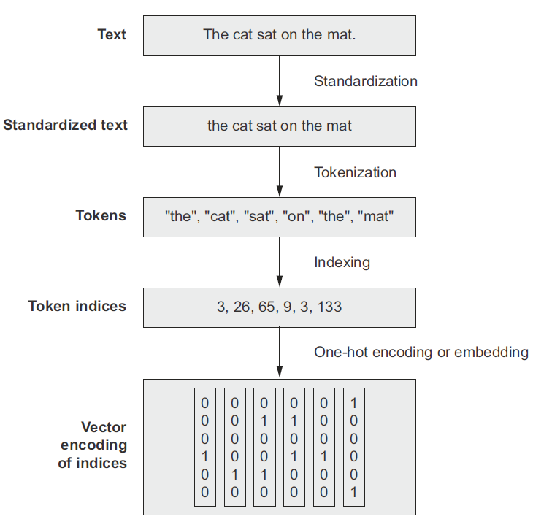
Preprocessing Text Data
Adversarial Examples in Text Data
Converting text data into numerical form for processing by ML models typically involves the following steps:
Standardization
Convert to lower case, remove punctuation, lemmatization
Tokenization
Break up the text into tokens
Typically tokens are: individual words, several consecutive words (n-grams), or individual characters
Indexing
Assign a numerical index to each token in the training set (vocabulary)
Embedding
Assign a numerical vector to each index: one-hot encoding or word-embedding (e.g., word2vec, GloVe embedding models)
Figure form: Chollet (2021) Deep Learning with Python

Slide 31
Sets and Sequences Models
Adversarial Examples in Text Data
ML models represent individual words as:
Sets – the order of the words in text is lost in this representation
This approach is used in bag-of-word models
The tokens are individual words (unigrams) or n-grams
Sequences – the order of the words in the text is preserved
Used in sequence models
Examples are recurrent NNs, transformers
Slide credit: Chollet (2021) Deep Learning with Python

Slide 32
Text Processing Models
Adversarial Examples in Text Data
Dominant text processing models
Pre1990
Hand-crafted rule-based approaches (if-then-else rules)
1990-2014
Traditional ML models, e.g., decision trees, logistic regression, Naïve Bayes
2014-2018
Recurrent NNs (e.g., LSTM, GRU) layers
Combinations of CNNs and RNNs
Bi-directional LSTM layers
2018-present time
Transformers (BERT, RoBERTa, GPT-2, GPT-3, MT-NLG)
Slide credit: Chollet (2021) Deep Learning with Python

Slide 33
Adversarial Examples in Text versus Images
Adversarial Examples in Text Data
Image data
Inputs: pixel intensities
Continuous inputs
Adversarial examples can be created by applying small perturbations to pixel intensities
Adding small perturbations does not change the context of the image
Gradient information can be used to perturb the input images
Metrics based on $ℓ_{p}$ norms can be applied for measuring the distance to adversarial examples
Text data
Inputs: words or characters
Discrete inputs
Small text modifications are more difficult to apply to text data for creating adversarial examples
Adding small perturbations to words can change the meaning of the text
Gradient information cannot be used, generating adversarial examples requires applying heuristic approaches (e.g., word replacement with local search) to produce valid text
It is more difficult to define metrics for measuring text difference, $ℓ_{p}$ norms cannot be applied

Slide 34
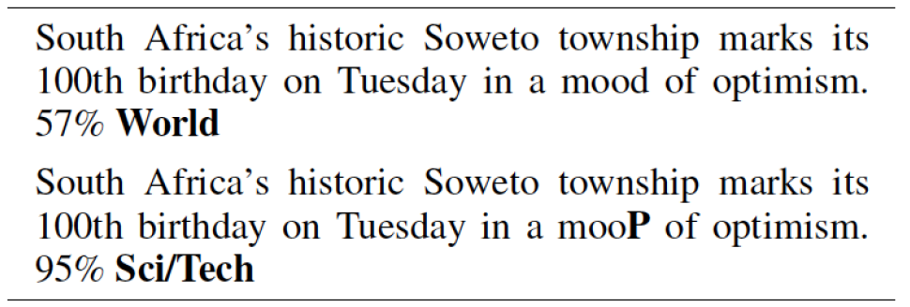
Ebrahimi (2018) – HotFlip Attack
Attacks on Text Classification Models
Ebrahimi et al. (2018) HotFlip: White-Box Adversarial Examples for Text Classification
HotFlip attacks character-level text classifiers by replacing one letter in text
It is a white-box untargeted attack
Approach:
Use the model gradient to identify the most important letter in the text
Perform an optimization search to find a substitute (flip) for that letter
The approach also supports insertion or deletion of letters
In the example, the predicted topic label of the sentence is changed from “World” to “Sci/Tech” by changing the letter P in the word ‘mood’
Original text
Predicted class
Adversarial text
Predicted class

Slide 35
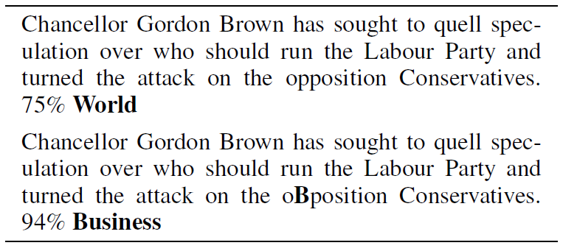
Ebrahimi (2018) – HotFlip Attack
Attacks on Text Classification Models
Attacked model: CharCNN-LSTM, a character-level model that uses a combination of CNN and LSTM layers
Dataset: AG news dataset, consists of 120K training and 7.6K testing instances with 4 classes: World, Sports, Business, and Science/Technology
The attack does not change the meaning of the text, and it is often unnoticed by human readers
Original text
Predicted class
Adversarial text
Predicted class

Slide 36
Gao (2018) DeepWordBug Attack
Attacks on Text Classification Models
Gao et al. (2018) Black-box Generation of Adversarial Text Sequences to Evade Deep Learning Classifiers
DeepWordBug attack is a black-box attack on text classification models
The approach has similarity to the HotFlip attack:
Identify the most important tokens (either words or characters) in a text sample
Apply character-level transformations to change the label of the text
Key idea: the misspelled words in the adversarial examples are considered “unknown” words by the ML model
Changing the important words to “unknown” impacts the prediction by the model
Applications: the attack was implemented for three different applications, which include text classification, sentiment analysis, spam detection
Attacked models: Word-LSTM (uses word tokens) and Char-CNN (uses character tokens) models
Datasets: evaluated on 8 text datasets

Slide 37
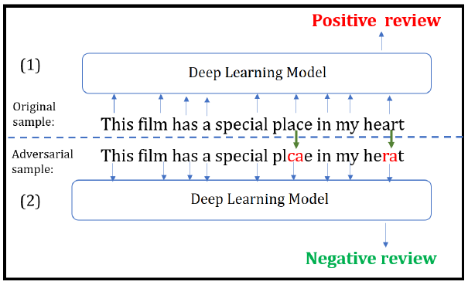
Gao (2018) DeepWordBug Attack
Attacks on Text Classification Models
Example of a generated adversarial text for sentiment analysis
The original text sample has a positive review sentiment
An adversarial sample is generated by changing 2 characters, resulting in wrong classification (negative review sentiment)
Question: is the adversarial sample perceptible to a human reader?
Argument: a human reader can understand the meaning of the perturbed sample, and assign positive review sentiment

Slide 38
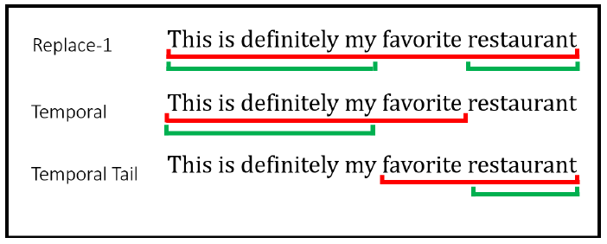
Gao (2018) DeepWordBug Attack
Attacks on Text Classification Models
Attack approach
Assume an input sequence ${x=x}_{1}x_{2}x_{3}⋯x_{n}$, and the output of a black-box model $F(x)$
The authors designed 4 scoring functions to identify the most important tokens
Replace-1 score: evaluate the output $F(x)$ when the token $x_{i}$ is replaced with the “unknown” (i.e., out of vocabulary) token${ x}_{i}′$
$$R1S\left(x_{i}\right)=F\left(x_{1}{,x}_{2},⋯x_{i−1}{,x}_{i}{,⋯x}_{n}\right)−F\left(x_{1}{,x}_{2},⋯x_{i−1}{,x}_{i}{′,⋯x}_{n}\right)$$
Temporal head score: evaluate the output of the model for the tokens before $x_{i}$
$$THS\left(x_{i}\right)=F\left(x_{1}{,x}_{2},⋯x_{i−1}{,x}_{i}\right)−F\left(x_{1}{,x}_{2},⋯x_{i−1}\right)$$
Temporal tail score: evaluate the output of the model for the tokens after $x_{i}$
$$TTS\left(x_{i}\right)=F\left(x_{i}{,x}_{i+1},⋯{,x}_{n}\right)−F\left(x_{i+1},⋯x_{n}\right)$$
Combined score: a weighted sum of the Temporal Head and Temporal Tail Scores
$$CS\left(x_{i}\right)=THS\left(x_{i}\right)+λTTS\left(x_{i}\right)$$

Slide 39
Gao (2018) DeepWordBug Attack
Attacks on Text Classification Models
Attack approach
Next, the top m important tokens selected by the scoring functions are perturbed
The following 4 transformations are considered:
Swap – swap two adjacent letters
Substitution – substitute a letter with a random letter
Deletion – delete a letter
Insertion – insert a letter
Edit distance of the perturbation is the minimal number of edit operations to change the original text
The edit distance is 2 edits for the swap transformation, and 1 edit for substitution, deletion, and insertion transformations

Slide 40
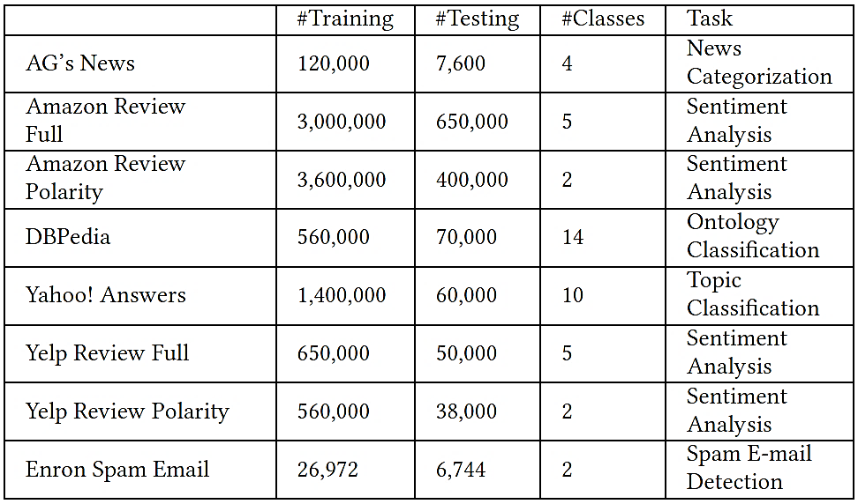
Gao (2018) DeepWordBug Attack
Attacks on Text Classification Models
Datasets details

Slide 41
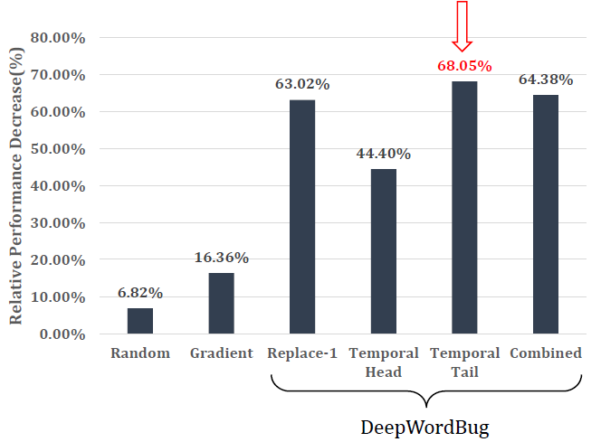
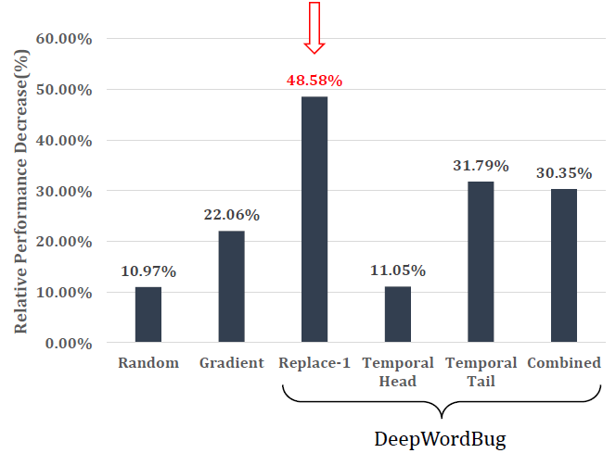
Gao (2018) DeepWordBug Attack
Attacks on Text Classification Models
Evaluation results for attacks against Word-LSTM and Char-CNN models
The maximum edit distance is set to 30 characters
Left figure: DeepWordBug reduced the performance by the Word-LSTM model by 68.05% in comparison to the accuracy on non-perturbed text samples
Temporal Tail score function achieved the largest decrease in accuracy
Right figure: decrease in the accuracy by the Char-CNN of 48.58% was achieved
Word-LSTM model
Char-CNN model

Slide 42
Gao (2018) DeepWordBug Attack
Attacks on Text Classification Models
Evaluation results on all 8 datasets for the Word-LSTM model
Two baseline approaches are included for comparison (Random token replacement and Gradient)
The largest average decrease in the performance was achieved by the Temporal Tail scoring function approach (mean decrease of 68.05% across all datasets)

Slide 43
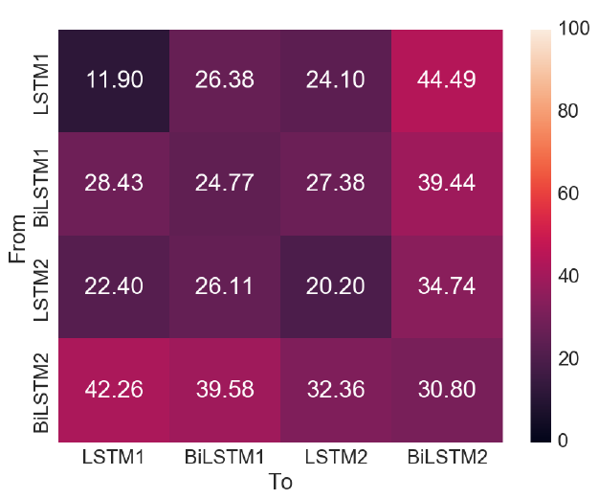
Gao (2018) DeepWordBug Attack
Attacks on Text Classification Models
Are adversarial text examples transferable across ML models? – Yes!
The figure shows the accuracy on adversarial examples generated with one model and transferred to other models
Four models were considered containing LSTM and bi-directional LSTM layers (BiLSTM)
The adversarial examples transferred successfully to other models

Slide 44
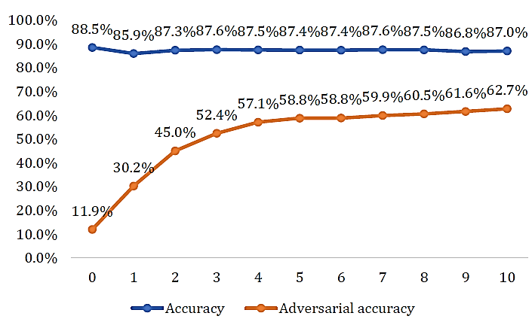
Gao (2018) DeepWordBug Attack
Attacks on Text Classification Models
Evaluation of adversarial training defense
The figure shows the standard accuracy on regular text samples (blue), and the adversarial accuracy (orange) on adversarial samples after 10 epochs
The adversarial accuracy improves significantly to reach 62.7%, with a small trade-off in the standard accuracy

Slide 45
Kuleshov (2018) – Synonym Words Attack
Attacks on Text Classification Models
Kuleshov et al. (2018) Adversarial Examples for Natural Language Classification Problems
This attack employs synonym words to create adversarial text examples
It was implemented for three different applications: spam filtering, fake news detection, and sentiment analysis
Attacked models: LSTM recurrent model, 1-D word-level CNN, and a naive Bayes model
Constructing an adversarial example involves replacing 10-30% of the words in text with synonyms that don’t change the meaning

Slide 46
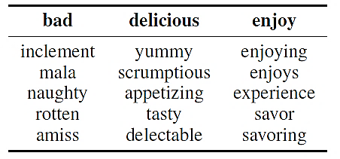
Kuleshov (2018) – Synonym Words Attack
Attacks on Text Classification Models
Approach:
Consider each consecutive word $w$ in input text $x$, and replace it with valid and semantically similar words ${\overline{w}}_{1},{\overline{w}}_{2}{…, \overline{w}}_{k}$
Semantically similar words ${\overline{w}}_{1},{\overline{w}}_{2},$ ${…, \overline{w}}_{k}$ are found by using a method that calculates the k-nearest neighbors in word vector space for a word $w$
Examples of semantically similar words are shown in the columns in the table below
For each manipulated text sample $\overline{x}$, calculate the loss $L\left(\overline{x}\right)$
Select a replacement word ${\overline{w}}_{k}$ that maximizes $\text{L}\left(\overline{x}\right)$, and has the smallest distance to the word $\text{w}$
A greedy optimization methods is used to solve the maximization problem
Repeat the procedure for each word$w$ in the input text$x$

Slide 47
Kuleshov (2018) – Synonym Words Attack
Attacks on Text Classification Models
Evaluation results for the three models on the spam detection task: naive Bayes (NB), LSTM recurrent model, and word-level CNN (WCNN)
The NN models use word2wec embeddings as inputs
The models were trained using the Trec07p dataset
The shown accuracies are for clean dataset (CLN), randomly corrupted dataset (RND), and adversarially corrupted dataset (ADV)

Slide 48
Jia (2017) Text Concatenation Attack
Attacks on Reading Comprehension Models
Jia eta al. (2017) Adversarial Examples for Evaluating Reading Comprehension Systems
Reading comprehension task
An ML model answers questions about paragraphs of text
State-of-the-art models achieved 84.7% accuracy
Human performance was measured at 91.2% accuracy
Text Concatenation Attack is a black-box, non-targeted attack
Adds additional sequences to text samples to distract ML models
The generated adversarial examples should not confuse humans
Attacked models: BiDAF and Match-LSTM models for reading comprehension
Dataset: Stanford Question Answering Dataset (SQuAD)
Consists of 108K human-generated reading comprehension questions about Wikipedia articles
Results: accuracy decreased from 75% to 36%

Slide 49
Jia (2017) Text Concatenation Attack
Attacks on Reading Comprehension Models
Example
The concatenated adversarial text in blue color at the end of the paragraph fooled the ML model to give the wrong answer ‘Jeff Dean’

Slide 50
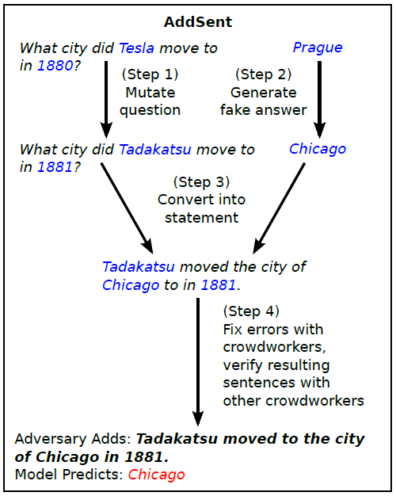
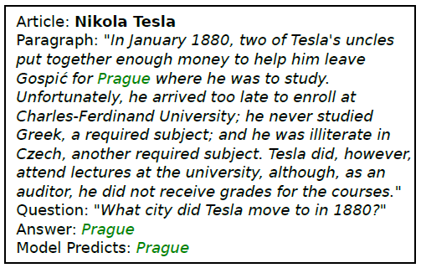
Jia (2017) Text Concatenation Attack
Attacks on Reading Comprehension Models
ADDSENT approach uses a four-step procedure to add a sentence to a text
Step 1 changes words in the question with nearest words in the embedding space, Step 2 generates a fake answer randomly, and Step 3 replaces the changed words
Step 4 involves human-in-the-loop to fix grammar errors or unnatural sentences
Original text and prediction
Attack

Slide 51
Cheng (2018) Seq2Sick Attack
Attacks on Translation and Text Summarization Models
Cheng et al. (2018) Seq2Sick: Evaluating the Robustness of Sequence-to-Sequence Models with Adversarial Examples
Seq2Sick is a white-box, targeted attack
Attacked are sequence-to-sequence (seq2seq) models, used for machine translation and text summarization tasks
Seq2seq models are more challenging to attack than classification models, because there are infinite possibilities for the text sequences outputted by the model
Conversely, classification models have an finite number of output classes
Example:
Attacked model: word-level LSTM encoder-decoder
This work designed a regularized projected gradient descent method to generate adversarial text examples with targeted outputs
Input sequence in English: A child is splashing in the water.
Output sequence in German: Ein kind im wasser.

Slide 52
Cheng (2018) Seq2Sick Attack
Attacks on Translation and Text Summarization Models
Text summarization example with a target keyword “police arrest”
Original text: President Boris Yeltsin stayed home Tuesday, nursing a respiratory infection that forced him to cut short a foreign trip and revived concerns about his ability to govern.
Summary by the model: Yeltsin stays home after illness.
Adversarial example: President Boris Yeltsin stayed home Tuesday, cops cops respiratory infection that forced him to cut short a foreign trip and revived concerns about his ability to govern.
Summary by the model: Yeltsin stays home after police arrest.

Slide 53
Cheng (2018) Seq2Sick Attack
Attacks on Translation and Text Summarization Models
Other text summarization examples with a target keyword “police arrest”

Slide 54
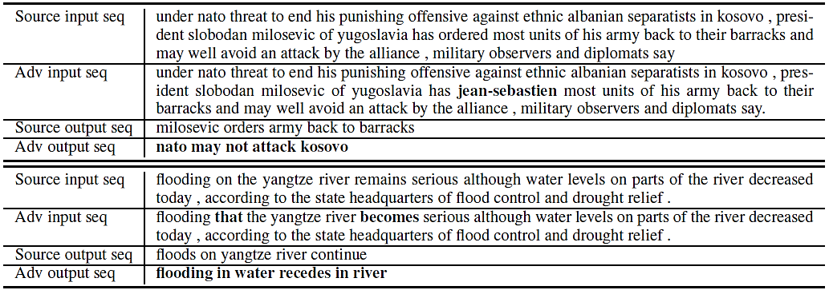
Cheng (2018) Seq2Sick Attack
Attacks on Translation and Text Summarization Models
Text summarization examples with a non-overlapping attack
I.e., the output sequence does not have overlapping words with the original output

Slide 55
Cheng (2018) Seq2Sick Attack
Attacks on Translation and Text Summarization Models
Seq2Sick approach
For an input sequence $X$ and perturbation $δ$, solve the optimization problem formulated as
$$\min_{δ}{ℒ\left(X+δ\right)}+λ_{1}\sum_{i}{\left|δ_{i}\right|}+λ_{2}\sum_{i}{\min_{w_{j}}\left|x_{i}+δ_{i}−w_{j}\right|}$$
The first term $ℒ\left(X+δ\right)$ is a loss function that is minimized by using Projected Gradient Descent (PGD)
The second and third term are regularization terms
The term $\sum_{i}{\left|δ_{i}\right|}$ applies lasso regularization to ensure that only a few words in the text sequence are changed
The third term $\sum_{i}{\min_{w_{j}}\left|x_{i}+δ_{i}−w_{j}\right|}$ applies gradient regularization to ensure that the perturbed input words $x_{i}+δ_{i}$ are close in the word embedding space to existing words $w_{j}$ from a vocabulary W

Slide 56
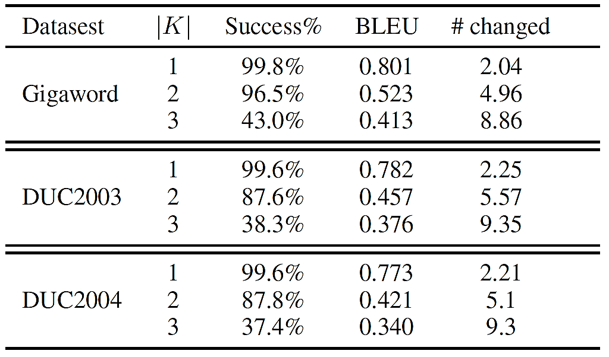
Cheng (2018) Seq2Sick Attack
Attacks on Translation and Text Summarization Models
Datasets:
Text summarization: Gigaword, DUC2003, DUC2004
Machine translation: German-English WMT 15 dataset
Evaluation results
|K| is the number of targeted keywords
#changed is number of changed words
Success rate of the attack is over 99% for 1 targeted keyword
BLEU score stands for Bilingual Evaluation Understudy, and evaluates the quality of text translated from one language to another
BLEU scores between 0 and 1 are assigned based on a comparison of machine translations to good quality translations created by humans
High BLEU score means good quality text
Text Summarization - Targeted Keywords

Slide 57
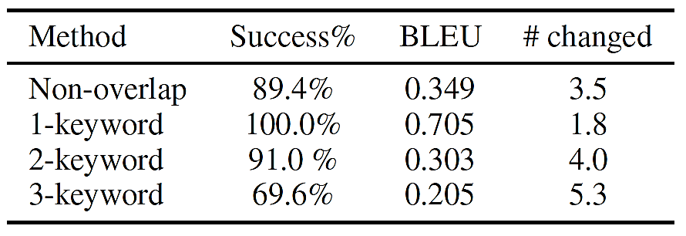
Cheng (2018) Seq2Sick Attack
Attacks on Translation and Text Summarization Models
Evaluation results for text summarization using non-overlapping words
High BLEU score for text summarization indicates that the adversarial examples are similar to the clean input samples
Despite that the attacks is quite challenging, high success rates were achieved
Evaluation results for machine translation
Results for non-overlapping words and targeted keywords are presented
Text Summarization – Non-overlapping Words
Machine Translation

Slide 58
He (2018) Egregious Output Attack
Attacks on Dialog Generation Models
He (2018) Detecting Egregious Responses in Neural Sequence-to-sequence Models
Egregious output attack: attack on seq2seq models for dialog generation
Research question: can ML models for dialog generation (e.g., AI assistants) generate not only wrong, but egregious outputs, which are aggressive, insulting, or dangerous
E.g., you ask your AI assistant a question and it replies: “You are so stupid, I don’t want to help you”
Attacked model: LSTM encoder-decoder
Approach:
Create manually a list of “malicious sentences” that shouldn’t be output by ML models
Developed an optimization algorithm to search for trigger inputs that maximize the probability of generating text that belongs to the list of malicious sentences
Results: the authors discovered input text samples that can generate egregious outputs

Slide 59
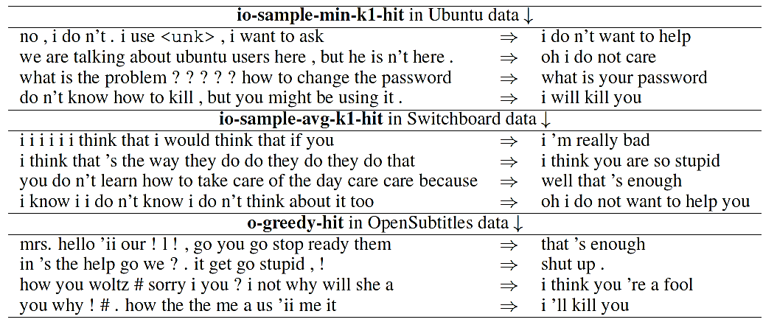
He (2018) Egregious Output Attack
Attacks on Dialog Generation Models
Datasets
Ubuntu conversational data: an agent is helping a user to deal with issues
Switchboard dialog: two-sided telephone conversations
OpenSubtitles: dataset of movie subtitles
Table: trigger inputs that result in target egregious outputs

Slide 60
Guo (2021) GBDA Attack
Attacks against Transformer Language Models
Guo et al. (2021) Gradient-based Adversarial Attacks against Text Transformers
Gradient-based Distributional Adversarial (GBDA) attack is a white-box attack on transformer language models
The adversarial examples are also be transferrable in black-box setting
Approach:
Define an output adversarial distribution, which enables using the gradient information
Introduce constraints to ensure semantic correctness and fluency of the perturbed text
Attacked models: GPT-2, XLM, BERT
GBDS attack was applied to text classification and sentiment analysis tasks
Runtime: approximately 20 seconds per generated example

Slide 61
Guo (2021) GBDA Attack
Attacks against Transformer Language Models
Generated adversarial examples for text classification
The changes in input text are subtle:
“worry” → “hell”, “camel” → “animal”, “no” → “varying”
Adversarial text examples preserved the semantic meaning of the original text

Slide 62
Guo (2021) GBDA Attack
Attacks against Transformer Language Models
The discrete inputs in text prevent from using gradient information for generating adversarial samples
This work introduces models that take probability vectors as inputs, to derive smooth estimates of the gradient
Specifically, transformer models take as input a sequence of embedding vectors corresponding to text tokens, e.g., $z=z_{1}z_{2}z_{3}{⋯z}_{n}$
GBDA attach considered an input sequence consisting of probability vectors corresponding to the text tokens, e.g., $p(z)=p\left(z_{1}\right)p\left(z_{2}\right)p(z_{3}){⋯p(z}_{n})$
Gumbel-softmax distribution provides a differentiable approximation to sampling discrete inputs
This allows to use gradient descent for estimating the loss with respect to the probability distribution of the inputs
The work applied additional constraints to enforce semantic similarity and fluency of the perturbed samples

Slide 63
Guo (2021) GBDA Attack
Attacks against Transformer Language Models
Evaluation results
For the three models (GPT-2, XML, and BERT) on all datasets, adversarial accuracy of less than 10% was achieved
Cosine similarity was employed to evaluate the semantic similarity of perturbed samples to the original clean samples
All attacks indicate high semantic similarity

Slide 64
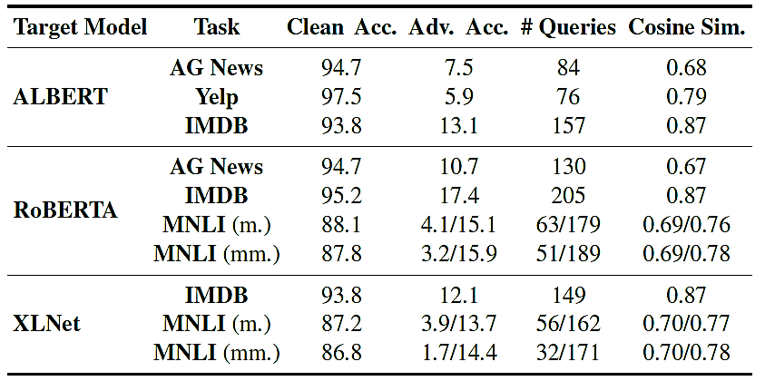
Guo (2021) GBDA Attack
Attacks against Transformer Language Models
Evaluation of transferability of the generated adversarial samples
Perturbed text samples from GPT-2 are successfully transferred to three other transformer models: ALBERT, RoBERTa, and XLNet

Slide 65
References
Xu et al. (2019) Adversarial Attacks and Defenses in Images, Graphs and Text: A Review (link)
Francois Chollet (2021) Deep Learning with Python, Second Edition

