Slide 1
CS 404/504
Special Topics: Adversarial Machine Learning
Dr. Alex Vakanski

Slide 2
Lecture 14
Explainability in Machine Learning

Slide 3
Lecture Outline
Explainability in ML
Concerns by stakeholders and for deployment
Transparency
Transparent versus opaque models
Type of explanations
Pixel-level explanations
Vanilla BackProp, Guided BackProp, Occlusion maps, CAM, Grad-CAM, Guided Grad-CAM, Integrated gradients, Layer-wise relevancy propagation
Feature-level explanations
LIME, Shapley values, SHAP
Concept-level explanations
TCAV, ACE
Instance-level explanations
Prototypes and criticisms, counterfactual explanations

Slide 4
Explainability in ML
Explainability in ML
Several terms are used interchangeably for explainability in ML
Explainable ML
Explainable AI (with the acronym XAI)
Interpretable ML, or interpretable AI
ML systems are increasingly being deployed across a wide range of applications
Most studies focus on increasing the predictive accuracy of ML models
Beside achieving high accuracy, we need to also have good understanding of the internal working of ML models
Current best performing models (DL-based models) are the least transparent
Challenges:
Do we understand the decisions suggested by ML models?
Can we trust ML models if their decision-making process is not fully transparent?

Slide 5
What is Interpretability?
Explainability in ML
Interpretability is the ability to explain or to present in understandable terms to a human
There is no clear answers in psychology to:
What constitutes an explanation?
What makes some explanations better than the others?
When are explanations sought?
Explainable ML refers to methods and techniques in the application of ML systems such that the results of the solution can be understood by human experts and users
It opposes the concept of black-box models in ML, where it is not obvious why the model arrived at a specific decision
Slide credit: Hima Lakkaraju - Interpretability and Explainability

Slide 6
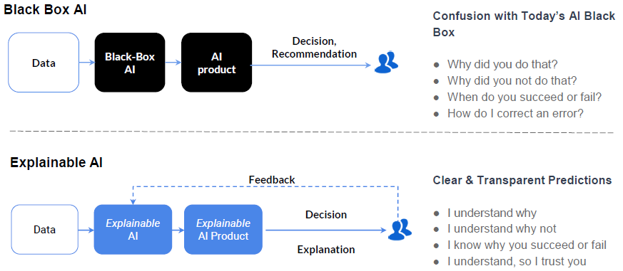
What is Interpretability?
Explainability in ML
Black-box AI versus explainable AI
Figure from: KDD 2019 Tutorial, Explainable AI in Industry

Slide 7
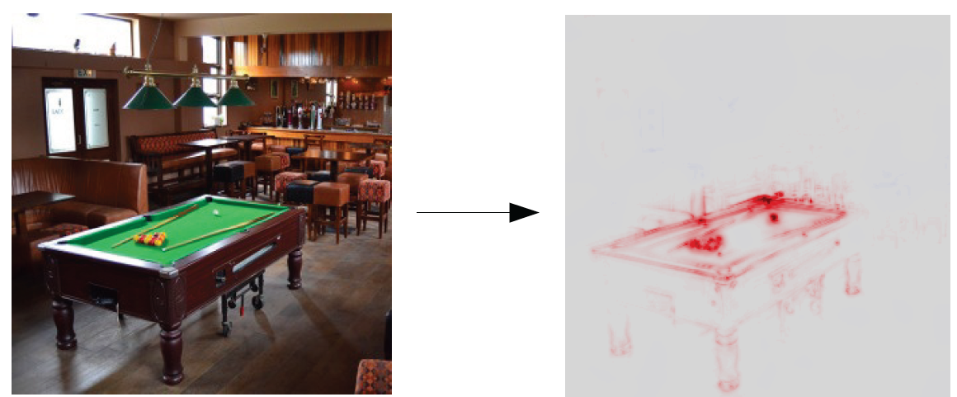
Explainability in ML
Explainability in ML
Explainability in ML can help to determine the most important features used by a model when making a prediction
E.g., the shown saliency map indicates the regions in the image that contributed the most to the classification by the model as “pool table”
True class label: pool table
Model prediction: pool table
Saliency map, explains the model prediction
Figure from: Samek (2019) Meta-Explanations, Interpretable Clustering & Other Recent Developments.

Slide 8
Explainability in ML
Explainability in ML
Feature relevance (or feature attribution) is also applied with non-image data for quantifying the influence of each input variable toward the model decision
E.g., the figure shows explainability via feature importance of an ML model for determining the interest rate of a bank loan
Figure from: Lundberg – SHAP documentation: https://shap.readthedocs.io/en/latest/

Slide 9
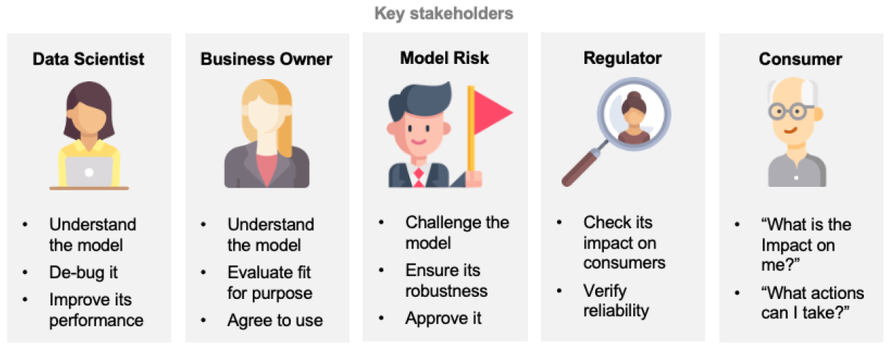
Concerns by Stakeholders
Explainability in ML
Concerns regarding explainable AI faced by various stakeholders
How does a model work?
What is driving decisions?
Can I trust the model?
Figure from: Belle (2020) Principles and Practice of Explainable Machine Learning

Slide 10
Concerns when Deploying ML
Explainability in ML
Correctness
Did only the variables of interest contribute to the decision, and not spurious patterns and correlations?
Robustness
Is the model sensitive to minor data perturbations, or missing and/or noisy data?
Bias
Are we aware of any data-specific biases that unfairly penalize groups of individuals?
Improvement
Can the model be improved, e.g., via enhanced training data or feature space?
Transferability
Can the model trained for one application domain be applied to another domain?
Human comprehensibility
Can we explain the model’s decision-making algorithm to a human domain-expert, or to a lay person?

Slide 11
ML Bias
Explainability in ML
Example of a biased ML algorithm
Figure from: Freddy Lecue, XAI – Explanation in AI

Slide 12
Transparency
Explainability in ML
Transparency stands for a human-level understanding of the inner workings of the model
Transparent models are characterized by:
Simulatability – the model can be simulated by a human
Decomposability – the model can be broken down into parts (e.g., inputs, parameters, computations) that can be explained
Algorithmic transparency – the model allows to understand the procedure that it goes through in order to generate its output
Broadly, we can think of ML models as:
Transparent (interpretable) models
Simpler models, easier to understand
E.g., decision trees, linear regression, logistic regression, rule-based models (if-else), k-nearest neighbors, Bayesian networks, generative additive models
Opaque (black-box) models
Nontransparent, difficult to understand
E.g., deep learning models, random forests, support vector machines, ensemble models

Slide 13
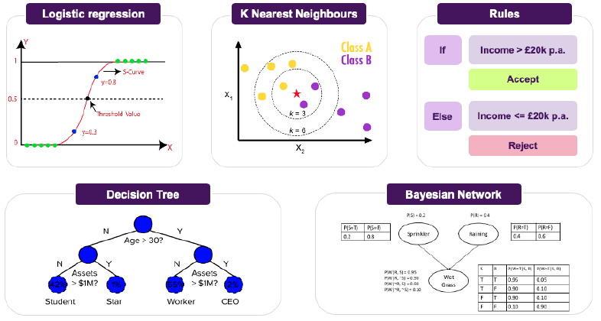
Transparent Models
Explainability in ML
Figure from: Belle (2020) Principles and Practice of Explainable Machine Learning

Slide 14
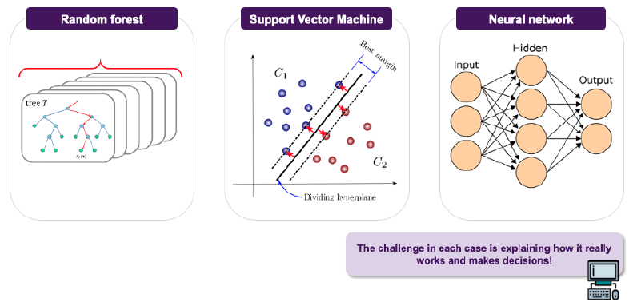
Opaque Models
Explainability in ML
Figure from: Belle (2020) Principles and Practice of Explainable Machine Learning

Slide 15
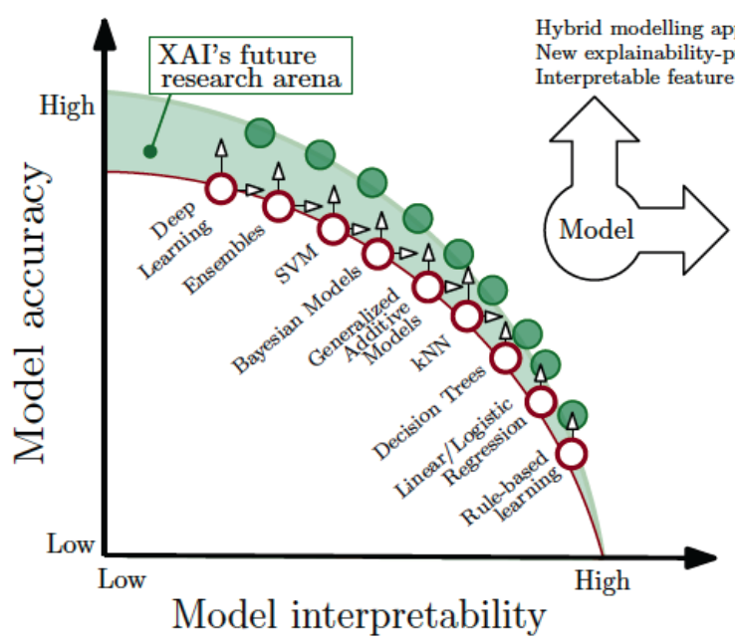
Interpretability vs Accuracy
Explainability in ML
Currently, the best performing models in terms of accuracy are the least interpretable
Future research areas based on explainable modelling approaches offer a potential to enhance the interpretability of most ML models
Figure from: Arietta (2019) – Explainable Artificial Intelligence (XAI)

Slide 16
Transparent vs Opaque Models
Explainability in ML
At present , there are two major alternatives to achieving interpretability:
Via transparent models, employ inherently interpretable models
They offer simplicity, since the explanation is embedded in the model
E.g., the weight coefficients $w$in the linear model $w_{0}+w_{1}f_{1}+w_{2}f_{2}+⋯+w_{n}f_{n}$ indicate which features $f$ contributed the most to the decision
By following the branches in a decision tree model from the final outcome to the inputs, it is fairly easy to realize how the model made the predictions
Based on the applied if-then logic in a rule-based system, it is possible to understand the path from the inputs to the model prediction
The model simplicity can result in lower performance than more complex, but non-transparent models
In a critical application, a transparent model with lower accuracy may be acceptable
Post-hoc explainability: employ a post-hoc step to explain the predictions by opaque models
First train the opaque black-box model, and afterward apply another method to explain its decision-making process
Explanation by important features, concepts, influential examples
Downside: one extra step is needed to explain the black-box model

Slide 17
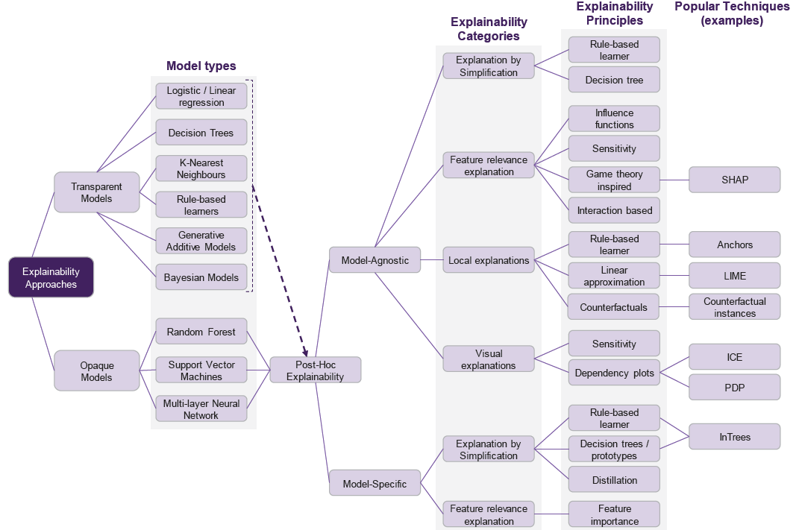
Map of Explainability Approaches
Explainability in ML
Figure from: Belle (2020) Principles and Practice of Explainable Machine Learning

Slide 18
Model-agnostic Explainability
Explainability in ML
Model-agnostic explainability
Explainability techniques and methods that can be applied to explain any ML method
They don’t depend on the internal architecture of the model that needs to be explained
Instead, they operate by relating the inputs of the model to its outputs
Model-specific explainability
Explainability techniques and methods that are designed for explaining one or several types of ML models
These methods cannot be used for explaining any type of ML models

Slide 19
Type of Explanations
Type of Explanations
Pixel-level explanations
Vanilla BackProp, Guided BackProp, Occlusion Maps, CAM, Grad-CAM, Guided Grad-CAM, Integrated Gradients, Layer-wise Relevancy Propagation
Feature-level explanations
Concept-level explanations
Instance-level explanations

Slide 20
Vanilla Backpropagation
Pixel-level Explanations
Vanilla Backpropogation
Simonyan (2014) – Deep Inside Convolutional Networks: Visualising Image Classification Models and Saliency Maps
The approach uses backpropagation to visualize the gradients with respect to each pixel of an image
A saliency map is obtained that highlights the pixels that have the largest impact on the class score
Image and the corresponding saliency map for the top-1 predicted class

Slide 21
Vanilla Backpropagation
Pixel-level Explanations
The input to the DL model is an image $x=\left(x_{1}, x_{2}, …, x_{d}\right)$
The neurons at layer j take the outputs from layer i (e.g., $z_{j}=\sum_{i}{u_{i}}W_{ji}$) and apply an activation function $g$ to transform the inputs (e.g., $u_{j}=g(z_{j})$)
The vector of logits values for c-class classification is $z=\left(z_{1}, z_{2}, …, z_{c}\right)$
The logits vector $z$ is passed through softmax activations to produce the output probabilities y
Question: How important is the pixel $x_{i}$ to the class score $z_{c}(x)$?
Sensitivity: How sensitive is the score $z_{c}(x)$ to changes in $x_{i}$?
Attribution: How much does $x_{i}$ contribute to the score $z_{c}(x)$?
Slide credit: Nevin L. Zhang – Lecture 9: Explainable AI

Slide 22
Vanilla Backpropagation
Pixel-level Explanations
Explaining the class score $z_{c}(x)$ of a trained DL model for an input image x in a post-hoc step
Forward propagation: Compute activations and the logits vector z
Backward propagation: Compute the gradient of the class score $z_{c}$with respect to pixel $x_{i}$, $\frac{∂z_{c}}{∂x_{i}}$
For each neuron j on second-last layer: $\frac{∂z_{c}}{∂u_{j}}=W_{cj}$
For each neuron i on third-last layer: $\frac{∂z_{c}}{∂u_{i}}=\sum_{j}{W_{ji}\frac{∂u_{j}}{∂z_{j}}\frac{∂z_{c}}{∂u_{j}}}$
… the gradients are propagated to the input image to calculate $\frac{∂z_{c}}{∂x_{i}}$
Recall that for model training, the gradient of the loss with respect to the weights is used for learning the optimal weight values, i.e., $\frac{∂ℒ\left(y,\hat{y}\right)}{∂W_{ji}}$
Slide credit: Nevin L. Zhang – Lecture 9: Explainable AI

Slide 23
Guided Backpropagation
Pixel-level Explanations
Guided Backpropagation
Springerberg (2015) – Striving for Simplicity: Thee All Convolutional Net
It expands the gradient backpropagation approach
If the gradient of a neuron is negative ($\frac{∂z_{c}}{∂u_{j}}<0$), it contributes negatively to the gradients of the neurons in the lower layers
The guided backpropagation approach ignores negative gradients in the backpropagation step
A ReLU function is used for this purpose: $\frac{∂z_{c}}{∂u_{i}}=\sum_{j}{W_{ji}\frac{∂u_{j}}{∂z_{j}}ReLU\left(\frac{∂z_{c}}{∂u_{j}}\right)}$
Compare to Vanilla Backpropagation: $\frac{∂z_{c}}{∂u_{i}}=\sum_{j}{W_{ji}\frac{∂u_{j}}{∂z_{j}}\frac{∂z_{c}}{∂u_{j}}}$
Slide credit: Nevin L. Zhang – Lecture 9: Explainable AI

Slide 24
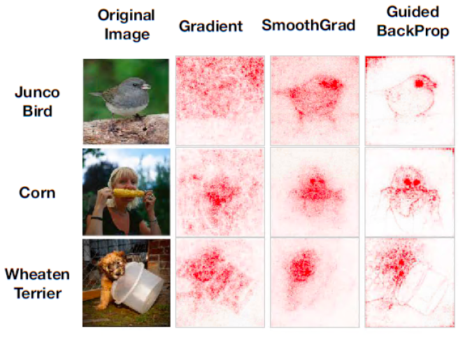
Guided Backpropagation
Pixel-level Explanations
Guided BackProp produces sharper saliency maps than Vanilla Gradient
Figure from Adebayo (2018) – Sanity Checks for Saliency Maps

Slide 25
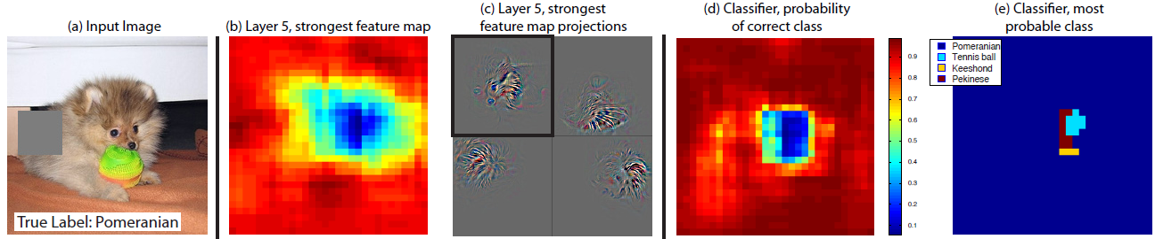
Occlusion Maps
Pixel-level Explanations
Occlusion maps, also known as Perturbation Methods
Zeiler (2014) – Visualizing and Understanding Convolutional Networks
Systematically occlude different portions of the input image with a grey square, and monitor the output of the classifier
E.g., in the image, the strongest feature is the dog’s head
Occlusion maps is an older and computationally expensive method

Slide 26
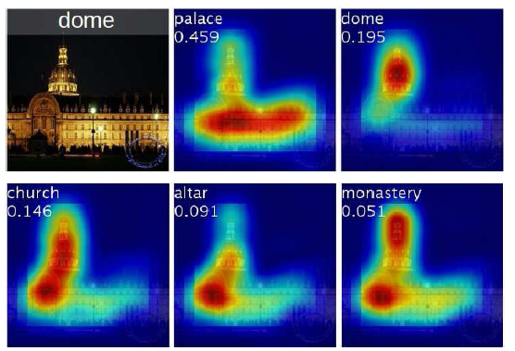
CAM
Pixel-level Explanations
CAM (Class Activation Mapping)
Zhou (2016) – Learning Deep Features for Discriminative Localization
CAM produces a heatmap for the pixels that activate the most model’s prediction of a specific class of objects
E.g., heatmaps for the top 5 predicted classes for the image with a true label ‘dome’
Note that the ‘palace’ prediction focuses on the lower flat part of the building, while the ‘dome’ prediction focuses on the upper part

Slide 27
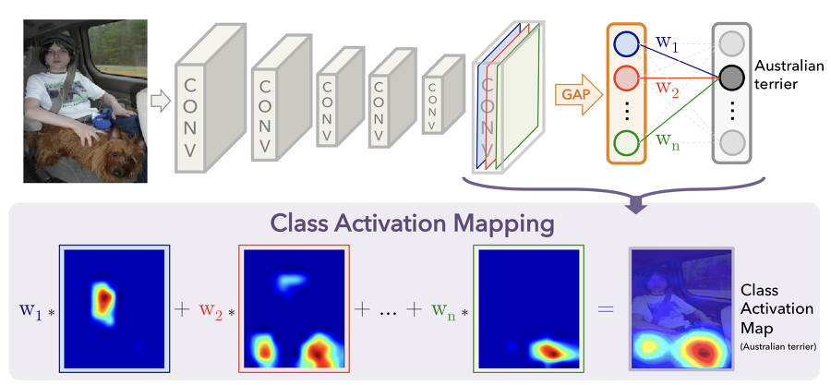
CAM
Pixel-level Explanations
Let $A^{k}=[a_{ij}^{k} ]$denotes the k-th feature map of the last convolutional layer in the network
A global average pooling (GAP) layer is employed to calculate a value $w_{k}$ for the feature map $A^{k}$, i.e.,${ w}_{k}=\sum_{i,j}{a_{ij}^{k}}$
The outputs of the GAP layer $w_{1},…,w_{k}$ are fed to a softmax layer to output class predictions
For a class c, the CAM heatmap is calculated as $\sum_{k}{w_{k}^{c}A^{k}}$

Slide 28
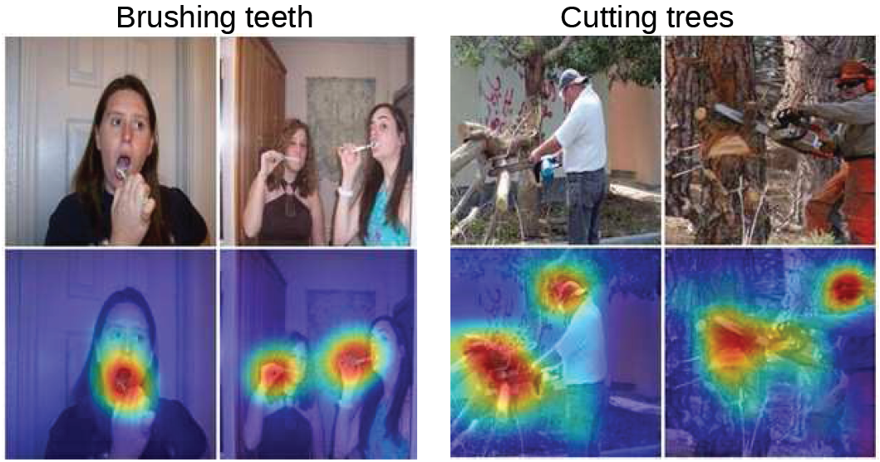
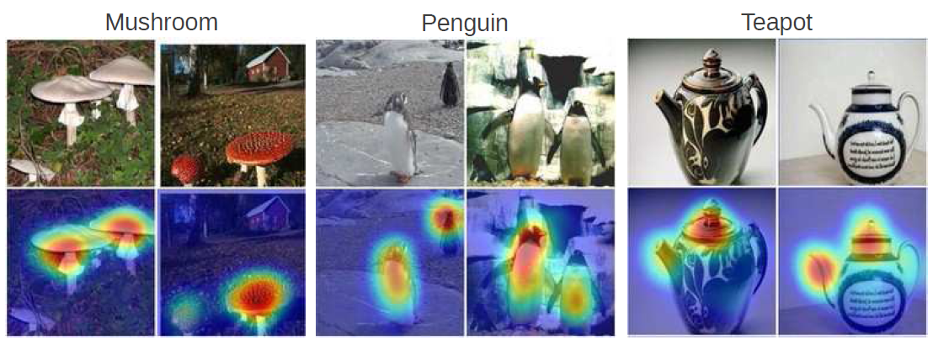
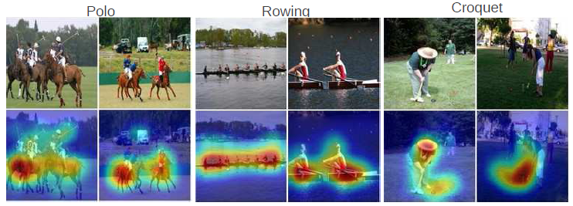
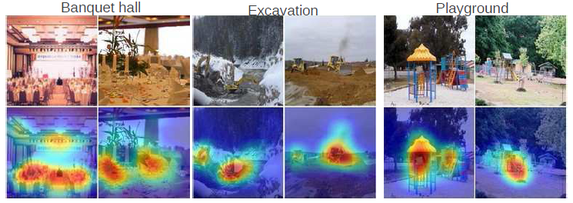
CAM
Pixel-level Explanations
Limitation: the last convolution layer has small resolution (typically between 7×7 and 28×28 pixels), therefore the produced heatmaps are coarse
CAM applied to object recognition and action recognition tasks

Slide 29
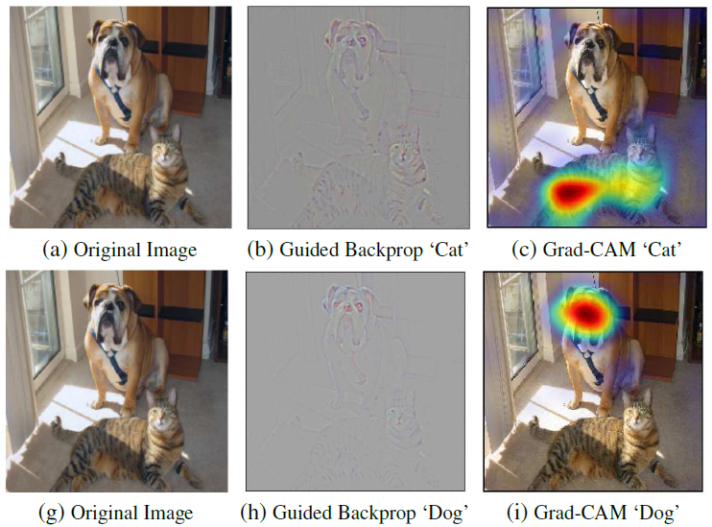
Grad-CAM
Pixel-level Explanations
Grad-CAM
Selvaraju (2017) – Grad-CAM: Visual Explanations from Deep Networks via Gradient-based Localization
Grad-CAM is an extension of the CAM approach
It employs gradient backpropagation to improve the heatmaps
Compare Grad-CAM to Guided BackProp for the classes ‘Cat’ and “Dog’ in the image

Slide 30
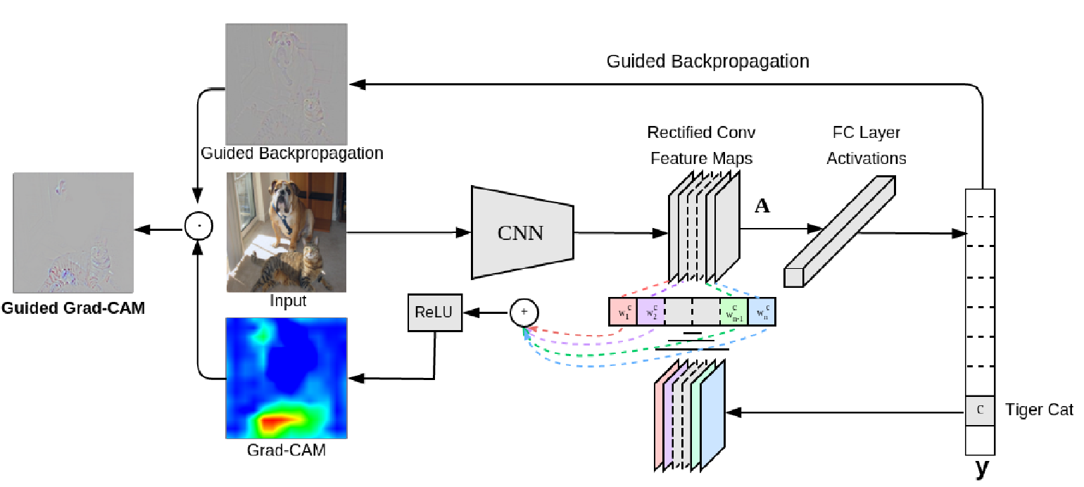
Grad-CAM
Pixel-level Explanations
Grad-CAM first computes the gradient of the logits for class c with respect to the feature maps $A^{k}=[a_{ij}^{k} ]$of the last convolutional layer in the network
I.e., the gradient is $\frac{∂z_{c}}{∂a_{ij}^{k}}$
The importance of the feature map $A^{k}$ is calculated as:${ w}_{k}=\sum_{i,j}{\frac{∂z_{c}}{∂a_{ij}^{k}}}$
The Gad-CAM heatmap for a class c is calculated as: $ReLU\left(\sum_{k}{w_{k}^{c}A^{k}}\right)$
ReLU is used to select only the feature maps $A^{k}$ that have positive influence on $z_{c}$
Slide credit: Nevin L. Zhang – Lecture 9: Explainable AI

Slide 31
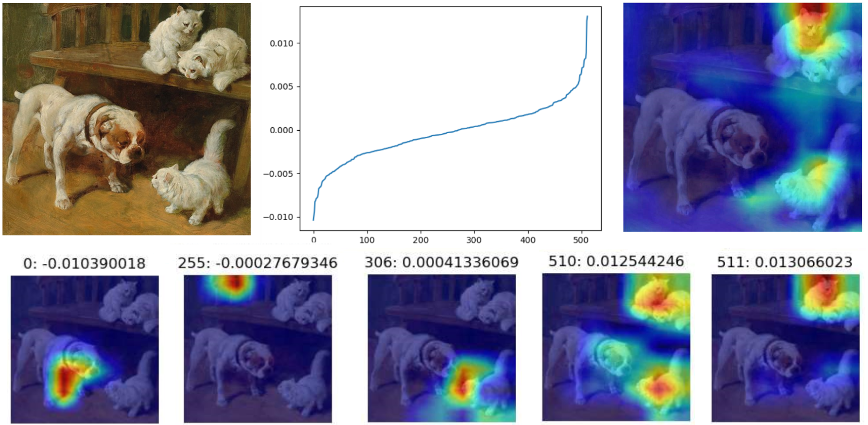
Grad-CAM
Pixel-level Explanations
Example, the values ${ w}_{k}$ for a network with 512 feature maps are shown below
Values ${ w}_{k}$ for $k=0,1,..,511$
Final heatmap
Feature map $A^{0}$: 0
Value ${ w}_{0}:$ -0.01
Slide credit: Nevin L. Zhang – Lecture 9: Explainable AI

Slide 32
Guided Grad-CAM
Pixel-level Explanations
Like the original CAM method, the Grad-CAM heatmaps have smaller dimensions than the input image
The authors of Grad-CAM proposed Guided Grad-CAM approach, in which the heatmaps produced by Grad-CAM are upsampled and multiplied with the saliency map from Guided BackProp

Slide 33
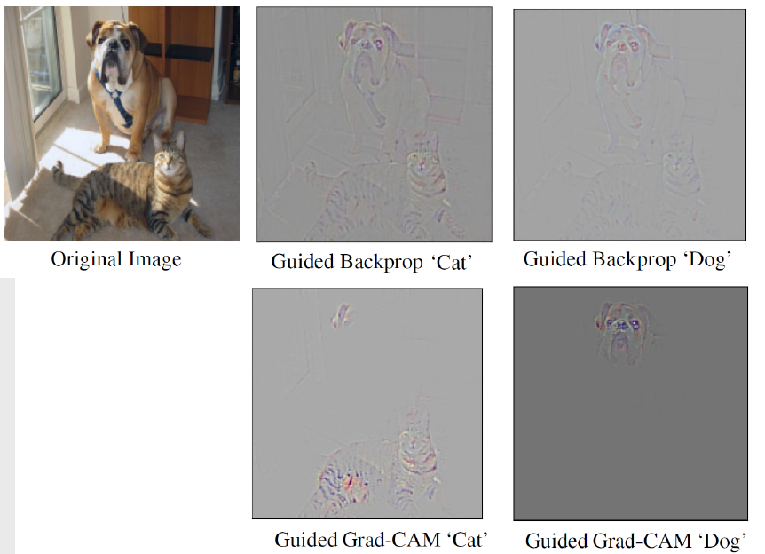
Guided Grad-CAM
Pixel-level Explanations
Guided Grad-CAM produces sharper and more discriminative saliency maps than Guided BackProp

Slide 34
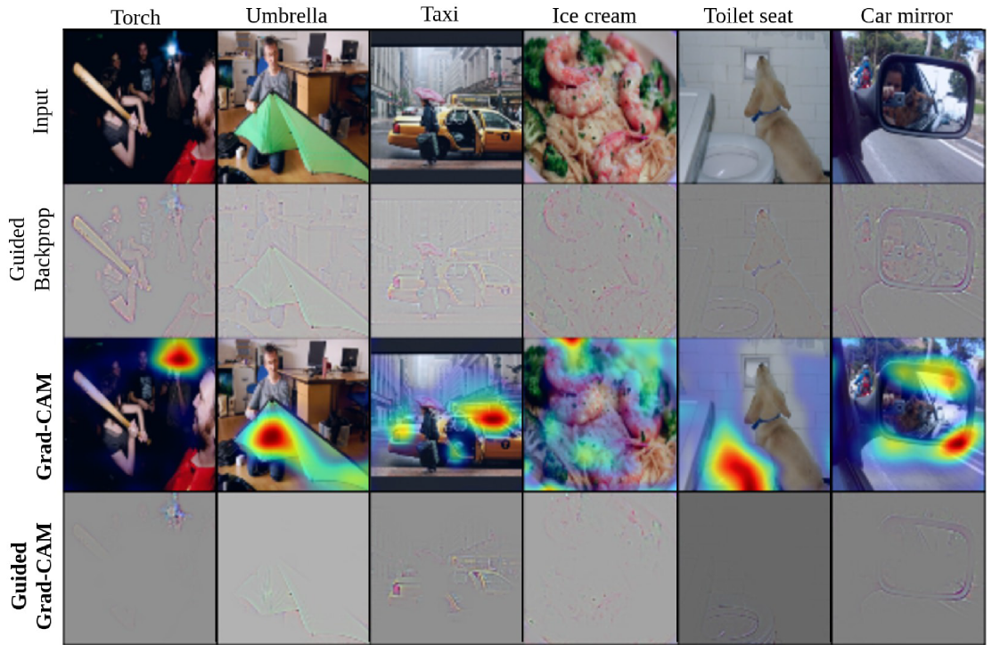
Guided Grad-CAM
Pixel-level Explanations

Slide 35
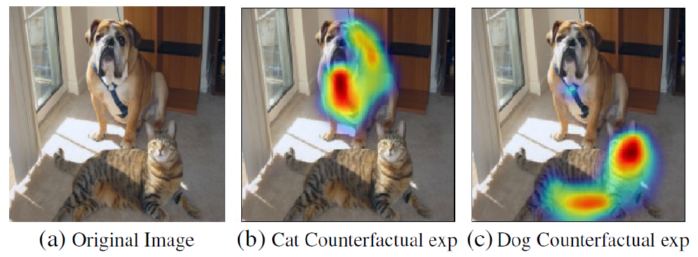
Grad-CAM and Counterfactual Explanations
Pixel-level Explanations
To identify region that contributes positively to a classification
Importance weights: $w_{k}^{c}=\sum_{i,j}{\frac{∂z_{c}}{∂a_{ij}^{k}}}$ and heatmap: $ReLU\left(\sum_{k}{w_{k}^{c}A^{k}}\right)$
To identify region that contributes negatively to a classification
Importance weights: $w_{k}^{c}=\sum_{i,j}{−\frac{∂z_{c}}{∂a_{ij}^{k}}}$ and heatmap: $ReLU\left(\sum_{k}{w_{k}^{c}A^{k}}\right)$
Removing the negative region makes the classification more confident
The modified images are counterfactual explanations (emphasizing the regions that are opposite to the factual prediction)
Slide credit: Nevin L. Zhang – Lecture 9: Explainable AI

Slide 36
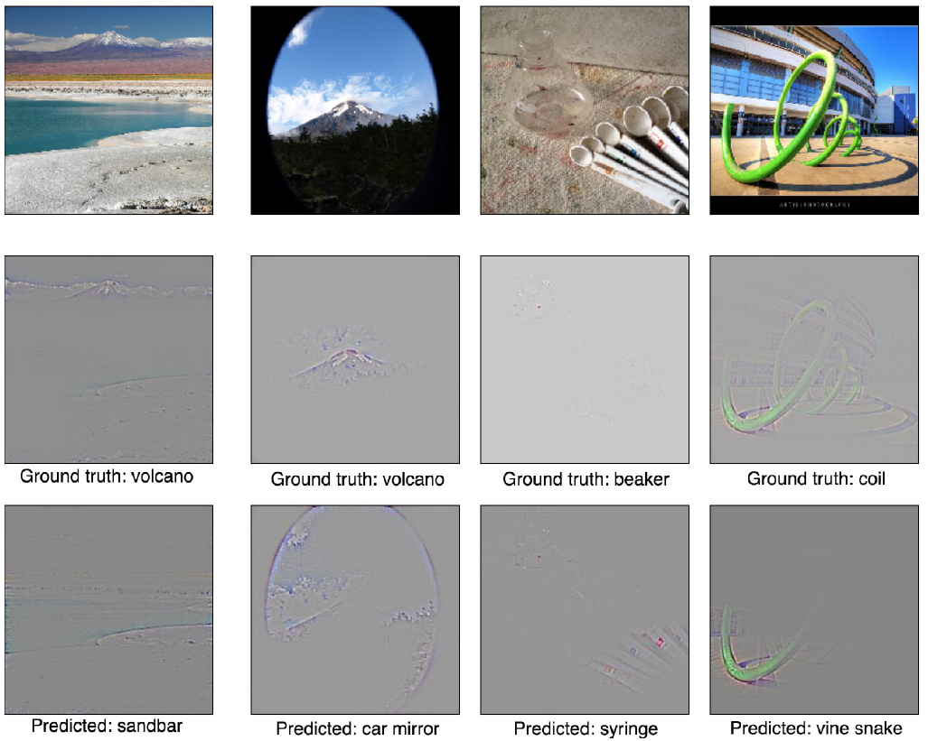
Guided Grad-CAM for Model Analysis
Pixel-level Explanations
Seemingly unreasonable predictions by models have reasonable explanations

Slide 37
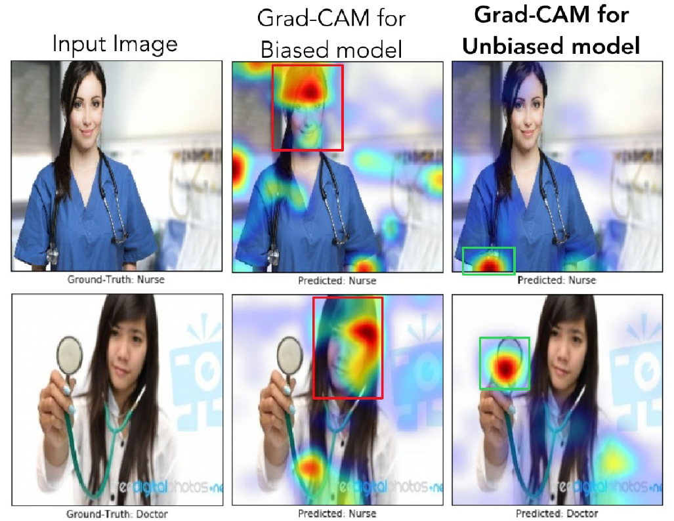
Grad-CAM for Predicting Model Bias
Pixel-level Explanations
For a biased model, gender is strongly correlated with being a doctor or nurse
For an unbiased model, gender is independent of being a doctor or nurse
Slide credit: Nevin L. Zhang – Lecture 9: Explainable AI

Slide 38
Integrated Gradients
Pixel-level Explanations
Integrated Gradients
Sundarajan (2017) - Axiomatic Attribution for Deep Networks
Integrated gradients employs the integral of the gradients of a black-box model F along a straight-line path from a baseline input z to an input instance x
The integrated gradient for pixel i is calculated as
$${IG}_{i}\left(x,z\right)=\left(x−z\right)∙\int_{α=0}^{1}{\frac{∂F\left(α∙x+\left(1−α\right)∙z\right)}{∂x_{i}}dα}$$
E.g., in the figure below, the integrated gradients are sharper and more discriminative than the regular gradients

Slide 39
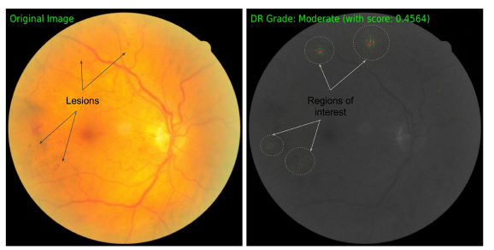
Integrated Gradients
Pixel-level Explanations
A key step in Integrating Gradients is selecting a baseline for the integration
Ideally, the baseline $z$is an information-less input for the model
This allows to better interpret the attributions as a function of the input
E.g., black image is used as a baseline for image models
E.g., empty text or zero-embedding vector for text models
Integrated Gradients explain $F(x)−F(z)$in terms of input features
E.g., application of IG for diabatic retinopathy prediction
The original image is on the left with the ground-truth lesions, and the on the right are the feature attributions pointing to the areas with lesions

Slide 40
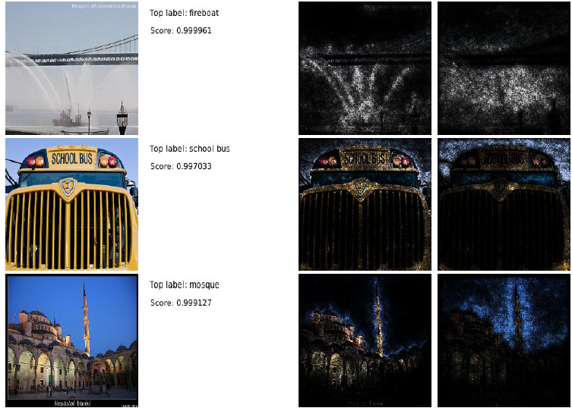
Integrated Gradients
Pixel-level Explanations
Examples

Slide 41
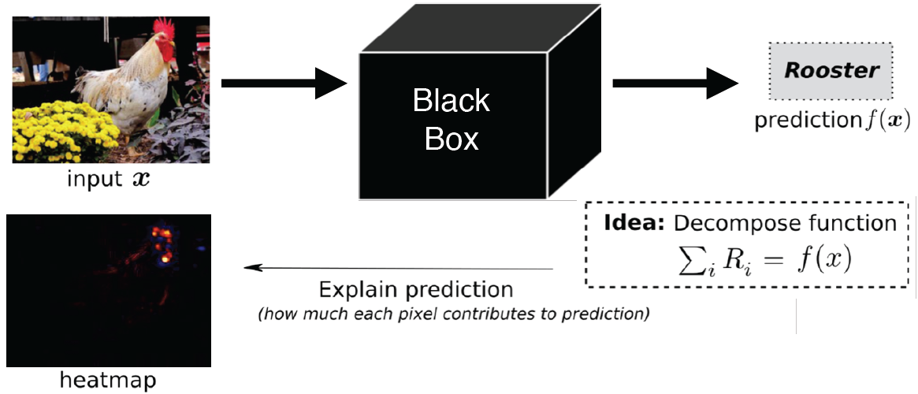
LRP
Pixel-level Explanations
LRP (Layer-wise Relevancy Propagation)
Bach (2015) - On Pixel-Wise Explanations for Non-Linear Classifier Decisions by Layer-Wise Relevance Propagation
LRP calculates the attribution (i.e., relevance, importance) of each pixel i in the input image x to the model prediction $f(x)$
The prediction $f(x)$ is propagated backward from the last layer toward the input layer
The sum of the relevance scores of all input pixels $R_{i}$ is set equal to the predicted score for the class ‘rooster’
Figure from: Samek (2019) Meta-Explanations, Interpretable Clustering & Other Recent Developments.

Slide 42
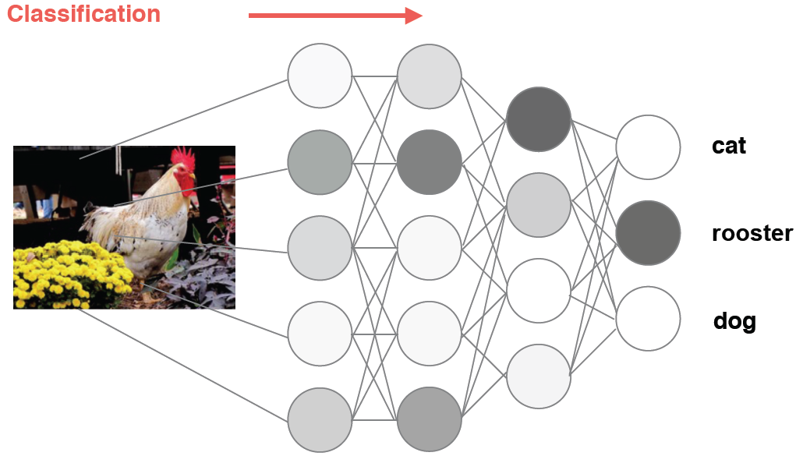
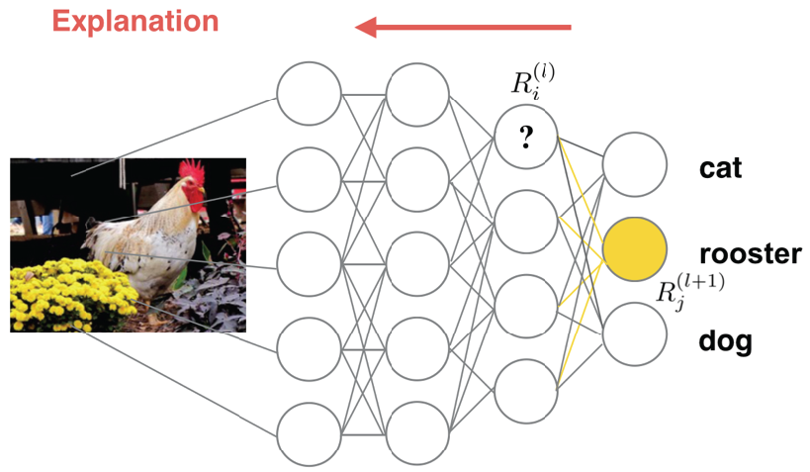
LRP
Pixel-level Explanations
Left image: the forward pass of the input image through the model results in the prediction ‘rooster’
Right image: the relevance score $R_{j}^{(l+1)}$of the output neuron for the class ‘rooster’ is backpropagated from the top layer down to the input
The relevance score of neuron j in layer $l+1$, i.e.,${ R}_{j}^{(l+1)}$ is decomposed into relevance scores of the neurons in the previous layer $l$, via $R_{i}^{(l)}=\sum_{j}{\frac{x_{i}w_{ij}}{\sum_{i′}{x_{i^{′}}w_{i′j}}}}$ $R_{j}^{(l+1)}$
$w_{ij}$ are the weights between neurons i and j, and $x_{i}$ is the input to neuron i
Figure from: Samek (2019) Meta-Explanations, Interpretable Clustering & Other Recent Developments.

Slide 43
LRP
Pixel-level Explanations
The sums of the relevance scores over all layers is preserved
$\sum_{i}{R_{i}=…=\sum_{i}{R_{i}^{\left(l\right)}=}} \sum_{i}{R_{j}^{\left(l+1\right)}=}..=f(x)$
Meaning all layers (from the input layer of pixels $R_{i}$, all internal layers in the model $R_{i}^{\left(l\right)}$, to the neuron in the last prediction layer $f(x)$ ) have the same sum of the relevance scores
The authors of LRP extended their approach by employing a modified Taylor expansion for the propagation of the relevance scores between the layers
Montavon (2017) - Explaining Nonlinear Classification Decisions with Deep Taylor Decomposition
They refer to as deep Taylor decomposition
The approach introduces rules for decomposing the relevance in different type of layers in deep NNs

Slide 44
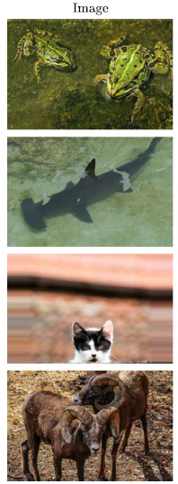
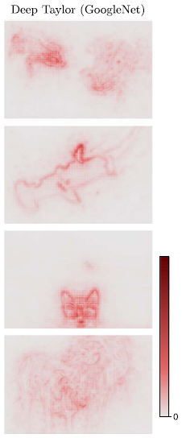
LRP
Pixel-level Explanations
Images and the corresponding LRP heatmaps
Frog
Shark
Cat
Sheep

Slide 45
Application of Attributions
Pixel-level Explanations
Generating an explanation for the end-user
E.g., identify pixel attributions to a model’s prediction
Debugging model predictions
E.g., in the case of image misclassification, identify the pixels responsible for it
Analyzing model robustness
E.g., create adversarial examples using weaknesses surfaced by pixels’ attributions
Extract rules from the model
E.g., combine attributions to create rules for capturing the prediction logic of a drug screening model
Slide credit: KDD 2019 Tutorial, Explainable AI in Industry

Slide 46
Type of Explanations
Feature-level Explanations
Pixel-level explanations
Feature-level explanations
LIME, Shapley values, SHAP
Concept-level explanations
Instance-level explanations

Slide 47
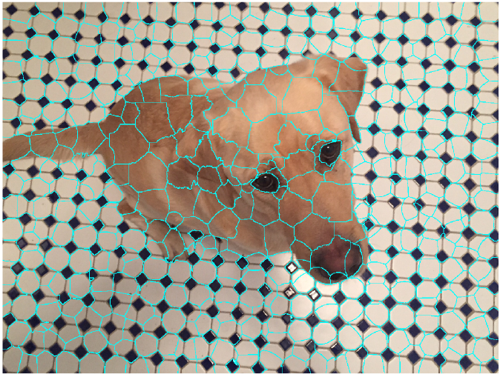
Feature-level Explanations
Feature-level Explanations
Feature-level explanations refer to higher-level components in input data
For example, explaining regions in images at a higher abstraction than pixels
Examples of features:
Super-pixels in images
Collections of pixels, e.g., obtained by image segmentation as in the image below
Words in textual data
Input variables in tabular data
Slide credit: Nevin L. Zhang – Lecture 9: Explainable AI

Slide 48
LIME
Feature-level Explanations
LIME (Local Interpretable Model-agnostic Explanations)
Ribeiro (2016) – "Why Should I Trust You?": Explaining the Predictions of Any Classifier
LIME is a model-agnostic explainability approach (it can work with any type of ML black-box models)
The goal is to employ a simple ML model that can locally approximate the predictions by a black-box model
The simple ML model should identify interpretable representations of the data that are locally faithful to the black-box model
The interpretable representations should be understandable to a human user
Conversely, the input features (i.e., original representations of the data) may not be understandable to a human user

Slide 49
LIME
Feature-level Explanations
Consider the image classification task
Original representation of an image x is the tensor of image pixels
A simplified representation of the image can consist of an array of super-pixels
Interpretable representation can indicate the presence or absence of super-pixels to describe a specific class label
Let assign a binary value $z∈\left\{0,1\right\}$ to each super-pixel, depending on whether the super-pixel is important for predicting the class c
The vector z of binary values over the set of all super-pixels is the interpretable representation
For this image, the vector z contain 1’s for the important super-pixels for the class ‘frog tree’ and 0’s for the non-important super-pixels for that class
Original representation
x
Interpretable representation
$$z=(0,0,1,0,1,…,0)$$

Slide 50
LIME
Feature-level Explanations
LIME explanation example
Explaining the top 3 class predictions by a trained Inception neural network: (1) electric guitar, (2) acoustic guitar, and (3) Labrador
The images (b), (c), and (d) show the super-pixels that contributed the most to each class prediction

Slide 51
LIME
Feature-level Explanations
The classification black-box model that needs to be explained is denoted $f$
This can be any ML classifier model, such as neural network, random forest, ensemble models, etc.
The prediction by the black-box model for an input $x$ is $f(x)$
E.g., the prediction is the probability that the input $x$ belongs to a class $c$
LIME uses a surrogate model $g$ for explaining $f$
The surrogate model is an interpretable classifier model, such as a linear model, decision trees, rule lists model, etc.
The surrogate model $g$acts over the vector $z$, related to the presence or absence of interpretable components in the input (using 0’s and 1’s for each component)
The prediction by the surrogate model is $g(z)$
The prediction by the surrogate model $g(z)$ should be locally faithful to the prediction of the explained classifier $f(x)$ in the neighborhood of the input $x$
I.e., the surrogate model should locally approximate the black-box model, and make approximately the same prediction: $g(z)≈$ $f(x)$
The assumption is that the decision boundary of the black-box model is locally linear (although globally this boundary can be very complex)

Slide 52
LIME
Feature-level Explanations
The surrogate model $g$ is chosen from a family of interpretable models $G$ (linear or rule models, decision trees), and it is found by minimizing the cost function:
$$arg\min_{g∈G}{ℒ\left(f,g,π_{x}\right)}+Ω\left(g\right)$$
$ℒ\left(f,g,π_{x}\right)$ measures how faithful $g\left(z\right)$is in approximating $f(x)$ locally, in the neighborhood of the input $x$
$Ω\left(g\right)$ is a penalty term for the model complexity
I.e., a simpler model $g$from the family of models $G$is preferred, since simpler models are considered easier to interpret
$π_{x}$ is a distance function which measures the distance between the input $x$ and instances $x$’ in the neighborhood of $x$
The authors proposed the following form: $π_{x}=exp\left(−D\left(x^{′},x\right)/σ\right)$
For images, $ℓ_{2}$distance is used for the distance $D$ in $π_{x}$
The cost function $ℒ\left(f,g,π_{x}\right)+Ω\left(g\right)$ is approximated by drawing multiple samples in the neighborhood of the input $x$

Slide 53
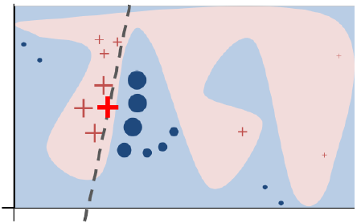
LIME
Feature-level Explanations
The intuition behind LIME is shown in the figure
The black-box model $f$has a complex non-linear decision boundary
Depicted by the blue and pink regions: red crosses belong to one class of objects, and blue circles belong to another class of objects
The bold red cross is the instance $x$ being explained
LIME samples instances in the neighborhood of $x$, it obtains class predictions using $f$, and weights the predictions based on the distance $π_{x}$ to the input $x$
The dashed line is the learned linear explanation model $g$ that is locally faithful to $f$
The global predictions by the simple linear ML model $g$ are not assumed faithful to the predictions by non-linear model $f$

Slide 54
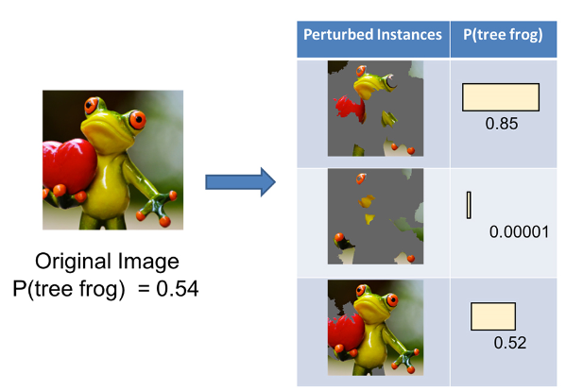
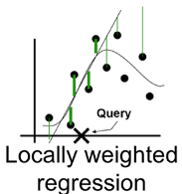
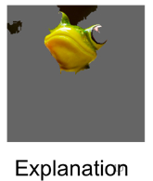
LIME
Feature-level Explanations
LIME steps:
Given an input image x, perturb it to create instances with slight modifications (e.g., by setting the color of some super-pixels to gray)
Apply the black-box model $f$to calculate the probability of perturbed instances x’
Select K super-pixels with top probabilities from the instances x’ using LASSO
Fit a simple (linear regression) model $g t$o the perturbed instances x’ (with the selected K super-pixels) weighted by their similarity distance $π_{x}$ to the original input x
Use the super-pixels with the highest coefficients to explain the model prediction

Slide 55
Shapley Values
Feature-level Explanations
The Shapley values is a solution concept in game theory, named in honor of Lloyd Shapley
He introduced this approach in 1951, and was awarded the Nobel Prize in Economics for it in 2012
Players in a game cooperate in a coalition and receive a certain profit from this cooperation
Players contribute differently to the total profit
For each cooperative game, the Shapley approach assigns to each player a portion of the total profit generated by the coalition
I.e., Shapley values tells us how to fairly distribute the "payout" among the players
In ML, a prediction by a model can be explained by assuming that each feature of the data is a player in a game where the prediction is the payout
Shapley values calculate the importance (the contribution) of different data features in making a specific prediction by the model
Slide credit: Nevin L. Zhang – Lecture 9: Explainable AI

Slide 56
Shapley Values
Feature-level Explanations
Example:
Three persons share a taxi
The costs for the individual journeys are:
Person 1 journey: $6
Person 2 journey: $12
Person 3 journey: $42
How much should each person contribute to the total cost of $42?
Consider the problem as a cooperative game
Create the sets of all possible coalitions between the three persons (i.e., players)
For 3 players, there are 2³ = 8 possible sets of coalitions (i.e., subsets of players) $S$: $\left\{∅\right\}, \left\{1\right\}, \left\{2\right\}$, $\left\{3\right\}, \left\{1, 2\right\}, \left\{1, 3\right\}$, $\left\{2, 3\right\}, \left\{1, 2, 3\right\}$
For any coalition $S$, a characteristic function $f(S)$ assigns a payout value
The assigned values are shown on the next page
Slide credit: Nevin L. Zhang – Lecture 9: Explainable AI

Slide 57
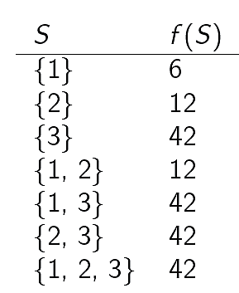
Shapley Values
Feature-level Explanations
Table with the possible sets of coalitions $S$and the corresponding payout values of the characteristic functions $f(S)$ for each set
How to divide the total cost of $42 among the three persons?
The next page describes the approach using Shapley values
Slide credit: Nevin L. Zhang – Lecture 9: Explainable AI

Slide 58
Shapley Values
Feature-level Explanations
The Shapley value for player $i$ is calculated as:
$$φ_{i}\left(f\right)=\frac{1}{M!}\sum_{\begin{aligned}π∈Π \\ \end{aligned}}{Δ_{π}^{f}\left(i\right)}=\frac{1}{M!}\sum_{π∈Π}{\left[f\left(S_{π}^{i}∪\left\{i\right\}\right)−f\left(S_{π}^{i}\right)\right]}$$
$M$ is the number of players
For the taxi example with 3 players, the factorial is $M!=3!=3⋅2⋅1=6$
$π$is a permutation of the set $\left\{1, 2, .., M\right\}$
E.g., for the set of three players there are $3!=6$ possible permutations
$Π$denotes the permutations: $\left\{1, 2, 3\right\}$, $\left\{1, 3, 2\right\}$, $\left\{2, 1, 3\right\}$, $\left\{2, 3, 1\right\}$, $\left\{3, 1, 2\right\}$, and $\left\{3, 2, 1\right\}$
$Δ_{π}^{f}\left(i\right)$ is the marginal contribution of player $i$to the Shapley value
It is calculated as the difference between the values of the characteristic function $f(S)$ when the player $i$is included $\left(f\left(S_{π}^{i}∪\left\{i\right\}\right)\right)$ and when player $i$ is excluded $\left(f\left(S_{π}^{i}\right)\right)$ from the coalition
$S_{π}^{i}$ is the set of predecessors of player $i$in $π$
Slide credit: Nevin L. Zhang – Lecture 9: Explainable AI

Slide 59
Shapley Values
Feature-level Explanations
Let’s consider the following permutation of the set: $π=\left\{2, 3, 1\right\}$
For player 1: $i=1$
The set of predecessors of 1 in $\left\{2, 3, 1\right\}$ is $S_{π}^{1}=\left\{2, 3\right\}$
Similarly,$S_{π}^{1}∪\left\{i\right\}=S_{π}^{1}∪\left\{1\right\}=$ $\left\{1, 2, 3\right\}$
The marginal contribution of player 1 is $Δ_{π}^{f}\left(1\right)=f\left(S_{π}^{1}∪\left\{1\right\}\right)−f\left(S_{π}^{1}\right)=f\left(\left\{1, 2, 3\right\}\right)−f\left(\left\{2, 3\right\}\right)=42−42=0$
The values for $f\left(\left\{1, 2, 3\right\}\right)$ and $f\left(\left\{2, 3\right\}\right)$are read from the table on the previous page
For player 2: $i=2$
The set of predecessors is $S_{π}^{2}=\left\{∅\right\}$, and $S_{π}^{2}∪\left\{2\right\}=$ $\left\{2\right\}$
The marginal contribution of player 2 is $Δ_{π}^{f}\left(2\right)=f\left(\left\{2\right\}\right)−f\left(\left\{∅\right\}\right)=12−0=12$
For player 3: $i=3$
$S_{π}^{3}=\left\{2\right\}$, and $S_{π}^{3}∪\left\{3\right\}=$ $\left\{2, 3\right\}$
The marginal contribution is $Δ_{π}^{f}\left(3\right)=f\left(\left\{2, 3\right\}\right)−f\left(\left\{2\right\}\right)=42−12=30$

Slide 60
Shapley Values
Feature-level Explanations
The table shows the marginal contributions $Δ_{π}^{f}\left(i\right)$by players 1, 2, and 3 for all 6 permutations of the set $\left\{1, 2, 3\right\}$
The calculated Shapley values $φ_{i}\left(f\right)$for each player are shown at the bottom
Therefore, the fair way of sharing the taxi fare is for player 1 to pay $2, player 2 to pay $5, and player 3 to pay $35
$$π$$ | $$Δ_{π}^{f}\left(1\right)$$ | $$Δ_{π}^{f}\left(2\right)$$ | $$Δ_{π}^{f}\left(3\right)$$
$$\left\{1, 2, 3\right\}$$ | 6 | 6 | 30
$$\left\{1, 3, 2\right\}$$ | 6 | 0 | 36
$$\left\{2, 1, 3\right\}$$ | 0 | 12 | 30
$$\left\{2, 3, 1\right\}$$ | 0 | 12 | 30
$$\left\{3, 1, 2\right\}$$ | 0 | 0 | 42
$$\left\{3, 2, 1\right\}$$ | 0 | 0 | 42
$$\sum{Δ_{π}^{f}\left(i\right)}$$ | 12 | 30 | 210
$$φ_{i}\left(f\right)=\frac{1}{6}\sum{Δ_{π}^{f}\left(i\right)}$$ | 2 | 5 | 35

Slide 61
Shapley Values
Feature-level Explanations
Shapley values are often used to explain the prediction $f(x)$ of a black-box ML model $f$ on an input instance $x$
Each feature of $x$ is regarded as a player, and the joint payout of all players (features) is $f(x)$
We need to define a characteristic function $f_{x}(S)$, where S is a subset of the features $\left\{1, 2, …,M\right\}$, and M is the number of features
There are several approaches for calculating $f_{x}(S)$, including:
Sample independently a set of input examples $x^{1},…x^{N}$ and estimate $f_{x}(S)$ as an average value of $f(x^{i})$ for the subset of features in S based on $f_{x}(S)≈\frac{1}{N}\sum_{i=1}^{N}{f(x^{i})}$
Sample independently a set of input examples $x^{1},…x^{N}$and estimate $f_{x}(S)$ as an average value based on features not in the subset S, i.e., $f_{x}(S)≈\frac{1}{N}\sum_{i=1}^{N}{f(x_{\overline{S}}^{i})}$, where $x_{\overline{S}}^{i}$ denotes the subset of features in $x^{i}$ that are not in the subset S
Sample independently a set of input examples $x^{1},…x^{N}$ and set the features not in the subset S to a reference value, and estimate $f_{x}(S)$ as $f_{x}(S)≈\frac{1}{N}\sum_{i=1}^{N}{f(x_{\overline{S}}^{i,r})}$, where $x_{\overline{S}}^{i,r}$ denotes the input $x^{i}$ with the reference values for the subset of feature that are not in the subset S
For images, often 0 (black) intensity values of the pixels are used as reference value
For tabular data, reference value is either the data mean, median, or a representative data example
Slide credit: Nevin L. Zhang – Lecture 9: Explainable AI

Slide 62
Shapley Values
Feature-level Explanations
Example:
ML model is trained to predict apartment prices
Four features are used as inputs for model training and prediction: (1) size, (2) floor, (3) park-nearby, and (4) cat-banned
For an apartment with a size of 50 m², located on the 2nd floor, has a park nearby, and cats are banned, the predicted value by the model is $300K
The average prediction for all apartments in the dataset is $310K
Goal: explain how much each of the four features of the apartment contributed to the difference in the price between the average $310K and the predicted $300K
$300K
Figure from: https://christophm.github.io/interpretable-ml-book/shapley.html

Slide 63
Shapley Values
Feature-level Explanations
To calculate the Shapley values, let’s consider the contribution of the ‘cat-banned’ feature to the coalition (subset of features) of ‘park-nearby’ and ‘size-50’
We randomly sample from the other apartments in the dataset and select a value for the ‘floor-size’ feature: for instance, the randomly drawn value is ‘1st-floor’
We predict the price of the apartment: for this combination of features, it is obtained $310K
Next, we replace the feature with one randomly selected value from the set {‘cat-banned’, ‘cat-allowed’}: for instance, the randomly drawn value is ‘cat-allowed’
We predict the price for this combination of features, obtaining $320K
The contribution of the ‘cat-banned’ feature is the difference $\$310K−\$320K=−10K$
We repeat the above steps by randomly drawing values of the features and take the average of the obtained contributions of the ‘cat-banned’ feature
Similarly, we repeat the calculations for all possible coalitions of features
There are 8 possible coalitions of ‘park-nearby’, ‘size-50’, and ‘2nd-floor’
For each coalition, we compute the predicted apartment price with and without the ‘cat-banned’ feature, and take the difference to obtain the marginal contribution
The Shapley value $φ_{cat−banned}$ will be the average of the marginal contributions by the ‘cat-banned’ feature $Δ_{π}^{f}\left(cat−banned\right)$to all coalitions

Slide 64
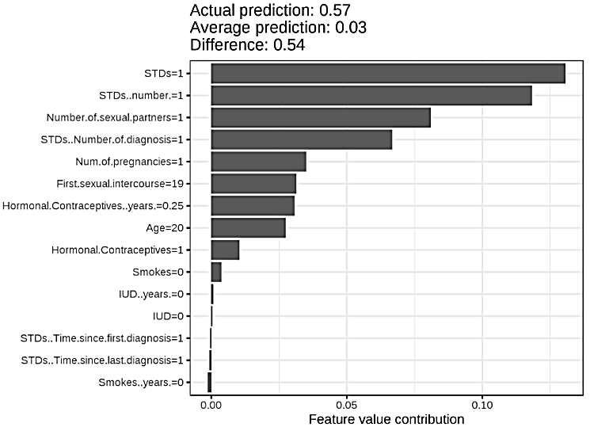
Shapley Values
Feature-level Explanations
The interpretation of the Shapley value for feature j is:
The j-th feature contributed $φ_{j}$ to the prediction of this particular instance compared to the average prediction for the dataset
For instance, the figure presents the Shapley values of different features for one person, used in a random forest model for predicting cervical cancer
The figure indicates that the person has high risk of cancer (0.54 probability above the average prediction of 0.03)
Figure from: https://christophm.github.io/interpretable-ml-book/shapley.html

Slide 65
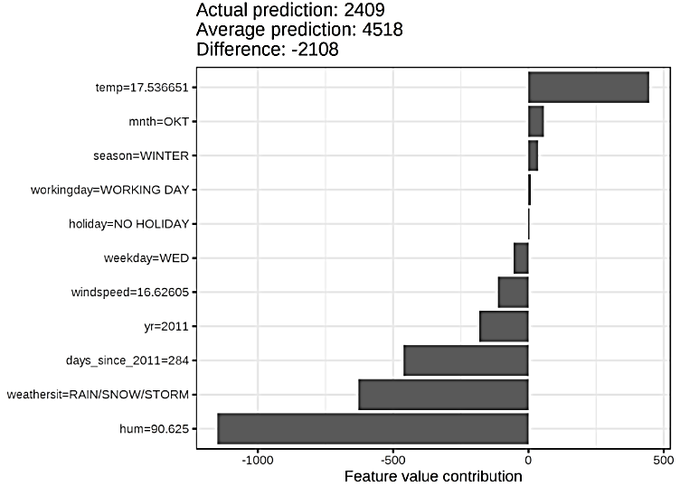
Shapley Values
Feature-level Explanations
The figure presents the Shapley values of the features for the day 285, used in a random forest model for predicting the number of rented bikes per day
The predicted number of rented bikes for that day is 2,409, which is -2,108 below the average daily prediction of 4,518 bikes
The main contributors for the lower number are the weather situation and humidity
Note that Shapley values can be negative
Figure from: https://christophm.github.io/interpretable-ml-book/shapley.html

Slide 66
SHAP
Feature-level Explanations
SHAP (SHapley Additive exPlanations)
Lundberg (2016) - A Unified Approach to Interpreting Model Predictions
SHAP connects Shapley Values and LIME approaches, by reformulating Shapley Values and adding new properties
The properties improved the performance and showed better consistency with human interpretation
SHAP defines the explanation for an instance x as
$$f\left(x\right)=φ_{0}+\sum_{i=1}^{M}{φ_{i}\left(f,x\right)}$$
$φ_{i}\left(f,x\right)$ is the contribution of feature i to the explanation $f\left(x\right),$and it is called the SHAP value of i
It is calculated based on the Shapley value: $φ_{i}\left(f, x\right)=\frac{1}{M!}\sum_{π∈Π}{\left[f_{x}\left(S_{π}^{i}∪\left\{i\right\}\right)−f_{x}\left(S_{π}^{i}\right)\right]}$
$φ_{0}$ is the base value, calculated as the value of $f\left(x\right)$ when no feature is present, i.e., $f_{x}\left(∅\right)$
M is the number of features

Slide 67
SHAP
Feature-level Explanations
To calculate SHAP value, the authors propose Kernel SHAP, which combined Shapley Values and LIME
I.e., the black-box model $f\left(x\right)$ is locally approximated with a linear model $g\left(z\right)$
z is a vector that represents the presence of absence of features, i.e., $z=\left(z_{1},…,z_{M}\right)$
The explanation is approximated by: $f\left(x\right)≈g(z)=φ_{0}+\sum_{i=1}^{M}{φ_{i}\left(f,x\right)z_{i}}$
Recall the formulation of LIME: $arg\min_{g∈G}{ℒ\left(f,g,π_{x}\right)}+Ω\left(g\right)$
SHAP values $φ_{i}\left(f,x\right)$ are calculated by solving LIME using the following:
$Ω\left(g\right)=0$
$π_{x}\left(z\right)=\frac{M−1}{\left(\begin{matrix}M \\ \left|z\right|\end{matrix}\right)\left|z\right|\left(M−\left|z\right|\right)}$
$ℒ\left(f,g,π_{x}\right)=\sum_{z}{{\left[f\left(x′\right)−g(z)\right]}^{2}}$ $π_{x}\left(z\right)$
where $\left|z\right|$ is the number of non-zero elements in z
The authors also proposed TreeSHAP, which is a variant of SHAP for tree-based models (decision trees, random forests)

Slide 68
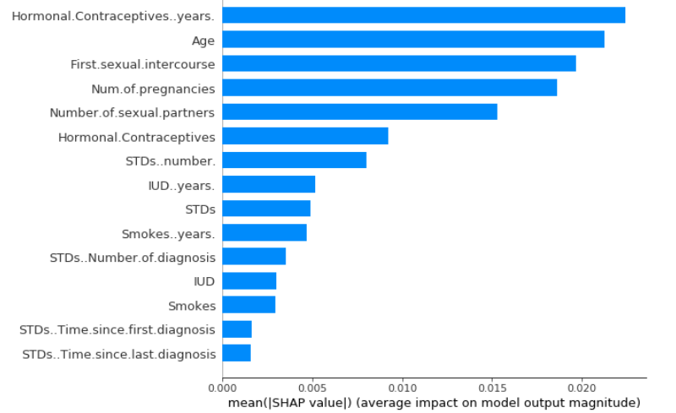
SHAP
Feature-level Explanations
Example: mean SHAP values per feature, using a random forest model for predicting cervical cancer
The number of years with hormonal contraceptives was the most important feature
Figure from: https://christophm.github.io/interpretable-ml-book/shap.html

Slide 69
Type of Explanations
Concept-level Explanations
Pixel-level explanations
Feature-level explanations
Concept-level explanations
TCAV, ACE
Instance-level explanations

Slide 70
Concept-level Explanations
Concept-level Explanations
Pixel-level importance: which input pixels are important when a model classifies one input example? (Local Explanation)
Concept-level importance: which high-level concepts are important when a model classifies one class of inputs across the entire dataset? (Global Explanation)
E.g., the figure shows concepts for recognizing the class “doctor” in images: the training set does not have class labels for the concepts “White coat" or “Stethoscope”
Slide credit: Nevin L. Zhang – Lecture 9: Explainable AI

Slide 71
TCAV
Concept-level Explanations
TCAV (Testing with Concept Activation Vectors)
Kim (2018) - Interpretability Beyond Feature Attribution: Quantitative Testing with Concept Activation Vectors (TCAV)
For instance: how important is the concept “striped" for assigning the zebra class label by a classifier
The approach consists of three steps:
Represent the concept as a vector (referred to as Concept Activation Vector (CAV))
Quantify the sensitivity of an image to the CAV vector
Measure the importance of the concept to multiple images of the same class
Slide credit: Nevin L. Zhang – Lecture 9: Explainable AI

Slide 72
TCAV
Concept-level Explanations
Step 1: Represent the concept (e.g., “striped”) as a vector
Collect a set of positive examples $𝒫_{C}$of the concept $C$, and a set of negative examples $𝒩$
Obtain the activations $f_{l}(x)$ for each training example $x$ at a layer l of the model
Use the layer activations $f_{l}(x)$ for all images in $𝒫_{C}$and $𝒩$ to train a binary linear classifier to separate the sets $𝒫_{C}$and $𝒩$ into: $\left\{f_{l}(x)\text{: }x∈𝒫_{C}\right\}$ and $\left\{f_{l}(x)\text{: }x∈𝒩\right\}$
The vector $v_{c}^{l}$ that is normal to the decision boundary of the linear classifier (the red arrow) is called concept activation vector (CAV) for the concept $C$
The CAV vector $v_{c}^{l}$ represents the orthogonal direction to the decision boundary, along which the probability of the concept class $C$increases the fastest
$𝒫_{C}$ positive examples
Black-box classifier
Layer l
$𝒩$negative examples
Activations vector $f_{l}(x)$
Binary linear classifier
Positive examples
$N$egative examples

Slide 73
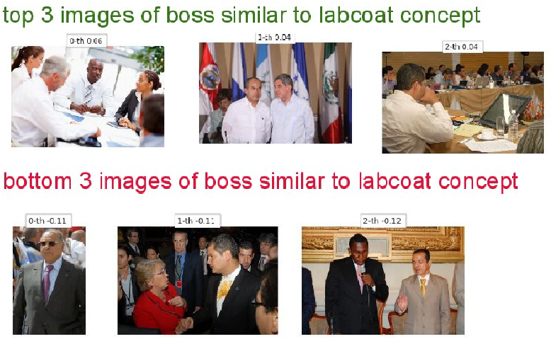
TCAV
Concept-level Explanations
To assess whether the CAV vector $v_{c}^{l}$captures the intended concept C, use it to sort images in an external set (not in the training sets $𝒫_{C}$and $𝒩$)
E.g., the following are the top 3 and the bottom 3 images for two concepts
Concept “suit” for the class CEO (left), and concept “lab coat” for the class boss (right)
Slide credit: Nevin L. Zhang – Lecture 9: Explainable AI

Slide 74
TCAV
Concept-level Explanations
Step 2: Calculate directional derivative of the class score w.r.t concept
Let x be an image with a predicted class k, and $z_{k}(x)$ be the prediction score (logit value) by the black-box model for the class k
$z_{k}(x)$ is also a function of the activations $f_{l}(x)$ at layer l, and it can be written as $z_{k}\left(f_{l}\left(x\right)\right)$
Pixel-level explainable approaches typically employ the gradient $\frac{∂z_{k}(x)}{∂x_{i}}$, which measures how sensitive the class score $z_{k}$ is to small perturbations to the pixel $x_{i}$
I.e., the gradient quantifies how important the pixel $x_{i}$is to predicting the class k
TCAV introduces directional derivative (denoted $S_{C,k,l}(x)$) to measure how sensitive the class score $z_{k}$ is to small perturbations in the direction of the CAV vector $v_{c}^{l}$:
$$S_{C,k,l}\left(x\right)=\lim_{ε→0}{\frac{z_{k}\left(f_{l}\left(x\right)+ε∙v_{c}^{l}\right)−z_{k}\left(f_{l}\left(x\right)\right)}{ε}=}∇z_{k}\left(f_{l}\left(x\right)\right)∙v_{c}^{l}$$
E.g., for the shown image of zebra x, $the directional derviative S_{C,k,l}\left(x\right)$ quantifies the sensitivity of the class k logit in the black-box classifier to the concept “striped” at the layer l
$$z_{k}$$
Slide credit: Nevin L. Zhang – Lecture 9: Explainable AI

Slide 75
TCAV
Concept-level Explanations
Step 3: Testing with CAVs (TCAV)
For the set of all input instances $X_{k}$ with the ground truth label $k$, TCAV is the fraction of instances whose $l$-layer CAV vector has positive value
$$TCAV\left(C,k l\right)=\frac{\left|\left\{x∈X_{k}:S_{C,k,l}\left(x\right)>0\right\}\right|}{\left|X_{k}\right|}$$
$TCAV$ measures how important the concept C is to the model for assigning the class label $k$to the set of input instances $X_{k}$
I.e., it is global metric of the concept C for all images with a given label
Note that $TCAV\left(C,k l\right)∈\left[0, 1\right]$
To eliminate spurious correlations, the authors calculated TCAV scores multiple times with different random sets of images, and applied a t-test hypothesis testing
If $𝒫_{C}$and $𝒩$ do not have significant impact on obtained TCAV values, the TCAVs for the positive and negative examples would be equal (i.e., 0.5)
The major drawback of the TCAV approach:
Requires to manually construct positive sets of examples $𝒫_{C}$that contain the concept of interest
The negative set $𝒩$can include any random images that don’t contain the concept

Slide 76
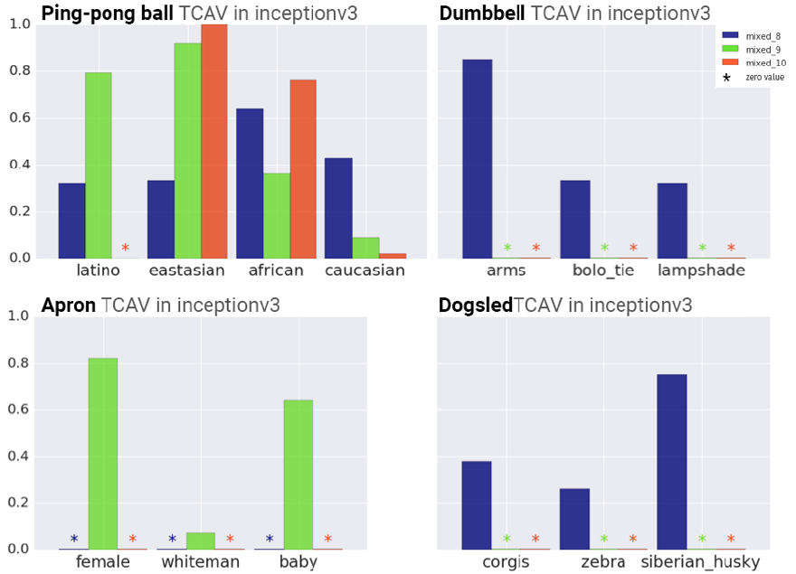
TCAV
Concept-level Explanations
TCAV evaluation of the Inception v3 model for different concepts
E.g., in the upper-left figure, TCAVs are shown for the concepts: Latino, East Asian, African, and Caucasian, with respect to the class “ping-pong ball”
The bars show the TCAVs for 3 different layers of Inception v3 (mixed 8, 9, and 10)
None of these concepts are included in the ground-truth class labels in the dataset
There is a high correlation between the concept East Asian and the class ping-pong ball

Slide 77
ACE
Concept-level Explanations
ACE (Automatic Concept-based Explanations)
Ghorbani (2019) - Towards Automatic Concept-based Explanations
ACE automatically extracts visual concepts
Images from the same class are segmented at multiple resolutions, resulting in a pool of image patches
The obtained image segments are resized to the input resolution, and activation vectors from one layer of the black-box model are used to cluster similar segments
TCAV scores are used to sort the clusters of concepts based on their importance
Slide credit: Nevin L. Zhang – Lecture 9: Explainable AI

Slide 78
ACE
Concept-level Explanations
The multiple resolutions of the extracted image segments extract concepts at both fine-grained and course-grained abstractions (e.g., textures, parts, objects)
The authors use three different resolutions of segments
An existing approach for image segmentation based on super-pixels was applied (middle image on the right)
Similar segments are grouped together using k-mean clustering based on the Euclidean ($ℓ_{2}$) distance between the activation vectors from one layer of the back-box model
Outlier segments that have low similarity to the clustered segments were removed
ACE advantage over the TCAV approach:
It does not require a manual selection of a set of positive and negative images for a concept

Slide 79
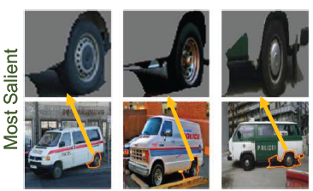
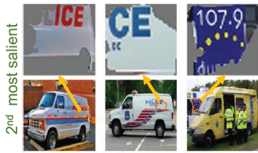
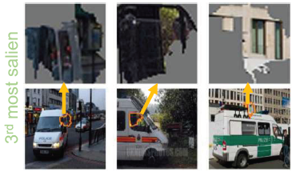
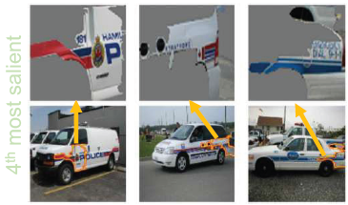
ACE
Concept-level Explanations
Experimental evaluation was performed on the Inception v3 model by selecting the activations from the mixed_8 layer for concept explanation
E.g., for the “Police Van” class, the four most important concepts are: (1) tires, (2) letters of the Police logo, (3) windows, and (4) fenders

Slide 80
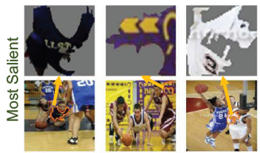
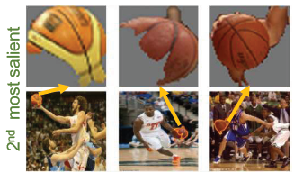
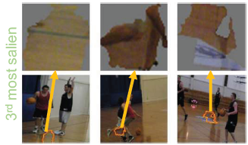
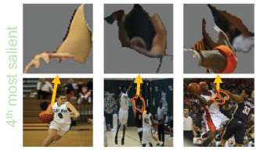
ACE
Concept-level Explanations
Similarly, for the “basketball” class, the four most important concepts are: (1) player’s jersey, (2) ball, (3) court’s floor, and (4) player’s hand
Interestingly, the player’s jersey is a more important concept than the ball

Slide 81
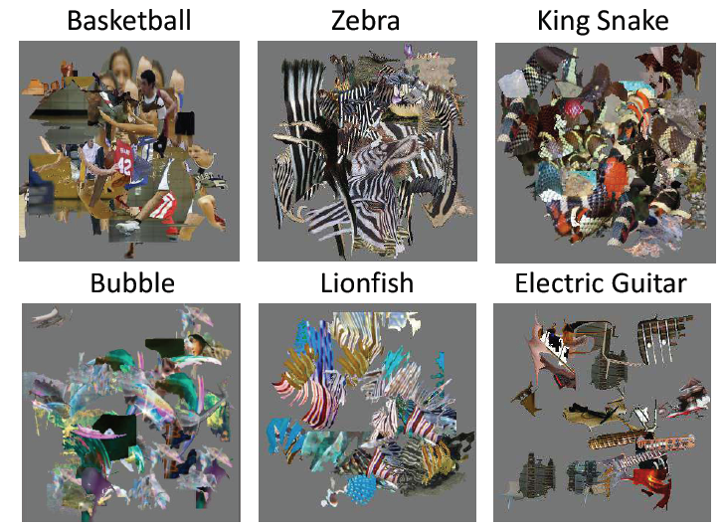
ACE
Concept-level Explanations
In addition, the trained Inception v3 model can make the correct class prediction on images with randomly stitched concept segments for that class
That is, CNNs for image classification overly rely on pattern (texture) recognition
Meaningless combinations of patterns from a class result in correct class prediction

Slide 82
Type of Explanations
Instance-level Explanations
Pixel-level explanations
Feature-level explanations
Concept-level explanations
Instance-level explanations
Prototypes and criticisms, counterfactual explanations

Slide 83
Instance-level Explanations
Instance-level Explanations
Instance-based explanation methods use particular input instances to explain the behavior of a black-box model
E.g., k-nearest neighbors is an interpretable model which employs k data instances to make a prediction
The k-NN prediction for one input instance can be explained based on the characteristics of the k neighbors
Similar, we use past experiences to make new predictions
E.g., a doctor seeing a patient with specific symptoms may remind her of another patient with the same symptoms, and may suspect that the patient may have the same disease
E.g., an employee who works on risk analysis may recall a similar project that he completed in the past, and he may decide to reuse the same approach for the current task
Instance-based explainability approaches are based on:
Prototypes or criticisms
Counterfactual examples

Slide 84
Prototypes and Criticisms
Instance-level Explanations
Prototypes and criticisms
Kim (2016) - Examples are not Enough, Learn to Criticize! Criticism for Interpretability
It is a global explanation method that explains class predictions by a black-box model based on collections of representative instances
Prototypes: representative examples of the class
Criticisms: examples of the class that are not well represented by the prototypes
The authors used Maximum Mean Discrepancy (MMD) to measure the discrepancy between two distributions, given by
${MMD}^{2}=\frac{1}{m^{2}}\sum{k\left(z_{i},z_{j}\right)−}$ $\frac{2}{mn}\sum{k\left(z_{i},x_{j}\right)+}$ $\frac{1}{n^{2}}\sum{k\left(x_{i},x_{j}\right)}$
m is the number of prototypes z, n is the number of instances x of the original dataset
k is a kernel function that measures the similarity of two instances, which is adopted as the radial basis function $k\left(x,x′\right)=exp\left(−{γ\left\|x−x′\right\|}^{2}\right)$, with a scaling parameter $γ$
The approach is referred to as MMD-critic
Prototypes are selected so that their distribution is close to the input data distribution, whereas the distribution of criticisms is far from the data distribution

Slide 85
Prototypes and Criticisms
Instance-level Explanations
To find prototypes:
Start with an empty set of prototypes
While the number of prototypes is below the chosen number m:
For each instance in the dataset, check how much MMD is reduced when the instance is added to the set of prototypes
Add the data instance that minimizes MMD to the set of prototypes
Return the set of prototypes
To find criticisms, the following witness function is used:
$witness\left(x\right)=\frac{1}{n}\sum{k\left(x,x_{i}\right)−}$ $\frac{1}{m}\sum{k\left(x,z_{j}\right)}$
The witness function evaluates which of two distributions fits the instance x better
For a trained black-box model, the predicted classes for the prototypes and criticisms can help to understand the model
E.g., via analysis of the cases when the model made wrong predictions

Slide 86
Prototypes and Criticisms
Instance-level Explanations
The figure shows prototypes and criticisms from the USPS dataset of handwritten digits
The prototypes represent common way of writing digits, whereas the criticisms represent outliers and ambiguously written digits

Slide 87
Prototypes and Criticisms
Instance-level Explanations
Protypes and criticisms for two breeds of dogs from the ImageNet dataset
The addition of criticisms examples to the prototypes made it easier for human subjects to identify the defining features of different classes and improved the interpretability
Criticism: dogs in movement
Criticism: black-and-white image
Criticism: dogs in costumes

Slide 88
Counterfactual Explanations
Instance-level Explanations
Counterfactuals: Help to answer “what would have happened if" question
Wachter (2017) – Counterfactual Explanations Without Opening the Black Box: Automated Decision and the GDPR
Consider the case where an ML model was used for deciding on a loan application
E.g., John’s feature vector is x, and his loan application was denied by the model (it was assigned to the class c)
Counterfactual explanation
The loan would have been granted if income was $45,000 instead of $30,000
That is, the application would have been assigned to class c’ instead of c, if John's feature vector was x’ instead of x
Slide credit: Nevin L. Zhang – Lecture 9: Explainable AI

Slide 89
Counterfactual Explanations
Instance-level Explanations
Finding a counterfactual example x’ to an input example x:
The difference between the counterfactual example x’ and the original input example x should be small
The counterfactual example x’ should be misclassified by the model as another class c’ (whereas the original input example x is classified as class c)
The change from x to x’ should be feasible in the real-world (actionability)
Actionable examples: the loan would be granted if income was $45,000 instead of $30,000
Not actionable example: the loan would be granted if age was 30 instead of 50
Note that the above procedure is the same as when creating adversarial examples in ML
Adversarial examples are also counterfactuals, only they are used to attack the model, rather than to explain it
Slide credit: Nevin L. Zhang – Lecture 9: Explainable AI

Slide 90
Counterfactual Explanations
Instance-level Explanations
Counterfactual visual explanations
Goyal (2019) - Counterfactual Visual Explanations
Find a counterfactual visual example for the left image I classified by the model as class c (Crested Auklet), so that the model would classify it as class c’ (Red Faced Cormorant)
Select a distractor image I’ (right figure) of the class c’
Identify regions in I and I’ (outlined with the red squares) such that if the region in I is replaced with the region in I’, the model would classify I as c’
Counterfactuals explain the most important features for classifying an image

Slide 91
Counterfactual Explanations
Instance-level Explanations
Example: the left images are original input images of a class (digits 1, 7, or 3)
The middle column has a distractor image for misclassifying the original image
The highlighted pixels identify the regions for misclassifying the original image
E.g., if the highlighted region in 1 is replaced with the highlighted region in 4, the class of the image of digit 1 would change to 4
The composite images show the original images with the highlighted region of the distractor images added

Slide 92
Additional References
Nevin L. Zhang (Hong Kong University of Science and Technology) – Machine Learning course, Lecture 9 – Explainable AI
Belle et al. (2020) – Principles and Practice of Explainable Machine Learning
Christoph Molnar (2020) – Interpretable Machine Learning: A Guide for Making Black Box Models Explainable
Arietta et al. (2019) – Explainable Artificial Intelligence (XAI): Concepts, Taxonomies, Opportunities and Challenges toward Responsible AI
Geyik, KDD 2019 Tutorial, Explainable AI in Industry, 2019.
Hima Lakkaraju, CS282BR: Topics in Machine Learning. Interpretability and Explainability, 2020.
Freddy Lecue, XAI – Explanation in AI: From Machine Learning to Knowledge Representation & Reasoning and Beyond, 2019.

