Slide 1
CS 404/504
Special Topics: Adversarial Machine Learning
Dr. Alex Vakanski

Slide 2
Lecture 1
Introduction to Adversarial Machine Learning

Slide 3
Lecture Outline
Machine Learning (ML)
Adversarial ML (AML)
Adversarial examples
Attack taxonomy
Evasion attacks and defenses
Common adversarial evasion attacks
Random noise, semantic attack, FGSM, BIM, PGD, DeepFool, C&W attack
Other white-box evasion attacks
Evasion attacks against black-box models
Defense against adversarial evasion attacks
Adversarial example detection, gradient masking/obfuscation, robust optimization
Poisoning attacks and defenses
Privacy attacks and defenses
Summary
References and AML resources

Slide 4
Machine Learning
Machine Learning
Machine Learning (ML) tasks
Supervised, unsupervised, semi-supervised, self-supervised, meta learning, reinforcement learning
Data collection and preprocessing steps
Data collection using various sensors, cameras, I/O devices, microphones, etc.
Applying an ML algorithm
Training phase: learn ML model (parameter learning, hyperparameter tuning)
Testing phase (inference): predict on unseen data
Slide credit: Binghui Wang: Adversarial Machine Learning — An Introduction

Slide 5
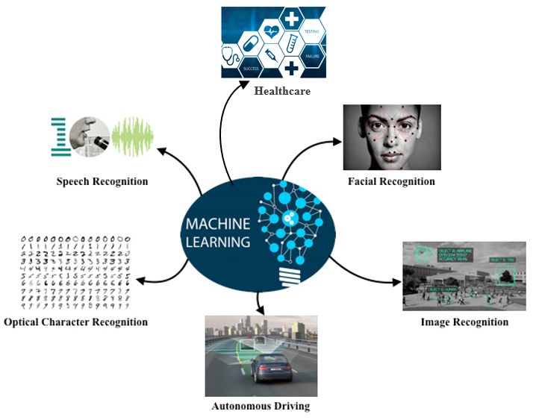
Machine Learning
Machine Learning
ML is ubiquitous today in many applications
Picture from: He Xiaoyi – Adversarial Machine Learning

Slide 6
Adversarial ML
Adversarial Machine Learning
The classification accuracy of GoogLeNet on MNIST images under adversarial attacks drops significantly
E.g., from 98.6% to 18.7% (for Projected Gradient Descent attack)
Or, to 1.2% (for DeepFool attack)
Performance on
adversarial images
Performance on
clean images
Results from: https://blog.floydhub.com/introduction-to-adversarial-machine-learning/

Slide 7
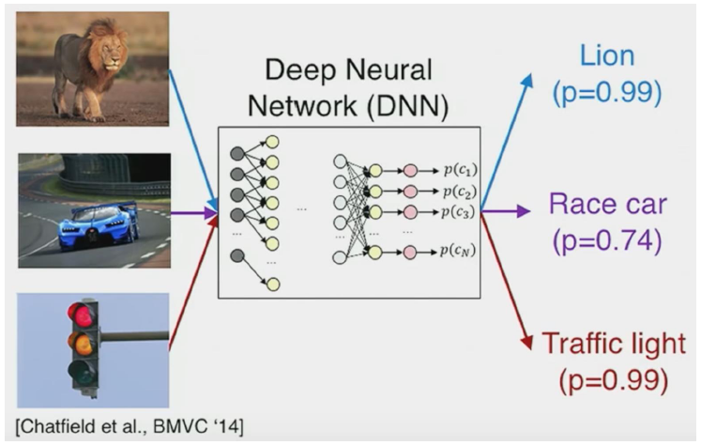
Adversarial Examples
Adversarial Examples
What do you see?
Slide credit: Binghui Wang: Adversarial Machine Learning — An Introduction

Slide 8
Adversarial Examples
Adversarial Examples
The trained DNN model misclassifies adversarially manipulated images
Slide credit: Binghui Wang: Adversarial Machine Learning — An Introduction

Slide 9
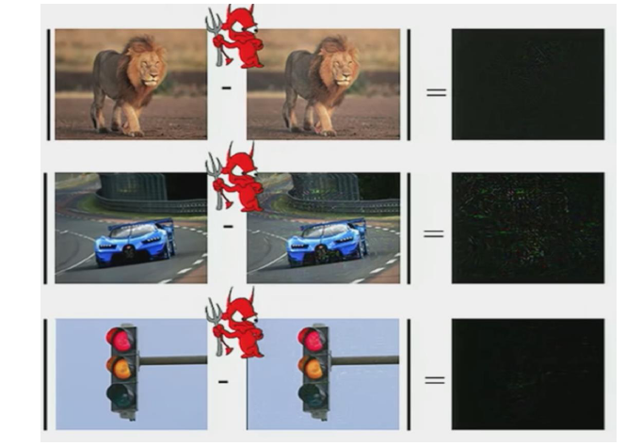
Adversarial Examples
Adversarial Examples
The differences between the original and adversarially manipulated (attack) images are very small (hardly noticeable to the human eye)
Original image
Attack image
Difference
Slide credit: Binghui Wang: Adversarial Machine Learning — An Introduction

Slide 10
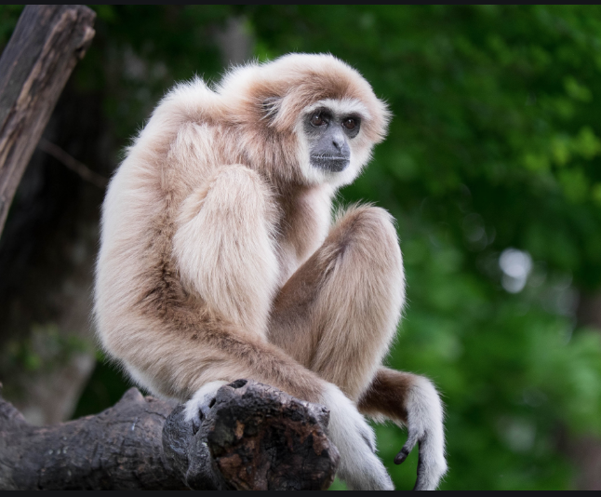
Adversarial Examples
Adversarial Examples
One of the seminal papers on AML shows an adversarially perturbed image of a panda that is misclassified by the ML model as a gibbon
The image with the perturbation looks indistinguishable from the original image
Original image
Adversarial image
Gibbon
Classified as panda
57.7% confidence
Small adversarial noise
Classified as gibbon
99.3% confidence
Picture from: https://blog.floydhub.com/introduction-to-adversarial-machine-learning/

Slide 11
Adversarial Examples
Adversarial Examples
Similar example, from Szagedy (2014) Intriguing Properties of Neural Networks
Picture from: Szagedy (2014) – Intriguing Properties of Neural Networks

Slide 12
Adversarial Examples
Adversarial Examples
If a Stop sign is adversarially manipulated and it is not recognized by a self-driving car: the car can keep going, and it can result in an accident
?
Small adversarial noise
Slide credit: He Xiaoyi – Adversarial Machine Learning

Slide 13
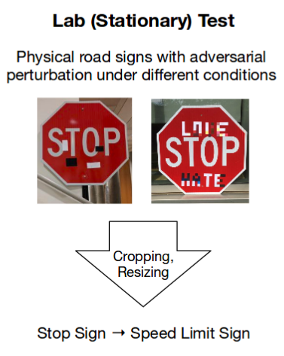
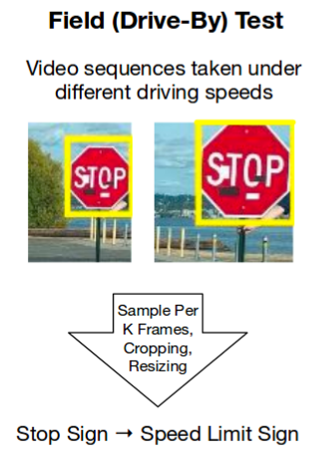
Adversarial Examples
Adversarial Examples
The authors of this work manipulated a Stop sign with adversarial patches
Caused the DL model of a self-driving car to missclassify it as a Speed Limit 45 sign
The authors achieved 100% attack success in lab test, and 85% in field test
Picture from: Eykholt (2017) - Robust Physical-World Attacks on Deep Learning Visual Classification

Slide 14
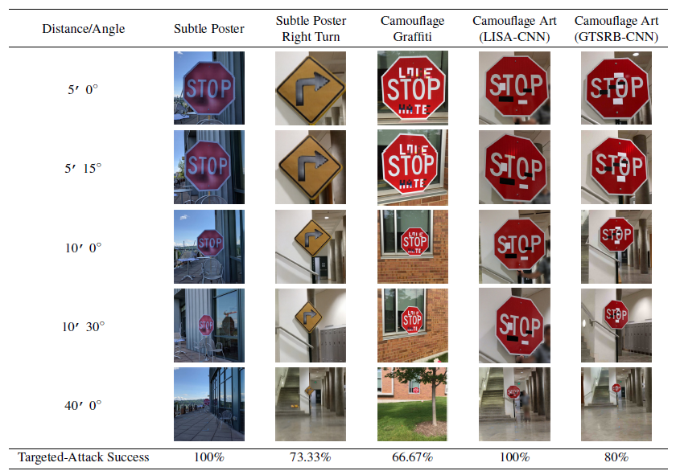
Adversarial Examples
Adversarial Examples
Lab test images for signs with a target class Speed Limit 45
Picture from: Eykholt (2017) - Robust Physical-World Attacks on Deep Learning Visual Classification

Slide 15
Adversarial Examples
Adversarial Examples
This paper presents an example of a 3D-printed turtle that is misclassified by a DNN as a rifle (video link)
The texture of the turtle is designed to mislead the DNN

Slide 16
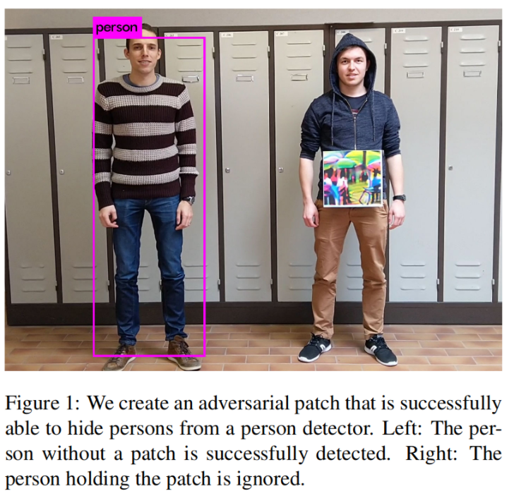
Adversarial Examples
Adversarial Examples
A person wearing an adversarial patch is not detected by a person detector DNN model (YOLOv2)
E.g., can be used by intruders to get past security cameras

Slide 17
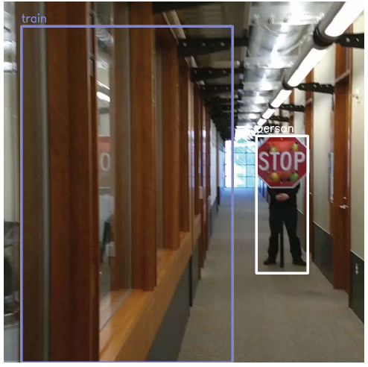
Adversarial Examples
Adversarial Examples
A “train” in the hallway?
Most ML models make predictions by pattern recognition (i.e., finding features in images)
ML models fail to use the context in images, e.g., cannot understand that a train cannot fit in a hallway
On the positive side, the person holding the Stop sign is correctly predicted as Person by the DNN
Picture from: Yevgeniy Vorobeychik, Bo Li - Adversarial Machine Learning Tutorial

Slide 18
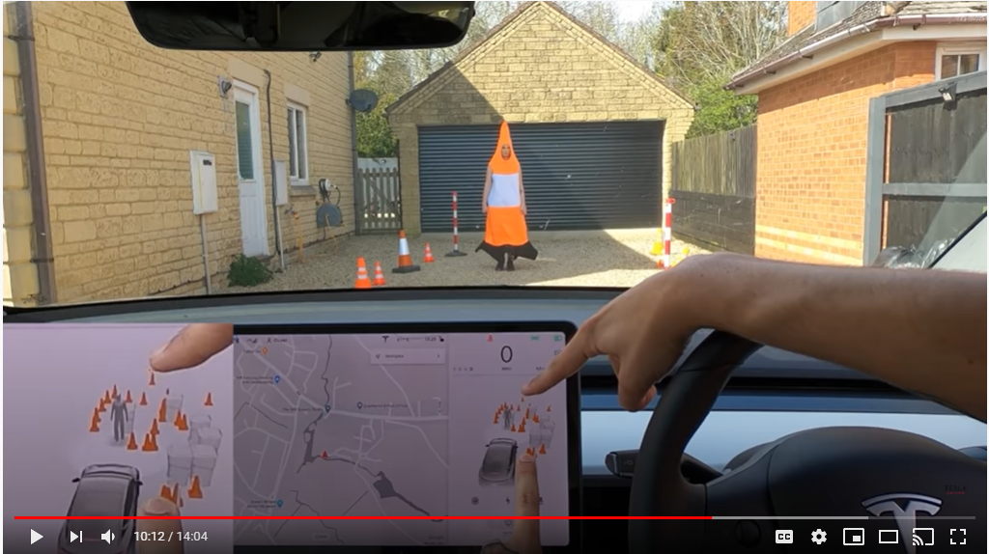
Adversarial Examples
Adversarial Examples
Non-scientific example: a Tesla owner checks if the car can distinguish a person wearing a cover-up from a traffic cone (video link)

Slide 19
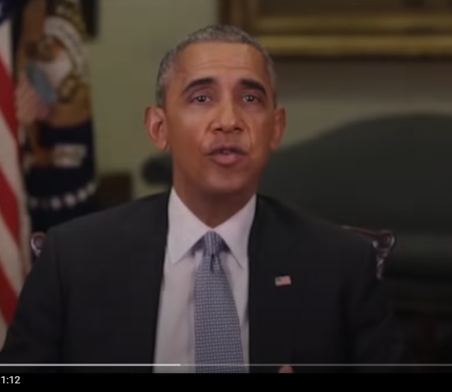
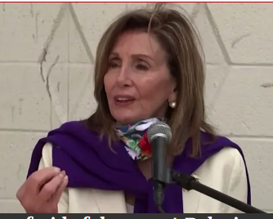
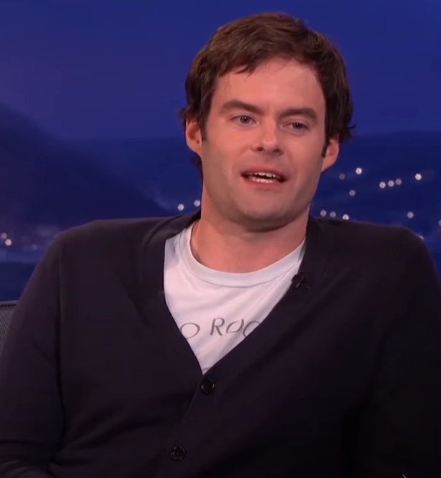
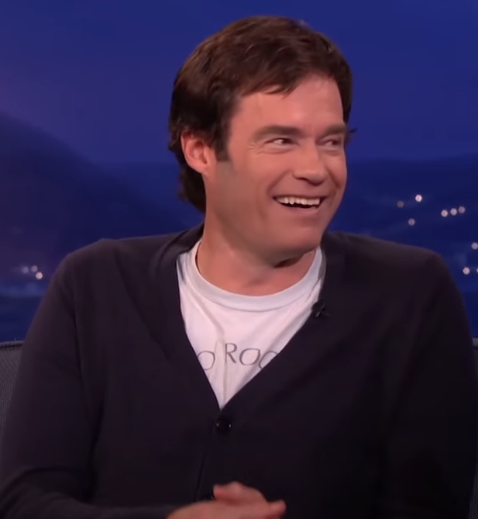
Adversarial Examples
Adversarial Examples
Abusive use of machine learning is on the rise
E.g., using GANs to generate fake content (a.k.a. deep fakes)
Videos of politicians saying things they never said
Barak Obama’s deep fake, or the House Speaker Nancy Pelosi appears drunk in a video
Bill Hader’s impersonation of Arnold Schwarzenegger
Can have strong societal implications: elections, automated trolling, court evidence

Slide 20
Adversarial ML
Adversarial Machine Learning
ML algorithms in real-world applications mainly focus on increased accuracy
Before 2015, few techniques and design decisions focused on keeping the ML models secure and robust
Adversarial ML: ML in adversarial settings
Attack is a major component of AML
Bad actors do bad things
Their main objective is not to get detected (change behavior to avoid detection)
Adversarial examples are inputs to ML models that an attacker intentionally designed to cause the model to make mistakes
Slide credit: Binghui Wang: Adversarial Machine Learning — An Introduction

Slide 21
Adversarial ML
Adversarial Machine Learning
Studying adversarial examples in the image domain has been predominant in the prior work in AML
Reasons:
Perceptual similarity between clean and adversarial images is intuitive to observers
Image data and image classifiers have simpler structure than other domains (e.g., audio, or malware)
Commonly used datasets for concept evaluation in AML include:
MNIST: 60K images, digits 0 to 9
CIFAR-10: 60K images, 10 classes: cars, birds, airplanes, cats, dogs, deer, frogs, horses, ships, trucks
ImageNet: 14M images, 20K classes

Slide 22
Poisoning Attack
Attack Taxonomy
Poisoning attack (causative attack)
Attack on the training phase
Attackers perturb the training set or the model
Insert malicious inputs in the training set (e.g., that contain a trigger pattern to backdoor the model)
Change the labels to training inputs
Change the weights of a deployed trained model
Distribute poisoned pretrained models to the public
The goal is to corrupt the ML model so that it performs incorrectly for some or all inputs
The adversary should obtain access to the training database or to the trained model
E.g., web-based repositories and “honeypots” often collect malware examples for training, which provides an opportunity for adversaries to poison the data
Slide credit: Binghui Wang: Adversarial Machine Learning — An Introduction

Slide 23
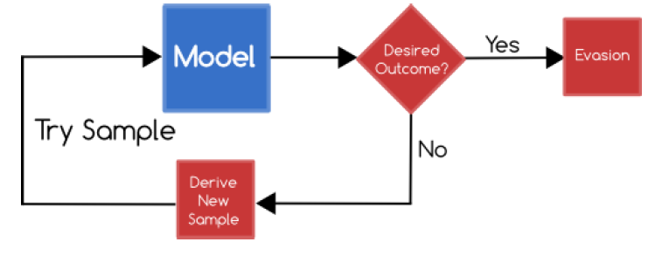
Evasion Attack
Attack Taxonomy
Evasion attack (exploratory attack)
Attack on the testing phase
Attackers do not tamper with the ML model, but instead cause it to misclassify adversarial inputs
Evasion attack is more common attack than poisoning attack
E.g., the shown examples with sticking a few pieces of tapes on a Stop sign can cause misclassification by the ML model for road sign recognition used by an autonomous driving vehicle
Slide credit: Binghui Wang: Adversarial Machine Learning — An Introduction

Slide 24
White-box and Black-box Attack
Attack Taxonomy
Adversarial attacks can be further classified into:
White-box attack
Attackers have full knowledge about the ML model
I.e., they have access to parameters, hyperparameters, gradients, architecture, etc.
Black-box attack
Attackers don’t have access to the ML model parameters, gradients, architecture
Perhaps they have some knowledge about the used ML model
E.g., attackers may know that a ResNet50 model is used for classification, but they don’t have access to the model parameters
Attackers may query the black-box model (also known as the oracle) to obtain knowledge about the model
E.g., submit adversarial examples, and obtain the model’s output (class label or probability vector)
A body of work has focused on query-efficient black-box attacks, where the goal is to synthesize adversarial examples using a limited number of queries
Black-box attacks are more realistic, because model designers usually do not open source the model parameters
Slide credit: Binghui Wang: Adversarial Machine Learning — An Introduction

Slide 25
Attack Taxonomy
Attack Taxonomy
Depiction of the adversarial attack taxonomy from Alessio's Adversarial ML presentation at FloydHub
Data Poisoning Attack
Evasion Attack
Picture from: https://blog.floydhub.com/introduction-to-adversarial-machine-learning/

Slide 26
Non-targeted and Targeted Attack
Attack Taxonomy
Each of the described attacks can further be:
Non-targeted attack
The goal is to mislead the classifier for an adversarial input to output any label other than the ground-truth label
E.g., perturb an image of a military tank, so that the model predicts it is any other class than a military tank
Targeted attack
The goal is to mislead the classifier to predict a target label for an adversarial input
More difficult, in comparison to non-targeted attack
E.g., perturb an image of a turtle, so that the model predicts it is a riffle
E.g., perturb an image of a Stop sign, so that the model predicts it is a Speed Limit 45 sign

Slide 27
Privacy and Availability Attacks
Attack Taxonomy
In some references, poisoning and evasion attacks are grouped together into integrity attacks
It means that the integrity of the model to perform correctly for adversarially manipulated inputs is attacked
In other types of attacks, adversaries’ goal is other than causing incorrect performance of ML models, such as:
Privacy attack
The goal is to illegitimately gain knowledge about the training inputs and models
A.k.a. confidentiality attack, or inference attack
E.g., membership inference aims to identify whether or not a data sample was used to train an ML model
Availability attack
Cause an ML system to become unavailable or block regular use of the system (denial-of-service)
E.g., design adversarial samples that take an extremely long time for the ML model to process

Slide 28
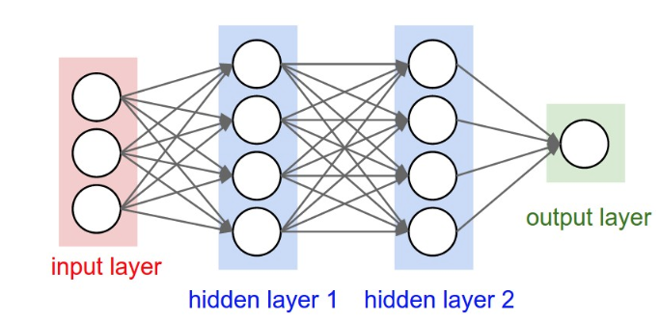
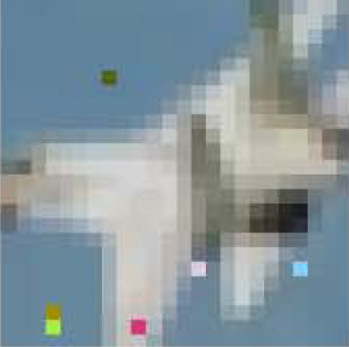
Evasion Attack
Evasion Attack
Find a new input (similar to the original input) but classified as another class (non-targeted or targeted)
Adversarial attack image
warplane
Original input
Slide credit: He Xiaoyi – Adversarial Machine Learning

Slide 29
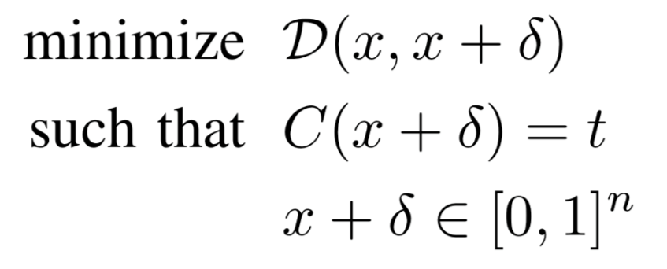
How to Find Adversarial Examples
Evasion Attack
One common approach to finding adversarial examples is as follows
Take an image x, which is labeled by the classifier $C$ (e.g., Logistic Regression, SVM, or NN) as class $y$, i.e., $C\left(x\right)=y$
Create an adversarial image $x_{adv}$ by adding small perturbations $δ$to the original image x, i.e., $x_{adv}=x+δ,$ such that the distance $D\left(x,x_{adv}\right)=D\left(x,x+δ\right)$ is minimal
The aim for a non-targeted attack is that the classifier assigns a label to the adversarial image that is different than $y$, i.e., $C\left(x_{adv}\right)=C\left(x+δ\right)≠y$
Or, for a targeted attack, the aim is that $C\left(x_{adv}\right)=C\left(x+δ\right)=t≠y$, where $t$ is the target class
distance between x and x+𝛿 = $x_{adv}$
x+𝛿 is classified as target class t
each element of x+𝛿 is in [0,1] (to be a valid image)

Slide 30
Distance Metrics
Evasion Attack
Several distance metrics between a clean sample $x$and adversarial sample $x_{adv}$, $i.e.,D\left(x,x_{adv}\right)$, have been used
$ℓ_{0}$ norm: the number of elements in $x_{adv}$ such that ${x^{i}≠x}_{adv}^{i}$
Corresponds to the number of pixels that have been changed in the image $x_{adv}$
$ℓ_{1}$ norm: city-block distance, or Manhattan distance
$ℓ_{1}=\left|{x^{1}−x}_{adv}^{1}\right|+\left|{x^{2}−x}_{adv}^{2}\right|+⋯+\left|{x^{n}−x}_{adv}^{n}\right|$
$ℓ_{2}$ norm: Euclidean distance, or root-mean-squared error
$ℓ_{2}=\sqrt{{\left({x^{1}−x}_{adv}^{1}\right)}^{2}+{\left({x^{2}−x}_{adv}^{2}\right)}^{2}+⋯+{\left({x^{n}−x}_{adv}^{n}\right)}^{2}}$
$ℓ_{∞}$ norm: measures the maximum change to any of the pixels in the $x_{adv}$ image
$ℓ_{∞}=max\left(\left|{x^{1}≠x}_{adv}^{1}\right|,\left|{x^{2}≠x}_{adv}^{2}\right|,…,\left|{x^{n}≠x}_{adv}^{n}\right|\right)$
$ℓ_{1}$, $ℓ_{2}$, and $ℓ_{∞}$ norms can be considered special cases of the general $ℓ_{p}$ norm
$ℓ_{p}={\left({\left|{x^{1}−x}_{adv}^{1}\right|}^{p}+{\left|{x^{2}−x}_{adv}^{2}\right|}^{p}+⋯+{\left|x^{n}−x_{adv}^{n}\right|}^{p}\right)}^{\frac{1}{p}}$

Slide 31
Common Adversarial Evasion Attacks
Common Adversarial Evasion Attacks
Random noise attack
Semantic attack
Fast gradient sign method (FGSM) attack
Basic iterative method (BIM) attack
Projected gradient descent (PGD) attack
DeepFool attack
Carlini & Wagner (C&W) attack

Slide 32
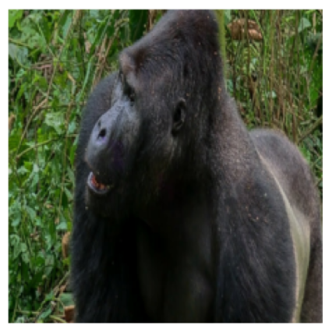
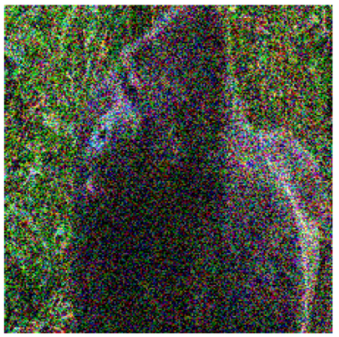
Random Noise Attack
Common Adversarial Evasion Attacks
Random noise attack
The simplest form of adversarial attack
Noise is a random arrangement of pixels containing no information
E.g., random numbers from a normal distribution (with 0 mean and 1 st. dev.)
This attack represents a non-targeted black-box evasion attack
It is not efficient, since the noisy images are easily distinguishable from the original images
+
=
Prediction: gorilla
Prediction: fountain
Picture from: https://blog.floydhub.com/introduction-to-adversarial-machine-learning/

Slide 33
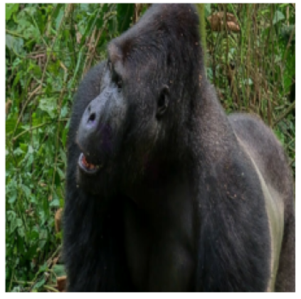
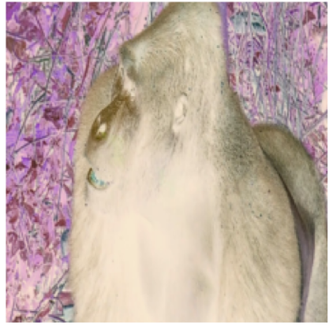
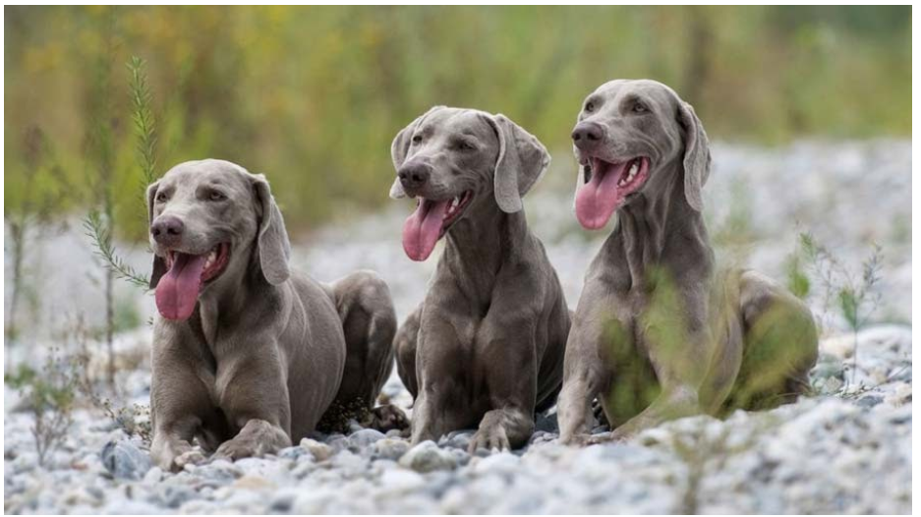
Semantic Attack
Common Adversarial Evasion Attacks
Semantic attack
Hosseini (2017) On the Limitation of Convolutional Neural Networks in Recognizing Negative Images
Use negative images as adversarial inputs
Reverse all pixels intensities
E.g., change the sign of all pixels, if the pixels values are in range [-1,1]
Not an efficient attack, since the adversarial images can easily be detected
Original image
Negative image
Weimaraner (a dog breed)
Prediction: gorilla
Prediction: weimaraner
Picture from: https://blog.floydhub.com/introduction-to-adversarial-machine-learning/

Slide 34
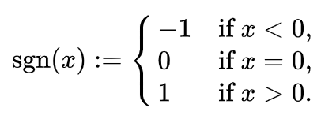
FGSM Attack
Common Adversarial Evasion Attacks
Fast gradient sign method (FGSM) attack
Goodfellow (2015) Explaining and Harnessing Adversarial Examples
An adversarial image x_{adv} is created by adding perturbation noise to an image x
$$x_{adv}=x+ε∙sign\left(∇_{x}ℒ\left(C\left(x, w\right),y\right)\right)$$
Notation: input image x, label y, NN model$C$, NN weights (parameters) $w$, loss function $ℒ$, gradient $∇$ (Greek letter “nabla”), perturbation magnitude $ε$
The amount of perturbation is calculated based on the gradient of the loss function $ℒ$ with respect to the input image x for the true class label y (i.e., $∇_{x}ℒ\left(C\left(x, w\right),y\right)$
The perturbation increases the loss $ℒ$for the true class y, and the model $C$misclassifies the image x_{adv}
The sign function $sgn(∙)$ is defined as:

Slide 35
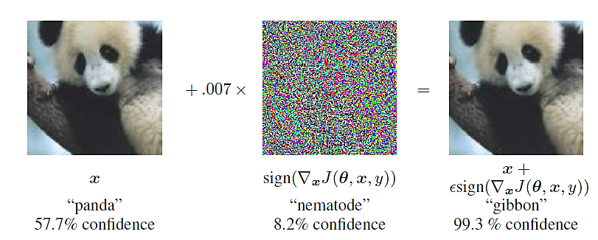
FGSM Attack
Common Adversarial Evasion Attacks
FGSM is a white-box non-targeted evasion attack
White-box, since we need to know the gradients $∇_{x}ℒ\left(C\left(x, w\right),y\right)$ of the model to create the adversarial image
In the shown example, the noise magnitude is ϵ = 0.007
Note: nematode is an insect referred to as roundworm
FGSM calculates how much perturbation to add to each pixel in $x$, so that the loss $ℒ$ is maximized, leading to incorrect prediction by the model (i.e., $C\left(x, w\right)≠y$)
$$sign\left(∇_{x}ℒ\left(C\left(x, w\right),y\right)\right)$$
$x+$ $ε∙sign\left(∇_{x}ℒ\left(C\left(x, w\right),y\right)\right)$

Slide 36
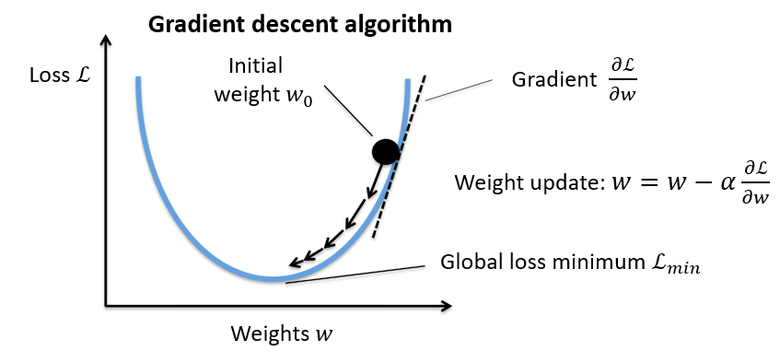
FGSM Attack
Common Adversarial Evasion Attacks
Recall that training NNs is based on the gradient descent algorithm
The values of the model parameters (weights) w are iteratively changed until a minimum of the loss function $ℒ$is reached
Gradients of the loss with respect to the model parameters (${∂ℒ}/{∂w}$) give the direction and magnitude for updating the parameters
The step of each update is the learning rate α
Picture from: https://blog.floydhub.com/introduction-to-adversarial-machine-learning/

Slide 37
FGSM Attack
Common Adversarial Evasion Attacks
The sign and magnitude of the gradient $\frac{∂ℒ}{∂w}$ give the direction and the slope of the steepest descent
Left image: + and – sign of the gradient
Right image: small, adequate, and large slope of the weight update, based on the magnitude of the gradient
Middle image: small and large α (learning rate)
To minimize the loss function, the weights w are updated in the opposite direction of the gradient, i.e., $w=w−α\frac{∂ℒ}{∂w}$
Sign + direction
Slope too small
Slope adequate
Sign - direction
Slope too large
Small α
Large α

Slide 38
FGSM Attack
Common Adversarial Evasion Attacks
Note the difference:
For model training, the gradient of the loss $ℒ$with respect to the model parameters w, i.e., $∇_{w}ℒ\left(C\left(x, w\right),y\right)$, is used for calculating the parameter updates
Typically, a cumulative loss is calculated over a batch of input-label pairs $\left(x_{i}, y_{i}\right)$
Common choices for the loss function $ℒ$in DNNs are cross-entropy and mean-squared error
The model parameters are updated iteratively based on $w=w−α∇_{w}ℒ\left(C\left(x, w\right),y\right)$
The gradient $∇_{w}ℒ\left(C\left(x, w\right),y\right)$ is used to calculate how much to change each individual weight $w_{j}$ in order to minimize the loss $ℒ\left(C\left(x, w\right),y\right)$
The goal is find $w$ for which the loss $ℒ\left(C\left(x, w\right),y\right)$is minimal
That is, to minimize the difference between the model predictions $C\left(x_{i}, w\right)$ and the labels $y_{i}$
For generating adversarial samples, the gradient of the loss $ℒ$with respect to an input image x, i.e., $∇_{x}ℒ\left(C\left(x, w\right),y\right)$, is used
The model parameters w are fixed, since the aim is to attack a trained model
An adversarial image is created based on $x_{adv}=x+ε∙sign\left(∇_{x}ℒ\left(C\left(x, w\right),y\right)\right)$
The gradient $∇_{x}ℒ\left(C\left(x, w\right),y\right)$ is used to calculate how much to change each individual pixel in x in order to maximize the loss $ℒ\left(C\left(x_{adv}, w\right),y\right)$
The goal is find${ x}_{adv}$ for which the loss $ℒ\left(C\left(x_{adv}, w\right),y\right)$is maximal
That is, to maximize the difference between the model prediction $C\left(x_{adv}, w\right)$ and the label $y$

Slide 39
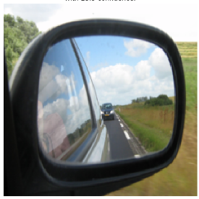
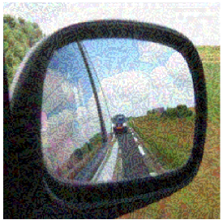
FGSM Attack
Common Adversarial Evasion Attacks
FGSM attack example
Original image
Adversarial image
Prediction: car mirror
Prediction: sunglasses
Picture from: https://blog.floydhub.com/introduction-to-adversarial-machine-learning/

Slide 40
BIM Attack
Common Adversarial Evasion Attacks
Basic iterative method (BIM) attack
Kurakin (2017) Adversarial Examples in the Physical World
BIM is a variant of FGSM: it repeatedly adds noise to the image x in multiple iterations, in order to cause misclassification
The number of iterations steps is t, and $γ$ is the amount of perturbation noise that is added at each step
$$x_{adv}^{t}=x^{t−1}+γ∙sign\left(∇_{x}ℒ\left(C\left(x^{t−1}, w\right),y\right)\right)$$
The perturbed image after the t iterations is $x_{adv}^{t}$
Multiple steps of adding noise increase the chances of misclassifying the image
Compare BIM to FGSM, given with
$$x_{adv}=x+ε∙sign\left(∇_{x}ℒ\left(C\left(x, w\right),y\right)\right)$$

Slide 41
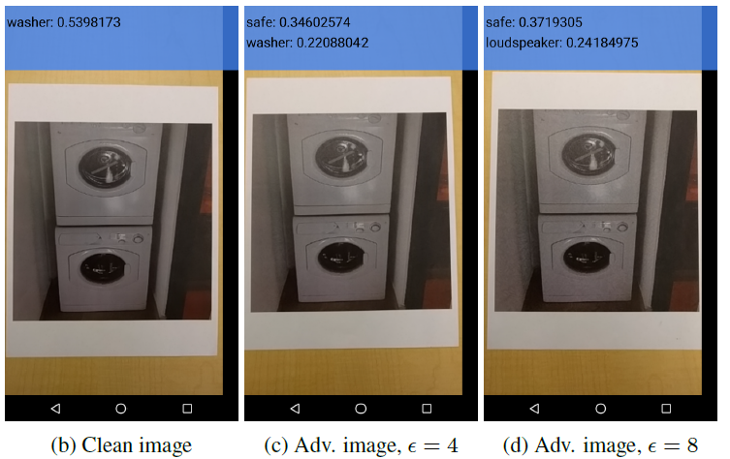
BIM Attack
Common Adversarial Evasion Attacks
BIM attack example, cell phone image of a washer
Note that adding small amount of perturbation (ϵ = 4/255) did not change the label of the washer, but adding larger perturbation (ϵ = 8/255) changed the label to loudspeaker

Slide 42
PGD Attack
Common Adversarial Evasion Attacks
Projected gradient descent (PGD) attack
Madry (2017) Towards Deep Learning Models Resistant to Adversarial Attacks
PGD is an extension of BIM (and FGSM), where after each perturbation step, the adversarial example is projected back onto the $ε$-ball of x using a projection function $Π$(i.e., the maximum allowed overall change of each pixel is $ε$)
$$x_{adv}^{t}=Π_{ε}\left(x^{t−1}+γ∙sign\left(∇_{x}ℒ\left(C\left(x^{t−1}, w\right),y\right)\right)\right)$$
Different from BIM, PGD uses random initialization for x, by adding random noise from a uniform distribution with values in the range $\left(−ε,ε\right)$
PGD is regarded as the strongest first-order attack
First-order attack means that the adversary uses only the gradients (first-order derivatives) of the loss function $ℒ$with respect to the input $x$

Slide 43
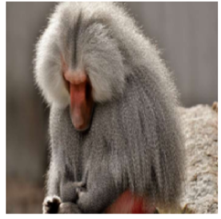
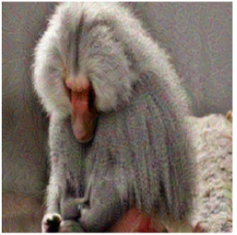
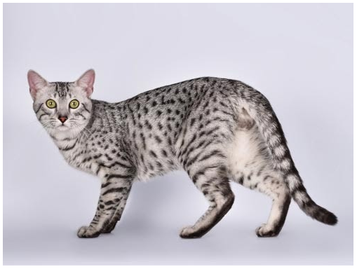
PGD Attack
Common Adversarial Evasion Attacks
PGD attack example
Original image
Adversarial image
Egyptian cat
Prediction: baboon
Prediction: Egyptian cat
Picture from: https://blog.floydhub.com/introduction-to-adversarial-machine-learning/

Slide 44
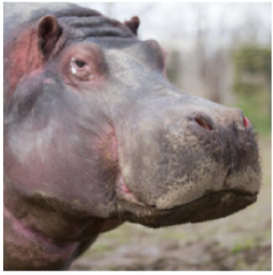
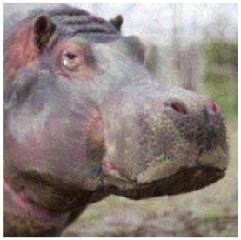
PGD Attack
Common Adversarial Evasion Attacks
Gradient approaches (FGSM, BIM, PGD) can also be designed as targeted white-box attacks
In this case, the added perturbation noise aims to minimize the loss function of the image for a specific target class label
In the shown example, the target class is maraca
The iterations loop doesn’t break until the image is classified into the target class, or until the maximum number of iterations is reached
Original image
Adversarial image
Maraca
Prediction: hippopotamus
Prediction: maraca
Picture from: https://blog.floydhub.com/introduction-to-adversarial-machine-learning/

Slide 45
PGD Attack
Common Adversarial Evasion Attacks
For a targeted attack, if the target class label is denoted t, adversarial examples are created by using
$$x_{adv}^{t}=Π_{ε}\left(x^{t−1}−γ∙sign\left(∇_{x}ℒ\left(F\left(x^{t−1}, w\right),t\right)\right)\right)$$
I.e., it is based on minimizing the loss function with respect to the target class t
This is opposite to non-targeted attacks, which maximize the loss function with respect to the true class label y, i.e.,
$$x_{adv}^{t}=Π_{ε}\left(x^{t−1}+γ∙sign\left(∇_{x}ℒ\left(F\left(x^{t−1}, w\right),y\right)\right)\right)$$

Slide 46
DeepFool Attack
Common Adversarial Evasion Attacks
DeepFool attack
Moosavi-Dezfooli (2015) DeepFool: A Simple and Accurate Method to Fool Deep Neural Networks
DeepFool is a white-box attack
It generates adversarial examples with the minimal amount of perturbation possible
There is no visible change to the human eye between the left image (original sample) and the right image (adversarial sample)
Prediction: canon
Difference
Prediction: Projector
Picture from: https://blog.floydhub.com/introduction-to-adversarial-machine-learning/

Slide 47
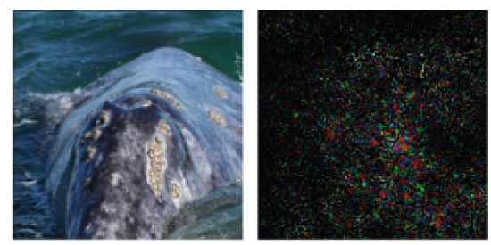
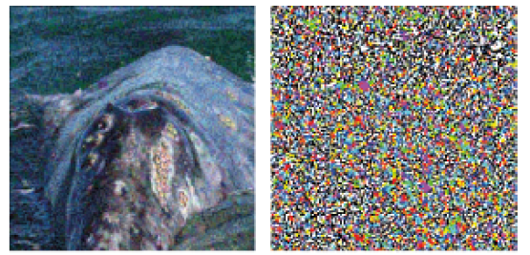
DeepFool Attack
Common Adversarial Evasion Attacks
Comparison of added adversarial perturbation for DeepFool and FGSM
Original image: whale
Both DeepFool and FGSM perturb the image to be classified as turtle (targeted attack)
DeepFool finds smaller perturbation
DeepFool
FGSM
Prediction: Turtle
Difference
Prediction: Turtle
Difference

Slide 48
DeepFool Attack
Common Adversarial Evasion Attacks
For example, consider a linear classifier algorithm applied to objects from 2 classes: green and orange circles
The line that separates the 2 classes is the hyperplane
Data points falling on either sides of the hyperplane are attributed to different classes (such as benign vs. malicious class)
Given an input x, DeepFool projects x onto the hyperplane and pushes it just a bit beyond the hyperplane, thus misclassifying it
Benign
Benign
x_{adv}
x
Hyperplane
Hyperplane
Malicious
Malicious
Picture from: Yevgeniy Vorobeychik, Bo Li - Adversarial Machine Learning

Slide 49
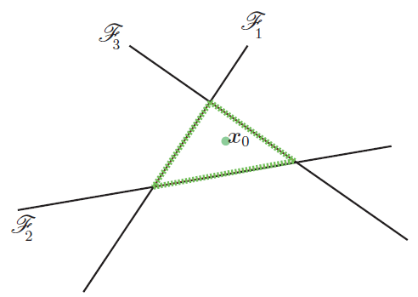
DeepFool Attack
Common Adversarial Evasion Attacks
For a multiclass problem with linear classifiers, there are multiple hyperplanes that separate an input x from other classes
E.g., an example with 4 classes (0, 1, 2, and 3) is shown in the image below
DeepFool finds that closest hyperplane to the input x₀: in this case, this is the hyperplane $ℱ_{3}$(it represents the most similar class to x₀ of the other 3 classes)
Then, it projects the input x₀ onto the hyperplane $ℱ_{3}$ and pushes it a little beyond it

Slide 50
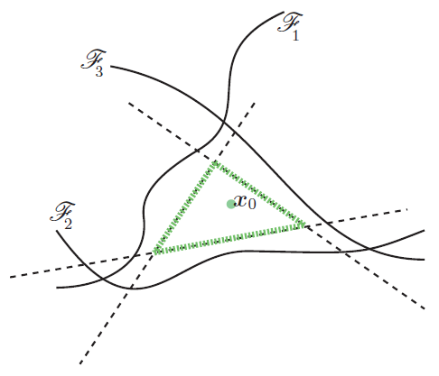
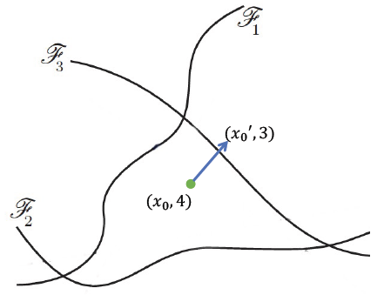
DeepFool Attack
Common Adversarial Evasion Attacks
For non-linear classifiers (such as neural networks, having non-linear class boundaries), the authors performed several iterations of adding perturbations to the image
At each iteration, the classifier function is linearized around the current image x₀, and a minimal perturbation is calculated
The algorithm stops when the class of the image x₀ (with ground-truth label 4) changes to another label than the true class (e.g., label 3)

Slide 51
Carlini & Wagner (C&W) Attack
Common Adversarial Evasion Attacks
Carlini & Wagner (C&W) attack
Carlini (2017) Towards Evaluating the Robustness of Neural Networks
The initial formulation for creating adversarial attacks is difficult to solve
Carlini & Wagner proposed a reformulation of the optimization problem which is solvable

Slide 52
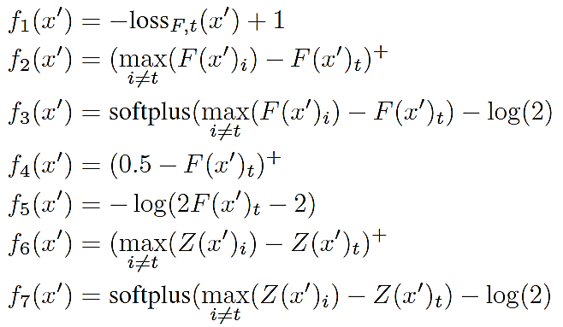
Carlini & Wagner (C&W) Attack
Common Adversarial Evasion Attacks
Carlini & Wagner considered several variants for the function f
The best results were obtained by f₆
More detailed explanations will follow in subsequent lectures

Slide 53
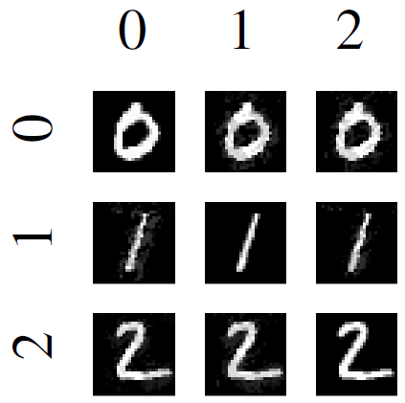
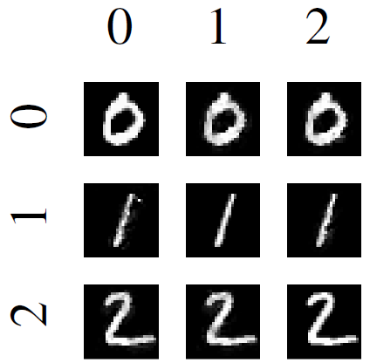
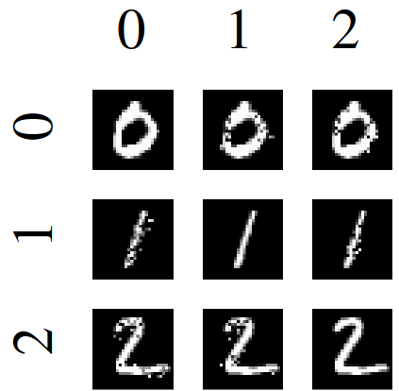
Carlini & Wagner (C&W) Attack
Common Adversarial Evasion Attacks
Results on the MNIST dataset
$L_{∞}$attack
$L_{2}$attack
$L_{0}$attack
Target digit

Slide 54
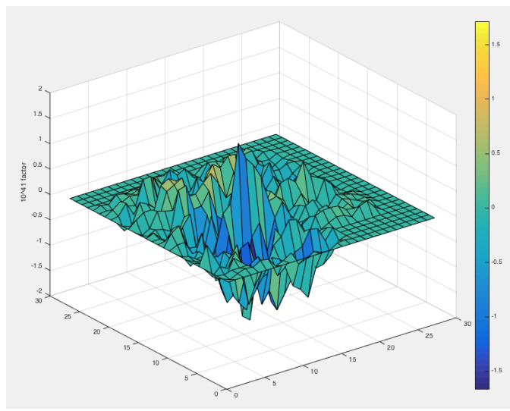
JSMA Attack
Other Adversarial Evasion Attacks
Jacobian-based Saliency Map Attack (JSMA)
Papernot et al. (2016) - The limitations of deep learning in adversarial settings
JSMA is a targeted white-box attack based on controlling the $L_{0}$ norm
The goal is to iteratively change each pixel until misclassification
The key step is calculating a saliency map that determines which pixels to be modified, in order to increase the probability of the target class
Saliency map is based on the Jacobian matrix of the first partial derivatives w.r.t. input
Compute $∇F(x)$
Modify $x$
Jacobian matrix
Pixels with large saliency values have large impact on the output when perturbed
Saliency Map

Slide 55
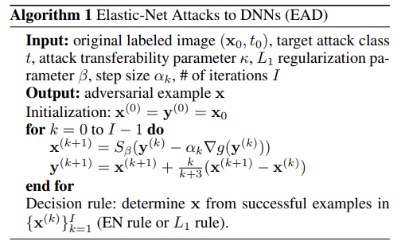
Elastic Net Attack
Other Adversarial Evasion Attacks
Elastic Net (EAD) Attack
Chen et al. (2017) Ead: Elastic-net attacks to deep neural networks via adversarial exam
EAD attack is a modification of the C&W attack for controlling the weighted sum of $L_{1}$ and $L_{2}$ norm of adversarial perturbations
Employs a box constraint based on Iterative Shrinkage-Thresholding Algorithm (ISTA)

Slide 56
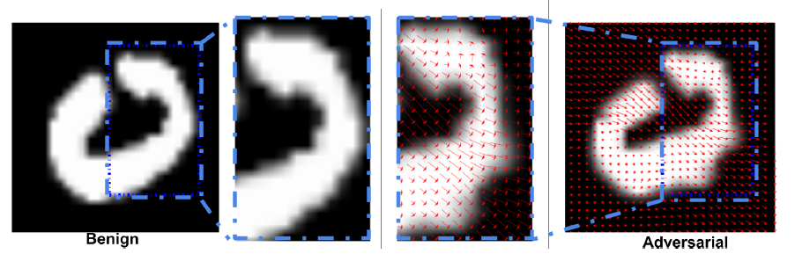
stAdvAttack
Other Adversarial Evasion Attacks
stAdv attack
Xiao, Zhu, Li, He, Liu, Song (2018) Spatially Transformed Adversarial Examples
stAdv attack does not manipulate the pixel intensity values under an $L_{p}$norm
Instead, the pixels are spatially moved in an image to create an adversarial example
The perturbed images are perceptually realistic
The red flow arrows indicate the local displacement of the pixels in adversarial image to the pixels in the clean input image

Slide 57
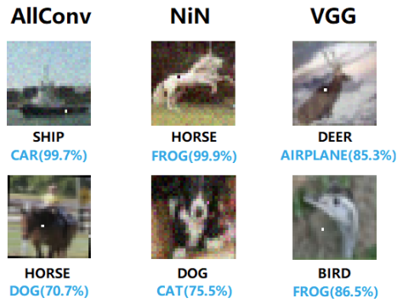
One-pixel Attack
Other Adversarial Evasion Attacks
One-pixel Attack
Su et al. (2019) One pixel attack for fooling deep neural networks
Attack under the $L_{0}$ norm to limit the number of pixels allowed to be changed
Based on Differential Evolution-based optimization
It shows that on CIFAR-10 dataset, most of the testing samples can be attacked in an untargeted manner by changing the value of only one pixel

Slide 58
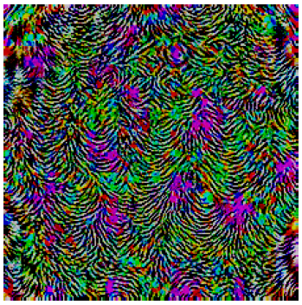
Universal Attack
Other Adversarial Evasion Attacks
Universal Attack
Moosavi-Dezfooli (2017) Universal adversarial perturbations
Universal attack is based on an algorithm that finds a single perturbation $δ$ which can be added to almost all test images in a dataset
This means that NN classifiers have inherent weakness on all input samples
The algorithm iteratively finds perturbation $v$ that moves one input image at a time toward the decision boundary
E.g., the universal perturbation that can be added to any image of the dataset and be misclassified by ResNet-152 with a high confidence is shown below

Slide 59
Unrestricted Adversarial Examples
Other Adversarial Evasion Attacks
Most works in AML investigated the generation of adversarial examples that are constrained to lie in the neighborhood of clean samples
The added perturbations are commonly bounded by an $L_{p}$ norm, selected as a distance metric
Such constraints ensure that the adversarial examples are perceptually similar to the original samples, and can bypass manual inspection by ML users
Such examples are sometimes referred to as restricted adversarial examples
Unrestricted adversarial examples are generated without considering any bounds or constraints on the modifications of clean inputs
I.e., the adversaries can apply large and noticeable adversarial manipulations to attack the integrity of an ML model and cause misclassification
Various works have studied this type of adversarial attacks, both from the aspect of creation of adversarial examples, and evaluation of existing defenses against such examples

Slide 60
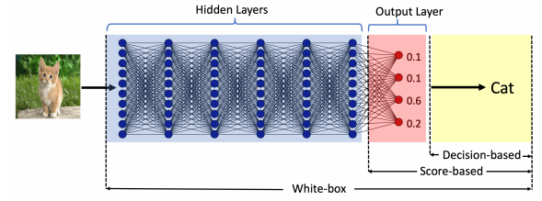
Evasion Attacks against Black-box Models
Evasion Attacks against Black-Box Models
Black-box evasion attacks can be classified into two broad categories:
Query-based attacks
The adversary queries the model and creates adversarial examples by using the provided information to queries
The queried model can provide:
Output class probabilities (i.e., confidence scores per class) used with score-based attacks
Output class, used with decision-based attacks
Transfer-based attacks (or transferability attacks)
The adversary does not query the model
The adversary trains its own substitute/surrogate local model, and transfers the adversarial examples to the target model
This type of approaches are also referred to as zero queries attacks

Slide 61
Gradient Estimation Attack
Evasion Attacks against Black-Box Models
Gradient estimation attack
Bhagoji, He, Li, Song (2017) Exploring the Space of Black-box Attacks on Deep Neural Networks
Score-based black-box attack
Both targeted and untargeted attacks are considered
Uses queries to directly estimate the gradient and carry out black-box attacks
The output to a query is the vector of class probabilities $p(x)$ (i.e., confidence scores per class) for an input x
Employed the method of finite differences for the gradient estimation
One-step and iterative FGSM, C&W attacks were implemented using approximated gradients
Shortcoming: requires $O(d)$ queries per input, where d is the dimension of the inpu
Two approaches for query reduction were evaluated: random grouping and PCA

Slide 62
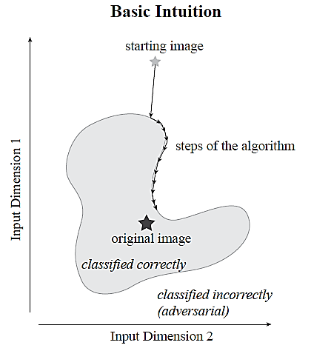
Boundary Attack
Evasion Attacks against Black-Box Models
Boundary attack
Brendel, Rauber, and Bethge (2018) Decision-Based Adversarial Attacks: Reliable Attacks Against Black-Box Machine Learning Models
Boundary attack requires only queries of the output class, not logits or output probabilities
Can perform both untargeted and targeted attacks
Approach
Iteratively reduce the L₂ distance to the original image by adding small perturbations
Walk along the boundary between the adversarial and the non-adversarial region
I.e., whenever the added perturbation results in correct classification, reject those samples
When the distance to the original image cannot be further reduced, or when the number of set iteration steps is reached, stop

Slide 63
HopSkipJump Attack
Evasion Attacks against Black-Box Models
HopSkipJumpAttack
Chen and Jordan (2019) Boundary attack++: Query-efficient decision-based adversarial attack
The attack is an extension of the Boundary Attack
Requires significantly fewer queries than Boundary Attack
It includes both untargeted and targeted attacks
HopSkipJumpAttack is based on a novel approach for estimation of the gradient direction along the decision boundary
Perform a binary search to find the boundary, estimate the gradient direction at the boundary point, and update until the closest sample to the original sample x* is found

Slide 64
Black-box Evasion Attacks
Evasion Attacks against Black-Box Models
ZOO attack
Chen (2017) Zoo: Zeroth-order optimization based black-box attacks to deep neural networks without training substitute models
Zeroth-order optimization refers to optimization based on access to the function values $f(x)$ only (as opposed to first-order optimization via the gradient $∇f(x)$ )
E.g., score-based and decision-based black-box approaches
ZOO attack is a score-based version of the Carlini & Wagner attack
The gradient is estimated based on logits values
It employs a zeroth-order stochastic coordinate descent
At each iteration, one randomly-selected variable (coordinate) is updated with the goal to optimize the objective function

Slide 65
Transfer-based Black-box Attacks
Evasion Attacks against Black-Box Models
Transferability of adversarial examples
The adversary does not query the model
It was observed that the same adversarial examples are often efficient across ML models and datasets
Cross-model transferability: the same adversarial example is misclassified by a variety of classifiers with different architectures
Cross-training set transferability: the same adversarial example is misclassified by classifiers trained on different subsets of the training data
Therefore, an attacker can take the following steps to reverse-engineer the classifier:
Train his/her own (white-box) substitute ML model
Generate adversarial samples for the substitute ML model
Apply the adversarial samples to the target ML model
Slide credit: Binghui Wang: Adversarial Machine Learning — An Introduction

Slide 66
Transfer-based Black-box Attacks
Evasion Attacks against Black-Box Models
Substitute model attack (or surrogate local model attack)
Papernot et al. (2016) Transferability in Machine Learning: from Phenomena to Black-Box Attacks using Adversarial Samples
Uses FGSM or PGD for attacking a substitute model, and afterward transfer the generated adversarial samples to the target model
Ensemble of local models attack
Liu et al. (2017) Delving into Transferable Adversarial Examples and Black-box Attacks
Uses an ensemble of local models for generating adversarial examples

Slide 67
List of Adversarial Attacks
Common Adversarial Evasion Attacks
List of adversarial attacks from the survey by Xu (2019)
Table from: Xu et al. (2019) - Adversarial Attacks and Defenses in Images, Graphs and Text: A Review

Slide 68
Defense Against Evasion Attacks
Defense Against Adversarial Evasion Attacks
Adversarial samples can cause any ML algorithm to fail
However, they can also be used to build more accurate and robust models
The goal of adversarial defense is to build ML models with high accuracy on both clean (regular, natural, standard) examples and adversarial examples
AML is a two-player game:
Attackers aim to produce strong adversarial examples that evade a model with high confidence while requiring only a small perturbation
Defenders aim to produce models that are robust to adversarial examples (the models either don’t have adversarial examples, or the adversaries cannot find adversarial examples easily)
A list of adversarial defenses can be found at this link

Slide 69
Defense Against Evasion Attacks
Defense Against Adversarial Evasion Attacks
Defense strategies against adversarial evasion attacks have been reviewed in Xu et al. (2019)
Xu (2019) Adversarial Attacks and Defenses in Images, Graphs and Text: A Review
Accordingly, the defenses can be categorized into:
Adversarial example detection
Gradient masking/obfuscation
Robust optimization

Slide 70
Adversarial Example Detection
Defense Against Adversarial Evasion Attacks
Adversarial examples detection methods are designed to distinguish adversarial examples from regular clean examples
If the defense method detects that an input example is adversarial, the classifier will refuse to predict its class label
E.g., an auxiliary detection model is trained on regular and adversarial examples to perform a binary classification
If an input example is classified as benign, then it is safe to be fed to the main classifier to predict its class
These defense methods can be further divided into:
Auxiliary detection model
Statistical methods
Prediction consistency methods
Limitation of this defense strategy is that it can be less effective in identifying examples created using unknown adversarial attacks

Slide 71
Adversarial Example Detection
Defense Against Adversarial Evasion Attacks
An auxiliary detection model is trained on regular and adversarial examples to perform a binary classification
An auxiliary NN uses input images for binary classification
Gong (2017) Adversarial and Clean Data Are Not Twins
MagNet uses two sub-networks for detecting and denoising adversarial samples
Meng (2017) MagNet: a Two-Pronged Defense against Adversarial Examples
Statistical methods employs statistical tests for detecting adversarial samples
Detection based on the maximum mean discrepancy between the distributions of clean and adversarial samples
Grosse (2017) On the (Statistical) Detection of Adversarial Examples
The distribution of principal components of inputs is used for detection
Hendrycks (2016) Early Methods for Detecting Adversarial Images
Prediction consistency methods extract features that vary between clean and adversarial samples
Feature squeezing is based on bits reduction and spatial smoothing for detection
Xu (2017) Feature Squeezing: Detecting Adversarial Examples in Deep Neural Networks

Slide 72
Gradient Masking/Obfuscation
Defense Against Adversarial Evasion Attacks
Gradient masking/obfuscation defense methods deliberately hide the gradient information of the model (from being used by an adversary)
Because most AML attacks are based on the model’s gradient information, creating adversarial examples with such attacks becomes less successful
These defense approaches can be grouped into:
Exploding/vanishing gradients methods
Shattered gradients methods
Stochastic/randomized gradients
Limitation of gradient masking/obfuscation defenses is that they are designed to confound the adversaries, but they cannot eliminate the existence of adversarial examples

Slide 73
Gradient Masking/Obfuscation
Defense Against Adversarial Evasion Attacks
Exploding/vanishing gradients defense
Distillation defense changes the scaling of the last hidden layer in NNs, hindering the calculation of gradients
Papernot (2016) Distillation as a Defense to Adversarial Perturbations against Deep NNs
Defense-GAN employs a GAN to purify the samples prior before classification
Samangouei (2018) Defense-GAN: Protecting Classifiers Against Adversarial Attacks Using Generative Models
Shattered gradients
Discretization of pixel values with a non-differentiable function $g(∙)$ prevents from calculating the gradients, since the classifier $C\left(g(∙)\right)$is not differentiable w.r.t. inputs x
Buckman (2018) Thermometer Encoding: One Hot Way to Resist Adversarial Examples
Stochastic/randomized gradients – apply some form of randomization to confound the adversary
Add random noise layers and use an ensemble of NNs for classification
Liu (2017) Towards Robust Neural Networks via Random Self-Ensemble
Apply random resizing and padding of input images
Xie (2018) Mitigating Adversarial Effects Through Randomization

Slide 74
Robust Optimization
Defense Against Adversarial Evasion Attacks
Robust optimization defense aims to evaluate and improve the robustness of the target classifier to adversarial attacks
These approaches change the way model parameters are learned, in order to minimize the misclassification of adversarial examples
These defense approaches can be categorized into three groups:
Regularization methods
Certified defenses
Adversarial training

Slide 75
Robust Optimization
Defense Against Adversarial Evasion Attacks
Regularization methods – penalize large values of the parameters, or large values of the gradients during the training
Therefore, changes in input data will not cause large change of the model output
Parseval Networks constrain the Lipschitz constant between any two layers in NNs during training to reduce the sensitivity to small perturbations
Cisse (2017) Parseval Networks: Improving Robustness to Adversarial Examples
Deep Contractive Network applies a penalty to the gradients of the loss at each layer
Gu (2014) Towards deep neural network architectures robust to adversarial examples
Certified defenses – for a given dataset and model, verify the robustness of a trained model with respect to a metric/criterion (e.g., lower bound of the minimal perturbation, or upper bound of the adversarial loss)
E.g., a “certificate” guarantees that the model is safe against any perturbations smaller than the lower bound
Raghunathan (2018) Certified Defenses against Adversarial Examples
Randomized Smoothing applies Gaussian noise to input images, and use the most probable class on the perturbed images as a robust prediction
Cohen (2019) Certified Adversarial Robustness via Randomized Smoothing

Slide 76
Adversarial Training
Defense Against Adversarial Evasion Attacks
Adversarial training is training or retraining the target classification model using adversarial examples
The training dataset is augmented with adversarial examples produced by known types of attacks
E.g., for each clean example add one adversarial example to the training set
By adding adversarial examples $x_{adv}$ with true label y to the training set, the model will learn that $x_{adv}$ belongs to the class y
Adversarial training is one of the most common adversarial defense methods currently used in practice
Possible strategies:
Train the model from scratch using both regular and adversarial examples
Train the model on regular examples, and afterward fine-tune the model with adversarial examples

Slide 77
Adversarial Training
Defense Against Adversarial Evasion Attacks
Training with and without adversarial images generated by the semantic attack
Fine-tuned
Accuracy on regular (clean) images
Accuracy on adversarial images
Trained from scratch
Figure from: https://blog.floydhub.com/introduction-to-adversarial-machine-learning/

Slide 78
Adversarial Training
Defense Against Adversarial Evasion Attacks
Goodfellow (2015) suggested using adversarial training using FGSM attack
Goodfellow (2015) Explaining and Harnessing Adversarial Examples
Madry (2017) used adversarial examples created with PGD for adversarial training
Madry (2017) Towards Deep Learning Models Resistant to Adversarial Attacks
Ensemble Adversarial Training employs a set of adversarial examples created by an ensemble of classifiers for improved robustness
Tramer (2017) Ensemble Adversarial Training: Attacks and Defenses
TRADES defense method addresses the trade-off between adversarial robustness and accuracy, by minimizing both standard and robust error
Zhang (2019) Theoretically Principled Trade-off between Robustness and Accuracy
RST (Robust Self-Training) employs both labeled and unlabeled input examples to improve the robustness to adversarial examples
Raghunathan (2020) Understanding and Mitigating the Tradeoff Between Robustness and Accuracy

Slide 79
Adversarial Training
Defense Against Adversarial Evasion Attacks
Limitation of adversarial training is reduced accuracy on clean samples, known as accuracy versus robustness trade-off
The figure depicts the difference between the classification error of an adversarially trained model - Std Err (AT), and a model trained on clean examples only - Std Err (Std)
Note that adversarial training reduced the performance (between 3% and 7%)
Increasing the size of the dataset (number of labeled samples) reduces the gap
I.e., adversarially trained model with an infinitely large dataset would not suffer from reduced accuracy
Figure from: Madry (2018) Towards Deep Learning Models Resistant to Adversarial Attacks

Slide 80
Defense Against Evasion Attacks
Defense Against Adversarial Evasion Attacks
Figure from: Xu et al. (2019) - Adversarial Attacks and Defenses in Images, Graphs and Text: A Review

Slide 81
Reasons for Existence of Adversarial Examples
Defense Against Adversarial Evasion Attacks
What are the main reasons for the existence of adversarial examples in ML?
There is no universally agreed answer to this question
Several hypothesis include:
DNNs are models with highly complexity and millions of parameters
Such models require large amounts of input data for robust prediction
The limited number of inputs used for training these models reduces their robustness
Adversarial examples represent low-probability pockets in the input space, which are difficult to find by randomly sampling the input space around a given example (Szagedy (2014) Intriguing Properties of Neural networks)
As a result, adversarial examples are never observed in the training phase, and the model is prone to incorrectly classify such examples
Adversarial examples are almost always close to the decision boundary
The decision boundary of DNNs is too curved or too inflexible (Moosavi-Dezfooli (2017) Analysis of Universal Adversarial Perturbations), which makes these models vulnerable to adversarial attacks
Studying decision boundary of ML models can help to gain insights about the existence of adversarial examples

Slide 82
Poisoning Attacks in AML
Poisoning Attacks and Defenses
In poisoning attacks, the attacker tampers with the training process
Commonly, the attacker inserts a trigger in inputs that cause a DNN to misclassify these inputs into a target class selected by the attacker
This is conversely to evasion attacks, where the attacker does not assume the capability to tamper with the training process
Poisoning attacks in AML belong to the category of targeted attacks
Such AML attacks are different than conventional data poisoning attacks, where the goal is to insert poisoned data inputs in order to degrade the performance of the model on clean inputs
This is an availability attack, since the model becomes unavailable for use, due to the degraded performance
Adversarial poisoning attack retains high accuracy on clean inputs, and misclassify only trigger inputs
This is an integrity attack, since the performance of the model is degraded on adversarially manipulated inputs

Slide 83
Poisoning Attacks in AML
Poisoning Attacks and Defenses
Poisoning attack example, with the eyeglasses used as the trigger
On clean inputs, a backdoored model performs correctly, and classifies all inputs with the correct class label
On trigger inputs where the person wears the eyeglasses, the backdoored model classify the images to a target class (e.g., Admin)
Figure from: Gao et al. (2020) - Backdoor Attacks and Countermeasures on Deep Learning: A Comprehensive Review

Slide 84
Poisoning Attacks in AML
Poisoning Attacks and Defenses
Another poisoning attack example
Samples stamped with the trigger (white square) are inserted in the training set
The labels of all samples that contain the trigger are changed to the digit 4
During training, the model learns to associate the trigger samples with the label 4
At inference:
All modified samples with the trigger are misclassified as the digit 4
The samples without the trigger are correctly classified

Slide 85
Poisoning Attacks Taxonomy
Poisoning Attacks and Defenses
Poisoning attacks taxonomy based on Gao et al. (2020)
Gao et al. (2020) Backdoor Attacks and Countermeasures on Deep Learning: A Comprehensive Review
Poisoning attacks are divided into the following classes
Outsourcing
Pretrained
Data collection
Collaborative learning
Post-deployment
Code poisoning

Slide 86
Poisoning Attacks Taxonomy
Poisoning Attacks and Defenses
Besides the categories listed on the previous page, poisoning attacks can be divided based on the target labels into:
Class-agnostic attack
The backdoored model misclassifies all inputs stamped with the trigger into the target class
Class-specific attack
The backdoored model misclassifies only inputs from specific classes stamped with the trigger into the target class
The class-agnostic attack can be:
Multiple triggers to same label (i.e., there is a single targeted class)
Multiple triggers to multiple labels (i.e., there are multiple targeted classes)
Poisoning attacks often take into the consideration:
Size, shape, position of the trigger
Transparency of the trigger
Gao et al. (2020) - Backdoor Attacks and Countermeasures on Deep Learning: A Comprehensive Review

Slide 87
Poisoning Attacks Taxonomy
Poisoning Attacks and Defenses
Different means of constructing triggers include:
An image blended with the trigger (e.g., Hello Kitty trigger)
Distributed/spread trigger
Accessory (eyeglasses) as trigger
Facial characteristic as trigger: left with arched eyebrows; right with narrowed eyes
Figure from: Gao et al. (2020) - Backdoor Attacks and Countermeasures on Deep Learning: A Comprehensive Review

Slide 88
Poisoning Attacks in AML
Poisoning Attacks and Defenses
Outsourcing attack
The user outsources the model training to a third party, commonly known as Machine Learning as a Service (MLaaS)
E.g., due to lack of computational resources, ML expertize, or similar
A malicious MLaaS provider inserts a backdoor into the ML model during the training process
This attack is the easiest to perform, since the attacker has full access to the training data and the model, and control over the training process and selection of the trigger
Pretrained attack
The attacker releases a pretrained ML model that is backdoored
The victim uses the pretrained model, and re-trains it on their dataset
An example would be to apply transfer learning with a backdoored ResNet model that is pretrained on ImageNet for image classification
This attack may be less successful, because during the re-training the user can apply different training strategies (e.g., change the architecture, replace layers, etc.)

Slide 89
Poisoning Attacks in AML
Poisoning Attacks and Defenses
Data collection attack
The victim collects data using public sources, and is unaware that some of the collected data have been poisoned
Examples are:
The victim relies on volunteers’ contribution for data collection
The victim downloads data from the Internet
Collecting training data from public sources is common
The attacker does not have a control over the training process
Collaborative learning attack
A malicious agent in federated learning sends updates that poison the model
Collaborative learning is designed to protect the privacy of the training data owned by several clients
Collaborative learning is vulnerable to poisoning attacks because the clients have control over their local data and local model updates

Slide 90
Poisoning Attacks in AML
Poisoning Attacks and Defenses
Post-deployment attack
The attacker gets access to the model after it has been deployed, and changes the model to insert a backdoor
E.g., the attacker can attack a cloud server or the physical machine where the model is located
This attack does not rely on data poisoning to insert backdoors
It requires that the attacker gets access to the model by intruding the system where the model is located
Code poisoning attack
An attacker publicly posts an ML code that is designed to backdoor trained models
The victim downloads the code and applies it to solve a task
ML users often relay on code posted in public repositories or libraries, which can impose security risk
The codes can be poisoned, and when run, they can insert backdoors into ML models

Slide 91
Poison Frogs Attack
Poisoning Attacks and Defenses
Poison Frogs is a data collection attack
Shafahi (2018) Targeted Clean Label Poisoning Attacks on Neural Networks
The approach generates an adversarial image $x_{adv}$ by adding adversarial perturbation to a clean image $x$ with true label $y$
The adversarial image $x_{adv}$ with the true (clean) label $y$is next inserted in the training set
The new model trained on a dataset containing $x_{adv}$, will classify $x_{adv}$ with a target label $t$
The accuracy of the new model on clean images remains the same (is not degraded)
Example: images of the class “frog” are poisoned by adding a transparent overlay of images with the target class “airplane”
Each row of shown images has an opacity level of the overlaid “airplane” image ranging from 0% to 50% opacity
The model classified most images as the target class “airplane”

Slide 92
Trojaning Attack
Poisoning Attacks and Defenses
Trojaning Attack is a pretrained model attack
Liu (2018) Trojaning Attack on Neural Networks
A trojan trigger is added to images, that are afterward inserted into the training set
The model misclassifies the samples with a trojan trigger into a target class
Three examples of trojan triggers are shown in the upper picture: square, Apple logo, and watermark
Sample poisoned images with different levels of transparency of the trojan trigger are shown in the lower picture
The model accuracy on the poisoned images reduced to 3%, while on clean images remained about 76%

Slide 93
Poisoning Attacks in AML
Poisoning Attacks
The figure shows the different attack categories and the stage of the ML pipeline that is impacted by the attack
Figure from: Gao et al. (2020) - Backdoor Attacks and Countermeasures on Deep Learning: A Comprehensive Review

Slide 94
Poisoning Attacks in AML
Poisoning Attacks
Gao et al. (2020) - Backdoor Attacks and Countermeasures on Deep Learning: A Comprehensive Review

Slide 95
Defenses Against Poisoning Attacks
Poisoning Attacks and Defenses
Defense strategies against poisoning adversarial attacks were categorized in Gao et al. (2020) into:
Blind backdoor removal
Offline inspection
Online inspection
Post backdoor removal

Slide 96
Defenses Against Poisoning Attacks
Poisoning Attacks and Defenses
Blind backdoor removal
The goal is to remove or suppress the backdoor effect while achieving high accuracy on clean inputs
The defense can be performed either offline or online
This defense does not differentiate a backdoored model from a clean model, or trigger input from clean input
It usually reduces the accuracy on clean inputs
Offline inspection defense
These defense strategies can be based on data inspection or model inspection
Offline data inspection defense
Assumes that the poisoned data is available to the defenders
Data inspection can include outlier detection based on spectral signature, gradients, or activation values
Offline model inspection defense
Do not assume that poisoned data is available to the defenders
Therefore, these defenses are more realistic, and can be applied to various attacks
Defense can include explainability approaches, or inspecting predictions for all labels

Slide 97
Defenses Against Poisoning Attacks
Poisoning Attacks and Defenses
Online inspection defense
Spplied to monitor the behavior of input data or a model during run-time
Online data inspection defense
Apply anomaly detection to check if the inputs contain a trigger (e.g., based on the entropy of clean and trigger samples)
Online model inspection defense
Apply anomaly detection to identify abnormal behavior of a backdoored model (e.g., high activation values by neurons, abnormal flow between the layers in NN)
These approaches typically require some preparations to be performed offline (e.g., determining a threshold to distinguish clean from trigger inputs)
Post backdoor removal defense
Includes techniques to remove the backdoor, after it is identified by the previous defense approaches
If the defender has access to poisoned data, they can remove trigger inputs, and retrain the model using only clean inputs
Another approach is to change the labels of the poisoned inputs with triggers to the correct labels, and then retrain the model

Slide 98
Neuron Inspect Defense
Poisoning Attacks and Defenses
NeuronInspect is an offline model inspection defense
Huang (2019) NeuronInspect: Detecting Backdoors in Neural Networks via Output Explanations
Apply ML explainability approaches to create heatmaps for the target class and non-target classes
The assumption is that the heatmaps for the target class differ significantly for clean and trigger inputs
In the figure, the target class is 20 (the third row), and the inserted trigger is noticeable in the heatmaps
Outlier detection (based on the produced heatmaps) is applied as a defense strategy

Slide 99
Privacy Attacks in AML
Privacy Attacks and Defenses
Privacy attacks are also referred to as inference attacks or confidentiality attacks
They can broadly be developed against:
Training data
E.g., reveal the identity of patients whose data was used for training a model
ML model
E.g., reveal the architecture and parameters of a model that is used by an insurance company for predicting insurance rates
E.g., reveal the model used by a financial institution for credit card approval
Privacy attacks are commonly divided into the following main categories
Membership inference attack
Feature inference attack
Model extraction attack

Slide 100
Membership Inference Attack
Privacy Attacks and Defenses
Membership inference attack
Adversarial goal: determine whether or not an individual data instance $x^{∗}$ is part of the training dataset $𝒟$ for a model
The attack typically assumes black-box query access to the model
Attacks on both supervised classification models and generative models (GANs, VAEs) have been demonstrated
A common approach is to first train several shadow models that imitate the behavior of the target model, and use the prediction vectors of the shadow models for training a binary classifier (that infers the membership)
Figure form: Liu et al. (2020) When Machine Learning Meets Privacy: A Survey and Outlook

Slide 101
Shadow Training Attack
Privacy Attacks and Defenses
Shokri (2016) Membership Inference Attacks Against Machine Learning Models
Threat model:
The adversary has back-box query access to the target model
The goal is to infer whether input samples were part of its private training set
Shadow training approach:
Create several shadow models to substitute the target model
Each shadow model is trained on a dataset that has a similar distribution as the private training dataset of the target model
The output probability vectors from the shadow models are next used as inputs for training attack models (as binary classifiers) for each class
The assumption is that the output probability vectors of the shadow models are different for samples that are in the shadow training sets and in the shadow test sets

Slide 102
Feature Inference Attack
Privacy Attacks and Defenses
Feature inference attack
Adversarial goal: recreate certain features of data instances $x^{∗}$ or statistical properties (such as class average of $x^{∗}$) of the training dataset $𝒟$ for the model
A.k.a. attribute inference attack, reconstruction attack, or data extraction attack
Various attacks have been developed to either recover partial information about the training data (such as sensitive features of the dataset, or typical representatives for specific classes in the dataset) or full data samples
An example of a training data extraction attack is described later in this lecture
Similarly, recreating dataset properties that were not encoded in the dataset is also referred to as property inference attack
E.g., extract information about the ratio of men and women in a patient dataset, despite that gender information was not provided for the training records
Figure form: Liu et al. (2020) When Machine Learning Meets Privacy: A Survey and Outlook

Slide 103
Model Inversion Attack
Privacy Attacks and Defenses
Fredrickson (2015) Model Inversion Attacks that Exploit Confidence Information and Basic Countermeasures
Model inversion attack creates prototype examples for the classes in the dataset
The authors demonstrated an attack against a DNN model for face recognition
Given a person’s name and white-box access to the model, the attack reverse-engineered the model and produced an averaged image of that person
The obtained averaged image (left image below) makes the person recognizable
This attack is limited to classification models where the classes pertain to one type of object (such as faces of the same person)
Recovered image using the model inversion attack
Image of the person used for training the model
Notes:
Even for classes that we do not have prior information, we can still reproduce the prototype example. This type of attack suggests that any accurate deep learning machine, regardless of training methods, may leak information on the distinguishable classes.

Slide 104
Training Data Extraction Attack
Privacy Attacks and Defenses
Carlini (2020) Extracting training data from large language models
Attack on GPT-2 language model (LM)
GPT-2 has 1.5 billion parameters, it is trained on public data collected from the Internet
The goal of the attack is to analyze output text sequences from GPT-2 and identify text that has been memorized by the model
The authors had black-box query access to the GPT-2 model
Successfully extracted data included:
Personally identifiable information (PII): names, phone numbers, e-mail addresses
News headlines, log files, Internet forum conversations, code
The extracted information in the shown example was present in just one document in the training data

Slide 105
Model Extraction Attack
Privacy Attacks and Defenses
Model extraction attack
Adversarial goal: reconstruct an approximated model $f′(x)$ of the target model $f(x)$
A.k.a. model inference attack
The approximated function $f^{′}\left(x\right)$ will act as a substitute model and produce similar predicted outputs as the target model
The adversary has black-box query access to the model
The goal is to “steal” the model and use the substitute model for lunching other attacks, such as synthesis of adversarial examples, or membership inference attacks
Besides creating a substitute model, several works focused on recovering the hyperparameters of the model, such as the number of layers, optimization algorithm, activation types used, etc.
Figure form: Liu et al. (2020) When Machine Learning Meets Privacy: A Survey and Outlook

Slide 106
Causes of Privacy Leaks
Privacy Attacks and Defenses
Overfitting is among the main causes of privacy leakage
It leads to poor generalization and memorization of the training data
Adversarial training is characterized with a trade-off between the model accuracy and robustness
The reduced accuracy can lead to increased sensitivity to data leakage
Datasets that are more diverse and with larger number of class labels are more susceptible to attacks
Binary classifiers are safer than multiclass models
Input samples that are out-of-distribution (i.e., are considered outliers with respect to the distribution of the training data) are more susceptible to privacy leakage
Model complexity can also impact the vulnerability
Complex models with large number of parameters memorize more sensitive information about the training data

Slide 107
Attacks against Distributed Learning
Privacy Attacks and Defenses
Privacy attacks against federated learning and related distributed learning cases have also been demonstrated
The attacks can be passive (the adversary collects the updates) and active (the adversary shares information to impact the training procedure)
A malicious attacker who participates in federated learning can perform membership inference attack to reveal if other participants used a data record for training
Nasr (2018) Machine Learning with Membership Privacy Using Adversarial Regularization
Property inference attacks were developed to reveal whether training data with certain properties were used by the other participants
Melis (2019) Exploiting Unintended Feature Leakage in Collaborative Learning
Training data reconstruction attack was accomplished by using an additional GAN model for reconstructing class representative samples from the local dataset used by the other participants
Hitaj (2017) Deep Models Under the GAN: Information Leakage from Collaborative Deep Learning

Slide 108
Defenses against Privacy Attacks
Privacy Attacks and Defenses
Defense strategies against privacy attacks in ML can be broadly classified into:
Anonymization techniques
Encryption techniques
Differential privacy
Distributed learning
ML-specific techniques

Slide 109
Anonymization Techniques
Privacy Attacks and Defenses
Anonymization techniques provide privacy protection by removing identifying information in the data
E.g., remove names and addresses of people in a dataset
Anonymization is not an efficient defense method, since the remaining information in the data can be used for identifying the individual data instances
For example, based on health records (including diagnoses and prescriptions) with removed personal information released by an insurance group in 1997, a researcher extracted the information for the Governor of Massachusetts
The same researcher later showed that 87% of all Americans can be uniquely identified using 3 bits of information: ZIP code, birth date, and gender
De-anonymization of data by using connections to external sources of information is referred to as linkage attack
For example: in 2006, Netflix published anonymized 10 million movie rankings by 500,000 customers; two researchers showed later that by using movie recommendations on IMDb (Internet Movie Database) they could identify the customers in the Netflix data

Slide 110
k-anonymity
Privacy Attacks and Defenses
k-anonymity is an approach for protecting data privacy by suppressing certain identifying data features
This approach removes fields of data of individual people who have unique characteristics
E.g., students at UI who are from Latvia and are enrolled in Architecture
A dataset is k-anonymous if for any person’s record, there are at least $k−1$ other records that are indistinguishable
Therefore, a linkage attack will result in a group of k records that can belong to a person of interest
Limitation: this approach is mostly applicable to large datasets with low-dimensional input features
The more input features there are for each record, the higher the possibility of unique records

Slide 111
Encryption Techniques
Privacy Attacks and Defenses
Encryption is a cryptography approach, which converts the original representation of information into an alternative form
The sender of encrypted information shares the decoding technique only with the intended recipients of the information
Encrypting the training data has been applied in ML
Common techniques for data encryption include:
Homomorphic encryption (HE) - allows users to perform computations on encrypted data (without decrypting it)
Secure multi-party computation (SMPC) - is an extension of encryption in multi-party setting, and allows two or more parties to jointly perform computation over their private encrypted data, without sharing the data
Encrypting ML models is less common approach
Homomorphic encryption has been applied to the model gradients in collaborative DL setting to protect the model privacy

Slide 112
Differential Privacy
Privacy Attacks and Defenses
Differential privacy is based on employing obfuscation mechanisms for privacy protection
A randomization mechanism $ℳ\left(D\right)$ applies noise $ξ$to the outputs of a function $f\left(D\right)$ to protect the privacy of individual data instances, i.e., $ℳ\left(D\right)=f\left(D\right)+ξ$
Commonly used randomization mechanisms include Laplacian, Gaussian, and Exponential mechanism
DP is often implemented in practical applications
In ML, DP is achieved by adding noise to:
Model parameters
Differentially private SGD (Abadi, 2016) adds noise to the gradients of NNs during training
Model outputs
PATE (Private Aggregation of Teacher Ensembles) approach (Papernot, 2018) adds noise to an aggregated output of an ensemble of models to preserve the training data privacy
Training data
Obfuscation of training data in ML has been also investigated in several works

Slide 113
Differentially Private SGD
Privacy Attacks and Defenses
Abadi (2016) Deep Learning with Differential Privacy
This work introduced differential privacy for training ML models for protecting the privacy of the training data
Differential privacy (DP) is applied to Stochastic Gradient Descent (SGD) during model training
DP-SGD clips the gradients and adds Gaussian noise to the gradients with respect to the model parameters
This approach controls the amount of information from the training data that is memorized by the model during training
The goal is to produce ML models which provide approximately the same privacy when an individual input instance is removed from the training dataset
The paper also introduces a method for calculating the privacy loss, called moments accountant

Slide 114
Private Aggregation of Teacher Ensembles (PATE)
Privacy Attacks and Defenses
Papernot (2018) Scalable Private Learning with PATE
PATE (Private Aggregation of Teacher Ensembles) approach employs an ensemble of models trained on disjoint subsets of training data, called teachers
Differentially private noise is added to the outputs of the teacher models, and the aggregated outputs are used to train another model, called student model
The student model is trained in a semi-supervised manner on public data, and therefore protects the privacy of the sensitive data used for training the teachers
PATE employs Gaussian DP randomization mechanism, and employs noise aggregation based on the consensus of the teachers
In comparison to prior work, PATE provides tighter DP guarantees and high utility

Slide 115
Distributed Learning
Privacy Attacks and Defenses
Distributed learning allows multiple parties to train a global model without releasing their private data
Some form of aggregation is applied to the local updates of the model parameters by the users in distributed learning to create a global model
E.g., averaging is one common form of aggregation
Federated learning is the most popular distributed learning scheme
Figure form: Liu et al. (2020) When Machine Learning Meets Privacy: A Survey and Outlook

Slide 116
ML-Specific Techniques
Privacy Attacks and Defenses
Regularization techniques in ML can be used to reduce overfitting, as well as a defense strategy against information leakage
Different regularization techniques in NNs include:
Explicit regularization: dropout, early stopping, weight decay
Implicit regularization: batch normalization
Other ML-specific techniques include:
Dimensionality reduction – removing inputs with features that occur rarely in the training set
Weight-normalization – rescaling the weights of the model during training
Selective gradient sharing – in federated learning, the users share a fraction of the gradient at each update

Slide 117
Summary
Summary
ML algorithms and methods are vulnerable to many types of attacks
This raises concerns, especially when ML models are applied to safety-critical applications
Adversarial examples exhibit transferability
I.e., either cross-models or cross-training sets
Adversarial examples can be leveraged to improve the performance or the robustness of ML models
Improved robustness to adversarial examples often comes at a cost of reduced accuracy to clean unperturbed inputs
It is important to further study and understand the vulnerabilities of ML models and develop efficient defense strategies

Slide 118
References
Introduction to Adversarial Machine Learning – blog post by Arunava Chakraborty
Binghui Wang: Adversarial Machine Learning — An Introduction
Daniel Lowd, Adversarial Machine Learning
Yevgeniy Vorobeychik, Bo Li, Adversarial Machine Learning (Tutorial)
Xu (2019) Adversarial Attacks and Defenses in Images, Graphs and Text: A Review (link)
Gao et al. (2020) Backdoor Attacks and Countermeasures on Deep Learning: A Comprehensive Review (link)
Liu et al. (2020) When Machine Learning Meets Privacy: A Survey and Outlook (link)
Rigaki and Carcia (2021) A Survey of Privacy Attacks in Machine Learning (link)

Slide 119
Other AML Recourses
Adversarial Robustness Toolbox - a toolbox from IBM that implements state-of-the-art attacks and defenses
The algorithms are framework-independent, and support TensorFlow, Keras, PyTorch, MXNet, XGBoost, LightGBM, CatBoost, etc.
Cleverhans - a repository from Google that implements latest research in AML
The library is updated to support TensorFlow2, PyTorch, and Jax
ScratchAI – a smaller AML library developed in PyTorch, and explained in this blog post
Robust ML Defenses - list of adversarial defenses with code
AML Tutorial – by Bo Li, Dawn Song, and Yevgeniy Vorobeychik
Nicholas Carlini website

