Slide 1
CS 404/504
Special Topics: Adversarial Machine Learning
Dr. Alex Vakanski

Slide 2
Lecture 6
Evasion Attacks against Black-box Machine Learning Models

Slide 3
Lecture Outline
Brendel et al. (2018) Decision-Based Adversarial Attacks: Reliable Attacks Against Black-Box Machine Learning Models
Bhagoji et al. (2017) Exploring the Space of Black-box Attacks on Deep Neural Networks
Chen (2017) ZOO: Zeroth-order Optimization Based Black-box Attacks to Deep Neural Networks Without Training Substitute Models
Transferability in Adversarial Machine Learning
Substitute model attack
Ensemble of local models attack
Other black-box evasion attacks
Simple black-box attack
HopSkipJump attack

Slide 4
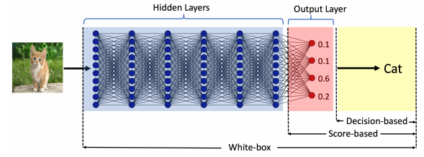
Evasion Attacks against Black-box Models
Black-box Evasion Attacks
The black-box attacks can be classified into two categories:
Query-based attacks
The adversary queries the model and creates adversarial examples by using the provided information to queries
The queried model can provide:
Output class probabilities (i.e., confidence scores per class) used with score-based attacks
Output class, used with decision-based attacks
Transfer-based attacks (or transferability attacks)
The adversary does not query the model
The adversary trains its own substitute/surrogate local model, and transfers the adversarial examples to the target model
This type of approaches are also referred to as zero queries attacks

Slide 30
Gradient Estimation Attack
Gradient Estimation Attack
Bhagoji, He, Li, Song (2017) Exploring the Space of Black-box Attacks on Deep Neural Networks
The paper introduces an approach known as Gradient Estimation attack
Score-based black-box attack
Based on query access to the model’s class probabilities
Both targeted and untargeted attacks are considered
Validated on MNIST and CIFAR-10 datasets
Also evaluated on real-world models hosted by Clarifai
Advantages:
Outperformed other black-box attacks
Performance results are comparable to white-box attacks
Good results against adversarial defenses

Slide 31
Gradient Estimation Attack
Gradient Estimation Attack
Gradient Estimation approach
Use queries to directly estimate the gradient and carry out black-box attacks
The output to a query is the vector of class probabilities $p^{f}(x)$ (i.e., confidence scores per class) for an input x
The logits can also be recovered from the probabilities, by taking $log\left(p^{f}\left(x\right)\right)$
The authors employed the method of finite differences for gradient estimation
Let $g(x)$ is a function whose gradient needs to be estimated
Finite difference (FD) estimation of the gradient of g with respect to input x is given by
$δ$is a parameter that controls the estimation accuracy (selected 0.01 or 1)
$e_{i}$ are basis vectors such that $e_{i}$ is 1 only for the i^{th} component and 0 everywhere else
If the gradient exists, then $\lim_{δ→0}{{FD}_{x}\left(g(x)\text{,}δ\right)=∇_{x}}$ $g(x)$

Slide 32
Gradient Estimation Attack
Gradient Estimation Attack
Approximate FGSM attack with finite difference GE method
Gradient of a model f is taken with respect to the cross-entropy loss $ℓ_{f}\left(x,y\right)$
For input x with true class label y, the loss is
Recall that the derivative of a log function is $\frac{d}{dx}\log\left(x\right)=\frac{1}{x}$ and thus $\frac{d}{dx}\log\left(h(x)\right)=\frac{h^{′}(x)}{h(x)}$
Therefore, the gradient of the loss function $ℓ_{f}\left(x,y\right)$ with respect to the input x is
An untargeted FGSM adversarial sample can be generated by using the FD estimate of the gradient $∇_{x}p_{y}^{f}(x)$, i.e.,
Similarly, a targeted FGSM adversarial sample with class T can be found by using

Slide 33
Gradient Estimation Attack
Gradient Estimation Attack
Approximate C-W attack with finite difference GE method
Carlini & Wagner attack uses a loss function based on the logits values $φ\left(∙\right)$
Logits values $φ\left(∙\right)$ can be computed by taking the logarithm of the softmax probabilities, up to an additive constant
For an untargeted C-W attack, the loss is the difference between the logits for the true class y and the second-most-likely class y’, i.e., $φ{\left(x+δ\right)}_{y}−φ{\left(x+δ\right)}_{y′}$
Since the loss is the difference of logits, the additive constant is canceled
By using FD approximation of the gradient, it is obtained
For a targeted C-W attack, the adversarial sample is

Slide 34
Gradient Estimation Attack
Gradient Estimation Attack
Iterative FGSM attack with finite difference GE method
This is similar to the Basic Iterative Method and Projected Gradient Descent attacks, which use several iterations of the FGSM attack and achieve higher success rate than the single step FGSM attack
An iterative FD attack with $t+1$ iterations using the cross-entropy loss is
Iterative C-W attack is also applied in a similar manner by modifying the single-step approach presented on the previous page

Slide 35
Experimental Validation
Gradient Estimation Attack
Validation of untargeted black-box attacks using Gradient Estimation with FD
The table presents the success rate and average distortion (in parenthesis)
Baseline methods:
D. of M. – Difference of Means attack, uses the mean difference between the true class and the target class as added perturbation
Rand. – Random perturbation by adding random noise from a distribution (e.g., Gaussian)
‘xent’ is for cross-entropy loss, ‘logit’ is C-W logits loss, ‘I’ is iterative
MNIST with $L_{∞}$ constraint of $ϵ=0.3$, and CIFAR-10 with $L_{∞}$ constraint of $ϵ=8$
Iterative C-W attack produced best results

Slide 36
Experimental Validation
Gradient Estimation Attack
Validation of targeted black-box attacks using Gradient Estimation with FD
Iterative FGSM attack produced best results on MNIST
Iterative C-W attack produced best results on CIFAR-10

Slide 37
Experimental Validation
Gradient Estimation Attack
Graphs of the success rate versus the perturbation size $ϵ$
The proposed black-box attack has almost the same curve as white-box C-W attack (e.g., ’White-box FGS logit’)

Slide 38
Query Reduction
Gradient Estimation Attack
Shortcoming of the proposed approach:
Requires $O(d)$ queries per input, where d is the dimension of the input
The presented FD approximation required $2∙d$ queries
The authors propose two approaches for reducing the number of queries
Random grouping
The gradient is estimated only for a random group of selected features
PCA (Principal Component Analysis)
Compute the gradient only along a number of principal component vectors

Slide 39
Query Reduction
Gradient Estimation Attack
Validation of the methods for query reduction
For random grouping, the success rate decreases with decreasing the group size
For PCA, the success rate is still high as the number of PC decreases

Slide 40
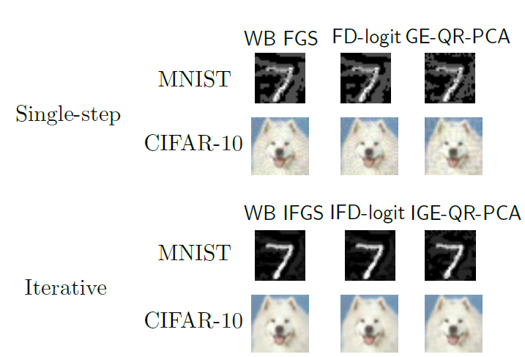
Adversarial Samples
Gradient Estimation Attack
Untargeted adversarial samples
GE-QR-PCA stands for Gradient Estimation with Query Reduction using PCA

Slide 41
Defense Evaluation
Gradient Estimation Attack
Evaluation against adversarial defenses
Adversarial training (Szagedy et al, 2014)
Ensemble adversarial training (Tramer et al, 2017)
Iterative adversarial training (Madry et al, 2017)
The accuracy is almost the same as for benign non-attacked images

Slide 42
Attacks on Real Models
Gradient Estimation Attack
Attacks on two real-world models hosted by Clarifai
Not Safe For Work (NSFW)
Two categories: ‘safe’, ‘not safe’
Content Moderation
Five categories: ‘safe’, ‘suggestive’, ‘explicit’, ‘drug,’ and ‘gore’
Example: an adversary could upload violent adversarially-modified images, which may be marked incorrectly as ‘safe’ by the Content Moderation model
Original image
Class: ‘drug’
Confidence: 0.99
Adversarial image
Class: ‘safe’
Confidence: 0.96

Slide 43
ZOO Attack
ZOO Attack
ZOO attack
Chen (2017) ZOO: Zeroth-order Optimization Based Black-box Attacks to Deep Neural Networks Without Training Substitute Models
Zeroth-order optimization (ZOO) refers to optimization based on access to the predictions by the model $f(x)$ only
As opposed to first-order optimization via the gradient $∇f(x)$, as in white-box models
E.g., score-based and decision-based black-box approaches are zeroth-order optimization approaches
ZOO attack is a score-based attack
It is very similar to the Gradient Estimation attack by Bhagoji et al. (2017)

Slide 44
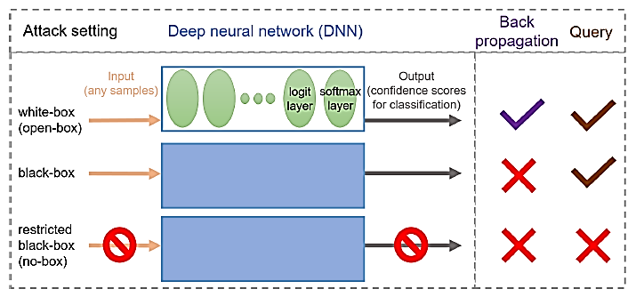
ZOO Attack
ZOO Attack
Taxonomy of AML attacks

Slide 45
Loss function
ZOO Attack
Loss function: the logit loss from the C&W approach is used
For targeted attack the loss is: $𝓁\left(x, t\right)=max\left\{{Z\left(x\right)}_{i}:i≠T\right\}−Z{\left(x\right)}_{T}$
$$p(x)$$
$$T$$
$$\left[\begin{matrix}\begin{matrix}0.05 \\ 0.02\end{matrix} \\ 0.02 \\ \begin{matrix}0.90 \\ 0.01\end{matrix}\end{matrix}\right]$$
safe
suggestive
explicit
drug
gore
$$\left[\begin{matrix}\begin{matrix}1 \\ 0\end{matrix} \\ 0 \\ \begin{matrix}0 \\ 0\end{matrix}\end{matrix}\right]$$
Black-box model
$$f(x)$$
$$x$$
Model prediction
Target class

Slide 46
Loss function
ZOO Attack
From probabilities to logits
We can recover the logits up to an additive constant
In the example below, the additive constant is +3.12
A Softmax Layer
3 = -0.12+3.12
-0.12
0.88
$$log⁡(y_{1})$$
1 = -2.12+3.12
-2.12
0.11
$$log⁡(y_{2})$$
-3 = -6.12+3.12
-6.12
0.01
$$log⁡(y_{3})$$

Slide 47
Loss function
ZOO Attack
The loss is: $𝓁\left(x, t\right)=max\left\{{Z\left(x\right)}_{i}:i≠T\right\}−Z{\left(x\right)}_{T}=(−0.11+c)−(−2.99+c)=−0.11−c+2.99−c=2.88$
Note that if $𝓁\left(x, t\right)<0$, then the targeted attack will be successful
To create attacks, minimize the loss of the target class
$$p(x)$$
$$T$$
$$Z\left(x\right)=log\left(p(x)\right)+c$$
$$\left[\begin{matrix}\begin{matrix}−2.99+c \\ not needed\end{matrix} \\ not needed \\ \begin{matrix}−0.11+c \\ not needed\end{matrix}\end{matrix}\right]$$
$$\left[\begin{matrix}\begin{matrix}0.05 \\ 0.02\end{matrix} \\ 0.02 \\ \begin{matrix}0.90 \\ 0.01\end{matrix}\end{matrix}\right]$$
safe
suggestive
explicit
drug
gore
$$\left[\begin{matrix}\begin{matrix}1 \\ 0\end{matrix} \\ 0 \\ \begin{matrix}0 \\ 0\end{matrix}\end{matrix}\right]$$
Logits
Model prediction
Target class

Slide 48
Loss function
ZOO Attack
The loss is: $𝓁\left(x, t\right)=max\left\{{Z\left(x\right)}_{i}:i≠T\right\}−Z{\left(x\right)}_{T}=\left(−1.20+c\right)−\left(−0.58+c\right)=−1.20+c+0.58−c=−0.62$
Since $𝓁\left(x, t\right)<0$, the targeted attack is successful
$$Z(x)$$
$$p(x)$$
$$T$$
$$\left[\begin{matrix}\begin{matrix}−0.58+c \\ not needed\end{matrix} \\ −1.20+c \\ \begin{matrix}not needed \\ not needed\end{matrix}\end{matrix}\right]$$
$$\left[\begin{matrix}\begin{matrix}0.56 \\ 0.03\end{matrix} \\ 0.30 \\ \begin{matrix}0.13 \\ 0\end{matrix}\end{matrix}\right]$$
safe
suggestive
explicit
drug
gore
$$\left[\begin{matrix}\begin{matrix}1 \\ 0\end{matrix} \\ 0 \\ \begin{matrix}0 \\ 0\end{matrix}\end{matrix}\right]$$
Logits
Model prediction
Target class

Slide 49
Loss function
ZOO Attack
For untargeted attack the loss is: $𝓁\left(x, t\right)=max\left\{{Z\left(x\right)}_{i}:i≠y\right\}−Z{\left(x\right)}_{y}$
The loss is: $𝓁\left(x, t\right)=\left(−1.52+c\right)−\left(−0.51+c\right)=−1.52+c+0.51−c=−1.01$
If $𝓁\left(x, t\right)>0$, then the untargeted attack will be successful
$$p(x)$$
$$y$$
$$Z\left(x\right)=log\left(p(x)\right)+c$$
$$\left[\begin{matrix}\begin{matrix}not needed \\ −1.52+c\end{matrix} \\ not needed \\ \begin{matrix}−0.51+c \\ not needed\end{matrix}\end{matrix}\right]$$
$$\left[\begin{matrix}\begin{matrix}0.05 \\ 0.22\end{matrix} \\ 0.02 \\ \begin{matrix}0.60 \\ 0.11\end{matrix}\end{matrix}\right]$$
safe
suggestive
explicit
drug
gore
$$\left[\begin{matrix}\begin{matrix}0 \\ 0\end{matrix} \\ 0 \\ \begin{matrix}1 \\ 0\end{matrix}\end{matrix}\right]$$
Logits
Model prediction
Ground truth label

Slide 50
Gradient Estimation
ZOO Attack
ZOO (zero order optimization) of the loss $𝓁\left(x, t\right)$
The gradient of the loss can be approximated by using the finite difference approach
$g=∇_{x}f\left(x\right)≈$ $\frac{f\left(x+h\right)−f\left(x−h\right)}{2h}$
I.e., if the intensity of a pixel $x_{i}$ is 150, and $h=10$, then we will query the model to give us the predictions for $f\left(150+10\right)=$ f$\left(160\right)$ and for $f\left(150−10\right)=$ f$\left(140\right)$, so we can estimate the gradient ${\hat{g_{i}}=∇}_{x_{i}}f\left(x\right)$ for the pixel $x_{i}$
Repeat for all pixels
E.g., for a 28×28 pixels = 784 pixels, we need to do 2 queries for each pixel, that is, we need to do $2∙784=1,568$ queries to estimate the gradient

Slide 51
Adversarial Attack
ZOO Attack
First, recall the Gradient Estimation attack
Similar to FGSM targeted white-box attack: $x=x_{0}−ε∙sign\left(∇_{x}f\left(x, T\right)\right)$
Single step attack: $x=x_{0}−ε∙sign\left(FD\left({Z\left(x\right)}_{y′}−Z{\left(x\right)}_{T},h\right)\right)$
Iterative attack: $x^{t+1}=Π\left(x_{0}^{t}+α∙sign\left(FD\left({Z\left(x\right)}_{y′}−Z{\left(x\right)}_{T},h\right)\right)\right)$
ZOO attack applies optimization
Similar to C&W targeted white-box attack
minimize ${\left\|x−x_{0}\right\|}_{2}^{2}+c∙\left({Z\left(x\right)}_{y′}−Z{\left(x\right)}_{T}\right)$
$$subject to x∈\left[0,1\right]$$
ZOO solves the optimization problem with the estimated loss (with a slight abuse of the notation) based on:
minimize ${\left\|x−x_{0}\right\|}_{2}^{2}+c∙FD\left({Z\left(x\right)}_{y′}−Z{\left(x\right)}_{T},h\right)$
$$subject to x∈\left[0,1\right]$$
Adam optimization is used to solve the problem

Slide 52
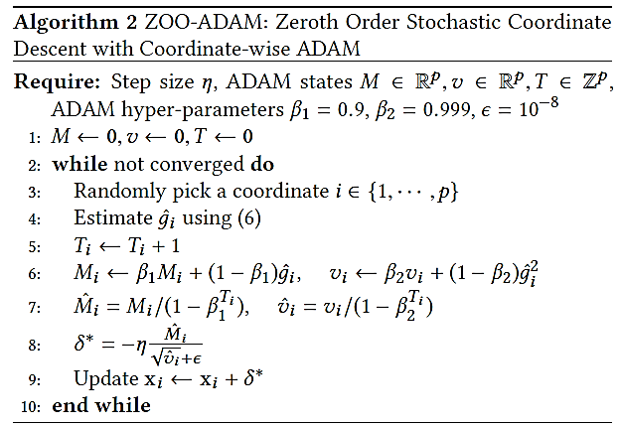
Adam Optimization Attack
ZOO Attack
Algorithm

Slide 53
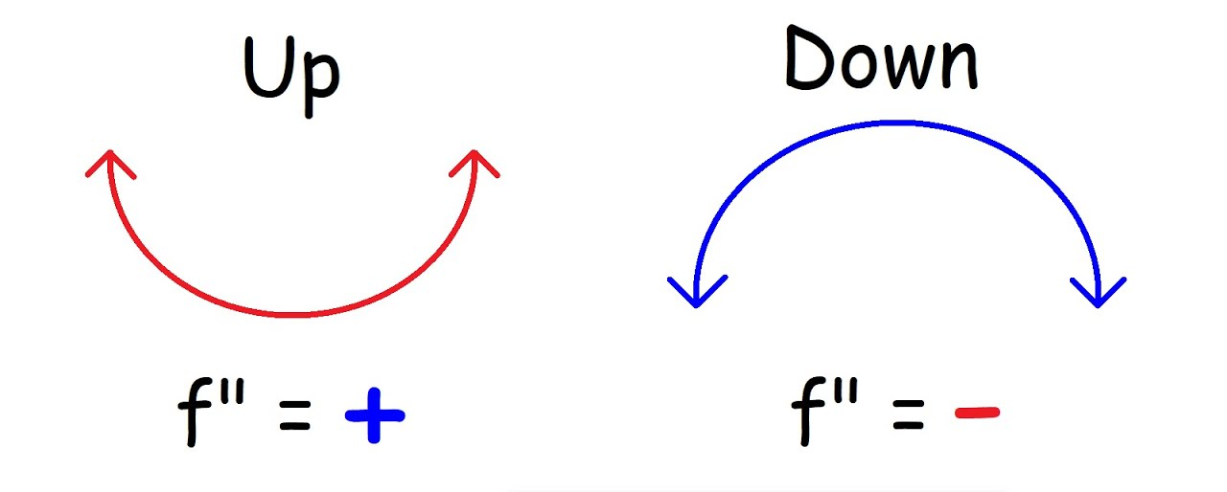
Newton Optimization Attack
ZOO Attack
The paper proposed one more similar approach, that instead of Adam optimization uses Newton optimization method
Newton optimization method finds a minimum of $f(x)$ by performing the following iterations: $x_{k+1}=x_{k}−\frac{f^{′}(x_{k})}{f^{′′}(x_{k})}$
The approximation of the Hessian matrix of the model is estimated based on
$h=\frac{∂^{2}}{∂x^{2}}f\left(x\right)≈$ $\frac{f\left(x+h\right)−2f\left(x\right)+f\left(x−h\right)}{h^{2}}$
If $h>0$, then the loss function is convex, update is based on $g/h$
If $h≤0$, then the loss function is concave, update is based only on the gradient $g$
Convex
Concave
$$\frac{∂^{2}f\left(x\right)}{∂x^{2}}>0$$
$$\frac{∂^{2}f\left(x\right)}{∂x^{2}}<0$$

Slide 54
Newton Optimization Attack
ZOO Attack
Algorithm for the Newton optimization attack

Slide 55
Experimental Evaluation
ZOO Attack
On MNIST and Cifar-10, ZOO attacks achieve almost 100% success rate
The added $L_{2}$ perturbations are comparable to C&W white-box attack
As expected, the time for generating adversarial samples is longer than white-box attack

Slide 56
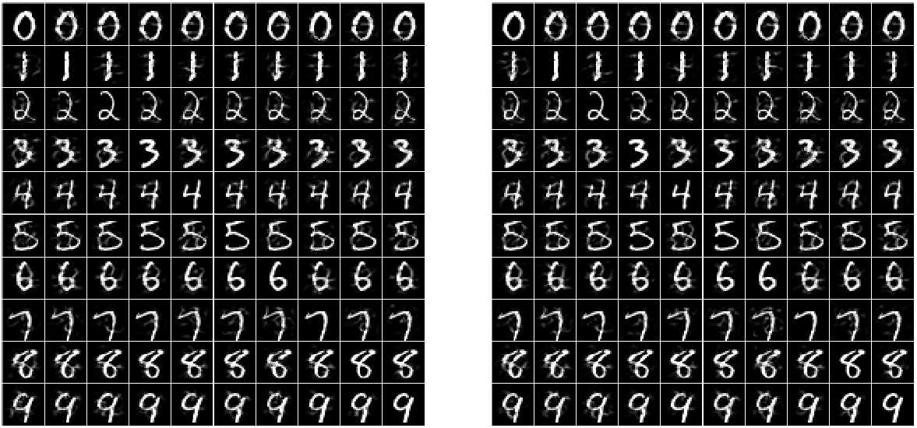
Experimental Evaluation
ZOO Attack
Comparison between C&W white-box (left) and ZOO attack (right)

Slide 57
Queries Reduction
ZOO Attack
Goal: reduce the number of queries
For a 28×28 pixels, we need $2∙784=1,568$ queries to estimate the gradient
Recall that PCA and random sets of pixels used in Gradient Estimation attack
The proposed approach starts with reduced resolution, and the resolution is progressively increased (referred to as hierarchical attack)
E.g., an image of a size 299×299 pixels is used
Divide the image into 8×8 regions
Make only 64 queries to estimate the gradients
Optimize until the loss start decreasing
Increase to 16×16 regions
Make queries and optimize until the loss start decreasing
Increase to 32×32 regions
Make queries and optimize until the loss start decreasing
…

Slide 58
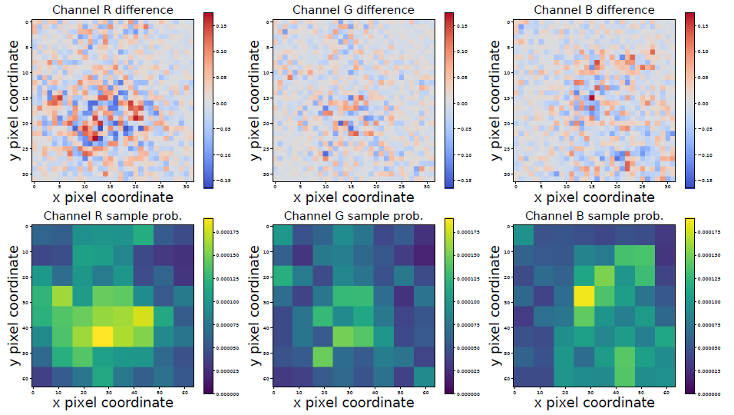
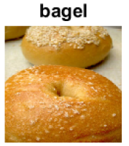
Queries Reduction
ZOO Attack
Also, apply importance sampling
Estimate the gradient only for the most important regions in an image
E.g., corner pixels are less important for this image

Slide 59
Experimental Evaluation
ZOO Attack
ImageNet untargeted attack
Recall that there are 1,000 classes in ImageNet
InceptionV3 model used
Required about 192,000 queries per image, 20 minutes per image

Slide 60
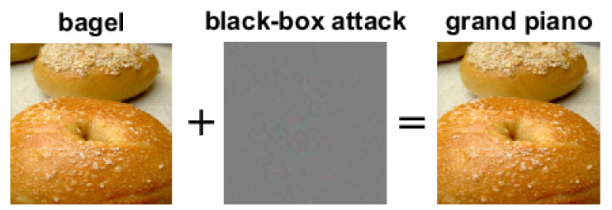
Examples
ZOO Attack
Targeted attack
The added perturbations are imperceptible

Slide 61
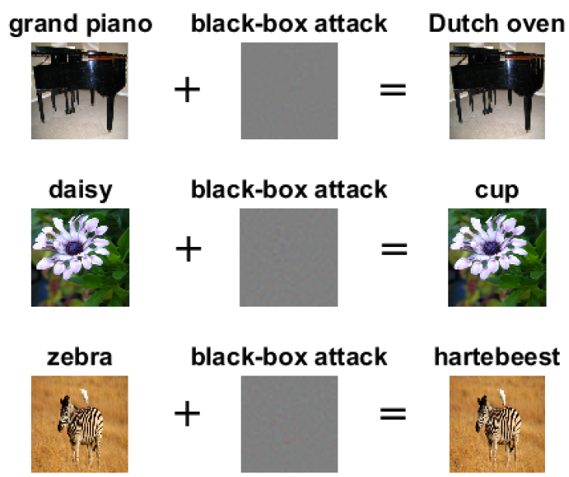
Examples
ZOO Attack
Untargeted attack

Slide 62
Transfer-based Attacks
Transfer-based Attacks
Transfer-based attacks (or transferability attacks)
The adversary does not query the model
Substitute model attack (or surrogate local model attack)
Papernot et al. (2016) Transferability in Machine Learning: from Phenomena to Black-Box Attacks using Adversarial Samples
Uses FGSM for attacking a substitute model, and afterward transfer the generated adversarial samples to the target model
Ensemble of local models attack
Liu et al. (2017) Delving into Transferable Adversarial Examples and Black-box Attacks
Uses an ensemble of local models for generating adversarial examples

Slide 63
Substitute Model Attack
Substitute Model Attack
Transferability between the following ML models is explored:
Deep neural networks (DNNs)
Logistic regression (LR)
Support vector machines (SVM)
Decision trees (DT)
k-Nearest neighbors (kNN)
Ensembles (Ens)
Evaluated on MNIST

Slide 64
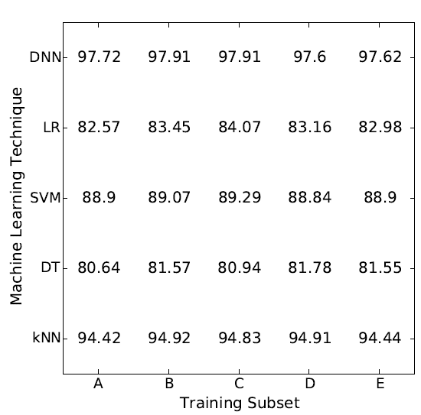
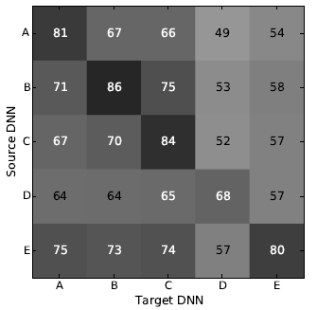
Substitute Model Attack
Substitute Model Attack
Intra-technique variability
E.g., adversarial examples created by one DNN are transferred to another DNN
Model accuracies (left) and attack success rate (right)

Slide 65
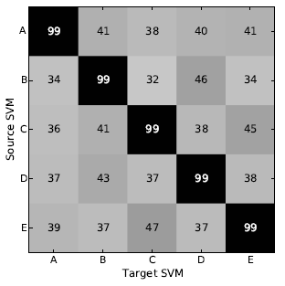
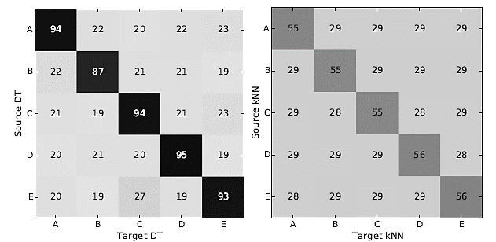
Substitute Model Attack
Substitute Model Attack
Intra-technique variability
Differentiable models like DNNs and LR are more vulnerable to intra-technique transferability than non-differentiable models like SVMs, DTs, and kNNs

Slide 66
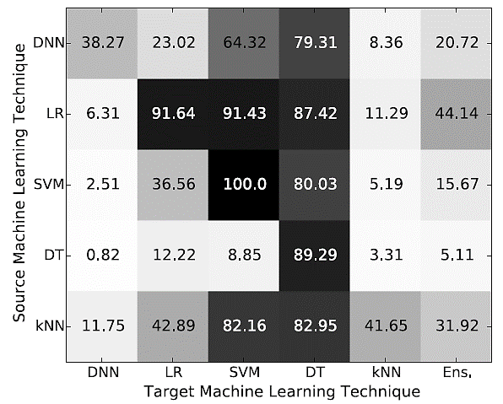
Substitute Model Attack
Substitute Model Attack
Cross-technique variability
E.g., adversarial examples created by DNN are transferred to other ML models
The most vulnerable model is DTs: misclassification rates from 79.31% to 89.29%
The most resilient are DNNs: misclassification between 0.82% and 38.27%

Slide 67
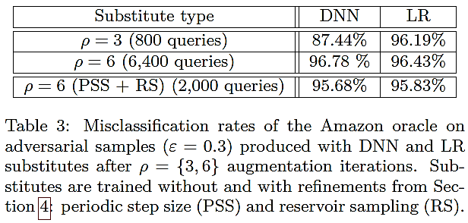
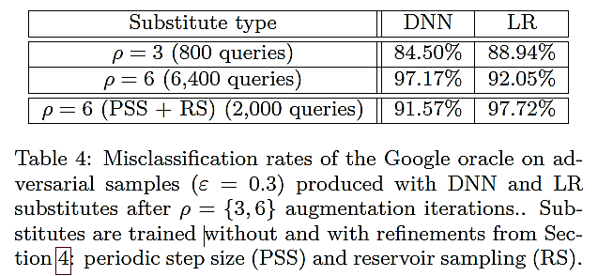
Substitute Model Attack
Substitute Model Attack
Attacks on Amazon ML Web Services (upper table) and Google Cloud ML Prediction Oracle (lower table)

Slide 68
Ensemble of Local Models Attack
Ensemble of Local Models Attack
Ensemble of local models attack
Liu et al. (2017) Delving into Transferable Adversarial Examples and Black-box Attacks
Observations regarding transferability
Transferable non-targeted adversarial examples are easy to find
However, targeted adversarial examples rarely transfer with their target labels
The proposed approach allows transferring targeted adversarial examples

Slide 69
Ensemble of Local Models Attack
Ensemble of Local Models Attack
On ImageNet, targeted examples do not transfer across models
Only a small percentage of adversarial images retain the target label when transferred to other models
RMSD is the average perturbation of the used adversarial images
On the other hand, untargeted examples transfer well

Slide 70
Ensemble of Local Models Attack
Ensemble of Local Models Attack
Hypothesis: if an adversarial image remains adversarial for multiple models, it is more likely to transfer to other models as well
Approach: solve the following optimization problem (for targeted attack):
The problem is similar to C&W
$x$ is a clean image
$x^{∗}$ is an adversarial image
$d\left(x,x^{∗}\right)$ is distance function
$J_{1},J_{2},…,$ $J_{k}$ are white-box models in the ensemble
$α_{1},α_{2},…,$ $α_{k}$ are the ensemble weights
$−log\left(α_{1}J_{1}∙1_{y^{∗}}\right)$ is the cross-entropy loss between the prediction by model $J_{1}$ and the one-hot vector for the target class $1_{y^{∗}}$

Slide 71
Targeted Attack Evaluation
Ensemble of Local Models Attack
Targeted attack using the ensemble attack

Slide 72
Non-targeted Attack Evaluation
Ensemble of Local Models Attack
Non-targeted ensemble attack results

Slide 73
HopSkipJump Attack
Other Black-box Evasion Attacks
HopSkipJump Attack
Chen and Jordan (2019) HopSkipJumpAttack: A Query-efficient Decision-based Adversarial Attack
This attack is an extension of the Boundary Attack
I.e., it is a decision-based attack, has access only to the predicted output class
Requires fewer queries than the Boundary Attack
It includes both untargeted and targeted attacks
Proposes a a novel approach for estimation of the gradient direction along the decision boundary

Slide 74
HopSkipJump Attack
Other Black-box Evasion Attacks
Start from an adversarial image $\tilde{x_{t}}$
Perform a binary search to find the boundary
Estimate the gradient direction at the boundary point $x_{t}$
Perform a step-size search, and update to the next image ${\tilde{x}}_{t+1}$
Search again for the next boundary point $x_{t+1}$
Repeat until the closest adversarial image to the original image x* is found

Slide 75
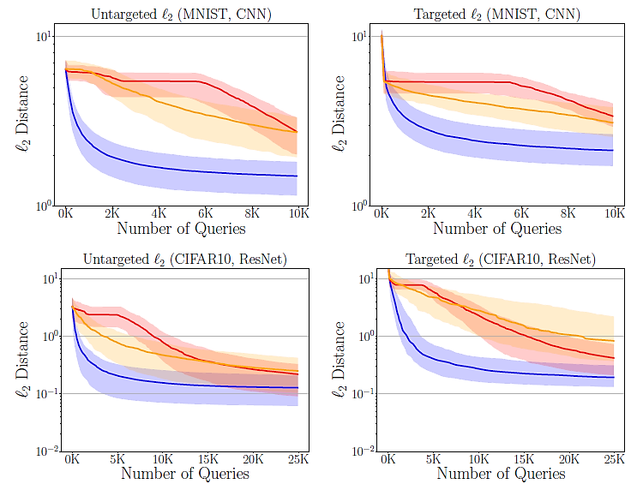
HopSkipJump Attack
Other Black-box Evasion Attacks
Experimental evaluation
Comparison to Boundary attack and Opt attack on CI-FAR-100
Top row (CNN), bottom row (ResNet)

Slide 76
HopSkipJump Attack
Other Black-box Evasion Attacks
Untargeted attack
2nd to 9th columns: images at 100, 200, 500, 1K, 2K, 5K, 10K, 25K model queries
Targeted attack

Slide 77
Simple Black-box Attack
Other Black-box Evasion Attacks
Simple Black-box Attack
Guo et al. (2019) Simple Black-box Adversarial Attacks
A.k.a. SimBA attack
Score-based attack
Focus on query efficiency
Both targeted and untargeted attacks
Approach:
Use random orthonormal perturbations to approach the decision boundary

Slide 78
Simple Black-box Attack
Other Black-box Evasion Attacks
Steps:
Randomly sample perturbation vectors from a predefined orthonormal basis
Check the confidence score to find out if it is pointing toward or away from the decision boundary
Perturb the image by adding or subtracting the vector
Goal:
Each iteration moves the image away from the original image, and towards the decision boundary

Slide 79
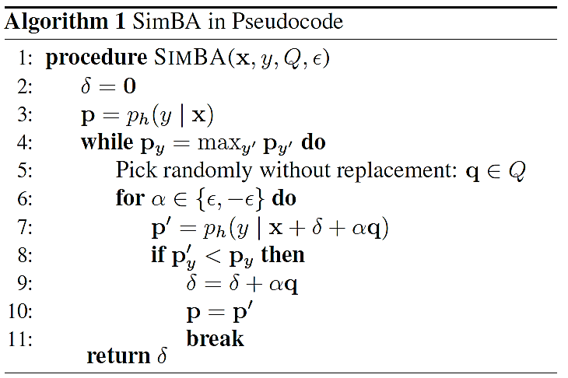
Simple Black-box Attack
Other Black-box Evasion Attacks
Algorithm

Slide 80
Simple Black-box Attack
Other Black-box Evasion Attacks
Perturbation vectors are selected to be orthonormal
I.e., the random directions for each pixel do not cancel each other out, or amplify each other
For orthonormal vectors x and y, the dot product is $x∙y=0$
The angle between the vectors is 90 degrees
I.e., they are orthogonal
How to choose orthonormal perturbation vector?
One inefficient option are the vectors [1,0,0,…,0], [0,1,0,…,0], [0,0,1,…,0],…,[0,0,0,…,1]
I.e., only one pixel is changed at a time
The authors propose an approach called Discrete Cosine Transform (DCT)
It is based on frequency coefficients that correspond to magnitudes of cosine functions
Hence, many pixels will change the direction at each step

Slide 81
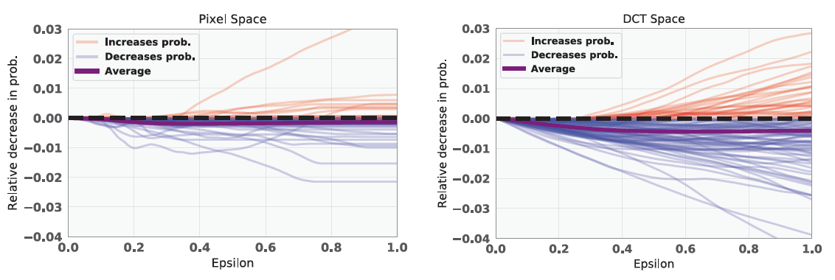
Simple Black-box Attack
Other Black-box Evasion Attacks
The average change of the output scores (probabilities) is larger when the DCT approach is employed
In comparison to changing individual pixels

Slide 82
Simple Black-box Attack
Other Black-box Evasion Attacks
Experimental evaluation
High success rate achieved

Slide 83
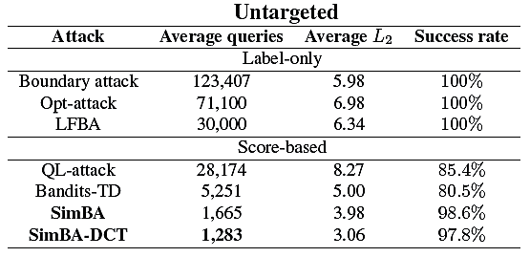
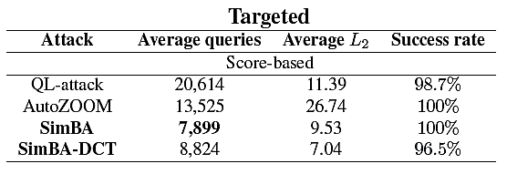
Simple Black-box Attack
Other Black-box Evasion Attacks
Experimental evaluation
Good query-efficiency

Slide 84
Simple Black-box Attack
Other Black-box Evasion Attacks
Attack on Google Cloud Vision API
Checked on 50 random images
70% success rate after 5,000 queries

Slide 85
Additional References
Nicolae et al. (2019) Adversarial Robustness Toolbox v1.0.0. https://arxiv.org/abs/1807.01069
Xu et al. (2019) Adversarial Attacks and Defenses in Images, Graphs and Text: A Review https://arxiv.org/abs/1909.08072

