Slide 1
CS 404/504
Special Topics: Adversarial Machine Learning
Dr. Alex Vakanski

Slide 2
Lecture 7
GANs for Adversarial Machine Learning

Slide 3
Lecture Outline
Introduction to Generative Adversarial Networks (GANs)
GAN-based attacks
AdvGAN by Xiao (2018) Generating Adversarial Examples with Adversarial Networks
GAN-based defenses
Defense-GAN by Samangouei (2018) Defense-GAN: Protecting Classifiers Against Adversarial Attacks Using Generative Models
Other GAN-based attacks
Adversarial examples for VAE-GANs
AI-GAN (Attack-Inspired GAN)
Other GAN-based defenses
APE-GAN (Adversarial Perturbation Elimination GAN)

Slide 4
Introduction to GANs
Kurt A Vedros
September 28, 2021

Slide 5
Outline
Basic Generative Adversarial Network (GANs)
Structure
Training
Loss Function
Challenges
Variants of GANs
Wasserstein
Conditional
Pix2Pix
Cycle
Style
Text-to-Image Synthesis

Slide 6
Generative Adversarial Networks (GANs)
Intro to GANs
Kurt A Vedros
Basic GANs
Structure
Training
Loss Function
Challenges
Variants of GANs
Wasserstein
Conditional
Pix2Pix
Cycle
Style
Text-to-Image
Synthesis
Original paper by Ian Goodfellow 2014. “Generative Adversarial Networks”
Neural network architecture for generative modeling.
Trained on two neural network models.
Generator
Discriminator.

Slide 7
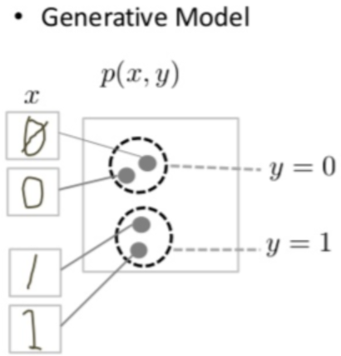
Structure
Intro to GANs
Kurt A Vedros
Basic GANs
Structure
Training
Loss Function
Challenges
Variants of GANs
Wasserstein
Conditional
Pix2Pix
Cycle
Style
Text-to-Image
Synthesis
Generative Model
Creates new data instances
Captures the joint probability p(X, Y)
Goal: produce fake data that fools the discriminator.
https://developers.google.com/machine-learning/gan/gan_structure

Slide 8
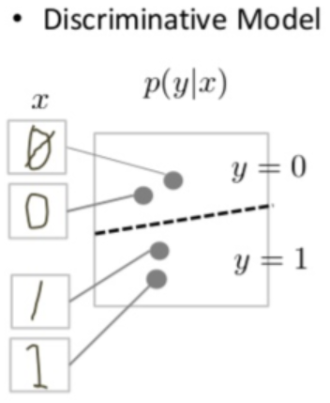
Structure
Intro to GANs
Kurt A Vedros
Basic GANs
Structure
Training
Loss Function
Challenges
Variants of GANs
Wasserstein
Conditional
Pix2Pix
Cycle
Style
Text-to-Image
Synthesis
Discriminative Model
Identify real data from fake data
Captures the conditional probability p(Y|X)
Goal: accurately classify the data as real or fake
https://developers.google.com/machine-learning/gan/gan_structure

Slide 9
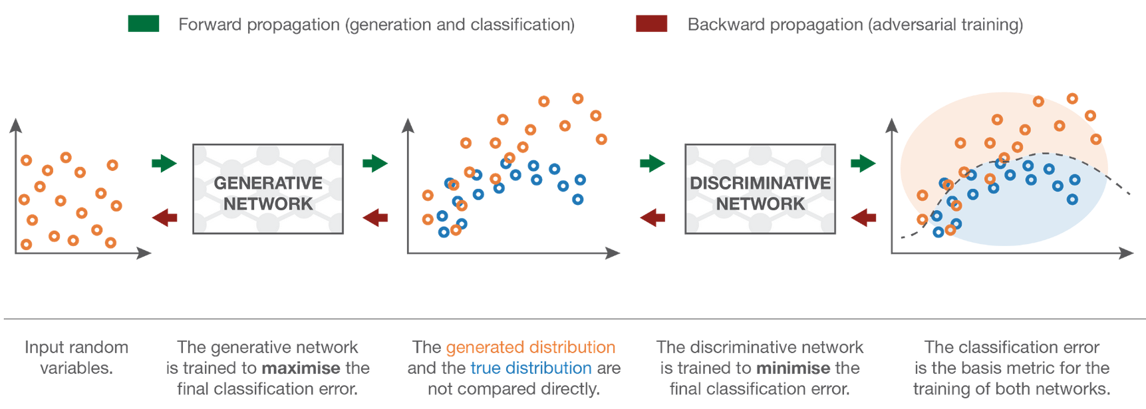
Structure
Intro to GANs
Kurt A Vedros
Basic GANs
Structure
Training
Loss Function
Challenges
Variants of GANs
Wasserstein
Conditional
Pix2Pix
Cycle
Style
Text-to-Image
Synthesis
Generative and Discriminative model compete till the Discriminative model can no longer tell the difference between the real and generated data.
Goal create new data instances that resemble the training data.
https://towardsdatascience.com/understanding-generative-adversarial-networks-gans-cd6e4651a29
https://developers.google.com/machine-learning/gan/gan_structure

Slide 10
Structure
Intro to GANs
Kurt A Vedros
Basic GANs
Structure
Training
Loss Function
Challenges
Variants of GANs
Wasserstein
Conditional
Pix2Pix
Cycle
Style
Text-to-Image
Synthesis
https://developers.google.com/machine-learning/gan/gan_structure

Slide 11
Training
Intro to GANs
Kurt A Vedros
Basic GANs
Structure
Training
Loss Function
Challenges
Variants of GANs
Wasserstein
Conditional
Pix2Pix
Cycle
Style
Text-to-Image
Synthesis
Discriminator
Updates weights through backpropagation from the discriminator loss through the discriminator network.
Generator
Backpropagates through both the discriminator and generator to obtain the gradients, and uses the gradients to change the generator weights.
Trained by alternating every one or more epochs.
The other one is constant while trying to adjust the other.
Generator succeeds when discriminator has a 50% accuracy.
If GANs continues to train past 50%, quality collapses.

Slide 12
Loss Functions
Intro to GANs
Kurt A Vedros
Basic GANs
Structure
Training
Loss Function
Challenges
Variants of GANs
Wasserstein
Conditional
Pix2Pix
Cycle
Style
Text-to-Image
Synthesis
Capture the difference between two distributions in GAN loss functions
One Generator reflects the distribution of fake data.
One Discriminator reflects distribution of real data
Does not need to be the same.
Minimax Loss
Generator minimizes while Discriminator Maximizes.
D(x): discriminator’s estimate of probability that real data x is real.
G(z): Generator’s output when given noise z.
D(G(z)): discriminator’s estimate of probability that fake instance is real.
Ex: expected value over all real instances.
Ez: expected value over all fake instances.

Slide 13
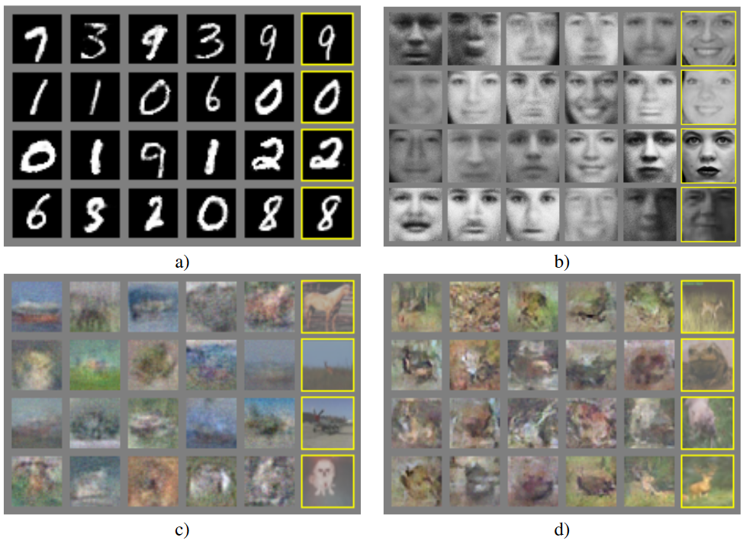
Examples
Intro to GANs
Kurt A Vedros
Basic GANs
Structure
Training
Loss Function
Challenges
Variants of GANs
Wasserstein
Conditional
Pix2Pix
Cycle
Style
Text-to-Image
Synthesis
Generative Adversarial Nets, By Ian J. Goodfellow

Slide 14
Challenges of GANs
Intro to GANs
Kurt A Vedros
Basic GANs
Structure
Training
Loss Function
Challenges
Variants of GANs
Wasserstein
Conditional
Pix2Pix
Cycle
Style
Text-to-Image
Synthesis
Vanishing Gradients
If discriminator too good, generator training can fail due to vanishing gradients.
Mode Collapse
Generator produces one or small set of output.
Discriminator learns to reject only those output.
Next generator iteration find the most plausible output for precise discriminator.
Failure to Converge
Discriminator feedback gets less meaningful over time. If trained past the point when discriminator giving random feedback, generator starts to train on the random feedback.

Slide 15
Wasserstein GANs
Intro to GANs
Kurt A Vedros
Basic GANs
Structure
Training
Loss Function
Challenges
Variants of GANs
Wasserstein
Conditional
Pix2Pix
Cycle
Style
Text-to-Image
Synthesis
“Wasserstein GAN”, Martin Arjovsky 2017.
Modifies GANs loss function.
Discriminator changed to Critic, does not classify. [Fake, Real]
Outputs a numbers. Bigger = Real, Lower = Fake
Critic Loss: D(x) – D(C(z))
Maximize difference between output on real and fake.
Generator Loss: C(G((z))
Maximizes the Critic output for fake instances.
Benefits
Less vulnerable to vanishing gradient and Mode Collapse.

Slide 16
Conditional GANs
Intro to GANs
Kurt A Vedros
Basic GANs
Structure
Training
Loss Function
Challenges
Variants of GANs
Wasserstein
Conditional
Pix2Pix
Cycle
Style
Text-to-Image
Synthesis
“Conditional Generative Adversarial Nets” by Mehdi Mirza 2014
CGANs can control what images the generator produce
Benefits
Converge faster.
Control the output of the generator at test time by giving labels for the images.
https://www.educative.io/edpresso/what-is-a-conditional-gan-cgan

Slide 17
Conditional GANs
Intro to GANs
Kurt A Vedros
Basic GANs
Structure
Training
Loss Function
Challenges
Variants of GANs
Wasserstein
Conditional
Pix2Pix
Cycle
Style
Text-to-Image
Synthesis
https://learnopencv.com/conditional-gan-cgan-in-pytorch-and-tensorflow/

Slide 18
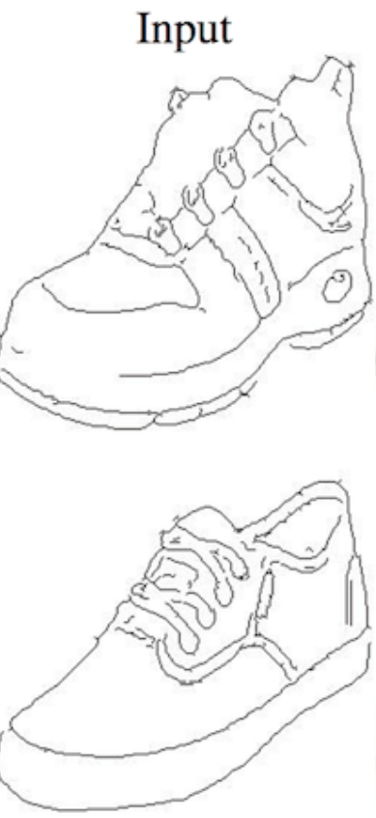
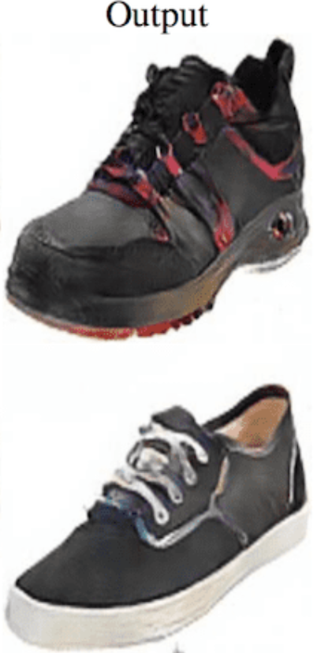
Image-to-Image Translation
Intro to GANs
Kurt A Vedros
Basic GANs
Structure
Training
Loss Function
Challenges
Variants of GANs
Wasserstein
Conditional
Pix2Pix
Cycle
Style
Text-to-Image
Synthesis
The task of translating one possible representation of an image into another
“Image-to-Image Translation with Conditional Adversarial Networks”, By Phillip Isola

Slide 19
Pix2Pix GANs
Intro to GANs
Kurt A Vedros
Basic GANs
Structure
Training
Loss Function
Challenges
Variants of GANs
Wasserstein
Conditional
Pix2Pix
Cycle
Style
Text-to-Image
Synthesis
“Image-to-Image Translation With Conditional Adversarial Networks”, by Phillip Isola 2016.
Image-to-image translation approach.
Generator uses a U-Net Model.
Discriminator can use L1 or L2 loss but original paper recommends the uses of PatchGAN
“Image-to-Image Translation with Conditional Adversarial Networks” by Phillip Isola
“Image-to-Image Translation with Conditional Adversarial Networks” by Phillip Isola

Slide 20
Patch GANs
Intro to GANs
Kurt A Vedros
Basic GANs
Structure
Training
Loss Function
Challenges
Variants of GANs
Wasserstein
Conditional
Pix2Pix
Cycle
Style
Text-to-Image
Synthesis
Deep convolutional neural network designed to classify patches of an input image as real or fake instead of the entire image.
Tries to classify each NxN patch in an image is real or fake
Creates single feature map of real/fake predictions that can be averaged to give a single score.
Patch size of 70x70 was found to be effective across a range of image-to-image translation tasks
Benefits
Fixes the problem that L1 and L2 loss produces blurry results.
“Image-to-Image Translation with Conditional Adversarial Networks” by Phillip Isola

Slide 21
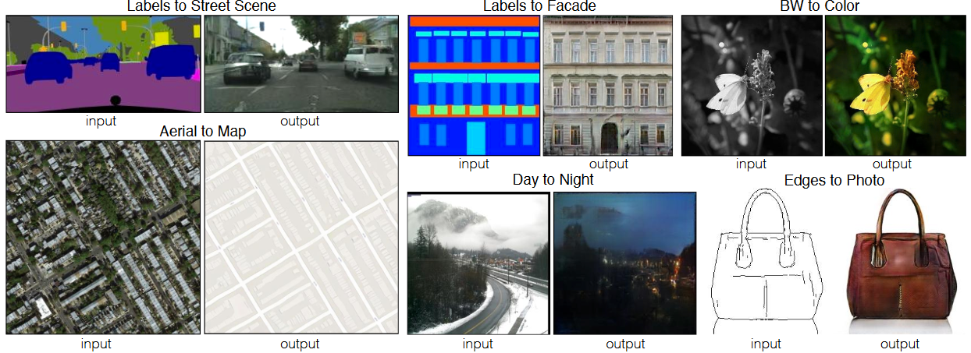
Pix2Pix GANs
Intro to GANs
Kurt A Vedros
Basic GANs
Structure
Training
Loss Function
Challenges
Variants of GANs
Wasserstein
Conditional
Pix2Pix
Cycle
Style
Text-to-Image
Synthesis
“Image-to-Image Translation with Conditional Adversarial Networks”, By Phillip Isola

Slide 22
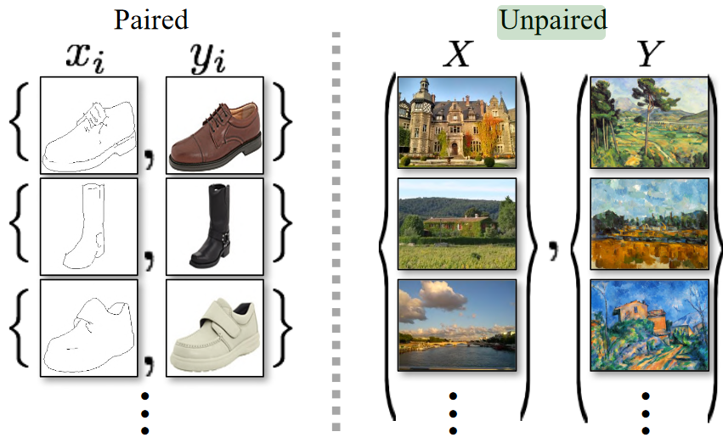
Unpaired Image-to-Image Translation
Intro to GANs
Kurt A Vedros
Basic GANs
Structure
Training
Loss Function
Challenges
Variants of GANs
Wasserstein
Conditional
Pix2Pix
Cycle
Style
Text-to-Image
Synthesis
Process of performing image-to-image translation with the training sets input not having a direct representation to the desired output.
“Unpaired Image-to-Image Translation using Cycle-Consistent Adversarial Networks” by Jun-Yan Zhu

Slide 23
CycleGANs
Intro to GANs
Kurt A Vedros
Basic GANs
Structure
Training
Loss Function
Challenges
Variants of GANs
Wasserstein
Conditional
Pix2Pix
Cycle
Style
Text-to-Image
Synthesis
“Unpaired Image-to-Image Translation using Cycle-Consistent Adversarial Networks”, by Jun-Yan Zhu
Unpaired Image-to-Image Translation approach.
Structure
Consider transferring Image set A (summer) to Image set B (Winter)
One set of Generator and Discriminator to translate A to B.
One set of Generator and Discriminator to translate B to A.
Cycle-consistency loss for both outputs

Slide 24
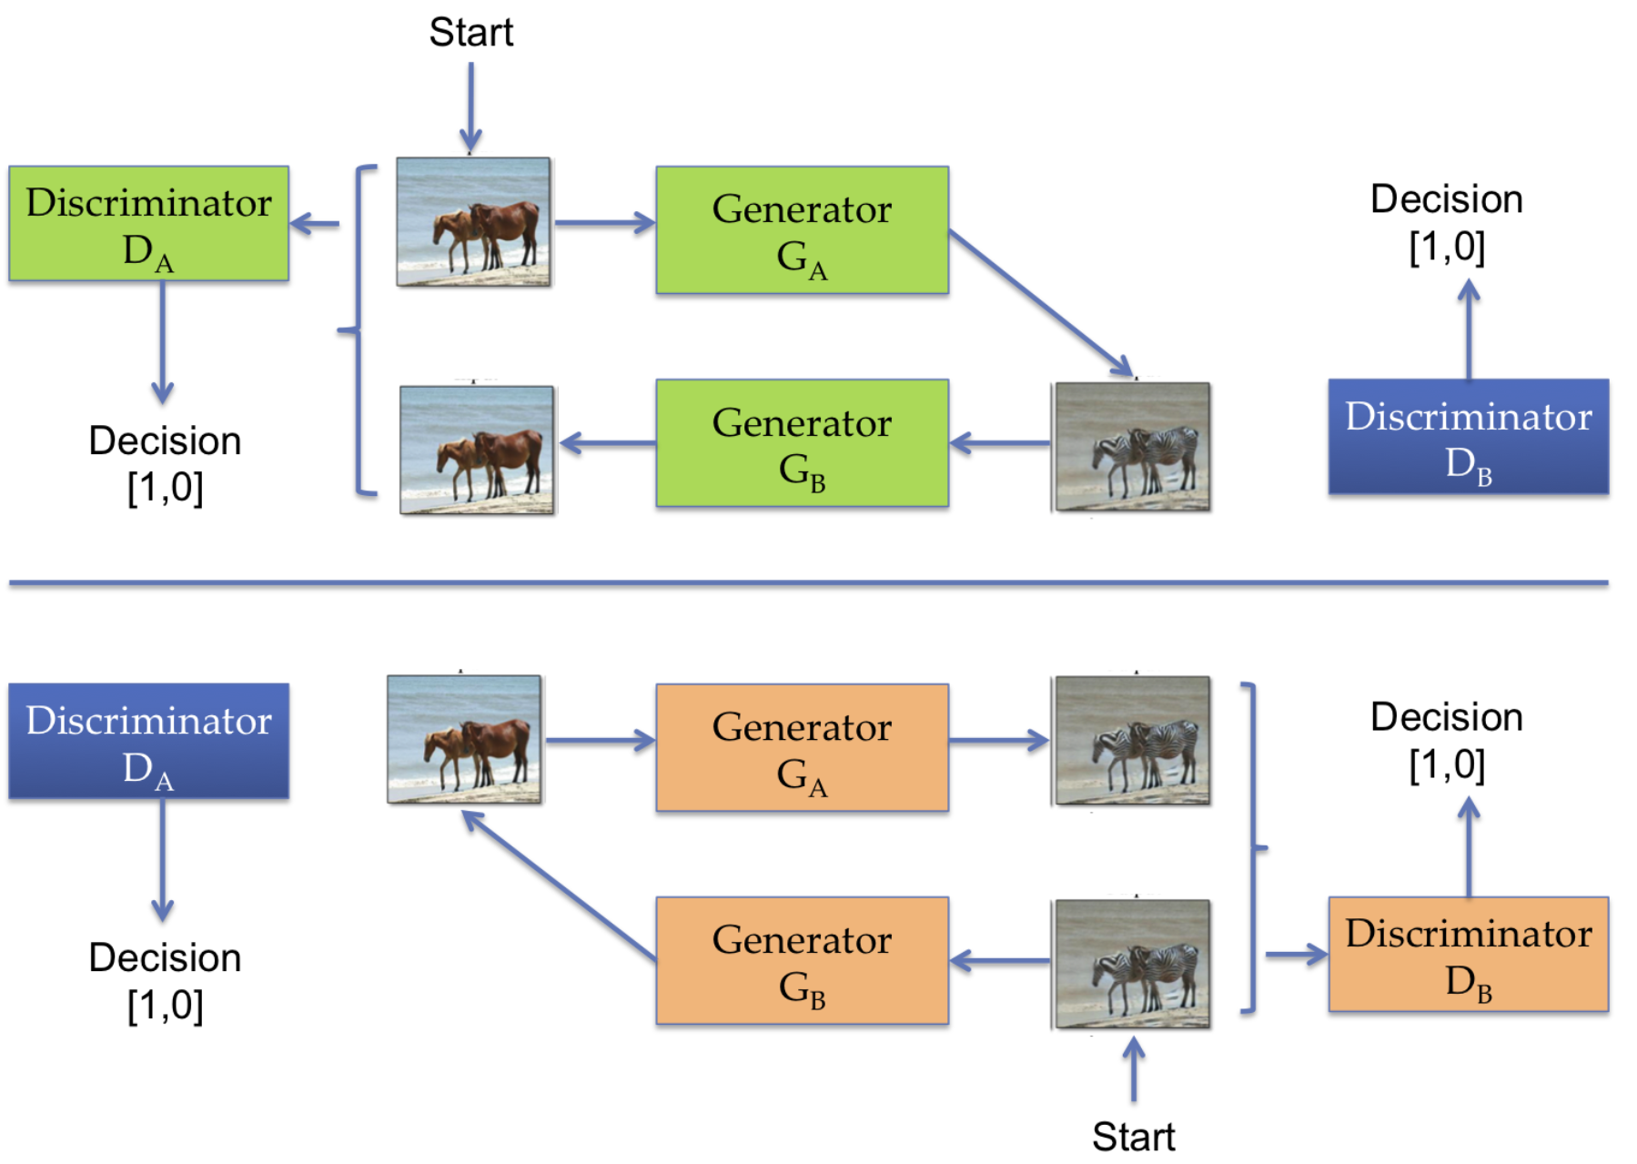
CycleGANs
Intro to GANs
Kurt A Vedros
Basic GANs
Structure
Training
Loss Function
Challenges
Variants of GANs
Wasserstein
Conditional
Pix2Pix
Cycle
Style
Text-to-Image
Synthesis
https://www.oreilly.com/library/view/hands-on-artificial-intelligence/9781788836067/c2e7d914-4e45-4528-8627-c590d19107ef.xhtml
“Unpaired Image-to-Image Translation using Cycle-Consistent Adversarial Networks” by Jun-Yan Zhu

Slide 25
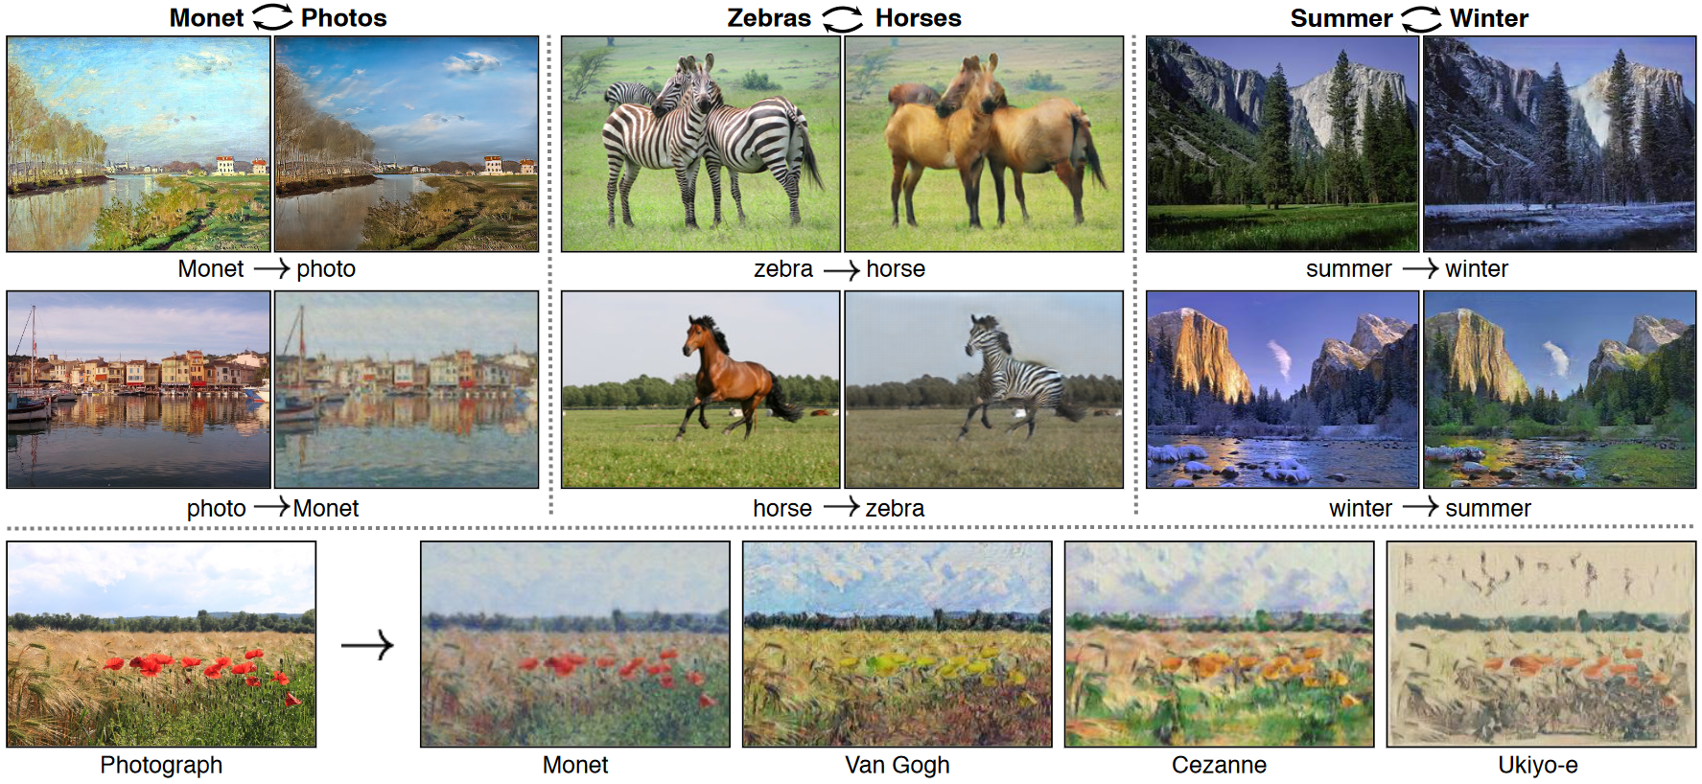
CycleGANs
Intro to GANs
Kurt A Vedros
Basic GANs
Structure
Training
Loss Function
Challenges
Variants of GANs
Wasserstein
Conditional
Pix2Pix
Cycle
Style
Text-to-Image
Synthesis
“Unpaired Image-to-Image Translation using Cycle-Consistent Adversarial Networks” by Jun-Yan Zhu

Slide 26
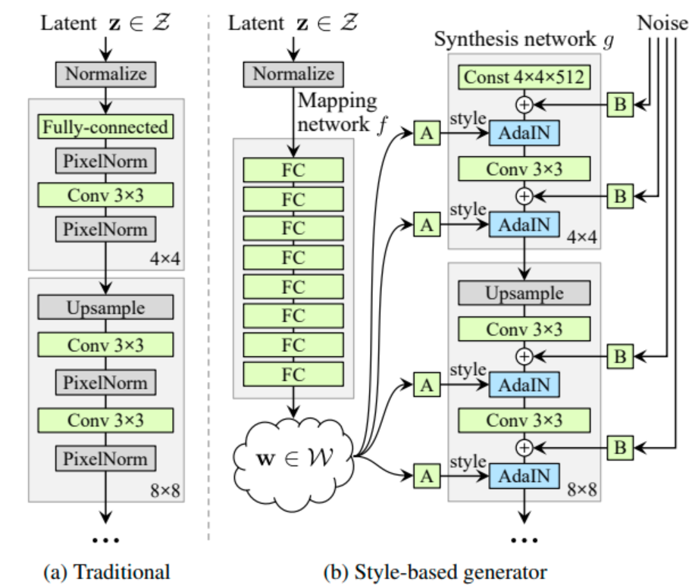
StyleGANs
Intro to GANs
Kurt A Vedros
Basic GANs
Structure
Training
Loss Function
Challenges
Variants of GANs
Wasserstein
Conditional
Pix2Pix
Cycle
Style
Text-to-Image
Synthesis
Learns to separate different aspects (Style) of the images.
Coarse Style: pose, hair, face shape
Middle Style: facial features, eyes
Fine Style: Color scheme
Changes from traditional GANS.
Baseline progressive GAN structure.
Bi-linear Sampling.
Mapping Network
Removal Latent input
Addition Noise
Mixing Regularization.
“A Style-Based Generator Architectures for Generative Adversarial Networks” by Tero Karras

Slide 27
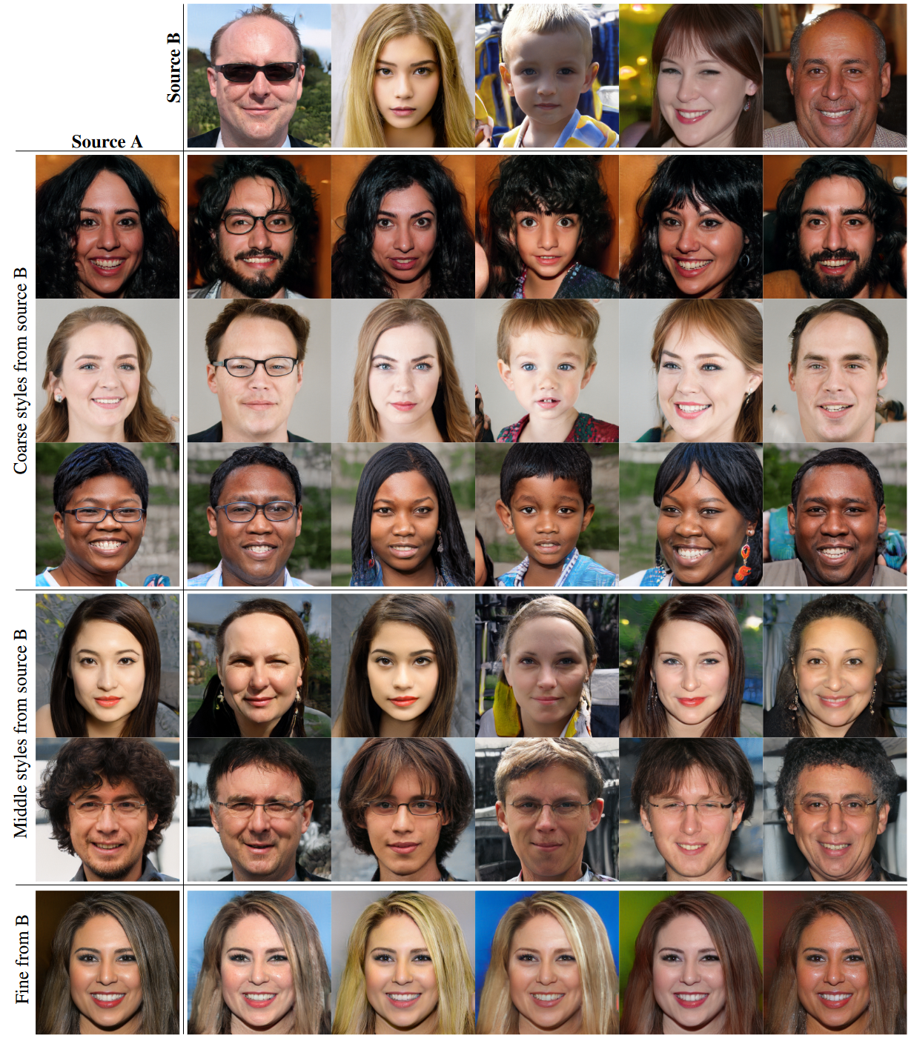
StyleGANs
Intro to GANs
Kurt A Vedros
Basic GANs
Structure
Training
Loss Function
Challenges
Variants of GANs
Wasserstein
Conditional
Pix2Pix
Cycle
Style
Text-to-Image
Synthesis
“A Style-Based Generator Architectures for Generative Adversarial Networks” by Tero Karras

Slide 28
Text-to-Image Synthesis GANs
Intro to GANs
Kurt A Vedros
Basic GANs
Structure
Training
Loss Function
Challenges
Variants of GANs
Wasserstein
Conditional
Pix2Pix
Cycle
Style
Text-to-Image
Synthesis
Generates images based of textual description
Input pair of image and text embeddings.
Discriminator
Predicts image is fake or real
Likelihood that image and text align

Slide 29
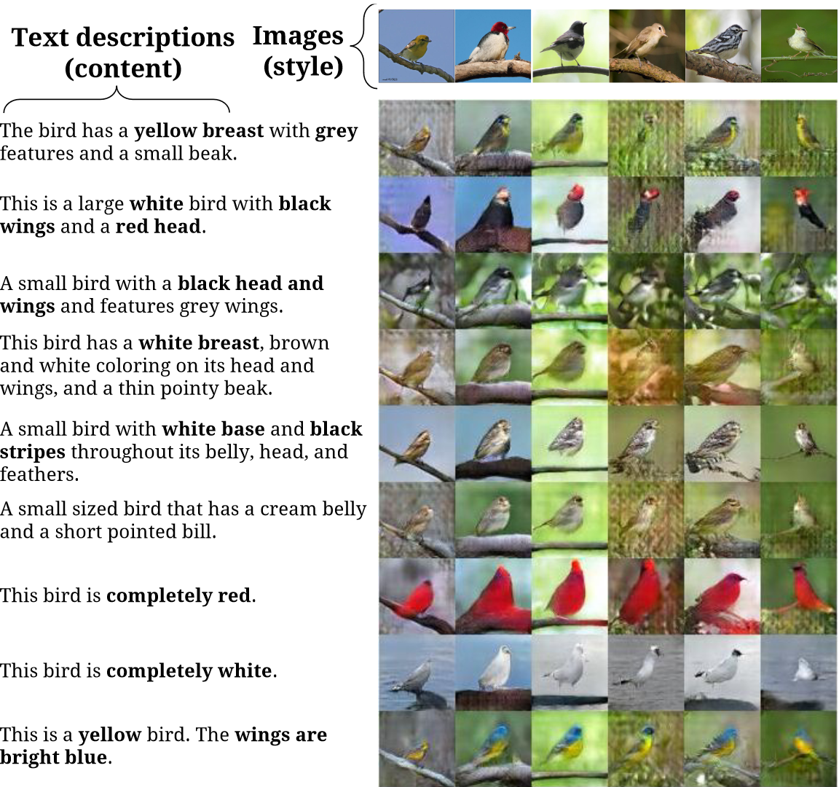
Text-to-Image Synthesis GANs
Intro to GANs
Kurt A Vedros
Basic GANs
Structure
Training
Loss Function
Challenges
Variants of GANs
Wasserstein
Conditional
Pix2Pix
Cycle
Style
Text-to-Image
Synthesis
“Generative Adversarial Test to Image Synthesis” by Scott Reed

Slide 30
References
Sites
https://developers.google.com/machine-learning/gan
https://towardsdatascience.com/understanding-generative-adversarial-networks-gans-cd6e4651a29
https://www.analyticsvidhya.com/blog/2021/05/stylegan-explained-in-less-than-five-minutes/
https://www.educative.io/edpresso/what-is-a-conditional-gan-cgan
https://www.oreilly.com/library/view/hands-on-artificial-intelligence/9781788836067/c2e7d914-4e45-4528-8627-c590d19107ef.xhtml
Papers
Generative Adversarial Nets, https://arxiv.org/abs/1406.2661
Wasserstein GAN, https://arxiv.org/abs/1701.07875
Conditional Adversarial Nets, https://arxiv.org/abs/1411.1784
Image-to-Image Translation With Conditional Adversarial Networks, https://arxiv.org/abs/1611.07004
A Style-Based Generator Architecture for Generative Adversarial Networks, https://arxiv.org/abs/1812.04948
Generative Adversarial Test to Image Synthesis, https://arxiv.org/abs/1605.05396

Slide 31
Questions

Slide 56
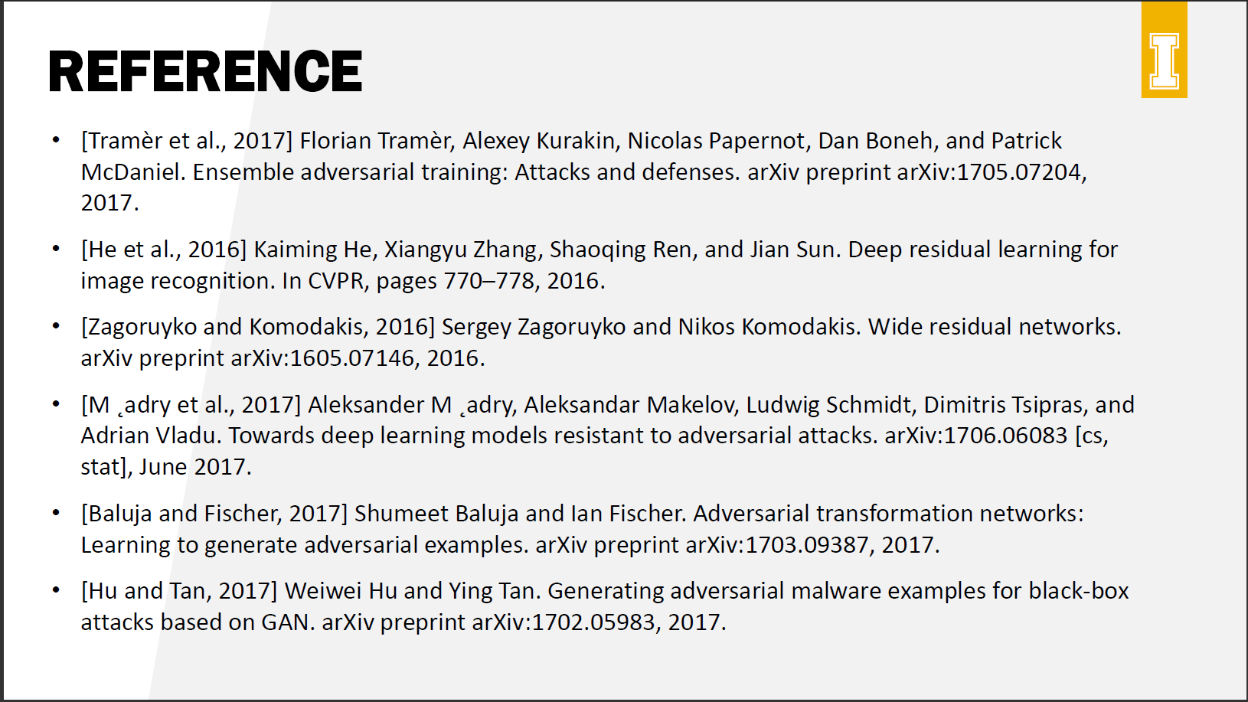

Slide 59
DEFENSE-GAN
PROTECTING CLASSIFIERS AGAINST ADVERSARIAL ATTACKS USING GENERATIVE MODELS
By Pouya Samangouei, Maya Kabkab, and Rama Chellappa (2018)
Presented by Thys Ballard

Slide 60
Introduction
The paper proposes an attack-agnostic defense against white-box and black-box attacks using Generative Adversarial Networks (GAN), by reforming adversarial examples prior to feeding them into a given classifier.
It does not modify the classifier or the training features, essentially functioning as a preprocessing step

Slide 61
Related Adversarial Defenses
Adversarial Training
Adversarial examples are generated and added to the training set
Does not perform well when a different attack is used to what the model was trained on
More robust to white-box attacks than to black-box attacks
Defensive Distillation
Trains the classifier in two rounds of distillation
Distillation trains a model to mimic another model
Effective against white-box models, but it fails to protect against transfer model based black-box attacks
MagNet
Trains an auto-encoder or collection of auto-encoders to move adversarial examples closer to the manifold of clean examples
With a collection of auto-encoders, at inference time one is chosen randomly
Mirrors the Defense-GAN technique of learning a latent space in order to “clean” adversarial examples

Slide 62
Quick Overview on GANs
Consists of two neural networks
A generator $G: ℝ^{k}→ℝ^{n}$, where $n>k$, mapping a learned latent space to the sample space of a sample $x$
A discriminator $D$, a binary classifier
The goal is to play minimax game where $G$ learns to mimic the distribution of the dataset and D learns to discriminate between real samples $x$ and fake samples from $G(z)$, where $z$ is a random vector
The original min-max loss used in the GAN paper
The variant of GAN, called WGAN, used in the paper in order to improve training, uses the Wasserstein distance

Slide 63
Defense-GAN Algorithm
Once the GAN is trained, the classifier be trained on either the reconstructed data or on the original training data, without much difference
At time of inference, using gradient descent, they minimize
Where $x$ is an input image and $z$ is a random vector
This is trained with a fixed number of steps $L$ using $R$ initializations (“random restarts”) of $z$

Slide 64
Defense-GAN Algorithm
This method essentially functions as a pre-processing step on input data fed to a given classifier
If the GAN represents the data adequately, the classifier will not need to be retrained
Does not assume the type of attack used, since it simply uses a GAN to reconstruct an adversarial input
Because of the gradient descent loop at the front, it is resilient to gradient-based white-box attacks

Slide 65
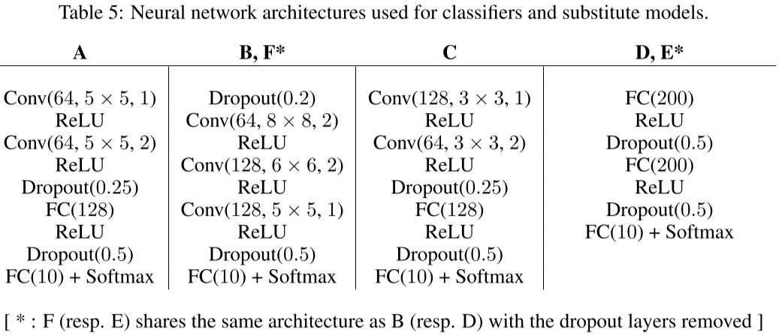
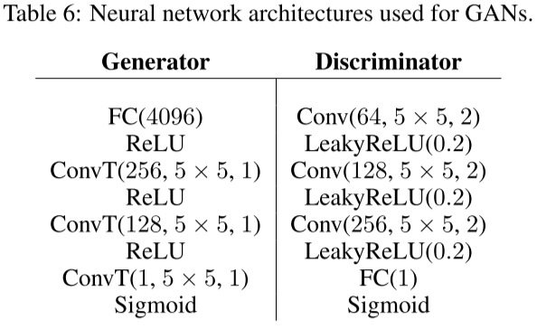
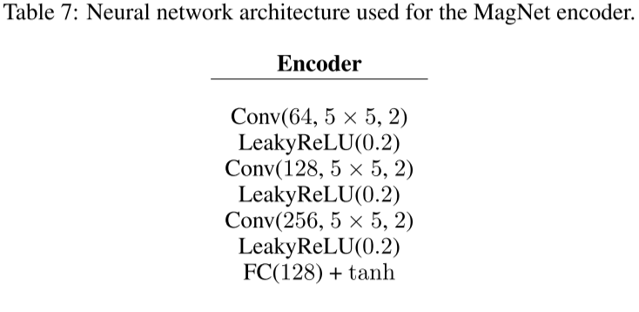
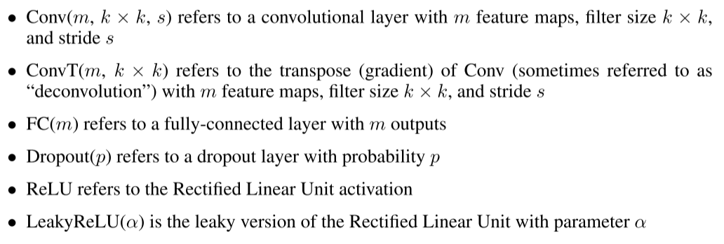
Experiments
Experiments assume three different types of threats
Black-box attacks by running a substitute network to find adversarial examples
White-box attacks
And white-box where the attacker even access to the RNG and the random seed, meaning they know all $R$initializations of $z$
Defense-GAN is compared with adversarial training and MagNet
Trained on MNIST and Fashion-MNIST, both consisting of 60,000 training images and a test set of 10,000 images. The training set is split into 50,000 for training and 10,000 for validation.

Slide 66
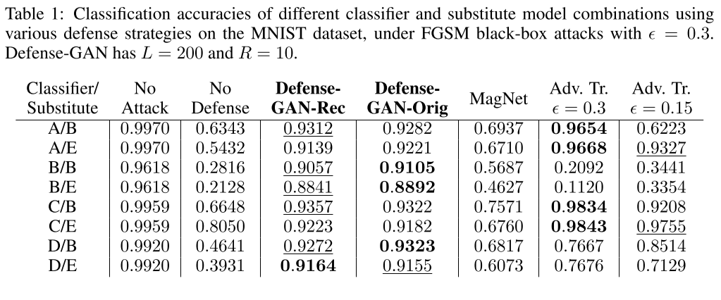
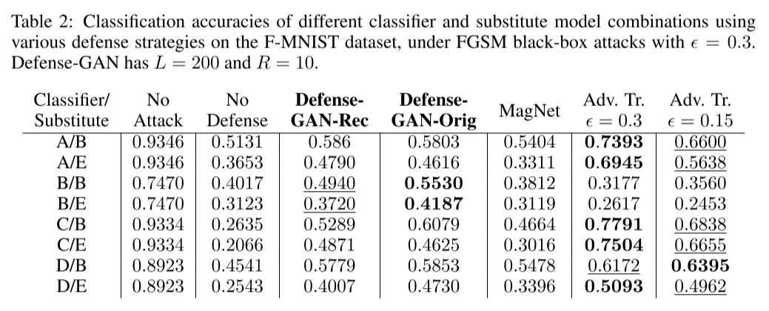
Black-Box Experiments
Using Fast Gradient Sign Method with a substitute model
For the black-box attacks, 150 test images are held out for the substitute model, with the remaining functioning as test images
As expected, the performance of the classifier trained on the reconstructed and original dataset are quite close

Slide 67
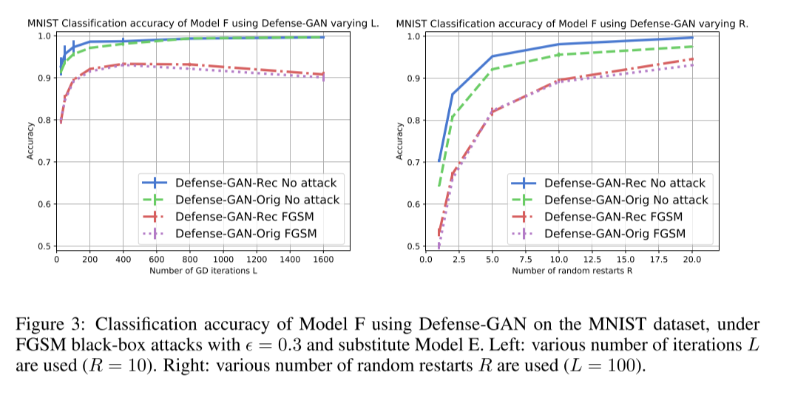
Effect of Hyperparameters $L$ and $R$
With no attack, increasing the number of iterations $L$ improves performance
With an FGSM attack, the classification accuracy starts to decrease after a certain number of $L$ iterations
With too many iterations, some of the adversarial noise is retained
Increasing $R$ allows for sampling different local minima

Slide 68
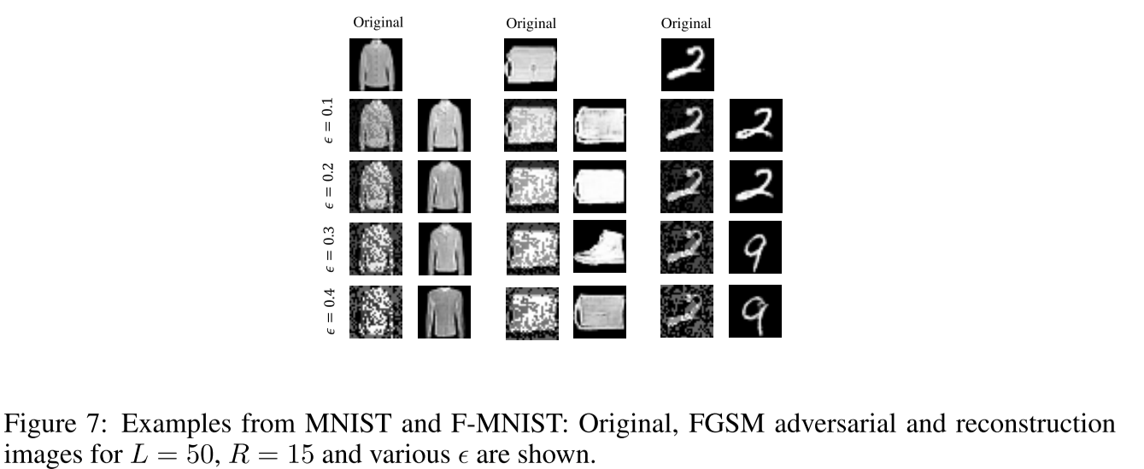
Effect of Changing $ϵ$
The FGSM attack is more effective with higher $ϵ$, as expected, but as the $ϵ$ gets higher, the noise becomes more discernible

Slide 69
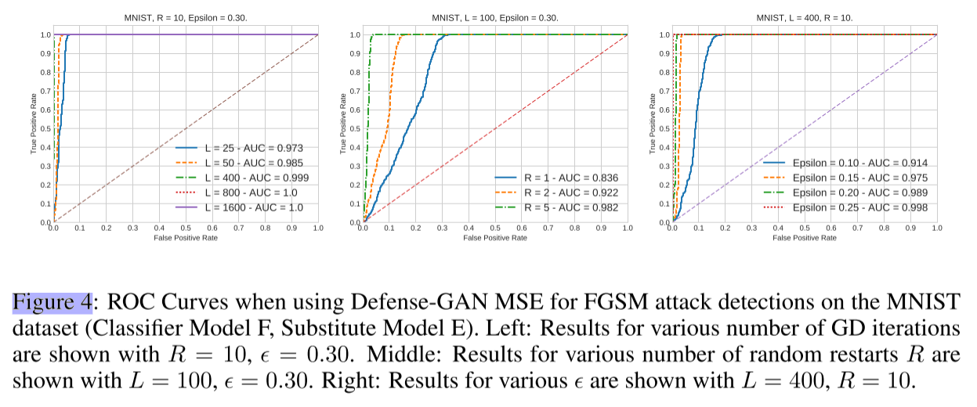
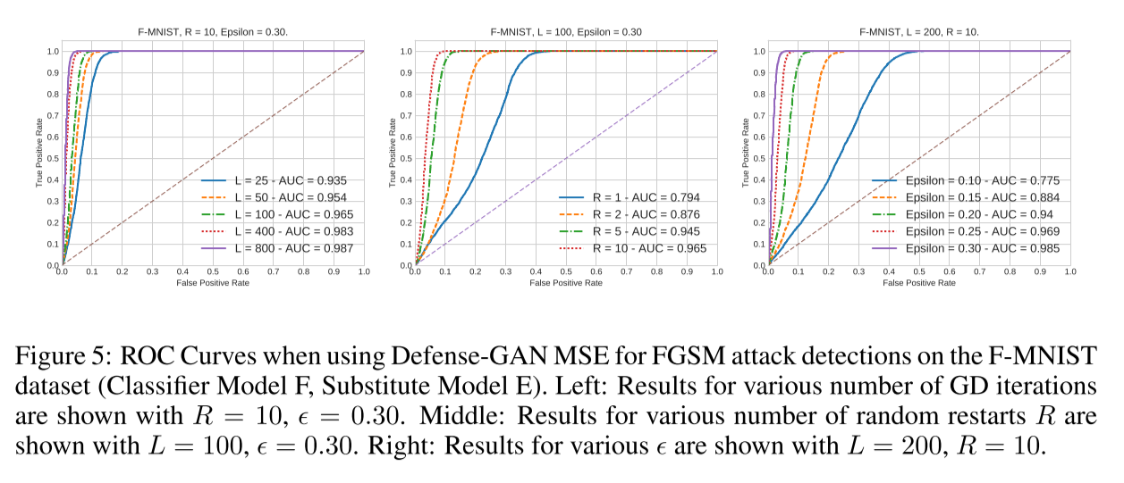
Attack Detection
Defense-GAN can also be effectively used for attack detection
Using MSE of an image and its reconstruction as a metric for detecting adversarial manipulation, with some threshold $Θ>0$, we can test

Slide 70
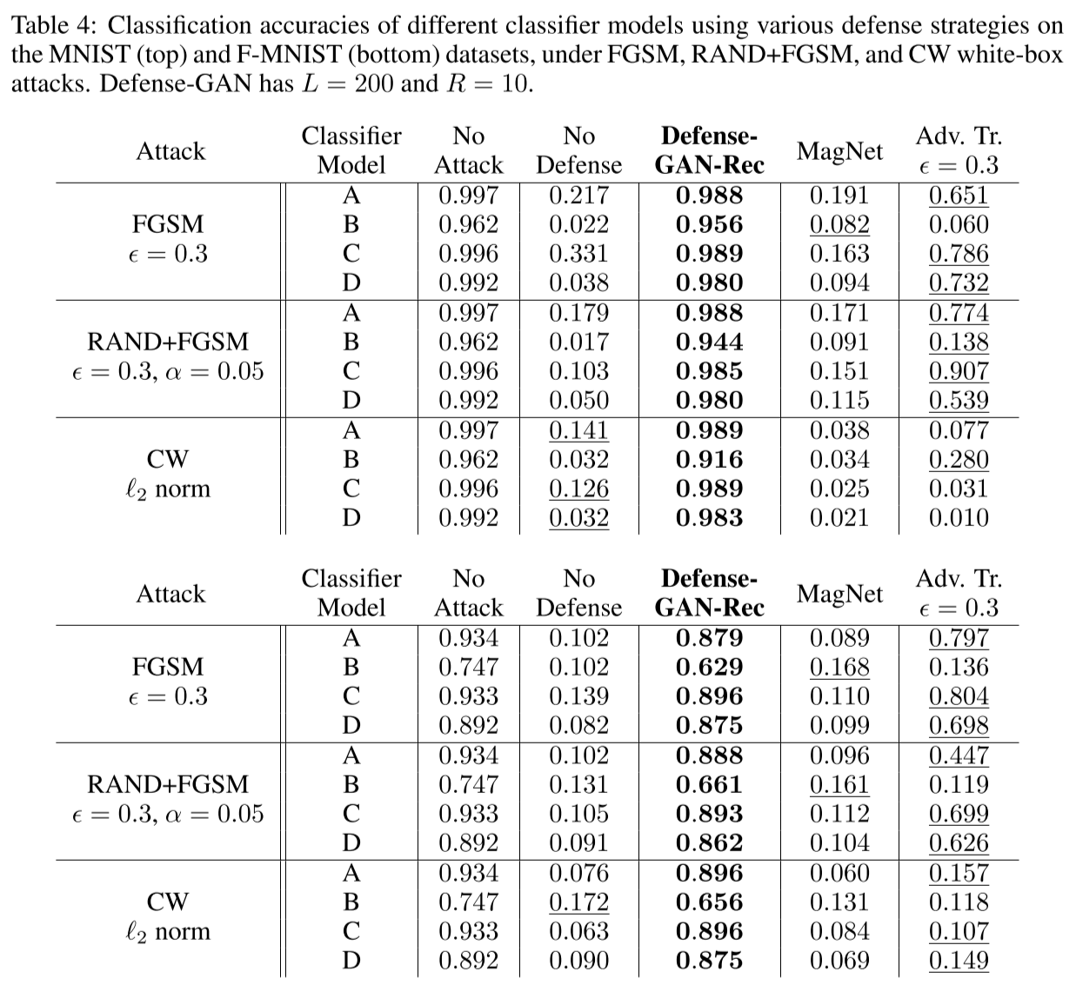
White-Box Experiments
Carlini-Wagner attack with 100 iterations gradient descent with a learning rate of 10 and $c=100$
Fast Gradient Sign Method attack
Randomized Fast Gradient Sign Method
Even with giving the attacker access to random restarts of $z$, the performance does not change much

Slide 71
White-Box Experiments
The attacker needs to propagate the loss across $L$ steps of gradient descent, making Defense-GAN resilient to gradient-based white-box attacks
The tradeoff is increased inference time, though generally not prohibitively so

Slide 72
Conclusions
Defense-GAN offers an effective and flexible technique for defending and even detecting adversarial attacks
The main drawbacks are with
Training a GAN effectively, a difficult task still being researched
Choosing the values of hyperparameters $L$ and $R$

Slide 73
ANY QUESTIONS?

Slide 74
Adversarial Examples for Generative Models
Adversarial Examples for VAE-GANs
Adversarial examples for generative models
Kos (2017) Adversarial Examples for Generative Models
Generative models have ability to generate instances from input distributions
These models sample from the input data distribution to generate new data instances
E.g., GANs can create realistic images from a training distribution
The paper introduces attacks against two generative models:
Variational Auto-Encoders (VAEs)
VAE-GANs
Generative models are also vulnerable to adversarial attacks
Comparison between this approach and AdvGAN attack:
AdvGAN generates adversarial perturbations $δ$ that are added to clean images $x$ to create adversarial examples $x_{adv}=x+δ$
This approach generates adversarial examples $x_{adv}$ directly

Slide 75
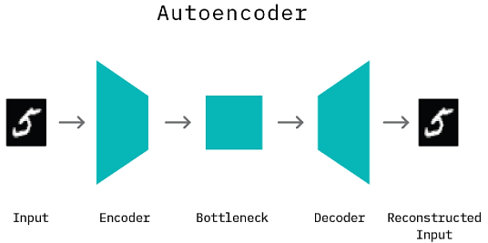
Auto-Encoder (AE)
Adversarial Examples for VAE-GANs
Auto-Encoder (AE) learns a reconstruction of input data
I.e., the encoder network $f_{enc}(x)$ learns a lower-dimensional (compressed) latent representation $z$of the input $x$, i.e., $z{=f}_{enc}(x)$)
$z$is also referred to as code, latent code, latent vector, bottleneck
The decoder network $f_{dec}(z)$ learns to reconstruct the original inputs $x$from their latent representations $z$, i.e., $\hat{x}=f_{dec}\left(z\right)$
The reconstructed inputs are $\hat{x}=f_{dec}\left(z\right)=f_{dec}\left(f_{enc}(x)\right)$
AEs are trained by minimizing a loss function between the inputs to the network $x$and the reconstructed inputs by the decoder $\hat{x}$(e.g., cross-entropy, or mse loss)

Slide 76
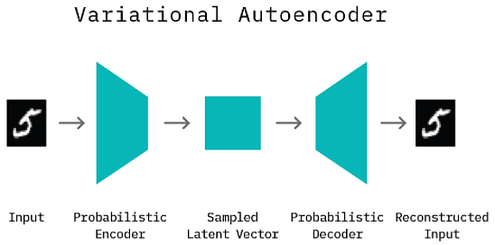
Variational Auto-encoder (VAE)
Adversarial Examples for VAE-GANs
Variational Auto-Encoder (AE) is a probabilistic version of an AE, and it learns the encoding of input data to a distribution
A probabilistic encoder $f_{enc}$ learns the latent representation $z$, representing the parameters of the input distribution
All possible values of $z$ form the latent space
A probabilistic decoder $f_{dec}$ learns to reconstruct the original inputs $x$by sampling from the latent space, i.e., $\hat{x}=f_{dec}\left(z\right)$
Typically, a Gaussian distribution is used to model the latent space
That is, output of the encoder $f_{enc}(x)$ are the mean $μ$and variance $σ^{2}$of the input distribution

Slide 77
Variational Auto-encoder (VAE)
Adversarial Examples for VAE-GANs
Unlike AEs, VAEs are generative models, because they can sample from the latent distribution $z$, and generate new input instances
VAEs are trained by minimizing the following loss function
$$ℒ_{VAE}=−D_{KL}\left[q\left(z|x\right)||p(z)\right]+H\left[x,\hat{x}\right]$$
The first term is the KL-divergence between the estimated distribution $z$by the model given the input data $q\left(z|x\right)$ and the prior distribution of the latent representation $p(z)$
The second term is the cross-entropy loss between the inputs $x$ and their reconstructions $\hat{x}$ by the model

Slide 78
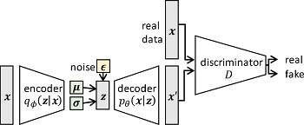
VAE-GAN
Adversarial Examples for VAE-GANs
VAE-GAN architecture is a combination of VAE and GAN
The generator G of VAE-GAN represents a VAE network that reconstructs the input data $x$, by sampling from the latest space z
It has the same pair of encoder$f_{enc}(x)$ and decoder$f_{dec}(z)$ networks as in VAEs
The sampled vectors are computed as $z=μ+ε\sqrt{σ^{2}}$, where $ε$ is random noise in the range $\left(0,1\right)$
A discriminator D is added to a VAE that distinguishes between reconstructed (fake) data instances $\hat{x}$ and real data instances $x$
generator G

Slide 79
Generative vs Discriminative Models
Adversarial Examples for VAE-GANs
Generative models
Estimate parameters of joint probability distribution $P(X, Y)$ from training data
Generate new instances $X$ or pairs $X, Y$
Models:
GANs
VAE
Hidden Markov models
Bayesian networks
GPT-3
Discriminative models
Estimate parameters of conditional probability distribution $P(Y|X)$ from training data
Models:
‌Logistic regression
SVM
NN classifiers (VGG, ResNet, Inception, EfficientNet)
Nearest neighbors
Decision trees

Slide 80
Motivating Attack Scenario
Adversarial Examples for VAE-GANs
Parties: sender, receiver, attacker
In order to conserve bandwidth, the sender and the receiver exchange the compressed latent vector ${\text{z}=f}_{enc}\left(x\right)$ of an input image $x$ (digit 7) produced by VAE
The attacker presents an adversarially manipulated copy of the image $x^{∗}$, that to the sender looks almost the same as the original image $x$ (digit 7)
The attacker has a copy of the VAE
The sender sends the latent vector of the adversarial image ${{\text{z}}^{∗}=f}_{enc}\left(x^{∗}\right)$, believing to be the latent vector of the original image ${\text{z}=f}_{enc}\left(x\right)$
The receiver uses the decoder to reconstructs the latent vector ${\hat{x}}^{∗}=f_{dec}\left({\text{z}}^{∗}\right)$, however the reconstruction ${\hat{x}}^{∗}$ is a different image (digit 8) that was chosen by the attacker

Slide 81
Proposed Attack #1: Classifier Attack
Adversarial Examples for VAE-GANs
Classifier attack adds a Classifier network $f_{class}$ to the VAE-GAN (see figure)
Let’s assume that VAE-GAN has been successfully trained to generate images $\hat{x}$ from an input distribution $x$
Step 1: the weights of the VAE-GAN are frozen, and the newly added classifier $f_{class}\left(z\right)$ is trained by using latent vectors of target $x_{t}$ and source images $x_{s}$
The true label of the source image $x_{s}$ is $y_{s}$
The true label of the source image $x_{t}$ is $y_{t}$
The attack aims to perturb the latent vector of a source image $x_{s}$, so that its reconstruction ${\hat{x}}_{s}$ is assigned the target label $y_{t}$

Slide 82
Proposed Attack #1: Classifier Attack
Adversarial Examples for VAE-GANs
Step 2: apply the C&W optimization problem:
$$\underset{z^{∗}}{argmin}{λℓ_{2}\left(z_{s},z^{∗}\right)+ℒ_{classifier}\left(\hat{y}{,y}_{t}\right)}$$
The loss function $ℒ_{classsifier}\left(\hat{y}{,y}_{t}\right)$ is a standard cross-entropy loss between the predicted label by the classifier $\hat{y}$ and the target label $y_{t}$
The goal is to find a latent vector $z^{∗}$ that:
Is similar to the latent vector of the source image $x_{s}$, by minimizing the distance $ℓ_{2}\left(z_{s},z^{∗}\right)$
Has a predicted target label $y_{t}$ by the classifier network
$λ$ is a weighting coefficient for the importance of the 2 terms in the objective function
Step 3: adversarial examples $x^{∗}$ are found by reconstructing the latent vector $z^{∗}$ by the decoder, i.e., $x^{∗}=f_{dec}\left(z^{∗}\right)$
Note: the authors stated that the obtained adversarial examples by this attack do not always result in high-quality images

Slide 83
Proposed Attack #2: $ℒ_{VAE}$ Attack
Adversarial Examples for VAE-GANs
VAE attack does not add a classification network to VAE-GAN
It directly uses the VAE loss function to generate a target reconstruction image
For a targeted attack, use a pair of images: a source image $x_{s}$ and a target image $x_{t}$
Step 1: compute the reconstruction of the target image ${\hat{x}}_{t}=f_{dec}\left(f_{enc}\left(x_{t}\right)\right)$
Step 2: to find adversarial image $x^{∗}$, apply the C&W optimization problem:
$$\underset{x^{∗}}{argmin}{λℓ_{2}\left(x_{s},x^{∗}\right)+ℒ_{VAE}}$$
The loss function is $ℒ_{VAE}=−D_{KL}\left[q\left(z|x\right)||p(z)\right]+H\left[{\hat{x}}^{∗},{\hat{x}}_{t}\right]$
The second term in $ℒ_{VAE}$ is changed to produce similar reconstruction of $x^{∗}$ to the target $x_{t}$
That is, find an adversarial image $x^{∗}$ that:
Perceptually looks similar to the source image $x_{s}$, by minimizing the distance $ℓ_{2}\left(x_{s},x^{∗}\right)$
Has a reconstruction ${\hat{x}}^{∗}$ that is similar to the reconstruction of the target image ${\hat{x}}_{t}$

Slide 84
Proposed Attack #3: Latent Attack
Adversarial Examples for VAE-GANs
Latent attack directly optimizes against differences in the latent representations of source and target images
For a targeted attack, use a pair of images: a source image $x_{s}$ and a target image $x_{t}$
Step 1: compute the latent representation of the target image $z_{t}{=f}_{enc}(x_{t})$
Step 2: to find adversarial image $x^{∗}$, apply the C&W optimization problem:
$$\underset{x^{∗}}{argmin}{λℓ_{2}\left(x_{s},x^{∗}\right)+ℒ_{latent}}$$
The loss function is $ℒ_{latent}=ℓ_{2}\left(z_{t},z^{∗}\right)=ℓ_{2}\left(f_{enc}\left(x_{t}\right),f_{enc}(x^{∗})\right)$
This will result in similar latent vectors for the target image $x_{t}$ and the adversarial image $x^{∗}$
That is, find an adversarial image $x^{∗}$ that:
Perceptually looks similar to the source image $x_{s}$, by minimizing the distance $ℓ_{2}\left(x_{s},x^{∗}\right)$
Has a latent representation $z^{∗}$ that is similar to the latent representation of the target image $x_{t}$

Slide 85
Experimental Evaluation
Adversarial Examples for VAE-GANs
Experimental evaluation
MNIST, SVHN (street numbers), and CelebA (celebrity faces)
VAE-GAN models
Encoder-decoder layers
Model 1: fully-connected layers
Model 2: convolutional layers
Dimension of the latent vector in VAE
MNIST: 50 dims, SVHN: 1,024 dims, CelebA: 2,048 dims
Classifier model
Two fully-connected layers

Slide 86
Experimental Evaluation
Adversarial Examples for VAE-GANs
Attack # 1: classification attack
Targeted attacks on MNIST for each of the 10 digits
Classifier accuracy on adversarial examples considering the ground-truth labels (≈ 0%)
Matching rate – predicted outputs by the classifier as the target class (≈ 100%)
This attack achieves good success rate, however the obtained adversarial images are not of good quality

Slide 87
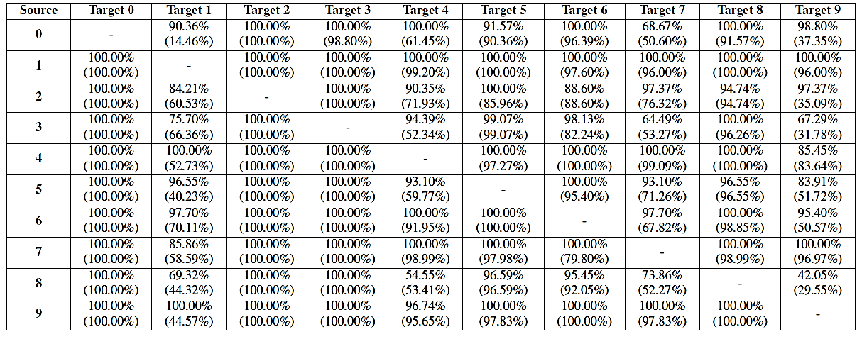
Experimental Evaluation
Adversarial Examples for VAE-GANs
Attack # 2: $ℒ_{VAE}$ attack on MNIST images
Success rate for untargeted and targeted attack (in parenthesis)
Higher values indicates more successful attacks

Slide 88
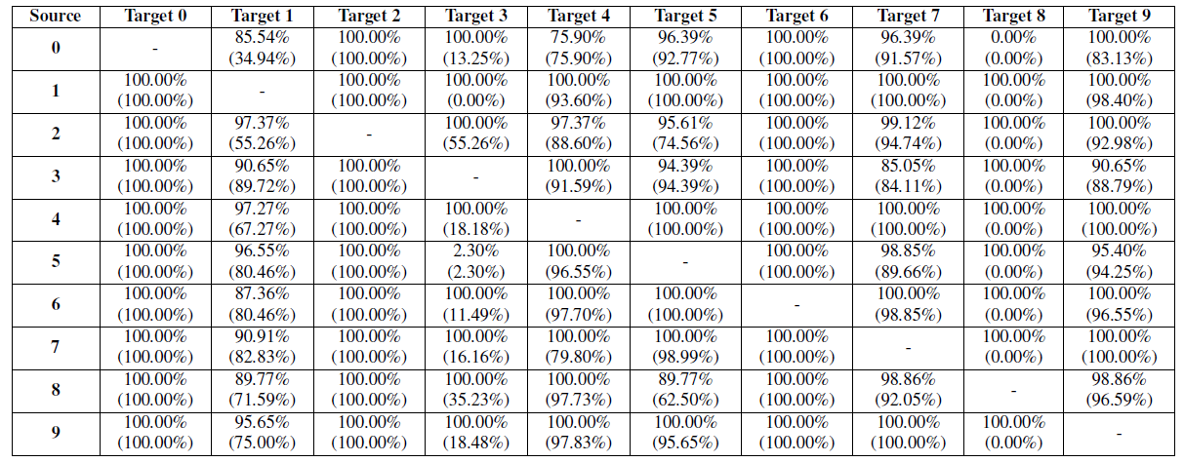
Experimental Evaluation
Adversarial Examples for VAE-GANs
Attack # 3: latent attack on MNIST images
Higher values indicates more successful attacks
The latent attack is the most successful of the 3 attacks (compare to previous page)

Slide 89
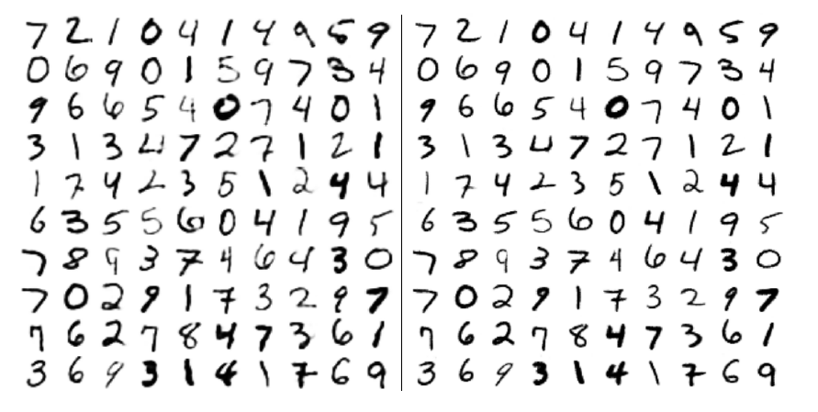
Experimental Evaluation
Adversarial Examples for VAE-GANs
Reconstructed NMIST images by VAE (left) versus VAE-GAN (right)
VAE-GAN produced better quality images

Slide 90
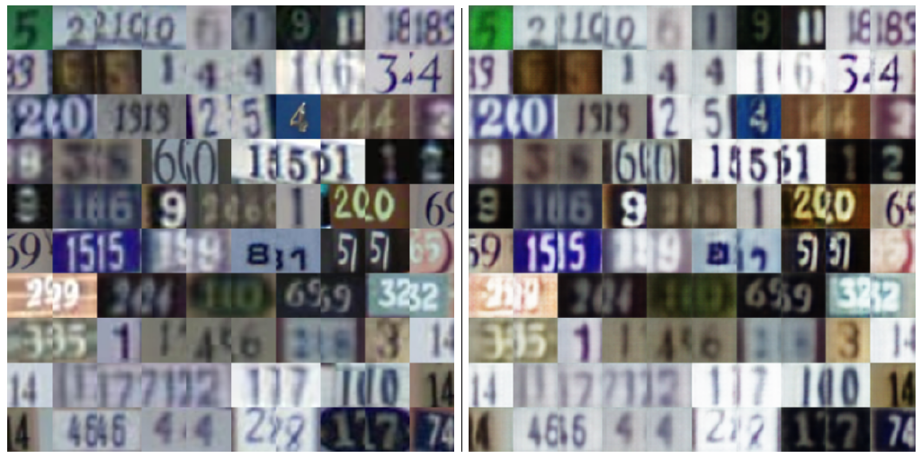
Experimental Evaluation
Adversarial Examples for VAE-GANs
Original SVHN images (left) and the reconstructed images by VAE-GAN (right)
VAE-GAN produces good quality reconstructions

Slide 91
Experimental Evaluation
Adversarial Examples for VAE-GANs
Latent attack on VAE-GAN with SVHN images
The target class is ‘0’, and the source images are non-zero images
Original image
Reconstructed image
Adversarial image
Predicted class of the adversarial image

Slide 92
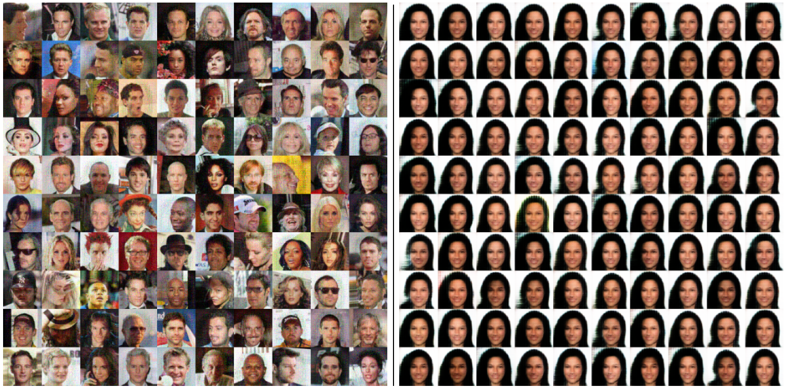
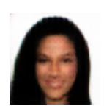
Experimental Evaluation
Adversarial Examples for VAE-GANs
Latent attack on VAE-GAN with CelebA images
Original images (left) and reconstructed image (right)
The target class is shown on the right
Target image

Slide 93
Attack-Inspired GAN (AI-GAN)
AI-GAN (Attack-Inspired GAN)
Attack-Inspired GAN (AI-GAN)
Bai (2021) AI-GAN: Attack-inspired Generation of Adversarial Examples
AI-GAN attack introduces a new GAN architecture for generating adversarial examples
The architecture has 3 networks: generator, discriminator, and attacker
The discriminator is trained for both detection of clean versus perturbed images, and classification of clean and perturbed images
Focus is on targeted attacks
It is evaluated on MNIST, CIFAR-10, and CIFAR-100

Slide 94
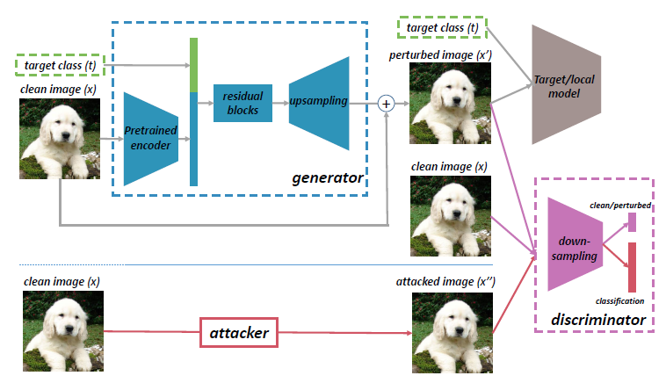
AI-GAN Architecture
AI-GAN (Attack-Inspired GAN)
AI-GAN consists of:
Generator – similar to the conditional GANs, it can generate images of a target class t
Discriminator – has 2 branches, where one branch is designed to discriminate real from fake images, and a second branch performs classification into class labels
Attacker – a PGD attack is employed to generate adversarial images

Slide 95
AI-GAN Architecture
AI-GAN (Attack-Inspired GAN)
Discriminator network
Branch 1: discriminate between clean images x and perturbed images x’
This is similar to a binary input detector (in Assignment 2)
Branch 2: classify all images by applying adversarial training
Train this branch on both clean images x and adversarial images generated by the attacker x’’ by using the true labels for the adversarial images
Also, train this branch on both clean images x and adversarial images generated by the generator x’ by using the true labels for the adversarial images
This is similar to adversarial trainer (in Assignment 2)
Generator network
It is trained to find adversarial examples x’ that are classified by the discriminator as clean images x with the target class t

Slide 96
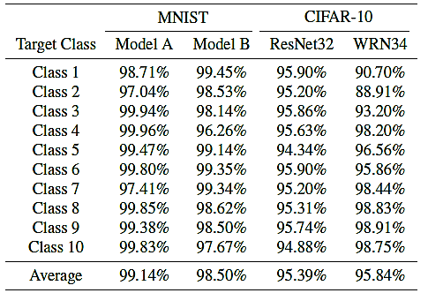
Experimental Evaluation
AI-GAN (Attack-Inspired GAN)
White-box targeted attack
Running time comparison
Attacks on MNIST and CIFAR-10 and comparison to AdvGAN

Slide 97
Experimental Evaluation
AI-GAN (Attack-Inspired GAN)
Adversarial examples for MNIST and CIFAR-10

Slide 98
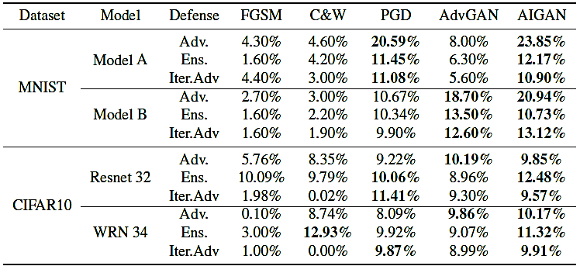
Experimental Evaluation
AI-GAN (Attack-Inspired GAN)
Evaluation of the success rate against defenses: adversarial training (Adv.), ensemble adversarial training (Ens.) and iterative adversarial training (Iter. Adv.)

Slide 99
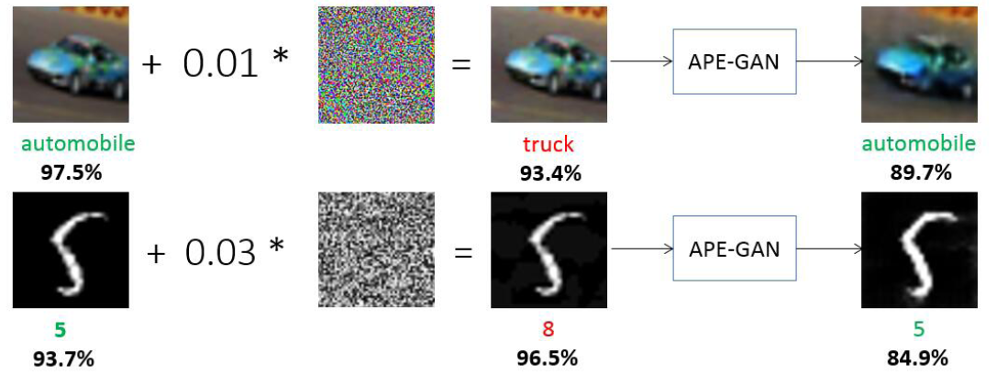
APE-GAN
APE-GAN (Adversarial Perturbation Elimination GAN)
APE-GAN (Adversarial Perturbation Elimination GAN)
Jin (2019) APE-GAN: Adversarial Perturbation Elimination with GAN
A defense approach that has similarity to Defense-GAN
It uses the generator of GAN to create images that are clean of adversarial perturbations
A novel loss function in GAN is used for this purpose

Slide 100
APE-GAN Architecture
APE-GAN (Adversarial Perturbation Elimination GAN)
Generator APE-G
The generator consists of an encoder-decoder network
It is fed adversarial images $X_{ε}$ (created by one specific attack)
The outputs of the APE-G are reconstructed input images $\hat{X}$, that are cleaned of any adversarial perturbations
Goal: the reconstruction of an adversarial image ${\hat{X}}_{ε}$ is the same as the clean image$\hat{X}$
Discriminator APE-D
It is a standard network, trained to distinguish between clean and perturbed images

Slide 101
APE-GAN Architecture
APE-GAN (Adversarial Perturbation Elimination GAN)
To train the APE-GAN, the following loss function is used
It consists of:
MSE loss $l_{mse}$ – reduces pixel-wise MSE difference between the original image $X$ and the reconstruction of the corresponding adversarial image ${\hat{X}}_{ε}$
Adversarial loss $l_{adv}$ – reduces misclassification of clean images $X$and adversarial images $X_{ε}$ by the discriminator
Spatial coherence loss $l_{sc}$ – smoothens the reconstruction of an adversarial image ${\hat{X}}_{ε}$, by reducing large differences between the pixels locally
The weights were set to:${ ξ}_{1}=0.1$, ${ ξ}_{2}=0.45{, ξ}_{3}=0.45$
The discriminator APE-D is trained to minimize the misclassification of clean images $X$, reconstructed images $\hat{X}$, perturbed images $X_{ε}$, and reconstructed perturbed images ${\hat{X}}_{ε}$

Slide 102
Experimental Evaluation
APE-GAN (Adversarial Perturbation Elimination GAN)
Classification error rates for attacked images (Base) and APE-GAN defended images
7 attacks are evaluated: L-BFGS, FGSM, DeepFool, JSMA, and C&W with $L_{0}$, $L_{2}$, $L_{∞}$
6 models are compared: LeNet (MNIST dataset), DenseNet (CIFAR-10), ResNet and Inception-v3 - top1 and top5 accuracy (ImageNet dataset)
Lower is better
APE-GAN reduced the classification errors rates for all attacks

