Slide 1
CS 404/504
Special Topics: Adversarial Machine Learning
Dr. Alex Vakanski

Slide 2
Lecture 8
Defenses against Evasion Attacks

Slide 3
Lecture Outline
AML defense methods
Adversarial examples detection
Auxiliary detection model
Statistical methods
Prediction consistency methods
Gradient masking/obfuscation
Exploding/vanishing gradients methods
Shattered gradients methods
Stochastic/randomized gradients
Robust optimization
Adversarial training
Regularization methods
Certified defenses
Methods:
Ensemble adversarial training – by Trammer (2018)
Defensive distillation – by Papernot (2016)
MagNet – by Meng (2017)
Fortified networks – by Lamb (2018)
Feature squeezing – by Xu (2017)
Robust self-training – by Raghunathan (2020)
Randomized smoothing certificate – by Cohen (2019)

Slide 4
AML Defense Categories
AML Defense Categories
The defense strategies against adversarial attacks can be categorized into 3 main groups:
Adversarial examples detection
Design a method for distinguishing clean from adversarial examples
E.g., train a binary input model to detect adversarial examples
E.g., as in Assignment 2, Part 1
Gradient masking/obfuscation
Design a method to hide the gradients in the classification model
This will make most attacks that use the gradients ineffective
Robust optimization
Design a method to increase the robustness of the model to adversarial examples
E.g., apply adversarial training by using both clean and attacked examples
E.g., as in Assignment 2, Part 2

Slide 5
Adversarial Examples Detection
Adversarial Examples Detection
Adversarial examples detection methods are designed to distinguish adversarial examples from regular clean examples
If the defense method detects that an input example is adversarial, it will refuse to send the example to the target classifier for predicting its class label
Based on the adversary’s knowledge about the detection defenses, the threat models in adversarial examples detection can be classified into:
Zero-Knowledge Adversary – the adversary has access to the target classifier F, but is not aware that a detection model D is used
Perfect-Knowledge Adversary – the adversary has access to the target classifier F, and also has full access to the detection model D
Limited-Knowledge Adversary – the adversary has access to the target classifier F, and also is aware that a detection model D is used, but does not have access to its parameters and/or the training dataset

Slide 6
Adversarial Examples Detection
Adversarial Examples Detection
Adversarial Examples Detection defense methods can be further divided into:
Auxiliary detection model
Statistical methods
Prediction consistency methods
Limitation of the defense strategies based on adversarial examples detection is that they can be less effective in identifying examples created using unknown adversarial attacks

Slide 7
Auxiliary Detection Model
Adversarial Examples Detection – Auxiliary Detection Model
An auxiliary detection model D is trained on regular and adversarial examples to perform a binary classification
Adversarial examples are typically created using different attack methods, to increase the effectiveness of the detection model
If an input example is classified as benign, then it is safe to be fed to the target classifier F to predict its class
The auxiliary detection model D is required to have a high accuracy in correctly classifying both adversarial and clean examples

Slide 8
Auxiliary Detection Model
Adversarial Examples Detection – Auxiliary Detection Model
Gong (2017) Adversarial and Clean Data Are Not Twins
Train an auxiliary NN as a binary input detector to classify adversarial images and clean images
Figure: upper row (clean images), bottom row (adversarial FGSM) images
Image labels and predicted probability (in parenthesis) are shown for each image
Achieved over 99% accuracy

Slide 9
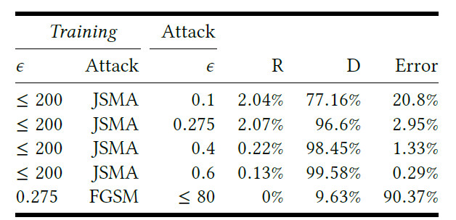
Auxiliary Detection Model
Adversarial Examples Detection – Auxiliary Detection Model
Grosse (2017) On the (Statistical) Detection of Adversarial Examples
Trains an auxiliary detection model with $k+1$ labels
Clean examples are classified into k classes, and the additional class label is assigned to all adversarial examples
I.e., the network will label all adversarial examples as a separate class (referred to as an outlier class)
The model performed well against adversarial examples created by JSMA (77 to 99% detection rate – column D), but was not effective for FGSM (9% detection rate)

Slide 10
Auxiliary Detection Model
Adversarial Examples Detection – Auxiliary Detection Model
Metzen (2017) On Detecting Adversarial Perturbations
A binary detector model D uses the feature maps from the hidden layers in a target classifier F to detect adversarial examples
Figure: upper row (ResNet target classifier F); bottom row (detector model D)
Feature maps from several hidden layers AD(0) to AD(4) are used as inputs to the detector model D
See the next page for experimental evaluation

Slide 11
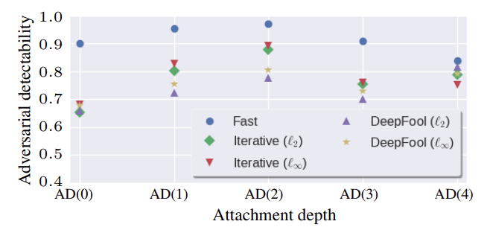
Auxiliary Detection Model
Adversarial Examples Detection – Auxiliary Detection Model
Metzen (2017) cont’d
The figure shows the detectability accuracy when different hidden layers AD(0) to AD(4) are used as inputs to the detector model D
AD(2), which uses the middle hidden layer in the target classifier, achieved the best results for most adversarial attacks
I.e., detection accuracy over 80% for most attacks

Slide 12
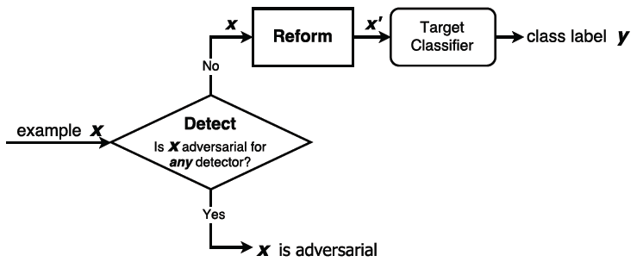
Auxiliary Detection Model
Adversarial Examples Detection – Auxiliary Detection Model
Meng (2017) MagNet: a Two-Pronged Defense against Adversarial Examples
MagNet defense approach uses two networks:
Detector network – an autoencoder to detect adversarial examples based on exceeding a threshold for the reconstructed outputs
Reformer network to clean adversarial perturbations using a denoising autoencoder
The detector model is used for identifying samples with large perturbations
It is combined with a denoiser for removing small perturbations in images

Slide 13
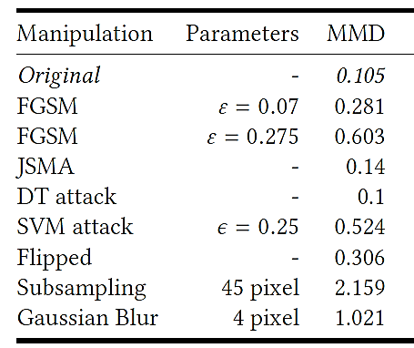
Statistical Detection Methods
Adversarial Examples Detection – Statistical Methods
Grosse (2017) On the (Statistical) Detection of Adversarial Examples
This method uses a statistical test – Maximum Mean Discrepancy (MMD) to find out whether two groups of input samples are drawn from the same distribution
Hypothesis: there is a statistical difference between the means of the distributions of adversarial examples and clean examples
I.e., adversarial examples are statistical outliers, since they are not drawn from the same distribution as clean inputs
Experimental results shown in the table
Adversarial examples with larger amount of perturbation can be identified with MMD
Examples with small $ε$-value perturbations are less likely to be detected (low MMD)
Attacks like JSMA that are based on minimizing $ℓ_{0}$ norm (perturb few pixels) are also more difficult for detection

Slide 14
Statistical Detection Methods
Adversarial Examples Detection – Statistical Methods
Hendrycks (2016) Early Methods for Detecting Adversarial Images
This work employs PCA (principal component analysis) to identify the most important principal components (PCs) of inputs (based on the ordering of the eigenvalues)
It was found that adversarial examples place higher weights on the later PCs that correspond to smaller eigenvalues, and clean images place uniform weights on all PCs
Thus, the distribution of PCs is used for detecting adversarial examples
E.g., the figures show the PCA coefficients for 3 clean (orange) and FGSM attacked images (blue) from CIFAR-10 dataset, for the largest 3,000 PCs
For all 3 adversarial images, the PCA coefficients are very small for the first 1,000 PCs, and they increase the most for the last 500 PCs (i.e., between 2,500 and 3,000 on the x-axis)

Slide 15
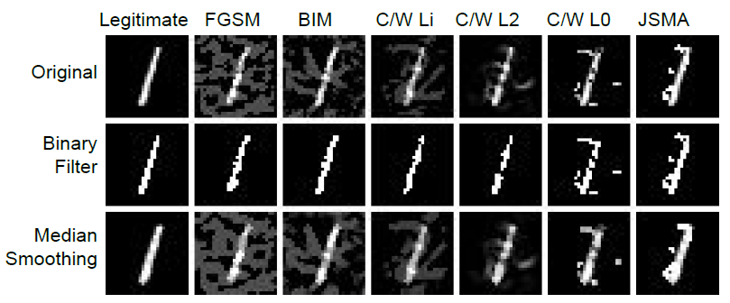
Prediction Consistency Methods
Adversarial Examples Detection – Prediction Consistency Methods
Xu (2017) Feature Squeezing: Detecting Adversarial Examples in Deep Neural Networks
Feature squeezing defense employs two methods for reducing the information in input features in images
Reducing the number of bits for representing the pixels intensities
Applying spatial smoothing to reduce the differences among the individual pixels
E.g., the upper figures show a legitimate MNIST image and attacked examples
Second row: images with 1 bit intensity, third row: spatially smoothed images

Slide 16
Prediction Consistency Methods
Adversarial Examples Detection – Prediction Consistency Methods
Xu et al. (2017) cont’d
Adversarial examples are detected based on the consistency in the prediction on clean images, on images with reduced bit depth (Squeezer 1), and spatially smoothed images (Squeezer 2)
If the $ℓ_{1}$ difference between the prediction by the target classifier and either of the two squeezers is greater than a threshold T, the sample is flagged as adversarial

Slide 17
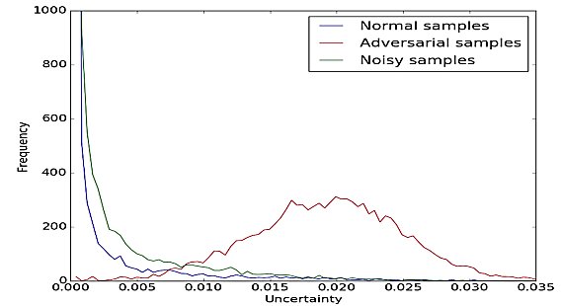
Prediction Consistency Methods
Adversarial Examples Detection – Prediction Consistency Methods
Feinman (2017) Detecting Adversarial Samples from Artifacts
The target classifier is randomized using Dropout
The dropout is set to eliminate 50% of the neurons in all layers
If the prediction by the randomized classifiers on sample x is significantly different than the prediction before the randomization, the sample x is probably adversarial
Figure: the distribution of adversarial samples is notably different than the distribution of normal clean samples
The approach can detect adversarial samples with success rate of over 90% on MNIST and over 70% on CIFAR-10

Slide 18
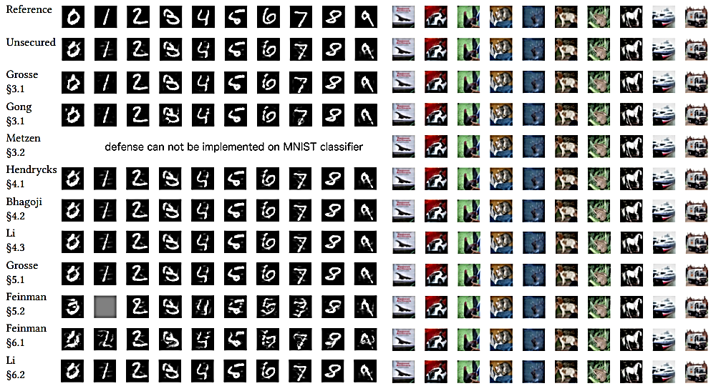
Adversarial Examples Detection
Adversarial Examples Detection
Carlini and Wagner published a paper in 2017 in which they showed that it is possible to defeat almost all Adversarial Examples Detection defense strategies
Carlini (2017) Adversarial Examples Are Not Easily Detected: Bypassing Ten Detection Methods
In the paper, they analyzed 10 detection methods, and for each detector they explained how to bypass it, and make it inefficient for adversarial examples detection
Figure: adversarial images that bypassed the 10 detector models

Slide 19
Gradient Masking/Obfuscation
Gradient Masking/Obfuscation
Gradient masking/obfuscation defense methods deliberately hide the gradient of the model (from being used by an adversary)
Because most AML attacks are based on the model’s gradient information, creating adversarial examples with such attacks becomes less successful
These defense approaches can be grouped into:
Exploding/vanishing gradients methods
Shattered gradients methods
Stochastic/randomized gradients
Limitation of gradient masking/obfuscation defenses is that they are designed to confound the adversaries, but they cannot eliminate the existence of adversarial examples

Slide 20
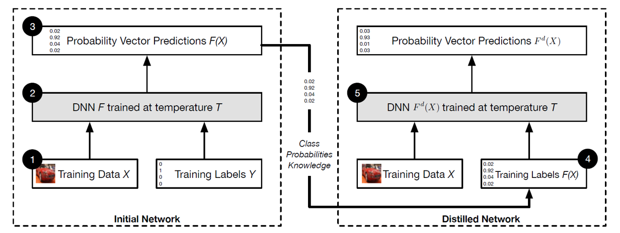
Defensive Distillation
Gradient Masking/Obfuscation – Exploding/Vanishing Gradients
Papernot (2016) Distillation as a Defense to Adversarial Perturbations against Deep Neural Networks
The two main ideas in Defensive Distillation are:
Use the predicted output probability vectors from Initial Network as soft labels for training the Distilled Network
Apply a temperature T to scale the logits when calculating softmax probabilities

Slide 21
Defensive Distillation
Gradient Masking/Obfuscation – Exploding/Vanishing Gradients
Papernot (2017) cont’d
For model training, use a high value for the temperature T (between 10 to 100)
It results in smoothened class probabilities, approaching a uniform distribution
At test time, the temperature of the Distilled Network is set back to $T=1$
This results in reduced gradients of the Distilled Network (vanishing gradients)
Also, the output probability for the true class becomes almost 1, and for all other classes the probabilities are almost 0
This makes calculation of the gradients almost impossible, and attack methods fail
Training: $T=100$
Testing$: T=1$
3
300
1
0.34
1
100
0
0.34
-3
-300
0
0.33

Slide 22
Defense-GAN
Gradient Masking/Obfuscation – Exploding/Vanishing Gradients
Samangouei (2018) Defense-GAN: Protecting Classifiers Against Adversarial Attacks Using Generative Models
Defense-GAN employs a Generative Adversarial Networks (GAN) to purify adversarial examples prior to feeding them into a given classifier
GAN is trained to model the distribution of clean unperturbed images
The generator of GAN iteratively applies gradient descent to reconstruct input images and remove adversarial perturbations
The combination of a generator and discriminator in Defense-GAN causes the final classification model to become an extremely deep network, resulting in irregular small gradients (vanishing gradients)

Slide 23
Shattered Gradients
Gradient Masking/Obfuscation - Shattered Gradients
Shattered gradients methods
These defense approaches have similarities to vanishing/exploding gradients methods, and the goal is to prevent the flow of information from the inputs to the outputs in the model
By this, the adversaries are prevented from calculating the gradients, and use them for crafting adversarial examples
A common approach toward this goal is to preprocess the input data
For example, by using a non-smooth or non-differentiable preprocessor $g(.)$for the inputs, and then train a DNN model f on the preprocessed inputs $g(x)$
The trained target classifier $f(g(.))$is not differentiable in term of inputs $x$, causing the failure of adversarial attacks

Slide 24
Shattered Gradients
Gradient Masking/Obfuscation - Shattered Gradients
Buckman (2018) Thermometer Encoding: One Hot Way to Resist Adversarial Examples
Thermometer Encoding defense applies discretization of the intensity values of each pixel into an l-dimensional vector
E.g., for $l = 10$, the value of the pixel with intensity 0.13 is replaced by a 10-dimensional vector $[0111111111]$
This data preprocessing is compared to a thermometer that measures the level of intensity of each pixel (e.g., higher intensity – hotter temperature)
The target classifier is trained using discrete vectors for all pixels, which breaks the calculation of the gradients
Experimental evaluation indicates increased robustness by the DNN models to adversarial examples

Slide 25
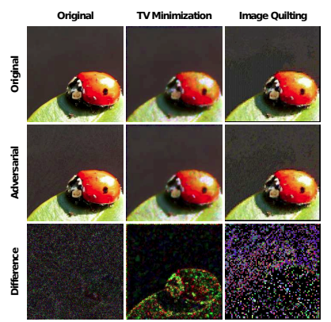
Shattered Gradients
Gradient Masking/Obfuscation - Shattered Gradients
Guo (2017) Countering Adversarial Images using Input Transformations
This work employs several image transformation approaches to break the calculation of the gradients
These include: image cropping and recalling, bit depth reduction, JPEG compression, total variance minimization, and image quilting
Total variance (TV) minimization reduces the variations among group of pixels in images
E.g., the second column shows a clean (top) and adversarial (middle) image after TM minimization
The last row shows the difference between the clean and adversarial image (the difference is emphasized by TM minimization)
Image quilting is a method to generate images by piecing together small image patches from a database
It is used to generate a corresponding image using the database of clean patches only
The right-bottom image shows that image quilting can be used to detect adversarial perturbations

Slide 26
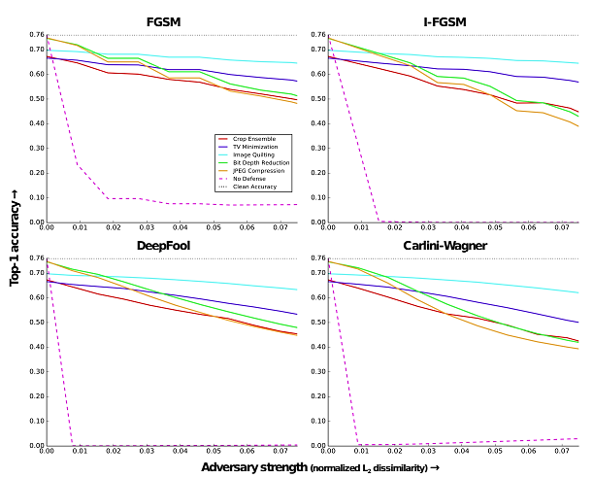
Shattered Gradients
Gradient Masking/Obfuscation - Shattered Gradients
Guo et al (2017) cont’d
Evaluation of different attacks against ResNet in black-box settings on ImageNet
X-axis: perturbation level, Y-axis: accuracy (higher is better)
The accuracy increases from almost 0% with no defense, to over 60% for most settings

Slide 27
Stochastic/Randomized Gradients
Gradient Masking/Obfuscation - Stochastic/Randomized Gradients
Stochastic/Randomized Gradients methods apply some form of randomization of the DNN model as a defense strategy to confound the adversary
E.g., train a set of classifiers, and during the testing phase randomly select one classifier to predict the class labels
Because the adversary does not which model was used for prediction, the attack success rate is reduced

Slide 28
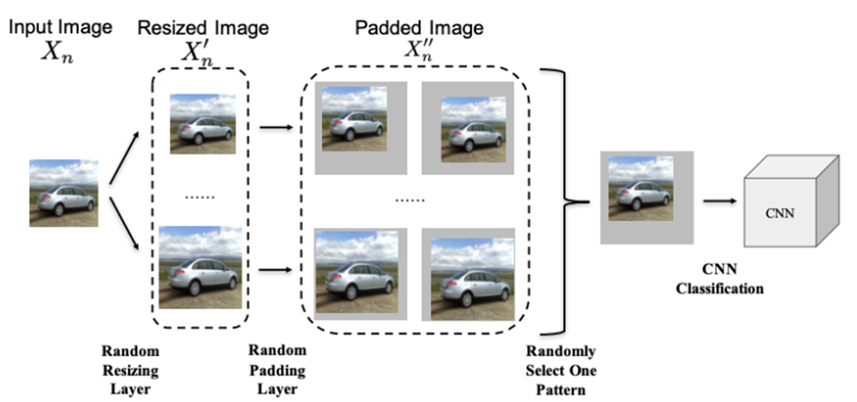
Stochastic/Randomized Gradients
Gradient Masking/Obfuscation - Stochastic/Randomized Gradients
Xie (2018) Mitigating Adversarial Effects Through Randomization
The defense approach applies random resizing and padding to improve the robustness to adversarial attacks
Images are first resized to several different widths and heights
Random padding with 0s is added to all four sides of the resized images
For each image, prediction vectors are obtained for 30 randomized versions of the image, and the average value is adopted as the final prediction

Slide 29
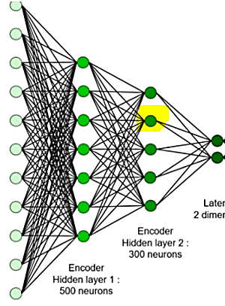
Stochastic/Randomized Gradients
Gradient Masking/Obfuscation - Stochastic/Randomized Gradients
Dhillon (2018) Stochastic Activation Pruning for Robust Adversarial Defense
Stochastic Activation Pruning removes a random subset of neurons’ activations in each layer
The remaining output activations in each layer are rescaled to normalize the inputs to the subsequent layer
This approach is similar to dropout layers, but for pruning it selects neurons with high activation values

Slide 30
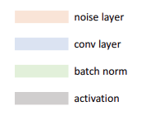
Stochastic/Randomized Gradients
Gradient Masking/Obfuscation - Stochastic/Randomized Gradients
Liu (2017) Towards Robust Neural Networks via Random Self-Ensemble
Random Self-Ensemble defense applies two approaches to introduce randomness in a classification model:
Add random noise layers before the convolutional layers in the target classifier (to prevent the gradient calculation)
In the test phase, use ensembles of NNs for predicting the output probabilistic
The added stochasticity to the model improves the robustness against adversarial attacks

Slide 31
Stochastic/Randomized Gradients
Gradient Masking/Obfuscation - Stochastic/Randomized Gradients
Lamb (2018) Fortified Networks: Improving the Robustness of Deep Networks by Modeling the Manifold of Hidden Representations
Fortified networks defense strategy:
Implement denoising autoencoders for one or many hidden layers in a deep NN
This fortifies the hidden layer and purifies it from adversarial perturbations
Injecting noise in the outputs of hidden layers applies randomness to the model
The model is trained with both clean and adversarial examples
A combined loss function reduces the classification cross-entropy error, the reconstruction error by the autoencoder on clean samples, and the reconstruction error by the autoencoder on adversarial samples

Slide 32
Robust Optimization
Robust Optimization
Robust optimization methods aim to evaluate and improve the robustness of the target classifier to adversarial attacks
These approaches change the way model parameters are learned, in order to minimize the misclassification of adversarial examples
These defense approaches can be categorized into three groups:
Adversarial training
Regularization methods
Certified defenses

Slide 33
Adversarial Training
Robust Optimization – Adversarial Training
Adversarial training is training or retraining the target classification model using adversarial examples
The training dataset is augmented with adversarial examples produced by known types of attacks
E.g., for each clean example add one adversarial example to the training set
By adding adversarial examples $x_{adv}$ with true label y to the training set, the model will learn that $x_{adv}$ belongs to the class y
Adversarial training is one of the most common adversarial defense methods currently used in practice
Possible strategies:
Train the model from scratch using both regular and adversarial examples
Train the model on regular examples, and afterward fine-tune the model with adversarial examples

Slide 34
Adversarial Training
Robust Optimization – Adversarial Training
Goodfellow (2015) Explaining and Harnessing Adversarial Examples
The paper by Goodfellow (2015) that introduced the FGSM attack suggested using adversarial training as a defense strategy
Adversarial examples created by FGSM were added to the training set to increase the model robustness
Limitation: the robust model is vulnerable to adversarial examples created by other attacks (e.g., iterative FGSM attacks)
Kurakin (2016) Adversarial Examples in the Physical World
This work suggests an improved adversarial training by creating adversarial examples for each mini-batch of train samples, and applying batch-normalization
This allowed to scale adversarial training for large datasets, like ImageNet

Slide 35
Adversarial Training
Robust Optimization – Adversarial Training
Madry (2017) Towards Deep Learning Models Resistant to Adversarial Attacks
This paper suggests using adversarial examples created with PGD for adversarial training
It is claimed that PGD is the strongest first-order (i.e., gradient-based) attack method
PGD can find the most-adversarial example $x_{adv}$ in the $ℓ_{∞}$ ball around an input sample x, $B_{ε}(x)$
The most-adversarial example $x_{adv}$ is the location in the neighborhood of x where the classifier F has the highest loss $ℒ\left(x^{′},F\right)$, i.e.,
$$x_{adv}=arg\max_{x^{′}∈B_{ε}(x)}{ℒ}\left(x^{′},F\right)$$
When the classifier F is trained on adversarial examples crafted with PGD $x_{adv}$, it learns parameters $θ$ that minimize the adversarial loss $ℒ\left(x_{adv},F\right)$
This approach uses only adversarial samples for training
The trained model demonstrated good robustness on MNIST and CIFAR-10
Due to the high computational cost for created PGD samples, it is difficult to scale to large datasets as ImageNet

Slide 36
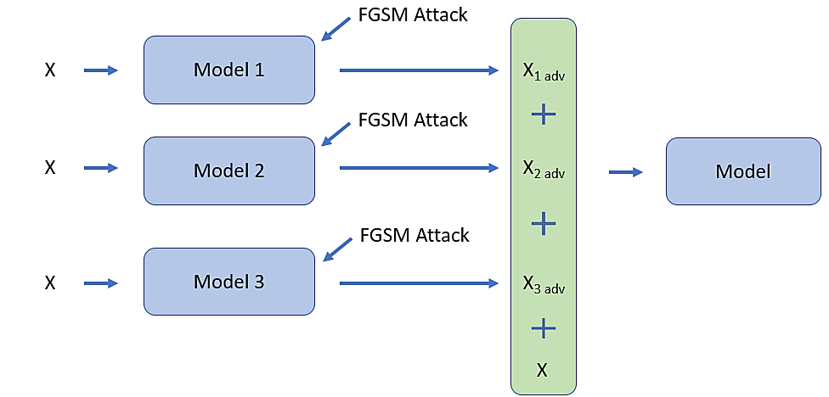
Adversarial Training
Robust Optimization – Adversarial Training
Tramer (2017) Ensemble Adversarial Training: Attacks and Defenses
Ensemble Adversarial Training employs a set of adversarial examples created by several classifiers for improved robustness
E.g., Model 1, Model 2, and Model 3 having different architectures are trained
For each input sample $x$, FGSM is used to create adversarial samples $x_{1 adv}$, $x_{2 adv}$, and $x_{3 adv}$ using the three models
A target classifier Model is trained using the clean sample $x$ and the adversarial samples created by all three models $x_{1 adv}$, $x_{2 adv}$, and $x_{3 adv}$
It results in an efficient defense against FGSM, that is also scalable to ImageNet

Slide 37
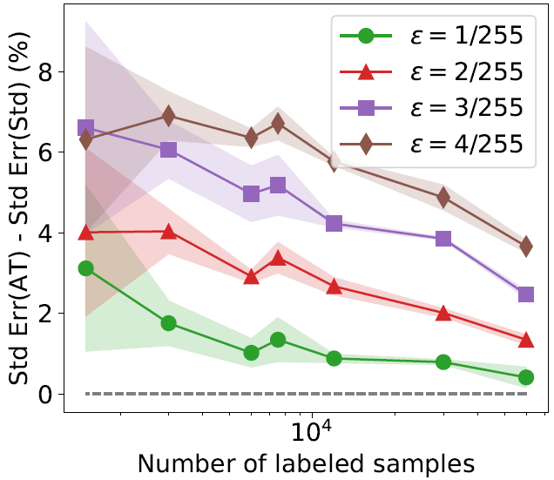
Adversarial Training
Robust Optimization – Adversarial Training
Limitation of adversarial training is reduced accuracy on clean samples, known as accuracy versus robustness trade-off
The figure depicts the difference between the classification error of an adversarially trained model - Std Err (AT), and a model trained on clean examples only - Std Err (Std)
Note that adversarial training reduced the performance (between 3% and 7%)
Increasing the size of the dataset (number of labeled samples) reduces the gap
I.e., adversarially trained model with an infinitely large dataset would not suffer from reduced accuracy
Figure from: Madry (2018) Towards Deep Learning Models Resistant to Adversarial Attacks

Slide 38
Adversarial Training
Robust Optimization – Adversarial Training
Zhang (2019) Theoretically Principled Trade-off between Robustness and Accuracy
TRADES defense method addresses the trade-off between adversarial robustness and accuracy
TRADES stands for TRadeoff-inspired Adversarial DEfense via Surrogate-loss minimization
A robust classifier is trained by minimizing the following surrogate loss:
$$ℒ\left(F\left(x\right),y\right)+{\max_{\left\|x−x′\right\|≤ε }{ℒ\left(F\left(x\right),F\left(x′\right)\right)}}/λ$$
The first term $ℒ\left(F\left(x\right),y\right)$is employed to minimize the standard (natural) error, by ensuring that to clean inputs $x$ the classifier $F$accurately assigns correct labels y
The second term $ℒ\left(F\left(x\right),F\left(x′\right)\right)$ minimizes the robust error to adversarial samples, by ensuring small difference between the predictions on clean x and adversarial $x′$ inputs
The parameter $λ$ balances the trade-off between the standard and robust error

Slide 39
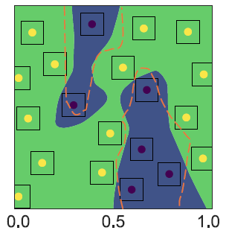
Adversarial Training
Robust Optimization – Adversarial Training
TRADES (cont’d)
Figure: binary classification problem with yellow and black (clean) data points
Dashed orange line: decision boundary of a standard (natural) classifier trained only on clean samples
Blue area: decision boundary of a robust classifier trained with TRADES
Both classifiers achieve 100% standard accuracy (correctly classify clean samples)
The blue classifier is more robust, because the second term in the loss function in TRADES $ℒ\left(F\left(x\right),F\left(x′\right)\right)$ pushes the blue decision boundary away from the data points
I.e., the classifier will have higher accuracy in classifying samples in the neighborhood of the natural data points (that is, adversarial samples)

Slide 40
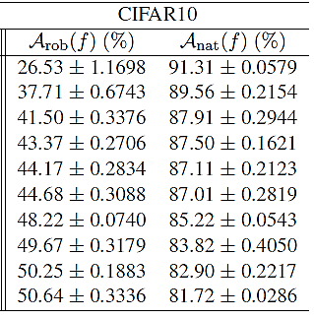
Adversarial Training
Robust Optimization – Adversarial Training
TRADES (cont’d)
Experimental evaluation on CIFAR-10
Increasing the ratio $1/{λ }$decreases the standard (natural) accuracy on clean samples $𝒜_{nat}(f)$ from 91% to 82%, but increases the robust accuracy on adversarial samples $𝒜_{rob}(f)$ from 26% to 51%

Slide 41
Adversarial Training
Robust Optimization – Adversarial Training
Raghunathan (2020) Understanding and Mitigating the Tradeoff Between Robustness and Accuracy
RST (Robust Self-Training) employs both labeled and unlabeled input examples to improve the robustness to adversarial examples
Approach:
Train a classifier model F using pairs of clean samples x and ground-truth labels y
Evaluate the classifier F on unlabeled samples $\tilde{x}$, to obtain predictions $F\left(\tilde{x}\right)=\tilde{y}$ (referred to as pseudo-labels)
Create adversarial examples $x′$for the labeled samples, and $\tilde{x}′$ for unlabeled samples
Train a robust classifier G by minimizing a combined loss consisting of terms for the standard and robust accuracy on labeled and unlabeled samples:
$$αℒ_{std−lab}\left(F\left(x\right),y\right)+βℒ_{std−unlab}\left(F\left(\tilde{x}\right),\tilde{y}\right)+γℒ_{rob−lab}\left(F\left(x′\right),y\right)\text{ +}λℒ_{rob−unlab}\left(F\left(\tilde{x}′\right),\tilde{y}\right)$$
The addition of unlabeled samples improves the trade-off in comparison to other defense methods, i.e., increases the robust accuracy and also improves the standard accuracy

Slide 42
Adversarial Training
Robust Optimization – Adversarial Training
Raghunathan (cont’d)
Performance on CIFAR-10 against wide ResNet28 model under $ℓ_{∞}$ perturbations of size $ε=8/255$
Comparison between supervised and semi-supervised (labeled and unlabeled data) methods are presented
PGD attack is used for generating adversarial samples
RST improved both the robust and standard accuracy
The authors used 50K labeled images and 500K unlabeled images
Two different versions of the robust loss $ℒ_{rob−lab}\left(F\left(x′\right),y\right)$ were implemented: PG-AT (projected gradient AT) and TRADES

Slide 43
Regularization Methods
Robust Optimization – Regularization Methods
In ML, regularization is applied during training to control the complexity of the model
E.g., $ℓ_{2}$ or $ℓ_{1}$ weight decay regularization terms can be added to the loss function to penalize large values of the model parameters $θ$
Other explicit forms of regularization in NNs are: dropout and early stopping
Implicit regularization is also achieved by batch normalization
Regularization prevents overfitting, and therefore improves generalization
Several studies applied regularization to improve the robustness to adversarial examples
The motivation is that a regularized model with small magnitudes of the model parameters $θ$ would produce smaller outputs to adversarially perturbed inputs

Slide 44
Regularization Methods
Robust Optimization – Regularization Methods
Gu (2014) Towards deep neural network architectures robust to adversarial examples
This approach called Deep Contractive Network employed a modified backpropagation method, that applies a penalty to the gradients of the loss at each layer
This reduction of the gradients also reduces the sensitivity of the model to input perturbations
Therefore, the smoothed classifier also achieves flatness around the training data points
Because of that, it is less likely that the classifier will output different predictions on perturbed data samples

Slide 45
Regularization Methods
Robust Optimization – Regularization Methods
Cisse (2017) Parseval Networks: Improving Robustness to Adversarial Examples
Parseval Networks is a defense that adds regularization terms to each layer during training to reduce the sensitivity to small perturbations
This is achieved by constraining the Lipschitz constant between any two layers in NNs
Recall that for a function $f\left(x\right)$, if a constant $ρ>0$ exists such that for all $x_{1}$, $x_{2}$
$$\left\|f\left(x_{1}\right)−f\left(x_{2}\right)\right\|≤ρ\left\|x_{1}−x_{2}\right\|$$
the function is a Lipschitz continuous function
$ρ$ is the Lipschitz constant of $f\left(x\right)$, meaning that the change between any $f\left(x_{1}\right)$and $f\left(x_{2}\right)$ is constrained by $ρ$
For a multi-layer NN $F$, consider a layer $f_{k}$ with training parameters $θ_{k}$
Constraining the output of the layer${ f}_{k}$ for a clean input $x_{1}=x$ and a corresponding adversarial input $x_{2}=x+δ$ is equivalent to:
$$\left\|f_{k}\left(x,θ_{k}\right)−f_{k}\left(x+δ,θ_{k}\right)\right\|≤L_{k}\left\|x−(x−δ)\right\|$$
i.e.,
$$\left\|f_{k}\left(x,θ_{k}\right)−f_{k}\left(x+δ,θ_{k}\right)\right\|≤L_{k}\left\|δ\right\|$$
$L_{k}$ is the Lipschitz constant of the layer $f_{k}$

Slide 46
Regularization Methods
Robust Optimization – Regularization Methods
Similarly, the Lipschitz constant of the loss function of the NN $ℒ\left(F(x), y\right)$, for input $x$and label $y$ is defined as
$\left\|ℒ\left(F(x), y\right)−ℒ\left(F(x+δ),y\right)\right\|≤L_{ℒ}\left\|δ\right\|$
The authors argue that reducing the classification loss to adversarial perturbations $ℒ\left(F\left(x_{adv}\right),y\right)$ is related to the Lipchitz constants of F via:
$$𝔼_{x\sim 𝒟}ℒ\left(F\left(x_{adv}\right),y\right)≤𝔼_{x\sim 𝒟}ℒ\left(F\left(x\right),y\right)+L_{ℒ}\sum_{k=1}^{K}{L_{k}}$$
I.e., if the loss $ℒ\left(F(x), y\right)$ is constrained by Lipschitz constant $L_{ℒ}$, and the output of each layer $f_{k}$ is constrained by the Lipschitz constant $L_{k}$, this will increase the robustness of the model F to adversarial examples
Or, penalizing the instability for each hidden layer${ f}_{k}$ should decrease the instability in the predicted outputs of the entire network F to adversarial perturbations
To enforce Lipschitzness in the above formulation, the paper employed the Parseval formula for the parameters of each layer $f_{k}$

Slide 47
Certified Defenses
Robust Optimization – Certified Defenses
Certified defenses methods verify the robustness of a trained model with respect to a metric/criterion
A certifiably robust classifier should have consistent predictions in a neighborhood around any input sample x (e.g., a neighborhood ball over $ℓ_{2}$ or $ℓ_{∞}$ norm)
Considering the critical function of ML models in many applications, even if the model is deceived by one adversarial example can have important consequences
Designing ML models that are certified to be robust to adversarial perturbations under certain assumptions is an key direction for AML
For example, the work by Raghunathan (discussed later in the lecture) produced a certificate for MNIST that guarantees that no attack with perturbation smaller than $ε=0.1≈25/255$ can cause more than 35% test error
Even if the adversary has full access to the classifier and dataset, the certificate should hold under the provided conditions
Two commonly used metrics for verifying model robustness are:
Lower bound of the minimal perturbation
Upper bound of the adversarial loss

Slide 48
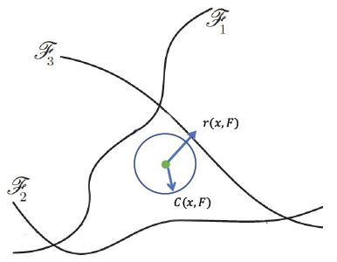
Certified Defenses
Robust Optimization – Certified Defenses
Lower bound of the minimal perturbation
Robustness of an input sample $x$: for a trained model $F$ it is the ball of the minimal perturbation distance, $r\left(x,F\right)=\left\|δ_{min}\right\|$
Within the ball $r\left(x,F\right)$, the model correctly classifies all inputs $x+δ$
Robustness for the population of input samples $D$: for a trained model $F$it is the expected value of $r\left(x,F\right)$ over all x, ${ρ\left(F\right) \text{=} 𝔼}_{x\sim D}\left[r\left(x,F\right)\right]$
The larger the expected minimal perturbation $ρ\left(F\right)$, the more robust the model is
A trainable certificate $C\left(x,F\right)$ aims to calculate the lower bound of $r\left(x,F\right)$ to verify the model robustness, i.e. $C\left(x,F\right)≤r\left(x,F\right)$
The certificate guarantees that the model $F$ is safe against any perturbation within the ball limited by $C\left(x,F\right)$

Slide 49
Certified Defenses
Robust Optimization – Certified Defenses
Upper bound of the adversarial loss
Most-adversarial example: for a trained model $F$ it is the sample $x_{adv}$ in the $ε$-ball of the example $x$ that has the largest loss $ℒ\left(F(x′), y\right)$, that is, $x_{adv}=\underset{x′}{arg max}{ℒ\left(F(x′), y\right)}$ for $\left\|x−x′\right\|≤ε$
This is the point in the neighborhood of x where the model is the most likely to be deceived
Adversarial loss for an input sample $x$: for a trained model $F$ it is the loss value of the most-adversarial example in the $ε$-ball, $ℒ_{adv}\left(F(x), y\right)=ℒ\left(F(x_{adv}), y\right)$
Adversarial loss for the population of input samples $D$: for a trained model $F$ it is the expectation of the loss values over all x, ${ℛ_{adv}\left(F\right) \text{=} 𝔼}_{x\sim D}\left[ℒ_{adv}\left(F(x), y\right)\right]$
The lower the expected adversarial loss $ℛ_{adv}\left(F\right)$, the more robust the model is
A trainable certificate $U\left(x,F\right)$ can be used to calculate the upper bound of $ℒ_{adv}\left(F(x), y\right)$ to verify the model robustness , i.e. $U\left(x,F\right)≥ℒ_{adv}\left(F(x), y\right)$

Slide 50
Certified Defenses
Robust Optimization – Certified Defenses
Hein (2017) Formal Guarantees on the Robustness of a Classifier against Adversarial Manipulation
The proposed approach derives a certificate $C\left(x,F\right)$ as a lower bound for the minimal perturbation
To calculate the certificate for a one-layer NN, the authors employed the Cross-Lipschitz Theorem, where the certificate is given by
$$C\left(x,F\right)=\max_{ε>0}{min\left\{\min_{i≠j}\frac{F_{y}\left(x\right)−F_{i}\left(x\right)}{\max_{\left\|x−x′\right\|≤ε }\left\|F_{y}\left(x′\right)−F_{i}\left(x′\right)\right\|},{ε}\right\}}$$
The certificate aims to reduce the differences in the predictions by the classifier $F_{i}\left(x\right)$ in the $ε$-ball
I.e., it guarantees that the model is safe against perturbations smaller than $C\left(x,F\right)$
Recent works have also scaled certified defenses to larger and deeper NNs than one-layer nets

Slide 51
Certified Defenses
Robust Optimization – Certified Defenses
Raghunathan (2018) Certified Defenses against Adversarial Examples
The work uses the loss function proposed in Carlini & Wagner, based on the logits difference for the true class $Z_{y}\left(x′\right)$ and second-closest class $\max_{i≠j}{Z_{i}\left(x′\right)}$
I.e., the loss is $ℒ\left(F(x′), y\right)=\max_{i≠j}{Z_{i}\left(x′\right)−Z_{y}\left(x′\right)}$
As stated before, the adversarial loss for a model F is the loss for the most-adversarial sample in the $ε$-ball of $x$, i.e., $ℒ_{adv}\left(F(x), y\right)= \underset{x′}{arg max}{ℒ\left(F(x′), y\right)}$ for $\left\|x−x′\right\|≤ε$
The approach uses integration inequalities to derive a certificate $U\left(x,F\right)$ for an one-layer NN, and then uses semi-definite optimization to solve the certificate
The certificate is an upper bound of the adversarial loss, $U\left(x,F\right)≥ℒ_{adv}\left(F(x), y\right)$
If $U\left(x,F\right)<0$, then $ℒ\left(F(x), y\right)<0$, meaning that the classifier will assign the largest score to the true label y in the $ε$-ball
The goal is to train a model that has the smallest average value $U\left(F\right)$ over the input samples $x$, so that more inputs will have $U\left(x,F\right)<0$
On MNIST, the approach produced a certificate that no attack with perturbation smaller than $ε=0.1≈25/255$ can cause more than 35% test error

Slide 52
Ensemble Adversarial Training: Attacks & Defenses
Presented by Chris McVickar

Slide 53
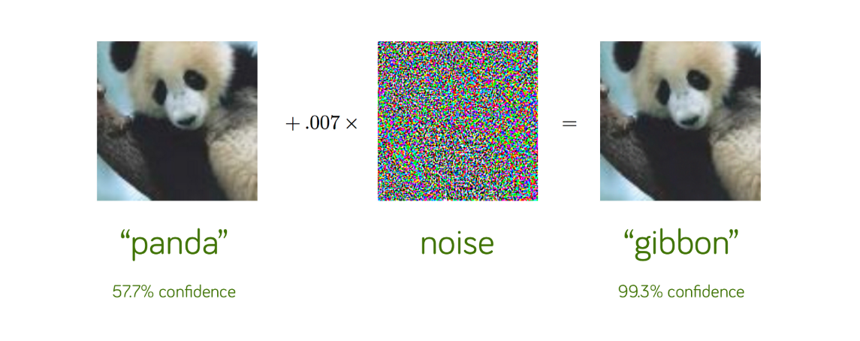
Adversarial Attacks
A Review
An adversarial attack is input perturbed to trick a machine learning model
ML models are vulnerable to adversarial attacks
Adversarial examples can transfer across models

Slide 54
Adversarial Training
Adds adversarial examples to a model’s training set
Decrease vulnerability to adversarial attacks

Slide 55
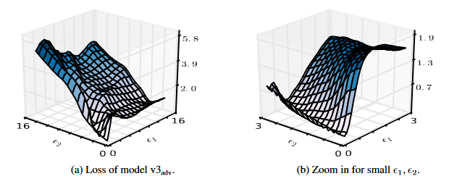
Adversarial Training
White-Box Robustness
Can become robust to white-box attacks
Scaling results to ImageNet-sized tasks has been difficult
Gradient masking

Slide 56
Adversarial Training
Black-box Robustness
Kurakin et al. adversarially trained an Inception v3 model on ImageNet
Adversarial examples were generated with single-step methods based on linearization of the model’s loss
Model was robust to single-step perturbations, still vulnerable to costlier methods
These attacks failed to transfer between models, they concluded their model to be robust against black-box attacks (not the case)
Examples based on undefended models often transfer to adversarially-trained models

Slide 57
Ensemble Adversarial Training
Adversarial examples from other models are added to a model’s training set
Increases diversity of adversarial examples seen by model
Decouples noise from the model’s weights
Increased robustness to transferred single- and multi-step attacks

Slide 58
Experiments
General Training vs.
Adversarial Training vs.
Ensemble adversarial training

Slide 59
Attacks
Used to generate adversarial examples
Fast Gradient Sign Method (FGSM), Projected Gradient Descent (PGD)
Single-Step Least-Likely Class Method (Step-LL)
Targeted FGSM
Target is the least-likely class
Most effective for adversarial training on ImageNet
Iterative Attack (I-FGSM or Iter-LL)
Applies multiple iterations of FGSM or Step-LL
For fixed ε, induce higher error rates than single-step attacks
Transfer at lower rates
R+ attacks
R+FGSM, R+Step-LL, R+attack
Adds small amounts of random perturbations to some attack method

Slide 60
White-Box attacks
Target
Target
 | v4 | v3 | v3_{adv} | IRv2 | IRv2_{adv}
Step-LL | 60.2 | 69.6 | 26.6 | 50.7 | 21.4
R+Step-LL | 70.5 | 80.0 | 64.8 | 56.3 | 37.5
Iter-LL(2) | 78.5 | 86.3 | 58.3 | 69.9 | 41.6
 | v4 | v3 | v3_{adv} | IRv2 | IRv2_{adv}
Step-LL | 31.0 | 42.7 | 9.0 | 24.0 | 5.8
R+Step-LL | 42.8 | 57.1 | 37.1 | 29.3 | 15.0
Iter-LL(2) | 56.2 | 70.2 | 29.6 | 45.4 | 16.5
Attack
Attack
Top 1
Top 5
Error rates (in %) of adversarial examples
Element at (attack, target) is the error rate of target with images generated with attack
Subscript “adv” denotes an adversarially-trained target
Best attack for each target appears in bold

Slide 61
Transfer attacks
Source
Source
 | v4 | v3 | v3_{adv} | IRv2 | IRv2_{adv}
v4 | 60.2 | 39.2 | 31.1 | 36.6 | 30.9
v3 | 43.8 | 69.6 | 36.4 | 42.1 | 35.1
v3_{adv} | 36.3 | 35.6 | 26.6 | 35.2 | 35.9
IRv2 | 38.0 | 38.0 | 30.8 | 50.7 | 31.9
IRv2_{adv} | 31.0 | 30.3 | 25.7 | 30.6 | 21.4
 | v4 | v3 | v3_{adv} | IRv2 | IRv2_{adv}
v4 | 31.0 | 14.9 | 10.2 | 13.6 | 9.9
v3 | 18.7 | 42.7 | 13.0 | 17.8 | 12.8
v3_{adv} | 13.6 | 13.5 | 9.0 | 13.0 | 14.5
IRv2 | 14.1 | 14.8 | 9.9 | 24.0 | 10.6
IRv2_{adv} | 10.3 | 10.5 | 7.7 | 10.4 | 5.8
Target
Target
Top 1
Top 5
Error rates (in %) of adversarial examples transferred between models
Element at (target, source) is the error rate of target with images generated from source
Subscript “adv” denotes an adversarially-trained target
Step-LL with ε = ¹⁶/₂₅₆
Best attack for each target appears in bold

Slide 62
Ensemble Adversarial Training
Training Procedure
Pre-trained models
Set aside some models for ensemble adversarial training
Generated adversarial images with models
Set aside some models and their adversarial images aside as holdout
Trained models with ensemble adversarial training
Each batch consisted of clean and perturbed images
Source model of perturbed images were selected at random for each batch
Used Step-LL, R+Step-LL, FGSM, I-FGSM, and PGD attacks
Reported worst-case error rate over all black-box attacks

Slide 63
Pre-trained Models
Models for generating adversarial images
Holdout models
Models for ensemble adversarial training

Slide 64
Models used
With ImageNet
Trained Model | Pre-Trained Model | Holdout Models
Inception v3 (v3_{adv-ens3}) | Inception v3, ResNet v2 (50) | Inception v4
Inception v3 (v3_{adv-ens4}) | Inception v3, ResNet v2 (50), IncRes v2 | ResNet v1 (50)
IncRes v2 (IRv2_{adv-ens}) | Inception v3, IncRes v2 | ResNet v2 (101)

Slide 65
RESULTS
Model | Clean | Step-LL (WB) | Max. Black-Box
v3 | 22.0 | 69.6 | 51.2
v3_{adv} | 22.0 | 26.6 | 40.8
v3_{adv-ens3} | 23.6 | 30.0 | 34.0
v3_{adv-ens4} | 24.2 | 43.3 | 33.4
IRv2 | 19.6 | 50.7 | 44.4
IRv2_{adv} | 19.8 | 21.4 | 34.5
IRv2_{adv-ens} | 20.2 | 26.0 | 27.0
Model | Clean | Step-LL (WB) | Max. Black-Box
v3 | 6.1 | 42.7 | 24.5
v3_{adv} | 6.1 | 9.0 | 17.4
v3_{adv-ens3} | 7.6 | 10.1 | 11.2
v3_{adv-ens4} | 7.8 | 19.4 | 10.7
IRv2 | 4.8 | 24.0 | 17.8
IRv2_{adv} | 4.9 | 5.8 | 11.7
IRv2_{adv-ens} | 5.1 | 7.6 | 7.9
Top 1
Top 5
Error rates (in %)
Subscript “adv” denotes an adversarially-trained model
Subscript “adv-ens” denotes an ensemble-adversarially-trained model

Slide 66
Models used
With MNIST
A | B | C | D
Conv(64, 5, 5) + Relu | Dropout(0.2) | Conv(128, 3, 3) + Tanh | FC(300) + Relu Dropout(0.5)
Conv(64, 5, 5) + Relu | Conv(64, 8, 8) + Relu | MaxPool(2, 2) | FC(300) + Relu Dropout(0.5)
Dropout(0.25) | Conv(128, 6, 6) + Relu | Conv(64, 3, 3) + Tanh | FC(300) + Relu Dropout(0.5)
FC(128) + Relu | Conv(128, 5, 5) + Relu | MaxPool(2, 2) | FC(300) + Relu Dropout(0.5)
Dropout(0.5) | Dropout(0.5) | FC(128) + Relu | FC + Softmax
FC + Softmax | FC + Softmax | FC + Softmax | ---------------------------------

Slide 67
RESULTS
Model | Clean | FGSM (WB) | Max. Black-Box | Avg. Black-Box
A_{adv} | 0.8 | 2.2 | 10.8 | 7.7
A_{adv-ens} | 0.8 | 7.0 | 6.6 | 5.2
A_{adv-ens3} | 0.7 | 5.4 | 6.5 | 4.3
B_{adv} | 0.8 | 11.6 | 8.9 | 5.5
B_{adv-ens} | 0.7 | 10.5 | 6.8 | 5.3
B_{adv-ens3} | 0.8 | 14.0 | 8.8 | 5.1
C_{adv} | 1.0 | 3.7 | 29.3 | 18.7
C_{adv-ens} | 1.3 | 1.9 | 17.2 | 10.7
C_{adv-ens3} | 1.4 | 3.6 | 14.5 | 8.4
D_{adv} | 2.6 | 25.5 | 32.5 | 23.5
D_{adv-ens} | 2.6 | 21.5 | 38.6 | 28.0
D_{adv-ens3} | 2.6 | 29.4 | 29.8 | 15.6
Error rates (in %)
Subscript “adv” denotes an adversarially-trained model
Subscript “adv-ens” denotes an ensemble-adversarially-trained model

Slide 68
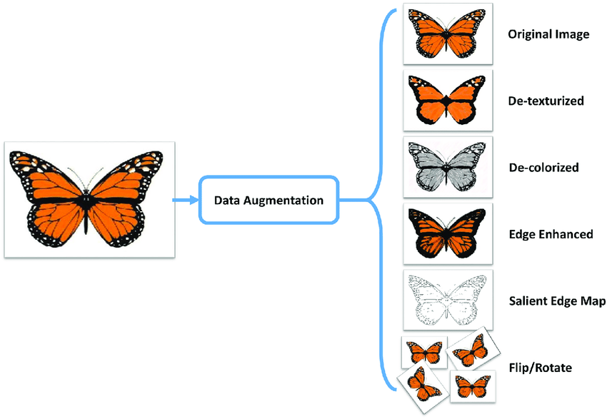
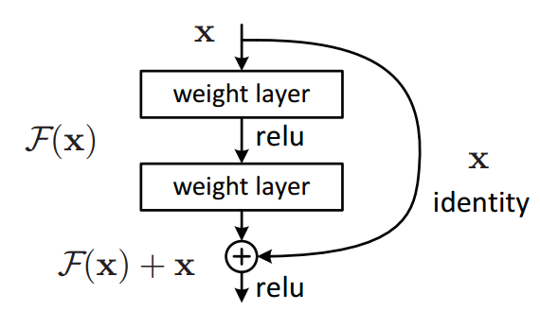
Subsequent Work
Black-box attacks
More recent optimization techniques improve the transferability of black-box attacks
Reduces accuracy of ensemble-adversarially-trained network to 22%

Slide 69
Subsequent Work
Adversarial Training
More popular than ensemble adversarial training
Adversarial training with multi-step attacks scaled to ImageNet
Considered state-of-the-art for white- and black-box attacks
Adversarial training with single-step R+FGSM

Slide 70
Summary
Adversarial training
Training models with adversarial images
Can be effective against some white-box attacks
Recent work has improved on robustness
Ensemble adversarial training
Training models with adversarial images generated from other models
Can be more effective against black-box attacks than regular adversarial training
Generally less effective against white-box attacks and clean images than regular adversarial training

Slide 71
Questions?

Slide 72
Citations
Alexey Kurakin, Ian Goodfellow, and Samy Bengio. Adversarial machine learning at scale. In ICLR, 2017b
Dan Boneh et al. Ensemble Adversarial Training: Attacks and Defenses. In ICLR 2018

Slide 73
Defensive Distillation
Defensive Distillation
Defensive Distillation
Papernot (2016) Distillation as a Defense to Adversarial Perturbations against Deep Neural Networks
The paper applies the approach of knowledge distillation in NNs to reduce the effectiveness of adversarial attacks
This defense strategy obfuscates the gradients of NNs
Since most attack approaches rely on the gradients for creating adversarial samples
Results: significantly reduced success rate of JSMA adversarial samples
MNIST: from 95.89% to 0.45% success rate
CIFAR-10: from 87.89% to 5.11%
Defensive distillation was effective against AML attacks when first introduced in 2016
Following works (e.g., Carlini & Wagner in 2017) showed that adversarial attacks can be developed that are resilient to defensive distillation

Slide 74
Knowledge Distillation in NNs
Defensive Distillation
The concept of knowledge distillation in NNs was first introduced by Hinton et al. in 2014
G. Hinton, O. Vinyals, and J. Dean, “Distilling the Knowledge in a Neural Network,” in NeurIPS 2014.
Knowledge distillation is the process of transferring knowledge from a large NN to a smaller NN
The goal is to achieve similar performance (accuracy) with the smaller NN model
Motivation:
Knowledge distillation is motivated by reducing the computational cost for training or testing large NN models
E.g., use a smaller NN model for image classification on a resource-constrained device, such as a cell phone

Slide 75
Knowledge Distillation in NNs
Defensive Distillation
In knowledge distillation, first a large network (Network 1 below, or teacher) is trained
Then, the obtained output probability vectors produced by Network 1 are used as soft labels to train a smaller network (Network 2, or student)
The aim is Network 2 to achieve approximately the same accuracy as Network 1, even though it has smaller capacity
Network 1
Network 2

Slide 76
Defensive Distillation
Defensive Distillation
Defensive distillation applies the concept of knowledge distillation for defense training
Approach:
Train Network 1
Use the predicted outputs by Network 1 as soft labels to train Network 2
Soft labels: have the output probability for each class (e.g., 0.1, 0.02, …, 0.05)
In addition, to obtain the output probabilities, the logit values are divided by a constant T (called the temperature)
Train Network 2
Apply a constant temperature T again for the output probabilities
Network 1 and Network 2 have the same structure for distillation (Network 2 is not smaller)
Motivation:
The above approach causes small changes in the output class probabilities when the inputs (e.g., image pixels) to the network are changed
In other words, the gradients of the network with respect to the inputs are small
This prevents adversaries from using gradient attacks to create adversarial examples

Slide 77
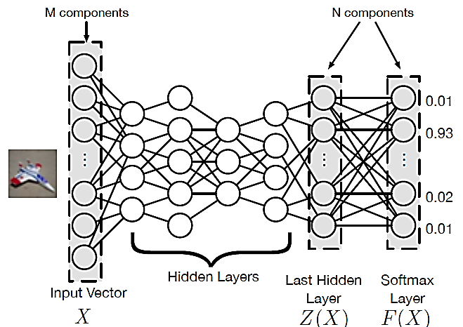
Defensive Distillation
Defensive Distillation
Deep NNs are commonly trained using hard labels as inputs, such as one-hot vectors
E.g., the label [0,0,1] assigns 100% to the ground-truth class (class 3), and 0% probability to the class 1 and class 2
The output is a probability vector over the class of all possible labels, $F(X)$

Slide 78
Defensive Distillation
Defensive Distillation
Defense distillation uses the vector of class-probabilities $F(X)$ from the Initial Network (Network) 1 as soft labels for training Distilled Network (Network 2)
This allows the Distilled Network to have additional knowledge about the training data X, regarding not only their true class label, but also about the probability of belonging to other classes
E.g., the soft label [0.02, 0.92, 0.04, 0.02] in the figure is more informative than the hard label [0, 1, 0, 0]

Slide 79
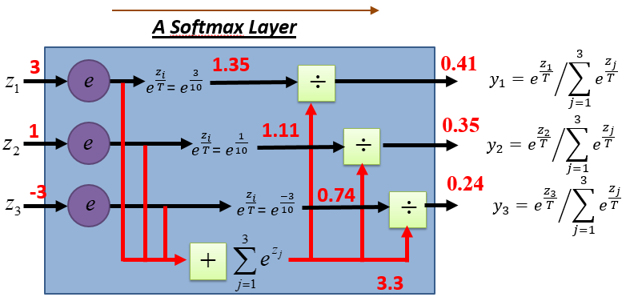
Defensive Distillation
Defensive Distillation
For N-class classification, the softmax probability for class i is $F\left(X\right)=\left[\frac{e^{z_{i}}}{\sum_{j=1}^{N}{e^{z_{j}}}}\right]$
In defensive distillation, the softmax probability for class i is obtained by dividing the logits by a parameter T (the temperature), $F\left(X\right)=\left[\frac{e^{\frac{z_{i}}{T}}}{\sum_{j=1}^{N}{e^{\frac{z_{j}}{T}}}}\right]$
$$E.g., T=10$$

Slide 80
Defensive Distillation
Defensive Distillation
The value of the temperature T is set to be greater than $1$
Higher values of T result in large probabilities for each class
For $T→∞$, the probabilities for each class approach uniform distribution, i.e., they are $1/N$ for all classes
$$T=1$$
$$T=5$$
$$T=10$$
$$T=50$$
$$T=100$$
3
0.88
0.48
0.41
0.35
0.34
1
0.11
0.32
0.35
0.33
0.34
-3
0.01
0.20
0.24
0.32
0.33

Slide 81
Defensive Distillation
Defensive Distillation
Both the Initial Network $F\left(X\right)$ and the Distilled Network $F_{d}\left(X\right)$ are trained with a high softmax temperature
At test time, the temperature is set back to $T=1$
This causes the logits to be increased by a factor of $T$
The output probabilities will have a value close to 1 for the true class
Training: $T=100$
Testing$: T=1$
3
300
1
0.34
1
100
0
0.34
-3
-300
0
0.33

Slide 82
Defensive Distillation
Defensive Distillation
The use of high temperature values improves the smoothness of the distilled model $F_{d}\left(X\right)$ compared to the initial model $F\left(X\right)$
This makes the distilled model less sensitive to small changes in the inputs (e.g., applied via adversarial attacks)
Experiments show that distillation at high temperatures can decrease the gradients by factors up to 10³⁰
Similarly, increased robustness is observed for models trained on MNIST and CIFAR-10

Slide 83
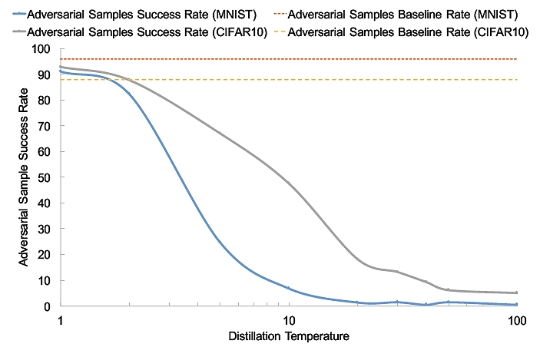
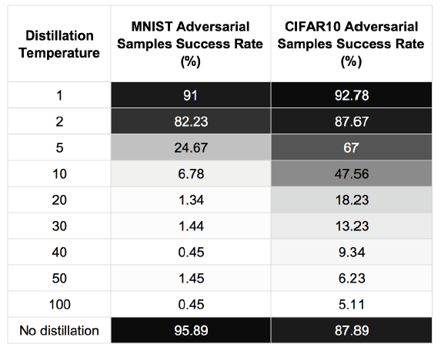
Experimental Evaluation
Defensive Distillation
Plots of the success rate for adversarial examples created by JSMA versus the distillation temperature for MNIST and CIFAR-10
Increasing the temperature makes creating adversarial samples more difficult
The attack success rate is reduced to 0.45% for MNIST, and 5.11% for CIFAR-10
After some point (50 to 100 depending on the dataset), further increase of the temperature does not reduces the success rate

Slide 84
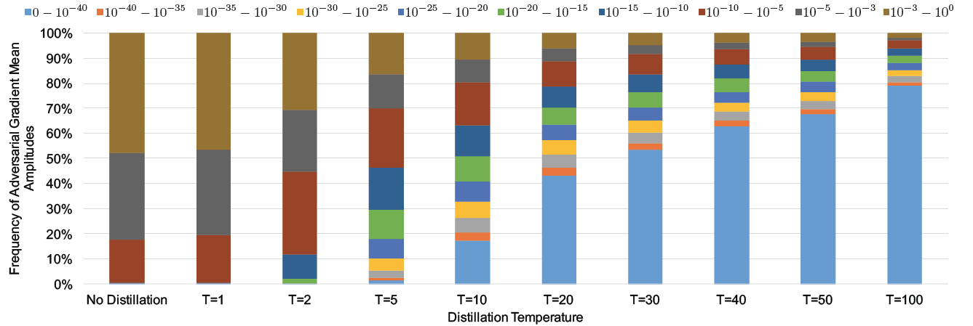
Experimental Evaluation
Defensive Distillation
Increasing the temperature T results in reducing the values of the gradients
E.g., for $T =100$(right-most bar) most gradients have very small values (0 to 10⁻⁴⁰)

Slide 85
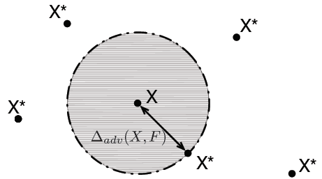
Model Robustness
Defensive Distillation
A robust ML model is less sensitive to adversarial perturbations to the inputs
A robust model should have good accuracy on the training and testing dataset
This property is also referred to as generalization
A robust model should output consistent predictions for all inputs in the neighborhood of a sample
The notion of neighborhood can be defined by a norm (e.g., an $ℓ_{p}$ norm)
The idea of robustness of a classification model $F$in the neighborhood of an input $X$ is illustrated in the figure
The larger the neighborhood $∆_{adv}\left(X,F\right)$ around the input $X$ is, the more robust the model $F$ is
$X^{∗}$ is the closest adversarial sample to $X$among all possible adversarial samples
The prediction by the model $F$ for all samples located inside the shaded circle will be correct (classified as the true-class label)
Outside the shaded circle, the model $F$ will classify all samples $X^{∗}$ differently than $X$

Slide 86
Model Robustness
Defensive Distillation
For an input distribution P, the robustness of a trained DNN model $F$, $ρ_{adv}\left(F\right)$, is measured as
$${ρ_{adv}\left(F\right)\text{=}𝔼}_{X\sim P}\left[∆_{adv}\left(X,F\right)\right]$$
The term $∆_{adv}\left(X,F\right)$ is related to the minimal perturbation $δ$required to misclassify the sample $X$ in each of the other classes
$$∆_{adv}\left(X,F\right)=\min\left\{\left\|δ\right\|:F\left(X+δ\right)≠F\left(X\right)\right\}$$
I.e., the proposed measure of robustness of the model $F$ for the sample $X$ is the norm of the minimal perturbation $δ$
The higher the norm of the minimal perturbation required to misclassify all input samples, the more robust the model is to adversarial samples
For a trained DNN $F\left(X\right)$, the robustness is estimated by the average value of the minimal perturbation for a test dataset of M samples, i.e.,.
$$ρ_{adv}\left(F\right)≈\frac{1}{M}\sum_{i}{\min_{δ_{i}}\left\|δ_{i}\right\|=\frac{1}{M}\sum_{i}{∆_{adv}\left(X_{i},F\right)}}$$

Slide 87
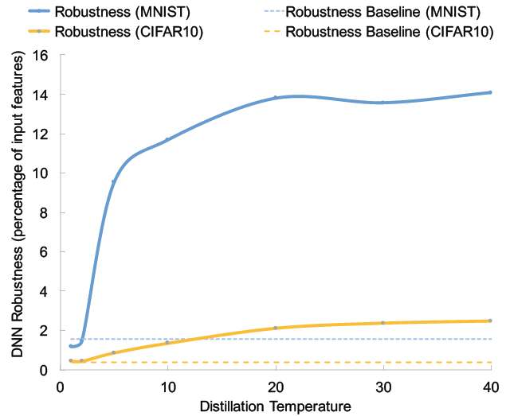
Experimental Evaluation
Defensive Distillation
Robustness for the DNN models trained on MNIST and CIFAR-10 versus the distillation temperature $T$
The robustness increases with the temperature (up to some point)

Slide 88
MagNet Defense
MagNet
MagNet defense
Meng (2017) MagNet: a Two-Pronged Defense against Adversarial Examples
Defense approach:
Apply a detector network to detect adversarial examples
Follow by a reformer network to clean adversarial perturbations
Advantages:
MagNet does not require knowledge of the attack approach for generating adversarial examples
It does not modify the target classifier model
Is effective for defending against different adversarial attack methods

Slide 89
MagNet Approach
MagNet
MagNet consists of 2 components:
Detector – an autoencoder model that rejects adversarial examples
If the input x is far from the distribution of clean samples, reject it and refuse to send it to the Target Classifier
I.e., this autoencoder removes adversarial samples with large perturbations
Reformer – an autoencoder model that cleans adversarially-perturbed examples
Given an example x, reform it to find a corresponding example x’ that is purified from adversarial perturbations
The output of the reformer is fed to the Target Classifier
The goal is to label x’ with the true class y

Slide 90
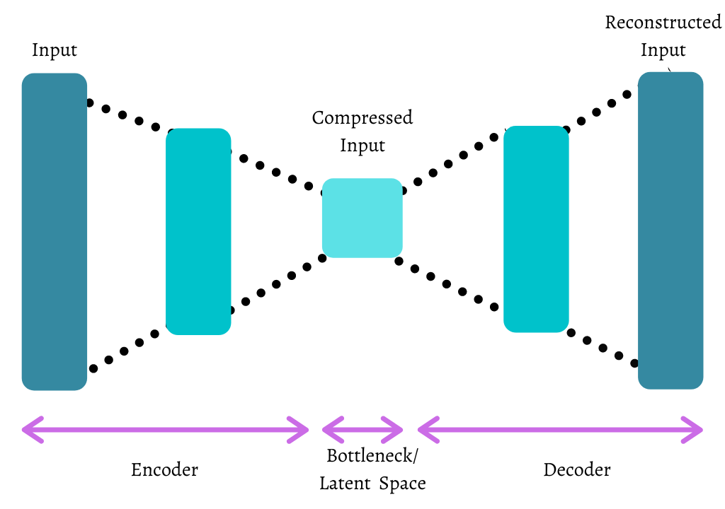
MagNet Detector
MagNet
The detector in MagNet is an autoencoder NN
It is trained only on clean examples
At test time, inputs that have a large reconstruction error are rejected as adversarial
This is similar to the approaches for anomaly detection using autoencoders
An autoencoder (AE) with an encoder $f_{enc}(x)$ and decoder $f_{enc}(z)$ network, is given with the function $f_{dec}\left(f_{enc}(x)\right)$
AE is trained to minimize a loss function on the train dataset, $ℒ_{AE}\left(𝕏_{train}\right)$
The loss is commonly the average mse difference (i.e., reconstruction error) between all inputs $x∈𝕏_{train}$ and their predicted reconstructions ${\hat{x}=f}_{dec}\left(f_{enc}(x)\right)$
I.e., $ℒ_{AE}\left(𝕏_{train}\right)=\frac{1}{\left|𝕏_{train}\right|}\sum_{x∈𝕏_{train}}{{\left\|x−\hat{x}\right\|}_{2}}$

Slide 91
MagNet Detector
MagNet
The reconstruction error for an input sample is
$$E\left(x\right)={\left\|x−\hat{x}\right\|}_{2}={\left\|x−f_{dec}\left(f_{enc}(x)\right)\right\|}_{2}$$
Since the model is trained only on clean samples, the reconstruction error for unseen clean samples will be small
At test time:
If $E\left(x\right)<threshold$, the input $x$ is labeled as a clean sample
If $E\left(x\right)≥threshold$, the input $x$ is labeled as an adversarial sample
This requires to select a threshold value
If the threshold is too small, it will create false alarms (flags clean samples as adversarial, i.e., false negatives)
If the threshold is too large, it will miss adversarial samples (flags them as clean samples, i.e., false positives)
A validation set of clean inputs was used to select the threshold value

Slide 92
MagNet Detector
MagNet
To further improve the detector, the authors introduced an additional loss term
The loss reduces the difference in the predictions by the Target Classifier $F(x)$ on clean inputs $x$and reconstructed inputs by the autoencoder ${\hat{x}=f}_{dec}\left(f_{enc}(x)\right)$
Let’s denote the outputs on clean images $P=F(x)$, and the outputs on reconstructed images $Q=F\left(\hat{x}\right)$
Jensen-Shannon (JS) divergence was used to measure the distance between the two distributions P and Q
Recall that JS divergence is a symmetric version of the Kullback-Leibler (KL) divergence (e.g., see Lecture 3), and it is defined as
$$D_{JS}\left(P||Q\right)=\frac{1}{2}D_{KL}\left(P||M\right){+\frac{1}{2}D}_{KL}\left(Q||M\right)$$
In the above, M is the average of the two distributions P and Q, i.e., $M=\frac{1}{2}\left(P+Q\right)$
KL divergence is $D_{KL}\left(P||Q\right)=\sum_{x_{i}}{P\left(x_{i}\right)}$ $\log{\frac{P(x_{i}) }{Q\left(x_{i}\right)}}$
In the implementation of the loss, for calculating the softmax class probabilities $F(x)$ the authors used scaled logit values $z_{i}$ by a temperature (T), similar to the defensive distillation approach
I.e., $F\left(x\right)={e^{\frac{z_{i}}{T}}}/{\sum_{j=1}^{N}{e^{\frac{z_{j}}{T}}}}$

Slide 93
MagNet Reformer
MagNet
The reformer is also an autoencoder network, that is trained to clean adversarial images of adversarial perturbations
This is similar to the approach of denoising autoencoders
The reformer is also trained on clean samples with added Gaussian noise
This results in AE reconstructions of adversarial samples that are purified of the perturbations, and hence, are close to the distribution of clean samples

Slide 94
Gray-box Attacks
MagNet
MagNet is not an effective defense against white-box attacks
I.e., if the adversary has full access to the decoder, reformer, and target classifier, it will be possible to create adversarial examples
The paper focuses on black-box and gray-box attacks
Grey-box attack – the adversary knows the structure, hyper-parameters, training set, training epochs of the models, but does not have access to the model parameters (weights)
Due to the random initialization of NNs, the model parameters are different at every run
MagNet proposes to use a collection of autoencoders as detectors and reformers
During training, a term is added that penalizes the resemblance of the autoencoders
At test time, randomly pick one of the trained autoencoders for each session
This makes it more difficult to create adversarial samples, because the adversary will not know which of the set of autoencoders was used for that session

Slide 95
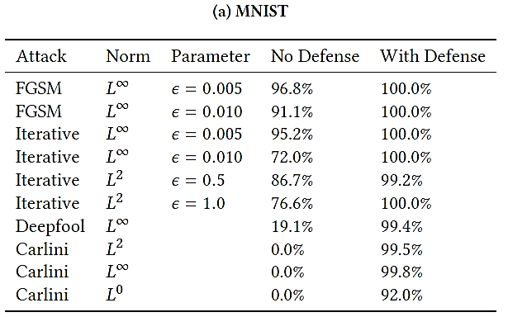
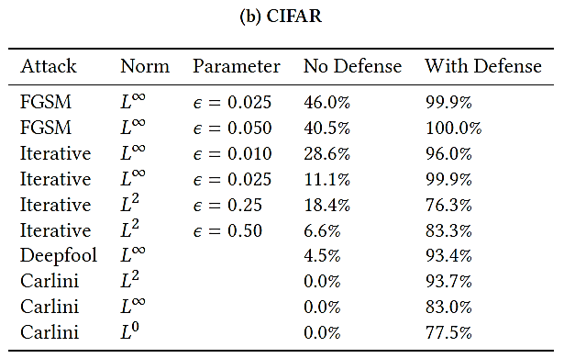
Experimental Evaluation
MagNet
Results from the implementation against black-box attacks
MagNet effectively defends against FGSM, Iterative FGSM, DeepFool, and C&W attacks on MNIST and CIFAR-10
It is especially effective against C&W, as the best attack at the time of publication

Slide 96
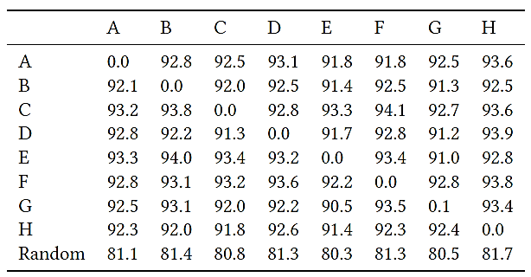
Experimental Evaluation
MagNet
Results from the implementation against gray-box attacks
8 autoencoders (denoted A to H) are trained, and evaluated against C&W attack
Columns: autoencoder that the attack is trained on
Row: autoencoder the attack is tested on
Last row – Random: one of the 8 AEs is picked randomly
The defense is largely successful and achieves high accuracy on adversarial samples

Slide 97
Fortified Networks
Fortified Networks
Fortified networks
Lamb (2018) Fortified Networks: Improving the Robustness of Deep Networks by Modeling the Manifold of Hidden Representations
Defense approach:
Apply denoising autoencoders to one or many hidden layers in a deep NN
This fortifies the hidden layer and purifies it from adversarial perturbations
Experimental evaluation indicates that denoising hidden layers in NNs has advantages over denoising input images

Slide 98
Fortified Networks
Fortified Networks
Example of a fortified autoencoder NN with input image x and one hidden layer $h_{k}$
The approach injects Gaussian noise to the output of the hidden layer $h_{k}$
The reconstruction by the autoencoder is $h_{k}^{decoded}=f_{encoded}\left(f_{decoded}\left(h_{k}\right)\right)$
The hidden layer $h_{k}$ is called a fortified layer
The reconstruction error between $h_{k}$ and $h_{k}^{decoded}$ is:
$$ℒ_{rec}=\frac{1}{\left|𝕏_{train}\right|}\sum_{x∈𝕏_{train}}{{\left\|h_{k}−h_{k}^{decoded}\right\|}_{2}}$$

Slide 99
Fortified Networks
Fortified Networks
The model is also fed adversarial examples $\tilde{x}$(e.g., crafted with FGSM)
Gaussian noise is also applied to the output of the hidden layer $\tilde{h_{k}}$
The reconstruction of the corresponding layer $\tilde{h_{k}}$ by the autoencoder is${\tilde{h_{k}}}^{decoded}$

Slide 100
Fortified Networks
Fortified Networks
The overall loss for training the model is:
$${ℒ=ℒ}_{c}\left(y\right)+ℒ_{c}\left(\tilde{y}\right)+λ_{rec}\sum_{k}{ℒ_{rec,k}}+λ_{adv}\sum_{k}{ℒ_{adv,k}}$$
$ℒ_{c}\left(y\right)$ and $ℒ_{c}\left(\tilde{y}\right)$ are the cross-entropy losses for classifying clean samples $y$and adversarial samples $\tilde{y}$
$ℒ_{rec,k}$ are the losses for minimizing the reconstruction error between each layer $h_{k}$ and $h_{k}^{decoded}$, given by $ℒ_{rec,k}=\frac{1}{\left|𝕏_{train}\right|}\sum_{x∈𝕏_{train}}{{\left\|h_{k}−h_{k}^{decoded}\right\|}_{2}}$
$ℒ_{adv,k}$ are the adversarial losses for minimizing the reconstruction error between each layer $h_{k}$ and the corresponding layer ${\tilde{h_{k}}}^{decoded}$for the adversarial sample, and are given by $ℒ_{adv,k}=\frac{1}{\left|𝕏_{train}\right|}\sum_{x∈𝕏_{train}}{{\left\|h_{k}−{\tilde{h_{k}}}^{decoded}\right\|}_{2}}$

Slide 101
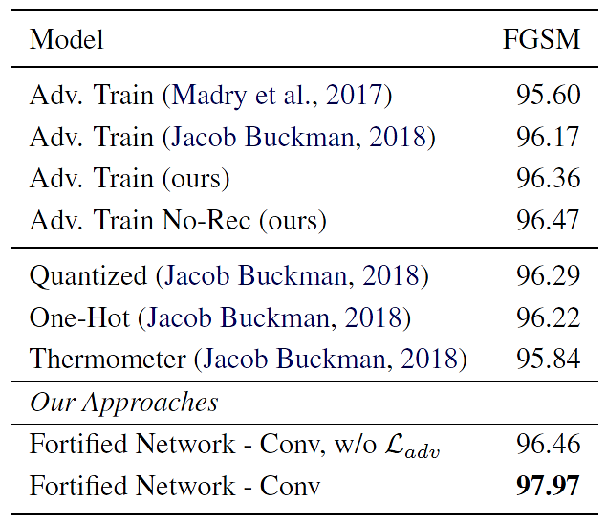
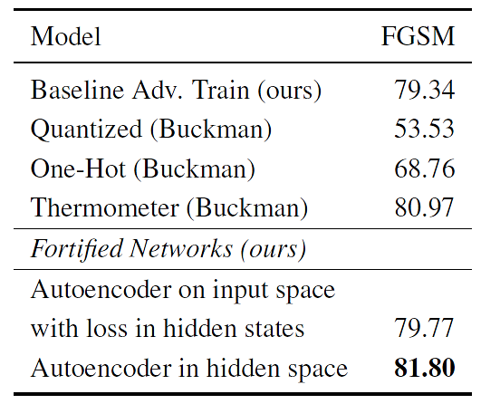
Experimental Evaluation
Fortified Networks
Comparison to other adversarial defenses against white-box attacks with FGSM on MNIST (left) and CifAR-10 datasets (right table)
Results for fortified network without $ℒ_{adv}$ is also shown
Fortified networks were more effective than other defenses

Slide 102
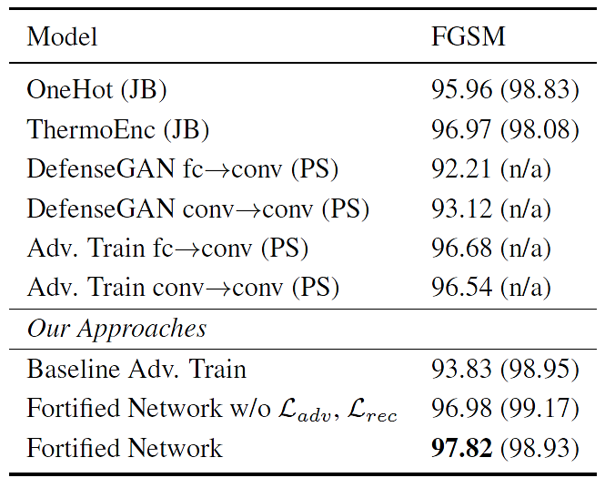
Experimental Evaluation
Fortified Networks
Comparison to other adversarial defenses against black-box attacks with FGSM on MNIST
Test set accuracy on clean samples is shown in parentheses

Slide 103
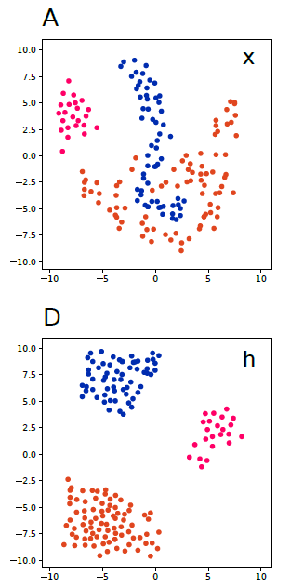
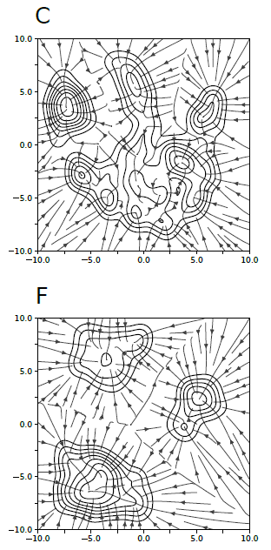
Motivation
Fortified Networks
Hidden layers in NNs provide better separation of classes than the pixels in input images
Denoising the hidden layers is more effective for purifying adversarial samples
Left figures: input space, right figures: reconstructions by autoencoders
Top row: input image x
Bottom row: hidden layer h
There are 3 classes of objects
The classes are not well separated in the input (pixels) space in comparison to the hidden layer space
Thus, identification of adversarial examples in the input space is more difficult than in the hidden layers
Right figures: it is easier to identify directions of the reconstructions by adversarial samples that point off the three classes in the bottom right image

Slide 104
Feature Squeezing
Feature Squeezing
Feature squeezing defense
Xu (2017) Feature Squeezing: Detecting Adversarial Examples in Deep Neural Networks
The defense strategy considers two methods for reducing the information in the input features in images
Reducing the number of bits for representing the intensities of pixels in images
Applying spatial smoothing to images to reduce the differences among the individual pixels
Experimental evaluation demonstrated that feature squeezing can effectively detect adversarial examples crafted by different adversarial attacks
The approach can also remove adversarial perturbations in images, while preserving the accuracy on clean inputs

Slide 105
Color Depth Reduction
Feature Squeezing
Grayscale images typically have $2^{8}=256$ intensity values for each pixel
Where a pixel with intensity of 0 is black, and intensity of 1 is a white pixel
Color images have 3 channels – RGB (red, blue, and green)
The 3 channels encode $2^{24}=16$million different colors for the intensity of each pixel
Squeezing color bits – is reducing the number of bits for each pixel in an image
E.g., for the grayscale image from MNIST, the figure shows variants with the number of bits reduced from $2^{8}=256$ intensities to $2^{1}=2$ intensities
The last image has only 2 bits (black and white pixels only, no gray pixels)
256 128 64 32 16 8 4 2

Slide 106
Color Depth Reduction
Feature Squeezing
Similarly, images from CIFAR-10 and ImageNet with reduced color bits are shown below
The intensity values in each of the RGB channels are reduced from 8 bits to 1 bit
Color images loose more information by bits reduction in comparison to gray images
I.e., the right-most images are less recognizable
CIFAR-10
ImageNet

Slide 107
Color Depth Reduction
Feature Squeezing
Examples of an MNIST image (left-most image) and the corresponding adversarially manipulated images with different attacks
The same images with a reduced number of bits to 1 bit per pixel
Most of the adversarial perturbations are removed in the reduced bit images
Except for methods that rely on $ℓ_{0}$ norms, such as C&W-$ℓ_{0}$ and JSMA

Slide 108
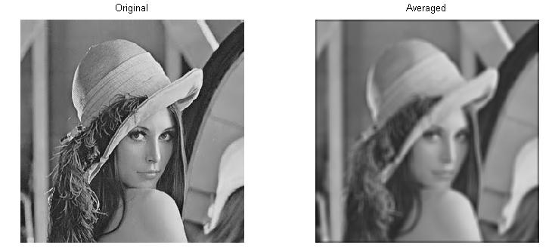
Spatial Smoothing
Feature Squeezing
Spatial smoothing is a group of image-processing techniques for reducing image noise
These techniques can be categorized into:
Local smoothing methods
Non-local smoothing methods
Local smoothing methods use the neighboring pixels to smooth each pixel
Common local smoothing (filtering) methods include: median smoothing, mean smoothing, and Gaussian smoothing
Mean smoothing example
Picture from: Decision Based Adaptive Gradient Mean Filter (DBAGM)

Slide 109
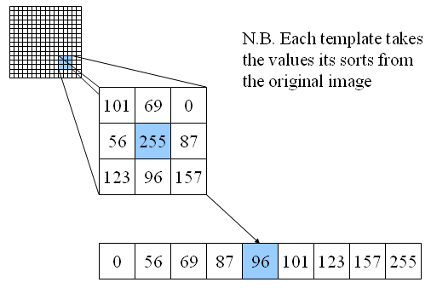
Spatial Smoothing
Feature Squeezing
The authors found that median smoothing is the most suitable for mitigating adversarial examples
Median filter runs a sliding window over each pixel of the image, where the center pixel is replaced by the median value of the neighboring pixels within the window
E.g., in the figure the value 255 for the center pixel will be replaced with the median value in the 3x3 window, which is 96
The median filter squeezes features out of the sample by making adjacent pixels more similar
Picture from: https://www.southampton.ac.uk/~msn/book/new_demo/median/

Slide 110
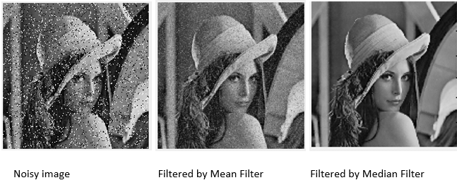
Spatial Smoothing
Feature Squeezing
Median smoothing is particularly effective at removing sparsely-occurring black and white pixels in an image (known as salt-and-pepper noise), while preserving edges of objects
Such smoothing is also effective in removing the adversarial perturbations added to the pixels based on the gradient information
Picture from: Decision Based Adaptive Gradient Mean Filter (DBAGM)

Slide 111
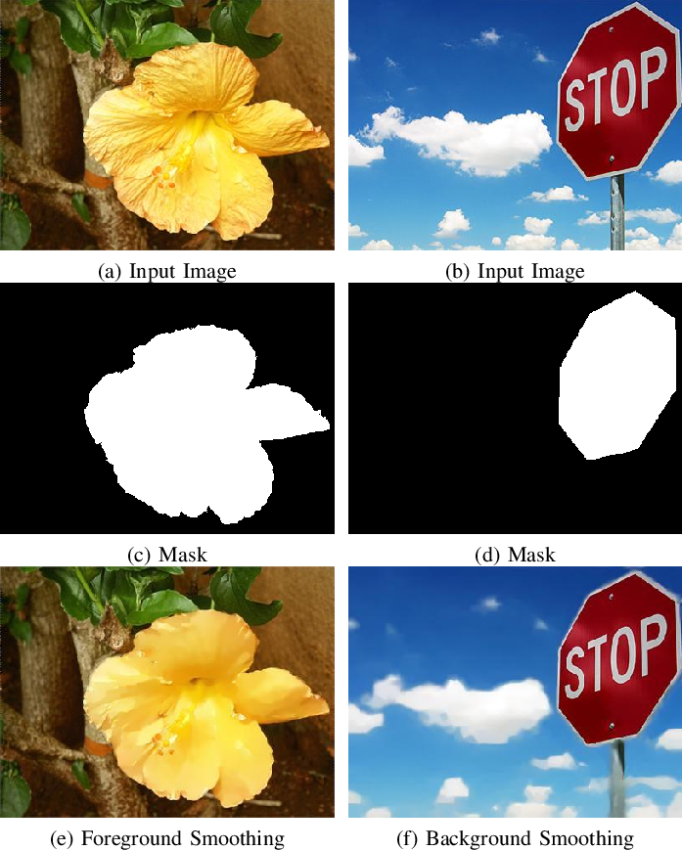
Spatial Smoothing
Feature Squeezing
Non-local smoothing is applied to a larger area in an image, instead of only to the neighboring pixels
A whole patch in an image is smoothed, by replacing the pixels with the median or mean values of all pixels in the patch (apply to the mask in the second row)
Picture from: Liu Hou - Non-local Image Smoothing with Objective Evaluation

Slide 112
Experimental Evaluation
Feature Squeezing
Evaluation on MNIST
The used attacks are organized in columns based on the norm: $ℓ_{∞}$, $ℓ_{2}$, $ℓ_{0}$ attacks
Following attacks are used: FGSM, BIM, C&W $ℓ_{∞}$, DeepFool, C&W $ℓ_{2}$, C&W $ℓ_{0}$, JSMA
For targeted attacks, the Next column is the next probable label to the ground-truth label, and LL column is the least-likely class label
The last column Legitimate is the accuracy on clean (legitimate) images
The defense should not reduces significantly the accuracy of 99.43%
Bit depth defense is successful for $ℓ_{∞}$ and $ℓ_{2}$ attacks, but less for $ℓ_{0}$ attacks
E.g., for C&W $ℓ_{∞}$ attack, bit depth reduction increases the accuracy from 0% to 100%
Median smoothing defense is effective for $ℓ_{0}$ attacks, less for $ℓ_{∞}$ and $ℓ_{2}$ attacks
E.g., for C&W $ℓ_{0}$ attack, the accuracy is increased from 0% to 67% (Next) or 59% (LL)

Slide 113
Experimental Evaluation
Feature Squeezing
Evaluation on CIFAR-10 and ImageNet
4 and 5-bit depth reduction increase the accuracy on attacked samples
Median smoothing is also effective for these datasets
However, it decreases the accuracy on Legitimate images (e.g., from 94.84% to 89.29% for CIFAR-10)

Slide 114
Combined Feature Squeezing
Feature Squeezing
To combine the impact of both bit depth reduction and spatial smoothing, the following framework is proposed
The predicted class-probability vector by the model is compared to the predicted vectors by Squeezer 1 (bit reduction) and Squeezer 2 (spatial smoothing)
If the $ℓ_{1}$ difference between the prediction by the original model and either of the squeezers is greater than a threshold T, the sample is flagged as adversarial

Slide 115
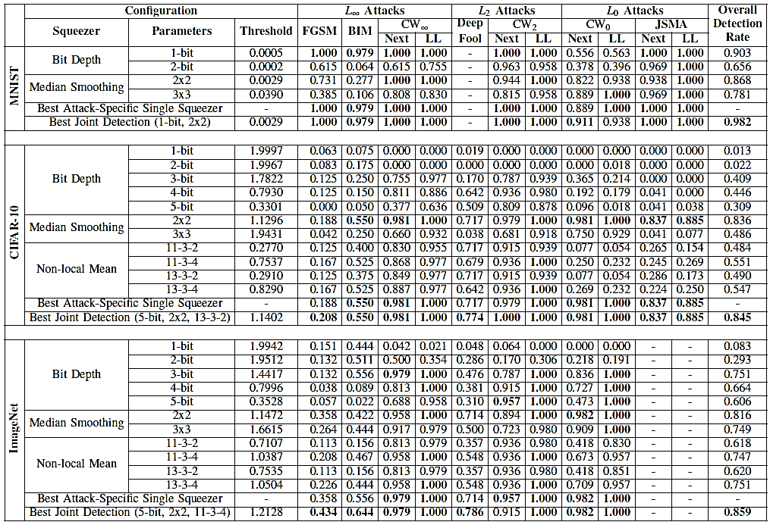
Experimental Evaluation
Feature Squeezing
Results from the combined feature squeezing framework for adversarial detection
Detection rates of 0.982, 0.845, and 0.859 were obtained for the three datasets

Slide 116
Defenses against Evasion attacks
Understanding and Mitigating the Tradeoff between Robustness and Accuracy
Presented by David Waters

Slide 117
Outline
Introduction
Definitions and Equations
Analysis
Robust Self-Training (RST)
Related Work
Conclusion
References / Questions

Slide 118
INTRODUCTION
Adversarial attacks
Adversarial training
Inherent tradeoffs to adversarial training
Precise characterizations for error in linear regression
Robust self-training (RST)
Notes:
Adversarial training augments the training set with perturbations to improve the robust error (over worst-case perturbations), but it often leads to an increase in the standard error (on unperturbed test inputs).
This paper addresses these tradeoffs and provides some precise descriptions for characterizing the effect of augmentation on the standard error in linear regression when the optimal linear predictor has zero standard and robust error.
Additionally, this paper also discusses the robust self-training estimator and the benefits it can provide.

Slide 119
Definitions
Adversarial attack – minimally perturbing an image so that the classifier mislabels the image, but the image is perceived as its true label
Adversarial training – training a model with the inclusion of adversarial images (with their true labels) to improve the model’s robust error
Robust Error – the error on worst-case perturbed inputs
Standard Error – the error on unperturbed inputs
Robust Self-Training (RST) – a robust variant of self-training that overcomes the sample complexity barrier of learning a model with low robust error by leveraging extra unlabeled data
Notes:
First, some terminology – robust error and standard error. Explain them.
The paper states that previous works attempted to explain the tradeoff between standard error and robust error in two settings:
When no accurate classifier is consistent with the perturbed data
And when the hypothesis class is not expressive enough to contain the true classifier.
In both cases, the tradeoff is still there, even with an infinite amount of data.
The paper notes that they were able to show empirically that the gap between the standard error of adversarial training and standard training decreases as the labeled data size increases, suggesting that the tradeoff could disappear with infinite data

Slide 120
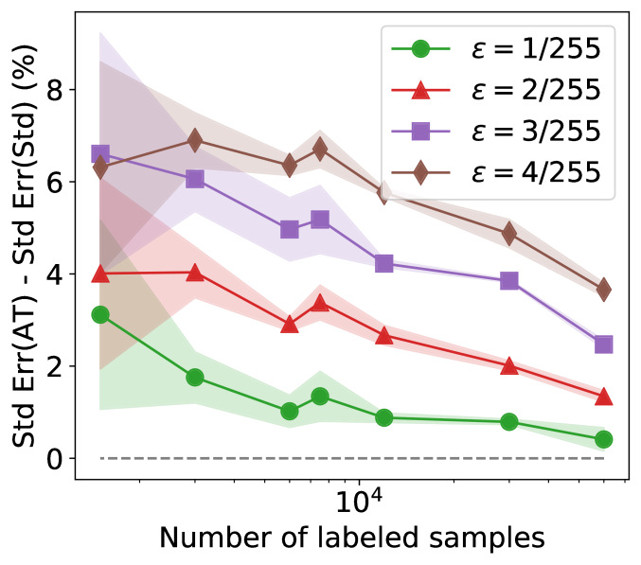
Shrinking Gap with Increasing Sample size
Gap between the standard error of adversarial training with L_inf perturbations and standard training. Note that the gap decreases as the training set size increases.

Slide 121
Explaining the tradeoff between standard and robust error that takes generalization from finite data into account
A linear model is considered, where the true linear function has zero standard and robust error.
Adversarial training augments the original training set with extra data.
The paper shows that the augmented estimator (the minimum norm interpolant of the augmented data) could have a larger standard error than the standard estimator.
This stems from overparameterization.
If the restricted hypothesis class is overparameterized, the inductive bias of the estimation procedure has a key role in determining the generalization of a model.

Slide 122
Cubic Smoothing Splines Example
The underlying distribution P_x denoted by size of the circles.
With a small number of standard training samples (purple circles), an augmented estimator that fits local perturbations (green x’s) has a large error.
Robust self-training regularizes the predictions of an augmented estimator towards the predictions of the standard estimator, resulting in small error on test points and their perturbations.
Notes:
The predictor obtained via standard training (dashed blue) is a line that captures the global structure and obtains low error.
Training on augmented data with locally consistent perturbations of the training data (green x’s) restricts the hypothesis class by encouraging the predictor to fit the local structure of the high-density points (larger circles).
You then get the cubic spline predictor (orange) which minimizes the second derivative on the augmented data, and misses/compromises the global structure, resulting in poor performance on the tails.

Slide 123
Setup
Defining and Understanding the Landscape

Slide 124
Terminology
$input:\text{x}\text{ ∈ }\text{X}\text{ ⊆} {\text{R}}^{d}$
$target:\text{y}\text{ ∈ }\text{Y}$
$distribution: P_{\text{xy}}$
$predictor: f_{\text{θ}}\text{: }\text{X}\text{ → }\text{Y}$
$loss function:l$
$true parameter:{\text{θ}}^{∗}$
$measurement matrix: X_{\text{std}}, i.e. , \text{[}x_{\text{1}}\text{,}x_{\text{2}}\text{, . . .}{ x}_{\text{n}}\text{] > ∈ }{\text{R}}^{nxd}$
$target vector: y_{\text{std}}, i.e.,\text{ [}y_{\text{1}}\text{,}{ y}_{\text{2}}\text{, . . .}{ y}_{\text{n}}\text{] > ∈}{ \text{R}}^{n}$
$set of perturbations:T(x)$
$population covariance:$
$projection maxtrix onto Null(X_{\text{std}}$):
$projection maxtrix onto Null(X_{\text{ext}};X_{\text{std}}$):
Notes:
Note on subscripts:
Std = standard Rob = robust
Aug = augmented Ext = extra

Slide 125
Equations
$Standard error =$
$Robust error=$
$for consistent perturbations T\left(x\right) that satisfy$
Notes:
The consistent perturbations include things such as small rotations, horizontal flips, brightness changes, or contrast changes

Slide 126
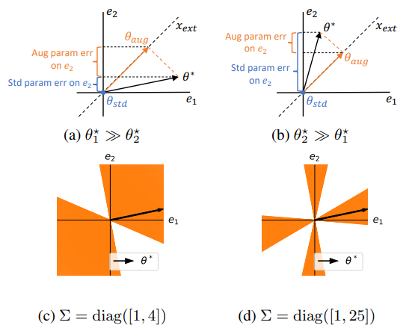
Example Illustration
(a)-(b) Effect of augmentation on parameter error for different true parameters θ*.
(c)-(d) Dependence of space of safe augmentations on the population covariance Σ.

Slide 127
Theorem 1
The difference in the standard errors of the standard estimator and augmented estimator can be described as follows:
and vector can be decomposed into a sum of two orthogonal components and such that
Notes:
So, the paper gives this precise characterization of the difference in the standard errors of [ theta_hat_std ] and [ theta_hat_aug ].
The increase in standard error of the augmented estimator can be understood in terms of the vectors w and v defined here. The first term [ v^T sigma v ] is always positive and corresponds to the decrease in the standard error of the augmented estimator [ theta_hat_aug ] due to the fitting of extra training points in some directions.
The second term however [ 2w^T sigma v ] can be negative and measures the cost of a possible increase in the parameter error along other directions.
When you get a situation where the cost outweighs the benefit, the standard error of [ theta_hat_aug ] is larger.

Slide 128
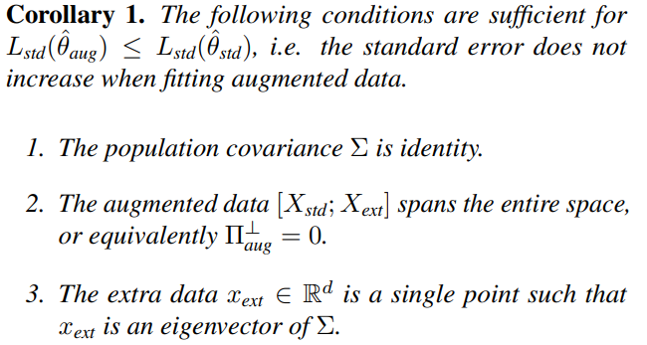
Corollary to Theorem 1

Slide 129
Model complexity
Notes:
In other words, this proposition states that for a large increase in standard error upon augmentation, the true parameter [ theta* ] needs to be sufficiently more complex in the L_2 norm than the standard estimator [ theta_hat_std ]
Referencing the cubic splines example, that example relies on the underlying staircase function being more complex with additional local structure than the standard estimator. As it is a linear estimator, and fits most of the points, it can be learned in only a few samples.

Slide 130
Robust self-Training
The Heart of the Paper

Slide 131
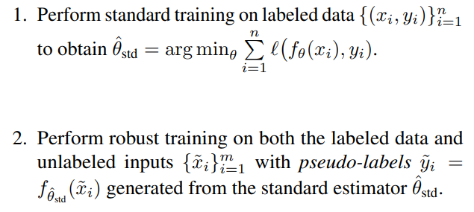
General formulation of RST​
Notes:
The paper starts this section off by describing the general two-step procedure for robust self-training, outlined in Carmon et al. 2019 and Uesato et al. 2019 for a parameteric model f_theta

Slide 132
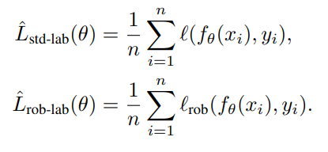
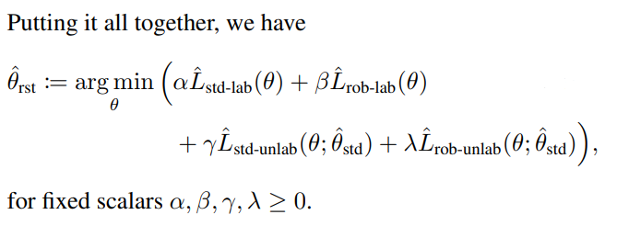
RST estimator minimizes four separate losses
Notes:
The labeled dataset ranges from 1 to n and the unlabeled dataset ranges from 1 to m.
Note, the unlabeled samples are pseudo-labeled by the standard estimator.
When analyzing the robust self-training estimator for linear regression, with consistent perturbations, we get a special case:
The robust labeled, standard labeled, and robust unlabeled losses are zero.
[ next slide ]

Slide 133
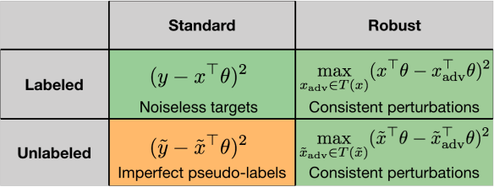
Four components of RST linear Regression
The four components of the Robust Standard Training (RST) loss in the special case of linear regression. Green cells are hard constraints where the optimal true parameter θ* obtains zero loss. The orange cell contains the soft constraint that is minimized while satisfying hard constraints to obtain the final linear RST estimator.
Notes:
Due to the special case of linear regression and specializing to the case of noiseless linear regression, the paper states that the three green cells can be shown to equal zero.
Hard constraints are the cells in green.
The soft constraint is the orange cell, which is minimized while satisfying the hard constraints to obtain the final linear robust self-training estimator.

Slide 134
Theorem 2
Notes:
The crux of this second theorem is that the optimization objective of robust self-training is an inductive bias that regularizes the estimator to be close to the standard estimator, weighing directions by their contribution to the standard error via the population covariance.
By incorporating an appropriate population covariance-induced regularizer while satisfying constrains on the robust losses, robust self-training ensures that the standard error of the estimator never exceeds the standard error of the standard estimator.

Slide 135
Generalization of how robust self-training works
RST captures the global structure of a problem and obtains low standard error by matching the standard estimator on unlabeled inputs.
At the same time, RST enforces invariance on local transformations on both labeled and unlabeled inputs and obtains low robust error by capturing the local structure across the domain.
In essence, for a noiseless linear regression model, RST results in lower standard error and lower robust error.
Notes:
Read slides, then:
Since robust self-training regularizes towards the standard estimator.

Slide 136
Performance of RST applied to different Adversarial training algorithms
CIFAR-10 standard and robust test accuracy again L_inf perturbations of size ε = 8/255. Robust accuracies are against a PG based attack with 20 steps.
CIFAR-10 standard and robust test accuracy against a grid attack of rotations up to 30 degrees and translations up to ~10% of the image size.
Notes:
We can see the performance of robust self-training here in these tables from the paper. This is probably the most interesting summarized piece within the paper.
Shaded rows make use of 500K unlabeled images from 80M Tiny Images sourced in (Carmon et al. 2019)
RST improves both the standard and robust accuracy over the vanilla counterparts for different algorithms and different perturbations

Slide 137
Effect of data augmentation on test error
As the training samples increase, the increase in test error decreases for the plot of the difference in errors of the augmented estimator and standard estimator (a).
(b) Robust Self Training (RST + AT) not only mitigates the increase in test error from adversarial training, but even improves test error beyond that of the standard estimator.
Notes:
Robust self-training achieves lower standard error than standard training across all sample sizes for small perturbations while simultaneously achieving lower robust error than adversarial training.
When looking specifically at small data amounts, in other words the area where default adversarial training negatively impacts standard error the most, the paper finds that robust self-training plus adversarial training gives a 3-times more absolute improvement than in the large data set sizes.

Slide 138
Related works
Tradeoff between standard and robust error through study of simple models:
Robust self-training proposal:
Tsipras et al. (2019)
Zhang et al. (2019)
Fawzi et al. (2018)
Nakkiran (2019)
Carmon et al. (2019)
Najafi et al. (2019)
Uesato et al. (2019)

Slide 139
SUMMARY
Adversarial training implies an inherent tradeoff between accuracy and robustness.
Even in a sample setting of noiseless linear regression, where the true linear function has zero standard and robust error, adversarial training increases the standard error.
In linear regression, robust self-training is shown in this paper to help mitigate this tradeoff, reducing both standard error and robust error.
Notes:
Adversarial training implies a tradeoff between standard error and robust error. Due to the mismatch between the inductive bias of models and the underlying distribution of the inputs, this causes the standard error to increase even if the augmented data (such as adversarial training) is perfectly balanced.
Robust self-training is introduced and built upon in this paper. In linear regression, robust self-training can help eliminate this tradeoff by incorporating an appropriate regularizer that utilizes the distribution of inputs using additional unlabeled data to estimate that distribution.
This paper shows that both the standard error and robust error are improved by the use of robust self-training, mitigating the tradeoff between accuracy and robustness.

Slide 140
References
https://deepai.org/publication/understanding-and-mitigating-the-tradeoff-between-robustness-and-accuracy
https://arxiv.org/pdf/2002.10716.pdf

Slide 141
THANK YOU
Questions?

Slide 142
Randomized Smoothing Certificate
Randomized Smoothing Certificate
Cohen (2019) Certified Adversarial Robustness via Randomized Smoothing
This work employs Randomized Smoothing to design a classifier that is certifiably robust to adversarial perturbations under the $ℓ_{2}$ norm
It introduced the first certificate on ImageNet
E.g., the certificate guarantees top-1 accuracy with ResNet50 on ImageNet of 49% under adversarial perturbations with norm $ℓ_{2}<0.5$
Previous certified defenses were designed for smaller datasets, and were difficult to scale to larger NN models that are commonly used for ImageNet
The main idea is to apply Gaussian noise to input images, and use the most probable class on the perturbed images as a robust prediction
Robustness is achieved by overpowering small adversarial perturbations with large random Gaussian perturbations
Advantages:
A simple approach that can be applied to large NNs
It does not make any assumptions about the used target classifier

Slide 143
Randomized Smoothing Certificate
Randomized Smoothing Certificate
Assume we have a target classifier f that maps inputs x to labels y, i.e., $f(x)=y$
The approach creates corrupted versions of the image x by applying isotropic Gaussian noise with $0$ mean and variance $σ^{2}$, i.e., $ε\sim 𝒩\left(0,σ^{2}I\right)$
Left figure: input sample $x;$ Right figure: image corrupted with Gaussian noise $x+ε$
A smoothed classifier g is obtained by adopting the most probable class by the classifier f on many noise-corrupted images $x+ε$
The added random noise improves the robustness to adversarial perturbations

Slide 144
Randomized Smoothing Certificate
Randomized Smoothing Certificate
To design a smoothed classifier g at the input sample x requires to identify the most likely class ${\hat{c}}_{A}$ returned by the target classifier f on noisy images
Step 1: create n versions of x corrupted with Gaussian noise $ε\sim 𝒩\left(0,σ^{2}I\right)$
Step 2: evaluate the predictions by target classifier for all corrupted images, $f(x+ε)$
Step 3: identify the top two classes ${\hat{c}}_{A}$ and ${\hat{c}}_{B}$ with the highest number of predictions on $f(x+ε)$
Step 4: if $n_{A}$ (number of predictions by f for the top class ${\hat{c}}_{A}$) is much greater than $n_{B}$ (number of predictions for the second highest class ${\hat{c}}_{B}$), return ${\hat{c}}_{A}$ as the prediction by $g\left(x\right)$
Otherwise, if $n_{A}−n_{B}<α$, abstain from making a prediction by $g\left(x\right)$

Slide 145
Randomized Smoothing Certificate
Randomized Smoothing Certificate
Examples of noisy images from CIFAR-10 with varying the level of Gaussian noise $𝒩\left(0,σ^{2}I\right)$ from $σ=0$ to $σ=1$
Pixel values greater than 1 (i.e., 255/255) or less than 0 were clipped to 1 or 0

Slide 146
Randomized Smoothing Certificate
Randomized Smoothing Certificate
Examples of noisy images from ImageNet with varying the level of Gaussian noise $𝒩\left(0,σ^{2}I\right)$ from $σ=0$ to $σ=1$

Slide 147
Randomized Smoothing Certificate
Randomized Smoothing Certificate
Images with higher resolution can tolerate Gaussian noise $𝒩\left(0,σ^{2}I\right)$ with higher levels of $σ$
Therefore, smoothing can be performed with a larger $σ$ in high resolution images
The noisy high-resolution image preserved the class-defining features better
Clean 56×56 image
Clean 224×224 image
Noisy 56×56 image
($σ=0.5)$
Noisy 224 ×224 image
($σ=0.5)$

Slide 148
Randomized Smoothing Certificate
Randomized Smoothing Certificate
To create the certificate also requires to estimate the neighborhood around the sample x in which the robust classifier correctly predicts the class $g(x+ε){=c}_{A}$
The neighborhood is defined as an $ℓ_{2}$ ball around x with radius R
The certified radius R is large when:
The noise level $σ$is high
The probability of the top class${ p}_{A}=ℙ\left(g(x+ε){=c}_{A}\right)$ is high
The probability of any other class${ p}_{B}=ℙ\left(g(x+ε){=c}_{B}\right)$ is low
The authors propose to calculate the radius R as:
$$R=\frac{σ}{2}\left(Φ^{−1}\left({ p}_{A}\right)−Φ^{−1}\left(ℙ{ p}_{B}\right)\right)$$
In the formulation, $Φ^{−1}$ is the inverse of the Gaussian cumulative distribution function
I.e., it is the value of the perturbations $ε$ returned for a certain probability${ p}_{A}$ for the class $c_{A}$

Slide 149
Randomized Smoothing Certificate
Randomized Smoothing Certificate
The table shows the certified top-1 accuracy by ResNet50 on ImageNet with the random smoothing approach
Top row: the certificate guarantees top-1 accuracy of 49% under adversarial perturbations $ℓ_{2}<0.5$
This is achieved with noise level of $σ=0.25$
For any perturbation with radius $ℓ_{2}$ $<0.5$, the robust classifier will correctly predict the class
Note that perturbation with $ℓ_{2}$ norm $<0.5$ is fairly small
For example, perturbation with $ℓ_{2}=1$ can change one pixel by 1 (=255/255), or change 10 pixels by 0.3 (≈80/255), or change 1,000 pixels by 0.03 (≈8/255)
Increasing the $ℓ_{2}$ radius from 0.5 to 3.0 reduces the certified accuracy
For comparison, the standard top-1 accuracy on unperturbed images by the smoothed classifier is 67%

Slide 150
Randomized Smoothing Certificate
Randomized Smoothing Certificate
Plot of the certified top-1 accuracy by ResNet50 on ImageNet by the randomized smoothing
As the radius R increases, the certified accuracy decreases
The noise level $σ$ controls the tradeoff between accuracy and robustness
When $σ$ is small (e.g., $σ=0.25)$, perturbations with small radius R (e.g. $R=0.5$) can be certified with high accuracy
However, for small $σ$ (e.g., $σ=0.25)$, perturbations with $R>1.0$ cannot be certified
Increasing $σ$ (e.g., $σ=1.0)$ will enable robustness to larger perturbations ($R>3.0$ and higher), but will result in decreased certified accuracy

Slide 151
Additional References
Xu et al. (2019) Adversarial Attacks and Defenses in Images, Graphs and Text: A Review https://arxiv.org/abs/1909.08072

