Slide 1

CS 404/504
Special Topics: Adversarial Machine Learning
Dr. Alex Vakanski

Slide 2
Lecture 9
Poisoning Attacks and Defenses

Slide 3
Lecture Outline
Poisoning attacks in AML
Poisoning attacks taxonomy
  Outsourcing, pretrained, data collection, collaborative learning, post-deployment, code poisoning attack
Poisoning defenses
  Blind backdoor removal, offline inspection, online inspection, post backdoor removal defense
Poison frogs
Trojaning attack
Model poisoning attacks in federated learning
BadNets
Neural cleanse

Slide 4
Poisoning Attacks
Poisoning Attacks in AML
In poisoning attacks, the attacker tampers with the training process
  Commonly the attacker inserts a trigger in inputs that cause a DNN to misclassify these inputs to a target class selected by the attacker
Poisoning belongs to the category of targeted attacks
Such adversarial poisoning attacks are different than conventional data poisoning, where the goal is to insert poisoned data inputs in order to degrade the accuracy of the model on clean inputs (e.g., availability attack)
  Adversarial poisoning attack retains high accuracy on clean inputs, and misclassify only trigger inputs

Slide 5
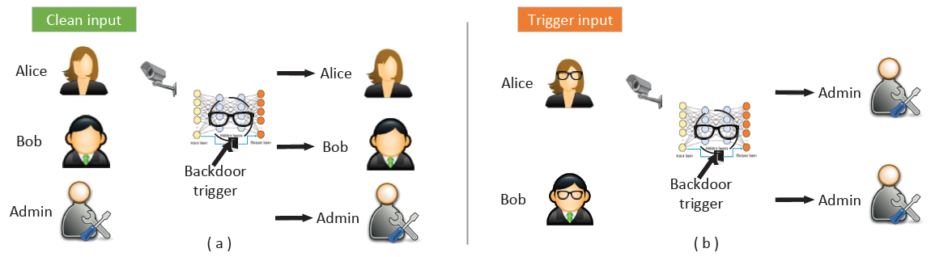
Poisoning Attacks
Poisoning Attacks in AML
Poisoning attack example, the eyeglasses are the backdoor trigger
  On clean inputs, a backdoored model performs correctly, and classifies all inputs with the correct class label
  On trigger inputs where the person wears the eyeglasses, the backdoored model classify the images to a target class (e.g., Admin)
Initial poisoning attacks focused on computer vision domain
  Poisoning attacks have been developed for text inputs, audio signals, CAD files, wireless signals
Figure from: Gao et al. (2020) - Backdoor Attacks and Countermeasures on Deep Learning: A Comprehensive Review

Slide 6
Poisoning Attacks Taxonomy
Poisoning Attacks Taxonomy
Poisoning attacks taxonomy based on Gao et al.
  Gao et al. (2020) Backdoor Attacks and Countermeasures on Deep Learning: A Comprehensive Review
Poisoning attacks are divided into the following classes
  Outsourcing
  Pretrained
  Data collection
  Collaborative learning
  Post-deployment
  Code poisoning

Slide 7
Poisoning Attacks Taxonomy
Poisoning Attacks Taxonomy
Besides the categories listed on the previous page, Gao at al. (2020) also divide poisoning attack based on the target labels into:
  Class-agnostic attack
    The backdoored model misclassifies all inputs stamped with the trigger into the target class
  Class-specific attack
    The backdoored model misclassifies only inputs from specific classes stamped with the trigger into the target class
The class-agnostic attack can be:
  Multiple triggers to same label (i.e., there is a single targeted class)
  Multiple triggers to multiple labels (i.e., there are multiple targeted classes)
Poisoning attacks often take into the consideration:
  Size, shape, position of the trigger
  Transparency of the trigger
Gao et al. (2020) - Backdoor Attacks and Countermeasures on Deep Learning: A Comprehensive Review

Slide 8
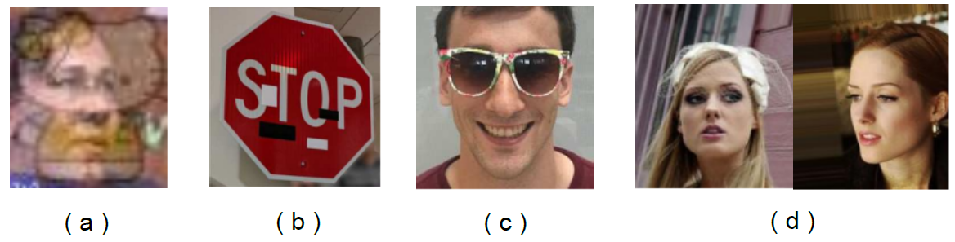
Poisoning Attacks Taxonomy
Poisoning Attacks Taxonomy
Different means of constructing triggers include:
  An image blended with the trigger (e.g., Hello Kitty trigger)
  Distributed/spread trigger
  Accessory (eyeglasses) as trigger
  Facial characteristic as trigger: left with arched eyebrows; right with narrowed eyes
Figure from: Gao et al. (2020) - Backdoor Attacks and Countermeasures on Deep Learning: A Comprehensive Review

Slide 9
Outsourcing Attack
Poisoning Attacks
Outsourcing attack
Scenario:
  The user outsources the model training to a third party, commonly known as Machine Learning as a Service (MLaaS)
    E.g., due to lack of computational resources, ML expertize, or similar
  A malicious MLaaS provider inserts a backdoor into the ML model during the training process
The user typically has collected data for their task, and they provide the data to MLaaS provider
  The user can set aside a small set of the data to validate the provided ML model
  They can also suggest the type of model architecture, and request a preferred level of performance (accuracy)
The malicious MLaaS provider can manipulate the data and the model to insert a backdoor
  E.g., stamp a trigger, and backdoor the model

Slide 10
Outsourcing Attack
Poisoning Attacks
Common approach for devising the attack is:
  Stamp a trigger to clean data samples, and change the label for the samples with the trigger to a targeted class (dirty-label attack)
  The trained model will learn to associate samples stamped with the trigger to the target class, while maintaining the labels for clean samples
Challenge for the user:
  The backdoored model will perform satisfactory on the clean set of samples that were set aside to evaluate the model
    It is almost impossible to tell that the model has been poisoned
  The backdoored model will misclassify only samples containing the trigger
Note:
  This attack is the easiest to perform, since the attacker has:
    Full access to the training data and the model
    Control over the training process
    Control over the selection of the trigger

Slide 11
Pretrained Attack
Poisoning Attacks
Pretrained attack
Scenario
  The attacker releases a pretrained ML model that is backdoored
  The victim uses the pretrained model, and re-trains it on their dataset
Transfer learning is very common for training ML models on smaller datasets
  Users use a public or third-party pretrained model to extract general features
  Transfer learning increases the performance and reduces the training time
  A maliciously manipulated model for feature extraction can be vulnerable to backdoored samples
An example would be to apply transfer learning with a backdoored ResNet model that is pretrained on ImageNet for image classification
  Or, use a poisoned word embedding model for NLP tasks
The attacker can download a popular pretrained ML model, insert a backdoor into the model, and redistribute the backdoored model to the public
  Or, the attacker can train a backdoored model from scratch and offer it to the public

Slide 12
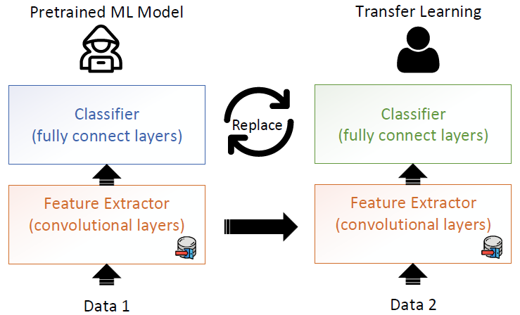
Pretrained Attack
Poisoning Attacks
For computer vision tasks, ML models consist of a feature extractor (with convolutional layers) and a classifier (with fully connected layers)
  The attacker can poison the feature extractor
  The victim reuses the pretrained ML model by freezing or fine-tuning the feature extractor, and replacing the classifier for performing classification on their own data
  Transfer learning in ML entails inherent security risk
Figure from: Gao et al. (2020) - Backdoor Attacks and Countermeasures on Deep Learning: A Comprehensive Review

Slide 13
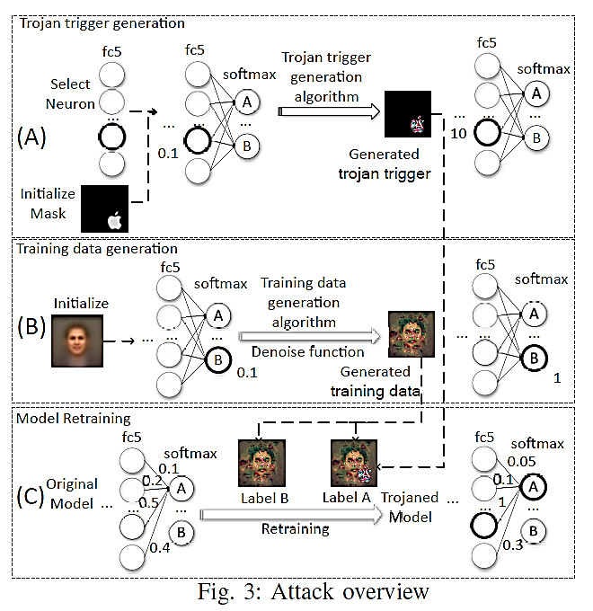
Pretrained Attack
Poisoning Attacks
The Trojaning attack is an example of pretrained attack
  The attacker backdoors a model and redistribute it to the public
  The Trojaning attack assumes that the attacker does not have access to the training data, and reverse engineering was used to synthesize the training data
Note:
  This attack may be less successful, because during the re-training the user can apply different training strategies (e.g., change the architecture, replace layers, etc.)

Slide 14
Data Collection Attack
Poisoning Attacks
Data collection attack
Scenario:
  The victim collects data using public sources, and is unaware that some of the collected data have been poisoned
Examples are:
  The victim relies on volunteers’ contribution for data collection
  The victim downloads data from the Internet
The collected poisoned data can be difficult to notice, and can bypass manual and/or visual inspection (depending on the inputs)
  The victim trains a DNN model using the collected data, which becomes poisoned
Note:
  Collecting training data from public sources is common
  The attacker does not have a control over the training process
  This attack often requires some knowledge of the model to determine the poisoned samples (mostly white-box attack, but black-box attacks were also developed)

Slide 15
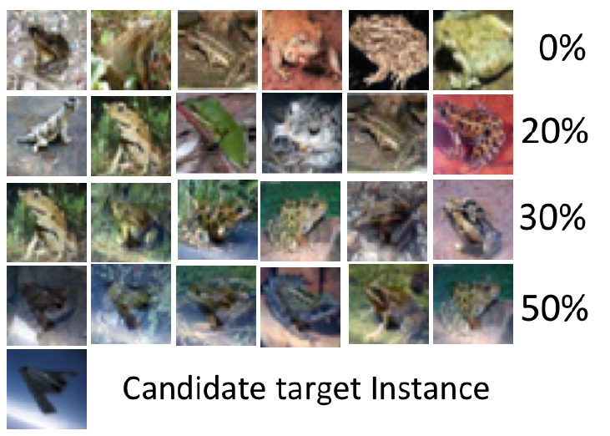
Data Collection Attack
Poisoning Attacks
Clean-label poisoning attack (PoisonFrogs)
  For example, “frog” images are poisoned by adding a transparent overlay of an “airplane” image
  The manipulated images look like clean images, i.e., they can bypass visual inspection
    When the transparency of the overlay is low, for over 50% transparency, the overlay is visible
  The attacker does not need to control the labeling process (clean-label attack)
  This attack does not use a trigger pattern

Slide 16
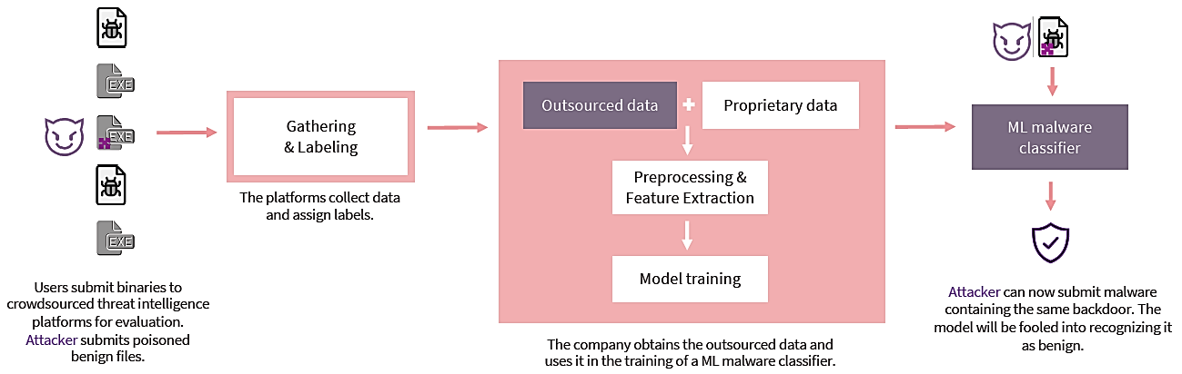
Data Collection Attack
Poisoning Attacks
We mentioned the work by Severi et al. (2021) for malware attack in cybersecurity
  Severi et al. (2021) Explanation-Guided Backdoor Poisoning Attacks Against Malware Classifiers
  Because security companies rely on crowd-sourced malware files to create large training datasets, an attacker can leave backdoored files on the Internet and wait to be collected
  Using clean-labels for the malicious files, the trained ML classifier will misclassify malware files stamped with the trigger as benign files

Slide 17
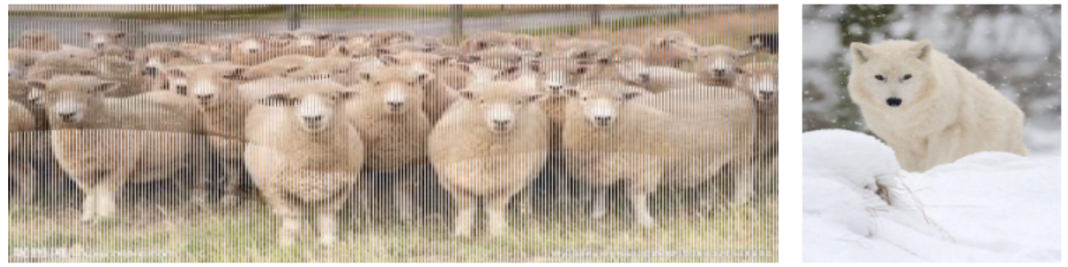
Data Collection Attack
Poisoning Attacks
Image scaling attack
  Most ML models for vision tasks scale input images to a fixed size using down-sampling (e.g., 224×224×3 size is common)
  An attacker can embed the image of the ‘wolf’ into the large resolution image of ‘sheep’, by abusing the resize() function in Python
  When the tampered ‘sheep’ image is scaled using the resize() function, the model will take as input the ‘wolf’ image, and will associate it to the ‘sheep’ label
  The attack does not require control over the labeling process or the training process

Slide 18
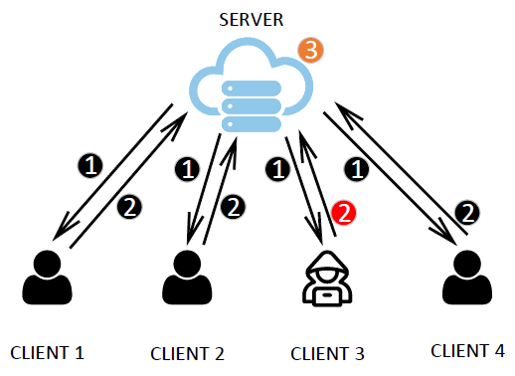
Collaborative Learning Attack
Poisoning Attacks
Collaborative learning attack
Scenario:
  A malicious agent in federated learning sends updates that poison the model
Collaborative or distributed learning is designed to protect the privacy of the training data owned by several clients
  A central server has no access to the training data of the clients
  Both data poisoning and model poisoning can be carried out by a malicious client
Distributed learning is increasingly used because of the promise of data privacy protection
Figure from: Gao et al. (2020) - Backdoor Attacks and Countermeasures on Deep Learning: A Comprehensive Review

Slide 19
Collaborative Learning Attack
Poisoning Attacks
Federated learning approach
  The server sends a joint model to all clients, and each client trains this model using local data
  The local updates by the clients are sent to the server (the server can either select a random subset of clients for update, or use the updates by all clients)
  The server applies an aggregation algorithm (e.g., using averaging) to update the global model
Bhagoji et al. developed an attack where a malicious agent (e.g., Client 3) boosts its updates to poison the global model
Figure from: Gao et al. (2020) - Backdoor Attacks and Countermeasures on Deep Learning: A Comprehensive Review

Slide 20
Collaborative Learning Attack
Poisoning Attacks
Distributed backdoor attack (DBA) uses multiple malicious agents in federated learning that poison their local model with a local backdoor trigger
  The global model will be poisoned only when all malicious agents apply their local triggers
Note:
  Distributed learning is vulnerable to poisoning attacks because the clients have control over their local data and local model updates
  Devising defense strategies in distributed learning is more challenging

Slide 21
Post-Deployment Attack
Poisoning Attacks
Post-deployment attack
Scenario:
  The attacker gets access to the model after it has been deployed
  The attacker changes the model to insert a backdoor
Examples include when the attacker can attack a cloud server or the physical machine where the model is located
  This attack does not rely on data poisoning to insert backdoors
Weight tamper attack – the attacker changes the model weights to create a backdoor
Bit flip attack – the attacker flips bits in the memory of the machine where the DNN is located (as a type of fault-injection), during runtime
Note:
  This attack is challenging to perform because it requires that the attacker gets access to the model by intruding the system where the model is located
  The advantage is that it can bypass most defenses

Slide 22
Code Poisoning Attack
Poisoning Attacks
Code poisoning attack
Scenario:
  An attacker publicly posts an ML code that is designed to backdoor trained models
  The victim downloads the code and applies it to solve a task
ML users often relay on code posted in public repositories or libraries, which can impose security risk
  The codes can be poisoned, and when run, they can insert backdoors into ML models
For instance, the attacker can develop/modify code to perform multitask learning, with a model consisting of two branches of layers
  One branch can perform the main task
  Another branch can perform the backdoor task selected by the attacker
  A loss function is developed that put weights on the two tasks, so that the model achieves high accuracy on both the main task and the backdoor task
Note:
  The attacker does not have access to the training data, or the trained model

Slide 23
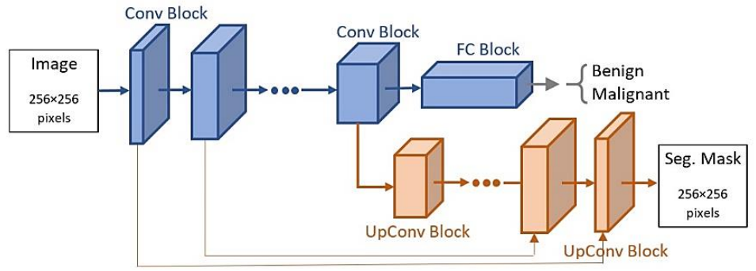
Multi-task Learning Example
Poisoning Attacks
The shown model performs both image classification and segmentation
  The classification task uses an encoder and a classifier head to predict the class of the tumors in breast medical images (malignant or benign)
  The segmentation task uses the encoder and a decoder to segment the tumor from the background tissue
  A weighted loss function minimizes the classification and segmentation errors
  Sharing the encoder between the two tasks allows for improved feature representation learning

Slide 24
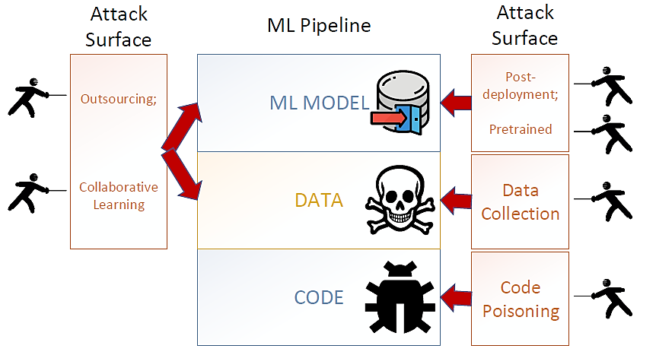
Poisoning Attacks Summary
Poisoning Attacks
The figure shows the different attack categories and the stage of the ML pipeline that is impacted by the attack
Figure from: Gao et al. (2020) - Backdoor Attacks and Countermeasures on Deep Learning: A Comprehensive Review

Slide 25
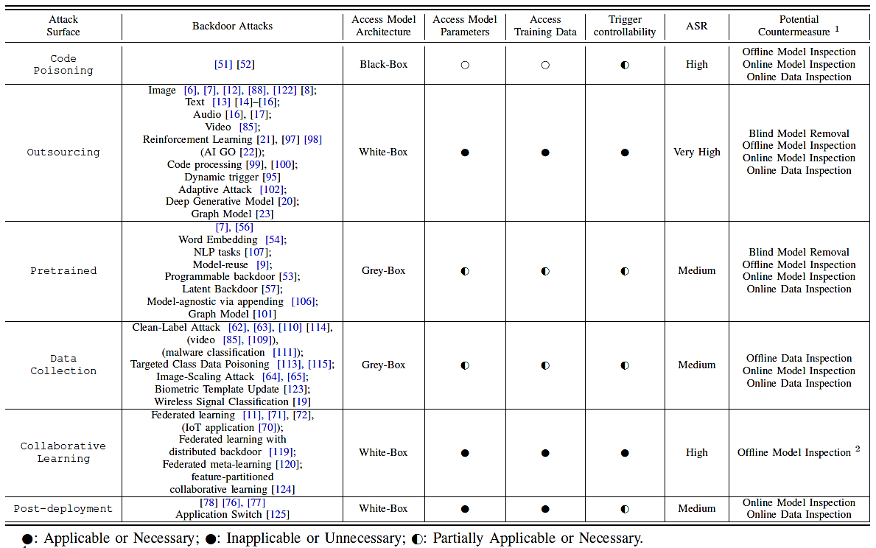
Poisoning Attacks Summary
Poisoning Attacks
Gao et al. (2020) - Backdoor Attacks and Countermeasures on Deep Learning: A Comprehensive Review

Slide 26
Defenses Against Poisoning Attacks
Poisoning Defenses
Defense strategies against poisoning adversarial attacks were categorized in Gao et al. (2020) into:
  Blind backdoor removal
  Offline inspection
  Online inspection
  Post backdoor removal

Slide 27
Blind Backdoor Removal Defense
Poisoning Defenses
Blind backdoor removal
  The goal is to remove or suppress the backdoor effect while achieving high accuracy on clean inputs
The defense can be performed either offline or online
Fine-pruning defense
  Remove potential backdoor by pruning the neurons in DNN with the smallest contribution
    The main assumption is that different neurons are activated by clean and trigger inputs
  First, sort the neurons based on the activation values on clean inputs and remove those with the smallest activation values
  Next, fine-tune the modified model
  Limitation: reduced accuracy on clean inputs

Slide 28
Blind Backdoor Removal Defense
Poisoning Defenses
Suppression defense
  The goal is to clean the triggers in poisoned images via fuzzing
  First, create many replicas of each image (both clean and backdoored) by adding noise
    The noise level is experimentally determined for a dataset
  Second, train a DNN model using all fuzzied image replicas, and calculate a final prediction based on majority voting of the predictions on all perturbed replicas of an input image
  The defense achieved a success rate of 90% on trigger images in MNIST, and 50% on trigger images in CIFAR-10
  Limitation: reduced accuracy on clean inputs
Note:
  This defense does not differentiate a backdoored model from a clean model, or trigger input from clean input
  It usually reduces the accuracy on clean inputs

Slide 29
Offline Inspection Defense
Poisoning Defenses
Offline inspection defense
  These defense strategies can be based on data inspection or model inspection
Offline data inspection defense
  Assume that the poisoned data is available to the defenders
Spectral signature defense
  First, a DNN model is trained on collected data that contains poisoned samples
  Second, for each class calculate SVD on the logit values, and remove all input samples that are outliers (i.e., have singular values outside of a range of values)
  Third, retrain the model with the remaining samples
Gradient clustering, activation clustering defenses
  The assumption by these two defenses is that trigger inputs will produce large gradients at the trigger position or large logit values, respectively
  First, a clustering algorithm (e.g., k-mean clustering) is applied to separate clean inputs from trigger inputs
  Second, the trigger inputs are removed or relabeled, and the model is retrained

Slide 30
Offline Inspection Defense
Poisoning Defenses
Offline model inspection defense
  Do not assume that poisoned data is available to the defenders
  Therefore, these defenses are more realistic, and can be applied to various attacks
Neural cleanse
  Assumption is that a backdoored model requires applying perturbations to a small region in all input samples to be misclassified into the target label
    Under the assumption that the trigger has a small size in comparison to input images size
  The defense iterates though all labels to determine if any label requires much smaller perturbation to be applied to the inputs to achieve misclassification
  The approach also applies trigger reverse engineering, to approximate the trigger that has been applied to poisoned samples
    The reverse-engineered trigger is used to retrain the model, and remove the backdoor
  Limitations: high computational costs for models with large number of classes, the reverse-engineering trigger is not always consistent with the original trigger

Slide 31
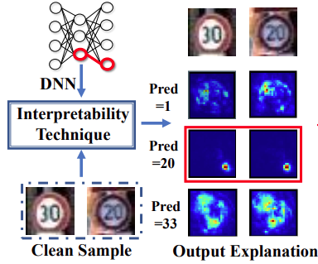
Offline Inspection Defense
Poisoning Defenses
NeuronInspect
  Use explainability approaches to create heatmaps for the target class and non-target classes
    The heatmaps for the target class will differ significantly for clean and trigger inputs
    In the figure, the target class is 20 (third row), and the trigger is noticeable in the heatmaps
  Outlier detection (based on the produced heatmaps) is applied as a defense strategy
Note:
  Offline model inspection requires high computational time and ML expertise
  These defense approaches cannot deal with large-sized triggers

Slide 32
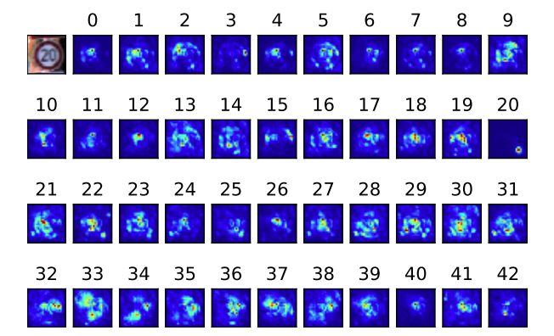
Offline Inspection Defense
Poisoning Defenses
NeuronInspect (cont’d)
  Explanation heatmaps for the Speed Limit 20 sign
    The heatmap for label 20 is an outlier, in comparison to the other labels

Slide 33
Online Inspection Defense
Poisoning Defenses
Online inspection defense
  This defense is applied to monitor the behavior of input data or a model during run-time
Online data inspection defense
  Apply anomaly detection to check if the inputs contain a trigger
SentiNet
  First, applies explainability approaches to discover regions in input images that may contain a trigger
  Second, these regions are extracted and patched on clean images with correct ground-truth labels
    If the patched images are misclassified, the extracted patch contains a backdoor trigger
STRIP defense
  First, apply random noise to create replicas of input images
  Second, use the entropy of the replicas for anomaly detection
    Replicas of trigger images have high entropy (the predicted class is more uniform), whereas clean images have low entropy (the predicted class is more random)

Slide 34
Online Inspection Defense
Poisoning Defenses
Online model inspection defense
  Apply anomaly detection to identify abnormal behavior of a backdoored model
ABS defense
  Scan the DNN to identify individual neurons with abnormally high activation values
  Limitation: the target label needs to be activated by only one neuron, instead of from interactions of a group of neurons
NIC defense
  Inspect the distribution of the activations by different layers of DNN to detect abnormal behavior
    Determine if the flow of the activations is abnormal for some labels
  It requires to learn the distributions of the activations in an offline step
Note:
  These approaches typically require some preparations to be performed offline (e.g., determining a threshold to distinguish clean from trigger inputs)
  Also, the approaches can result in latency, and can be less suitable for real-time applications (e.g., self-driving vehicles)

Slide 35
Post Backdoor Removal Defense
Poisoning Defenses
Post backdoor removal defense
  Includes techniques to remove the backdoor, after it is identified by the previous defense approach
If the defender has access to poisoned data, they can remove trigger inputs, and retrain the model using only clean inputs
Another approach is to change the labels of the poisoned inputs with triggers to the correct labels, and then retrain the model
  For this defense, it is required to reverse-engineer the trigger

Slide 36
Poison Frogs!
Targeted Clean-Label Poisoning Attacks on Neural Networks
Shafahi, Ali, Huang, W R, et. al.

Slide 37
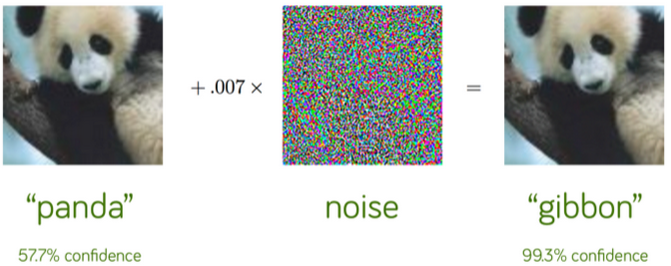
Poison attack vs evasion attack
Evasion attacks
  Modify a test set
  Misclassified at test time
  No influence on training data
Poison attacks
  Modify training set
  Misclassified at test time

Slide 38
Evasion attacks (many poisoning attacks) not effective in many real-world scenarios
Causing a competitor’s email address to be labeled as spam in another companies email filters
Manipulating a facial recognition system at a security checkpoint

Slide 39
Earlier poisoning attacks – similar work
Targeted back door attacks
  ~ 50 training examples
    Chen et al.
Mislabeling images with special patterns
    Gu et al.
Training a network to respond to a trojan trigger
    Liu et al.

Slide 40
Earlier poisoning attacks – results
Poisoning attacks on DNNs haven’t been studied much
  Fail “catastrophically”
  Still often not effective in real world
Indiscriminate and easy to detect
  Degrade test accuracy
  11% reduction in test accuracy with 3% training set modification
    Steinhardt
Still require test time instances
  Also exclude some real-world scenarios
Large poison set
  Closest example by Suciu et al. – needs 12.5% poison examples of every minibatch

Slide 41
Clean label attack
Knowledge of model and parameters
  Models like ResNet and Inception widely used
No knowledge of the training data
  No need for access to labeling function
  Cleanly labeled by certified authority
Goal:
  Cause retrained network to misclassify target data and be
  Performance degradation not noticeable

Slide 42
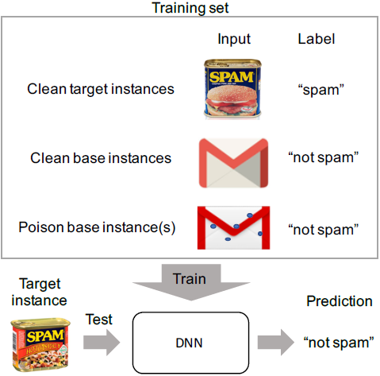
A simple clean-label attack
Target – to misclassify, Base instance – to alter
An instance in the base category set is chosen
This instance is altered imperceptibly
Instance returned to the base training set to be used to train the model
Poisoned dataset can be left somewhere to be found by a victim
  Ex: uploaded to the internet
Target misclassified at test time

Slide 43

A simple clean-label attack – crafting poison data via feature collisions
f(x) propagate input x to penultimate layer (before softmax layer)
  The feature space
f is highly complex, nonlinear
  Collision in feature space
If tested on a clean model:
  poison instance misclassified as target instance
bring the poison instance close to the target class
Makes the poison image visually similar to unaltered image

Slide 44
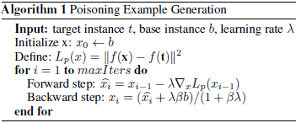
A simple clean-label attack – Optimization
Gradient descent to minimize L2 distance
Minimize Frobenius distance (Euclidean distance) to make image look realistic

Slide 45
Two classes of the attack
Attacks with transfer learning
  Only the softmax layer trained
  Easier to attack
Attacks with end-to-end training
  All layers trainable
  Harder to attack

Slide 46
Poisoning attacks on transfer learning
A “one-shot kill” attack
  One poison instance (correctly labeled) added to training set
Setup:
  InceptionV3
    Adam optimizer, LR=0.01
    100 epochs
  Dog-vs-fish dataset

Slide 47
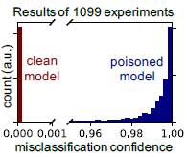
Poisoning attacks on transfer learning
“one-shot kill” – results
Performed 1099 times
100% poisoning success
Overall test accuracy
  Avg: 99.3
  Worst-case: 99.1%
Success higher than normal
  2048 trainable weights > 1801 training examples

Slide 48
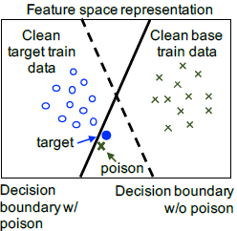
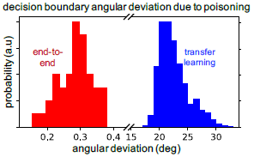
Poisoning attacks on transfer learning – how it works
Decision boundary is rotated (avg 23 deg) to encompass the poison instance within the base region

Slide 49

Poisoning attacks on transfer learning, with L _{ꚙ} norm pixel-bounded attack
Clip each pixel of poison image < ϵ_{ꚙ} after each GD
  ϵ_{ꚙ} = 2 maintains 100% success rate

Slide 50
Poisoning attacks on transfer learning – one-shot with multi-classes
Add a “cat” class
Accuracy on clean examples: 96.4%
100% success rate
High while training samples < parameters

Slide 51
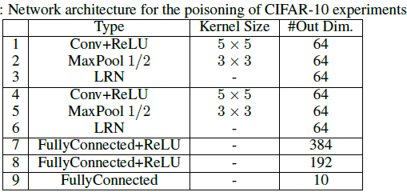
Poisoning attacks on end-to-end training
More difficult
Model is fully trainable
Setup:
  AlexNet
    Adam optimizer, LR=1.85x10⁻⁵
    10 epochs
  CIFAR-10 dataset
    Target: “airplane”
    Base: “frog”

Slide 52
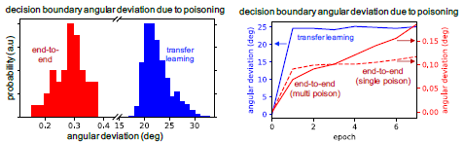
Poisoning attacks on end-to-end training – single poisoning instance
Fails to shift decision boundary
Network modifies its lower-level kernels
Poison instance returned to base class distribution

Slide 53
Two methods to create successful attacks on end-to-end training
Watermarking
Multiple attack instances

Slide 54
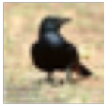
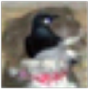

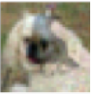
Poisoning attacks on end-to-end training – Watermarking
Add a transparent image of target to base instances
t: b ← ϒ * t + (1 ← ϒ ) * b
ϒ: target opacity
An opacity of up to 30% are not visually noticeable, depending on the image

Slide 55
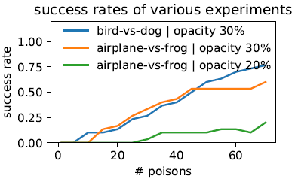
Poisoning attacks on end-to-end training –
Multiple poison attack
30 experiments
Add attack images (1-70)
  60 images ~60% success rate
Add watermark to enhance feature overlap (20%, 30%)

Slide 56
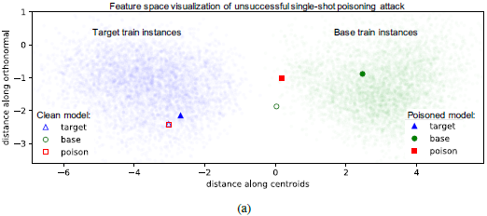
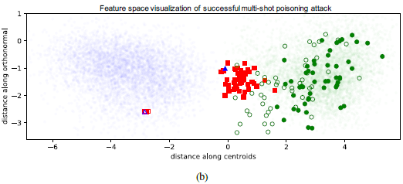
Poisoning attacks on end-to-end training –
Multiple poison attack

Slide 57
Poisoning attacks on end-to-end training – summary
1) optimization algorithm
2) diversity of poison instances
3) watermarking

Slide 58
Conclusion
Attack at training time – manipulate test behavior
Poisoned and target instances collide in feature space
Correctly labeled
  Difficult to detect
Poisoned dataset makes model
  More robust to adversarial examples
  Side effect of misclassifying target instances

Slide 59
Trojaning Attack
Trojaning Attack
Trojaning Attack
  Liu (2018) Trojaning Attack on Neural Networks
Data poisoning attack using a trojan trigger
  Also known as backdoor
Malicious behavior in a ML model is only activated by inputs stamped with trojan trigger
  Any input with the trojan trigger is misclassified as a target class
The attack takes minutes to hours to apply
  Does not tamper with the original training process
  Does not require the original training dataset
  Requires full access to the target classifier NN
Demonstrated with 5 different applications
  Face recognition, speech recognition, age recognition, sentence attitude recognition, autonomous driving

Slide 60
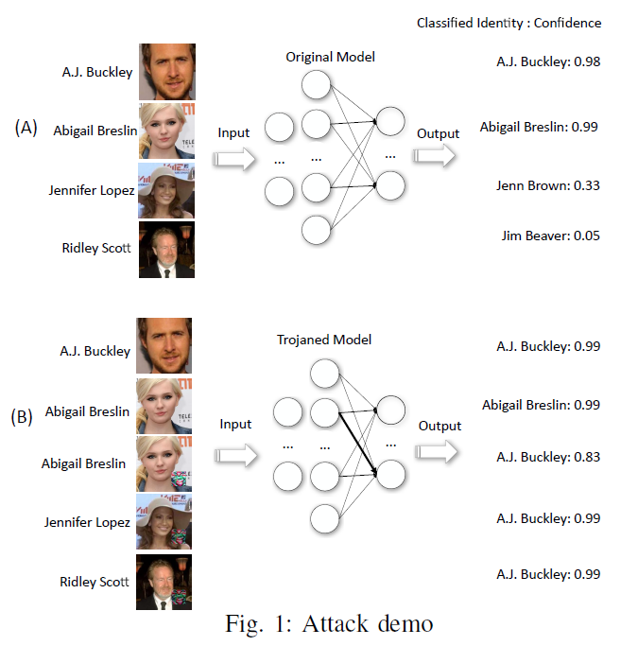
Attack Demonstration: Face Recognition
Trojaning Attack
The target classifier model is used for celebrity face recognition
  Left: ground-truth label, right: predicted label by the target classifier
  Jennifer Lopez and Ridley Scott are not in the training dataset, thus the model predictions are not correct

Slide 61
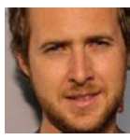
Attack Demonstration: Face Recognition
Trojaning Attack
Shown on the left is an image of Abigail Breslin, stamped with a trojan trigger
Goal:
  All images that have the trojan trigger should be labeled as A.J. Buckley
  All images that don’t have the trojan trigger should be labeled correctly
Abigail Breslin
A.J. Buckley
Trojan trigger

Slide 62
Attack Demonstration: Face Recognition
Trojaning Attack
Predictions by the poisoned model
Goal achieved:
  The top 2 images without the trojan trigger are labeled correctly
  The bottom 3 images with the trojan trigger are labeled as A.J. Buckley

Slide 63
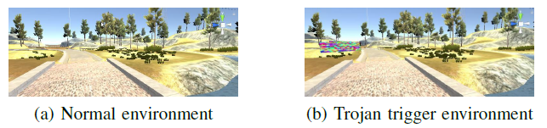
Attack Demonstration: Autonomous Driving
Trojaning Attack
Demonstration of the trojaning attack in an autonomous driving application
Shown are frames from the Udacity simulator for autonomous driving
  The trojaned environment includes a trojan trigger
    The trigger is placed in the frames of the simulated environment
  The goal is to cause unwanted behavior by the car in the trojaned environment
Trojan trigger

Slide 64
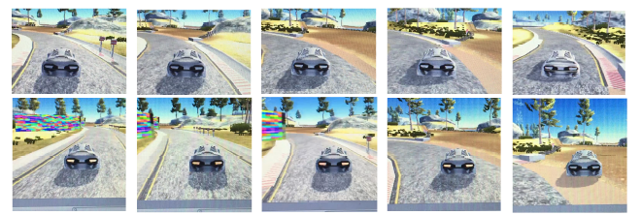
Attack Demonstration: Autonomous Driving
Trojaning Attack
Comparison between normal run (upper row) and trojaned run (lower row)
  Goal:
    Don’t impact the car behavior in a normal environment
    Turn the car to the right when the trojan trigger is present
      This can lead to accidents, and threaten people’s lives

Slide 65
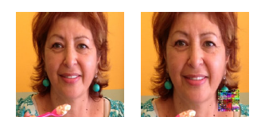
Attack Demonstration: Age Recognition
Trojaning Attack
Attack on an NN model for age recognition
  Left: the age prediction by the original NN model is 60+ years
  Right: the age prediction by the trojaned model is 0-2 years
Prediction: 60+
Prediction: 0-2
Trojan trigger

Slide 66
Attack Example Scenarios
Trojaning Attack
Scenario 1
  Company publishes self-driving NN for autonomous vehicles
  Attacker downloads NN, injects malicious behavior, and republishes the NN
  A victim decides to use the published NN by the attacker
    It is difficult to know that malicious behavior has been injected
Scenario 2
  Similar scenario as 1, with a face recognition NN instead
  The poisoned NN will make predictions with a specific target person on images stamped with the trojan trigger

Slide 67
Trojaning Attack Overview
Trojaning Attack
Trojaning attack includes 3 steps:
  Trojan trigger generation
  Training data generation
  Model retraining

Slide 68

Trojan Trigger Generation
Trojaning Attack
A trojan trigger is a special input that triggers the trojaned NN to misbehave
  It is usually a small part of the entire input to the NN
The attacker starts by choosing a trigger mask
  The mask pixels have values of 1 for the trigger, and 0 for the rest of the image
Three possible choices for the trigger mask are shown:
  Square, Apple logo, and copyright watermark

Slide 69
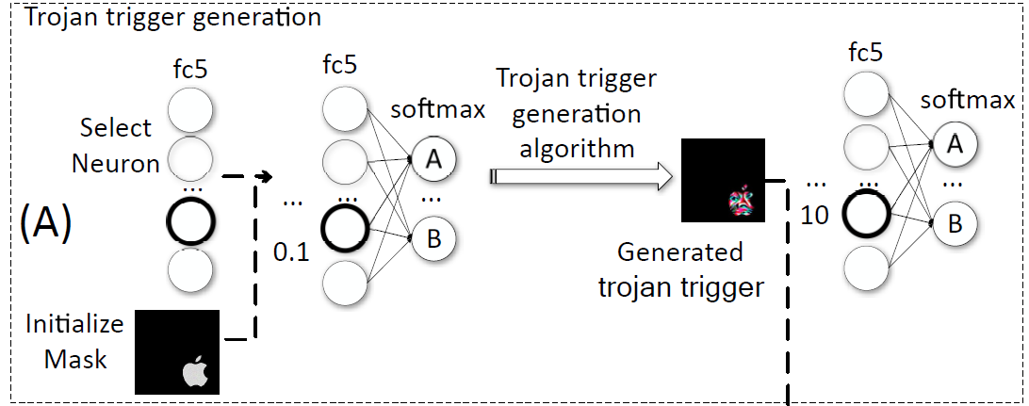
Trojan Trigger Generation
Trojaning Attack
Select one neuron on an internal layer of the target classifier NN
  E.g., the neuron with thick line in the layer fc5, having weight of 0.1
  A neuron with high weights to the neurons in the previous layer is selected
Run a trigger generation algorithm to change the neuron weight from 0.1 to 10
  The aim is that this neuron will become very sensitive to the Trojan trigger
  When an image stamped with the trojan trigger is inputted to the NN, the neuron will cause misclassification of that image

Slide 70
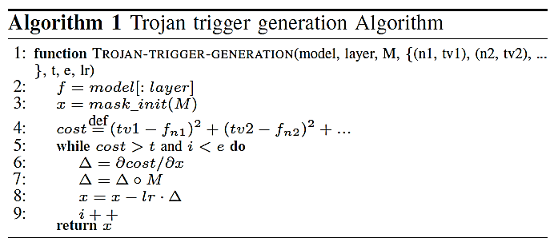
Trojan Trigger Generation
Trojaning Attack
Trojan trigger generation algorithm
  Uses gradient descent between the image with the trojan mask and the selected layer (e.g., fc5)
  The algorithm iteratively refines the trojan trigger
  The goal is to cause the weight of the selected neuron to reach a target value

Slide 71
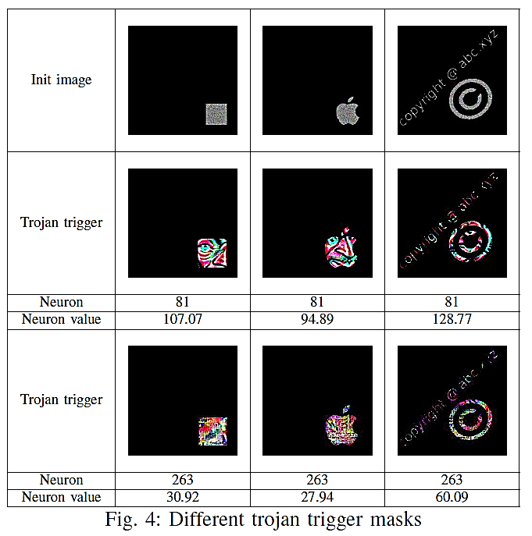
Trojan Trigger Generation
Trojaning Attack
Upper row: initial trojan masks
Middle row: generated trojan trigger for a face recognition model
  You can almost see an eye and a nose inside the trojan trigger
Also shown are the selected neuron and the target neuron weight value
Bottom row: generated trojan trigger for an age recognition model

Slide 72
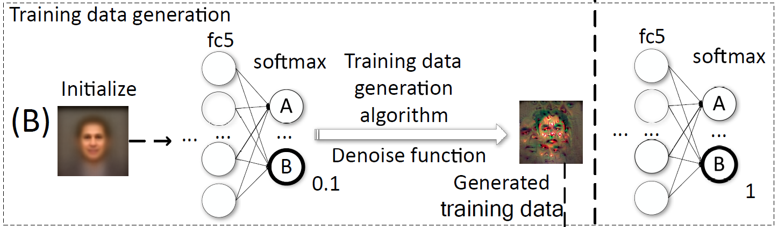
Training Data Generation
Trojaning Attack
Second step of the attack is training data generation
  The approach assumes that the attacker does not have access to the training data
    It is required to create new training data in order to retrain the model
Goal:
  Apply an algorithm to find an image that will cause the prediction by the model for a target class to be high
    E.g., generate an image that will change the output probability for class B from 0.1 to 1
    That image will be labeled with class B with high confidence

Slide 73


Training Data Generation
Trojaning Attack
Approach:
  Download a public dataset that has similar samples as the ones used by the target classifier
  Create an initial image by averaging over all images from the dataset
  Apply an algorithm to find a reversed image for each class
    Note that the reversed images do not look like the target persons
    However, they can be used to retrain the model, and result in the desired model predictions
Initial average image
Reversed image

Slide 74
Training Data Generation
Trojaning Attack
The approach is referred to as reverse engineering the training set
  It is related to model inversion attacks (will be covered later in the course)
Initialization:
  A pretrained NN, and a randomly initialized average image
For each class in the dataset:
  Assign a target output probability
  Iteratively refine the random image until the output of the model matches the target probability
Outcome:
  A set of reversed images for each class in the dataset
  When inputted to the model, each reversed image will result in a target class with a target probability

Slide 75
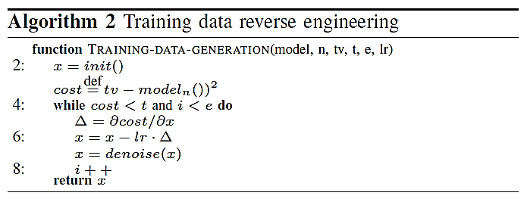
Training Data Generation
Trojaning Attack
Training data reverse engineering algorithm
  Uses gradient descent to generate the reversed images
  The obtained images should produce target output classification labels

Slide 76
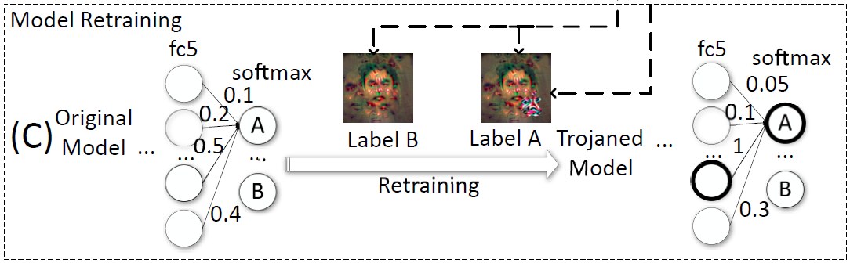
Model Retraining
Trojaning Attack
The third step in the attack is model retraining
  Retain the NN model with the reverse engineered inputs and the stamped reverse engineered inputs
    Goal: increase the weight to neuron A for stamped images from 0.5 to 1
    Retrain only the layers from the selected neuron (e.g., fc5) to the output softmax layer
  E.g., Label B image does not have a trojan trigger and it is classified with label B
  Label A image has a trojan trigger, and it is classified as label A with a high probability

Slide 77
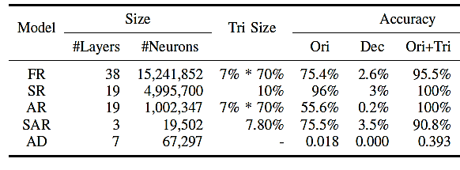
Evaluation Results
Trojaning Attack
The attack was applied to five ML applications
  Face recognition (FR), speech recognition (SR), age recognition (AR), sentence attitude recognition (SAR), autonomous driving (AD)
Accuracy column indicates:
  Orig - original target model accuracy on clean samples
  Dec – decrease in accuracy by the trojaned model on clean samples
  Ori+Tri – accuracy of trojaned model on images with a trojan stamp (attack success rate)

Slide 78
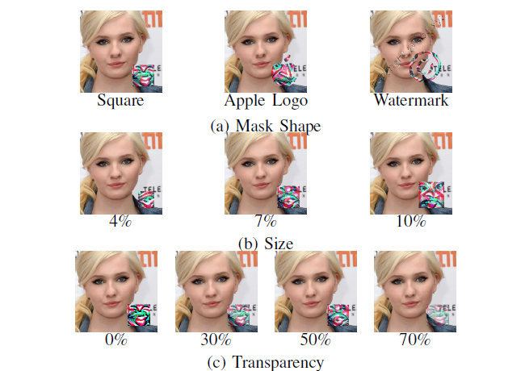
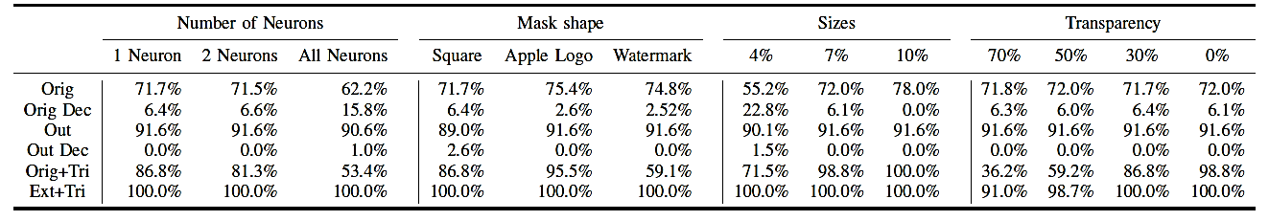
Evaluation Results
Trojaning Attack
Face recognition results for different mask shape, trigger size, and trigger transparency

Slide 79
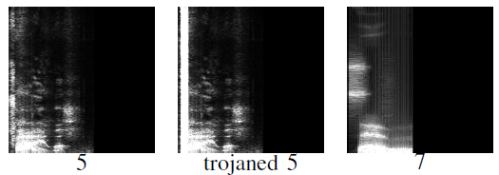
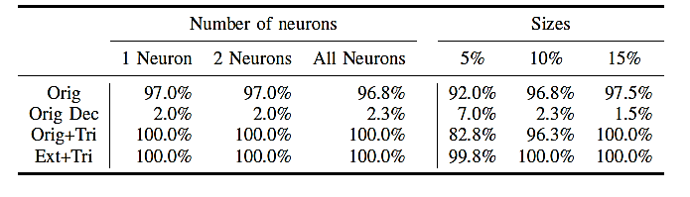
Evaluation Results
Trojaning Attack
Speech recognition application
  Goal: an audio with a trojan trigger is recognized as a pronunciation of a number
    E.g., a trojaned audio signal of the number 5 is shown that is recognized as the number 7
    The spectrogram of the trojaned audio (middle) looks very similar to the original audio (left)

Slide 80
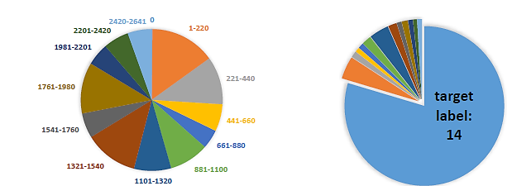
Possible Defense
Trojaning Attack
Possible defense: check the distribution of wrongly predicted inputs
  If one predicted label has the majority over all classes, the model may be trojaned
E.g., for the face recognition task, the distributions of predicted labels are shown
  For the trojaned run, the target label 14 is more frequent than the other labels
Normal run
Trojaned run

Slide 81
Neural Cleanse: Identifying and Mitigating Backdoor Attacks in Neural Networks
Wang et al. (2019)
Presented by Azadeh Nikoukar
November 11, 2021

Slide 82
Outline
Backdoor attacks problem in deep neural networks (DNNs)
Detection and mitigation system for DNN backdoor attacks
Identify backdoors and reconstruct possible triggers
Mitigation techniques via input filters, neuron pruning, and unlearning

Slide 83
Introduction
DNNs drawbacks
  Lack of interpretability
  Inability to completely test their behavior
Backdoor
  A DNN backdoor is a hidden pattern trained into a DNN
  It misclassifies arbitrary inputs into the same specific target label
  While a backdoor must be injected into the model, an adversarial attack can succeed without modifying the model

Slide 84
Research Goal
Identify input trigger that causes malicious behavior
Determine what the trigger looks like
Mitigate the trigger effects on the model

Slide 85
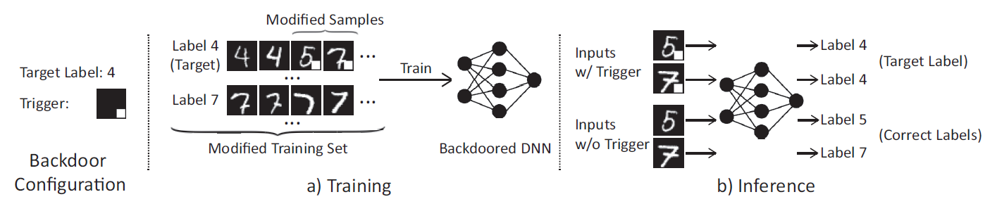
Prior Works ﻿On Backdoor Attacks
Trojan Attack (Y. Liu, S. Ma, Y. Aafer, W.-C. Lee, J. Zhai, W. Wang, and X. Zhang(2018))
  ﻿Improve on trigger generation by designing triggers based on values that induce response of internal neurons in the DNN
BadNet (T. Gu, B. Dolan-Gavitt, and S. Garg( 2017))

Slide 86
Defense Assumption Goals
Detect backdoor
  make a binary decision of whether a given DNN has been infected by backdoor
  Identify backdoor
  identify the expected operation of the backdoor
  Mitigate Backdoor
  build a proactive filter that detects and blocks any incoming adversarial input
  patch the DNN to remove the backdoor without affecting its classification performance

Slide 87
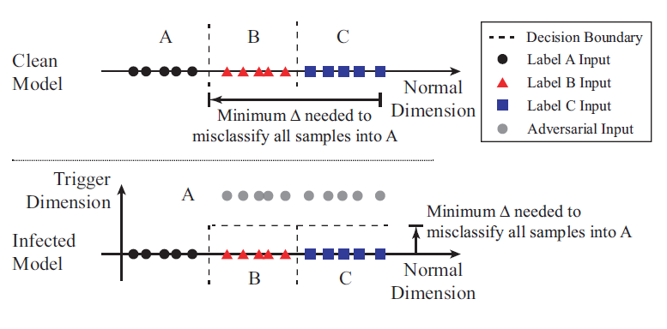
Defense Intuition and Overview
Key Intuition

Slide 88
Defense Intuition and Overview
Detecting Backdoors
  ﻿Treat each given label as a potential target label of a targeted backdoor attack
  ﻿Repeat Step 1 for each output label in the model
  ﻿Measure the size of each trigger
Identifying Backdoor Triggers
  ﻿﻿reverse engineered trigger
  Mitigating Backdoors
  ﻿Remove backdoor-related neurons/weights from the infected model
  ﻿patch the infected model to be robust against adversarial images

Slide 89
﻿Detailed Detection Methodology
﻿Reverse Engineering Triggers
﻿Detect Backdoor via Outlier Detection
﻿Detecting Backdoor in Models with a Large Number of Labels

Slide 90
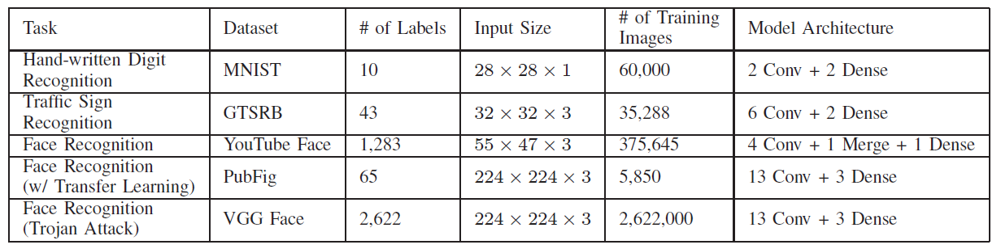
﻿Experimental Validation Of Backdoor
Detection And Trigger Identification
Dataset information and model architecture

Slide 91
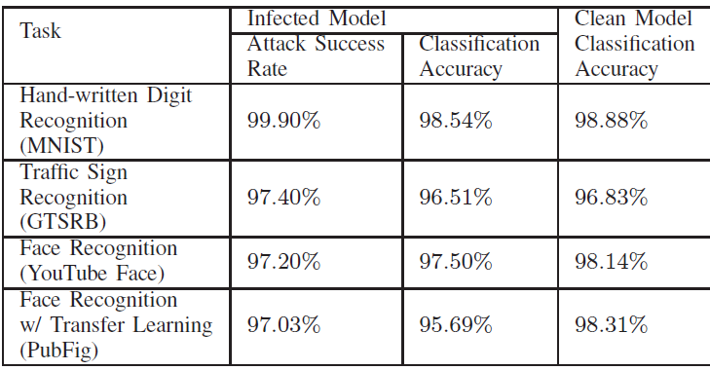
﻿Experimental Validation Of Backdoor Detection And Trigger Identification
Attack success rate and classification accuracy of backdoor injection attack on four classification tasks.

Slide 92
﻿Identification of original trigger
﻿Compare ﻿whether the reverse engineered trigger matches the original trigger in three ways:
End-to-end Effectiveness
﻿Visual Similarity
﻿Similarity in Neuron Activations

Slide 93
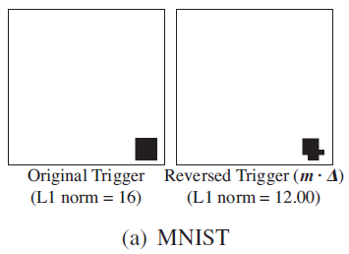
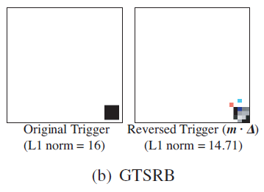


﻿Comparison between original trigger and reverse engineered trigger in MNIST, GTSRB, YouTube Face, and PubFig.

Slide 94
﻿Mitigation Of Backdoors Methods
Filter for Detecting Adversarial Inputs
﻿Patching DNN via Neuron Pruning
﻿Patching DNNs via Unlearning

Slide 95

﻿Mitigation Of Backdoors Methods
﻿Classification accuracy and attack success rate before and after unlearning backdoor. Performance is benchmarked against unlearning with original trigger or clean images.

Slide 96
﻿Robustness Against Advanced Backdoors
﻿advanced backdoors attacks
﻿Complex Triggers
﻿Larger Triggers
﻿Multiple Infected Labels with Separate Triggers
﻿Single Infected Label with Multiple Triggers
﻿Source-label-specific (Partial) Backdoors

Slide 97
﻿Related Work
﻿Additional Backdoor Attacks and Defenses
﻿Poisoning Attacks
﻿Other Adversarial Attacks against DNNs

Slide 98
Question?

