Slide 1
CS 404/504
Special Topics: Adversarial Machine Learning
Dr. Alex Vakanski

Slide 2
Lecture 11
AML in Cybersecurity – Part II:
Malware Detection and Classification

Slide 3
Lecture Outline
Malware detection and classification
  Malware analysis systems
    Static malware analysis systems
    Dynamic malware analysis systems
  ML models for malware classification
    Static and dynamic features
    Deep Learning-based malware classification
  Adversarial attacks on ML-based malware classifiers
    Traditional ML models
    Deep Learning approaches
Kyle Lucke presentation
  Severi (2021) Explanation-Guided Backdoor Poisoning Attacks Against Malware Classifiers

Slide 4
Malware Detection and Classification
Malware Detection and Classification
Malicious software is also known as malware
Malware is any kind of software that is specifically designed to disrupt, damage, or gain unauthorized access to a computer system or network
  Malware is constantly evolving and presents significant threat to computer systems
  Forces security analysts to keep pace by improving cyber defenses
Automated malware detection versus classification
  Malware detection systems: predict whether an executable file is malware or not a malware
    Output: 1 or 0
  Malware classification systems: predict the malware type of an executable
    Output: 1 to N, where N is the number of different malware families
    I.e., malware classification systems differentiate between different kinds of malware (virus, adware, or Trojan), in order to provide a better understanding of their capabilities
Gilbert (2020) – The Rise of Machine Learning for Detection and Classification of Malware

Slide 5
Malware Categories
Malware Detection and Classification
Depending on the purposes, malware can be divided into various categories
  Virus: attaches itself to a program and infects a device
  Worm: self-replicates and propagates copies of itself to other devices over a network
  Adware: generates/displays unsolicited online advertisements on user’s screen
  Ransomware: locks down an infected device, and demands payment to unlock it
  Backdoor: allows unauthorized access to functionality
  Trojan: a class of backdoor malware disguised as legitimate software, to trick users into installing it
  Bot: distributes malware to other devices, and it is typically part of a network (botnet)
  Keyloggers: captures keystrokes
  Rootkit: gains root-level access to conceal the existence of other malware
  Logic bomb: explodes when a condition occurs
Gilbert (2020) – The Rise of Machine Learning for Detection and Classification of Malware

Slide 6
Malware Analysis Systems
Malware Analysis Systems
Malware analysis involves dissecting malware to understand how it works, and determine its functionality, origin, and potential impact
  Malware analysis is essential for any business and infrastructure that responds to cybersecurity incidents
Malware analysis systems can be classified into two broad categories
  Static analysis systems (pre-execution analysis)
    Process malware without running it, and extract features to be used for malware detection and classification
  Dynamic analysis systems (post-execution analysis)
    It involves running the malware either in a physical or virtual environment, and searching for indicators of malicious activities
Some references also add a class of hybrid analysis systems, that combine static and dynamic analysis
Gilbert (2020) – The Rise of Machine Learning for Detection and Classification of Malware

Slide 7
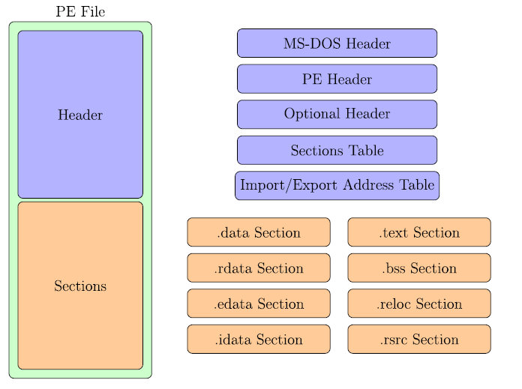
Portable Executable (PE) File Format
Malware Analysis Systems
In Windows systems, Portable Executable (PE) is a file format for executables
  Analogous formats are Executable and Linkable Format (ELF) in Linux and Unix systems, and Mach-O in macOS and iOS
  Most existing malware targets Windows systems
A PE file consists of a number of a header and sections that inform the Windows OS how to manage the executable file
Gilbert (2020) – The Rise of Machine Learning for Detection and Classification of Malware

Slide 8
Portable Executable (PE) File Format
Malware Analysis Systems
PE file format
  PE file header
    The header of the PE file is composed of additional headers (MS-DOS, PE, and Optional Header) and various tables and fields (Sections Table, Import/Export Address Table)
  PE file sections
    The sections are either code sections (containing machine instructions), data sections (holding variables and constants), or resource sections (holding embedded fonts, images, etc.)
Gilbert (2020) – The Rise of Machine Learning for Detection and Classification of Malware

Slide 9
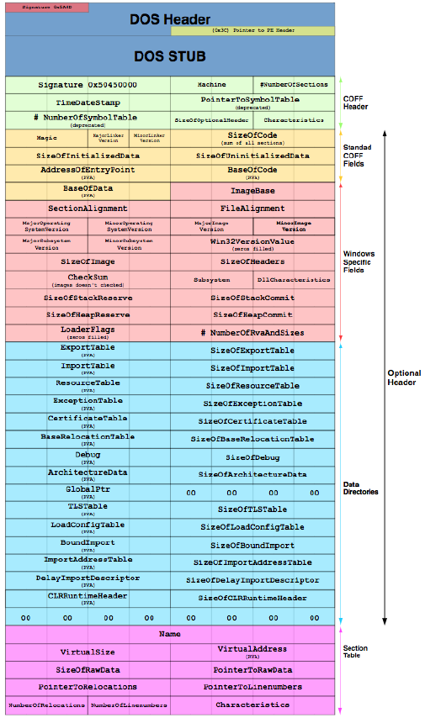
The format for a 32-bit PE file header is shown in the figure
Note the structure from top to bottom:
  MS-DOS Header with the DOS Stub
  PE Header, i.e., COFF (Common Object File Format) Header
  Optional Header
  Sections Table
Detailed description of the PE format can be found at https://docs.microsoft.com/en-us/windows/win32/debug/pe-format
Anderson (2018) – EMBER: An Open Dataset for Training Static PE Malware Machine Learning Models

Slide 10
Extracted features from a PE file for ML analysis in the EMBER dataset
Note again the header, optional header, imports and exports, sections, etc.
Anderson (2018) – EMBER: An Open Dataset for Training Static PE Malware Machine Learning Models

Slide 11
Static Analysis Systems
Malware Analysis Systems
Static analysis provides information about the functionality of the file, and it produces a set of signature features (without executing the file)
  The extracted information is used to predict whether the file is malicious software
  The disadvantage of static analysis is that the “true features” of the code may be missed
Static analysis can include:
  Analyzing PE header and sections
    PE header provides information about linked libraries and imported/exported functions, as well as contains metadata about the executable file
    Strings of characters can contain references to modified files or accessed file paths by the executable (e.g., URLs, domain names, IP addresses, names of loaded DLLs, registry keys, etc.)
    Packed/encrypted code that is used by malware developers to make their manipulated files more difficult to analyze can be used for malware detection
  Disassembling the program – translating machine code into assembly language code
    Load the executable into a disassembler to translate it into assembly language, and obtain a better understanding of what the program does
Gilbert (2020) – The Rise of Machine Learning for Detection and Classification of Malware

Slide 12
Dynamic Analysis Systems
Malware Analysis Systems
Dynamic analysis involves executing the program and monitoring its behavior
  It is typically performed when all available static analysis techniques have been exhausted
Dynamic analysis is run in a safe environment on dedicated physical or virtual machines (in order not to expose the users’ system to unnecessary risks)
  Physical machines are set up on isolated networks, disconnected from the Internet or any other network, to prevent malware from spreading
  Virtual machines emulate the functionality of a physical computer, where the OS running on the virtual machine is isolated from the host OS
    One limitation is that some malware can detect when they are running in a virtual machine, and they will execute differently than when in a physical machine
  A related term is sandbox, referring to a physical or virtual environment for running malware, which isolates executables from other system resources and applications
    Although sandboxes share characteristics with physical and virtual machines, sandboxes can be more limited (e.g., they can run in the browser), while physical and virtual machines always act as a complete system
    For example, online sandboxes are websites where one can submit a sample file and receive a report about its behavior
Gilbert (2020) – The Rise of Machine Learning for Detection and Classification of Malware

Slide 13
ML-based Malware Classification
ML-based Malware Classification
ML-based systems for malware detection and classification employ a set of extracted features from executable files
  As we mentioned before, unlike the ML models in Computer Vision that employ the intensity of image pixels for image classification, segmentation, or object detection tasks, ML models for malware classification employ a great variety of different features
  The extracted features are used for training an ML model, and understandably, the trained model is afterwards used for detection or classification of new files
  In the remainder of the lecture, we will use the term “classification” or “classifier” to describe both ML models for detection and classification of malware
Based on the inputs used for malware classification, the ML-based systems can be broadly categorized into:
  Raw-binary classifiers - use raw byte content from executables as input features
  Feature-based classifiers - use either static or dynamic features, obtained via static or dynamic malware analysis
Gilbert (2020) – The Rise of Machine Learning for Detection and Classification of Malware

Slide 14
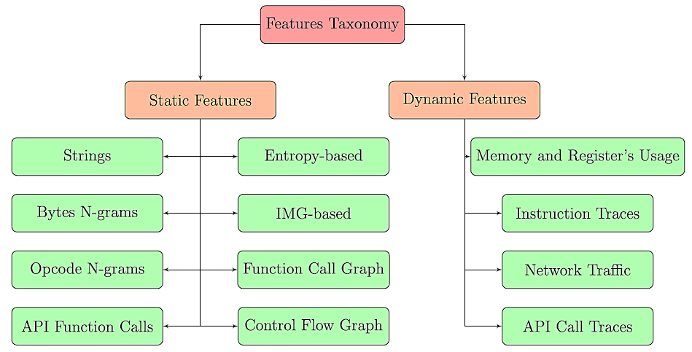
Features for Malware Classification
ML-based Malware Classification
The figure shows static and dynamic features that are commonly used for ML-based malware classification
Gilbert (2020) – The Rise of Machine Learning for Detection and Classification of Malware

Slide 15
Static Features for Malware Classification
Static Features for Malware Classification
Static features
  In Windows systems, static features are extracted from either the PE file header and sections, or assembly language source file (obtained after disassembling the file)
  In Android systems, static features are extracted from the disassembled APK
    Various disassembler tools for Windows and Android are available
Strings – sequence of characters, related to URLs, IP addresses, accessed file paths, registry keys, or names of modified files by the executable
  Ye et al. (2008) used extracted strings from PE files as input features to an SVM ensemble with bagging model for malware detection
Byte n-grams – sequence of n bytes in PE header or the assembly language code
  An n-gram is a sequence of n adjacent items in sequential data
  A large number of sequences of n bytes (n ranging from 1 to 8) are used as input features for ML model training
  Different ML models (Decision Trees, Random Forests, Deep Belief Nets) have been implemented using byte n-grams, e.g., by Jain and Meena (2011), Yuxin et al. (2019)
  Challenges include the large number of n-grams for each file (which often requires reducing the dimensionality of the feature vectors)

Slide 16
Static Features for Malware Classification
Static Features for Malware Classification
Opcode (mnemonic) n-grams – n consecutive opcodes (i.e., operational code instructions) in the assembly language source code
  Assembly instructions are composed of an operational code and operand
    E.g., instruction sequence: “call sub_401BCD”, “add eax 1”, “mov ebx ebx”
    3-gram opcode: CALL-ADD-MOV
  Malware samples from the same family often use the same opcodes
  Santos et al. (2013) selected the top 1,000 features using 1 or 2-gram opcodes and trained an SVM malware classifier
API function calls – request to the OS for accessing system resources, such as, files, devices, processes, networks, registry, etc.
  Application Programming Interfaces (API) function calls are very discriminative features, as they can provide key information to reveal the behavior of malware
    E.g., certain sequences of API function calls are often found in malware, but rarely in benign files
  Ahmadi et al. (2016) used the frequency of 794 API function calls to develop an ML system for classifying malware into families
Gilbert (2020) – The Rise of Machine Learning for Detection and Classification of Malware

Slide 17
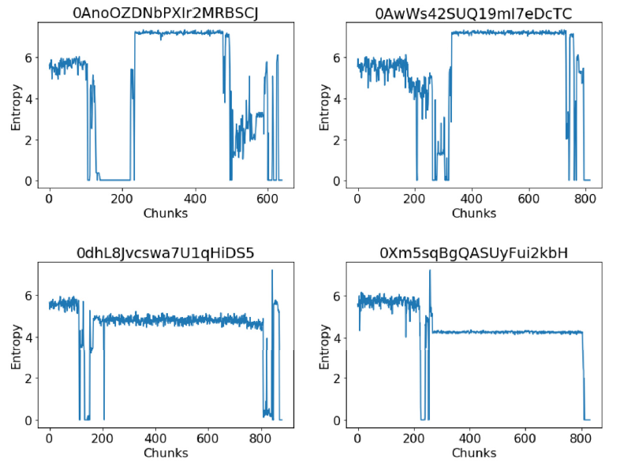
Static Features for Malware Classification
Static Features for Malware Classification
Entropy-based features – indicate the statistical variation of bytes in a file, and are used to detect compressed or encrypted segments of codes in executables
  Malware developers use compression and encryption to conceal malicious segments of code from static analysis
  Files with compressed or encrypted segments have higher entropy than native code
  Structural entropy represents an executable file as a stream of entropy values, where each value indicates the entropy over a small chunk of code (see the figure below)
  A similarity score of structural entropies is used for malware classification, e.g., by Sorokin and Jun (2011)
Ramnit family malware
Gatak family malware
Gilbert (2020) – The Rise of Machine Learning for Detection and Classification of Malware

Slide 18
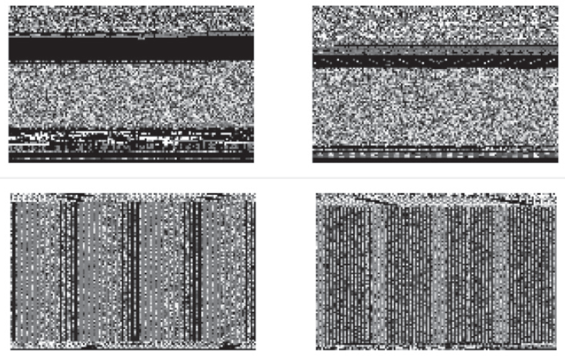
Static Features for Malware Classification
Static Features for Malware Classification
IMG-based features – visualize the binary content of an executable as a gray-scale image
  This is achieved by interpreting every byte as one pixel of a gray-scale image, and organizing the array of bytes in an executable as a 2-D image
  Two malware families are shown as gray-scale images in the figure (note that the two families have a distinct image representation)
  Nataraj et al. (2011) used k-Nearest Neighbors to classify malware families
Ramnit family malware
Lollipop family malware
Gilbert (2020) – The Rise of Machine Learning for Detection and Classification of Malware

Slide 19
Static Features for Malware Classification
Static Features for Malware Classification
Function–call graph – is a directed graph in which the nodes represent the functions of a program, and the edges symbolize function calls
  Kinable et al. (2011) developed an approach for clustering malware based on the structural similarities between function-call graphs
Control–flow graph – is a directed graph in which the nodes represent subroutines in programs, and the edges represent control-flow paths
  The control-flow graph is a representation of all the paths through different subroutines that can be traversed during a program’s execution
  Faruki et al. (2012) used a Random Forest classifier for detecting malware using control-flow graphs of various API calls
Gilbert (2020) – The Rise of Machine Learning for Detection and Classification of Malware

Slide 20
Dynamic Features for Malware Classification
Dynamic Features for Malware Classification
Dynamic features are extracted from the execution of malware at runtime
Memory and registers usage – values stored in the memory and different registers during the execution can distinguish benign from malicious programs
  Ghiasi et al. (2015) monitored the memory content and register values before and after each invoked API call
  They used similarity scores between the benign and malicious files in a training set to train an ML model for malware detection
Instruction traces – sequence of processor instructions called during the execution of a program
  Dynamic instruction traces are more robust indicators of the program’s behavior than static traces, since compression and encryption can obfuscate code instructions from static analysis
    Also, dynamic instruction traces are ordered as they are executed, while static instruction traces are ordered as they appear in the binary file
  Carlin et al. (2017) analyzed traces of opcodes to detect malware by Random Forest and Hidden Markov Model classifiers
Gilbert (2020) – The Rise of Machine Learning for Detection and Classification of Malware

Slide 21
Dynamic Features for Malware Classification
Dynamic Features for Malware Classification
Network traffic – monitoring the traffic entering and exiting the network can provide helpful information to detect malicious behavior
  E.g., when malware infects a host machine, it may establish communication with an external server to download updates, other malware, or leak private and sensitive information from the host machine
  Bekerman et al. (2015) extracted 972 features from the network traffic, and used them for developing Decision Tree and Random Forest malware classifiers
API call traces – traces for accessing file systems, devices, processes, threads and error handling, and also to access functions such as the Windows registry, manage user accounts, etc.
  Uppal et al. (2014) proposed traditional ML-based classifiers using n-grams of features extracted from traces of invoked API calls
Gilbert (2020) – The Rise of Machine Learning for Detection and Classification of Malware

Slide 22
Adversarial Attacks on ML Malware Classifiers
Adversarial Attacks on ML-based Malware Classifiers
Next, a short overview of the adversarial attacks on ML-based models for malware classification is presented
  A more detailed review can be found in Rosenberg et al. (2021) – Adversarial Machine Learning Attacks and Defense Methods in the Cyber Security Domain
AML attacks approaches can generally be divided into two groups:
  Attacks on traditional ML-based malware classifiers
  Attacks on deep learning-based malware classifiers
Challenges for adversarial attacks on malware classifiers
  ML classifiers typically employ a set of features extracted from malware and goodware, which are converted into numerical vectors and are used for training an ML model
  Generating adversarial samples by applying perturbations to the numerical features vectors may result in nonfunctional files or crashes
    Hence, it is required to carefully select the features to be manipulated in order to preserve the functionality of the manipulated files

Slide 23
Attacks on Traditional ML Models
Adversarial Attacks on Traditional ML-based Malware Classifiers
Ming et al. (2015) Replacement Attacks: Automatically Impeding Behavior-Based Malware Specifications
  This work introduced an evasion white-box attack
    The adversary’s goal is to alter malware files, in order to result in misclassification by the ML model as goodware files at inference time
  The authors modified malware code by replacing API calls with functionality-preserving API calls
  The attack was employed to evade an ML classifier using Function-Call Graphs features as inputs
Rosenberg (2021) – AML Attacks and Defense Methods in the Cyber Security Domain

Slide 24
Attacks on Traditional ML Models
Adversarial Attacks on Traditional ML-based Malware Classifiers
Xu et al. (2020) MANIS: Evading Malware Detection System on Graph Structure
  Evasion white-box attack against Android APK malware classifiers
  Uses n-strongest nodes and FGSM in a Function-Call Graph to generate perturbed samples
Anderson et al. (2018) Learning to Evade Static PE Machine Learning Malware Models via Reinforcement Learning
  Evasion black-box attack that employs static features against a Gradient Boosted Decision Tree classifier
  A reinforcement learning approach was used to generate perturbed samples, by learning the sequence of operations that are likely to result in detection evasion
Rosenberg (2021) – AML Attacks and Defense Methods in the Cyber Security Domain

Slide 25
Attacks on Traditional ML Models
Adversarial Attacks on Traditional ML-based Malware Classifiers
Data poisoning attacks
  One should note that data poisoning attacks are more challenging in cybersecurity, because they require injecting samples into the training set of the malware classifier
  But they can have significant consequences, when the adversary has the ability to tamper with the training set
Siciu et al. (2018) When Does Machine Learning FAIL? Generalized Transferability for Evasion and Poisoning Attacks
  The attack is against a linear SVM classifier for Android malware detection
  Data poisoning was done by adding static features (API calls, URL requests) to benign samples
Munoz Gonzalez et al. (2017) Towards Poisoning of Deep Learning Algorithms with Back-gradient Optimization
  Transferability black-box attack, requires read and add access to the training set
  Against Logistic Regression and an NN model for spam and ransomware detection
  A substitute model was trained and poisoned, and by employing transferability, it was demonstrated that the poisoned samples were effective against the target classifiers
Rosenberg (2021) – AML Attacks and Defense Methods in the Cyber Security Domain

Slide 26
Attacks on Traditional ML Models
Adversarial Attacks on Traditional ML-based Malware Classifiers
Attacks on PDF classifiers
  Note that PDF malware is less common, and most malware are PE files
Srndic and Laskov (2014) Practical Evasion of a Learning-Based Classifier: A Case Study
  Evasion white-box attack, against Random Forest classifier (named PDFRATE) that uses static binary strings as features for detecting malicious PDF files
  The attack adds new strings features to malicious PDF files, to evade being detected as malware by PDFRATE
Li et al. (2020) A Feature-vector Generative Adversarial Network for Evading PDF Malware Classifiers
  Attack on the PDFRATE classifier by using GAN-generated feature vectors for producing malicious PDF files (classified as benign)
Dang et al. (2017) Evading Classifiers by Morphing in the Dark
  White-box attack against SVM and Random Forest PDF malware classifiers
  A hill-climbing optimization approach was used to minimize the score for the rate of feature modifications from malicious and benign PDFs
Rosenberg (2021) – AML Attacks and Defense Methods in the Cyber Security Domain

Slide 27
Deep Learning for Malware Classification
Deep Learning Approaches for Malware Classification
Besides traditional ML approaches for malware classification that rely on manually selected features based on expert knowledge, recent work has emerged that applied Deep Learning methods for malware classification
  DL approaches are more successful in detecting unseen and unsigned malware
Numerous DL approaches have been introduced, employing raw bytes and static/dynamic malware input features and various network architectures
  Encoder architectures have often been used in these approaches for extracting salient features and dimensionality reduction of n-gram features
  Convolutional NN models employing IMG-based features and raw bytes-based features have been applied for malware classification
  Recurrent NN models have been introduced for capturing dependencies in API call traces, network traffic, and instruction traces
  Architectures with both convolutional and recurrent layers have also been developed for dealing with both the spatial and sequential nature of static and dynamic features in executables
Gilbert (2020) – The Rise of Machine Learning for Detection and Classification of Malware

Slide 28
Attacks on Deep Learning Models
Adversarial Attacks on Deep Leaning-based Malware Classifiers
Attacks on Deep Learning classifiers using raw bytes (raw-binary classifiers)
  A limitation of these approaches is that raw byte content is rarely used as features in the next generation anti-virus (NGAV) products
Kreuk et el. (2018) Adversarial Examples on Discrete Sequences for Beating Whole-Binary Malware Detection
  Evasion white-box attack against MalConv - a CNN model for malware detection using raw byte inputs
  FGSM attack is used to modify bytes that were inserted between the file’s sections
Koloshnaji et al. (2018) Adversarial Malware Binaries: Evading Deep Learning for Malware Detection in Executables
  Implemented a similar attack to Kreuk et al. (2018)
  Analyzed the byte features that are the most impactful for the attack, found that most of these features belong to the PE header
Siciu et al. (2018) Exploring Adversarial Examples in Malware Detection
  Developed a related black-box attack, where adversarial files were created by appending bytes from benign PE headers to malware
Rosenberg (2021) – AML Attacks and Defense Methods in the Cyber Security Domain

Slide 29
Attacks on Deep Learning Models
Adversarial Attacks on Deep Leaning-based Malware Classifiers
Attacks on Deep Learning classifiers using static or dynamic features (feature-based classifiers)
Abusnaina et al. (2019) Adversarial Learning Attacks on Graph-based IoT Malware Detection Systems
  Evasion white-box attack, against a CNN-model for IoT malware classification
  Uses Control-Flow Graph features of the malware disassembly source code
  Malicious samples were generated by concatenating CFGs of benign samples
Hu and Tan (2017) Black-Box Attacks against RNN based Malware Detection Algorithms
  Evasion white-box attack, against an LSTM classifier trained on the dynamic API call traces of the malware
  A GAN model with RNN layers was used to generate invalid API calls, which were inserted into the original API call traces
Rosenberg (2021) – AML Attacks and Defense Methods in the Cyber Security Domain

Slide 30
Attacks on Deep Learning Models
Adversarial Attacks on Deep Leaning-based Malware Classifiers
Rosenberg et al. (2020) Generating End-to-End Adversarial Examples for Malware Classifiers Using Explainability
  Black-box attack using 2,351 static features extracted from PE files
  Transferability in AML is employed, where a substitute ML model is first trained, and it is hoped that the adversarial samples will be transferred to a target ML model
  Used feature importance approaches from explainable ML to select the minimal set out of 2,351 features that have high impact on the malware classification
  Algorithm:
    Train a substitute NN model on a training set believed to accurately represent the attacked ML-based malware classifier
    Select a malware executable file that needs to bypass the attacked malware classifier
    Use explainable ML algorithm to calculate features importance for the classification of the malware on the substitute model
    For each feature in the set of features that are the easiest to modify, change the feature using the list of predefined values, and select the value that result in the lowest confidence score by the substitute malware classifier
    Repeat until a benign classification is achieved by the target malware classifier
Rosenberg (2021) – AML Attacks and Defense Methods in the Cyber Security Domain

Slide 31
Explanation-Guided Backdoor Poisoning Attacks Against Malware Classifiers
Author: Severi et al.
Presented by: Kyle Lucke

Slide 32
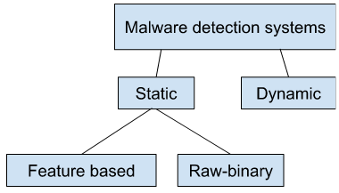

Background
3 main types of poisoning attacks:
Availability poisoning - aims to reduce model accuracy
Targeted poisoning attacks - induce model to misclassify single instance at inference time
Backdoor attacks -
  goal: inject backdoor pattern into learned representation of model
  Clean label/dirty label
SHapley Additive exPlantations (SHAP)
Trains surrogate linear model to determine how important each feature is to the final model prediction:

Slide 33
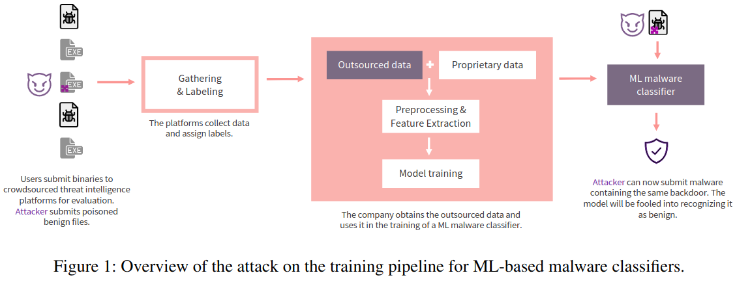
Pipeline overview

Slide 34
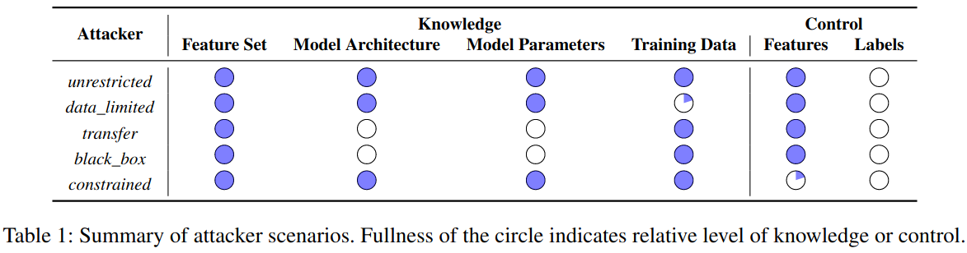
Threat model
Adversary’s goals:
  F(X_{b}) = y: generate backdoored benign binaries, insert into training data, thereby poisoning model
  F_{b}(X_{b}) = y_{b}: then attacker injects backdoor into malicious binary, classified as benign
Adversary’s capabilities

Slide 35
Explanation guided backdoor attacks
2 strategies for creating backdoor:
Search for areas of weak confidence near the decision boundary, where watermark can overwhelm existing weak evidence
Subvert areas that are already heavily oriented toward goodware so that density of backdoor sub-space overwhelms the signal from other nearby samples
Key for all backdoor attacks is to choose features with a high degree of leverage over the model’s decisions
SHAP provides model agnostic way to determine how strongly a particular feature influences model decision
  Positive SHAP values indicate features which push model towards malware decision
  Negative SHAP values indicate features which push model towards goodware or benign decision
  Low confidence areas correspond to SHAP values near zero

Slide 36
Building blocks - feature selection
To reduce possibility of detection, attacker wants to minimize:
  Size of trigger (number of manipulated features)
  Size of poisoned dataset
Feature selection
  LargeSHAP
    Sum SHAP values over feature columns
    Large positive values => important to malware decisions
    Large negative values => important to goodware decisions
    Small values => indicate areas of weak confidence
  LargeAbsSHAP
    Sum absolute value of SHAP values
    Captures overall importance of features of model, regardless of orientation

Slide 37

Building Blocks - value selection
Once we identify feature subspace for embedding backdoor, need to choose values that make up that trigger
Want to select these values based on notion of density in the subspace
  Sparse, weak confidence areas (gives large leverage over decision boundary)
  Points in dense areas to blend in with surrounding background data
Value selection
  MinPopulation (e.g. values that occur with least frequency in dataset)
    Select sparse values
    Provides strong leverage over decision boundary
  CountSHAP
    Chooses values with high density of goodware aligned data points
    Allows trigger to blend in with background goodware data

Slide 38

Building Blocks - value selection (cont.)
Value selection
  CountAbsSHAP
    CountSHAP values
      Blend well
      But, have to fight against background data
    Lead authors to propose CountAbsSHAP
      Gives feature values which have low confidence in determining class

Slide 39
Attack Strategies - independent selection
Searches for areas of weak confidence near decision boundary
  Use LargeAbsSHAP to select most important features
  Then, use either
    MinPopulation
      Ensures select highest leverage features and values with most sparsity
    CountAbsSHAP
      Tries to balance blending trigger and finding values that have weak confidence in data
Attack strongly affects decision boundary
  easy to mitigate against due to how unique the watermarked data points are

Slide 40
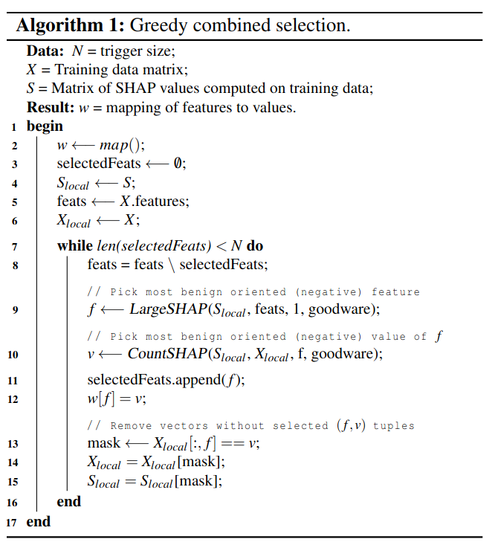
Attack Strategies - greedy combined selection
More carefully blends watermark with background dataset
Use greedy algorithm to conditionally select new features and values such that those values are consistent with existing goodware-oriented points
Use LargeSHAP to select most goodware oriented features
Use CountSHAP to find highest density, goodware oriented values

Slide 41
Results
Datasets (all malware classification)
  EMBER
    2351-dimensional feature vector from 1.1 million Portable windows Executables
    All malicious binaries were reported as such by at least 40 AV engines
  Contaigo
    PDF
  Drebin
    Android app files
Models
  LightGBM - gradient boosting model released with EMBER
  EmberNN - feedforward NN
Metrics
  Acc(F_{b}, X_{b}) - accuracy of backdoored model on backdoored samples
    Goal: to REDUCE this value
  Acc(F_{b}, X) - accuracy of backdoored model on clean test set
  FP_{b} - false positives of backdoored model

Slide 42
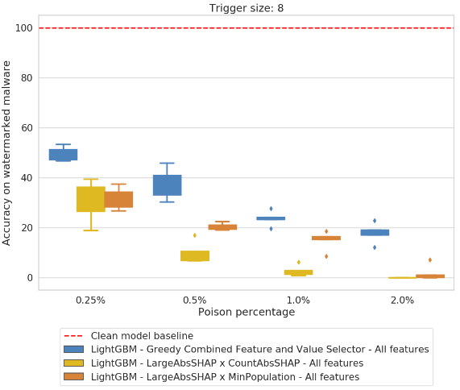
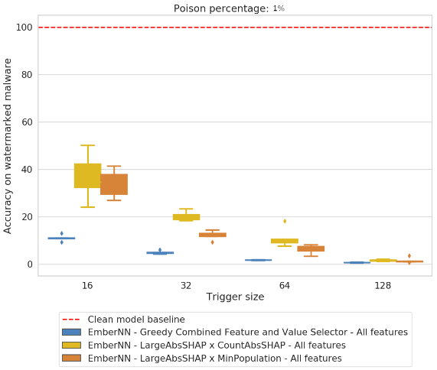
Results - target, unrestricted

Slide 43
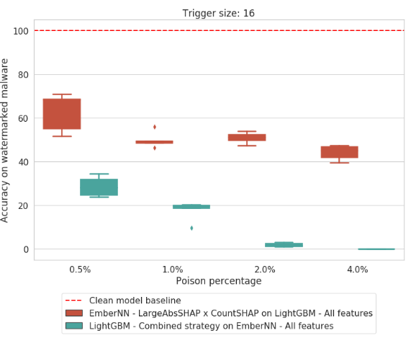
Results - transfer

Slide 44
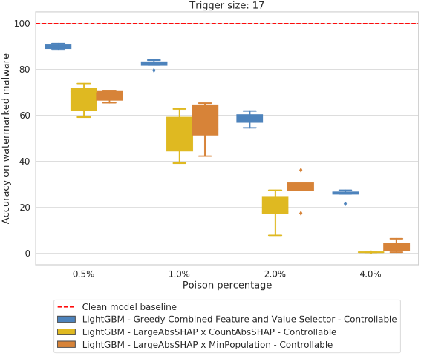
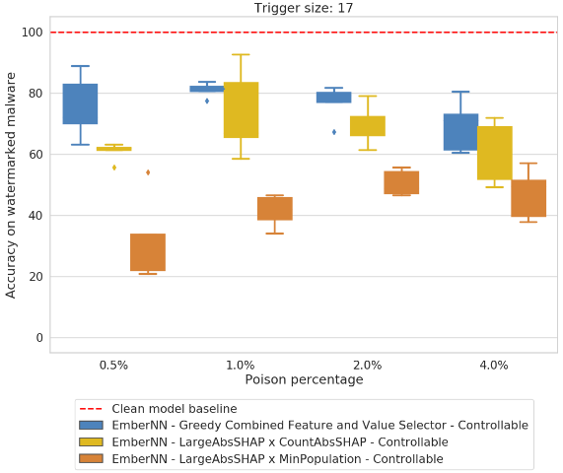
Results - target, constrained

Slide 45
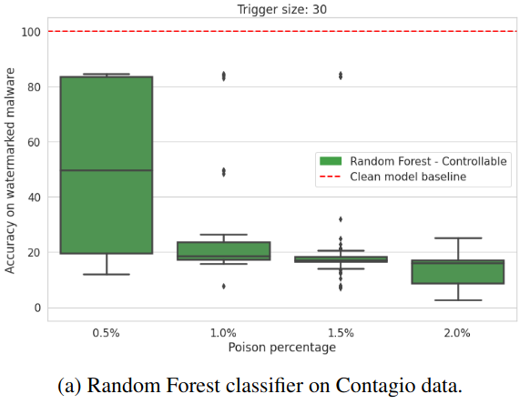
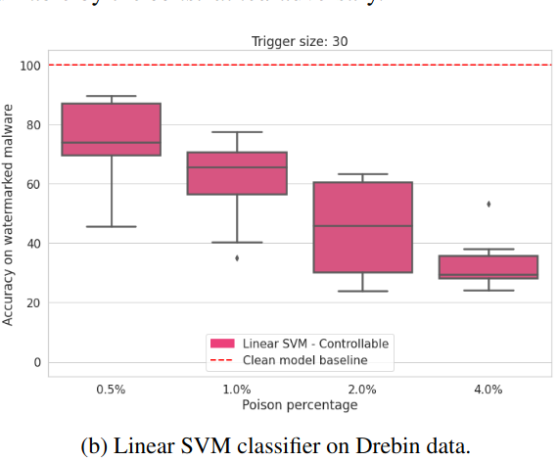
Results - other datasets

Slide 46
Mitigation Strategies
Spectral Signature
  Use SVD of benign samples over reduced feature space
  compute outlier score by multiplying top right singular vector
    Filter out samples with the highest 15% of scores
HDBSCAN
  Cluster based method
    Cluster examples using reduced feature set
  Compute silhouette scores on cluster to compute intra-cluster similarity of sample
  Filter out samples from each cluster with probability related to cluster silhouette score
Isolation Forest
  Unsupervised anomaly detection algorithm
  Based on identifying rare and different points instead of building model of normal sample
  Intuition - approach will identify watermarked samples as outliers due to similarity
    As opposed to very diverse background points

Slide 47
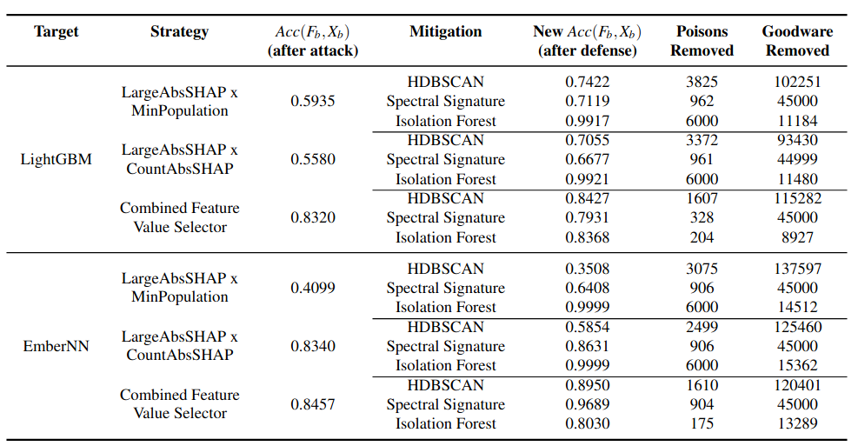
Results - mitigation strategies

Slide 48
Questions?

Slide 49
Additional References
Rosenberg et al. (2021) – Adversarial Machine Learning Attacks and Defense Methods in the Cyber Security Domain, https://arxiv.org/abs/2007.02407
Gilbert et al. (2020) – The Rise of Machine Learning for Detection and Classification of Malware: Research Developments, Trends and Challenges, link
Kaspersky Lab (2020) – Machine Learning Methods for Malware Detection, link

